Slide 1
Python selenium
Nebula AI Course

Slide 2
Test Automation Using Selenium
Selenium IDE
Xpath
CSS selector
Demo

Slide 3
Selenium

Slide 4
Selenium
Selenium is a robust set of tools that supports rapid development of test automation for web-based applications.
Selenium provides a rich set of testing functions specifically geared to the needs of testing of a web application.
Selenium operations are highly flexible, allowing many options for locating UI elements and comparing expected test results against actual application behavior.

Slide 5
Selenium Features
Supports Cross Browser Testing. The Selenium tests can be run on multiple browsers.
Allows scripting in several languages like Java, C#, PHP and Python.
Assertion statements provide an efficient way of comparing expected and actual results.
Inbuilt reporting mechanism.

Slide 6
Selenium IDE
Selenium IDE is an integrated development environment for Selenium tests.
It is implemented as a Firefox extension, and allows you to record, edit, and replay the test in firefox
Selenium IDE allows you to save tests as HTML, Java, Ruby scripts, or any other format
It allows you to automatically add assertions to all the pages.
https://addons.mozilla.org/en-US/firefox/addon/selenium-ide/
firebug

Slide 7
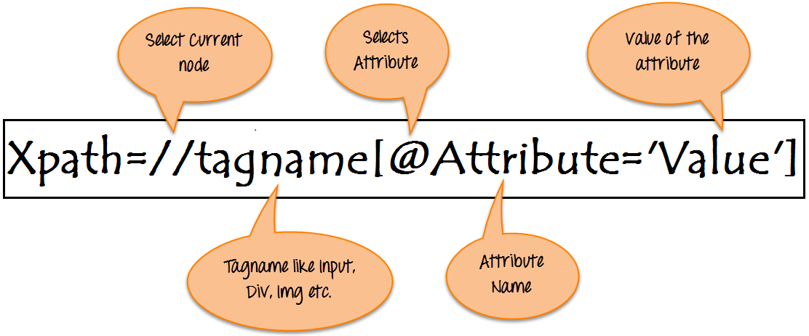
What is XPath

Slide 8
Xpath=//tagname[@attribute='value']
// : Select current node.
Tagname: Tagname of the particular node.
@: Select attribute.
Attribute: Attribute name of the node.
Value: Value of the attribute.

Slide 9
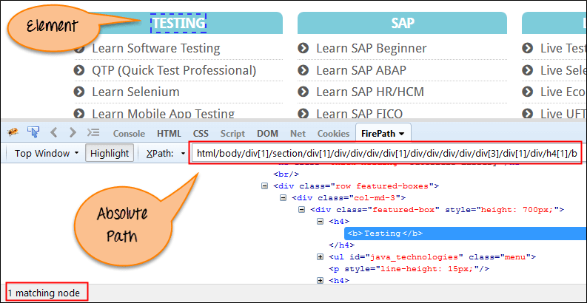
Absolute xpath:

Slide 10
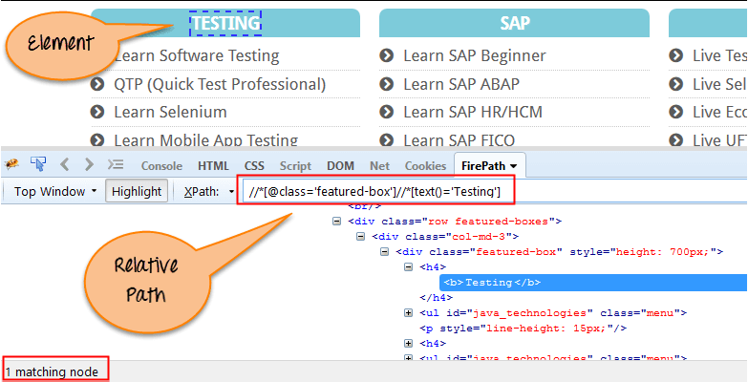
Relative xpath:

Slide 11
CSS Selector
https://www.w3schools.com/cssref/trysel.asp
https://saucelabs.com/resources/articles/selenium-tips-css-selectors
http://toolsqa.com/cucumber/data-driven-testing-using-examples-keyword/

Slide 12
Install selenium
pip3 install selenium

Slide 13
Drivers
Chrome: | https://sites.google.com/a/chromium.org/chromedriver/downloads
Edge: | https://developer.microsoft.com/en-us/microsoft-edge/tools/webdriver/
Firefox: | https://github.com/mozilla/geckodriver/releases
Safari: | https://webkit.org/blog/6900/webdriver-support-in-safari-10/

Slide 14
Robot Framework
ccao@nebula-ai.com

Slide 15
Introduction
Robot Frameworkis a generic open source testautomation framework for acceptance testing and acceptance test-drivendevelopment (ATDD). It has easy-to-use tabular test data syntax and it utilizesthe keyword-driven testing approach. Its testing capabilities can be extendedby test libraries implemented either with Python or Java, and users can createnew higher-level keywords from existing ones using the same syntax that is usedfor creating test cases.

Slide 16
Installation
If you already havePythonwithpipinstalled,you can simply run:
pip3 install robotframework
Alternatively you can get Robot Framework source code by downloading the sourcedistribution fromPyPIand extracting it, or by cloning the project repositoryfromGitHub. After that you can install the framework with:
python setup.py install

Slide 17
pip3 install robotframework-selenium2screenshots
pip3 install SeleniumLibrary

Slide 18
Run script with tags
pybot --variable BROWSER:IE facebook.robot

Slide 19
Run script with tags
pybot -i 'Functional Test' facebook.robot

Slide 20
robot tests.robotrobot --variable HOST:example.com --outputdir results path/to/tests/

