Slide 1
Introduction to python
Charles Cao
ccao@ecvictor.com
Thanks to www.programiz.com

Slide 2
Instructors
Charles Cao
Team leader of Paysafe
Founder of ECVictor
10+ software development experience
Dr. Tony Deng
Data scientist
Richard Yan
Senior python developer

Slide 3
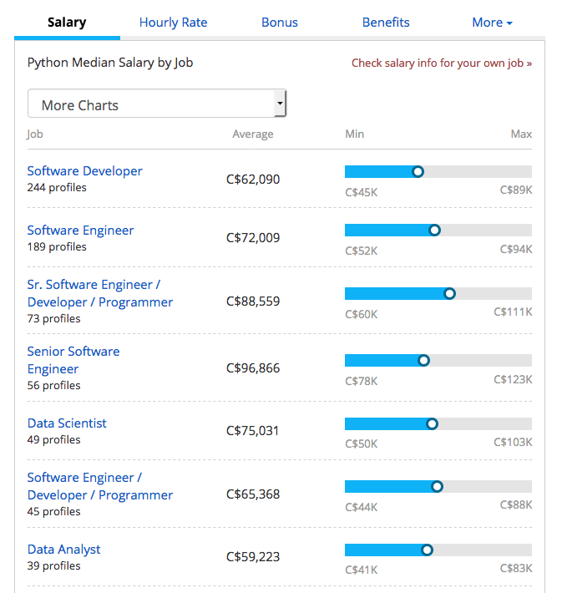
Python Salary
http://www.payscale.com/research/CA/Skill=Python/Salary
http://www.payscale.com/research/CA/Skill=Python/Salary

Slide 4
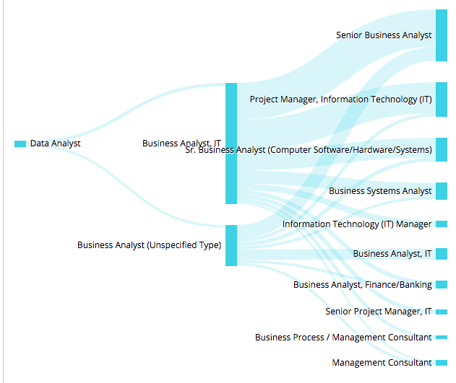
Common Career Paths for Data Analyst

Slide 5
Course Outline
Hello, World! Variables and Types Lists Basic Operators String Formatting Basic String Operations Conditions Loops Functions Classes and Objects Dictionaries Modules and Packages

Slide 6
Projects
Automation Testing Selenium Automation testing with Python
Stock Market Prediction in Python The aim of the project is to predict whether future daily returns of a S&P 500 are going to be positive or negative.
Bitcoin/Digital currency Automated Trading Professional algorithmic trading solution to support automated Bitcoin/Digital currency trading Reference: http://francescopochetti.com/stock-market-prediction-part-introduction/

Slide 7
An Informal Introduction to Python

Slide 8
History of Python
Why Python was created?
In late 1980s, Guido Van Rossum was working on the Amoeba distributed operating system group. He wanted to use an interpreted language like ABC (ABC has simple easy-to-understand syntax) that could access the Amoeba system calls. So, he decided to create a language that was extensible. This led to a design of new language which was later named Python.

Slide 9
Release Dates of Different Versions
Python 1.0 (first standard release) Python 1.6 (Last minor version) | January 1994 September 5, 2000
Python 2.0 (Introduced list comprehensions) Python 2.7 (Last minor version) | October 16, 2000 July 3, 2010
Python 3.0 (Emphasis on removing duplicative constructs and module) Python 3.6.2 (Last updated version) | December 3, 2008 December 12, 2016

Slide 10
Run Python on Your Operating System
https://www.python.org/downloads/release/python-362/
When the download is complete, open the package and follow the instructions. You will see "The installation was successful" message when Python is successfully installed.

Slide 11
Hello World Example
print("Hello world!")

Slide 12
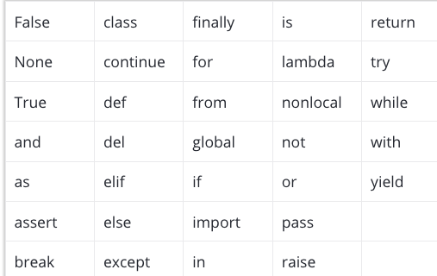
Python Keywords
We cannot use a keyword as variable name, function name or any other identifier. They are used to define the syntax and structure of the Python language. In Python, keywords are case sensitive.

Slide 13


Python Statement

Slide 14
Python Comments
#This is a comment
#print out Hello
print('Hello')
#This is a long comment
#and it extends
#to multiple lines

Slide 15
Variables and Types
Numbers
Python supports two types of numbers - integers and floating point numbers.
E.g A=7
Strings
Strings are defined either with a single quote or a double quotes.

Slide 16
Mixing operators between numbers and strings is not supported
one = 1
two = 2
hello = "hello”
print(one + two + hello)

Slide 17
Naming Styles
b (single lowercase letter)
B (single uppercase letter)
lowercase
lower_case_with_underscores
UPPERCASE
UPPER_CASE_WITH_UNDERSCORES
CapitalizedWords (or CapWords, or CamelCase -- so named because of the bumpy look of its letters. This is also sometimes known as StudlyCaps.
Note: When using abbreviations in CapWords, capitalize all the letters of the abbreviation. Thus HTTPServerError is better than HttpServerError.
mixedCase (differs from CapitalizedWords by initial lowercase character!)
Capitalized_Words_With_Underscores (ugly!)

Slide 18
Tip
local_var_name
GLOBAL_VAR_NAME
module_name
package_name
ClassName
method_name
ExceptionName
function_name
instance_var_name
function_parameter_name

Slide 19
Lists
Lists are very similar to arrays
mylist = []
mylist.append(1)

Slide 20
List count start from 0
my_list=[1,2,3,4]
print(1)

Slide 21
Basic Operators
Arithmetic Operators
Comparison (Relational) Operators
Assignment Operators
Logical Operators
Bitwise Operators
Membership Operators
Identity Operators

Slide 22
Arithmetic Operators
Operator | Description | Example
+ Addition | Adds values on either side of the operator. | a + b = 30
- Subtraction | Subtracts right hand operand from left hand operand. | a – b = -10
* Multiplication | Multiplies values on either side of the operator | a * b = 200
/ Division | Divides left hand operand by right hand operand | b / a = 2
% Modulus | Divides left hand operand by right hand operand and returns remainder | b % a = 0
** Exponent | Performs exponential (power) calculation on operators | a**b =10 to the power 20
// | Floor Division - The division of operands where the result is the quotient in which the digits after the decimal point are removed. But if one of the operands is negative, the result is floored, i.e., rounded away from zero (towards negative infinity): | 9//2 = 4 and 9.0//2.0 = 4.0, -11//3 = -4, -11.0//3 = -4.0

Slide 23
Comparison Operators
Operator | Description | Example
== | If the values of two operands are equal, then the condition becomes true. | (a == b) is not true.
!= | If values of two operands are not equal, then condition becomes true.
> | If the value of left operand is greater than the value of right operand, then condition becomes true. | (a > b) is not true.
< | If the value of left operand is less than the value of right operand, then condition becomes true. | (a < b) is true.
>= | If the value of left operand is greater than or equal to the value of right operand, then condition becomes true. | (a >= b) is not true.
<= | If the value of left operand is less than or equal to the value of right operand, then condition becomes true. | (a <= b) is true.

Slide 24
Assignment Operators
Operator | Description | Example
= | Assigns values from right side operands to left side operand | c = a + b assigns value of a + b into c
+= Add AND | It adds right operand to the left operand and assign the result to left operand | c += a is equivalent to c = c + a
-= Subtract AND | It subtracts right operand from the left operand and assign the result to left operand | c -= a is equivalent to c = c - a
*= Multiply AND | It multiplies right operand with the left operand and assign the result to left operand | c *= a is equivalent to c = c * a
/= Divide AND | It divides left operand with the right operand and assign the result to left operand | c /= a is equivalent to c = c / ac /= a is equivalent to c = c / a
%= Modulus AND | It takes modulus using two operands and assign the result to left operand | c %= a is equivalent to c = c % a
**= Exponent AND | Performs exponential (power) calculation on operators and assign value to the left operand | c **= a is equivalent to c = c ** a
//= Floor Division | It performs floor division on operators and assign value to the left operand | c //= a is equivalent to c = c // a

Slide 25
Logical Operators
Operator | Description | Example
and Logical AND | If both the operands are true then condition becomes true. | (a and b) is true.
or Logical OR | If any of the two operands are non-zero then condition becomes true. | (a or b) is true.
not Logical NOT | Used to reverse the logical state of its operand. | Not(a and b) is false.

Slide 26
Membership Operators
Operator | Description | Example
in | Evaluates to true if it finds a variable in the specified sequence and false otherwise. | x in y, here in results in a 1 if x is a member of sequence y.
not in | Evaluates to true if it does not finds a variable in the specified sequence and false otherwise. | x not in y, here not in results in a 1 if x is not a member of sequence y.

Slide 27
Identity Operators
Operator | Description | Example
is | Evaluates to true if the variables on either side of the operator point to the same object and false otherwise. | x is y, here is results in 1 if id(x) equals id(y).
is not | Evaluates to false if the variables on either side of the operator point to the same object and true otherwise. | x is not y, here is not results in 1 if id(x) is not equal to id(y).

Slide 28
Bitwise Operators
Operator | Description | Example
& Binary AND | Operator copies a bit to the result if it exists in both operands | (a & b) (means 0000 1100)
| Binary OR | It copies a bit if it exists in either operand. | (a | b) = 61 (means 0011 1101)
^ Binary XOR | It copies the bit if it is set in one operand but not both. | (a ^ b) = 49 (means 0011 0001)
~ Binary Ones Complement | It is unary and has the effect of 'flipping' bits. | (~a ) = -61 (means 1100 0011 in 2's complement form due to a signed binary number.
<< Binary Left Shift | The left operands value is moved left by the number of bits specified by the right operand. | a << 2 = 240 (means 1111 0000)
>> Binary Right Shift | The left operands value is moved right by the number of bits specified by the right operand. | a >> 2 = 15 (means 0000 1111)

Slide 29
Operators Precedence
Operator | Description
** | Exponentiation (raise to the power)
~ + - | Complement, unary plus and minus (method names for the last two are +@ and -@)
* / % // | Multiply, divide, modulo and floor division
+ - | Addition and subtraction
>> << | Right and left bitwise shift
& | Bitwise 'AND'
^ | | Bitwise exclusive `OR' and regular `OR'
<= < > >= | Comparison operators
<> == != | Equality operators
= %= /= //= -= += *= **= | Assignment operators
is is not | Identity operators
in not in | Membership operators
not or and | Logical operators

