Slide 1
Introduction to python
Charles Cao
ccao@ecvictor.com
Thanks to www.programiz.com

Slide 2
Instructors
Charles Cao
Team leader of Paysafe
Founder of ECVictor
10+ software development experience
Tony Deng
Phd
Data scientist
Richard Yan
Senior python developer

Slide 3
History of Python
Why Python was created?
In late 1980s, Guido Van Rossum was working on the Amoeba distributed operating system group. He wanted to use an interpreted language like ABC (ABC has simple easy-to-understand syntax) that could access the Amoeba system calls. So, he decided to create a language that was extensible. This led to a design of new language which was later named Python.

Slide 4
Release Dates of Different Versions
Python 1.0 (first standard release) Python 1.6 (Last minor version) | January 1994 September 5, 2000
Python 2.0 (Introduced list comprehensions) Python 2.7 (Last minor version) | October 16, 2000 July 3, 2010
Python 3.0 (Emphasis on removing duplicative constructs and module) Python 3.6.2 (Last updated version) | December 3, 2008 December 12, 2016

Slide 5
Run Python on Your Operating System
https://www.python.org/downloads/release/python-362/
When the download is complete, open the package and follow the instructions. You will see "The installation was successful" message when Python is successfully installed.

Slide 6
Hello World Example
print("Hello world!")

Slide 7
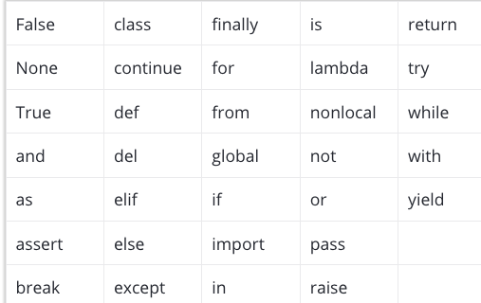
Python Keywords
We cannot use a keyword as variable name, function name or any other identifier. They are used to define the syntax and structure of the Python language. In Python, keywords are case sensitive.

Slide 8


Python Statement

Slide 9
Python Comments
#This is a comment
#print out Hello
print('Hello')
#This is a long comment
#and it extends
#to multiple lines

