Slide 1
第十一章
面向对象设计

Slide 2
第十一章内容概要
★
面向对象设计的准则
SOLID Principle
启发规则
软件重用
系统分解
设计问题域子系统
设计人机交互子系统
设计任务管理子系统
设计数据管理子系统
设计类中的服务
设计关联
设计优化
设计模式
软件工程 -2024 -第十一章 面向对象设计

Slide 3
面向对象设计的准则
模块化
抽象
信息隐藏
弱耦合
  交互耦合
  继承耦合
软件工程 -2024 -第十一章 面向对象设计

Slide 4
面向对象设计的准则
强内聚(服务内聚、类内聚、一般-特殊内聚)
LCOM1方法：假设M1, M2…Mn为类C的n个方法，Ik是方法Mk所访问的成员变量集合。于是存在n个成员变量集合I1, I2…In。令 ， 则
显然，LCOM1方法通过相似方法和非相似方法的差异计算内聚度，LCOM1（C）值越大表明内聚度越小。
软件工程 -2024 -第十一章 面向对象设计

Slide 5
面向对象设计的准则
可重用
  尽量使用已有的类
  如果确实需要创建新类，则在设计这些新类的协议时，应该考虑将来的可重复使用性
软件工程 -2024 -第十一章 面向对象设计

Slide 6
第十一章内容概要
面向对象设计的准则
SOLID Principle
启发规则
软件重用
系统分解
设计问题域子系统
设计人机交互子系统
设计任务管理子系统
设计数据管理子系统
设计类中的服务
设计关联
设计优化
设计模式
★
软件工程 -2024 -第十一章 面向对象设计

Slide 7
本讲内容
Contents: SOLID Principle
Single responsibility principle （单一责任原则）
Open/closed principle （开闭原则）
Liskov substitution principle （Liskov替换原则）
Interface segregation principle （接口分离原则）
Dependency inversion principle （依赖倒转原则）
软件工程 -2024 -第十一章 面向对象设计

Slide 8
Single Responsibility Principle
软件工程 -2024 -第十一章 面向对象设计

Slide 9
Single Responsibility Principle (单一责任原则)
单一责任原则的定义
In object-oriented programming, the single responsibility principle states that
  every context (class, function, variable, etc.) should have a single responsibility, and that
  responsibility should be entirely encapsulated by the context.
  All its services should be narrowly aligned with that responsibility.
软件工程 -2024 -第十一章 面向对象设计

Slide 10
责任的定义
Martin defines a responsibility as a reason to change, and concludes that a class or module should have one, and only one, reason to change.
责任：
责任有大有小
责任越小越好
软件工程 -2024 -第十一章 面向对象设计

Slide 11
例1：Consider a module that compiles and prints a report. Such a module can be changed for two reasons.
  First, the content of the report can change.
  Second, the format of the report can change.
These two things change for very different causes; one substantive, and one cosmetic.
软件工程 -2024 -第十一章 面向对象设计

Slide 12
Report
Original design
-contents: String
+printReport()
+formatReport()
原设计的缺点：If there is a change to the formatReport() method, there is greater danger that the printing code will break.
软件工程 -2024 -第十一章 面向对象设计

Slide 13
By the single responsibility principle, these two aspects of the problem are really two separate responsibilities, and should be in two classes
Format f = new Format1();
Report r = new Report(f);
r.printReport()
Client
Report
Format
-f: Format
-content: String
-format
+format()
+printReport()
Format1
Format2
New design
-format
-format
+format()
+format()
软件工程 -2024 -第十一章 面向对象设计

Slide 14
新设计的优点
Better extensibility: you can add a new format 3 easily by adding a subclass Format3 to the Format class hierarchy
Better maintainability: you can change the Report class and the Format class separately
软件工程 -2024 -第十一章 面向对象设计

Slide 15
例2. Consider airplane auto pilot system, in which there is a flight information display module. Its responsibility includes displaying
  Height (feet, meter)，
  Speed (miles per hour, kilometer per hour)，
information by the LED display
软件工程 -2024 -第十一章 面向对象设计

Slide 16
Original design：Use an InfoDisplay
class to encapsulate all the 2 kinds
of information: height and speed
InfoDisplay
-sensor: Sensor
-speed: int
-height: int
+getSpeed()
+getHeight()
+updateSpeed()
+updateHeight()
+showHeight()
+showSpeed()
Sensor
+reportData():void
HeightSensor
SpeedSensor
-height: int
-speed: int
+compHeight():void
+reportData():void
+compSpeed():void
+reportData():void
软件工程 -2024 -第十一章 面向对象设计

Slide 17
The information needed by the InfoDisplay class is from the sensors carried by an airplane：
  Height sensor;
  Speed sensor, and
The sensors continuously measure the height and speed.
软件工程 -2024 -第十一章 面向对象设计

Slide 18
In the class InfoDisplay, there are 2 methods:
  updateSpeed( )，
  updateHeight( )
They call the reportData in the 2 sensor classes to get the
  Speed and
  Height
values
Then store the data into the attributes of the class InfoDisplay
软件工程 -2024 -第十一章 面向对象设计

Slide 19
The class InfoDisplay also has another 2 methods:
  showSpeed( );
  showHeight( );
for actually displaying
  the height（feet, meters），
  speed(miles/per hour, kilometer/per hour)
onto the screen of the display
软件工程 -2024 -第十一章 面向对象设计

Slide 20
原设计的缺点
Put all the height and speed responsibilities into one class results in a design that is hard to maintain and extend.
  Whenever one aspect is changed, the whole class needs to be recompiled.
By using the single responsibility principle, we may reconsider to design as below.
软件工程 -2024 -第十一章 面向对象设计

Slide 21
HeightDisplay
SpeedDisplay
-sensor: Sensor
-feet: int
-meters: int
-sensor: Sensor
-milesPh: int
-metersPh: int
+convert()
+getData(): int
+update(): void
+display(): void
+convert()
+getData(): int
+update(): void
+display(): void
Improved design 1
Sensor
+reportData():void
HeightSensor
SpeedSensor
-height: int
-speed: int
+compHeight():void
+reportData():void
+compSpeed():void
+reportData():void
软件工程 -2024 -第十一章 面向对象设计

Slide 22
Advantage of the improved design 1:
  Two responsibilities have been separated, that is, the height display responsibility and the speed display responsibility are encapsulated into two classes and hence the maintainability and extensibility are better.
Disadvantage of the improved design 1:
  In classes HeightDisplay and SpeedDisplay, all the methods must consider the two measures:
    meters
    feet
软件工程 -2024 -第十一章 面向对象设计

Slide 23
HeightDisplay
Improved design 2
#htSensor: Sensor
+convert(h: int): int
#getHeight(): int
+update(): void
+display(): void
MetricHeightDsp
EngHeightDsp
-meters: int
-feet: int
+update(): void
+display(): void
+update(): void
+display(): void
软件工程 -2024 -第十一章 面向对象设计

Slide 24
SpeedDisplay
#spSensor: Sensor
Improved design 2
+convert(h: int): int
+getSpeed(): int
+update(): void
+display(): void
MetricSpeedDsp
EngSpeedDsp
-kelometersPh: int
-milePh: int
+update(): void
+display(): void
+update(): void
+display(): void
软件工程 -2024 -第十一章 面向对象设计

Slide 25
HeightDisplay
SpeedDisplay
#htSensor: Sensor
#spSensor: Sensor
+convert(h: int): int
#getHeight(): int
+update(): void
+display(): void
+convert(h: int): int
+getSpeed(): int
+update(): void
+display(): void
MetricHtDsp
EngHtDsp
MetricSpeedDsp
EngSpeedDsp
-meters: int
-feet: int
-kelometersPh: int
-milePh: int
+update(): void
+display(): void
+update(): void
+display(): void
+update(): void
+display(): void
+update(): void
+display(): void
Sensor
Improved design 2
+reportData():void
HeightSensor
SpeedSensor
-height: int
-speed: int
+compHeight():void
+reportData():void
+compSpeed():void
+reportData():void
软件工程 -2024 -第十一章 面向对象设计

Slide 26
Advantage of the improved design 2:
  The system can be easily extended
  For example, if you need to add a new functionality to display the temperature outside the airplane, you only need to add a new sensor and a new class hierarchy.
软件工程 -2024 -第十一章 面向对象设计

Slide 27
HeightDisplay
SpeedDisplay
MetricHtDsp
EngHtDsp
MetricSpeedDsp
EngSpeedDsp
TempDisplay
<<interface>>
Sensor
CelTempDsp
FahTempDsp
+reportData():void
扩展：只需新增温度显示层次类与温度传感器子类
HeightSensor
SpeedSensor
TempSensor
-height: int
-speed: int
-temperature: int
+compHeight():void
+reportData():void
+compSpeed():void
+reportData():void
+compTemp():void
+reportData():void
Back
软件工程 -2024 -第十一章 面向对象设计

Slide 28
Open-closed principle
软件工程 -2024 -第十一章 面向对象设计

Slide 29
Open/closed Principle (开闭原则)
开闭原则的定义
In object-oriented programming, the open- closed principle states software entities (classes, modules, functions, etc.) should be
  open for extension, but
  closed for modification
that is, such an entity can allow its behavior to be modified without altering its source code.
软件工程 -2024 -第十一章 面向对象设计

Slide 30
开闭原则的好处
This is especially valuable in a production environment, where changes to source code may necessitate
  code reviews (代码评审),
  unit tests, and (单元测试)
  Integration test etc., procedures (集成测试)
to qualify it for use in a product.
Code obeying the principle doesn't change when it is extended, and therefore needs no such effort.
软件工程 -2024 -第十一章 面向对象设计

Slide 31
关于开闭原则的两种策略
Bertrand Meyer的策略(不太好)
A class could only be modified to correct errors;
New or changed features would require that a different class be created.
Bank
+deposit(amt)
+withdraw(amt)
New class could reuse coding from the original class through inheritance.
The derived subclass might or might not have the same interface as the original class.
NewBank
+deposit(amt)
+withdraw(amt)
+transfer(amt)
软件工程 -2024 -第十一章 面向对象设计
接口改变了

Slide 32
Meyer的主要思想是：重用实现（代码），而不重用接口
Meyer‘s definition advocates implementation inheritance. Implementation can be reused through inheritance but interface specifications need not be (子类的接口变了).
The existing implementation is closed to modifications, and new implementations need not implement the existing interface.
软件工程 -2024 -第十一章 面向对象设计

Slide 33
1990年代新思维：重用抽象接口，而不是重用实现（接口）
During the 1990s, the open-closed principle became popularly redefined to refer to the use of abstracted interfaces （抽象接口）,
  where the implementations can be changed and multiple implementations could be created and polymorphically substituted for each other.
软件工程 -2024 -第十一章 面向对象设计

Slide 34
<<interface>>
SortAlgorithm
抽象接口
+sort()
BubbleSort
HeapSort
+sort()
+sort()
重用抽象接口，而不是重用实现（代码）
软件工程 -2024 -第十一章 面向对象设计

Slide 35
<<interface>>
SortAlgorithm
抽象接口
+sort()
BubbleSort
HeapSort
InsersionSort
+sort()
+sort()
+sort()
接口不变，通过新增加子类扩展系统功能
软件工程 -2024 -第十一章 面向对象设计

Slide 36
重用抽象接口的好处
This 1990’s new definition advocates inheritance from abstract base classes. Interface specifications can be reused through inheritance but implementation need not be.
The existing interface is closed to modifications and new implementations must, at a minimum, implement that interface.
软件工程 -2024 -第十一章 面向对象设计

Slide 37
例3. If you are required to design a program to do encryption on string of text. Currently, there are two algorithms
  Encryption Algorithm1
  Encryption Algorithm2
which can be used to encrypt text strings, in
different ways.
软件工程 -2024 -第十一章 面向对象设计

Slide 38
Your original design may look like this:
Encryption
+encryptAlgorithm1(a: String): String
+encryptAlgorithm2(a: String): String
软件工程 -2024 -第十一章 面向对象设计

Slide 39
Comment: this design works, but it has problems:
  If you want to change an algorithm, you need to change the class, and
  If you want add a new algorithm, you still need change the class
It doesn’t follow the open-closed principle
软件工程 -2024 -第十一章 面向对象设计

Slide 40
The improved design: use an abstract super class, and its two subclass, each does encryption the way its class name suggests.
Encryption
Encryption
+encrypt(a: String): String
+encrypt(a: String): String
Encryption1
Encryption2
Encryption1
+encrypt(a: String): String
+encrypt(a: String): String
+encrypt(a: String): String
软件工程 -2024 -第十一章 面向对象设计

Slide 41
Advantage of the new design:
In this design, the super class is an abstract class, in which an abstract method encrypt(a: String) is claimed.
If you want to modify an algorithm, you only need to modify a subclass, without affecting all existing classes
If you want to add a new algorithm, you only need to add a new subclass, without affecting all existing classes
也就是说，此设计符合开闭原则。
Back
软件工程 -2024 -第十一章 面向对象设计

Slide 42
Liskov Substitution Principle
软件工程 -2024 -第十一章 面向对象设计

Slide 43
Liskov substitution principle (Liskov替换原则)
里氏替换原则的定义
Substitutability principle states that, in a computer program,
  if S is a a subtype of T,
  then objects of type T may be replaced with objects of type S
without altering any of the desirable properties of that program (correctness, task performed, etc.).
子类型对象可以替换超类型对象
软件工程 -2024 -第十一章 面向对象设计

Slide 44
例4. Consider a Square class that derives from a Rectangle class, assuming getter and setter methods exist for both width and height.
The Square class always assumes that the width is equal with the height.
If a Square object is used in a context where a Rectangle is expected, unexpected behavior may occur because the dimensions of a Square cannot (or rather should not) be modified independently.
软件工程 -2024 -第十一章 面向对象设计

Slide 45
Rectangle
#width: float
#height: float
+setWidth(w: float): void
+setHeight(h: float): void
+getArea(): float
+getPerimeter(): float
Square
-r: float
+setSide(r: float): void
+getSide(): float
软件工程 -2024 -第十一章 面向对象设计

Slide 46
Rectangle的构造方法：
Public Rectangle (float w, float h){
width = w;
height = h;
}
子类Square 的构造方法：
public Square (float s){
super(s, s);
r = s;
}
软件工程 -2024 -第十一章 面向对象设计

Slide 47
The constructors are quite normal, but there are problems.
See the code below
Rectangle s = new Square (35.6);
s.setWidth(66.3)；
s.setHeight(55.2)；
This results in ridiculous result: a square with width=66.3，height = 55.2。
软件工程 -2024 -第十一章 面向对象设计

Slide 48
非常明显地，本例子的继承关系违反了Liskov替换原则。
因此，在设计层次类的时候，一定要注意到超类的操作也必须适合子类。
根据一个继承是否符合里氏代换原则，可以判断该继承是否合理（是否隐藏有缺陷）。
软件工程 -2024 -第十一章 面向对象设计

Slide 49
解释
This problem is not easy to fix: if we modify the setter methods in the Square class so that they keep the dimensions w and h equal, then these methods will violate the postconditions for the Rectangle setters: dimensions can be modified independently.
软件工程 -2024 -第十一章 面向对象设计

Slide 50
package com.oo.java.principles.lsp;
Public class Rectangle {
protected int _width;
protected int _height;
public void setWidth (int width) {
this._width = width;
}
public void setHeight (int height) {
this._height = height;
}
public void getArea () {
return this._width *this._height;
}
}
软件工程 -2024 -第十一章 面向对象设计

Slide 51
package com.oo.java.principles.lsp;
Public class Square extends Rectangle {
public void setWidth (int width) {
this._width = width;
this._height = width;
}
public void setHeight (int height) {
this._width = height;
this._height = height;
}
}

Slide 52
package com.oo.java.principles.lsp;
Public class UnitTester {
public static void main (String[] args) {
Rectangle rectangle = new Rectangle();
rectangle.setWidth (4);
rectangle.setHeight (5);
//如下assert判断为true
assert (rectangle.getArea() ==20 );
rectangle = new Square();
rectangle.setWidth (4);
rectangle.setHeight (5);
//如下assert判断为false, 断言失败
assert (rectangle.getArea() ==20);
}
软件工程 -2024 -第十一章 面向对象设计

Slide 53
可变性问题
If Square and Rectangle had only getter methods, but no setter methods (they were immutable objects), then no violation of LSP could occur.
针对父类的单元测试用例，传入子类是否也能够通测试通过。如果测试能通过，则说明符合LSP原则；否则就说明不符合LSP原则。
Back
软件工程 -2024 -第十一章 面向对象设计

Slide 54
Interface segregation principle
软件工程 -2024 -第十一章 面向对象设计

Slide 55
Interface segregation principle (接口分离原则)
接口分离原则的定义
The interface segregation principle (ISP) states that no client (class) should be forced to depend on methods it does not use.
软件工程 -2024 -第十一章 面向对象设计

Slide 56
接口分离原则的意义
By following the ISP principle, you will split very large interfaces into smaller and more specific ones so that clients will only have to know about the methods that are of interest to them.
ISP is intended to keep a system decoupled and thus easier to refactor, change, and redeploy.
软件工程 -2024 -第十一章 面向对象设计

Slide 57
接口隔离原则出现的背景
The ISP was first used and formulated by Robert C. Martin while consulting for Xerox.
Xerox had created a new printer system that could perform a variety of tasks such as
  stapling and
  faxing.
A Job class contains all the functionalities. When a print job or a stapling job needed to be done, a call was made to the Job class
软件工程 -2024 -第十一章 面向对象设计

Slide 58
Job
-file: String
+print( start: int, end: int)
+printDoubleSides(start: int, end: int)
+staple()
+bind()
+fax(file: String)
+call(numb: String)
+sendMsg(s: String)
+talkByVideo()
软件工程 -2024 -第十一章 面向对象设计

Slide 59
于是产生了接口分离原则
The solution suggested by Martin is called the “Interface Segregation Principle” today.
An interface layer between the Job class and its clients was added. Created 2 interfaces:
  A Staple Job interface or a
  A Print Job interface
was created that would be used by the Staple or Print classes, respectively, calling methods of the Job class.
Therefore, one interface was created for each job type, which were all implemented by the Job class.
软件工程 -2024 -第十一章 面向对象设计

Slide 60
Client
Stapling s = new Stapling()
s.staple()
Stapling
Printing
Faxing
+staple()
+print(s: int, e: int)
+fax(file: String)
调用
调用
调用
Job job = new Job()
job.staple()
Job
-file: String
+print( start: int, end: int)
+printDoubleSides(start: int, end: int)
+staple()
+bind()
+fax(file: String)
+call(numb: String)
+sendMsg(s: String)
+talkByVideo()
软件工程 -2024 -第十一章 面向对象设计

Slide 61
Client
Stapling job = new Job();
job. staple(file);
<<interface>>
Stapling
<<interface>>
Printing
<<interface>>
Faxing
+staple()
+print(s: int, e: int)
+fax(file: String)
Job
-file: String
+print( start: int, end: int)
+printDoubleSides(start: int, end: int)
+staple()
+bind()
+fax(file: String)
+call(numb: String)
+sendMsg(s: String)
+talkByVideo()
软件工程 -2024 -第十一章 面向对象设计

Slide 62
例5 A house sale website wants to design a estate information module
This module has responsibility of displaying seller’s estate information, including pictures, area, location and asking price, etc
Estate can be divided into 2 types: house and condo;
Each type can be further divided into 2 categories: Super and Medium
软件工程 -2024 -第十一章 面向对象设计

Slide 63


House
独立房屋
Condo
独立公寓
软件工程 -2024 -第十一章 面向对象设计

Slide 64
Building
Original design
-Type: String
-category: String
-HOUSE: String
-CONDO: String
-SUPER: String
-MEDIUM: String
ClientGUI
+getHouseInfo(): void
+getCondoInfo(): void
+showHousePicture(): void
+showCondonPicture(): void
+getType(): String
+setType(): String
+getLevel(): String
+setLevel(): String
main()
软件工程 -2024 -第十一章 面向对象设计

Slide 65
针对以上设计的具体分析
The Building class encapsulates all of features of a building, including
  the type (house, condo)
  the category (Super, Medium)
The main functionality of this Building class is to show the information about a specific type and category of a building
The Building class contains too many responsibilities
According to the interface segregation principle, the Building class can be redesigned into several smaller classes
软件工程 -2024 -第十一章 面向对象设计

Slide 66
<<interface>>
House
ClientGUI
main()
+getHouseInfo()
+showPicture()
SuperHouse
MediumHouse
+getHouseInfo()
+showPicture()
+getHouseInfo()
+showPicture()
<<interface>>
Condo
+getCondoInfo()
+showPicture()
SuperCondo
MediumCondo
+getCondoInfo()
+showPicture()
+getCondoInfo()
+showPicture()
软件工程 -2024 -第十一章 面向对象设计

Slide 67
Advantage of the new design
Better extension
  You can easily add a new kind of estate, e.g., a town house by adding a new class hierarchy Townhouse, without affecting all the existing code
  You can also add new category like “economy” by adding a new subclass EconomyHouse to House class hierarchy and EconomyCondo subclass to the Condo hierarchy
Better maintainability
软件工程 -2024 -第十一章 面向对象设计

Slide 68
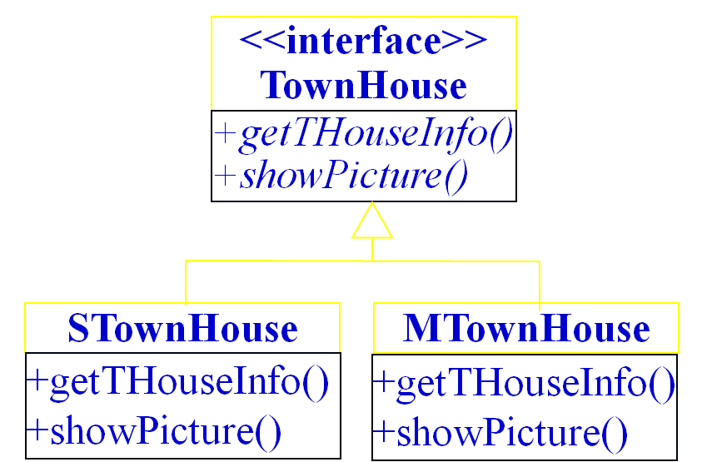
ClientGUI
<<interface>>
House
main()
+getHouseInfo()
+showPicture()
<<interface>>
Condo
SuperHouse
MediumHouse
+getHouseInfo()
+showPicture()
+getHouseInfo()
+showPicture()
+getCondoInfo()
+showPicture()
SuperCondo
MediumCondo
+getCondoInfo()
+showPicture()
+getCondoInfo()
+showPicture()
Add a TownHouse class hierarchy
软件工程 -2024 -第十一章 面向对象设计

Slide 69
<<interface>>
House
ClientGUI
+getHouseInfo()
+showPicture()
SuperHouse
MediumHouse
EconHouse
+getHouseInfo()
+showPicture()
+getHouseInfo()
+showPicture()
+getHouseInfo()
+showPicture()
<<interface>>
Condo
Add a new category class hierarchy
+getCondoInfo()
+showPicture()
SuperCondo
MediumCondo
EconCondo
+getCondoInfo()
+showPicture()
+getCondoInfo()
+showPicture()
+getCondoInfo()
+showPicture()
Back
软件工程 -2024 -第十一章 面向对象设计

Slide 70
Dependency inversion principle
软件工程 -2024 -第十一章 面向对象设计

Slide 71
Dependency inversion principle (依赖倒转原则)
依赖倒转原则的定义
The Dependency inversion principle states:
    High-level modules should not depend on low-level modules. Both should depend on abstractions.
    Abstractions should not depend on details. Details should depend on abstractions.
软件工程 -2024 -第十一章 面向对象设计

Slide 72
结构化设计中的依赖关系
In structured design, lower-level components are designed to be consumed by higher-level components which enable increasingly complex systems to be built.
Higher-level components depend directly upon lower-level components to achieve some task.
This dependency upon lower-level components limits the reuse opportunities of the higher-level components.
软件工程 -2024 -第十一章 面向对象设计

Slide 73
Function
依赖
Function
Function
依赖
Function
Function
Function
结构化设计-高层依赖于低层
软件工程 -2024 -第十一章 面向对象设计

Slide 74
Class
依赖
Class
Class
依赖
Class
Class
Class
面向对象设计中-某些人不良的设计习惯
软件工程 -2024 -第十一章 面向对象设计

Slide 75
哪种好的设计思路导致依赖倒转？
OO design encourages using abstract interface to define the methods and let its subclasses to implement the methods
Different subclass can implement the interface in different ways
It makes reuse of the higher level components easier (application logics), and the maintainability increases
By letting the sub class implement the middle layer interface, it makes the lower layer depend on the middle layer
软件工程 -2024 -第十一章 面向对象设计

Slide 76
Class
依赖
<<Interface>>
Class
<<Interface>>
Class
依赖
Class
Class
Class
高层逻辑与低层都依赖于接口-依赖倒转
软件工程 -2024 -第十一章 面向对象设计

Slide 77
结构化设计，上层调用下层，上层依赖于下层，当下层剧烈变动时上层也要跟着变动，这就会导致模块的复用性降低而且大大提高了开发的成本。
面向对象设计中的依赖倒转：一般情况下抽象的变化概率很小，让客户类依赖于抽象，实现的细节也依赖于抽象。
即使实现细节不断变动，只要抽象不变，客户程序就不需要变化。这大大降低了客户程序与实现细节的耦合度。
软件工程 -2024 -第十一章 面向对象设计

Slide 78
【例5-12】假设有一个软件公司的软件工程师设计了一个无人机自动驾驶系统。
暂时假设 考虑世界上的波音与空客两种飞机厂商生产的无人机。软件设计师定义了一个AutoAirSystem类，一个Boeing类，一个Airbus类。
Boeing类和Airbus类中各有5个方法: takeOff(), climb(), cruise(), descend()与land()方法，当然了一个无人机驾驶系统肯定不止这些功能，这里只要能说明问题即可。
AutoAirSystem类是一个自动驾驶系统，自动操纵这两种型号的飞机。设计类图如下图所示。
软件工程 -2024 -第十一章 面向对象设计

Slide 79
Example
Boeing
AutoAirSystem
+takeOff(): void
+climb(): void
+cruise(): void
+descend(): void
+land(): void
-boeing: Boeing
-airbus: Airbus
+doTakingOff(): void
+doClimbing(): void
+doCruising(): void
+doDescending(): void
+doLanding(): void
Airbus
+takeOff(): void
+climb(): void
+cruise(): void
+descend(): void
+land(): void
方法中含有很多条件语句，判断是Boeing还是Airbus；增加新的机种困难：需要修改所有方法
问题： AutoAirSystem直接依赖于两个具体的类Boeing，Airbus
软件工程 -2024 -第十一章 面向对象设计

Slide 80
public class Boeing{
public void takeOff(){
System.out.print("Boeing is taking off"); }
public void climb(){
System.out.print("Boeing is climbing"); }
public void cruise(){
System.out.print("Boeing is cruising"); }
public void descend(){
System.out.print("Boeing is descending"); }
public void land(){
System.out.print("Boeing is landing"); }
}
软件工程 -2024 -第十一章 面向对象设计

Slide 81
public class Airbus{
public void takeOff(){
System.out.println("Airbus is taking off"); }
public void climb(){
System.out.println("Airbus is climbing"); }
public void cruise(){
System.out.println("Airbus is cruising"); }
public void descend(){
System.out.println("Airbus is descending"); }
public void land(){
System.out.println("Airbus is landing"); }
}
软件工程 -2024 -第十一章 面向对象设计

Slide 82
public class AutoAirSystem {
private String craftType = null;
private AirbusAutoAircraft airbus = new Airbus();
private BoeingAutoAircraft boeing = new Boeing();
public AutoAirSystem(String craftType){
this.craftType = craftType;
}
public void doTakingOff(){
if(craftType.equals(BOEING))
boeing.takeOff();
else if(craftType.equals(AIRBUS))
airbus.takeOff();
}
public void doLanding(){ … }
}
软件工程 -2024 -第十一章 面向对象设计

Slide 83
设计缺点：
  随着时间推移，更多的新型无人机会加入到AutoAirSystem中，该类将频繁增加条件语句；
  只要低层类发生变动，AutoAirSystem就必须跟着变动，它最终将变得混乱不堪，难以扩展与维护。
原因：AutoAirSystem类依赖于它所控制的低层的具体细节的类Boeing和Airbus。
改善：找到一种方法使AutoAirSystem类独立于它所控制的具体细节，那么我们就可以自由地复用它了。
软件工程 -2024 -第十一章 面向对象设计

Slide 84
<<interface>>
AutoAirCraft
Improved design
+takeOff()
+climb()
+cruise()
+descend()
+land()
AutoAirSystem
-a: AutoAirCraft
+doTakingOff(): void
+doClimbing(): void
+doCruising(): void
+doDescending(): void
+doLanding(): void
Boeing
Airbus
+takeOff()
+climb()
+cruise()
+descend()
+land()
+takeOff()
+climb()
+cruise()
+descend()
+land()
AutoAirSystem 仅仅 依赖于AutoAirCraft
软件工程 -2024 -第十一章 面向对象设计

Slide 85
public class AutoAirSystem {
private AutoAircraft aircraft = null;
public AutoAirSystem(AutoAircraft aircraft ){
this. aircraft = aircraft ;
}
public void doTakingOff(){
aircraft.takeOff();
}
public void doClimbing(){
aircraft.climb();
}
public void doCruising(){ … }
public void doDescending(){… }
public void doLanding(){…}
}
软件工程 -2024 -第十一章 面向对象设计

Slide 86
优点：
AutoAirSystem仅仅依赖于接口AutoAirCraft；容易扩展与重用。
If a new kind of aircraft is added to the class hierarchy of AutoAirCraft, the AutoAirSystem does not need to change
Back
软件工程 -2024 -第十一章 面向对象设计

Slide 87
第十一章内容概要
面向对象设计的准则
SOLID Principles
启发规则
软件重用
系统分解
设计问题域子系统
设计人机交互子系统
设计任务管理子系统
设计数据管理子系统
设计类中的服务
设计关联
设计优化
设计模式
★
软件工程 -2024 -第十一章 面向对象设计

Slide 88
启发规则
设计结果应该清晰易懂
  用词一致
  使用已有的协议
  减少消息模式的数目
  避免模糊的定义
一般-特殊结构的深度应适当
设计简单的协议
  一般说来，消息中的参数不要超过3个。
软件工程 -2024 -第十一章 面向对象设计

Slide 89
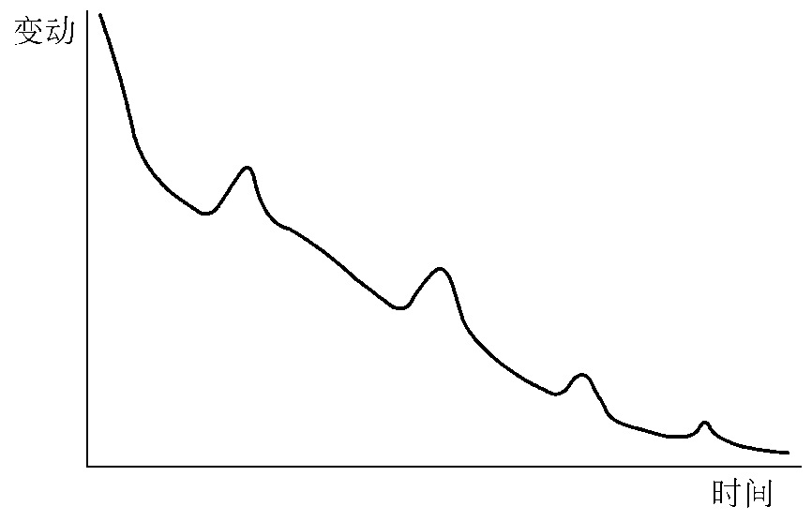
启发规则
设计简单的类
  避免包含过多的属性
  有明确的定义
  尽量简化对象之间的合作关系
  不要提供太多服务
使用简单的服务
把设计变动减至最小
软件工程 -2024 -第十一章 面向对象设计

Slide 90
第十一章内容概要
面向对象设计的准则
SOLID Principle
启发规则
软件重用
系统分解
设计问题域子系统
设计人机交互子系统
设计任务管理子系统
设计数据管理子系统
设计类中的服务
设计关联
设计优化
设计模式
★
软件工程 -2024 -第十一章 面向对象设计

Slide 91
软件重用
重用也叫再用或复用，是指同一事物不作修改或稍加改动就多次重复使
软件重用分为3个层次
  知识重用(例如，软件工程知识的重用)
  方法和标准的重用(例如，面向对象方法或国家制定的软件开发规范的重用)
  软件成分的重用
软件工程 -2024 -第十一章 面向对象设计

Slide 92
软件重用
软件成分的重用
  代码重用
    源代码剪贴
    源代码包含
    继承
  设计结果重用
  分析结果重用
软件工程 -2024 -第十一章 面向对象设计

Slide 93
软件重用
典型的可重用软件成分
  项目计划
  成本估计
  体系结构
  需求模型和规格说明
  设计
  源代码
  用户文档和技术文档
  用户界面
  数据
  测试用例
软件工程 -2024 -第十一章 面向对象设计

Slide 94
类构件
可重用软构件应具备的特点
  模块独立性强
  具有高度可塑性
  接口清晰、简明、可靠
类构件的重用方式
  实例重用
  继承重用
  多态重用
软件工程 -2024 -第十一章 面向对象设计

Slide 95
多态重用
利用多态性不仅可以使对象的对外接口更加一般化(基类与派生类的许多对外接口是相同的)，而且还提供了一种简便可靠的软构件组合机制。系统运行时，根据接收消息的对象类型，由多态性机制启动正确的方法，去响应一个一般化的消息。
软件工程 -2024 -第十一章 面向对象设计

Slide 96
多态重用
为充分实现多态重用，在设计类构件时，应该把注意力集中在下列一些可能影响重用性的操作上（使用转换接口/扩充接口）：
  与表示方法有关的操作。例如，不同实例的比较、显示、擦除等等
  与数据结构、数据大小等有关的操作
  与外部设备有关的操作。例如，设备控制
  实现算法在将来可能会改进(或改变)的核心操作
软件工程 -2024 -第十一章 面向对象设计

Slide 97
多态重用的效益
质量
生产率
成本
C=Cs-Cr-Cd
其中，Cs是项目从头开发（没有重用）时所需要的成本；Cr是与重用相关联的成本；Cd是交付给客户的软件的实际成本。
软件工程 -2024 -第十一章 面向对象设计

Slide 98
第十一章内容概要
面向对象设计的准则
SOLID Principle
启发规则
软件重用
系统分解
设计问题域子系统
设计人机交互子系统
设计任务管理子系统
设计数据管理子系统
设计类中的服务
设计关联
设计优化
设计模式
★
软件工程 -2024 -第十一章 面向对象设计

Slide 99
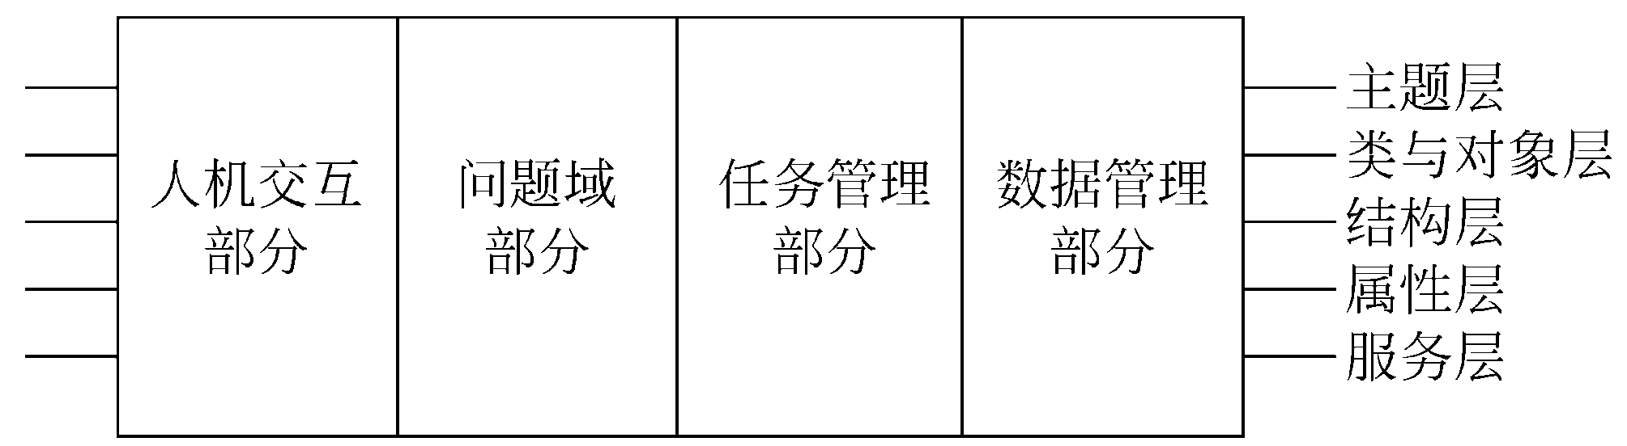
系统分解
软件工程 -2024 -第十一章 面向对象设计

Slide 100
系统分解
子系统之间的两种交互方式
  客户-供应商关系
  平等伙伴关系
组织系统的两种方案
  层次组织
    封闭式
    开放式
  块状组织
软件工程 -2024 -第十一章 面向对象设计

Slide 101
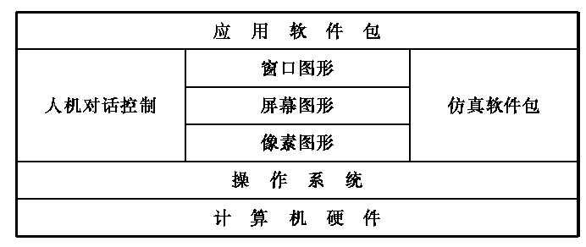
图11.3 典型应用系统的组织结构
软件工程 -2024 -第十一章 面向对象设计

Slide 102
第十一章内容概要
面向对象设计的准则
SOLID Principle
启发规则
软件重用
系统分解
设计问题域子系统
设计人机交互子系统
设计任务管理子系统
设计数据管理子系统
设计类中的服务
设计关联
设计优化
设计模式
★
软件工程 -2024 -第十一章 面向对象设计

Slide 103
设计问题域子系统
只要可能，就应该保持面向对象分析所建立的问题域结构。通常，面向对象设计仅需从实现角度对问题域模型做一些补充或修改，主要是增添、合并或分解类与对象、属性及服务，调整继承关系等等。
软件工程 -2024 -第十一章 面向对象设计

Slide 104
设计问题域子系统
在面向对象设计过程中，可能对面向对象分析所得出的问题域模型做的补充或修改
  调整需求
  重用已有的类
    选择有可能被重用的已有类，标出这些候选类中对本问题无用的属性和服务，尽量重用那些能使无用的属性和服务降到最低程度的类
    在被重用的已有类和问题域类之间添加泛化关系(即从被重用的已有类派生出问题域类)
    标出问题域类中从已有类继承来的属性和服务，现在已经无须在问题域类内定义它们了
    修改与问题域类相关的关联，必要时改为与被重用的已有类相关的关联
软件工程 -2024 -第十一章 面向对象设计

Slide 105
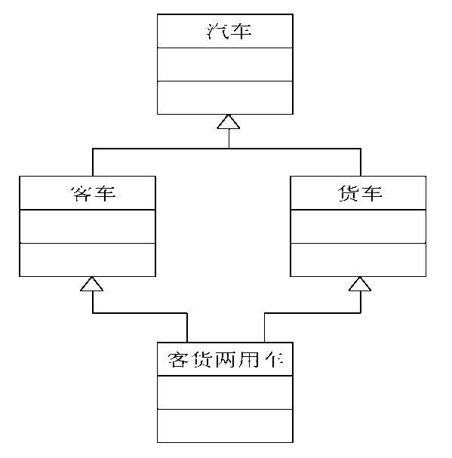
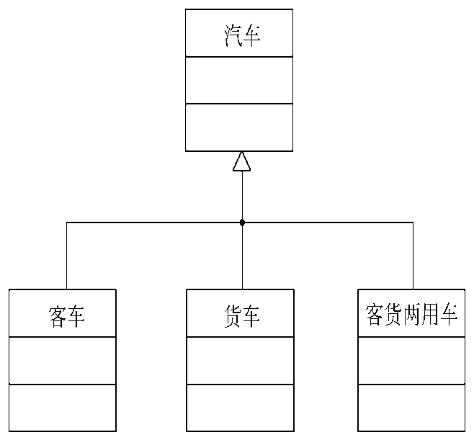
设计问题域子系统
把问题域类组合在一起
增添一般化类以建立协议
调整继承层次
软件工程 -2024 -第十一章 面向对象设计

Slide 106
第十一章内容概要
面向对象设计的准则
SOLID Principle
启发规则
软件重用
系统分解
设计问题域子系统
设计人机交互子系统
设计任务管理子系统
设计数据管理子系统
设计类中的服务
设计关联
设计优化
设计模式
★
软件工程 -2024 -第十一章 面向对象设计

Slide 107
设计人机交互子系统
分类用户
  按技能水平分类(新手、初级、中级、高级)
  按职务分类(总经理、经理、职员)
  按所属集团分类(职员、顾客)
描述用户
  用户类型
  使用系统欲达到的目的
  特征(年龄、性别、受教育程度、限制因素等)
  关键的成功因素(需求、爱好、习惯等)
  技能水平
  完成本职工作的脚本
软件工程 -2024 -第十一章 面向对象设计

Slide 108
设计人机交互子系统
设计命令层次
  研究现有的人机交互含义和准则
  确定初始的命令层次
  精化命令层次
    次序
    整体-部分关系
    操作步骤
软件工程 -2024 -第十一章 面向对象设计

Slide 109
设计人机交互子系统
设计人机交互类
  人机交互类与所使用的操作系统及编程语言密切相关。例如，在Windows环境下运行的Visual C++语言提供了MFC类库，设计人机交互类时，往往仅需从MFC类库中选出一些适用的类，然后从这些类派生出符合自己需要的类就可以了。
软件工程 -2024 -第十一章 面向对象设计

Slide 110
第十一章内容概要
面向对象设计的准则
SOLID Principle
启发规则
软件重用
系统分解
设计问题域子系统
设计人机交互子系统
设计任务管理子系统
设计数据管理子系统
设计类中的服务
设计关联
设计优化
设计模式
★
软件工程 -2024 -第十一章 面向对象设计

Slide 111
设计任务管理子系统
分析并发性
设计任务管理子系统
  常见的任务有事件驱动型任务、时钟驱动型任务、优先任务、关键任务和协调任务等。设计任务管理子系统，包括确定各类任务并把任务分配给适当的硬件或软件去执行
软件工程 -2024 -第十一章 面向对象设计

Slide 112
设计任务管理子系统
确定事件驱动型任务
确定时钟驱动型任务
确定优先任务
确定关键任务
确定协调任务
尽量减少任务数
确定资源需求
软件工程 -2024 -第十一章 面向对象设计

Slide 113
第十一章内容概要
面向对象设计的准则
SOLID Principle
启发规则
软件重用
系统分解
设计问题域子系统
设计人机交互子系统
设计任务管理子系统
设计数据管理子系统
设计类中的服务
设计关联
设计优化
设计模式
★
软件工程 -2024 -第十一章 面向对象设计

Slide 114
设计数据管理子系统
选择数据存储管理模式
  文件管理系统
  关系数据库管理系统
    提供了各种最基本的数据管理功能
    为多种应用提供了一致的接口
    标准化的语言
    运行开销大
    不能满足高级应用的需求
    与程序设计语言的连接不自然
  面向对象数据库管理系统
    扩展的关系数据库管理系统
    扩展的面向对象程序设计语言
软件工程 -2024 -第十一章 面向对象设计

Slide 115
设计数据管理子系统
设计数据管理子系统
  设计数据格式
    文件系统：定义第一范式表；为每个第一范式表定义一个文件；测量性能和需要的存储容量；修改原设计的第一范式，以满足性能和存储需求
    关系数据库管理系统：定义第三范式表；为每个第三范式表定义一个数据库表；测量性能和需要的存储容量；修改先前设计的第三范式，以满足性能和存储需求
软件工程 -2024 -第十一章 面向对象设计

Slide 116
设计数据管理子系统
    面向对象数据库管理系统：扩展的关系数据库途径：使用与关系数据库管理系统相同的方法；扩展的面向对象程序设计语言途径：不需要规范化属性的步骤，因为数据库管理系统本身具有把对象值映射成存储值的功能。
  设计相应的服务
    文件系统：被存储的对象需要知道打开哪个(些)文件，怎样把文件定位到正确的记录上，怎样检索出旧值(如果有的话)，以及怎样用现有值更新它们。此外，还应该定义一个ObjectServer (对象服务器)类，并创建它的实例。该类提供下列服务：通知对象保存自身；检索已存储的对象(查找，读值，创建并初始化对象)，以便把这些对象提供给其他子系统使用。
    关系数据库管理系统
    面向对象数据库管理系统
软件工程 -2024 -第十一章 面向对象设计

Slide 117
第十一章内容概要
面向对象设计的准则
SOLID Principle
启发规则
软件重用
系统分解
设计问题域子系统
设计人机交互子系统
设计任务管理子系统
设计数据管理子系统
设计类中的服务
设计关联
设计优化
设计模式
★
软件工程 -2024 -第十一章 面向对象设计

Slide 118
设计类中的服务
确定类中应有的服务
设计实现服务的方法
  设计实现服务的
    算法复杂度
    容易理解与容易实现
    易修改
  选择数据结构
  定义内部类和内部操作
软件工程 -2024 -第十一章 面向对象设计

Slide 119
第十一章内容概要
面向对象设计的准则
SOLID Principle
启发规则
软件重用
系统分解
设计问题域子系统
设计人机交互子系统
设计任务管理子系统
设计数据管理子系统
设计类中的服务
设计关联
设计优化
设计模式
★
软件工程 -2024 -第十一章 面向对象设计

Slide 120
设计关联
关联的遍历
  单向关联
  双向关联
实现单向关联
实现双向关联
  只用属性实现一个方向的关联，当需要反向遍历时就执行一次正向查找
  两个方向的关联都用属性实现
  用独立的关联对象实现双向关联
软件工程 -2024 -第十一章 面向对象设计

Slide 121
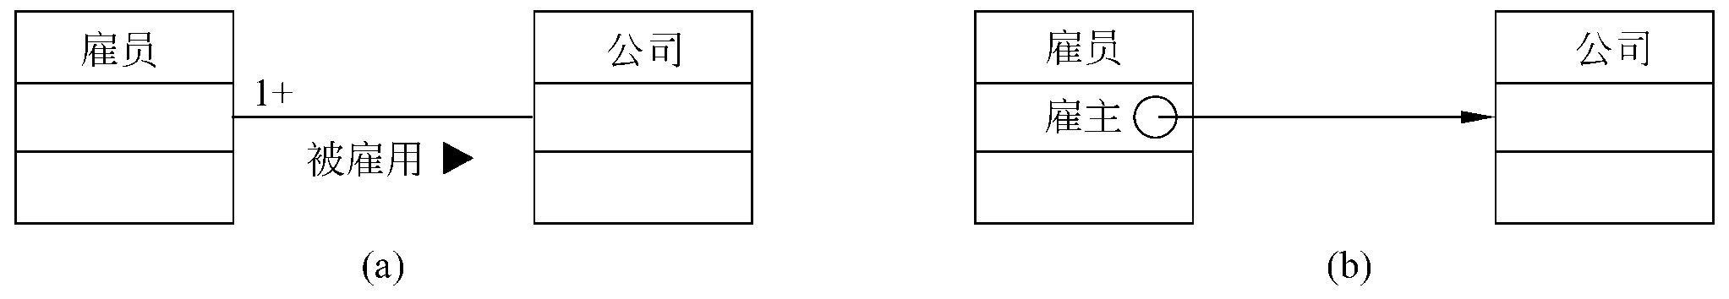
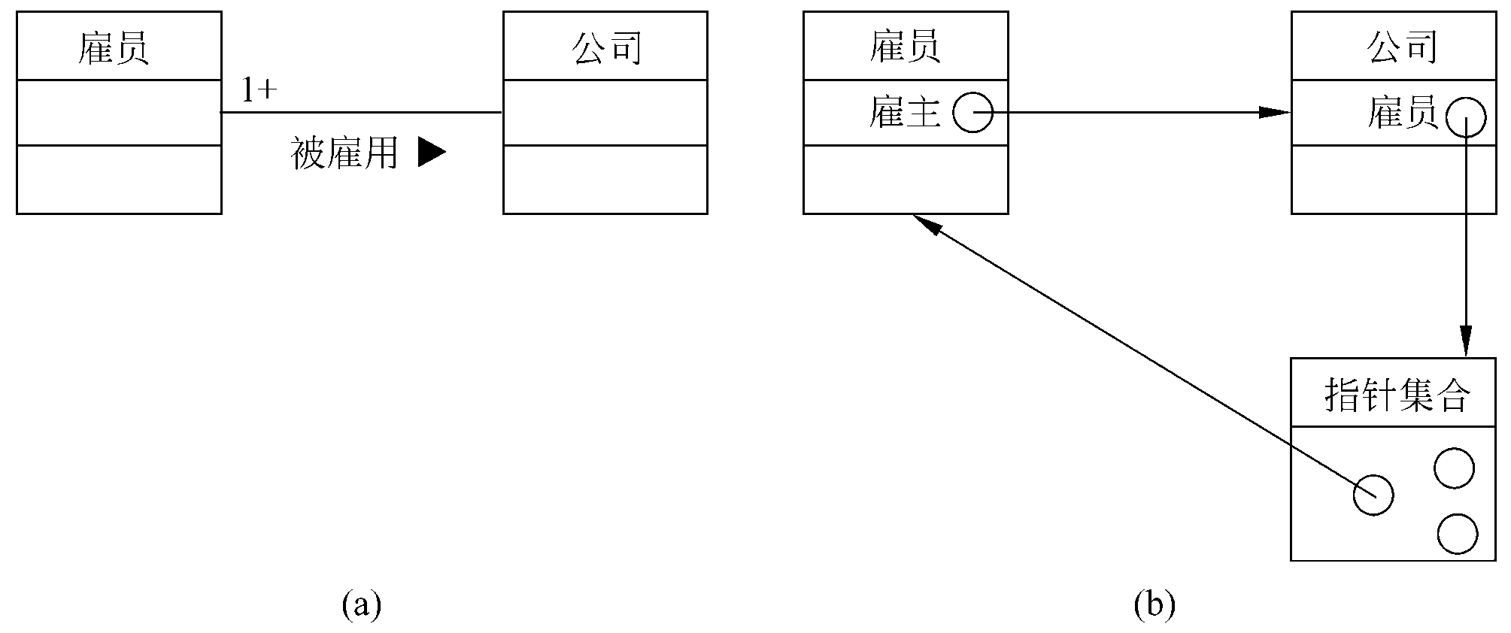
软件工程 -2024 -第十一章 面向对象设计

Slide 122
设计关联
关联对象的实现
  对于一对一关联来说，关联对象可以与参与关联的任一个对象合并。对于一对多关联来说，关联对象可以与“多”端对象合并。如果是多对多关联，则关联链的性质不可能只与一个参与关联的对象有关，通常用一个独立的关联类来保存描述关联性质的信息，这个类的每个实例表示一条具体的关联链及该链的属性。
软件工程 -2024 -第十一章 面向对象设计

Slide 123
第十一章内容概要
面向对象设计的准则
SOLID Principle
启发规则
软件重用
系统分解
设计问题域子系统
设计人机交互子系统
设计任务管理子系统
设计数据管理子系统
设计类中的服务
设计关联
设计优化
设计模式
★
软件工程 -2024 -第十一章 面向对象设计

Slide 124
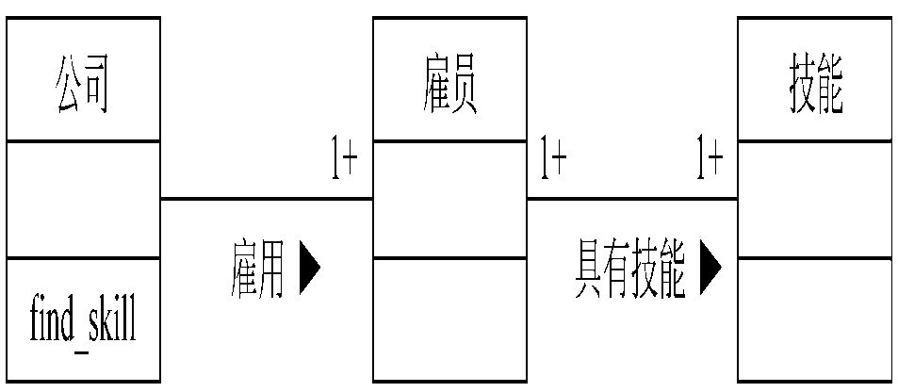
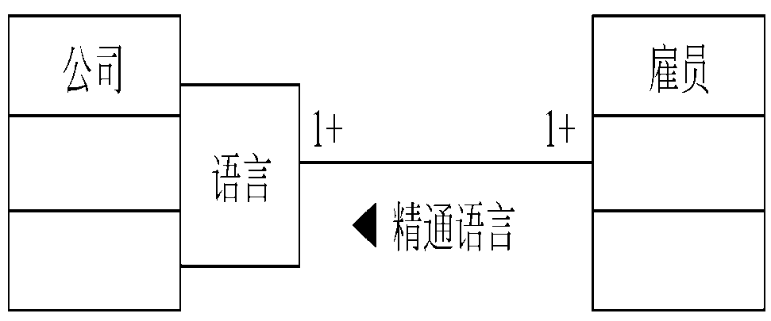
设计优化
确定优先级（系统的各项质量指标并不是同等重要的）
提高效率的几项技术
  增加冗余关联以提高访问效率
软件工程 -2024 -第十一章 面向对象设计

Slide 125
设计优化
  调整查询次序
  保留派生属性
调整继承关系
  抽象与具体
  为提高继承程度而修改类定义
    各个现有类中的属性和行为(操作)，虽然相似却并不完全相同，在这种情况下需要对类的定义稍加修改，才能定义一个基类供其子类从中继承需要的属性或行为
  利用委托实现行为共享
软件工程 -2024 -第十一章 面向对象设计

Slide 126
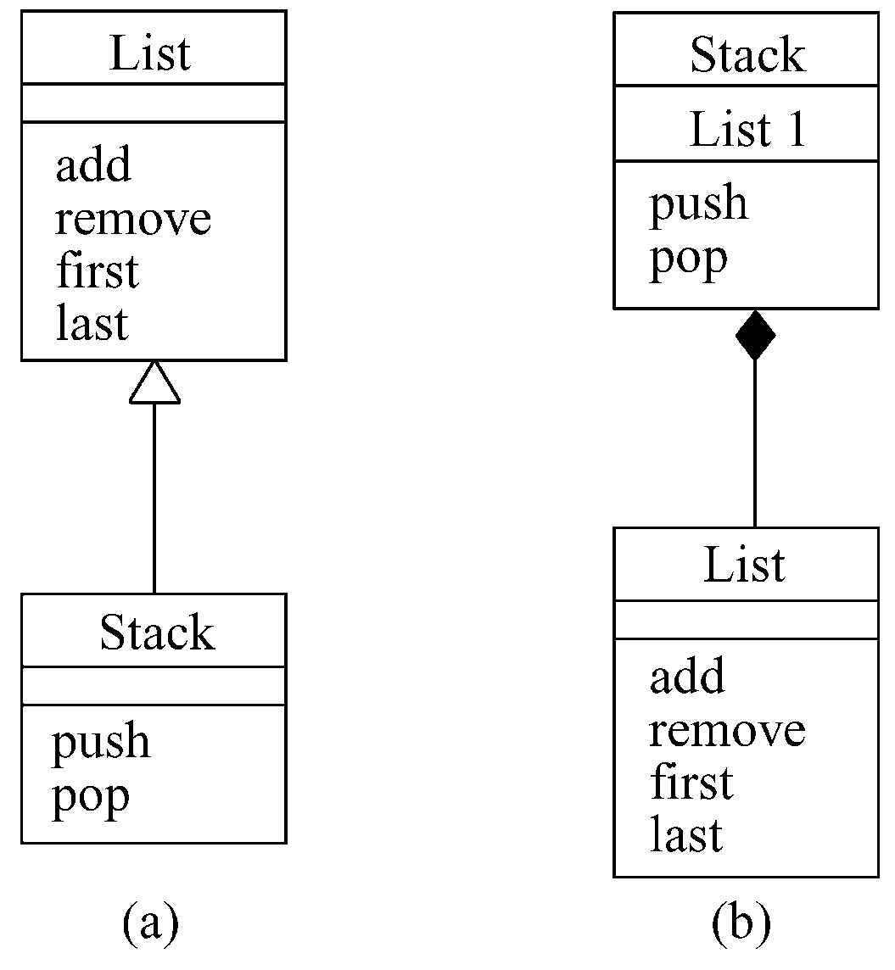
软件工程 -2024 -第十一章 面向对象设计

Slide 127
第十一章内容概要
面向对象设计的准则
SOLID Principle
启发规则
软件重用
系统分解
设计问题域子系统
设计人机交互子系统
设计任务管理子系统
设计数据管理子系统
设计类中的服务
设计关联
设计优化
设计模式
★
软件工程 -2024 -第十一章 面向对象设计

Slide 128
  一、什么是设计模式
1、引言
Christopher Alexander: “每一个模式描述了一个在我们
周围不断重复发生的问题，以及该问题的解决方案的核心。
这样，你就能一次又一次地使用该方案而不必做重复劳动”。
2、模式的基本要素
(1) Pattern Name
(2) Problem
(3) Solution
(4) Consequences
软件工程 -2024 -第十一章 面向对象设计

Slide 129
二、设计模式的描述
(1) 模式名和分类（简洁地描述模式的本质）
(2) 意图（模式是做什么的？它的基本原理和意图是什么？它解决的是什么样的特定设计问题？）
(3) 别名（模式的其他名称）
(4) 动机（用以说明一个设计问题以及如何使用模式中的类、对象来解决该问题的特定情景。
该情景回帮助你理解随后对模式更抽象的描述。）
(5) 适用性（什么情况下可以使用该设计模式？该模式可用来改进那些不良设计？
怎样识别这些情况？）
(6) 结构（采用对象建模技术OMT的表示法对模式中的类进行图形描述）
(7) 参与者（指设计模式中的类和/对象以及它们各自的职责。）
(8) 协作（模式怎样协作以实现它们的职责。）
(9) 效果（模式怎样支持它的目标？使用模式的效果和所需做的权衡取舍？
系统结构的那些方面可以独立改变。）
(10) 实现（实现模式时需要知道的一些提示、技术要点及应避免的缺陷，
以及是够存在某些特定于实现语言的问题）
(11) 代码示例（用来说明怎样用C++或Smalltalk实现该模式的代码片段）
(12) 已知应用（实际系统中发现的模式的例子，每个模式至少包括了两个不同领域的实例）
(13) 相关模式（与这个模式紧密相关的模式有那些？其间重要的不同之处？
该模式应与那些其他模式一起使用？）
软件工程 -2024 -第十一章 面向对象设计

Slide 130
(1)关于模式的分类和组织编目
 |  | 目的
 |  | 创建型 | 结构型 | 行为型
范 围 | 类 | Factory Method | Adapter | Interpreter Template Method
 | 对象 | Abstract Factory Builder Prototype Singleton | Adapter Bridge Composite Decorator Façade Flyweight Proxy | Chain of Responsibility Command Iterator Mediator Memento Observer State Strategy Visitor
软件工程 -2024 -第十一章 面向对象设计

Slide 131
三、怎样选择设计模式
1、考虑设计模式是怎样解决设计问题的
2、浏览模式的意图部分
3、研究模式怎样互相关联
4、研究目的相似的模式
5、检查重新设计的原因
6、考虑你的设计中哪些是可变的
软件工程 -2024 -第十一章 面向对象设计

Slide 132
四、怎样使用设计模式
(1) 大致浏览一遍模式，特别市实用性部分和效果部分，
确定它适合你的问题；
(2) 回头研究结构部分和协作部分；
(3) 看代码示例部分；
(4) 选择模式参与者的名字，使他们在应用上下文中有意义；
(5) 定义类；
(6) 定义模式中专用于应用的操作名称；
(7)实现执行模式中责任和协作的操作。
软件工程 -2024 -第十一章 面向对象设计

Slide 133
五、引子
—— 一个迷宫游戏
软件工程 -2024 -第十一章 面向对象设计

Slide 134
Mapsite
Enter()
sides
ROOM
Wall
Door
Enter()
Enter()
Enter()
SetSide()
isOpen()
Maze
rooms
GetSide()
AddRoom()
RoomNo()
RoomNumber
class maze {
public:
Maze();
Void AddRoom(Room*);
Room* RoomNo(int) const;
private:
//… …
};
Enum Direction {North, South, East, West};
软件工程 -2024 -第十一章 面向对象设计

Slide 135
class MapSite {
public:
virtual void Enter() = 0;
};
class Wall:public MapSite {
public:
Wall ();
virtual void Enter();
};
class Room: public MapSite {
public:
Room(int roomNo);
MapSite* GetSide(Direction) const;
void SetSide(Direction, MapSite*);
virtual void Enter();
private:
MapSite* _sides[4];
int _roomNumber;
};
class Door: public MapSite {
public:
Door(Room*=0,Room*=0);
virtual void Enter();
Room* OtherSideFrom(Room*);
private:
Room* _room1;
Room* _room2;
bool _isOpen;
};
软件工程 -2024 -第十一章 面向对象设计

Slide 136
Maze* MazeGame::CreateMaze() {
Maze* aMaze=new Maze();
Room* r1=new Room(1);
Room* r2=new Room(2);
Door* theDoor=new Door(r1,r2);
aMaze->AddRoom(r1);
aMaze->AddRoom(r2);
r1->SetSide(North, new Wall);
r1->SetSide(East, theDoor);
r1->SetSide(South, new Wall);
r1->SetSide(West, new Wall);
r2->SetSide(North, new Wall);
r2->SetSide(East, new Wall);
r2->SetSide(South, new Wall);
r2->SetSide(West, theDoor);
return aMaze;
}
r1
r2
软件工程 -2024 -第十一章 面向对象设计

Slide 137
Factory Method是如何解决这个问题的：
class MazeGame {
Public:
Maze* CreateMaze();
//factory methods:
virtual Maze* MakeMaze() const
{ return new Maze;}
virtual Room* MakeRoom(int n) const
{ return new Room(n);}
virtual Wall* MakeWall() const
{ return new Wall;}
virtual Door* MakeDoor(Room* r1,Room* r2) const
{return new Door(r1,r2); }
};
软件工程 -2024 -第十一章 面向对象设计

Slide 138
Maze* MazeGame::CreateMaze() {
Maze* aMaze=MakeMaze();
Room* r1=MakeRoom(1);
Room* r2=MakeRoom(2);
Door* theDoor=MakeDoor(r1,r2);
aMaze->AddRoom(r1);
aMaze->AddRoom(r2);
r1->SetSide(North, MakeWall);
r1->SetSide(East, theDoor);
r1->SetSide(South, MakeWall);
r1->SetSide(West, MakeWall);
r2->SetSide(North, MakeWall);
r2->SetSide(East, MakeWall);
r2->SetSide(South, MakeWall);
r2->SetSide(West, theDoor);
return aMaze;
}
软件工程 -2024 -第十一章 面向对象设计

Slide 139
利用Factory Method模式，产生一个有炸弹的迷宫：
class BombedMazeGame:publlic MazeGame {
public:
BombedMazeGame();
virtual Wall* MakeWall() const
{ return new BombedWall; }
virtual Room* MakeRoom(int n) const
{ return new RoomWithBomb(n); }
};
软件工程 -2024 -第十一章 面向对象设计

Slide 140
利用Factory Method模式，产生一个有魔法的迷宫：
class EnchantedMazeGame:public MazeGame {
public:
EnchantedMazeGame();
virtual Room* MakeRoom(int n) const
{ return new EnchantedRoom(n, CastSpell()); }
virtual Door* MakeDoor(Room* r1,Room* r2) const
{return new DoorNeedingSpell(r1,r2); }
protected:
Spell* CastSpell() const;
};
软件工程 -2024 -第十一章 面向对象设计

Slide 141
另一个在实际应用中，常见的例子：
Document
docs
Application
Open()
CreateDocument()
Document* doc=CreateDocument();
Docs.Add(doc);
Doc->Open();
Close()
NewDocument()
Save()
OpenDocument()
Revert()
MyDocument
MyApplication
CreateDocument()
Return new MyDocument
软件工程 -2024 -第十一章 面向对象设计

Slide 142
FACTORY METHOD模式的结构部分：
Creator
Product
FactoryMethod()
AnOperation()
…
Product = FactoryMethod()
…
ConcreteProduct
ConcreteCreator
FactoryMethod()
Return new ConcreteProduct
软件工程 -2024 -第十一章 面向对象设计

Slide 143
小结：类创建型模式
创建型模式抽象了实例化过程，它们帮助一个系统独立于
如何创建、组合和表示它的那些对象。因此，创建型模式
在什么被创建、谁创建它、它是怎样被创建的，以及何时
被创建这些方面给予你很大的灵活性。它们允许你用功能
差别很大的“产品”对象配置一个系统。
一个类创建型模式使用继承来改变实例化的类。
下面的对象创建型模式将实例化委托给另一个对象。
软件工程 -2024 -第十一章 面向对象设计

Slide 144
AbstractFactory是如何解决这个问题的：
class MazeFactory {
public:
MazeFactory();
virtual Maze* MakeMaze() const
{ return new Maze; }
virtual Wall* MakeMaze() const
{ return new Wall; }
virtual Room* MakeRoom(int n) const
{ return new Room(n); }
virtual Door* MakeDoor(Room* r1,Room* r2) const
{ return new Door(r1,r2); }
软件工程 -2024 -第十一章 面向对象设计

Slide 145
Maze* MazeGame::CreateMaze(MazeFactory& factory) {
Maze* aMaze=factory.MakeMaze();
Room* r1=factory.MakeRoom(1);
Room* r2=factory.MakeRoom(2);
Door* aDoor=factory.MakeDoor(r1,r2);
aMaze->AddRoom(r1);
aMaze->AddRoom(r2);
r1->SetSide(North, factory.MakeWall);
r1->SetSide(East, aDoor);
r1->SetSide(South, factory.MakeWall);
r1->SetSide(West, factory.MakeWall);
r1->SetSide(North, factory.MakeWall);
r1->SetSide(East, factory.MakeWall);
r1->SetSide(South, factory.MakeWall);
r1->SetSide(West, aDoor);
return aMaze;
}
软件工程 -2024 -第十一章 面向对象设计

Slide 146
利用AbstractFactory模式，产生一个有魔法的迷宫：
class EnchantedMazeFactory:public MazeFactory {
public:
EnchantedMazeFactory();
virtual Room* MakeRoom(int n) const
{ return new EnchantedRoom(n, CastSpell()); }
virtual Door* MakeDoor(Room* r1,Room* r2) const
{return new DoorNeedingSpell(r1,r2); }
protected:
Spell* CastSpell() const;
};
软件工程 -2024 -第十一章 面向对象设计

Slide 147
利用AbstractFactory模式，产生一个有炸弹的迷宫：
class BombedMazeFactory:publlic MazeFactory {
public:
BombedMazeFactory();
virtual Wall* MakeWall() const
{ return new BombedWall; }
virtual Room* MakeRoom(int n) const
{ return new RoomWithBomb(n); }
};
软件工程 -2024 -第十一章 面向对象设计

Slide 148
AbstractFactory模式的结构：
AbstractFactory
Client
CreateProductA()
CreateProductB()
AbstractProductA
productA2
productA1
ConcreteFactory1
ConcreteFactory2
CreateProductA()
CreateProductB()
CreateProductA()
CreateProductB()
AbstractProductB
productB2
productB1
软件工程 -2024 -第十一章 面向对象设计

Slide 149
行为模式
行为模式涉及到算法和对象间职责的分配。行为模式不仅是描
述对象或类的模式，还描述他们之间的通信模式。这些模式刻
画了在运行时刻难以跟踪的负载的控制流。他们将你的注意力
从控制流转移到对象件的联系方式上来。
行为类模式使用继承机制在类间分派行为。其中，Template
Method较为简单和常用。模板方法是一个算法的抽象定义，
它逐步地定义该算法，美意部调用一个抽象操作或一个原语操
作，子类定义抽象操作以具体实现该算法。
行为对象模式使用对象复合而不是继承。一些行为对象模式描
述了一组对等的饿对象怎样相互协作以完成其中任一个对象都
无法单独完成的任务。
软件工程 -2024 -第十一章 面向对象设计

Slide 150
TEMPLATE METHOD----类行为模式
1、意图
定义一个操作中的算法的骨架，而将一些步骤延迟到子类中。
Template Method使得子类可以不改变一个算法的结构即可以重新定
义该算法的某些特定步骤。
2、动机
void Application::OpenDocument(const char*name) {
if (!CanOpenDocument(name)) {
return;
}
Document* doc=DoCreateDocument();
if (doc) {
_docs->AddDocument(doc);
AboutToOpenDocument(doc);
doc->Open();
doc->DoRead();
}
}
软件工程 -2024 -第十一章 面向对象设计

Slide 151
docs
Document
Application
Save()
Open()
Close()
DoRead()
AddDocument()
OpenDocument()
DoCreateDocument()
CanOpenDocument()
AboutToOpenDocument()
MyDocument
MyApplication
DoCreateDocument()
CanOpenDocument
AboutToOpenDocument()
Return new MyDocument()
DoRead()
软件工程 -2024 -第十一章 面向对象设计

Slide 152
3、适用性
模板方法应用于下列情况：
（1）一次性实现一个算法的不变的部分，并将可变的行为留给子类来实现。
（2）各子类中公共的行为应被提取出来并集中到一个公共父类中以避免代码
重复。
（3）控制子类的扩展。模板方法只在特定点调用“hook”操作。
4、结构
AbstractClass
…
PrimitiveOperation1()
PrimitiveOperation2()
…
TemplatMethod()
PrimitiveOperation1()
PrimitiveOperation2()
ConcreteClass
PrimitiveOperation1()
PrimitiveOperation2()
软件工程 -2024 -第十一章 面向对象设计

Slide 153
5、参与者
（1）AbstractClass (抽象类，如Application)
定义抽象的原语操作(primitive operation)，具体的子类将重定义它们以
实现一个算法的各步骤。
实现一个 模板方法，定义一个算法的骨架。该模板方法不仅调用原语
操作，也调用定义在AbstractClass或其他对象中的操作。
（2）ConcreteClass(具体类，如MyApplication)
实现原语操作以完成算法中与特定子类相关的步骤。
6、协作
ConcreteClass靠AbstractClass来实现算法中不变的步骤。
7、效果
模板方法是一种代码复用的基本技术，他们在类库中尤为重要，它们提
取了类库 中的公共行为。模板方法导致一种反向的控制结构，这种结构
有时被称为“好莱坞”法则，即“别找我们，我们找你”。这指的是父类调用
子类的操作，而不是相反。
软件工程 -2024 -第十一章 面向对象设计

Slide 154
模板方法调用下列类型的操作：
具体的操作（ ConcreateClass的操作）；
具体的AbstracteClass的操作（即，通常对子类有用的操作）；
原语操作（即，抽象操作）；
Factory Method；
钩子操作（hook operations），它提供了缺省的行为名字类可以在必要是进行
扩展。一个钩子操作在缺省操作是通常是一个空操作。
OBSERVER----对象行为型模型
1、意图
定义对象间的一种一对多的依赖关系，当一个对象的状态发生改变时，
所有依赖于它的对象都得到通知并被自动更新。
2、别名
依赖(Dependents)，发布-订阅(Publish-Subscribe)
软件工程 -2024 -第十一章 面向对象设计

Slide 155
3、动机
将一个系统分割成一系列 相互协作 的类有一个常见的副作用：需要维护
相关对象间的一致性。我们不希望为了维护一致性而是各类紧密耦合，因为
这样降低了他们的可重用性。
例如，许多图形用户界面工具箱将用户应用的界面表示与底下的应用数据
分离。定义应用数据的类和负责截面表示的类可以各自独立地复用。当然它们
也可一起工作。一个表格对象和一个柱状图对象可使用不同的表示形式描述同
一个应用数据对象的信息。表格对象和柱状图对象互相并不知道对方的存在，
这样使你可以根据需要单独复用表格或柱状图。但在这里是他们表现的似乎并
不知道。当用户该面表格中的信息时，柱状图能立即反映着一变化，反之依然。
这一行为意味着表格对象和柱状图对象都依赖于数据对象，因此数据对象的
任何状态改变都应立即通知它们。同时也没有理由将依赖于该数据对象的数目限
定为两个，对相同的数据可以有任意数目的不同的用户界面。
Observer模式描述了如何建立这种关系。这一模式中的关键对象是Subject和
Observer。一个目标可以有任意数目的依赖它的观察者。一旦目标的状态发生
改变，所有的观察者都得到通知。作为对这个通知的响应，每一个观察者都将
查询目标以使其状态与目标的状态同步。
软件工程 -2024 -第十一章 面向对象设计

Slide 156
observers
Subject
Observer
Attach(Observer)
Datach(Observer)
Notify()
Update()
For all o in observers {
o->Update()
}
subject
ConcreteSubject
ConcreteObserver
observerState=
Subject->GetState()
GetState()
SetState()
Update()
return subjectState
observerState
subjectState
软件工程 -2024 -第十一章 面向对象设计

Slide 157
代码示例
class Subject;
class Observer {
public:
virtual ~observer();
virtual void Update(Subject* theChangedSubject) = 0;
Protected:
Observer();
};
软件工程 -2024 -第十一章 面向对象设计

Slide 158
class Subject {
public:
virtual ~subject();
virtual void Attach(Observer*);
virtual void Dettach(Observer*);
virtual Notify();
protected:
Subject();
private:
List<Observer*> *_observers;
}
void Subject::Attach(Observer* o) {
_observer->Append(o);
}
void Subject::Detach(Observer* o) {
_observer->remove(o);
}
软件工程 -2024 -第十一章 面向对象设计

Slide 159
void Subject::Notify() {
ListIterator<Observer*> i (_observers);
for (i.First(); !i.IsDone(); i.Next()) {
i.CurrentItem->Update(this);
}
}
class ClockTimer: public Subject {
public:
clockTimer();
virtual int GetHour();
virtual int GetMinute();
virtual int GetSecond();
void Tick() { …
Notify;
}
}
软件工程 -2024 -第十一章 面向对象设计

Slide 160
class DigitalClock: public Widget, public Observer {
public:
DigitalClock(ClockTimer*);
virtual ~DigitalClock();
virtual void Update(Subject*);
virtual void Draw();
private:
ClockTimer* _subject;
};
DigitalClock::DigitalClock(ClockTimer* s) {
_subject=s;
_subject->Attach(this);
}
DigitalClock::~DigitalClock() {
_subject->Detach(this);
}
void DigitalClock::Update(Subject* theChangeSubject) {
if (theChangeSubject==_subject) {
Draw();
}
}
软件工程 -2024 -第十一章 面向对象设计

Slide 161
void DigitalCLock::Draw() {
int hour=_subject->GetHour();
int minute=_subject->Minute();
//draw the digital clock
};
class AnalogClock::public Widget, public Observer {
public:
AnalogClock(ClockTimer*);
virtual void Update(Subject*);
virtual void Draw();
//…
};
ClockTimer* timer=new ClockTimer;
AnalogClock* analogClock= new AnalogClock(timer);
DigitalClock* digitalClock= new DigitalClock(timer);
软件工程 -2024 -第十一章 面向对象设计

Slide 162
结构型模式
结构型模式设计到如何组合类和对象以获得更大的结构。
结构型类模式采用继承机制来组合接口或实现。一个简单的例子
是采用多重继承方法将两个以上的类组合成一个类，结果这个类
包含了所有父类的性质。
结构型对象模式不是对接口和事项进行组合，而是描述了如何对
一些对象进行组合，从而实现新功能的一些方法。
软件工程 -2024 -第十一章 面向对象设计

Slide 163
ADAPTER(适配器)——类结构型模式/对象结构型模式
作为类结构型模式，具有如下结构：
Client
Target
Adaptee
Request()
SpecialRequest()
(implementation)
Adapter
Request()
SpecialRequest()
软件工程 -2024 -第十一章 面向对象设计

Slide 164
作为对象结构型模式，具有如下结构：
Client
Target
Adaptee
Request()
SpecialRequest()
adaptee
Adapter
Request()
Adaptee->SpecialRequest()
软件工程 -2024 -第十一章 面向对象设计

Slide 165
COMPOSITE(组合)——对象结构
1、意图：
将对象组合成属性结构以表示“整体-部分”的层次结构。
Composite使得用户对单个对象和组合催乡的使用具有一
致性。
2、动机
软件工程 -2024 -第十一章 面向对象设计

Slide 166
Graphic
Draw()
Add(Graphic)
Remove(Graphic)
GetChild()
graphics
Line
Rectangle
Text
Picture
Draw()
Draw()
Draw()
Draw()
Add(Graphic g)
Remove(Graphic)
GetChild(int)
for all g in graphics
g.Draw()
add g to list of graphics
软件工程 -2024 -第十一章 面向对象设计

Slide 167
aPicture
aPicture
aLine
aRectangle
aLine
aRectangle
软件工程 -2024 -第十一章 面向对象设计

Slide 168
Client
Component
Operation()
Add(Component)
Remove(Component)
GetChild(int)
children
Leaf
Composite
Operation()
for all g in children
g.Operation();
Operation()
Add(Component)
Remove(Component)
GetChild(int)
软件工程 -2024 -第十一章 面向对象设计

Slide 169
适用性：
。你想表示对象的部分-整体层次结构
。你希望用户忽略组合对象和单个对象的不同，用户将统一
地使用组合结构中的所有对象
软件工程 -2024 -第十一章 面向对象设计

Slide 170
PROTOTYPE——对象创建型模式
1、意图
用原型实例指定创建对象的种类，并且通过拷贝这些
原型创建新的对象。
2、动机
软件工程 -2024 -第十一章 面向对象设计

Slide 171
prototype
Graphic
Tool
Draw(Position)
Clone()
Manipulate()
RotateTool
GraphicTool
Staff
MusicalNote
Manipulate()
Manipulate()
Draw(Position)
Clone()
WholeNote
HalfNote
P=prototype->Clone()
While (user drags mouse) {
P->Draw(new position)
}
Insert p into drawing
Draw(Position)
Clone()
Draw(Position)
Clone()
软件工程 -2024 -第十一章 面向对象设计
Reture copy of self
Reture copy of self

Slide 172
prototype
Prototype
Client
Operation()
Clone()
p=prototype->Clone()
ConcretePrototype1
ConcretePrototype2
Clone()
Clone()
Return copy of self
Return copy of self
软件工程 -2024 -第十一章 面向对象设计

Slide 173
class MazePrototypeFactory: public MazeFactory {
public:
MazePrototypeFactory(Maze*, Wall*, Room*, Door*);
virtaul Maze* MakeMaze() const;
virtual Room* MakeRoom(int) const;
virtual Wall* MakeWall() const;
virtual Door* MakeDoor(Room*,Room*) const;
private:
Maze* _prototypeMaze;
Room* _prototypeRoom;
Wall* _prototypeWall;
Door* _prototypeDoor;
}
MazePrototypeFactory::MazePrototypeFactory (Maze* m, Wall * w, Room* r, Door* d) {
_prototypeMaze=m;
_prototypeWall=w;
_prototypeRoom=r;
_prototypeDoor=d;
}
软件工程 -2024 -第十一章 面向对象设计

Slide 174
Wall* MazePrototypeFactory::MakeWall() const {
reture _prototypeWall->Clone();
}
Door* MazePrototypeFactory::MakeDoor(Room* r1, Room* r2) {
Door* door=_prototypeDoor->Clone();
door->Initialize(r1,r2);
return door;
}
接下来，我们只需使用基本迷宫构件的原型进行初始化，
就可以由MazePrototypeFactory来创建一个缺省的迷宫：
MazeGame game;
MazePrototypeFactory simpleMazeFactory (new Maze, new Wall, new Room, new Door);
Maze* maze=game.Create(simpleMazeFactory);
有炸弹的迷宫，包含有炸弹的房间和被炸坏的门
MazePrototypeFactory bombedMazeFactory (
new Maze, new BombedWall, new RoomWithABomb, new Door);
软件工程 -2024 -第十一章 面向对象设计

Slide 175
STRATEGY(策略)——对象行为型模式
1、意图
定义一系列的算法，把它们一个个封装起来，并且使它们
可相互替换。本模式使得算法可独立于使用它的可户而变化。
2、动机
软件工程 -2024 -第十一章 面向对象设计

Slide 176
compositor
Composition
Compositor
Traverse()
Repair()
Compose()
compositor->Compose()
SimpleCompositor
TeXCompositor
ArrayCopositor
Compose()
Compose()
Compose()
软件工程 -2024 -第十一章 面向对象设计

Slide 177
strategy
Context
Strategy
ContextInterface()
AlgorithmiInterface()
ConcreteStrategyA
ConcreteStrategyB
ConcreteStrategyC
AlgorithmiInterface()
AlgorithmiInterface()
AlgorithmiInterface()
软件工程 -2024 -第十一章 面向对象设计

