Slide 1
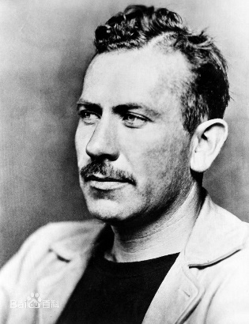
Getting Started
“I suffer . . . from the fear of putting down the first line. It is amazing the terrors, the magics, the prayers, the straightening shyness that assails one” and if he had trouble starting, it can’t be surprising if you or I do (Steinbeck 1969; 13 Feb. 1951, 9).
End up in same place—not having started
Unintentional Non-starting
Intentional Non-starting
Distinguish them by behavior
Notes:
As a crucial tool for simultaneous searching and detection, phased array millimeter-wave radar has recognized advantages of Long operational range, Small size, Low-cost; and Wide scene coverage through beam scanning and so on. Nowadays, phased array radar has been widely applied to Vehicle sensing, medical imaging and so on

Slide 2
Getting Started
Unintentional Non-starting
A ∝ ( E * V ) / ( Γ * D )
A (Attractiveness)
E (Expectancy)
V (Value)
Γ (Discounting)
D (Delay)
Temporal motivation theory models task choice as the outcome of a calculation of the attractiveness of each task, with the most attractive being chosen. Task attractiveness depends on four major factors: Expectancy, Value, Discounting and Delay.
Notes:
As a crucial tool for simultaneous searching and detection, phased array millimeter-wave radar has recognized advantages of Long operational range, Small size, Low-cost; and Wide scene coverage through beam scanning and so on. Nowadays, phased array radar has been widely applied to Vehicle sensing, medical imaging and so on

Slide 3
Getting Started
Unintentional Non-starting
A ∝ ( E * V ) / ( Γ * D )
A (Attractiveness)
E (Expectancy)
V (Value)
Γ (Discounting)
D (Delay)
make writing seem easier
work to get better at writing
think more highly of yourself as a writer
Notes:
As a crucial tool for simultaneous searching and detection, phased array millimeter-wave radar has recognized advantages of Long operational range, Small size, Low-cost; and Wide scene coverage through beam scanning and so on. Nowadays, phased array radar has been widely applied to Vehicle sensing, medical imaging and so on

Slide 4
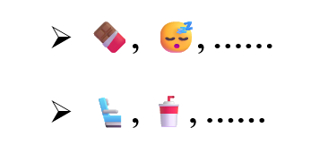
Getting Started
Unintentional Non-starting
Increase the rewards associated with writing
🍫 , 😴, ……
💺 , 🥤, ……
These self-rewards, when linked to task completion, can make the writing experience more enjoyable. Embrace these strategies, and you’ll find writing becomes not just a task, but a rewarding experience.
A ∝ ( E * V ) / ( Γ * D )
A (Attractiveness)
E (Expectancy)
V (Value)
Γ (Discounting)
D (Delay)
Notes:
As a crucial tool for simultaneous searching and detection, phased array millimeter-wave radar has recognized advantages of Long operational range, Small size, Low-cost; and Wide scene coverage through beam scanning and so on. Nowadays, phased array radar has been widely applied to Vehicle sensing, medical imaging and so on

Slide 5
Getting Started
Unintentional Non-starting
A ∝ ( E * V ) / ( Γ * D )
A (Attractiveness)
E (Expectancy)
V (Value)
Γ (Discounting)
D (Delay)
If you have a job offer contingent on defending your thesis, display it over your computer screen.
If you are writing a journal paper, display a mockup of how its title will appear on the cover.
Notes:
As a crucial tool for simultaneous searching and detection, phased array millimeter-wave radar has recognized advantages of Long operational range, Small size, Low-cost; and Wide scene coverage through beam scanning and so on. Nowadays, phased array radar has been widely applied to Vehicle sensing, medical imaging and so on

Slide 6
Getting Started
Unintentional Non-starting
A ∝ ( E * V ) / ( Γ * D )
A (Attractiveness)
E (Expectancy)
V (Value)
Γ (Discounting)
D (Delay)
Offering small rewards for incremental progress—rather than a big reward for completing the entire task—can significantly motivate you to start writing and reduce procrastination.
Notes:
As a crucial tool for simultaneous searching and detection, phased array millimeter-wave radar has recognized advantages of Long operational range, Small size, Low-cost; and Wide scene coverage through beam scanning and so on. Nowadays, phased array radar has been widely applied to Vehicle sensing, medical imaging and so on

Slide 7


Getting Started
Intentional Non-starting
I don’t have all the data or analyses yet.
They worry that if they begin writing too soon, the last analysis will change the story, and their effort will be wasted.
I don’t know what I’m going to say yet.
They wait to write until their ideas are perfectly clear, believing that starting early would waste effort due to necessary revisions.
Notes:
As a crucial tool for simultaneous searching and detection, phased array millimeter-wave radar has recognized advantages of Long operational range, Small size, Low-cost; and Wide scene coverage through beam scanning and so on. Nowadays, phased array radar has been widely applied to Vehicle sensing, medical imaging and so on

Slide 8
Getting Started
Intentional Non-starting
I don’t have all the data or analyses yet.
They worry that if they begin writing too soon, the last analysis will change the story, and their effort will be wasted.
I don’t know what I’m going to say yet.
They wait to write until their ideas are perfectly clear, believing that starting early would waste effort due to necessary revisions.
Notes:
As a crucial tool for simultaneous searching and detection, phased array millimeter-wave radar has recognized advantages of Long operational range, Small size, Low-cost; and Wide scene coverage through beam scanning and so on. Nowadays, phased array radar has been widely applied to Vehicle sensing, medical imaging and so on

Slide 9
Getting Started
Early Writing
This approach integrates writing with research planning and execution, making it a continuous thread rather than a separate task.
Easing In
start with writing acknowledgments, drafting figures or tables, or outlining your paper.
helps build momentum and makes the transition to more challenging parts of the writing process smoother.
Notes:
As a crucial tool for simultaneous searching and detection, phased array millimeter-wave radar has recognized advantages of Long operational range, Small size, Low-cost; and Wide scene coverage through beam scanning and so on. Nowadays, phased array radar has been widely applied to Vehicle sensing, medical imaging and so on

