Slide 1


Slide 2



Slide 3

To understand the importance and major components of a research proposal;
To become aware of the use of personal pronouns and nominalization in academic writing;
To initiate your own research;
To learn to write a research proposal.
Learning Objectives

Slide 4
I. Warm-up
What is your purpose of initiating an academic research?
Why do you need to write a research proposal?
How do you choose a topic?
Do you often encounter the first and second personal pronouns in academic writing? And why?

Slide 5
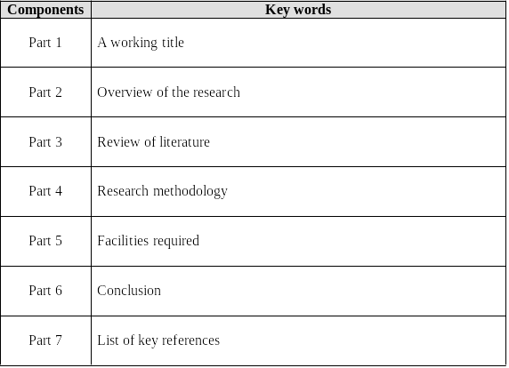
II. Sample Reading
1. Summarize the components of a research proposal based on the text in a few keywords and fill in the following table.

Slide 6
II. Sample Reading
2. Read the following pairs of topics and decide which is more suitable for a short-term research. The first one is given as an example.

Slide 7
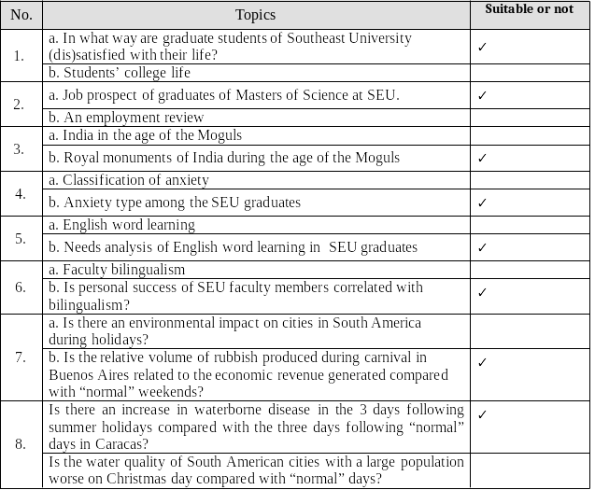

Slide 8
II. Sample Reading
3. Decide if the following questions are appropriate for research topics. Why or why not? And how to improve them if necessary?
1) How many cars are there visiting the Desert Vista Mall?
It’s too small and too trivial. You know how to answer this question. You know which mall to visit and what to do. The problem with this question is that it does not address what is important in the literature. This question could be important for the transportation planning literature however and could be rephrased to reflect that. The question is improved by relating it to weekend or weekday traffic or which mall entrance has more or less traffic.

Slide 9
2) How do we improve reading in elementary schools?
It’s too large and not doable. This question ties clearly into the research area of elementary school success by researching reading in general, but it lacks any link to the research methods. The question could be improved by asking how different intervention programs help struggling students or how curricula at charter schools differ from public schools.

Slide 10
3) Can remote sensing be used to detect impervious surfaces?
It can be answered yes or no (while some yes-or-no questions are actually okay, they need to be testing something specific). This is a weak yes-or-no question. There is a link to both the literature review (the need to detect impervious surfaces) and the approach (remote sensing), but both pieces lack specificity. You can improve the question by adding details to both:
Can Markov random fields improve classification of impervious surfaces in Quickbird imagery compared to maximum likelihood classifiers in desert cities?
This is an example of a strong yes-or-no question. On the literature side it suggests a history of detecting impervious surfaces with maximum-likelihood classification approaches. On the methods side, it suggests the approach will use Markov random fields methods in an unspecified desert city.

Slide 11

III. Language Focus
A. Personal pronouns
• First person pronouns
  Establishing author identify by using it and strengthening impersonal tone by removing it.
• Second person pronouns
  Seldom used unless you give instructions.
• Third person pronouns
  Sounds more objective and convincing.

Slide 12
Tasks
1. Rewrite the following sentences to make them more academic by avoiding first and second person pronouns.
I think that the methodology section is a hugely important part of your research proposal.
The methodology section is of great importance for the research proposal.
2) When you review literature, you should be aware that you need to identify existing gaps that your research intends to fill.
Existing gaps should be identified that the present research intends to fill in the literature review.
3) I chose this method because it was less complex.
This method was chosen for its simplicity.

Slide 13
4) My reading has shown that there are several reasons why plants are dispersed by ants.
According to the literature reviewed, there are several reasons why plants are dispersed by ants.
5) The review of recent related literature could help you discover the latest facilities that are more efficient than earlier existing ones in carrying out your work.
In the review of the recent literature, latest facilities could be found which are more efficient than earlier existing ones in the current study.
6) I also found that the results of this study concurred with Berg’s (1975) hypothesis that seeds are protected from fire through their burial in ants nests.
The results of this study concurred with Berg's (1975) hypothesis that seeds are protected from fire through their burial in ants nests.

Slide 14
2. Rewrite the following paragraphs to make them more academic by avoiding first and second person pronouns.
The present study is to investigate the impact of two simple actions aimed at getting more female employees to use the stairs at a five floor worksite. The first step was that a health sign was put up that linked stair use to health and fitness. And the second step was that the worksite doctor sent out an E-mail and pointed out the positive effects on general fitness. The study was followed up in four states: a baseline week, the week after the sign, the week after the email and then 3 weeks after that.
Results showed that stair use went up dramatically in a week after the sign, from a baseline of 69% to 77%, and then up again to 89% after the E-mail. Unfortunately, 4 weeks after the E-mail was sent out, stair use declined to 67% . these simple actions were supposed to lead to more stair use but the positive effect vanished after a month. So it’s really difficult to make any recommendations based on the evidence.

Slide 15
III. Language Focus
B. Nominalization
When you turn a verb or an adjective into a noun, you nominalize it, creating a nominalization.

Slide 16
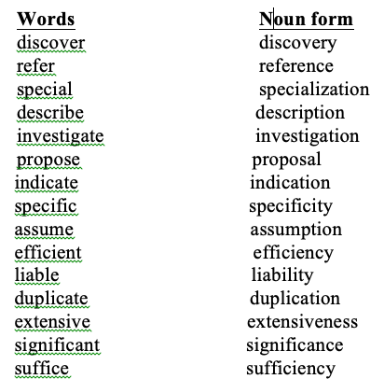
Tasks
1. Write down the noun form of the words in the following table.

Slide 17
2. Rewrite the following sentences to make them more academic by using nominalization.
1) Many children experience worries when they go to school for the first time.
The experience of worries with respect to being at school for the first time is common for children.
2) Crime was increasing rapidly and the police were becoming concerned.
The police were becoming concerned about rapid increase of crimes . Or The rapid increase in crime was causing concern among the police.
3) Elephants argue over small concerns, just like humans.
Arguments over small concerns are something elephants have, as well as humans.

Slide 18
4) We need to know which parts of our library are being used most extensively so that we can project what resources are most needed.
It must be found out which parts of the library are in most extensive use so that it can be determined what resources are most in need.
5) I know English well. I worked for three years in a factory in Shanghai. I think I am good enough for the job.
Both my English proficiency and my three- year work experience in a factory in Shanghai qualify me to be an ideal candidate for the job.

Slide 19
3. Rewrite the following paragraph to make it more academic by using nominalization.
The inequity in the distribution of wealth in Australia is yet another indicator of Australia's lack of egalitarianism. In1985, 20% of the Australian population owned 72.2% of the wealth with the top 50% owning 92.1% (Raskall, 1988: 287: ). Such a significant skew in the distribution of wealth indicates that, at least in terms of economics, there is an established class system in Australia. McGregor (1988) argues that Australian society can be categorised into three levels: the Upper; Middle and Working classes. In addition, it has been shown that most Australians continue to remain in the class into which they were born (McGregor,1988: 156) despite arguments about the ease of social mobility in Australian society (Fitzpatrick, 1994). The issue of class and its inherent inequity, however, is further compounded by factors such as race and gender within and across these class divisions.

Slide 20
IV. Academic Writing Skills
A. Selecting a topic
B. Formulating the focus
C. Establishing a working title

Slide 21
IV. Academic Writing Skills
A. Selecting a topic
Select a topic you really like, are curious about, or are an expert on.
Choose three topics given in the textbook and discuss their possibilities as subjects for your group project with your teammates. If you find none of the following interesting, you can propose your own.

Slide 22
IV. Academic Writing Skills
B. Formulating the Focus
The generalized idea you select as a research topic should be narrowed down and developed to a specifically defined written document and oral presentation.
Narrow down the three topics that you are most interested in by limiting them to some aspects, e.g., to certain population, theoretical foundation and methodology.

Slide 23
IV. Academic Writing Skills
C. Establishing a working title
The following is Eric’s research topic. Fill in the blanks to show a possible process of refinement of his working title.
Explaining vulnerability
Explaining vulnerability of adolescent girls
Explaining vulnerability of adolescent girls in North America
Explaining vulnerability of adolescent girls in North America to violence
Explaining vulnerability of adolescent girls in North America to violence though empirical field work

Slide 24



