Slide 1


Slide 2



Slide 3

Learning Objectives
To learn to describe research methodology;
To understand the importance of passive voice in academic writing;
To make proper use of sequential markers in writing a process;
To acquire the skills in designing a questionnaire.

Slide 4
I. Warm-up
1. What is the function of the method section?
2. What information elements does a method section usually include?
3. Any differece between method and methodology?
4. What types of data are normally collected for research?
5. Any difference between qualitative data and quantitative data?
6. What methods are normally adopted for collecting data?

Slide 5
I. Warm-up
1. What is the function of the method section?
The method section is the most important aspect of a research paper because it provides the information by which the validity of a study is ultimately judged. Therefore, the researcher must provide a clear and precise description of how an experiment is to be carried out, and the rationale for the specific experimental procedures chosen. It must be written with enough information so that: (1) the experiment could be repeated by others to evaluate whether the results are reproducible, and (2) the readers can judge whether the results and conclusions are valid.

Slide 6
I. Warm-up
2. What information elements does a method section usually include?
overview of the research; research population / subjects;
research location; research materials;
sampling techniques; procedure and / or process;
statistical treatment; possible restrictions

Slide 7
I. Warm-up
3. Any differece between method and methodology?
Methodology is the systematic, theoretical analysis of the methods applied to a field of study, or the theoretical analysis of the body of methods and principles associated with a branch of knowledge. It is the systematic study of methods that are, can be, or have been applied within a discipline. It is the study or description of methods. (Wikipedia)

Slide 8
I. Warm-up
4. What types of data are normally collected for research?
Perspective | Type of Research
the way of collection | primary data
 | secondary data
the nature of data | quantitative data
 | qualitative data

Slide 9
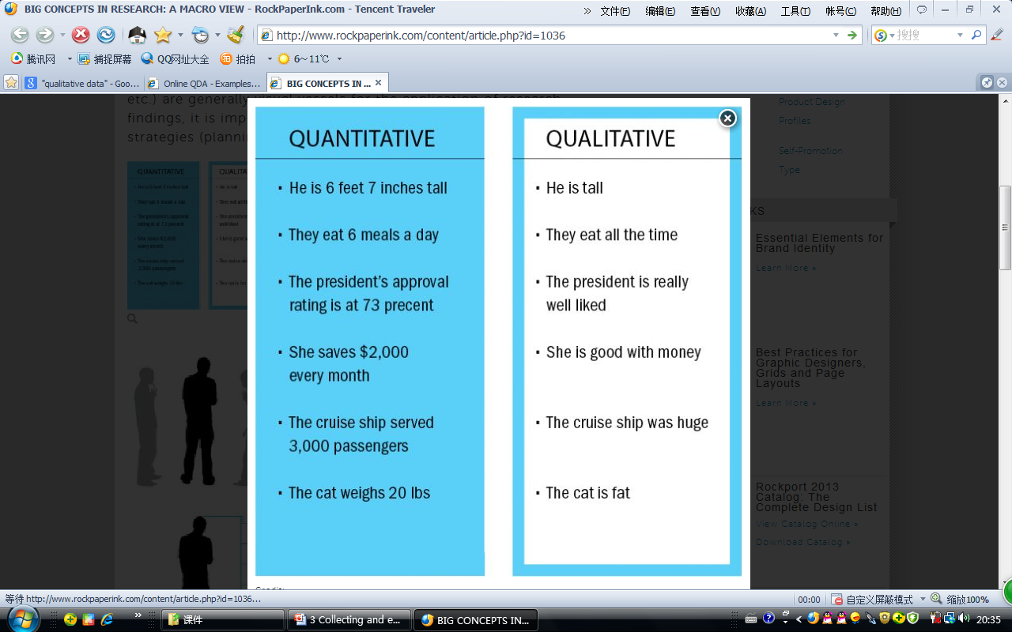
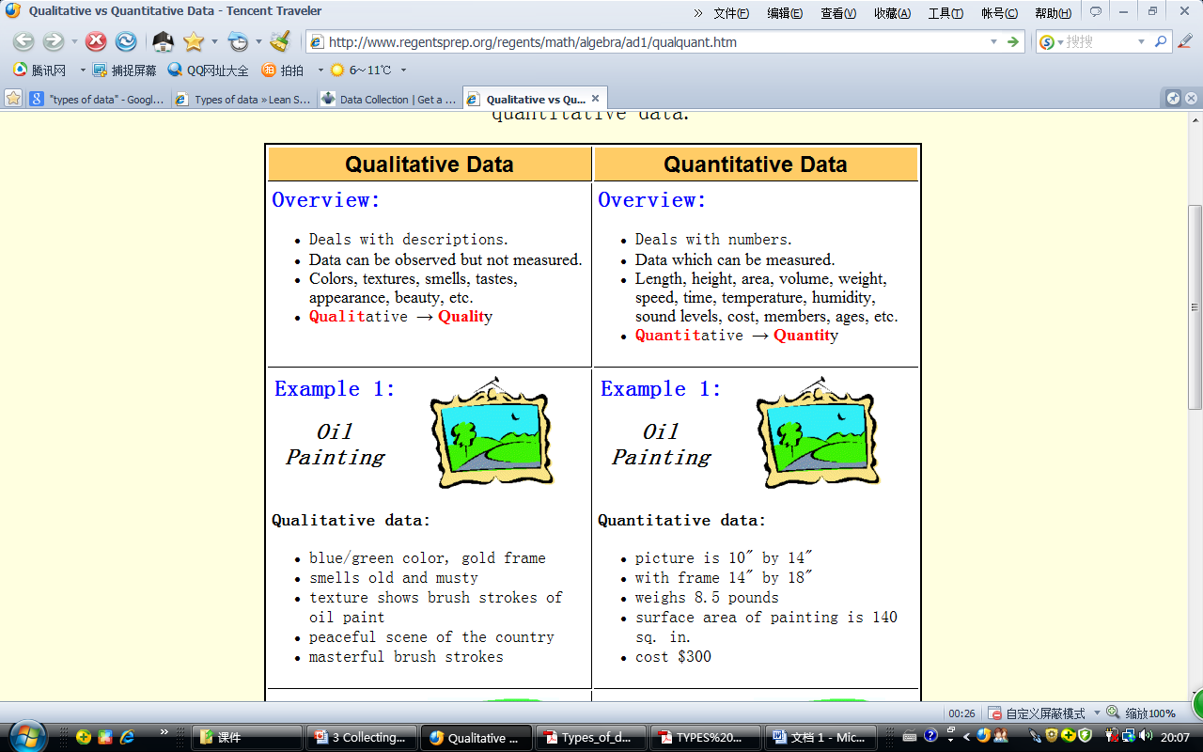
I. Warm-up
5. Any difference between qualitative data and quantitative data?

Slide 10
Data Collection Methods
I. Warm-up
6. What methods for
collecting data?
Secondary Data
Primary Data
Experiment
Survey
In-depth interview
observation
Internet
Telephone
Mail
Questionnaire
Personal Interview
Field
Lab
Qualitative Data
Quantitative Data

Slide 11
II. Sample Reading
1. What information elements does this method section include? Fill in
the following table with relevant details from the passage.
Information elements | Relevant details
Research objective | pls. see Title
Research subjects | pls. refer to para. 1
Research location | Nanjing, China
Materials | a questionnaire, a collection of urine samples
Procedure | pls. refer to para. 2
Statistical analysis | pls. refer to para. 3

Slide 12
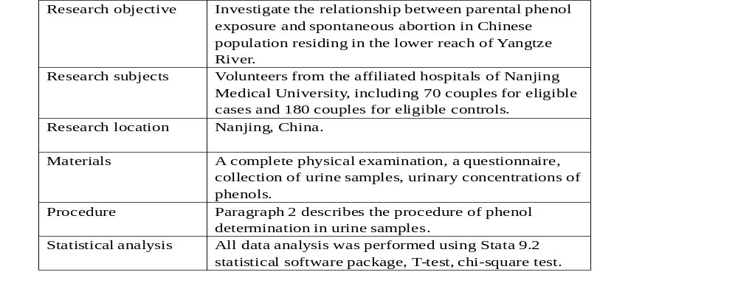
II. Sample Reading
1. What information elements does this method section include? Fill in the following table with relevant details from the passage.

Slide 13
II. Sample Reading
2. Answer the following questions based on the sample reading.
1) Paragraph One is about the sample collection.
2) As to the sample size, the hospital controls may not be completely representative of the study population because it is not a random sample from all the target population. When compared with a random sample from all the target population, a hospital-based control might underestimate the actual effects to some degree.
3)When recruiting samples, a questionnaire was designed to collect information including personal background, lifestyle factors, genetic risk factors, occupational and environmental exposures, reproduction and sexual status, medical history and physical activity.

Slide 14
III. Language Focus
A. The Passive Voice
The passive voice is widely used in academic writing, because passive structures have less subjective coloring in most cases than active ones. When describing a process or a scientific experiment, it is important to write in a neutral style, as an observer. There are three instances in which the passive voice is recommended:
1) when you don't know or don't care about who has performed the action;
2) when you focus on the receiver instead of the performer of the action;
3) when you'd like to remain in a neutral or objective position in writing.

Slide 15
III. Language Focus
1. Go over the sample reading again and write down the verbs using the
passive voice in the following table.
Information elements | Verbs using the passive voice
Sample collection | was performed, was designed, to be associated, were recruited
Procedure | were collected, were frozen, were analyzed
Materials | was designed, was performed, was measured, was incubated, were extracted
Data analysis | was performed, was used, are divided into, were assigned, were calculated

Slide 16
III. Language Focus
2. Use the passive voice to rewrite the following text.
A poison ivy infection is considered by some to be humorous. But it is not funny at all. A rash that has the intensity of a fresh mosquito bite and lasts for several days is caused by contact with the plant. Poison ivy infection has been studied by scientists for centuries, but no preventive pill or inoculation has been found. The poisonous substance in the plant is called urushiol. After the skin is touched by urushiol, the exposed area will soon be covered by blisters and weeping sores.

Slide 17
III. Language Focus
3. The following expressions in the table are commonly used in the method section. Try to complete the paragraph below by translating Chinese in the brackets into English.
1) The questionnaire was administered.
2) completed the questionnaire.
3) Background information about these participants was presented in
Table 2.
4) The mean age of the participants was approximately 29 years old.
5) the year of their working experience was six on the average.

Slide 18
III. Language Focus
4. The following sentences are taken from method sections of different published articles. Polish or correct them so that they are more academically acceptable.
1) Table 5 presents the number of students per level as well as their Ll language backgrounds.
2) Two questionnaires sent respectively to the personnel officers and business employees reveal a similar result in terms of their perception of the use of English in their firm.
3) The scores of the two raters were averaged and entered for statistical analysis.
4) The model used in the experiment was a modified version of the 2009 Test package, originally developed by the Morrison Research Institute.

Slide 19
III. Language Focus
5) These engines used to be started by hand. Now they are started by electricity.
6) One of the great advantages of atomic power stations is the fact that they can be built in the very region where power is inadequate.
7) Observations are made daily at two hundred weather stations in and around the British Isles, which send in reports every three hours. The measurements of wind speed, temperature and pressure are also made by weather ships in the Atlantic.
8) A kind of lid is fixed to the top of the pipe so that oil is allowed to flow out gently through taps.

Slide 20
III. Language Focus
B. Sequential Markers
A process paragraph explains how to do sth or how sth works. Process paragraphs are usually developed step-by-step in a chronological or logical sequence. The following sequencing expressions are more frequently used to link steps in a description of a process or to divide a process into steps:
• To begin with..., First of all... etc.;
• Secondly..., Next..., After that..., In addition... etc.;
• Finally..., Lastly... etc.

Slide 21
III. Language Focus
The following sentences describe the process of making paper. Use
sequential expressions to rewrite them into a cohesive paragraph.
Firstly, the logs are placed in the shredder. Then they are cut into small chips which are mixed with water and acid. After that, they are heated and crushed to a heavy pulp which is cleaned. It is also chemically bleached to whiten it. Later, it is passed through rollers to flatten it. Then sheets of wet paper are produced. Finally, the water is removed from the sheets which are pressed, dried and refined until the finished paper is produced.

Slide 22
IV. Academic Writing Skills
A. Identifying Information Elements
Normally, a method section includes the following information elements:
• Overview of the research: brief description about what has been done;
• Subjects: the people/subjects studied, or the things tested;
• Location: where a research takes place;
• Restrictions/Limiting conditions: precautions taken to make sure that the data is valid;
• Sampling techniques: describing how the subjects are selected for research;
• Materials: the materials used to conduct a study or an experiment;
• Procedure: the steps of conducting the research in a chronological order;
• Statistical treatment: describing how the statistics are examined.
Of all the information elements in this list, the only items that are always included in the method section are materials and procedure.

Slide 23
IV. Academic Writing Skills
The following sentences are taken from method sections of different
research articles. Try to identify what information element is presented.
1) subjects 2) material
3) procedure 4) overview
5) statistical treatment 6) procedure and material
7) sampling 8) research location

Slide 24
IV. Academic Writing Skills
B. Reordering Sentences
Research methodology is mainly about the procedures by which researchers go about their work of describing, explaining, and predicting phenomena. You need to state the purpose of the study and define the problem /issue clearly. This guides you in deciding the methodology of research which involves:
• identifying the method of research;
• specifying the subjects of study;
• selecting an adequate representative sample of subjects;
• selecting reliable instruments for measuring the variables in a research problem;
• describing the procedure to be employed for conducting your research;
• collecting data;
• analyzing and interpreting your results.

Slide 25
IV. Academic Writing Skills
The following sentences are taken from the method section of a research
article in a scrambled order. Try to put them back into logical order. Write
the sequential number in the box on the right side of the table below.
Reordering sentences:
1c 2 e 3 d 4 f
5g 6 b 7 I 8 a 9h

Slide 26
IV. Academic Writing Skills
C. Turning Notes into a Passage
A few tips are provided below for writing a well organized, logically ordered and easily understandable chapter on methodology. This section need not be described in detail, but has to be justified so that the results have a validity and credibility.
• The selection between qualitative and quantitative research has to be justified.
• If a survey of students in five high schools in an area is selected, the sample size and the selection of samples have to be justified. Selection methods also have to be stated.
• Arrangements for data collection have to be stated and justified. Interview questions or questionnaires have to be stated and justified.
• Methods and software for analyzing data have to be stated and justified.

Slide 27
IV. Academic Writing Skills
Study the following table and write the method section of a research
paper about an experiment to investigate into students’ preferences and
attitudes towards sugar-sweetened and artificially-sweetened beverages.
A taste test was conducted to determine students’ preferences and attitudes toward sugar-sweetened and artificially-sweetened beverages. Ten people, five male students and five female students, from Science English class 1 were chosen at random to participate in the test. The materials used were thirty straws, two cups, one blindfold, and two containers of Kool-Aid, a popular drink in the United States. One container held four cups of orange Kool-Aid sweetened with one half cup of sugar. The other container held four cups of orange Kool-aid sweetened with 9 packets of Nutrasweet brand artificial sweetener.

Slide 28
IV. Academic Writing Skills
The steps included in the test were as follows. Ten volunteer students were chosen, five male students and five female students. They were placed into two lines, one for the males and the other for the females. Alternately, men and women completed the taste test. To complete the test a blindfold was first fastened over the eyes of the tester so that he/she could not see. Then the two cups were filled with beverage, one with artificially-sweetened Kool-Aid and the other with sugar-sweetened Kool-Aid. The tester was then asked three questions from a survey and the answers were tabulated. Next, using a straw, the tester took a sip from each cup. Then the final two questions on the survey were asked and the answers tabulated. Finally, the remaining drink was thrown away, and the next tester came forward to repeat the process.

Slide 29
IV. Academic Writing Skills
D. Gathering Information for a Method Section
The method section of a research paper provides the information by which a study's validity is judged. So it requires a clear and precise description of how an experiment was done, and the rationale for why specific experimental procedures were chosen. Therefore, the method section should describe:
• the materials used in the study;
• how the materials were prepared for the study;
• the research protocol;
• how measurements were made and what calculations were performed;
• which statistical tests were done to analyze the data.

Slide 30
IV. Academic Writing Skills
Group work: You are required to write the method section of a research paper about a group of students’ attendance in English class. The necessary information elements have been given below. Gather information for your research to fill in the blanks of the table.

Slide 31
IV. Academic Writing Skills
E. Designing a Questionnaire
The design of a questionnaire depends on whether the researcher wishes to collect qualitative information or quantitative information. A good questionnaire is one that: i) enables you to collect accurate data effectively; ii) facilitates data collecting, data processing and data tabulating; iii) ensures that there is no collection of non-essential information; and iv) permits comprehensive and meaningful analysis as well as purposeful utilization of the data collected. There are many different types of questions you can use to get the information that you need. In general, they fall into open and closed questions.

Slide 32
IV. Academic Writing Skills
E. Designing a Questionnaire
The following are eight steps involved in designing a questionnaire:
• Determine the information required;
• Define the target respondents;
• Choose the method(s) of reaching your target respondents;
• Design questions;
• Put questions into a meaningful order and format;
• Check the length of the questionnaire;
• Pre-test the questionnaire;
• Develop the final survey form.

Slide 33
IV. Academic Writing Skills
Now work in groups of four and design a questionnaire to obtain information about students’ class attendance and the causes of their absence.
Sample:
Class Attendance Survey
Students sometimes miss lectures in university. As part of a research project I am trying to find why this happens. Your responses to this questionnaire will be completely anonymous and entirely confidential. It is aimed at determining an overall picture of the reasons why students miss lectures rather than being targeted at individual students. A general account of the results will be made available when the project is completed but no respondents answer will be identifiable in any way. Please help by trying to answer all the questions as fully as you can and feel free to add comments at any point. Do this by placing ticks in the brackets beside the answers or write in the spaces provided. You are free to withdraw from this research at any time and your questionnaire will be destroyed.

Slide 34
IV. Academic Writing Skills
Background information
1. What degree program are you taking?
___________________________________________
2. At what stage of your degree are you?
1 ( ) 2 ( ) 3 ( ) 4 ( )
3. Are you Male ( ) or Female ( )?
4. How old are you?
18- 20 ( ) 21- 30 ( ) 31 and above ( )
5. What is your major in university?
Social Science ( ) Engineering ( ) Law ( ) Natural Science ( )
Others, please specify: __________________________________________

Slide 35
IV. Academic Writing Skills
6. What was your reason for coming to university? Please tick one:
Natural progression; it seemed the obvious thing to do after ‘A’ levels. ( )
To get a qualification that would improve my long term job prospects ( )
For my own personal fulfillment and because I am interested in the subject ( )
Other, please specify:______________________________________________
7. How long does it take you to travel to university?
Less than a quarter hour ( ) A quarter to half an hour ( )
Half an hour to an hour ( ) An hour to an hour and a half ( )
Hour and half to two hours ( ) More than two hours ( )
8. Do you have a job? Yes ( ) No ( )

Slide 36
IV. Academic Writing Skills
Attendance
9. Roughly what proportion of lectures, practical sessions and tutorials do you attend?
Lectures: 100 % ( ) 75% ( ) 50% ( ) 25% ( ) less than 25% ( )
Practical sessions:100% ( ) 75% ( ) 50% ( ) 25% ( ) less than 25% ( )
Tutorials: 100% ( ) 75% ( ) 50% ( ) 25% ( ) less than 25% ( )
(If you have not missed any of the above then go to question 12.)
10. Thinking back over your time at university so far what are the most common
reasons for missing lectures, practical session or tutorials? Please choose the main
three reasons and rank them 1 to 3 (3 being the most common reason and 1 being the
least common reason).
◇ It takes too long to get to the University ( )
◇ There was only one lecture in a day ( )

Slide 37
IV. Academic Writing Skills
◇There were too many consecutive sessions in the day ( )
◇The lectures/tutorials were too early or too late in the day ( )
◇I had problems with transport ( )
◇The weather conditions were too bad ( )
◇I had to go to work ( )
◇I was ill ( )
◇I had appointments with doctors or dentists ( )
◇I had family commitments ( )
◇I had relationship problems ( )
◇I do not like the lecturer ( )
◇Other, please specify:__________________________________________

Slide 38
IV. Academic Writing Skills
11. How has your attendance changed since you started at university?
Lectures: Improved ( ) About the same ( ) Declined ( )
Practical sessions: Improved ( ) About the same ( ) Declined ( )
Tutorials: Improved ( ) About the same ( ) Declined ( )
12. How do you think that your attendance compares with that of the rest of the people on your degree
program? My attendance at
Lectures is better ( ), about the same ( ), poorer ( ) than my colleagues.
Practical sessions is better ( ), about the same ( ), poorer ( ) than my colleagues.
Tutorials is better ( ), about the same ( ), poorer ( ) than my colleagues.
13. Looking ahead do you expect your attendance at:
Lectures to: Improve ( ); Remain about the same ( ); Decline ( )
Practical sessions to: Improve ( ); Remain about the same ( ); Decline ( )
Tutorials to: Improve ( ); Remain about the same ( ); Decline ( )

Slide 39
IV. Academic Writing Skills
Remedial actions
14. If you missed a lecture what actions would you take to make up for it? Please choose the main three
actions and rank them 1 to 3 (3 being the most common action and 1 being the least common action).
◇ Contact the lecturer to find out what you have missed and make up for it by yourself. ( )
◇ Contact the lecturer to get a copy of any handouts. ( )
◇ Ask a classmate what you have missed and make up for it by yourself. ( )
◇ Borrow lecture notes from a classmate and copy them. ( )
◇ Look on the student portal for information about the lecture. ( )
◇ Take no actions. ( )
◇ Others, please specify:__________________________________________

Slide 40
IV. Academic Writing Skills
15. Do you have any general comments on attendance that you would like to make?
____________________________________________________________
____________________________________________________________
16. Have you any suggestions of things the University could do, or changes the
University could make, which would influence you attendance at lectures?
(For legal reasons, it is important that you do not identify by name individual
members of staff in your comments.)
Thank you very much for taking the time to fill in this questionnaire！
(http://www.bioscience.heacademy.ac.uk)

Slide 41



