Slide 1


Slide 2


Slide 3

To understand the components of an acknowledgement;
To write an acknowledgement;
To write a submission cover letter.
Learning Objectives

Slide 4
I. Warm-up
• Do you need to write an acknowledgement in your paper？ Why or why not ?
• How would your paper be processed after submission ?
• What should you write in the cover letter when submitting the paper ?

Slide 5
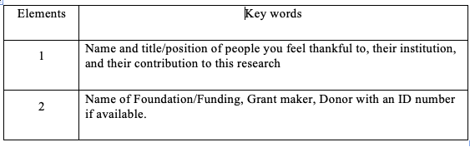
II. Sample Reading
1. List the information elements that you should include in Acknowledgments of a journal paper based on Sample Reading 1.

Slide 6
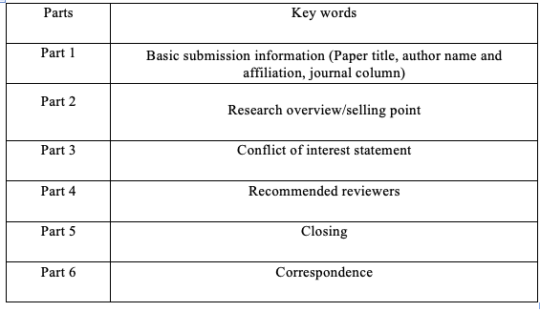
2. List the information elements of a submission cover letter based on Sample Reading 2.

Slide 7
3. Fill in the blanks according to the Chinese clue in the brackets.
The authors would like to thank/thank (感谢) the patients who participated/were involved/were recruited（参与）in the study. We would also like to show our gratitude（感激）to Dr. Jean-Frederic Colombel (co-director of the Feinstein IBD Center, Mount Sinai Hospital, New York, NY) for invaluable discussions and insights on Crohn’s disease, and we thank 3 “anonymous” reviewers (匿名评审员) for their detailed comments (修回意见). We are also immensely grateful to（感激）Dr. Emilie Grasset (Precision Immunology Institute, Icahn School of Medicine at Mount Sinai, New York, NY) for her expertise (专长) and discussion on an earlier version of the manuscript (稿子). This research is partially supported /was supported in part（部分由...资助）by R01 DK106593, and the Sanford J. Grossman Charitable Trust; R.U. is supported/funded (资助) by a Career Development Award from the Crohn's and Colitis Foundation and an NIH K23 Career Development Award (K23KD111995-01A1).

Slide 8
III. Language Focus
Politeness
Politeness in letter/e-mail writing involves taking into account the correspondent’s feelings.

Slide 9
Tasks
The following sentences are taken from reviewers’ comments. Make a point-by-point response to the comments with reference to the expressions listed in the table above.
1) The entire manuscript needs to be edited for proper use of the English language and syntax.
  We are really sorry for the inappropriate English language use. We have asked an English expert consultant to proofread the paper.
2) Check instructions for authors for the required journal format for referring to the published literature.
  We are very sorry for our incorrect reference to published literature, and checked instructions for authors for the required journal format and correct the reference accordingly.
3) Avoid the use of ± to express variation.
  We have made correction according to the reviewer’s comments on the use of ±to express variation, and changed it to mean (SD).

Slide 10
4) The sample size of included studies may be shown in the forest plots (Figure 2).
  Thank you for raising this point. The sample size has been added to the forest plots in Figure 2.
5) Methods: The reference standard investigations (“gold standard” investigation for final diagnosis) used in the studies may be briefly described.
  We have moved the section on the description of gold standard from the appendix to the main body of the manuscript.

Slide 11
2. Fill in the blanks according to the Chinese information in the brackets.
1) Thank you for raising this point/pointing it out.
2) Please let me know
3) Please find attached the manuscript.
4) I’d appreciate it
5) as suggested by the reviewer/according to the reviewer’s comment

Slide 12
IV. Academic Writing Skills
A. Writing a submission cover letter
B. Writing a reply to the decision letter

Slide 13
IV. Academic Writing Skills
A. Writing a submission cover letter
The submission cover letter gives the first impression of your paper and it may help the editor-in-chief to make a decision about whether your paper can be published.
Task:
Write a submission cover letter for your own manuscript. You can refer to Sample Reading 2.

Slide 14
IV. Academic Writing Skills
B. Writing a reply to the decision letter
1. Fill in the blanks based on the decision letter.
Decision: major revision
The author should:
1) make point-by-point revision according to the reviewers' comments;
2) check spelling and format in the main body and the references;
3) highlight the change in the "track change " mode;
4) upload and resubmit the paper.

Slide 15
2. Write a reply to the decision letter.
Dear Editor-in-chief,
We are grateful to the editors and reviewers for their time and constructive comments on our manuscript. We have implemented their comments and suggestions and wish to submit a revised version of the manuscript for further consideration of publication in the journal. Changes in the initial version of the manuscript are either highlighted for added sentences or strikethrough for deleted sentences in the revised version. Below, we also provide a point-by-point response explaining how we have addressed each of the editors or reviewers’ comments. We look forward to the outcome of your assessment.
Yours sincerely,
On behalf of the co-authors
Ling Huchong, MD, Ph.D.

Slide 16



