Slide 1
1st TA Task

Slide 2
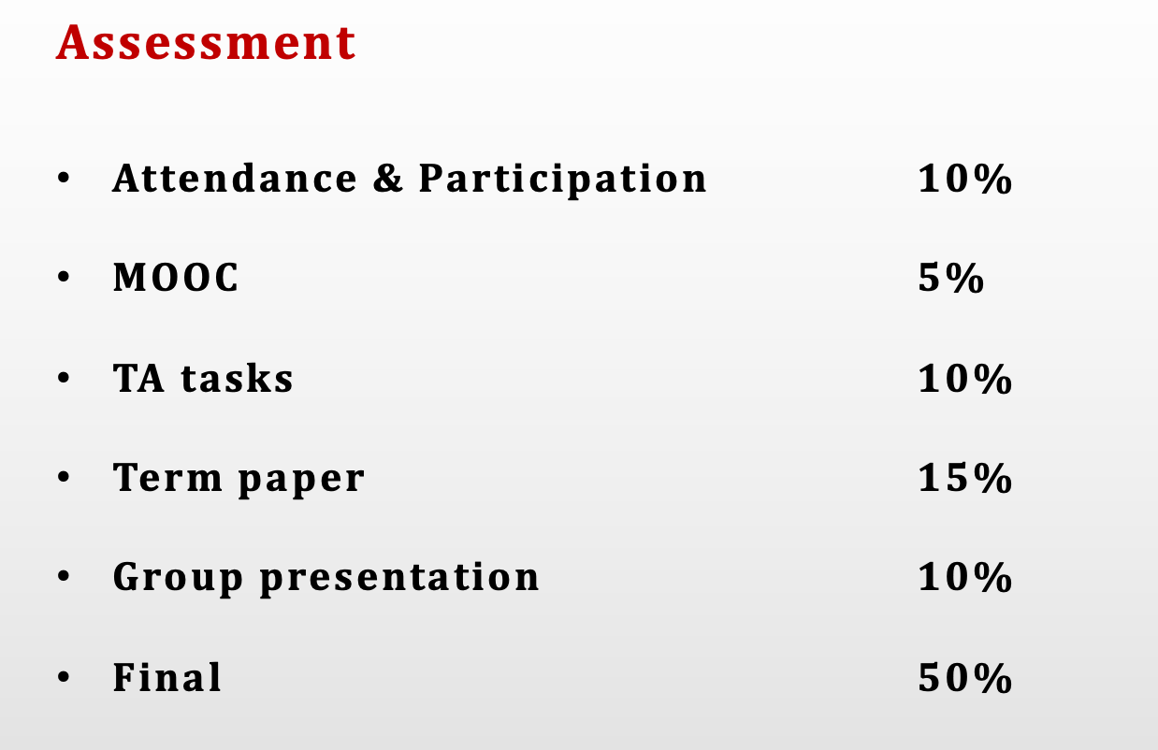

Slide 3


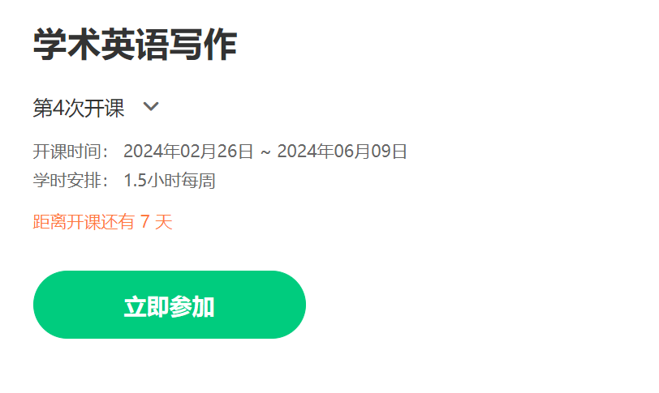
Academic English Writing
Mooc： Academic English Writing （中国大学MOOC）
https://www.icourse163.org/course/SEU-1462660161
昵称格式：SEU-研XX班-校区(九/四/丁/苏/无)—学号(6位)—姓名
e.g., SEU-研09班-四-201234-王东南

Slide 4
Assignment（week 3 或根据教师安排）
Presentation（每组一个代表）: 结合MOOC，分析本专业高水平文献的文体语言特征。
文章信息（题目，作者，日期，杂志名称，IF）
人称、名词化、句子复杂程度、选词、标题五个语言纬度在本文有何特点？

Slide 5
How to write a title
Discussion (Topic selection + Work division)
APA格式教学

Slide 6
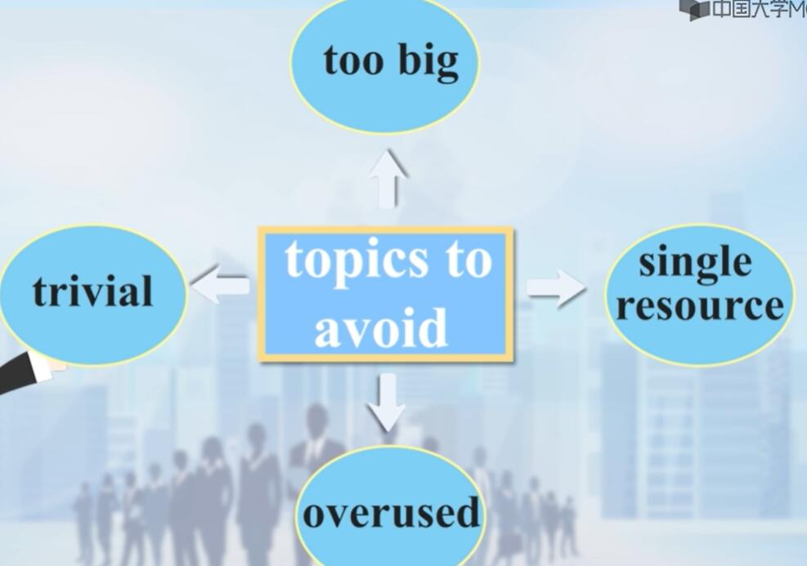
How to write a title
Topics that we are quite familiar with: abortion, teenage marriage, substance abuse, global warming the death penalty.
If you have to write about an overused topic, try to approach it from a new angle to produce something new and to distinguish yourself from the familiar cliché.

Slide 7
What makes a good title?
SCI principles:
S – specific, a title cannot be too broad or general
C – concise, a title contains as few words as possible, usually of noun phrases
I -- informative, a title should contain all key words of the research objectives

Slide 8
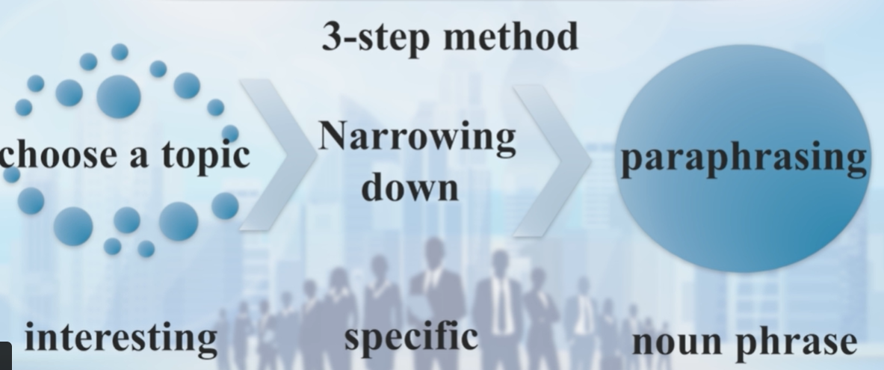
3-step method to write a title
Choose a topic (interesting)
Narrowing down (adding determiners-specific)
Paraphrasing (noun phrase less than 15 words)

Slide 9
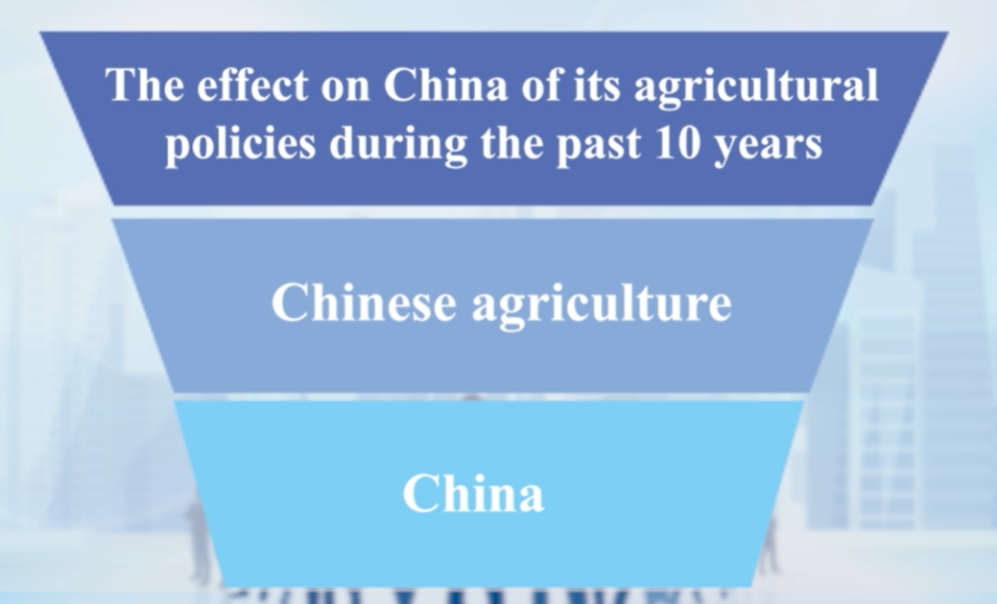

Examples

Slide 10
Structure of the term paper
Title
Abstract （不需要在最后展示的时候一起）
Introduction
Literature Review
Method and materials
Results （客观）
Discussion
Conclusion

Slide 11
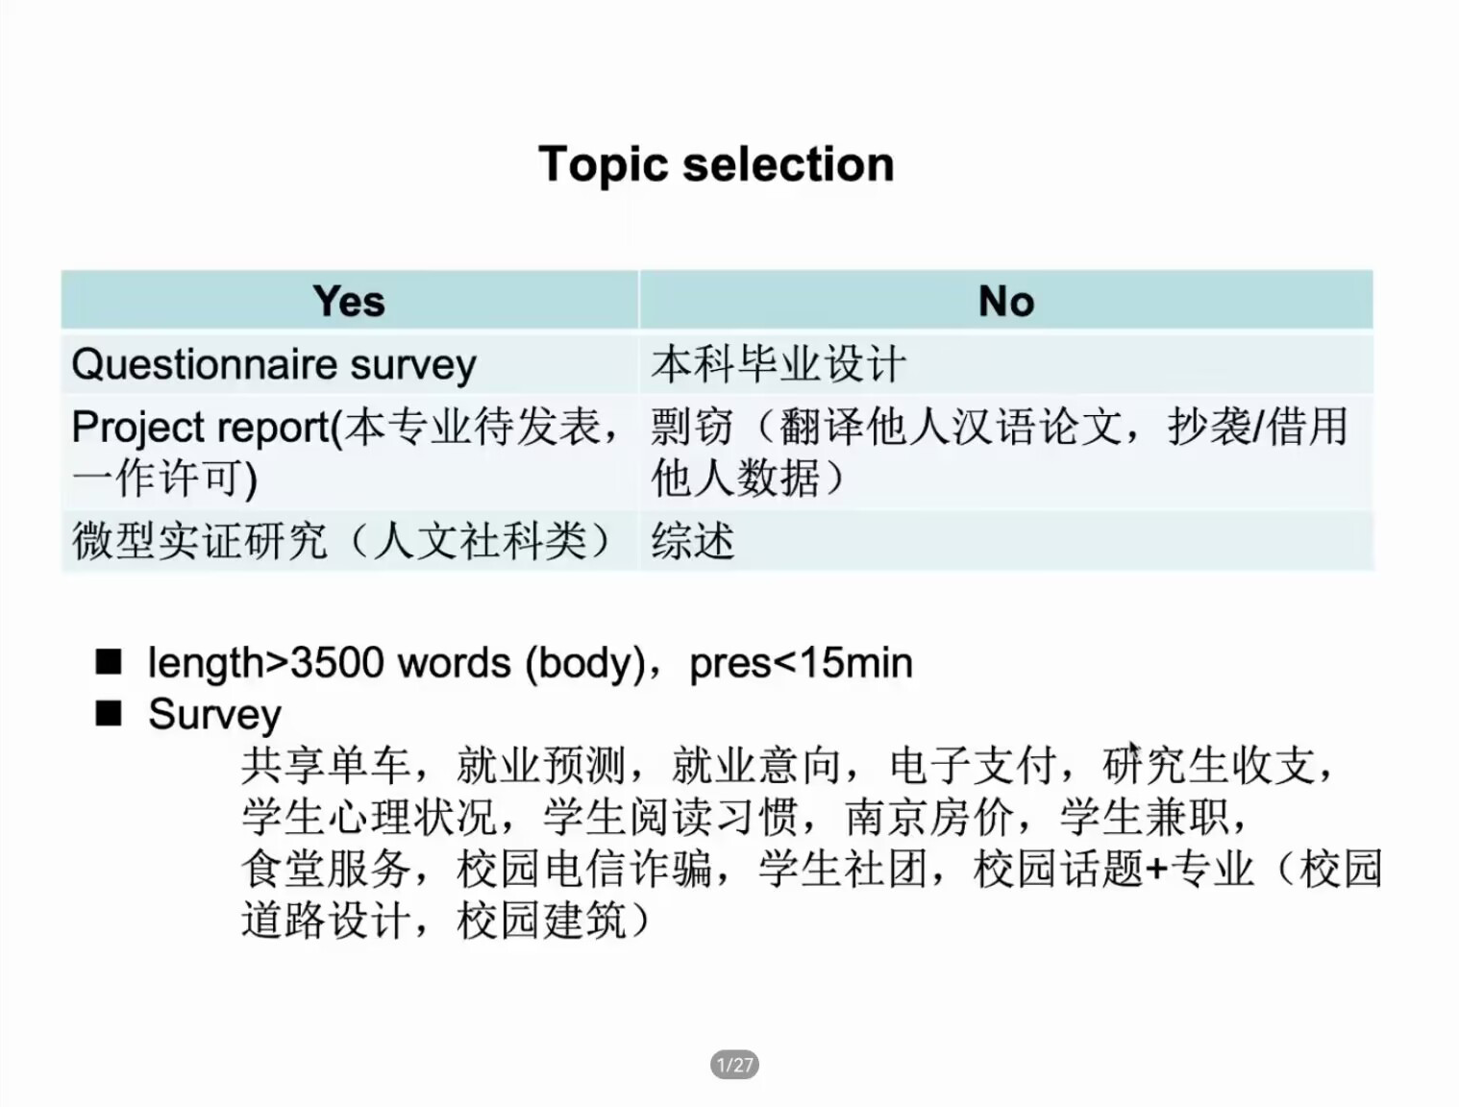
Discussion
Topic Selection
Work division
(Abstract – 1, Introduction – 1, Literature Review – 1, Methodology –1-2, Results-1 Discussion – 1, Conclusion – 1)
个人演示时间2-3分钟
*问卷调查 – √
微型实证研究 (spss分析数据等) – √
本专业论文 – ×

Slide 12
Language focus
Tense (in different part of the paper)
Citing verbs
Some verbs to avoid
Accuracy (hyponyms preferred) say，think，state
Critical thinking
Neutral/tentative/strong
Using reference(in-text citation文内夹注)
Information prominent
Author prominent
Week author prominent
Notes:
某些专业文内夹注格式有不同。比如《通讯学报》：文献［10］的观点是。。。有的sci编码不是上标，如。。。。［10］

Slide 13
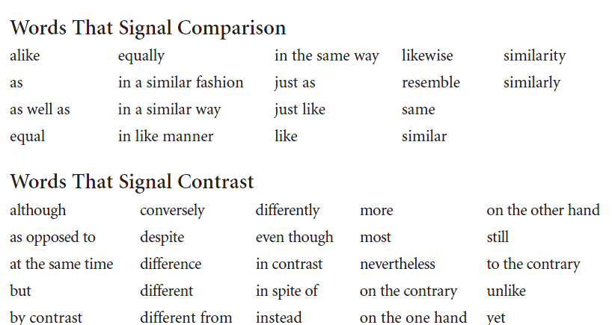
Comparison and contrast
a common way to deal with data
To show similarities
To show differences

Slide 14
Notes
请组长记录选题、分工，并整理提交 (下周五前)

Slide 15
That’s all. :)

