Slide 1
小世界模型与
可搜索问题研究
陈根文

Slide 2
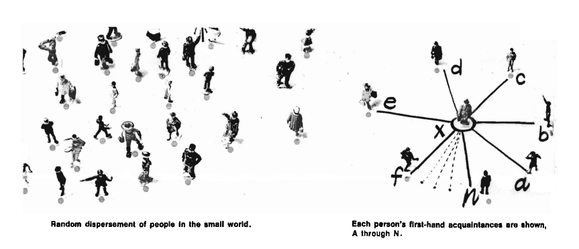
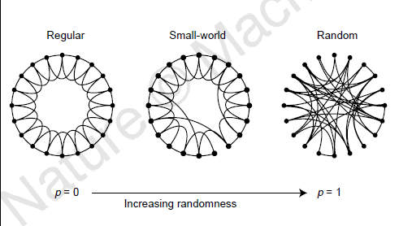
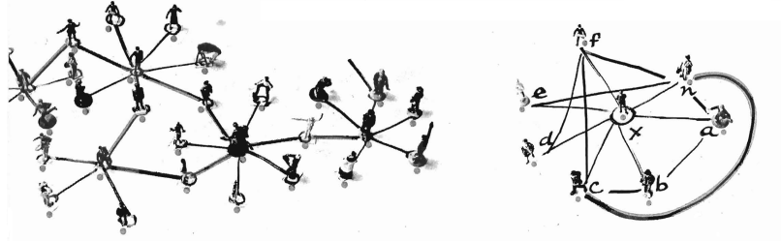
论文主要内容
Milgram S. The small world problem[J]. Psychology today, 1967, 2(1): 60-67.
Watts D J, Strogatz S H. Collective dynamics of ‘small-world’networks[J]. nature, 1998, 393(6684): 440-442.
Key Words:
"small-world" networks
clustering coefficient (C)
characteristic path length (L)
dynamical systems
disease spreading
random rewiring
signal-propagation speed
computational power
synchronizability
network topology

Slide 3
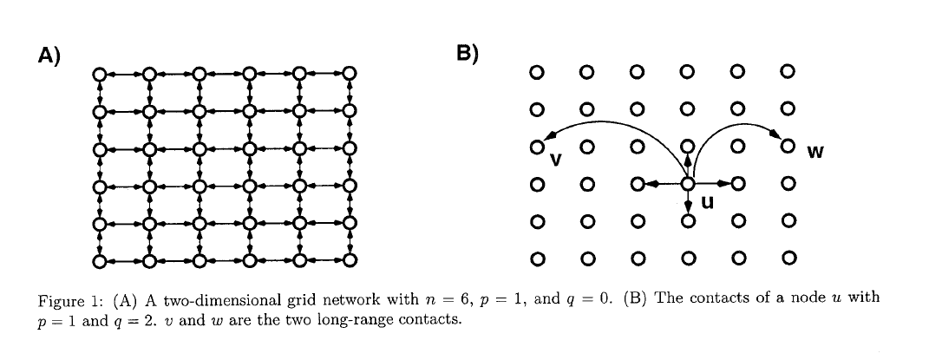
论文主要内容
Kleinberg J. The small-world phenomenon: An algorithmic perspective[C]//Proceedings of the thirty-second annual ACM symposium on Theory of computing. 2000: 163-170.
Key Words:
small-world phenomenon
six degrees of separation
decentralized algorithms
local information
short paths
social networks
Watts-Strogatz model
inverse rth-power distribution
lattice distance
transmission rate

Slide 4
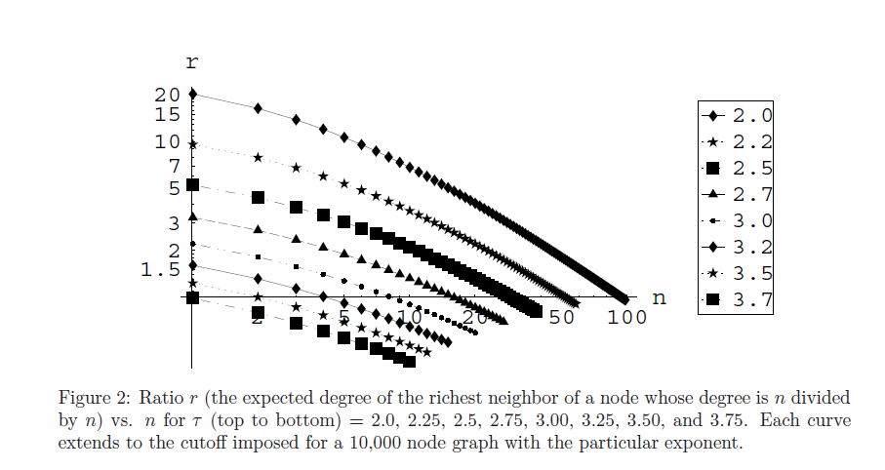
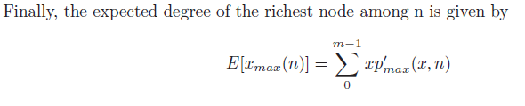
论文主要内容
Adamic L A, Lukose R M, Puniyani A R, et al. Search in power-law networks[J]. Physical review E, 2001, 64(4): 046135.
Key Words:
Power-law networks
Search algorithms
High degree nodes
Sub-linear scaling
Gnutella peer-to-peer network
Local search strategies
Communication and social networks

Slide 5
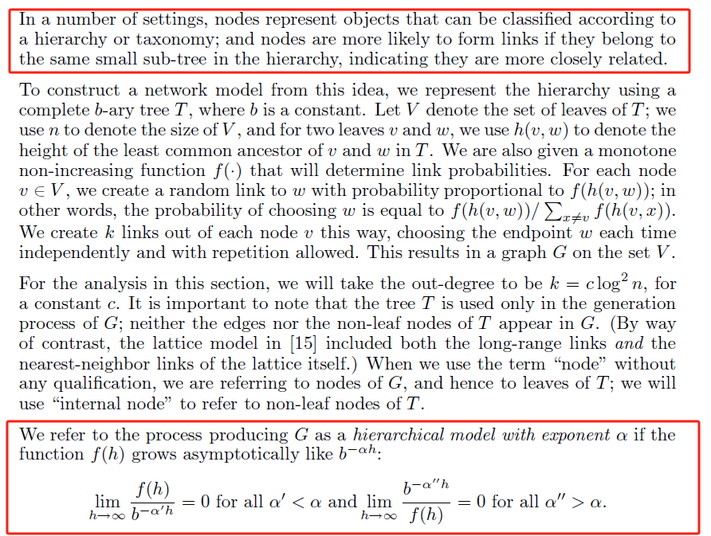
论文主要内容
Kleinberg J. Small-world phenomena and the dynamics of information[J]. Advances in neural information processing systems, 2001, 14.
Key Words:
"small-world" networks
clustering coefficient (C)
characteristic path length (L)
dynamical systems
disease spreading
random rewiring
signal-propagation speed
computational power
synchronizability
network topology

Slide 6
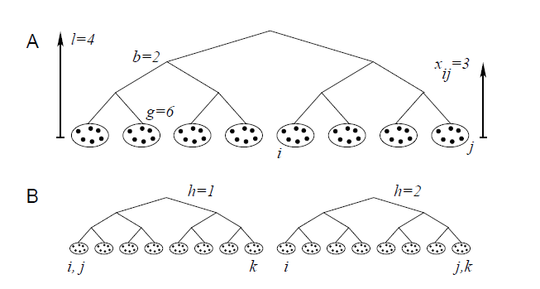
论文主要内容
Watts D J, Dodds P S, Newman M E J. Identity and search in social networks[J]. science, 2002, 296(5571): 1302-1305.
Key Words:
Social networks
Searchability
Personal identities
Hierarchical categorization
Social distance
Decentralized search
Greedy algorithm
Small-world problem

Slide 7
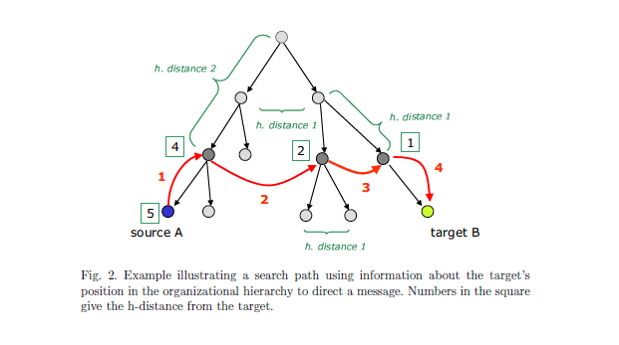
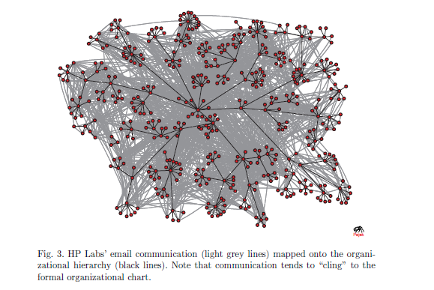
论文主要内容
Adamic L, Adar E. How to search a social network[J]. Social networks, 2005, 27(3): 187-203.
Key Words:
Social networks
Small world experiment
Local search strategies
Email analysis
Online communities
Greedy search strategy
Organizational hierarchy
Physical proximity

Slide 8
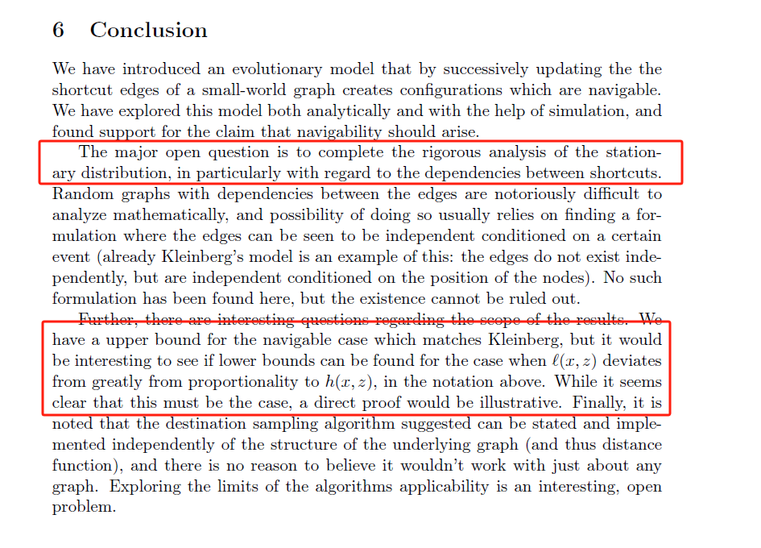
论文主要内容
Sandberg O, Clarke I. The evolution of navigable small-world networks[J]. arXiv preprint cs/0607025, 2006.
Key Words:
Small-world networks
Navigable graphs
Random graph models
Evolutionary model
Greedy walks
Rewiring algorithm
Decentralized routing
Simulation analysis

Slide 9
思考与讨论
局限性
未来展望
模型简化
数据依赖较强
算法复杂
局部最优解
动态网络适应性不足
算法设计
学科交叉
大数据与人工智能技术优化
复杂系统研究

Slide 10
感谢聆听！
陈根文

