Slide 1
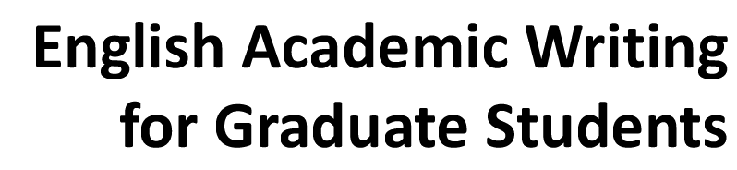

Slide 2



Slide 3

Learning Objectives
To understand the style and features of academic discourses;
To distinguish between the academic style and the personal style of writing;
To recognize various levels of formality;
To use appropriate words and sentences in academic writing.

Slide 4
I. Warm-up
How is academic writing different from other forms of writing?
What is your purpose of initiating an academic research?
What are the key characteristics of academic writing?

Slide 5
II. Sample Reading
1. Summarize the key characteristics of academic writing and discuss with a partner about why these features prevail in academic writing.
Key academic writing features | Reasons behind
Objectivity
Complexity
Formal structure
Referencing
The readers need evidence-based facts rather than your personal opinions.
Academic writing often discusses difficult, challenging ideas which can only be expressed with particular grammar and language.
Academic writing should be clear, concise and structured.
Scientific discoveries are made by building on the ideas of other people. Another reason is to avoid plagiarism.

Slide 6
II. Sample Reading
2. Match the following writing strategies with the possible features in the box.
a. objectivity b. complexity c. formal structure d. referencing
d
_________1) a reference system
_________2) empty introductory phrases
_________3) a greater use of content words
_________4) passive voice
_________5) cohesion and coherence
_________6) relative clauses
_________7) hedging language
_________8) same-length Paragraphs
_________9) noun phrases
a
b
a
c
b
a
c
b

Slide 7
II. Sample Reading
3. Which of the italicized words in each sentence would be more suitable for an academic paper? Write down the correct answers.
The government has made good / considerable progress in solving environmental problems.
The government has made considerable progress in solving environmental problems.
2. We got / obtained encouraging results.
We obtained encouraging results.
3. The results of a lot of / numerous different projects have been pretty good / encouraging.
The results of numerous different projects have been pretty good / encouraging.
4. A loss of jobs is one of the things that will happen / consequences if the process is automated.
A loss of jobs is one of the consequences if the process is automated.
5. The future of Federal funding is up in the air/uncertain.
The future of Federal funding is uncertain.

Slide 8

III. Language Focus
A. Word Choice
Academic voice can be well expressed by choosing words.
A distinctive feature of academic writing style is choosing the more formal ones.
The English language often has two or more choices to express an action or occurrence.
a phrasal verb vs. a single verb
Less formal style: Researchers looked at the way strain builds up around a fault.
Academic style: Researchers observed the way strain accumulates around a fault.

Slide 9
III. Language Focus
A. Word Choice
1. Match the informal phrases in the first column with the formal verbs in
the second column. Then write the noun forms of these formal verbs in
the third column. The first one is given as an example.

Slide 10
Column 1
Column 2
Column 3
try to find out
look at carefully
go up and down
set up
get rid of
cut down
help out
go up
look into
make sure something is true
verify ( )
examine ( )
establish ( )
increase ( )
investigate ( )
assist ( )
discover ( )
eliminate ( )
reduce ( )
fluctuate ( )
verification
examination
establishment
increase
investigation
assistance
discovery
eliminate
reduction
fluctuation
10
2
4
8
9
7
1
5
6
3

Slide 11
III. Language Focus
A. Word Choice
2. Rewrite the following sentences to make them more formal by substituting a single verb for the phrase in italics.
The implementation of computer-integrated-manufacturing (CIM) has brought about some serious problems.
2. The process should be done over until the desired results are achieved.
3. Plans are being made to come up with a database containing detailed environmental information for the region.
4. Subtle changes in the earth's crust were picked up by these new devices.
5. Proposals to construct new nuclear reactors have met with great resistance from environmentalists.
The implementation of computer-integrated-manufacturing (CIM) has created some serious problems.
The process should be repeated until the desired results are achieved.
Plans are being made to devise/compile/create a database containing detailed environmental information for the region.
Subtle changes in the earth's crust were detected by these new devices.
Proposals to construct new nuclear reactors have encountered great resistance from environmentalists.

Slide 12
III. Language Focus
B. Formal Grammar and Style
Sentence structures in academic writing are more complex.
Academic writing should NOT be complicated. It should be relatively easy to follow, written in a clear, direct style.
Recommendations for maintaining a formal academic writing style.
Avoid contractions.
Export figures won't improve until the economy is stronger.
Export figures will not improve until the economy is stronger.

Slide 13
III. Language Focus
B. Formal Grammar and Style
Use the more appropriate formal negative forms.
not . . . any —> no
not. . . much —> little
not . . . many —> few
The analysis didn't yield any new results. -»
The analysis yielded no new results.
The government didn't allocate much funding for the program. -»
The government allocated little funding for the program.
This problem doesn't have many viable solutions. -»
This problem has few viable solutions.

Slide 14
III. Language Focus
B. Formal Grammar and Style
Limit the use of "run on" expressions, such as "and so forth“ and "etc."
These semiconductors can be used in robots, CD players, etc. —>
These semiconductors can be used in robots, CD players, and other electronic devices.
Avoid addressing the reader as "you".
You can see the results in Table 1. -»
The results can be seen in Table 1.
Limit the use of direct questions.
What can be done to lower costs? —>
We now need to consider what can be done to lower costs, or
We now need to consider how costs may be lowered.

Slide 15
III. Language Focus
B. Formal Grammar and Style
Rewrite the following sentences to make them more formal.
1. If you fail the exam, you can't enter the university.
__________________________________________________________________________
2. So, why did the bridge collapse? There’re a lot of reasons.
__________________________________________________________________________
3. You can clearly see the difference between these two processes.
__________________________________________________________________________
A passing grade on the exam is a prerequisite for admission to the university.
There are many/several/various reasons for the collapse of the bridge/bridge's collapse.
The difference between these two processes is clear.

Slide 16
III. Language Focus
B. Formal Grammar and Style
Rewrite the following sentences to make them more formal.
4. These special tax laws have been enacted in six states: Iowa, Illinois, Ohio, etc.
_________________________________________________________________________________
5. So far there hasn't been much research on how conflict influences the level of trust and respect in a group.
_________________________________________________________________________________
These special tax laws have been enacted in six states, including Iowa, Illinois and Ohio.
There has been little research on how conflict influences the level of trust and respect in a group.

Slide 17
III. Language Focus
C. Linking Words and Flow
Sentences that are too short and poorly connected can be irritating to read. Linking words and phrases can help a writer maintain flow and establish clear relationships between ideas.

Slide 18
III. Language Focus
C. Linking Words and Flow
Rewrite the following passage into a text with an easy flow.
A conjunction connects words, phrases, or clauses. It indicates the relationship between the elements. These elements connect. We often find the following thing. In only one single sentence a conjunction contains one or more ideas. These ideas may be equal or unequal in importance. Ideas are equal, and we call them coordinate ideas. For example, John studies electronics. Helen studies Computing. These two sentences can become a compound sentence. It shows the relationship between the two ideas. We want to maintain the equality of the ideas. We call the clauses in the new sentence coordinate clauses.
A conjunction connects words, phrases, or clauses and can also indicate the relationship between the elements it connects. In only one single sentence we often find that it contains one or more ideas which may be equal or unequal in importance.
When the ideas are equal, they are called coordinate ideas. These sentences may be joined into a compound sentence that shows the relationship between the two ideas. When this is done in such a way that the equality of the ideas is maintained, we call the clauses in the new sentence coordinate clauses.

Slide 19
IV. Academic Writing Skills
A. Recognizing Different Styles
There are a number of different styles of writing that you may encounter in the course of your life. Styles may be formal or informal, and will usually vary to fit the audience and the medium of publication. However, the style will also affect how you read and interpret the document concerned. Understanding the writing style will help you to put your writing into perspective.

Slide 20

IV. Academic Writing Skills
A. Recognizing Different Styles
Read the following texts and choose from the box to decide where they
come from.

Slide 21
IV. Academic Writing Skills
A. Recognizing Different Styles
Read the following texts and choose from the box to decide where they
come from.
1. At AT & Bell Laboratories infrared lasers are being used to capture live microbes. Working like optical tweezers, the pressure of the laser light traps minute objects in its focus point. Researchers are using the device to move around viruses bacteria, and other cells they are study under the microscope. After several hours, however, the focus light will heat up the microbes to a boiling point.
_________________
Science magazine

Slide 22
IV. Academic Writing Skills
A. Recognizing Different Styles
Read the following texts and choose from the box to decide where they
come from.
2. All we ask is that you spend two hours of your time attending a Barratt Sales presentation. There, you’ll discover the benefits of timeshare. At Barratt we call it Holiday Ownership because that’s why it really is. You’ll be under no obligation to purchase, but we think you may be tempted.
___________________
Advertisement

Slide 23
IV. Academic Writing Skills
A. Recognizing Different Styles
Read the following texts and choose from the box to decide where they
come from.
3. There were only two Americans stopping at the hotel. They did not know any of the people they passed on the stairs on their way to and from their room. Their room was on the second floor facing the sea. It also faced the public garden and the war monument. There were big palms and green benches in the public garden. In the good weather there was always an artist with his easel. Artists liked the way the palms grew and the bright colors of the hotels facing the gardens and the sea.
_______________________
Hemingway’s short story: Cat in the rain

Slide 24
IV. Academic Writing Skills
A. Recognizing Different Styles
Read the following texts and choose from the box to decide where they
come from.
4. Although many studies have already been done, more studies are needed to determine the effects of microcomputer-assisted instruction in various teaching situations.
____________
A research paper

Slide 25
IV. Academic Writing Skills
A. Recognizing Different Styles
Read the following texts and choose from the box to decide where they
come from.
5. The parents of a seven-year-old Australian boy woke to find a giant python crushing and trying to swallow him. The incident occurred in Cairns, Queensland and the boy’s mother, Mrs. Dryden said: “it was like a horror movie. It was a hot night. He suddenly started screaming. We rushed to the bedroom to find a huge snake trying to strangle him. ” Mrs. Dryden and her husband, Peter, tried to stab the creature with knives, but the python bit the boy several times before escaping.
_________________
A newspaper

Slide 26

Choosing Appropriate Styles
Choosing Appropriate Styles
IV. Academic Writing Skills
B. Choosing Appropriate Styles
Academics want to ensure that their work is clearly understood, and there is no room for ambiguity. They also want to justify their point of view. They therefore support their writing with evidence, either from their own work, or that of others. This means that academic texts are usually precise, reliable, formal and structured.

Slide 27
IV. Academic Writing Skills
B. Choosing Appropriate Styles
1. Suppose you are going to write an essay in class for your teacher’s assignments. Which of the following sentences would you like to use for your writing? Then give your reasons.

Slide 28
IV. Academic Writing Skills
B. Choosing Appropriate Styles
No. | Y/N | Reason(s) for your decision
1
2
3
4
5
6
7
8
9
10
N
Oral expressions
Y
Passive voice
N
First singular person used, oral presentation
Y
Others’ opinion presented
Y
Passive voice
N
First singular person used
N
Loosely-connected sentence
N
Verbal phrase used
N
This is from a newspaper advertisement: A new translating machine
Y
Structural complexity

Slide 29
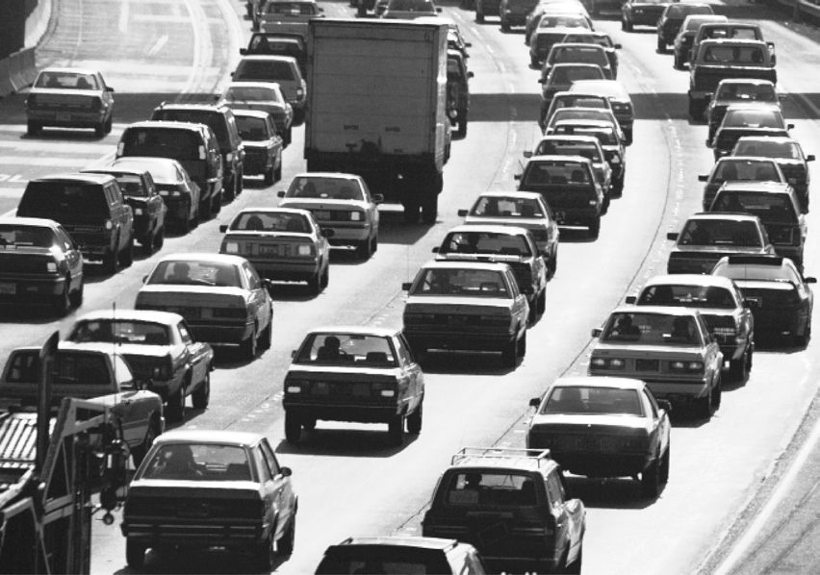
IV. Academic Writing Skills
B. Choosing Appropriate Styles
2. Read the following paragraph beside the picture. Then revise and rewrite it in academic style.
Why are there so many jams on the roads these days? One thing is that public transportation like trains, buses, etc., is so dear. A long time ago cars cost a lot, but now, unfortunately, they’ve got a lot cheaper. Another thing is that driving is a lot nicer than waiting for a bus. The trouble is that if everyone buys a car, the roads get packed.

Slide 30
IV. Academic Writing Skills
B. Choosing Appropriate Styles
A：There appear to be two principal reasons for the growing traffic congestion. Firstly, public transportation has become increasingly expensive in relation to the falling cost of driving. In addition, car ownership is more convenient than using public transportation. These factors together result in higher vehicle density.

Slide 31
IV. Academic Writing Skills
B. Choosing Appropriate Styles
3. Read an article/book extract in your subject area and identify examples to match the characteristics of academic writing in the table. Make a list of these findings for future reference.

Slide 32



