Slide 1
Back Propagation
學號: 410985015
系級: 資工三
姓名: 陳弘竣

Slide 2
Program structure
Statistics
Conclusion

Slide 3
Program structure
1

Slide 4

Shuffle dataset

Slide 5
Program Structure
class BP
Property
1. weight
Function
init
forward_pass
backward_pass
train
predict
test

Slide 6
Neural Network
512 neurons
64 neurons
.
.
.
784
inputs
.
.
.
10 classes
.
.
.
Input layer
Hidden layer
Output layer

Slide 7
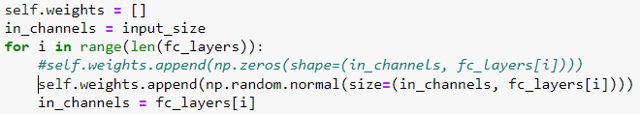
Init function
Input:
input size (image size)
mnist datasets use(28*28=784)
fc layer (including hidden layer & output layer)

Slide 8


Forward Pass & Backward Pass
Forward:
Backward:

Slide 9
Statistics
2

Slide 10
data
100%
75%
50%
25%
0%
92.75%
data/255
92.00%
weight=0
87.95%
72.02%
64.66%
62.87%
10.28%
10.28%
10.62%
1st iteration
2nd iteration
3rd iteration
Validation accuracy

Slide 11
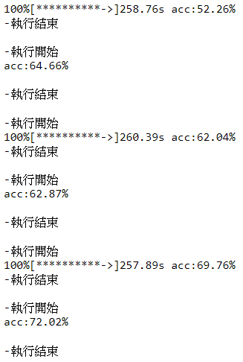
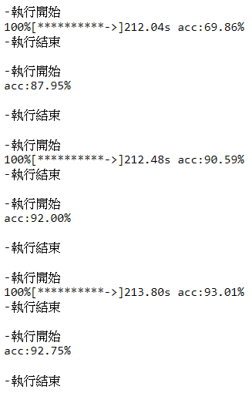
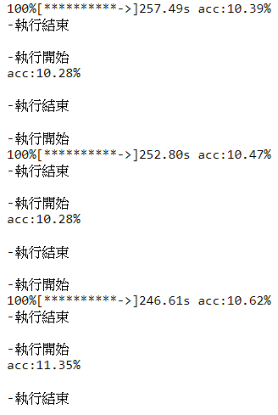









data/255
data
weight=0
Real Data

Slide 12
conclution
3

Slide 13
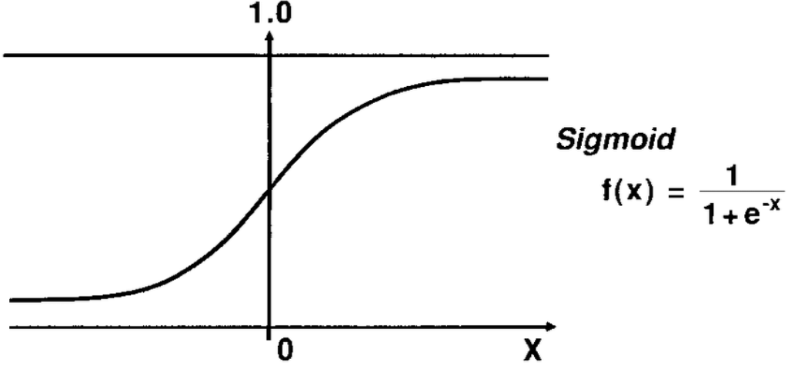
Problems
Weight don’t set 0.
The value of image should be between 0~1.

Slide 14
Thanks!

