Slide 1
Web Info Processing
- with Deep Learning Models

Slide 2
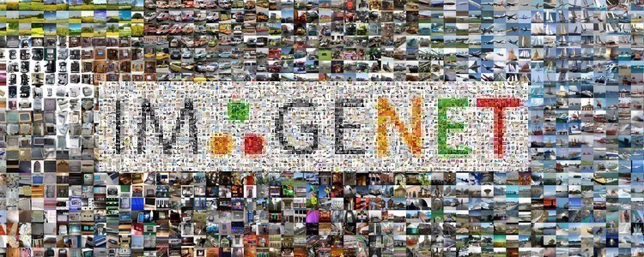
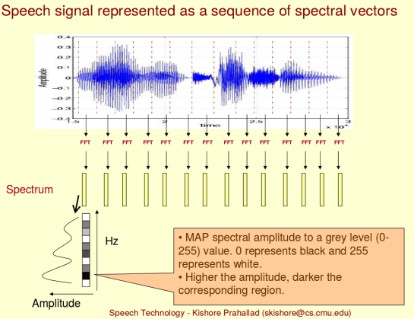

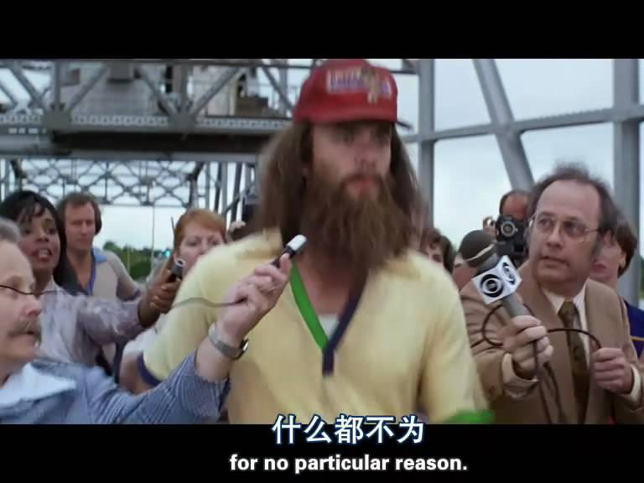

Web information

Slide 3
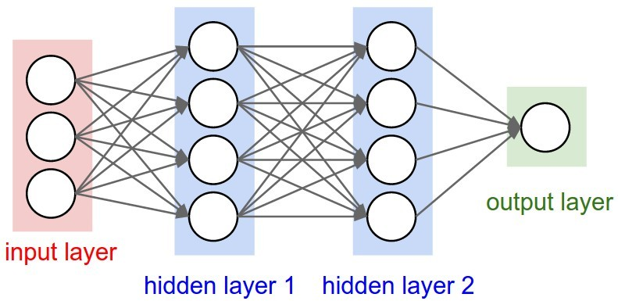
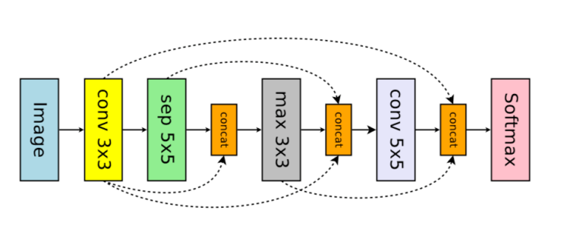
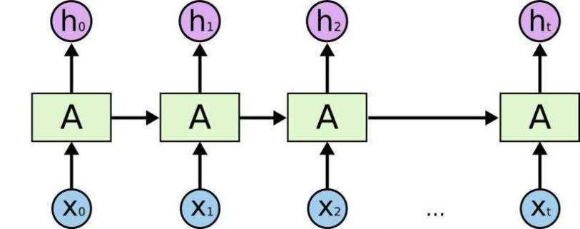
A Unified Approach

Slide 4

Deep Learning Models
Fundamental DL Models
Convolutional Neural Network
Recurrent Neural Network
Generative Adverial Network
Advanced DL Models
CapsuleNet
Transformers
WGAN

Slide 5
Class Project
Every class member should submit ONE class project with PyTorch
You should prepare your own dataset, and train your own model with PyTorch
The project should be focused on Image, Sound，Video, or Textual contents.

Slide 6
Grading Policy
50% points for the final project report (on Github)
50% points for the final class presentation

Slide 7
Project Submission
Please use our project submission repo on Github.
https://github.com/info-ruc/Web-20

