Slide 1
Getting Started with Cloud Foundry
Deploying your First Application
Setup, Deploy and Manage

Slide 2

What is Cloud Foundry?
Introduction to Cloud
Cloud Foundry
Key Concepts
Pivotal CF

Slide 3
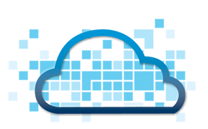
“The Cloud”
Means many things to many people.
  Distributed applications accessible over a network
    Typically, but not necessarily, The Internet
  An application and/or it's platform
  Resources on demand
  Inherently virtualized
  Can run in-house (private cloud) as well
  Hardware and/or software sold as a commodity

Slide 4



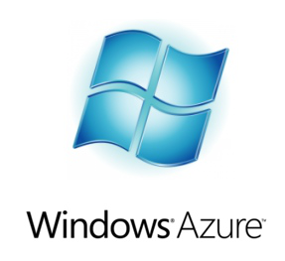
Types of Cloud Computing: IaaS
Infrastructure as a Service
  Replacement for physical hardware
  Provides virtual hardware, OS, Network
  Amazon Web Services (AWS), RackSpace, Microsoft Azure, VMware vCloud Air

Slide 5
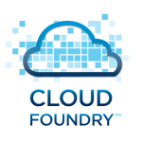

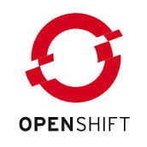


Types of Cloud Computing: PaaS
Platform as a Service
  More than a raw machine with OS
  Provides ready-made platform for running apps
  CloudFoundry, Heroku, Google App Engine, Amazon Elastic Beanstalk

Slide 6
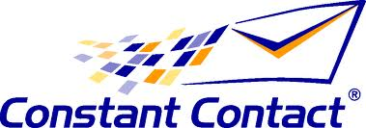
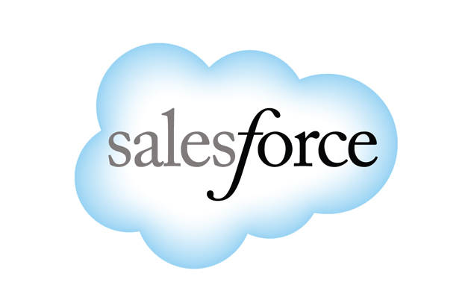
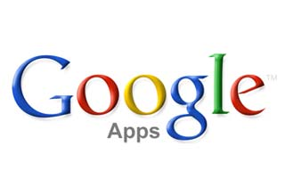


Types of Cloud Computing: SaaS
Software as a Service
  Complete software application
  SalesForce.com, Google Apps, hundreds of examples

Slide 7
PaaS: Pizza as a Service!
You Manage
Provided
Traditional data-
center (on-prem)
Infrastructure as
a Service (IaaS)
Platform as
a Service (PaaS)
Software as
a Service (SaaS)
Dining Table
Dining Table
Dining Table
Dining Table
Soda
Soda
Soda
Soda
Electric/Gas
Electric/Gas
Electric/Gas
Electric/Gas
Oven
Oven
Oven
Oven
Fire
Fire
Fire
Fire
Pizza Dough
Pizza Dough
Pizza Dough
Pizza Dough
Tomato Sauce
Tomato Sauce
Tomato Sauce
Tomato Sauce
Toppings
Toppings
Toppings
Toppings
Cheese
Cheese
Cheese
Cheese
Make at Home
Frozen Pizza
Home Delivery
Eat Out
Albert Barron: http://www.linkedin.com/today/post/article/20140730172610-9679881-pizza-as-a-service
Notes:
This neat analogy shows the difference between On Premise, IaaS, PaaS and SaaS in terms of how much effort you need to put in to make a pizza and how much you contract out to someone else.
Doing it all at home is traditional IT: build-it and maintain it yourself. But not everyone is an expert pizza-chef or has the right kind of oven.
Take and Bake is a US concept where you buy a raw, pre-prepared pizza but bake it at home just when you need it. Buying a frozen pizza from the supermarket amounts to the same thing. The pizza equivalent of IaaS. Someone else provides the infrastructure but you need to do something with it. (This analogy is not perfect. Renting someone else's kitchen, infrastructure, to bake your own pizza is nearer).
Having a cooked pizza delivered means all you have to do is serve and eat it. More like a PaaS deploying ready-made (cooked) applications. Does that makes Soda a service?!
Or you just go to a restaurant and dine out. You do nothing but pay for the food and the “ambiance”. Like SaaS renting time on an existing application.
Another analogy is a car:
Make at home – buy and assemble a kit car (nobody does this but a die-hard enthusiast). Most people have an IaaS car – someone else built it, but you own it, drive it and maintain it. The PaaS car is the hire car – just drive it, no maintenance. The SaaS car is a taxi or limo-service – you don't even drive it yourself.

Slide 8
PaaS: Platform as a Service
You Manage
Provided
Traditional IT
IaaS
PaaS
Agility
And
Cost
Savings
Applications
Applications
Applications
Data
Data
Data
Runtime
Runtime
Runtime
Middleware
Middleware
Middleware
O/S
O/S
O/S
Virtualization
Virtualization
Virtualization
Servers
Servers
Servers
Storage
Storage
Storage
Network
Network
Network
Cloud Enablement

Slide 9
What is Cloud Foundry?
Introduction to Cloud
Cloud Foundry
Key Concepts
Pivotal CF

Slide 10
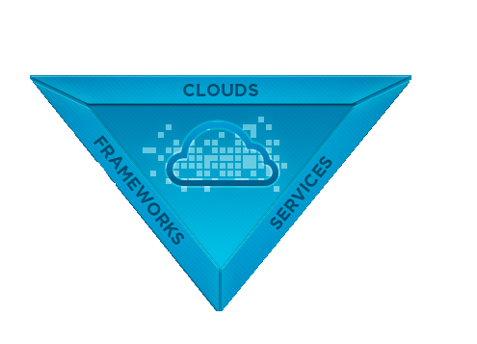

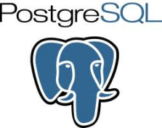
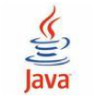


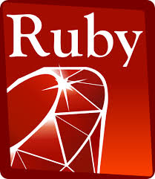



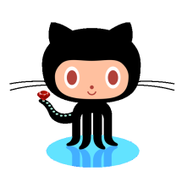
Cloud Foundry – The Open PaaS
Public
Clouds
Private
Clouds
CUSTOM
RUNTIMES
CUSTOM
SERVICES
Open
Source
Notes:
Start at the bottom. 1. First and foremost, CF is open source software, not a proprietary solution. You can download the bits, build it, and run it yourself.
2. Look at the left. CF is for running applications. But not just apps written in one language (like a Java app server), CF supports many languages and frameworks. Out of the box, Java, Ruby, and Node.js (JavaScript) apps are supported. But there are lots of contributions for other languages, including PHP and even .NET (Much more about this later).
Cloud applications can easily and declaratively connect to many kinds of services, and you can build your own (much more about this later).
Finally, many assume that cloud = public. CF is not a public-only solution, but allows you to host your own cloud privately. This is exactly what “Pivotal CF” is all about. The platform is the same whether hosted publicly (run.pivotal.io) or privately (Pivotal CF). “Micro-cloud” is a bit of a tender spot at the time of this writing, “Micro Cloud Foundry” has been discontinued and replaced with BOSH Lite, and the current rumor is that this will be supplanted by a ready-to-go Bosh-Lite VM that bypasses all the installation hassle (which is what Micro CF was all about)

Slide 11

Why Cloud Foundry?
Open Source
  Reduce vendor-lock
Public OR Private
Language Independence
  Via Buildpacks
Wide, growing range of services
Notes:
Open Source – Most of Pivotal CF's competitors are proprietary, for example Amazon Elastic Beanstalk, Google App Engine, or Azure. Single vendor too.
Public / Private – This is a big item for many companies and a big part of Pivotal CF's projected business. Google, Amazon, Azure are Public ONLY. Many firms (rightly or wrongly) do not wish to run their business on public infrastructure.
Language Independence – A traditional Java App server can run JEE apps, period. CF can run Java, JS, Ruby, Python, or any language / framework for which a buildback exists. Interestingly, the buildpack concept is a concept which we freely admit stole from Heroku.
Services – Whether public or private there are a large # of services one can bind to their application.

Slide 12

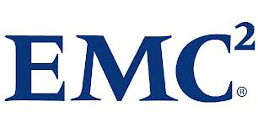

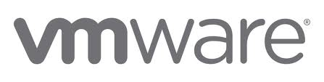



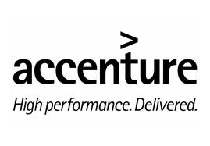

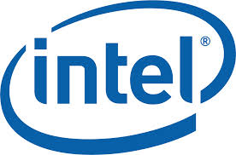

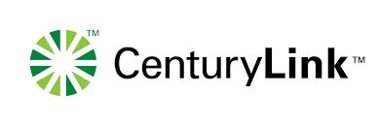
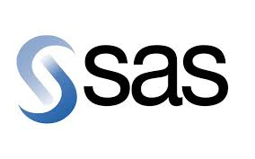








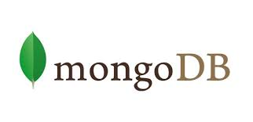




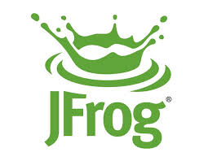
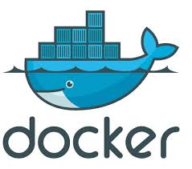



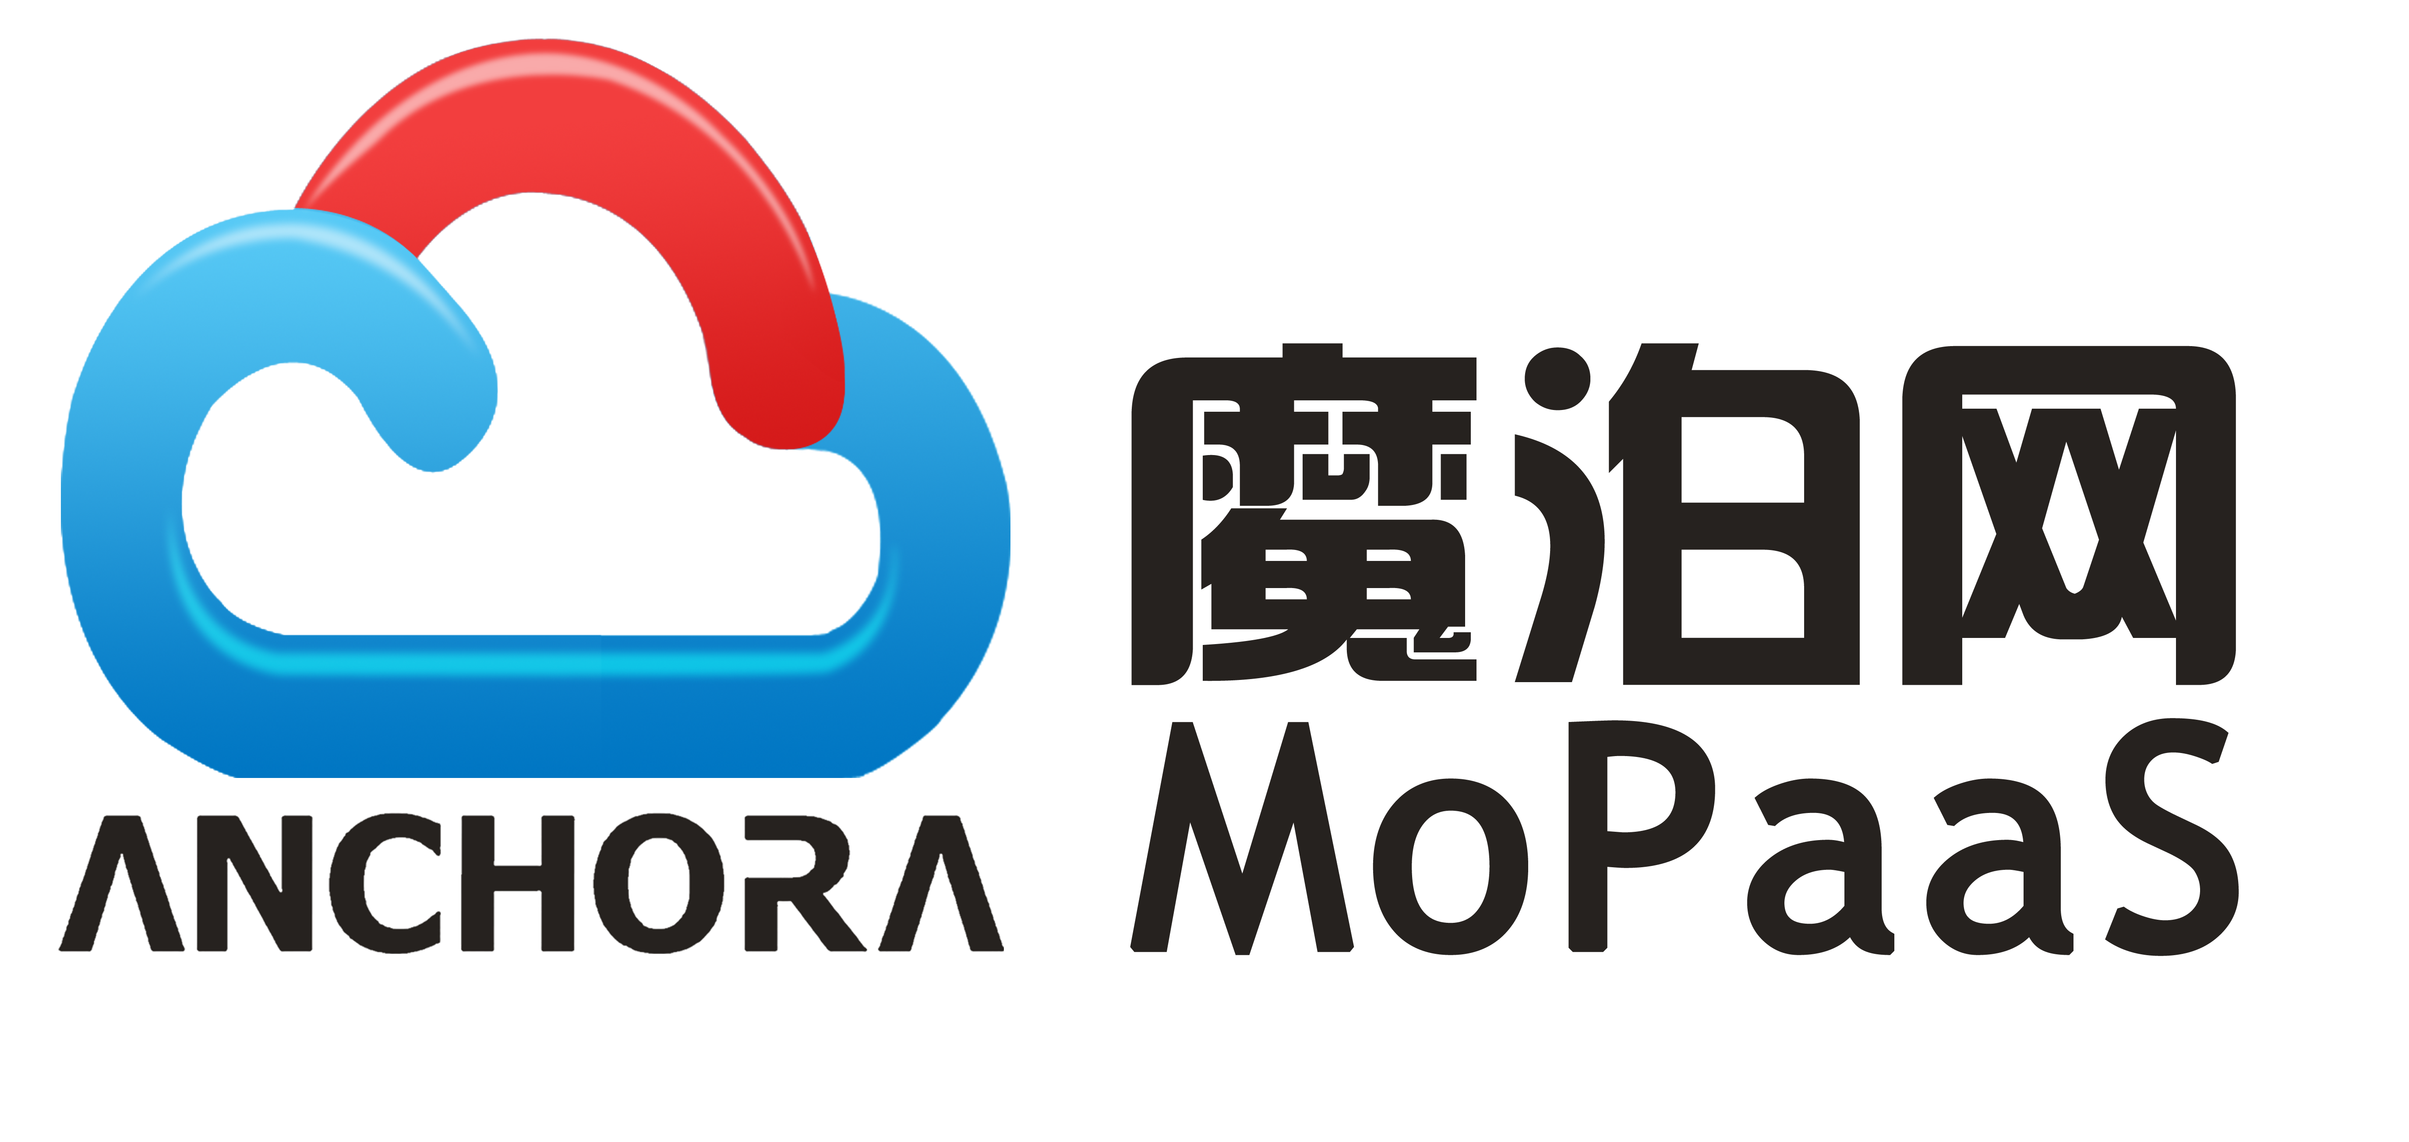



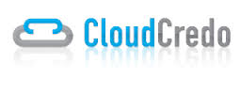

Cloud Foundry: Foundation
Open Governance
Platinum
Gold
Silver
Notes:
Another factor where CF is Open – the Governance is Open
CF is not just run by Pivotal. A deliberate move has been made to ensure that CF remains open and not dominated by a single vendor. Pivotal is certainly a big player but not the only one. The membership levels are based on contributions to the foundation.
The coming Spring IO foundation is based on this model.
For more details:
Cloud Foundry Foundation tab on: http://www.cloudfoundry.org/about/index.html
Mike Maxey <mmaxey@pivotal.io> is a contact for CFF

Slide 13
An Explanation of the Various Web Sites
A web-search for “Cloud Foundry” can be confusing!
URL | Details
cloudfoundry.org | The open source project's home page No hosting of any kind here. Documentation
github.com/cloudfoundry | The location of the source Download, build, and run if you like!
cloudfoundry.com | Old commercial web-site Superseded by run.pivotal.io Redirects to pivotal.io product page
blog.cloudfoundry.org | Technical blog
run.pivotal.io | Pivotal Web Services (PWS) Pivotal's hosted environment, runs PivotalCF
Notes:
I added this because I found “Cloud Foundry” very difficult to understand as a newbie. I think it helps to distinguish between the .org and the .com to help you see where the Pivotal value add is, and how much is available without vendor lock.

Slide 14
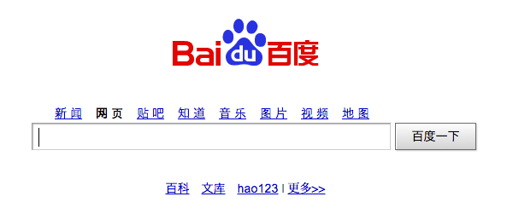
A Major Cloud Foundry Site
Largest Chinese Internet search site
  One billion page views per day
  Ad-Words facility powered by Cloud Foundry
Notes:
Baidu is our ultimate example of CF scalability. See http://gigaom.com/2013/07/24/cloud-foundry-grabs-paas-momentum-as-ibm-baidu-climb-aboard/ for background.
Baidu is also one of our cases for why you want to use Pivotal CF rather than just CF. Baidu employs approx 200 engineers on the team to keep CF up and running. With Pivotal CF most of the operational headaches are eliminated by BOSH, so it would probably only take 4 or 5. No need to drag the student through this at this point in the course though, mainly we just want to let the student know that CF is used right now in prime time on huge sites.

Slide 15



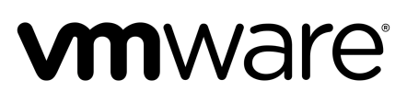


Cloud Foundry Architecture
High-Level View
Cloud Controller
Service
Broker(s)
EA
EA
EA
EA
Container
Container
Container
Container
Router
Container
Container
Container
Container
Container
Container
Container
Container
B O S H
EA = Execution Agent
= A VM where apps run
Notes:
This is a simplified view – we will add more details later.
An application runs in a warden container. A warden container is a secure, isolated “mini-VM” inside an Execution Agent, which is a genuine virtual machine.
Several warden containers can run on each Exec Agent, each can have a different “size”, i.e. memory. There are many Exec Agents, perhaps hundreds. The Cloud Controller orchestrates the routing and lifecycle of all Exec Agents in the pool. Router(s) manage application traffic.
The “Support Facilities” cannot easily be discussed this early, but if pressed the Service Broker provides an interface for provisioning services (native or external) such as Database access for CF apps. There are many more components to add and discuss later.
Apps are accessed directly through the router while web and CLI clients (such as cf, STS) access the Cloud Controller via RESTful services, also via the router.
A Messaging bus (NATS) currently manages all system communication – but this may go in a future release.
The BOSH layer provides a IaaS-specific interface to the underlying IaaS.

Slide 16
DEA vs DIEGO
Execution Agents
  Virtual Machines (VMs) where applications run
  Could be a DEA or a Diego Cell
Cloud Foundry Version | Execution Agent Type | Description
Since 1.0 | Droplet Execution Agent or DEA | A VM running one or more “Droplets” - each Droplet is an application instance
Since 1.5 (Diego) | Cell | A VM running one or more Droplets, Docker images, ...
Notes:
Where possible, everything covered by this course applies to both the original DEA-based architecture or the revamped DIEGO architecture introduced from mid 2015.
The generic term Execution Agent is used to refer to the Virtual Machine (VM) where applications are run. An execution agent might be
A Droplet Execution Agent (original architecture) – normally referred to as a DEA
A Cell which performs the same function in DIEGO. Cells are more flexible, not limited to only running Cloud Foundry Droplets.
Unfortunately we haven't covered Droplets yet, so it is hard to discuss this in detail now. Many students have heard of Diego but it is not the standard architecture yet (mid-2015) and probably won't be the default for some time.
Note 1: What matters is that in either case, an application is pushed to CF and one or more instances are run in a secure Warden container on one or more Execution Agent VMs. Almost everything covered by this course applies to either architecture.
Note 2: The differences between the original and new DIEGO architectures fascinate most students, and it is always good to know what is happening “inside the box”. But in reality it does't matter at all when pushing applications.
Diego only becomes important:
When you want to push other application images like Docker images
If you want to run .NET applications (not yet available as at mid-2015 anyway)
If you are considering overall scalability and other production issues for your whole Cloud Foundry Foundation (an installation of CF is termed a Foundation).

Slide 17

Services
Anything external your application relies on
  Database, email server, messaging, web-service …
“Marketplace” provides a pool of services
  Create the service you need
    Select the “plan” – typically involves more cost for more performance and/or capacity
    Bind to your application(s)
User-defined services for external services
  Existing databases, legacy applications …
Service(s) available to application at runtime
  Connection information passed by Cloud Foundry runtime

Slide 18
What is Cloud Foundry?
Introduction to Cloud
Cloud Foundry
Key Concepts
Pivotal CF

Slide 19
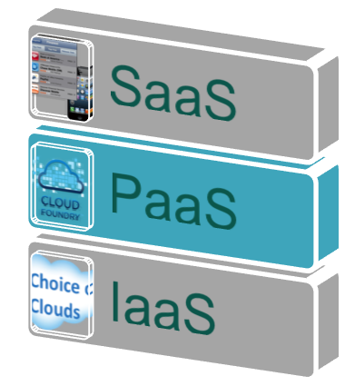
Cloud Foundry Platform as a Service
Application is the new unit of deployment and control
  Abstracting VMs and Middleware
  Abstracting containers and processes
  Data as a service
  Eliminate bottleneck of provisioning &
  deployment
Notes:
This is a subtle concept. If using IaaS, you have to worry about servers, Os’s, network, etc. CF (and others) tend to focus on the application itself as the center of the universe – everything else is a supporting actor.
No need to configure VMs, databases, AppServers, Load-balancers…
Developers can focus on development and not infrastructure plumbing
Separate the concerns of AppDev and Operations
Make full use of investments in the “Cloud”

Slide 20

IaaS: VM-centric Deployment
}
Application
App Server (Tomcat)
unit of deployment
Runtime (JVM)
VM
Infrastructure
Scaling = creating VMs from blueprints/templates
© Copyright 2013 Pivotal. All rights reserved.
Notes:
Many organizations attempt to build their own PaaS on top of IaaS. They make scripts (puppet, chef) for building out servers pre-configured with runtime and containers for devs to use to run apps.
Such attempts fall short because they are missing integrated load balancing, health monitoring, log aggregation, services, scaling, etc.

Slide 21
PaaS: App-centric Deployment
}
Application
unit of deployment
}
App Server (Tomcat)
Runtime (JVM)
the platform
Container
VM
Infrastructure
Scaling = creating containers in a VM pool
© Copyright 2013 Pivotal. All rights reserved.
Notes:
In CF, the container, runtime, frameworks, etc. are all assembled with your app into a deployable artifact called a “Droplet” by a buildpack.
The VM pool are the Execution Agents (either DEAs or DIEGO containers).
We cover all this in more detail later – don't get distracted by this now.

Slide 22

Core Tenets of Pivotal CF
Radically Simple, Developer Friendly
Operational Benefits for every Application
Broad Ecosystem of Services
Operational Benefits for Applications
Push an app – “it just works”
Supporting wide ranging use cases
Support new application patterns – microservices
Easy to add/customize
Data
Services
Highly scalable
Self healing
Logging & audit trail
Existing enterprise policies – user access & authorization
Application monitoring
Operational metrics
App uptime SLAs
App
Services
Mobile
Services
Notes:
Cover briefly for now, we will come back to these in the Tech Overview

Slide 23
What is Cloud Foundry?
Introduction to Cloud
Cloud Foundry
Key Concepts
Pivotal CF

Slide 24


Which Cloud Foundry Product?
Open Source Setup and run a PaaS for yourself No paid support No tools | PWS Pivotal Web Services Public CF PaaS run/ managed by Pivotal Hosted on AWS No guaranteed SLAs, not for production Support offered PWS-E PWS Enterprise For existing Pivotal customers to use PWS | Commercial product Run private PaaS in-house, or Create public PaaS (ISP managed) Sophisticated Web Console (App Mgr) Additional Tools (Ops Mgr) Less hassle Support offered
Notes:
Good description of difference: http://www.infoworld.com/d/cloud-computing/review-cloud-foundry-brings-power-and-polish-paas-246315

Slide 25
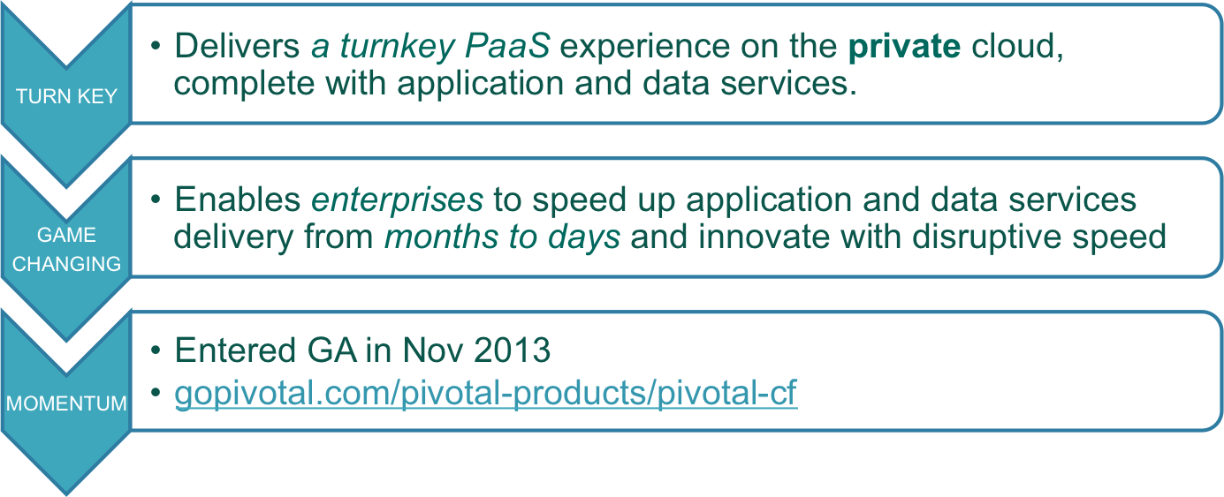
What is Pivotal CF?
An Enterprise PaaS powered by Cloud Foundry
www.pivotal.io/pivotal-products/pivotal-cf

Slide 26
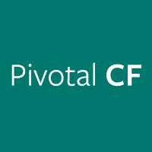
Pivotal CF: Enterprise PaaS
Commercially Supported
Certified upgrades, curated & tested quarterly releases
Operations Manager Cloud Administrative Console
Elastic Runtime Application Manager *
Built-in Application Performance Monitoring (APM)
Operational Metrics service
Auto-Scaling service
Easy LDAP/Active Directory Integration
Historical Usage Data per Application Instance
Declarative Availability Zones
Behind the firewall download packages (do not require internet access)
Enterprise documentation (PDF format)
* Formerly Developer Console

Slide 27

OSS vs Pivotal CF
OSS
PivotalCF
Managed Services
Elastic
Runtime
+
Data
Services
Messaging
Services
Mobile Services
Core Cloud
Foundry Components
App Manager
Console
Pivotal
Support
Operators Console (Ops Mgr)
B O S H
Data Services: RDB and NOSQL
Messaging Services: Rabbit/MQ
Mobile Services: Push Notifications, API Gateway, Data Sync, ...
Notes:
The boxes in Pivotal Green are the value-added extras of Pivotal CF vs OSS. Plus you get Pivotal support.
The Ops console is the VM setup at the start of the PivotalCF installation process.
The app console (formerly the dev console) is what all the students logged into PWS or their PivotalCF instance are using.
All the different services are those provided as “Tiles” for easy installation into PivotalCF using the Ops Manager.

Slide 28
Pivotal CF – Commercial Components
PCF Ops Manager | One Pivotal CF Operation Manager instance hosted across a cluster of VMs. Typical enterprise deployment contains 2-3 Pivotal CF Ops Manager instances (dev/test + production x2 for HA)
PCF Elastic Runtime Application Instances (AI) | Individual instances of deployed applications on PCF Elastic Runtime or on Pivotal Web Services (PWS) An application may scale up to multiple instances For a Java app: each AI is a Java Virtual Machine (JVM)
Service Instances (SI) | A single, unique configuration of a service (such as a database or other software or middleware) within a PCF Foundation (installation) Utilizes resources (such as CPU, cores, virtual machines, memory, messaging, development and/or data storage) within the same (or another) licensed Foundation

Slide 29
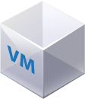
What We Charge For
Each App Instance, each Op Manager, each managed service
App Instances
App Instances
Service Instances
User- Provided Services
(free)
External Servers
not running on PCF
(such as Oracle DB, Pivotal Big Data Suite)
Pivotal Web
Services
(PWS)
PCF
Services Suite
Pivotal MySQL,
Pivotal RabbitMQ,
Pivotal Redis
…
PCF Elastic Runtime
$
$
$
AI
Partner Provided Services
AI
$
$
PCF Operations Manager
HOSTED
SELF OPERATED
IaaS Provider

Slide 30
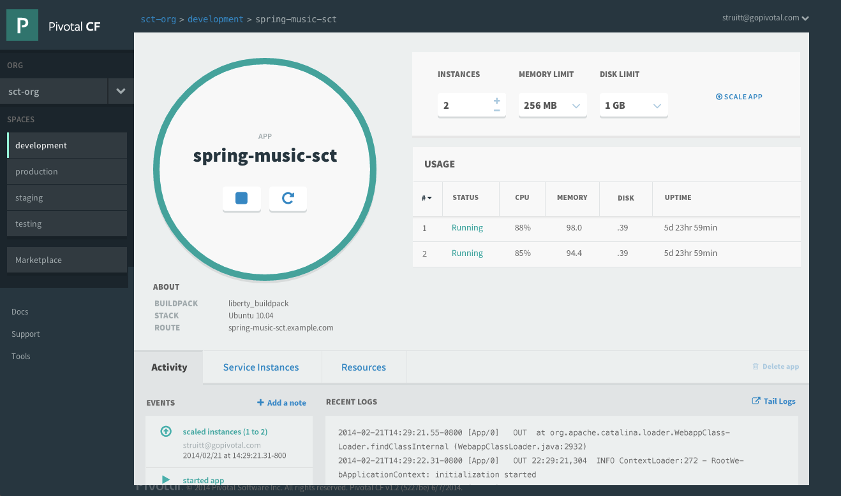
Pivotal CF: Developer Benefits
Application Manager
  Start/stop
  Scale
  Services
  Logs
  etc.

Slide 31
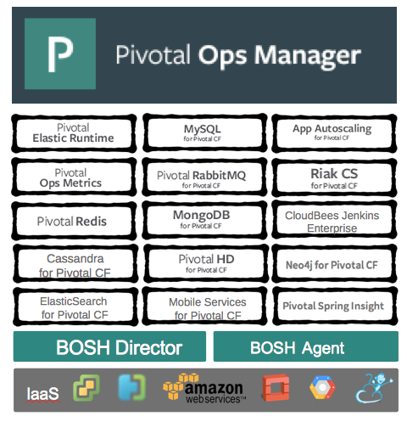
Pivotal CF: Operator Benefits
Click to Install
No downtime updates
Explore install logs
Click to scale platform
Built-in high availability
Built-in platform monitoring
Integrated services

Slide 32
How can I use Pivotal CF?
Pivotal CF is the commercial PaaS based on CF
Many options:
  Public – Pivotal Web Services: run.pivotal.io
  Basis of other public PaaS offerings
  Run it in-house as the basis of your private cloud
  Run it yourself on third-party cloud provider
    Open Stack, AWS …
Notes:
Cloud Foundry – the open source PaaS. You download, build and run it.
Pivotal CF – our branded version of Cloud Foundry. You download and run it, but it is easier, supported, etc.
Pivotal Web Services – Our hosted instance of Cloud Foundry. Interestingly, we run it on Amazon. Intended more for Proof of concepts and light usage, we offer no SLA. It is a paid service. Our business plan is not to make our money here, but on Pivotal CF. Companies are free to buy Pivotal CF to make a public PaaS to compete with PWS.
Running on Open Stack or AWS requires effort to setup, typically requiring paid professional services from us.

Slide 33
Roadmap
Getting Started with the Command Line Interface
Login
Deploying an Application
Using a Manifest
The Application Manager

Slide 34
The Command Line Interface
Several interface options exist for Cloud Foundry
  Command Line Interface (CLI)
  Web-based Application Manager Console
  Eclipse / STS plugin, IntelliJ plugin*
Primary access is done via the CLI
  Make sure you have it installed
    Installation was covered in the “Setup” guide
* Not discussed in this course
Notes:
I ran into an issue where an older v5 version of CLI was installed on my computer. Use instructions at http://docs.cloudfoundry.org/devguide/installcf/install-go-cli.html to uninstall. I doubt many students will run into this issue though, especially in the future.

Slide 35
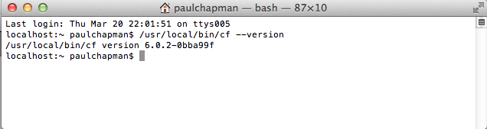
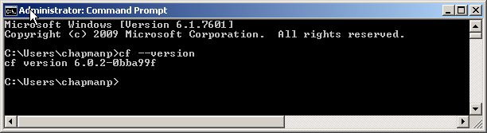
Test the CLI Utility
It is called cf
  Open a Command/Shell window
  At the prompt type: cf --version

Slide 36
Getting Help
Get help at any time via cf help
Or cf help <command>

Slide 37
DO NOW – Get Help on a Command
Perform these steps on your computer:
  Open a command prompt
  Issue the cf help command
  Get help on the login command: cf help login
Answer these questions:
  What option do you use to specify username?
  Is specifying the password option encouraged?
Notes:
This “DO NOW” is a mini-lab. The point is to get the students to work on their keyboards for just a second to make sure they know how to get help.

Slide 38
Roadmap
Getting Started with the Command Line Interface
Login
Deploying an Application
Managing Application Instances

Slide 39
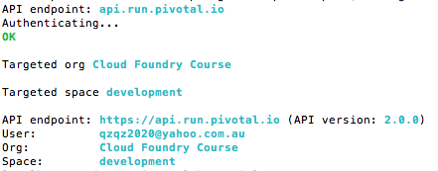
Login to Cloud Foundry
Need to tell cf
  What cloud foundry instance you are using
  What your account details are
  Use cf login
Color highlighting
MacOS, Linux only
>
Will prompt for anything you
don't specify
No -p? Prompts for password
Notes:
If cf can't access your home directory (for example a mounted drive not available when off your work network), you can override this location by setting CF_HOME.

Slide 40
Cloud Foundry URLs
To access CF you need to know 3 URLs
  API Endpoint
    Identifies your CF instance
    Used to deploy applications, manage spaces, routes …
    The cf utility makes RESTful requests to this URL
      Actually to the Cloud Controller
  Apps Manager
    Application management dashboard (console)
    Pivotal CF only
  Apps Domain
    Used to access deployed applications
    May be same as System Domain
Notes:
Commands sent to the API URL are actually sent to the Cloud Controller.
The API Endpoint and Apps Manager URL are sub.domains of the System Domain (see next slide)

Slide 41

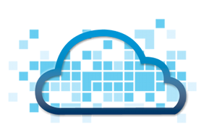
Cloud Foundry URLs
For simplicity, most examples
in this section show PWS URLs
System & App domains defined when CF was installed
If using PWS
  System domain: run.pivotal.io
    API Endpoint: api.run.pivotal.io
    Apps Manager: console.run.pivotal.io
  Apps domain: cfapps.io
Your own CF installation
  System domain: <your-cf-system-domain>
    API Endpoint: api.<your-cf-system-domain>
    Apps Manager: console.<your-cf-system.domain>
  Apps domain: <your-cf-apps-domain>

Slide 42
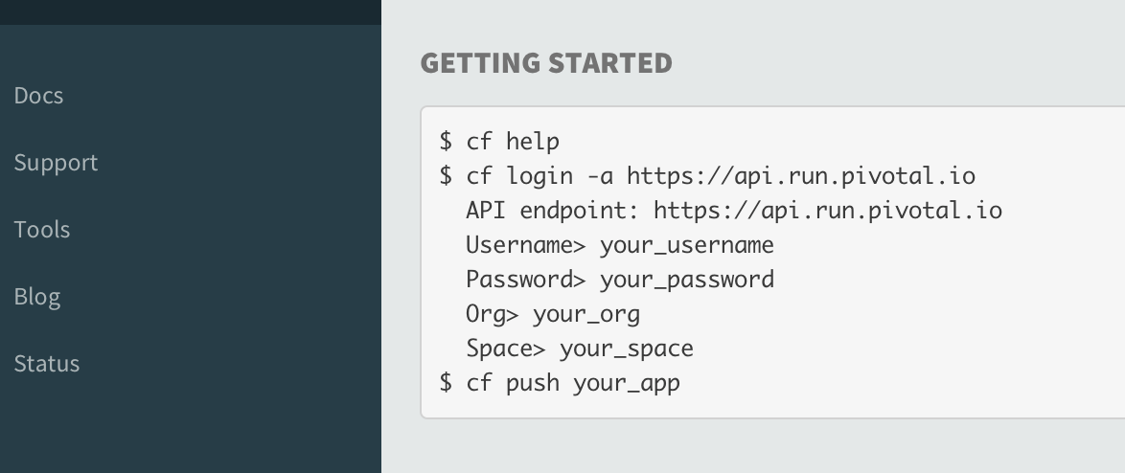
Finding the API Endpoint URL
URL of Cloud Controller in your Cloud Foundry instance
  On Apps Manager home-page on first login
  Or click Tools
  Shows how to run cf login, including the API Endpoint

Slide 43
DO NOW – Login
Perform these steps on your computer:
  Login with cf login command
    Specify CF instance using -a <API-URL>
      For PWS: -a api.run.pivotal.io
    Specify email / password
    If prompted, select an organization and space
    Firewall issues?
$> cf login -a <API-URL> -u <your-email-or-username>
API endpoint: api.run.pivotal.io
...
http://docs.cloudfoundry.org/devguide/installcf/http-proxy.html
Notes:
This “DO NOW” is a mini-lab.
If doing this on-site, there my be firewall issues. To get cf to use an HTTP proxy, set the HTTP_PROXY environment variable in the shell.

Slide 44
The .cf Directory
cf creates a .cf directory in your home directory
  Stores context, logs, crash reports …
  Remembers your CF API Endpoint
    Don't need to specify -a option at next login
localhost:dev$ ls -l ~/.cf
total 48
-rw------- 1 paulchapman staff 2491 15 Aug 14:06 config.json
-rw-r--r-- 1 paulchapman staff 11737 29 Nov 2013 crash
drwxr-xr-x 3 paulchapman staff 102 12 Sep 2013 logs
-rw-r--r-- 1 paulchapman staff 26 12 Sep 2013 target
-rw-r--r-- 1 paulchapman staff 2084 29 Nov 2013 tokens.yml
You can override this location by setting CF_HOME

Slide 45
DO NOW – .cf folder
Perform these steps on your computer:
  Find the .cf folder / directory on your computer
    You won't (yet) have all the files shown on previous slide
  Open the config.json file, observe the contents
Notes:
This “DO NOW” is a mini-lab.

Slide 46

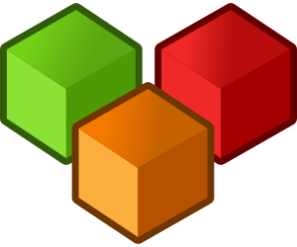
Organizations and Spaces
Cloud Foundry is designed for collaboration
  Developers in the same organization can work together
  An org can be a department, project, company …
  Every PWS user is put in their own organization
  Org owners can invite other users to join
Applications execute within a space
  Spaces typically represent a stage in the development lifecycle
    development, test, QA, ...

Slide 47
Current Targets
When you first login you see output like this:
  Notice it shows current organization and space
  At any time, run cf target to get same information
By default a PWS organization only has one space
  development
  Recall: On PWS you are setup as your own organization
API endpoint: https://api.run.pivotal.io (API version: 2.6.0)
User: pchapman@pivotal.io
Org: pivotaledu
Space: development
Notes:
When a new account is created on PWS, the name of the user specified defines their organization too.

Slide 48
Viewing Organization
Commands
  cf orgs All orgs for current user
  cf org <org-name> Shows specified org
>$ cf org pivotaledu
Getting info for org myorg as user@somedomain.com...
OK
pivotaledu:
domains: cfapps.io
quota: paid (10240M memory limit, Unlimited instance
memory limit, 1000 routes, -1 services,
paid services allowed)
spaces: development, production, staging
space quotas:
>$

Slide 49
Managing Spaces
To see all the spaces in an organization
  cf spaces
Create a new space (in current organization by default)
  cf create-space <space-name>
  cf create-space <space-name> -o <org-name>
Use target command to change space (or organization)
  cf target -s <space-name>
  cf target -o <org-name>
Notes:
If someone asks, there is a cf create-org command, but only admin users are authorized to run it.

Slide 50
Roadmap
Get Setup
Login
Deploying an Application
Using a Manifest
The Application Manager

Slide 51
Deploy Using the CLI
You need a deployable application
  For example with Java: a jar or war
    Ant, Maven or Gradle build-tools can make it for us
    Cloud Foundry doesn't care how you build your application
  Other languages (Ruby, Node.js, etc.): the source will do
Notes:
Previously, when using Eclipse/STS integration, Eclipse/STS managed this for us. In the case of spring-music, it was a Gradle-based app, and we have the Gradle extension installed, so STS took care of the jar/war for us. From the CLI, we have to do this step separately.

Slide 52

The cf push Philosophy
Onsi Fakhouri (Cloud Foundry PM)
  Here is my source code
  Run it on the cloud for me
  I do not care how
The architecture of CF is fascinating
  And we will cover it
  But ultimately irrelevant
I just want to push an application
  I no longer need to know: how that happens, how it is packaged or how it is run?
Haiku
Notes:
This Haiku or philosophy is particularly important when contrasted with Docker. With Docker I have to know exactly what I am packaging. There are advantages to this for testing and CI, but it sucks for deployment. Why should the developer dictate how the app is deployed into production, on what OS and so on. None of their concern – basic Spring principle: separation of concerns applies.

Slide 53
Deploy (push) to Cloud Foundry
Deploy by running cf push <name-of-your-app>
  Many options
    -i Number of instances
    -m Memory limit (e.g. 256M, 1024M, 1G)
    -n Hostname (e.g. my-subdomain)
    -p Local path to app directory, jar, war, zip file …
    … Others will be covered later
Your application appears in Cloud Foundry
under the name you specify here

Slide 54
Domains and URLs
Every CF instance is assigned a domain at installation
  Known as the Apps Domain
  For PWS this is cfapps.io
When you deploy, your application gets a unique route (URL) to access it: hostname + app domain name
  By default, hostname = application name
  Make sure hostname is unique
    cf push returns an HTTP 400 error if not
PWS example:
  cf push spring-music ...
  gets route: spring-music.cfapps.io
Notes:
Don't want to get into Spaces and other CF features, do for now click Finish at second step.
Buildpacks explained later, bypass for now.
Each student, and many CF users before, have deployed “spring-music” to Pivotal Web Services. Suggest the students prefix it with their name or initials.

Slide 55
Examples of Using cf push
Specify unique sub-domain
by adding numbers, initials ...
Fully specified (recommended)
  Deploys war file (specify path if needed)
  1 instance, 512M memory
  Name: spring-music
    Appears as spring-music in Cloud Foundry
  Hostname: spring-music-678
    Creates URL (PWS): spring-music-678.cfapps.io
cf push spring-music -i 1
-m 512M
-n spring-music-678
-p build/libs/spring-music.war

Slide 56
What Happens ?
cf connects to Cloud Foundry using your credentials
It 'pushes' your application to CF and tells it to deploy it
  The whole application is uploaded – takes a while
  CF “stages” your application
    Recognizes Java WAR file, prepares a “droplet” with a JRE and Tomcat server
  “Droplet” is deployed to a container and starts running
  All requests to the Deployed URL route to your application
Whole process logged on screen
  See next 3 slides
Notes:
Avoid the gory details of the push process for the moment.
“Takes a while” - We will discuss some ways to mitigate this later in the course. There are ways you can 'ignore' files you don't want to send each time. You can also use a technology like Spring Boot to build a jar that has only the “real” dependencies.
A Java application is subject to the rules of the Java build pack, and by default will get a Tomcat server. There are ways to alter this; the Websphere Liberty buildpack would obviously use Websphere. Java apps can run from the main method and use an embedded tomcat or Jetty instance. Node and Ruby apps are completely different, subject to their buildpacks.

Slide 57
What Happens - 1
URL: spring-music-678.cfapps.io
cf push spring-music -n spring-music-678 -i 1 -m 512M
-p pre-built/spring-music.war
> cf push spring-music -n spring-music-678 -p build/libs/spring-music.war -i 1 -m 512M
Updating app spring-music in org your-org / space development as your-id@company.io...
OK
Using route spring-music-678.cfapps.io
Uploading spring-music...
Uploading app files from: pre-built/spring-music.war
Uploading 574.8K, 95 files
Done uploading
OK
Starting app spring-music in org your-org / space development as your-id@company.io...
...
Updates CF metadata
(app name, instances, memory)
Establish route
Uploads war
Next...
Notes:
What happens when you execute this push command. Keep this high-level; the student will not be able to absorb all of the architecture yet. We will return to this process several times in the course, so stay high-level yet be factually accurate:
First thing to note is that, because we are declaring the host specifically, this will result in spring-music-678.cfapps.io when deployed on PWS. Students will need to use their own host in the exercise as spring-music-678 will be taken
Second, the cloud controller updates metadata: app name, host, instances, memory, etc. Students don't need to know anything more than “CF updates metadata”, the rest will be explained later
Third, the route is established. If not unique (or already belonging to this app), error.
Fourth, upload. Note that we were specific about the file being uploaded. If we weren't, the entire directory contents would be uploaded.
And now, on to the next step, the staging process...

Slide 58
What Happens - “Staging”
CF must prepare the app before its first run
...
Starting app spring-music in org your-org / space development as your-id@company.io...
OK
-----> Downloaded app package (21M)
-----> Java Buildpack Version: v2.7.1 | https://github.com/cloudfoundry/java-buildpack#fee275a
-----> Downloading Open Jdk JRE 1.8.0_40 from https://download.run.pivotal.io/openjdk/lucid/x86_64/openjdk-1.8.0_40.tar.gz (6.1s)
Expanding Open Jdk JRE to .java-buildpack/open_jdk_jre (1.3s)
-----> Downloading Spring Auto Reconfiguration 1.7.0_RELEASE from https://download.run.pivotal.io/auto-reconfiguration/auto-reconfiguration-1.7.0_RELEASE.jar (0.2s)
-----> Downloading Tomcat Instance 8.0.20 from https://download.run.pivotal.io/tomcat/tomcat-8.0.20.tar.gz (1.1s)
Expanding Tomcat to .java-buildpack/tomcat (0.1s)
-----> Downloading Tomcat Lifecycle Support 2.4.0_RELEASE from https://download.run.pivotal.io/tomcat-lifecycle-support/tomcat-lifecycle-support-2.4.0_RELEASE.jar (0.0s)
-----> Uploading droplet (73M)
...
“Buildpack” selected and executed
Buildpack configures Java
Reconfigure Spring
for cloud environment
Buildpack creates
“Droplet”
Next...
Buildpack obtains Tomcat
Notes:
Without overwhelming the student with details: after the application artifacts are uploaded, CF will try to start the application, but before it can 'start' an application is must go through a “staging” process.
First, it tries to select a matching buildpack for this artifact. This is a WAR, so Java buildpack is selected. (Note that the “app package” is “downloaded”. This is the same artifact that was just uploaded from client to CF. This download is from blobstore to staging DEA. Students don't need to be overwhelmed with this detail for right now)
Second, the Java buildpack runs. The steps you see here are specific to the Java buildpack, Ruby and Node (and anything else) will be different. The buildpack, running on a staging DEA, is gathering all of the artifacts to build a 'droplet', which is everything needed to run this kind of app. WARs will require Java and Tomcat, and this particular one is Spring so an auto-configure framework is brought in too. The droplet is created. Note the size of the original WAR (20MB) and the finished droplet (60mb).
A Java application is subject to the rules of the Java build pack, and by default will get a Tomcat server. There are ways to alter this; the Websphere Liberty buildpack would obviously use Websphere. Java apps can run from the main method and use an embedded tomcat or Jetty instance. Node and Ruby apps are completely different, subject to their buildpacks.
Once droplet is created (and stored in blobstore) staging is complete. Next, start the app..

Slide 59
What Happens - “Start”
...
0 of 1 instances running, 1 starting
0 of 1 instances running, 1 starting
1 of 1 instances running
App started
OK
App spring-music was started using this command `JAVA_HOME=$PWD/.java-buildpack/open_jdk_jre JAVA_OPTS="-Djava.io.tmpdir=$TMPDIR -XX:OnOutOfMemoryError=$PWD/.java-buildpack/open_jdk_jre/bin/killjava.sh -Xmx382293K -Xms382293K -XX:MaxMetaspaceSize=64M -XX:MetaspaceSize=64M -Xss995K -Daccess.logging.enabled=false -Dhttp.port=$PORT" $PWD/.java-buildpack/tomcat/bin/catalina.sh run`
Showing health and status for app spring-music in org your-org as your-id@company.io...
OK
requested state: started
instances: 1/1
usage: 512M x 1 instances
urls: spring-music-678.cfapps.io
last uploaded: Tue Mar 17 17:58:35 UTC 2015
state since cpu memory disk
#0 running 2015-03-17 01:59:35 PM 0.0% 474.4M of 512M 150.3M of 1G
Cloud Foundry runs the “Droplet” on a “container”
Health Check
Done! 1 application instance running on spring-music-678.cfapps.io
Notes:
Avoid the gory details of the push process for the moment.
“Takes a while” - We will discuss some ways to mitigate this later in the course. There are ways you can 'ignore' files you don't want to send each time. You can also use a technology like Spring Boot to build a jar that has only the “real” dependencies.
A Java application is subject to the rules of the Java build pack, and by default will get a Tomcat server. There are ways to alter this; the Websphere Liberty buildpack would obviously use Websphere. Java apps can run from the main method and use an embedded tomcat or Jetty instance. Node and Ruby apps are completely different, subject to their buildpacks.

Slide 60
Application State and Logs
Run cf apps
cf logs spring-music
> cf apps
Getting apps in org pivotaledu / space development as kkrueger@pivotal.io...
OK
name requested state instances memory disk urls
spring-music started 1/1 512M 1G spring-music-678.cfapps.io
> cf logs spring-music
Connected, tailing logs for app spring-music in org pivotaledu / space development as kkrueger@gopivotal.com...
2014-06-07T23:01:47.68-0400 [RTR] OUT spring-music-678.cfapps.io - [08/06/2014:03:01:47 +0000] "GET /assets/js/status.js HTTP/1.1" 200 844 "http://spring-music-678.cfapps.io/" "Mozilla/5.0 (Macintosh; Intel Mac OS X 10_7_5) AppleWebKit/537.73.11 (KHTML, like Gecko) Version/6.1.1 Safari/537.73.11" 10.10.66.34:64401 vcap_request_id:73037523-63ef-498f-6cd8-d3b48fe69e84 response_time:0.003693009 app_id:314f0434-d2c9-446c-ab4a-6c310878ca80
2014-06-07T23:01:48.47-0400 [RTR] OUT spring-music-678.cfapps.io - [08/06/2014:03:01:48 +0000] "GET /assets/templates/header.html HTTP/1.1" 200 1060 "http://spring-music-678.cfapps.io/" "Mozilla/5.0 (Macintosh; Intel Mac OS X 10_7_5) AppleWebKit/537.73.11 (KHTML, like Gecko) Version/6.1.1 Safari/537.73.11" 10.10.66.34:64324 vcap_request_id:39fbb3f2-46fb-4bd7-78d6-8994fafade9f response_time:0.004132254 app_id:314f0434-d2c9-446c-ab4a-6c310878ca80
Notes:
Details on debugging and tailing logs will be covered in a later chapter. For now just explain that we can tell that we are up
Incoming port 4443: cf logs receives its data via secure websocket on port 4443. Most corporate firewalls block this. Using PWS when on-site, cf logs inevitably fails unless we have specifically arranged to open up this port first.
Fortunately you can view the logs in the App Manager console without any problems.
A formal note on this issue appears in the logging and troubleshooting section – don't want to go into it here, unless it's an issue.

Slide 61
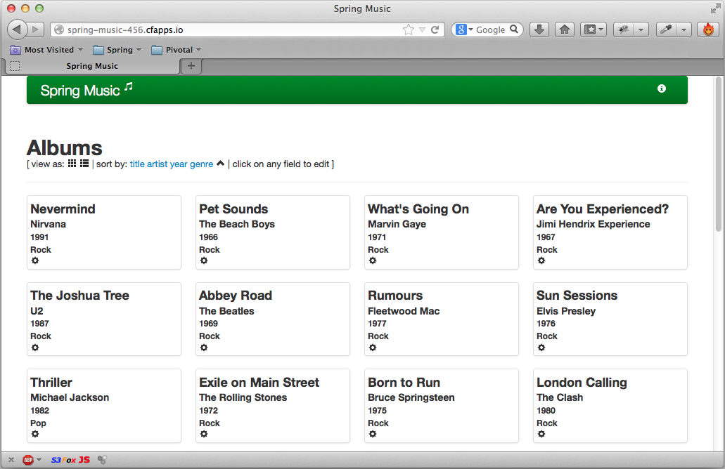
See The Application Running
Open a browser window to spring-music-678.cfapps.io
Notes:
Students may be lost on a lot of the details. That's ok, we'll be back over this. But one thing to hammer in is that the url is not spring-music.cfapps.io because we specified the host.

Slide 62
Configuring a Deployed Application
Change the number of instances
  cf scale <app> -i <new-value>
  Two instances: cf scale spring-music -i 2
  New instances added, or some existing instances stopped
Change the memory allocation
  cf scale <app> -m <new-value>
  1024M: cf scale spring-music -m 1024M
  Requires a restart to take effect
Note: Default memory quote on PWS is only 2G for all applications in total

Slide 63
Stopping and Starting
cf stop
cf start
cf restart
cf restage
Sends SIGTERM message to application
Sends SIGKILL 10 seconds later if still running
Starts existing application
cf stop followed by cf start
Repeats the staging process, and starts the app.
Useful when environment variables / bound services change
  (Covered later)
Notes:
Although this seems basic there are some fundamental points here.
When stopping apps, each instance gets a SIGTERM message that indicates that you have 10 seconds before you are killed by the OS. Spring apps will get their applicationcontext.close() methods called and @PreDestroy methods invoked at this point. 10 seconds later, if the app is still running it will be killed hard.
Starting simply means sending a signal to the DEA to start a droplet in a container. No uploading or staging needs to take place.
Restart is a bounce, stop then start
Restaging is new. This forces CF to go through the staging/buildpack process to create a new droplet. This is useful when the buildpack itself has been changed (say the Java version), environment variables change, or bound services are changed. These all used to require a CF push, which implied waiting for an upload.

Slide 64
Roadmap
Get Setup
Login
Deploying an Application
Using a Manifest
The Application Manager

Slide 65

Cloud Foundry Manifest file
Describes the application deployment options
  Automates subsequent deployments
  Same options as cf push command
    Plus options only available in the manifest
Default name: manifest.yml
  YAML* format
  Human friendly data serialization standard
  Supported by many programming languages
  Less verbose than XML, similar to JSON
  http://www.yaml.org
Create using
your favorite
text editor
* YAML Ain’t Markup Language
Notes:
All info in this section comes from http://docs.cloudfoundry.com/docs/using/deploying-apps/manifest.html#attributes

Slide 66
Using a Manifest with Push
cf push automatically detects manifest
  In current directory or parent directories
  Expects file named manifest.yml
  Override with -f option
    cf push -f dev-manifest.yml
  Or ignore with --no-manifest option
No manifest found?
  cf push will default all deployment options
    Not the best choices
Most labs in
this course use
a manifest

Slide 67
YAML Format
3 dashes
  Indicate start of section
Indent with spaces, not tabs!
  Determines hierarchy
  Each indent 2 spaces
  “-” defines “group”
Syntax: property: value pairs
  Space after colon required
# starts a one line comment
See http://www.yaml.org/spec/1.2/spec.html
---
applications:
- name: nodetestdh01
memory: 64M
instances: 2
host: crn # comment
domain: cfapps.io
path: .
# comment
- name: nextapp # group 2
memory: 256M
...
Notes:
Welcome to your first YAML file.

Slide 68
manifest.yml Example
---
applications:
- name: cf-node-demo
command: node app.js
memory: 128M
instances: 1
host: demo-${random-word}
domain: cfapps.io
path: .
applications: can describe one or more applications
name: of the app – used in commands
command: command to run – optional (-c)
memory ceiling / instances to run (-m, -i)
host: your choice, must be unique within domain (-n)
  Tip: use ${random-word}
path: to executable (-p)
Notes:
See http://docs.cloudfoundry.com/docs/using/deploying-apps/manifest.html
Although you can define multiple applications, a typical manifest describes only one. But it is common for applications that have been 'decomposed' to have a single coordinating manifest for pushing all the pieces.
Name can be flexible, does not need to correspond to any folder or url name. For ease of use should equate to host. Note that when you push an application, the app name becomes the route, but you can specify different behavior here. MY PERSONAL RECOMMENDATION is that you make the name short and easy to type, because you need to specify it over and over when using the CLI.
Command is needed to describe how to run your application from a command line. For example a Spring Boot app or as we have here, a node.js app. For most Java web applications this is not needed as the Java build pack will detect that this is a WAR type of app (in fact, I've found it can cause problems).
Memory – The docs say to be liberal here. It is a ceiling and if you bump against it you will have memory issues. But the memory you reserve counts against your org quota. See the earlier section on debugging.
Instances – How many of these do you want to run. A load balancer automatically distributes traffic.
Host / Domain – The domain should be fixed by your cloud environment (I think), but the host you can specify as long as no other host in the entire domain is using it. ${random-word} is really only useful with demos that lots of people might run. If you re developing your own app, you can easily give it a unique name manually - ditto production.
Path – Where the executable to be uploaded is located. This is from the perspective of where the manifest file itself is located. The . Means ‘right here’, meaning this entire app folder. May need to specify location of war file.

Slide 69
Roadmap
Get Setup
Login
Deploying an Application
Using a Manifest
The Application Manager (Console)

Slide 70
Apps Manager
Login to Cloud Foundry using your web-browser
  Pivotal Web Services: http://run.pivotal.io
    Your Cloud Foundry instance URL will be different
    console.<your-cf-domain>
  Use the username and password you registered with
  Our new application should show green in the Apps Manager
Next slide ...
NOTE: Only Pivotal CF comes with the Apps Manager
Open Source Cloud Foundry does not

Slide 71
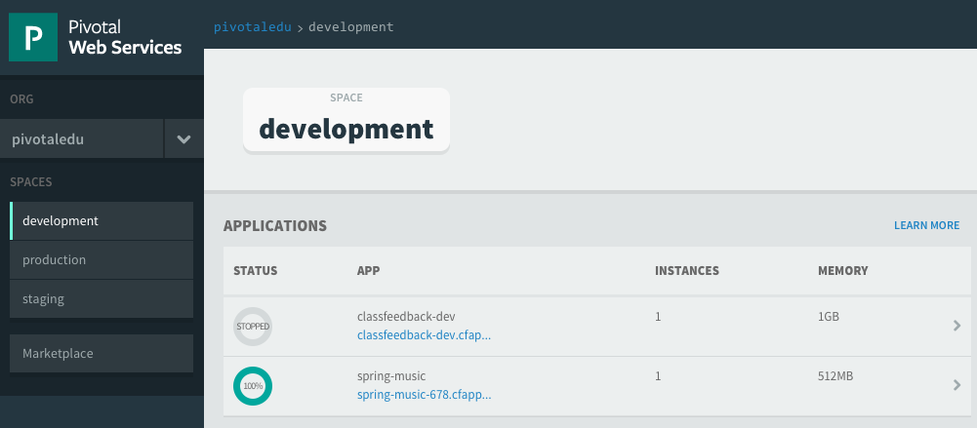
Apps Manager Home Page
At a glance view of all your applications
  Shows current space
Click application name to see its dashboard
(next slide)
YOUR@EMAIL.ADDRESS
Click to select different space
URL of your application

Slide 72
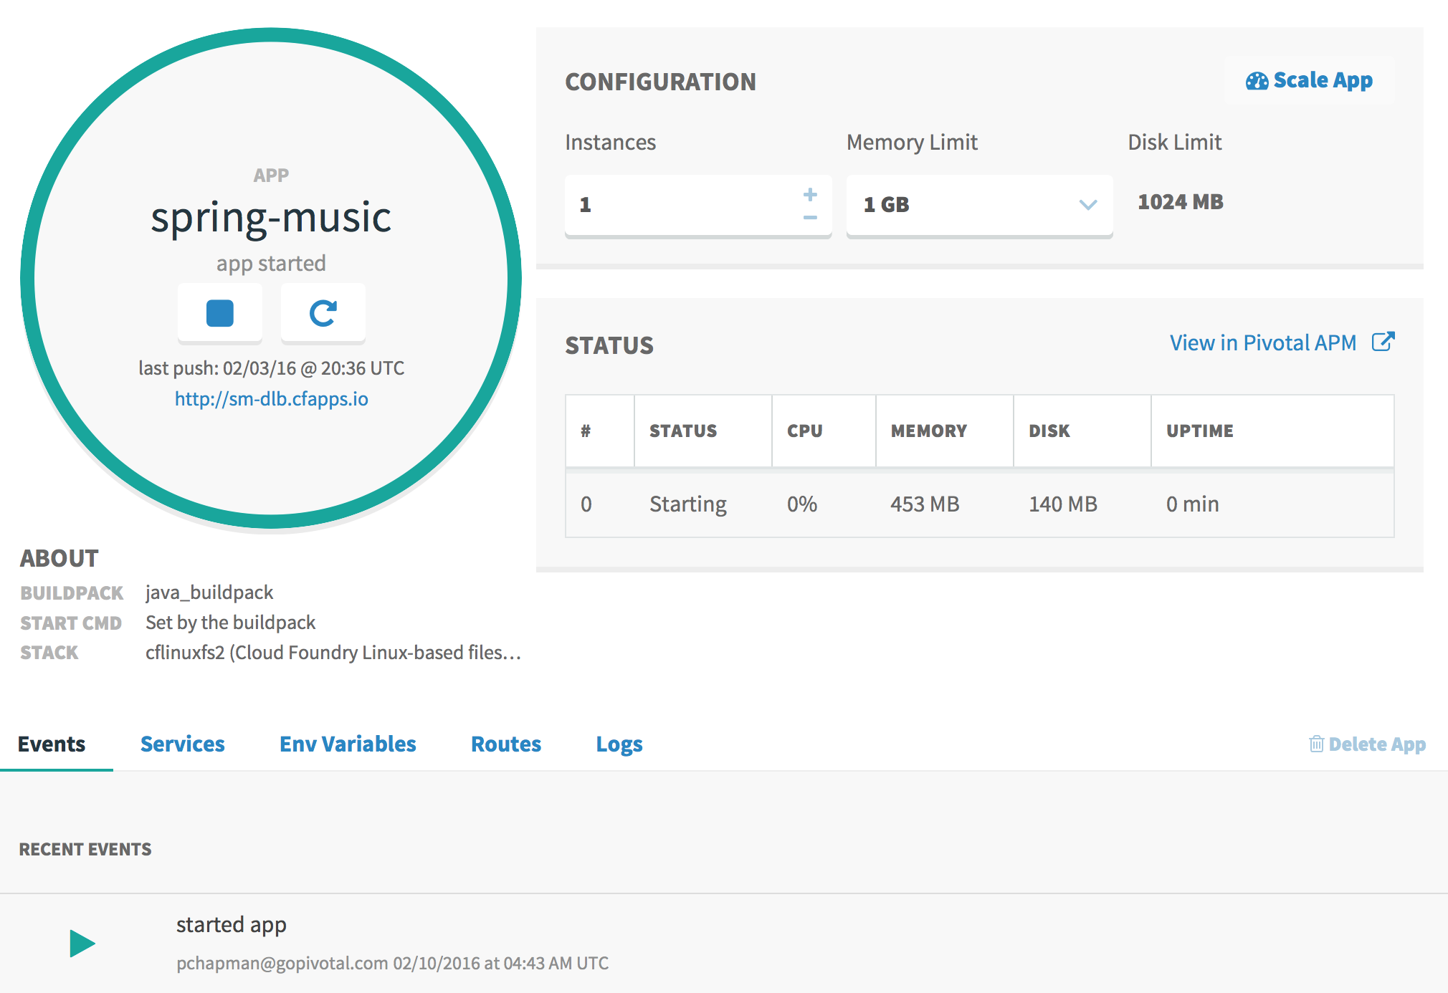
Application state
Application Dashboard
YOUR@EMAIL.ADDRESS
Change instances, memory
Instance Statistics
Application
Information

Slide 73
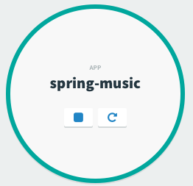
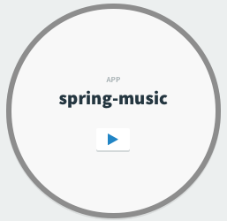
Stopping and Starting
Just click the square to stop
Click play to start
Click to Stop
Click to Start

Slide 74
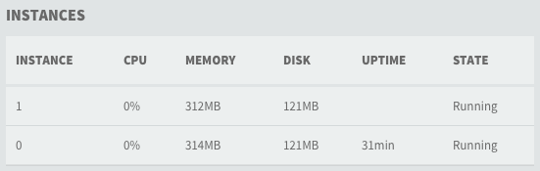
Monitoring Instances
The status panel shows all your instances
  Provides statistics
  Updated live (slight time-lag)

Slide 75
Summary
After completing this lesson, you should have learned:
  How to Deploy an application to CloudFoundry using CLI
  Managing application instances using Apps Manager

Slide 76
Labs
Using Cloud Foundry
• Push existing application
• Binding to services
• Scale an application
• Monitoring

