Slide 1
Polyglot Persistence
Different Databases for Different Services
Use the right tool for the job at hand

Slide 2
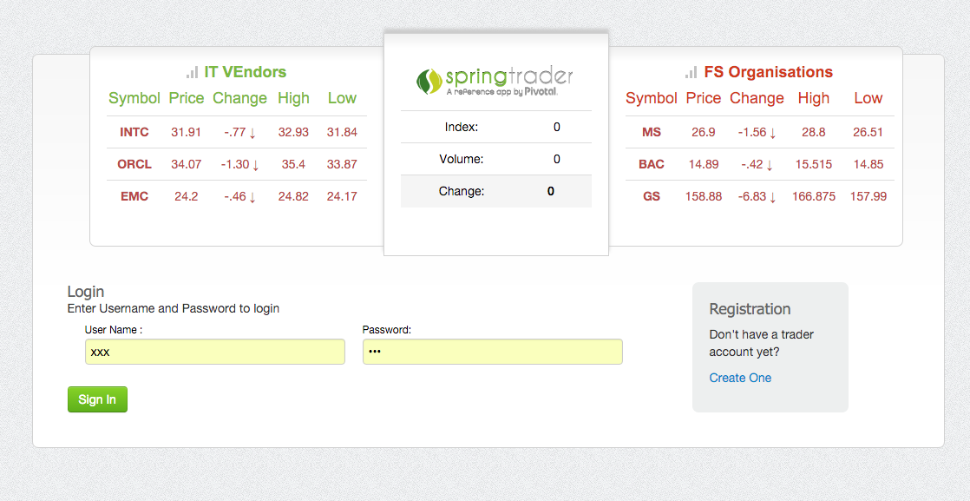
SpringTrader

Slide 3
Imagine 4 Teams
Quotes
Accounts
Portfolio
Web UI

Slide 4
SpringTrader Cloud - High-Level Architecture

Slide 5
In this session
Quotes (MongoDB)
Accounts (MySQL/Postgres)
Portfolio (MySQL/Postgres)
All via Spring Data

Slide 6
Lab
Picking the best persistence

