Slide 1
Cloud Native Architecture - I
Spring Cloud – Config Server, Eureka

Slide 2
Roadmap
Service Configuration: Config Server
Service Registry: Eureka

Slide 3

Spring Cloud Config Service
Overview
Distributed Resolution of Configuration Settings
  REST-WS API Service
Configuration Settings Repository
  Multiple Options
    GIT – Version Control
    Local File System
Security Mechanisms
  Encryption of Settings on Repository
  Decryption on the wire

Slide 4


Spring Cloud Config Service
Distributed Architecture
Config Server
GIT
REST-WS
API
Remote
Repository
GIT
Client App
REST-WS
API
JGit
Repository
Application Context
JGIT
Environment
key = value
Repo
Clone
Config
Resource
key = value
key = value
Local
Repo
key = value
key = value
Native
Repository
key = value
key = value
FS

Slide 5
Spring Cloud Config Server
Starting Server – Embedded & Standalone
Embedded
import org.springframework.cloud.config.server.EnableConfigServer;
@SpringBootApplication
@EnableConfigServer
public class ConfigServer {
public static void main(String[] args) {
SpringApplication.run(ConfigServer.class, args);
}
}
Standalone
java -jar spring-cloud-config-server.jar
cd spring-cloud-config-server
mvn spring-boot:run

Slide 6
Spring Cloud Config Server
Server Dependency
Dependencies
<dependencies>
<dependency>
<groupId>org.springframework.cloud</groupId>
<artifactId>spring-cloud-config-server</artifactId>
</dependency>
</dependencies>

Slide 7
Spring Cloud Config Server
Server Configuration
Custom Configuration
application.properties
server.port: 8888
spring.cloud.config.server.git.uri: file://myproject/config-repo
application.yml
server:
port: 8888
spring:
cloud:
config:
server:
git:
uri: file://myproject/config-repo

Slide 8
Spring Cloud Config Server
Repository File Tree Layout
Common Config
File Tree
application.properties
application.yml
config-repo/
application.properties
application.yml
myapp.properties
myapp.yml
myapp-dev.properties
myapp-prod.properties
myotherapp.properties
Profile Specific
application-dev.properties
application-prod.properties
App Specific Config
FS
Repo
myapp.properties
myapp.yml
.git/
Profile Specific
myapp-dev.properties
myapp-prod.properties

Slide 9

Spring Cloud Config Server
Server REST-WS Endpoints
Source Detailed Responses
GET /{application}/{profiles}
GET /{application}/{profiles}/{label}
Portable Formats
GET /{application}-{profiles}.json
GET /{application}-{profiles}.properties
GET /{application}-{profiles}.yml
GET /{application}-{profiles}.yaml
GET /{label}/{application}-{profiles}.json
GET /{label}/{application}-{profiles}.yml
GET /{label}/{application}-{profiles}.yaml
GET /{label}/{application}-{profiles}.properties

Slide 10
Spring Cloud Config Client
Client Architecture – Review
Client App
GET /myapp/dev
REST-WS
API
Environment
Config
Server
key = value
key = value
key = value
key = value
environment
FS
@Value("${prop}")
Application Beans
Component
FS

Slide 11
Spring Cloud Config Client
Client Dependencies
Dependencies
<dependencies>
<dependency>
<groupId>org.springframework.cloud</groupId>
<artifactId>spring-cloud-starter-config</artifactId>
</dependency>
</dependencies>

Slide 12
Spring Cloud Config Client
Configuration
App Name (& Profiles)
bootstrap.properties
spring.application.name: myapp
spring.application.profiles: dev
bootstrap.yml
spring:
application:
name: myapp
profiles: dev
Custom Server Location
bootstrap.properties
spring.cloud.config.uri: http://myconfigserver.cfapps.io:8888
default port

Slide 13
Spring Cloud Config Client
Sample Client
@SpringBootApplication
@RestController
public class HomeControllerApplication {
@Value("${greeting}")
private String greeting;
@RequestMapping("/")
public String home() {
return "Config Server Says: " + greeting;
}
public static void main(String[] args) {
SpringApplication.run(HomeControllerApplication.class, args);
}
}
curl localhost:8000/
Config Server Says: Hello Cloud!

Slide 14
Roadmap
Service Configuration: Config Server
Service Registry: Eureka

Slide 15


Eureka Server
Distributed Architecture
REST-WS
API
Service A
Instance #0
Eureka
Server
Register
Keep Alive
Service B
Service A
#0: URL+MD
Client
App
Lookup
#1: URL+MD
#2: URL+MD
URL
+MD
Cache
Service A

Slide 16
Eureka Server
Starting Server – Standalone
Start Eureka Standalone Server – w/o Peers
import org.springframework.cloud.netflix.eureka.server.EnableEurekaServer;
@SpringBootApplication
@EnableEurekaServer
public class EurekaServer {
public static void main(String[] args) {
new SpringApplicationBuilder(EurekaServer.class)
.web(true).run(args);
}
}
application.yml
eureka:
client:
registerWithEureka: false
fetchRegistry: false

Slide 17
Eureka Server
Server Dependency
Dependencies
<dependencies>
<dependency>
<groupId>org.springframework.cloud</groupId>
<artifactId>spring-cloud-eureka-server</artifactId>
</dependency>
</dependencies>

Slide 18
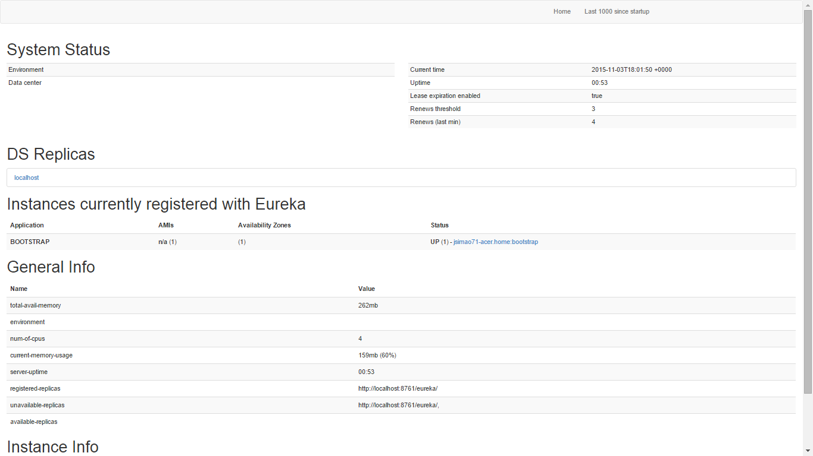
Eureka Server
Dashboard
http://localhost:8761/

Slide 19

Eureka Server
High-Availability Peer Architecture
Eureka
Server
Eureka
Server
Register
Service A
Instance #0
Register
Keep Alive
Service A
Service A
Register
Fetch
Service B
Keep Alive
Keep Alive
Register
Keep Alive
Service B
Instance #0

Slide 20
Eureka Server
Server Configuration – High-Availability Mode
Configuration for Peer Structure (#2 nodes)
application.yml
---
spring:
profiles: peer1
eureka:
instance:
hostname: peer1
client:
serviceUrl:
defaultZone: http://peer2/eureka/
---
spring:
profiles: peer2
eureka:
instance:
hostname: peer2
client:
serviceUrl:
defaultZone: http://peer1/eureka/
Register & Fetch
Eureka
Server
peer1
Eureka
Server
peer2
Register & Fetch

Slide 21
Eureka – Service Registration
Service Registration as Eureka Client
Annotation-Driven Declarative Service Registration
import org.springframework.cloud.netflix.eureka.client.EnableEurekaServer;
@SpringBootApplication
@EnableEurekaClient
public class MyService {
public static void main(String[] args) {
new SpringApplicationBuilder(MyService.class)
.web(true).run(args);
}
}
Eureka Service Property | Boot Property | Default Value
Service ID | ${spring.application.name} | "unknown"
Virtual Host | ${spring.application.name} | "unknown"
Port (non-SSL) | ${server.port} | 8080

Slide 22
Eureka – Service Registration
Eureka Client Configuration
Eureka Single Server Coordinates
Configuration
application.yml
eureka:
client:
serviceUrl:
defaultZone: http://localhost:8761/eureka/
Eureka Registration Configuration (Instance)
eureka:
instance:
appname: myservice
instanceid: myservice:${spring.application.instance_id:${random.value}
default
${spring.cloud.client.hostname}:${spring.application.name}:${server.port}

Slide 23
Eureka – Service Registration
Eureka Client – Advanced Configuration
Port Advertising – Secured & Non-Secured
eureka:
instance:
nonSecurePortEnabled: true
securePortEnabled: false
nonSecurePort: 8080
securePort: 443
Dynamic Health Check Propagation
eureka:
client:
healthcheck:
enabled: true

Slide 24
Eureka – Service Lookup
Resolving Service Names – Spring Cloud API
Service Instance URI Lookup – Spring Cloud Generic API
import org.springframework.cloud.netflix.eureka.client.EnableDiscoveryClient;
import org.springframework.cloud.client.discovery.DiscoveryClient;
@SpringBootApplication
@EnableDiscoveryClient
public class MyClient {
@Autowired
private DiscoveryClient discoveryClient;
public String getServiceUrl() {
List<ServiceInstance> instances =
discoveryClient.getInstances("products");
return (list != null && !list.isEmpty() > 0 ) ?
list.get(0).getUri().getPath() : null;
}
}

Slide 25
Eureka – Service Lookup
Automatic Service Lookup – RestTemplate
RestTemplate w/ Logical Service URI
@Configuration
@EnableDiscoveryClient
public class RemoteProductsManager implements ProductsManager {
private RestTemplate template = new RestTemplate();
public List<Map<?,?>> getProducts() {
return template.getForObject("http://PRODUCTS/catalog", List.class);
}
}

Slide 26
Labs!

