Slide 1
Cloud Native Architecture - I I
Spring Cloud – Ribbon, Hystrix, Feign

Slide 2
Roadmap
Loadbalancing: Ribbon
Circuit Breaker: Hystrix
REST Client: Feign

Slide 3
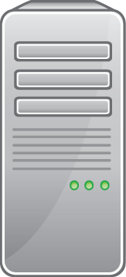

Load-Balancing & Routing
x%
Challenges
Challenge I – Load-Balancing:
  How to distribute load across multiple (functional equivalent) service-instances ?
Challenge II – Routing:
  What simple configuration & programming model to use to distribute work across multiple (functional dissimilar) services ?
Challenge III – Load-Balancing & Routing:
  How to seamlessly integrate Load-Balancing & Routing in a coherent architecture ?

Slide 4
Client-Side Load-Balancing
Generic Distributed Architecture
Service A
Instance #2
Client
App
Service A
Instance #1
Load-
Balancer
Server
List
Service A
Instance #0
Server
List
Configuration Source
/ Service Registry
Register

Slide 5
Load-Balancing w/ Ribbon
Enabling & Service Instance Resolution
Access Load-Balanced Service
import org.springframework.cloud.netflix.ribbon.RibbonClient;
import org.springframework.cloud.client.loadbalancer.LoadBalancerClient;
@RibbonClient
public class AppConfig {
}
@Service
public class RemoteProductsService implements ProductsService {
@Autowired
private LoadBalancerClient loadBalancer;
public static List<Map<?,?>> getProducts() {
ServiceInstance instance = loadBalancer.choose("products");
String uri = String.format("http://%s:%s/product",
instance.getHost(), instance.getPort());
return new RestTemplate().getForObject(uri);
}
}

Slide 6
Load-Balancing w/ Ribbon
Dependencies
Dependencies
<dependencies>
<dependency>
<groupId>org.springframework.cloud</groupId>
<artifactId>spring-cloud-starter-ribbon</artifactId>
</dependency>
</dependencies>

Slide 7
Load-Balancing w/ Ribbon
Eureka Provided Configuration – Architecture
Service A
Instance #2
Client
App
Service A
Instance #1
Ribbon
Server
List
Service A
Instance #0
Server
List
Eureka
Server
Register

Slide 8
Load-Balancing w/ Ribbon
Configuration w/ Eureka Integration
Load-Balancing Eureka Registered
Service Instances
application.yml
eureka:
client:
serviceUrl:
defaultZone: http://localhost:8761/eureka/
Maven Dependencies
<dependency>
<groupId>org.springframework.cloud</groupId>
<artifactId>spring-cloud-starter-ribbon</artifactId>
</dependency>
<dependency>
<groupId>org.springframework.cloud</groupId>
<artifactId>spring-cloud-starter-eureka</artifactId>
</dependency>

Slide 9
Load-Balancing w/ Ribbon
Ribbon Global Client Configuration
Global Ribbon Configuration – Failure-Detection Rule
@Configuration
public class ClientConfig {
@Bean
public IPing ribbonPing(IClientConfig config) {
return new PingUrl();
}
}
Client with Global Configuration
@SpringBootApplication
@RibbonClient(name="products")
public class MyClientApp {
…
}

Slide 10
Load-Balancing w/ Ribbon
Ribbon Client Specific Configuration
Client Specific Configuration – Failure-Detection Rule
@SpringBootApplication
@RibbonClient(name="products",configuration=ProductsClientConfig.class)
public class MyClientApp { … }
public class ProductsClientConfig {
public IPing ribbonPing(IClientConfig config) {
return new PingUrl();
}
}
Multi-Client Combined Configuration
@SpringBootApplication
@RibbonClients({
@RibbonClient(name="products", configuration=ProductsClientConfig.class),
@RibbonClient(name="orders")
})
public class MyClientApp { … }

Slide 11
Load-Balancing w/ Ribbon
Ribbon Client Configuration Strategies
Strategy Beans
Bean Type | Default Implementation | Description
IClientConfig | DefaultClientConfigImpl | General configuration
IPing | NoOpPing | Failure Detection
ServerList<Server> | ConfigurationBasedServerList | Service Instance List
ServerListFilter<Server> | ZonePreferenceServerListFilter | Filtered Server List
IRule | ZoneAvoidanceRule
ILoadBalancer | ZoneAwareLoadBalancer | Service instance selection
Eureka Integration Specific Configuration
Bean Type | Eureka Implementation | Description
IClientConfig | DefaultClientConfigImpl | General configuration
IPing | NIWSDiscoveryPing | Check Status in Eureka Cache
ServerList<Server> | DiscoveryEnabledNIWSServerList | Lookup in Eureka
ServerListFilter<Server> | ZonePreferenceServerListFilter | Prefer Server in Zone (or Domain)
IRule | ZoneAvoidanceRule
ILoadBalancer | ZoneAwareLoadBalancer

Slide 12
Roadmap
Loadbalancing: Ribbon
Circuit Breaker: Hystrix
REST Client: Feign

Slide 13
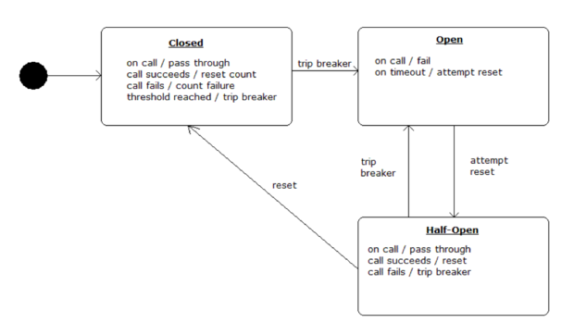
Circuit Breaker Pattern

Slide 14
Circuit Breaker: Hystrix
Latency and fault tolerance
Isolates access to other services
Stops cascading failures
Enables resilience
Circuit breaker pattern
Dashboard

Slide 15
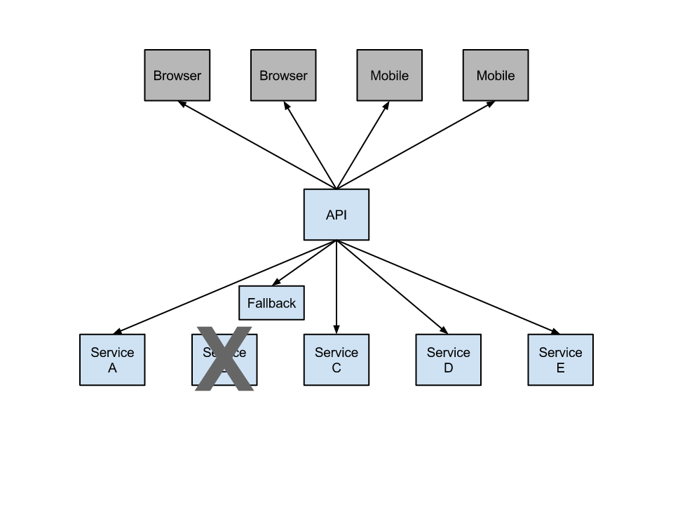
Hystrix Fallback

Slide 16
Declarative Hystrix
Programmatic access is cumbersome
@HystrixCommand to the rescue
@EnableHystrix via starter pom
Wires up spring aop aspect

Slide 17
Fallback: Synchronous
...
@HystrixCommand(fallbackMethod = "getProducerFallback")
public ProducerResponse getValue() {
return restTemplate.getForObject("http://producer", ProducerResponse.class);
}
private ProducerResponse getProducerFallback() {
return new ProducerResponse(42);
}
...

Slide 18
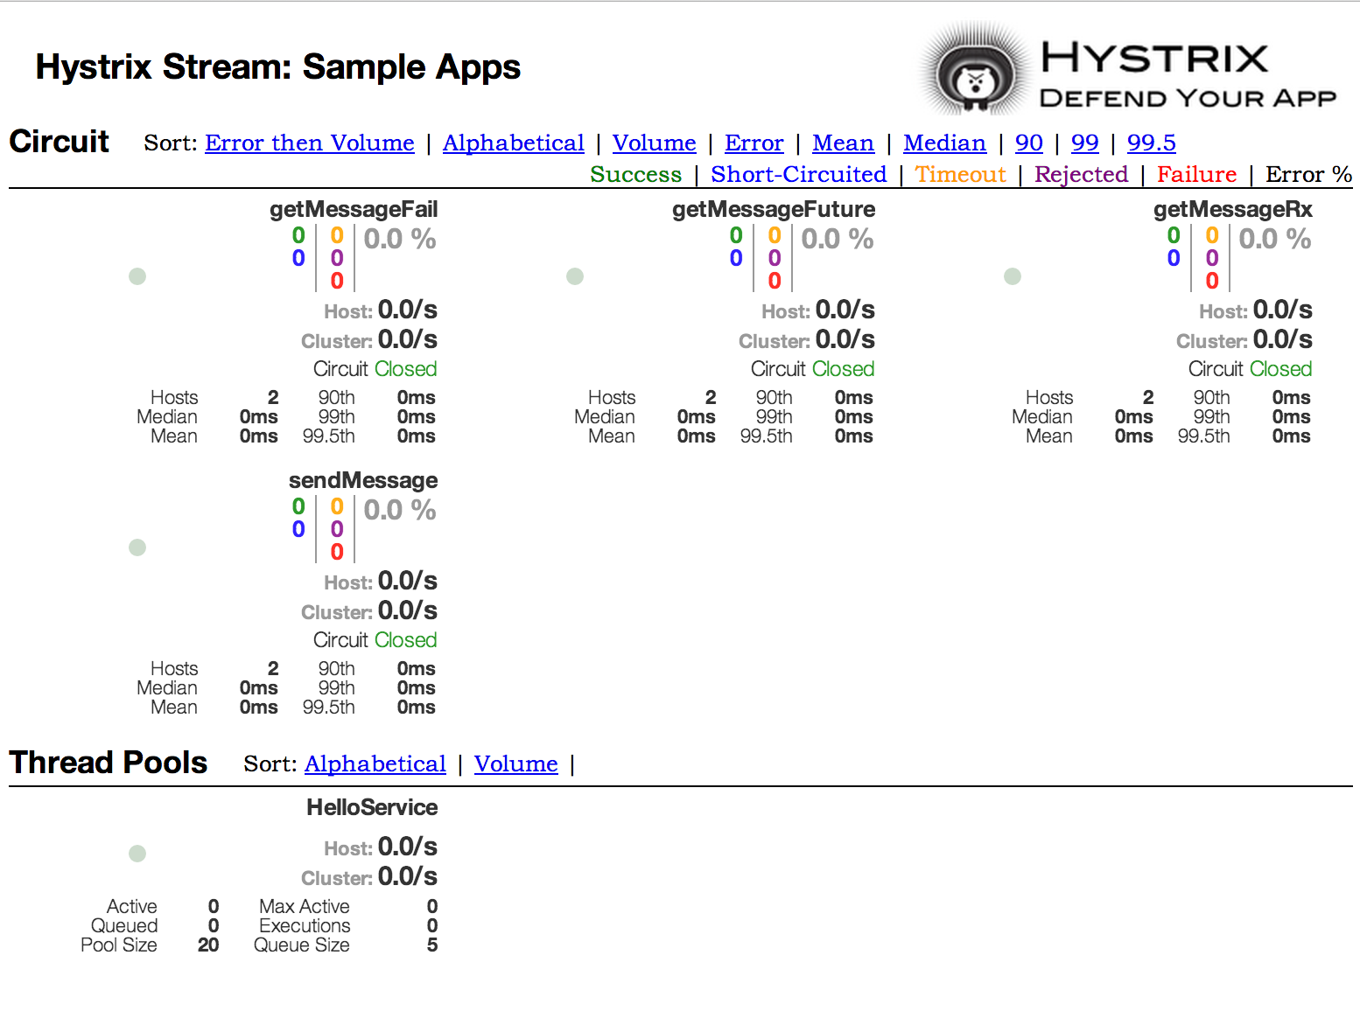
Hystrix Dashboard

Slide 19
Roadmap
Loadbalancing: Ribbon
Circuit Breaker: Hystrix
REST Client: Feign

Slide 20
Declarative REST-WS with Feign
REST-WS Defined as Java Interface
Ribbon Client Binding & Spring MVC Annotated Interface
@FeignClient("products")
public interface ProductService {
@RequestMapping(value="/product", method=RequestMethod.GET)
List<Map> getProducts();
@RequestMapping(value="/product", method=RequestMethod.POST)
void newProduct(Map<String,Object> product);
}
Hard-Coded Static Server URL
@FeignClient(url="http://products.myorg.org")
public interface MyService {
…
}

Slide 21
Declarative REST-WS with Feign
REST-WS Defined as Java Interface
Enable Feign Proxy Creation
@SpringBootApplication
@EnableFeignClients
public class MyClientApp {
…
}
Proxy Injection & Service Invocation
@Controller
public class ProductController {
@Autowired
private ProductService service;
@RequestMapping(value="/catalog")
public static void List<Map> listProducts() {
return service.getProducts();
}
}
PROXY

Slide 22
Labs!

