Slide 1
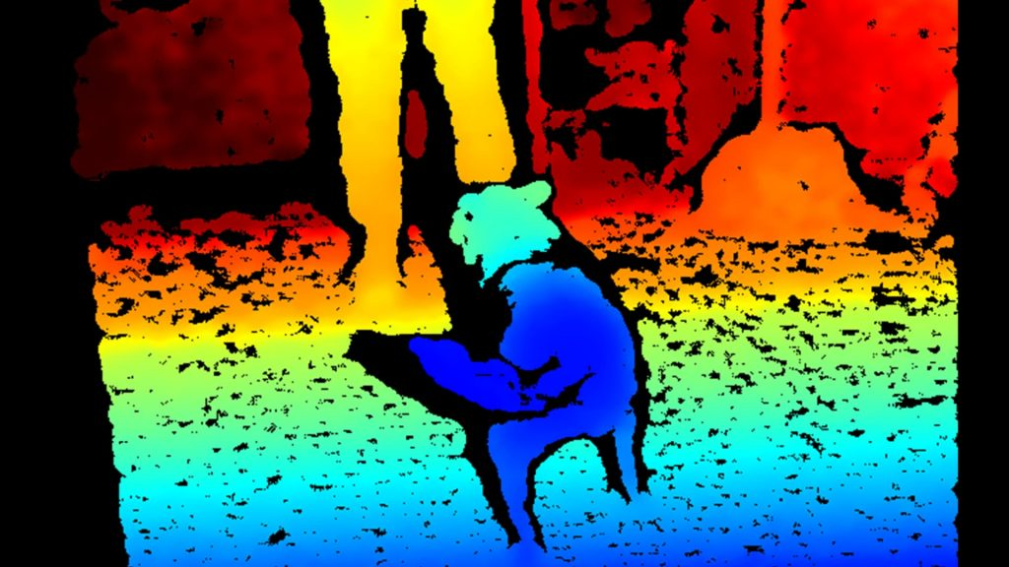
Stereo

Slide 2
References
http://szeliski.org/Book/
http://www.cs.cornell.edu/courses/cs5670/2019sp/lectures/lectures.html
http://www.cs.cmu.edu/~16385/

Slide 3

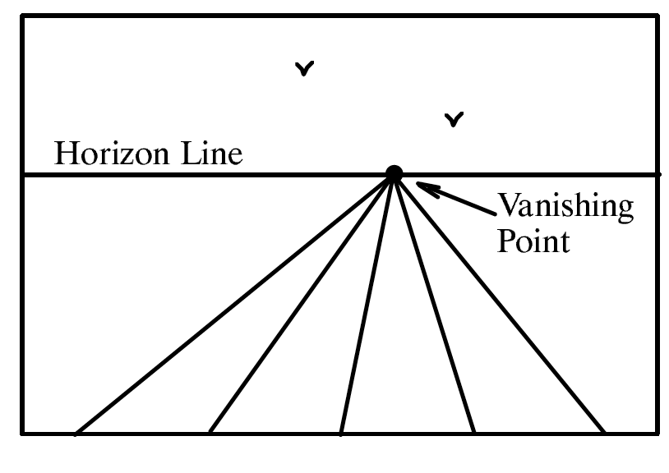
Vanishing points

Slide 4
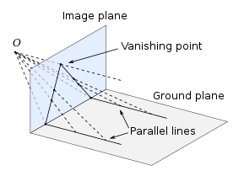
Vanishing points
A vanishing point is a point on the image plane of a perspective drawing where the two-dimensional perspective projections (or drawings) of mutually parallel lines in three-dimensional space appear to converge. [Wikipedia]
image plane
vanishing point
camera
center
line on ground plane

Slide 5
Vanishing points
Properties
Any two parallel lines (in 3D) have the same vanishing point v.
The ray from C through v is parallel to the lines.
An image may have more than one vanishing point.
Sometimes vanishing points can be out of FOV of the image.
image plane
vanishing point V
camera
center
C
line on ground plane
line on ground plane
Notes:
How to determine which lines in the scene vanish at a given pixel?

Slide 6

One-point perspective
A drawing/ image has one-point perspective when it contains only one vanishing point.

Slide 7
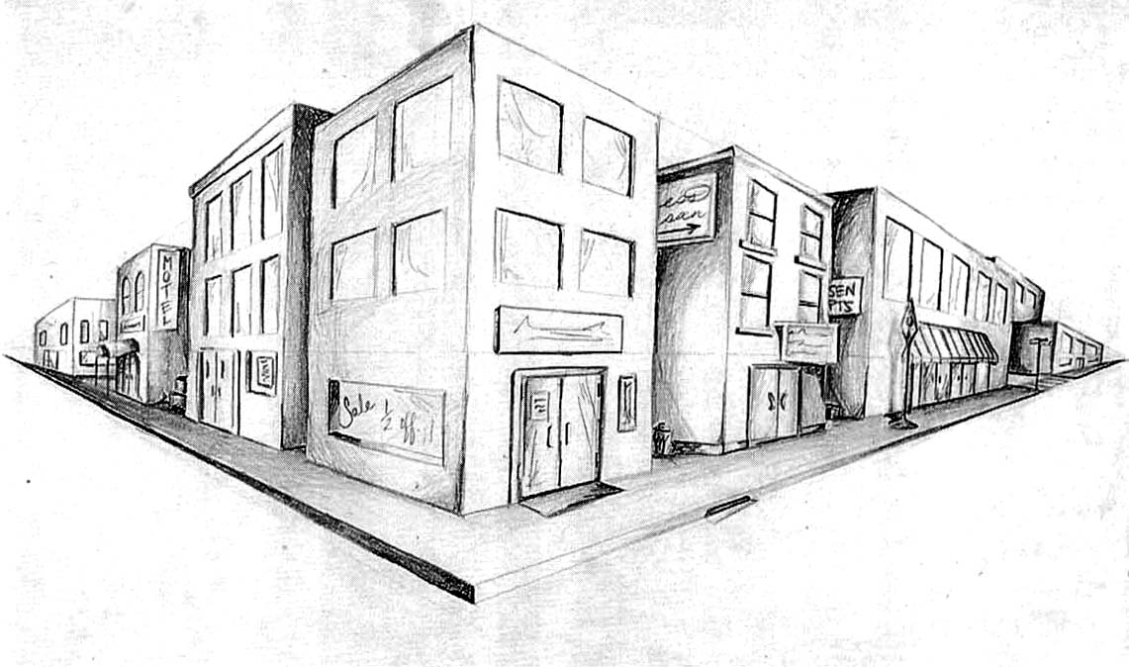
Two-point perspective
v_{y}
v_{x}

Slide 8

Two-point perspective

Slide 9
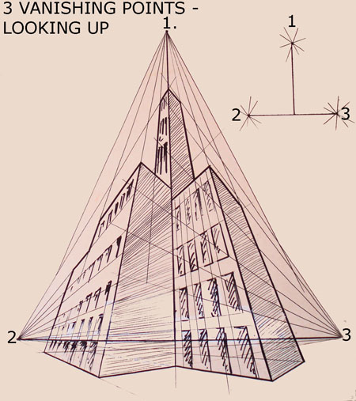
Three-point perspective

Slide 10
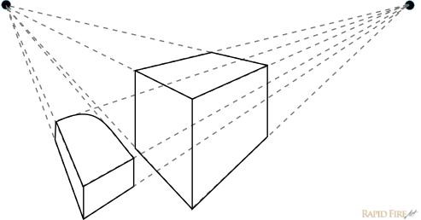
Vanishing points
Sometimes vanishing points can be out of FOV of the image.

Slide 11
Vanishing lines
v₁
v₂
Any set of parallel lines on the plane define a vanishing point.
The union of all these vanishing points is the horizon line
also called vanishing line
Note that different planes (can) define different vanishing lines

Slide 12
Vanishing lines
Three different vanishing lines (and points…).

