Slide 1
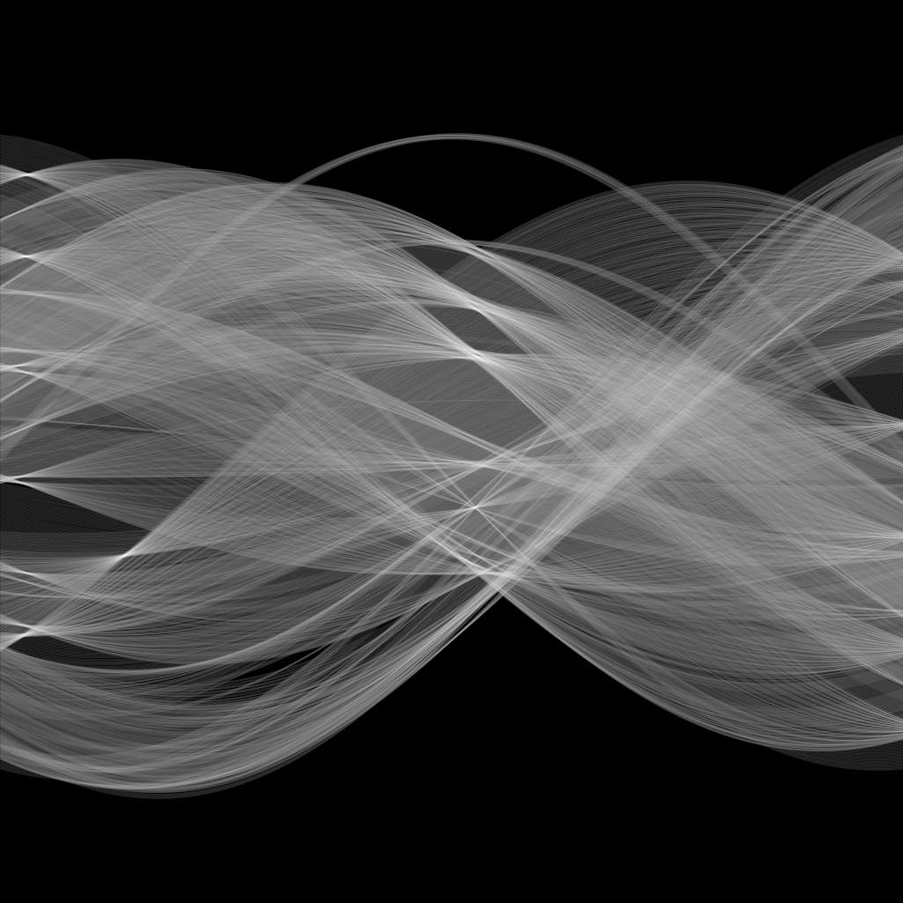

Hough transform
Yoni Chechik
www.AIisMath.com

Slide 2
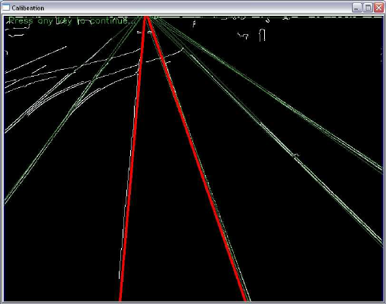
Problem 3: fitting multiple lines
(This class is a follow-up of the last curve fitting class).
What if the initial data has multiple lines needed to detect. What can we do?

Slide 3

TOC
Hough transform
$(m,b)$ parameter space
$(ρ,θ)$ parameter space

Slide 4

$(m,b)$ Parameter space
Line function: $y=mx+b$
Usually we are given $(m,b)$ constants, and the variables are $(x,y)$.
In a regression problem we are given $\left(x,y\right)$, and the unknowns we wish to find are the best fit for $(m,b)$.
Let’s look at $(m,b)$ as our variables.

Slide 5

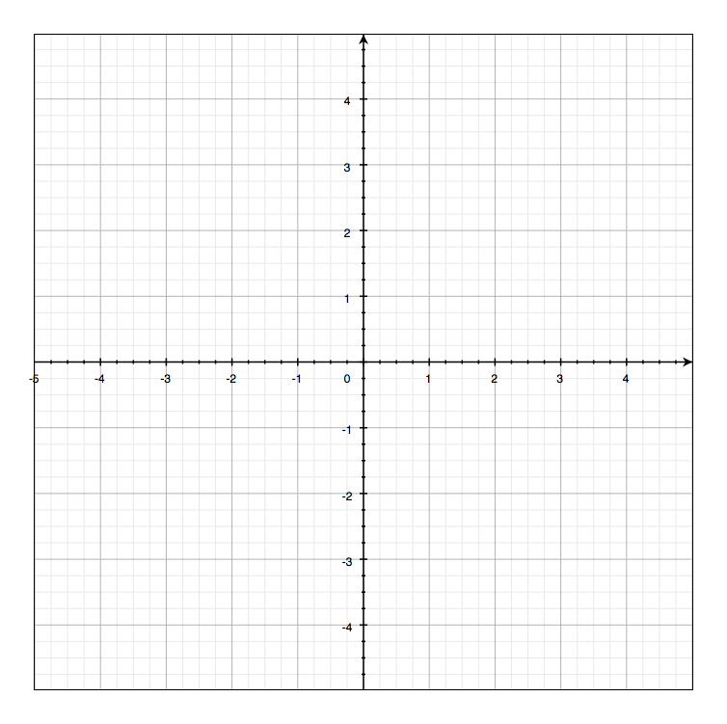
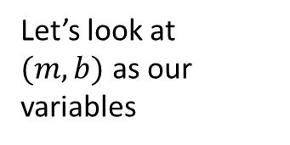
$(m,b)$ Parameter space
variables
parameters
Let’s look at $(m,b)$ as our variables
Image space
Plots are from: http://www.cs.cmu.edu/~16385/

Slide 6


$(m,b)$ Parameter space
variables
variables
parameters
parameters
a line becomes a point
Image space
Parameter space

Slide 7
$(m,b)$ Parameter space
variables
parameters
a point becomes a ?
Image space

Slide 8
$(m,b)$ Parameter space
variables
variables
parameters
parameters
a point becomes a ?
Image space
Parameter space

Slide 9
$(m,b)$ Parameter space
variables
variables
parameters
parameters
a point becomes a ?
Image space
Parameter space

Slide 10
$(m,b)$ Parameter space
variables
variables
parameters
parameters
a point becomes a ?
Image space
Parameter space

Slide 11
$(m,b)$ Parameter space
variables
variables
parameters
parameters
a point becomes a line
Image space
Parameter space

Slide 12

$(m,b)$ Parameter space
variables
variables
parameters
parameters
two points become
?
Image space
Parameter space

Slide 13
$(m,b)$ Parameter space
variables
variables
parameters
parameters
two points become
Two lines
Image space
Parameter space

Slide 14

$(m,b)$ Parameter space
variables
variables
parameters
parameters
three points become
?
Image space
Parameter space

Slide 15
$(m,b)$ Parameter space
variables
variables
parameters
parameters
three points become
Three lines
Image space
Parameter space

Slide 16

$(m,b)$ Parameter space
variables
variables
parameters
parameters
four points become
?
Image space
Parameter space

Slide 17
$(m,b)$ Parameter space
variables
variables
parameters
parameters
four points become
Four lines
Image space
Parameter space

Slide 18
Parameter space- what for?
How can we find lines in dataset using the parameter space?

Slide 19
Parameter space- what for?
How can we find lines in dataset using the parameter space?
1. Quantize the output parameter space to user defined bins- we will call this table the accumulator table.
Image space
Parameter space

Slide 20
Parameter space- what for?
How can we find lines in dataset using the parameter space?
2. For each point in image space- find corresponding line in parameter space and increment +1 the intersecting bins.
1
1
1
1
1
1
1
1
Image space
Parameter space

Slide 21
Parameter space- what for?
How can we find lines in dataset using the parameter space?
2. For each point in image space- find corresponding line in parameter space and increment +1 the intersecting bins.
1
1
1
1
1
1
1
1
2
1
1
1
1
1
1
1
Image space
Parameter space

Slide 22
Parameter space- what for?
How can we find lines in dataset using the parameter space?
2. For each point in image space- find corresponding line in parameter space and increment +1 the intersecting bins.
1
1
1
1
1
1
1
1
1
1
2
1
3
1
2
1
1
1
1
1
1
1
1
1
1
Image space
Parameter space

Slide 23
Parameter space- what for?
How can we find lines in dataset using the parameter space?
2. For each point in image space- find corresponding line in parameter space and increment +1 the intersecting bins.
1
1
1
1
1
1
1
1
1
1
1
1
1
2
1
1
3
2
2
1
1
1
1
1
1
1
2
1
1
1
1
Image space
Parameter space

Slide 24
Parameter space- what for?
How can we find lines in dataset using the parameter space?
3. Threshold the accumulator table result by some TH and get the corresponding line parameters.
1
1
1
1
1
1
1
1
1
1
1
1
1
2
1
1
3
3
2
2
1
1
1
1
1
1
1
2
1
1
1
1
Image space
Parameter space

Slide 25
Hough transform
Build accumulator table.
For each point in image space:
find corresponding line in parameter space and increment +1 the intersecting bins.
Threshold the accumulator table result by some TH and get the corresponding line parameters.

Slide 26
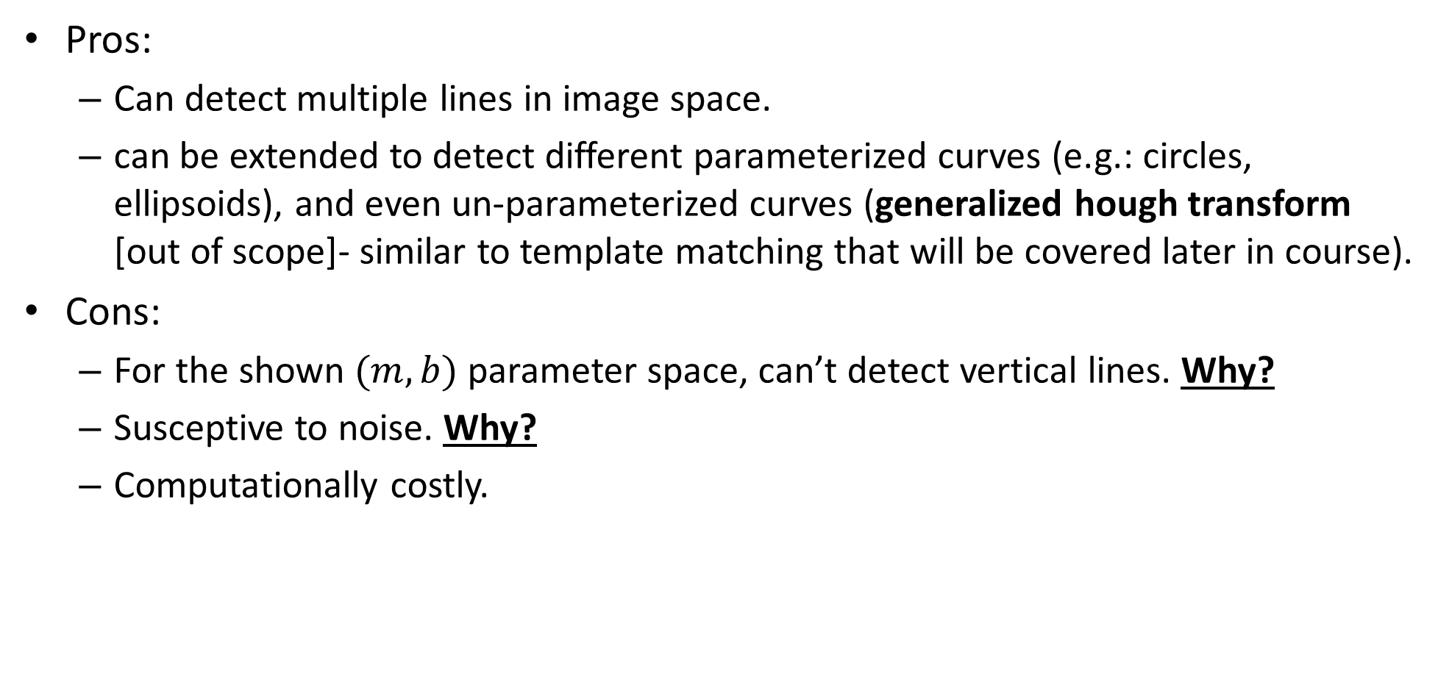
Hough transform- pros & cons
Pros:
Can detect multiple lines in image space.
can be extended to detect different parameterized curves (e.g.: circles, ellipsoids), and even un-parameterized curves (generalized hough transform [out of scope]- similar to template matching that will be covered later in course).
Cons:
For the shown $(m,b)$ parameter space, can’t detect vertical lines. Why?
Susceptive to noise. Why?
Computationally costly.

Slide 27
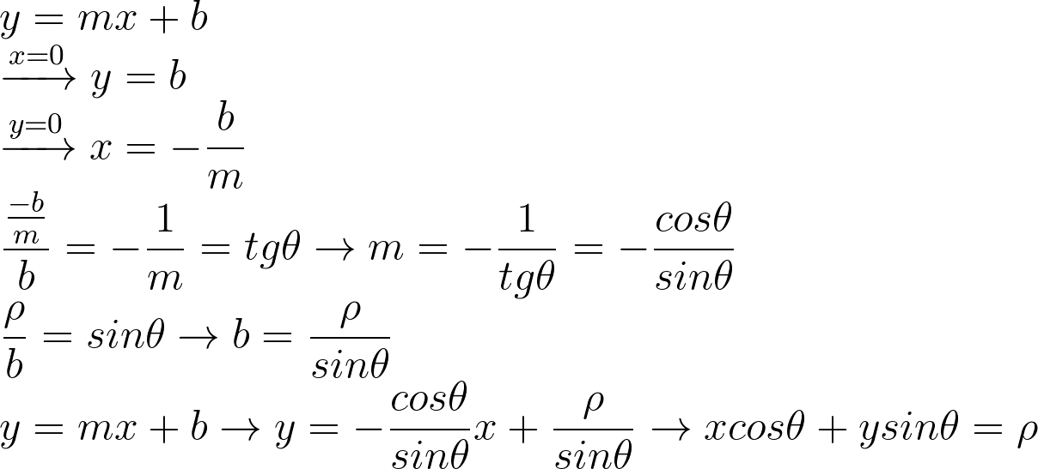

Problem 1: vertical line detection
Vertical (or near vertical) lines have a big slope: $m→∞$. This causes the accumulator table to be very big in $m$ direction.
A solution is to give a different parameterization to lines:
Notes:
\\
y=mx+b\\
\xrightarrow{x=0}y=b\\
\xrightarrow{y=0}x=-\frac{b}{m}\\
\frac{\frac{-b}{m}}{b}=-\frac{1}{m}=tg\theta\rightarrow m=-\frac{1}{tg\theta}=-\frac{cos\theta}{sin\theta} \\
\frac{\rho}{b}=sin\theta\rightarrow b=\frac{\rho}{sin\theta}
\\
y=mx+b\rightarrow y=-\frac{cos\theta}{sin\theta}x+\frac{\rho}{sin\theta}
\rightarrow xcos\theta +ysin\theta = \rho

Slide 28
Problem 1: vertical line detection
Vertical (or near vertical) lines have a big slope: $m→∞$. This causes the accumulator table to be very big in $m$ direction.
A solution is to give a different parameterization to lines:
Notes:
\\
y=mx+b\\
\xrightarrow{x=0}y=b\\
\xrightarrow{y=0}x=-\frac{b}{m}\\
\frac{\frac{-b}{m}}{b}=-\frac{1}{m}=tg\theta\rightarrow m=-\frac{1}{tg\theta}=-\frac{cos\theta}{sin\theta} \\
\frac{\rho}{b}=sin\theta\rightarrow b=\frac{\rho}{sin\theta}
\\
y=mx+b\rightarrow y=-\frac{cos\theta}{sin\theta}x+\frac{\rho}{sin\theta}
\rightarrow xcos\theta +ysin\theta = \rho

Slide 29
Problem 1: vertical line detection
Vertical (or near vertical) lines have a big slope: $m→∞$. This causes the accumulator table to be very big in $m$ direction.
A solution is to give a different parameterization to lines:
Notes:
\\
y=mx+b\\
\xrightarrow{x=0}y=b\\
\xrightarrow{y=0}x=-\frac{b}{m}\\
\frac{\frac{-b}{m}}{b}=-\frac{1}{m}=tg\theta\rightarrow m=-\frac{1}{tg\theta}=-\frac{cos\theta}{sin\theta} \\
\frac{\rho}{b}=sin\theta\rightarrow b=\frac{\rho}{sin\theta}
\\
y=mx+b\rightarrow y=-\frac{cos\theta}{sin\theta}x+\frac{\rho}{sin\theta}
\rightarrow xcos\theta +ysin\theta = \rho

Slide 30
Problem 1: vertical line detection
Vertical (or near vertical) lines have a big slope: $m→∞$. This causes the accumulator table to be very big in $m$ direction.
A solution is to give a different parameterization to lines:
Notes:
\\
y=mx+b\\
\xrightarrow{x=0}y=b\\
\xrightarrow{y=0}x=-\frac{b}{m}\\
\frac{\frac{-b}{m}}{b}=-\frac{1}{m}=tg\theta\rightarrow m=-\frac{1}{tg\theta}=-\frac{cos\theta}{sin\theta} \\
\frac{\rho}{b}=sin\theta\rightarrow b=\frac{\rho}{sin\theta}
\\
y=mx+b\rightarrow y=-\frac{cos\theta}{sin\theta}x+\frac{\rho}{sin\theta}
\rightarrow xcos\theta +ysin\theta = \rho

Slide 31
Problem 1: vertical line detection
Vertical (or near vertical) lines have a big slope: $m→∞$. This causes the accumulator table to be very big in $m$ direction.
A solution is to give a different parameterization to lines:
Notes:
\\
y=mx+b\\
\xrightarrow{x=0}y=b\\
\xrightarrow{y=0}x=-\frac{b}{m}\\
\frac{\frac{-b}{m}}{b}=-\frac{1}{m}=tg\theta\rightarrow m=-\frac{1}{tg\theta}=-\frac{cos\theta}{sin\theta} \\
\frac{\rho}{b}=sin\theta\rightarrow b=\frac{\rho}{sin\theta}
\\
y=mx+b\rightarrow y=-\frac{cos\theta}{sin\theta}x+\frac{\rho}{sin\theta}
\rightarrow xcos\theta +ysin\theta = \rho

Slide 32
Problem 1: vertical line detection
Vertical (or near vertical) lines have a big slope: $m→∞$. This causes the accumulator table to be very big in $m$ direction.
A solution is to give a different parameterization to lines:
Notes:
\\
y=mx+b\\
\xrightarrow{x=0}y=b\\
\xrightarrow{y=0}x=-\frac{b}{m}\\
\frac{\frac{-b}{m}}{b}=-\frac{1}{m}=tg\theta\rightarrow m=-\frac{1}{tg\theta}=-\frac{cos\theta}{sin\theta} \\
\frac{\rho}{b}=sin\theta\rightarrow b=\frac{\rho}{sin\theta}
\\
y=mx+b\rightarrow y=-\frac{cos\theta}{sin\theta}x+\frac{\rho}{sin\theta}
\rightarrow xcos\theta +ysin\theta = \rho

Slide 33
Problem 1: vertical line detection
Vertical (or near vertical) lines have a big slope: $m→∞$. This causes the accumulator table to be very big in $m$ direction.
A solution is to give a different parameterization to lines:
Notes:
\\
y=mx+b\\
\xrightarrow{x=0}y=b\\
\xrightarrow{y=0}x=-\frac{b}{m}\\
\frac{\frac{-b}{m}}{b}=-\frac{1}{m}=tg\theta\rightarrow m=-\frac{1}{tg\theta}=-\frac{cos\theta}{sin\theta} \\
\frac{\rho}{b}=sin\theta\rightarrow b=\frac{\rho}{sin\theta}
\\
y=mx+b\rightarrow y=-\frac{cos\theta}{sin\theta}x+\frac{\rho}{sin\theta}
\rightarrow xcos\theta +ysin\theta = \rho

Slide 34
Problem 1: vertical line detection
Vertical (or near vertical) lines have a big slope: $m→∞$. This causes the accumulator table to be very big in $m$ direction.
A solution is to give a different parameterization to lines:
Notes:
\\
y=mx+b\\
\xrightarrow{x=0}y=b\\
\xrightarrow{y=0}x=-\frac{b}{m}\\
\frac{\frac{-b}{m}}{b}=-\frac{1}{m}=tg\theta\rightarrow m=-\frac{1}{tg\theta}=-\frac{cos\theta}{sin\theta} \\
\frac{\rho}{b}=sin\theta\rightarrow b=\frac{\rho}{sin\theta}
\\
y=mx+b\rightarrow y=-\frac{cos\theta}{sin\theta}x+\frac{\rho}{sin\theta}
\rightarrow xcos\theta +ysin\theta = \rho

Slide 35
Problem 1: vertical line detection
Vertical (or near vertical) lines have a big slope: $m→∞$. This causes the accumulator table to be very big in $m$ direction.
A solution is to give a different parameterization to lines:
Notes:
\\
y=mx+b\\
\xrightarrow{x=0}y=b\\
\xrightarrow{y=0}x=-\frac{b}{m}\\
\frac{\frac{-b}{m}}{b}=-\frac{1}{m}=tg\theta\rightarrow m=-\frac{1}{tg\theta}=-\frac{cos\theta}{sin\theta} \\
\frac{\rho}{b}=sin\theta\rightarrow b=\frac{\rho}{sin\theta}
\\
y=mx+b\rightarrow y=-\frac{cos\theta}{sin\theta}x+\frac{\rho}{sin\theta}
\rightarrow xcos\theta +ysin\theta = \rho

Slide 36

TOC
Linear least squares
Total least squares
Least squares
RANSAC
Hough transform
$(m,b)$ parameter space
$(ρ,θ)$ parameter space

Slide 37

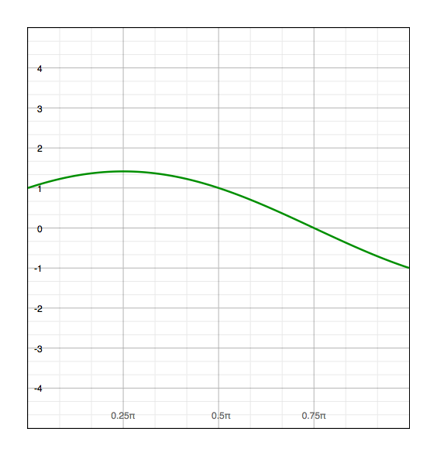
$(ρ,θ)$ parameter space
variables
parameters
parameters
variables
a point becomes a wave
Image space
Parameter space

Slide 38
$(ρ,θ)$ parameter space
variables
parameters
a line
becomes a point
Image space
Parameter space

Slide 39
$(ρ,θ)$ parameter space
variables
parameters
a line
becomes a point
Image space
Parameter space

Slide 40
$(ρ,θ)$ parameter space
variables
parameters
a line
becomes a point
Image space
Parameter space

Slide 41
$(ρ,θ)$ parameter space
variables
parameters
a line
becomes a point
Image space
Parameter space

Slide 42
$(ρ,θ)$ parameter space
variables
parameters
a line
becomes a point
Image space
Parameter space

Slide 43

$(ρ,θ)$ parameter space
variables
parameters
$$ρ=−1$$
a line
becomes a point
Image space
Parameter space

Slide 44

Notes on $(ρ,θ)$ parameter space
We only care about $0≤θ<π$, otherwise it’s symmetric.
As we so earlier, for some $θ→sign\left(ρ\right)=−1$. this is acceptable since the derivation earlier was right only for the first quadrant.

Slide 45
$(ρ,θ)$ parameter space
variables
parameters
a point becomes a wave
Image space
Parameter space

Slide 46
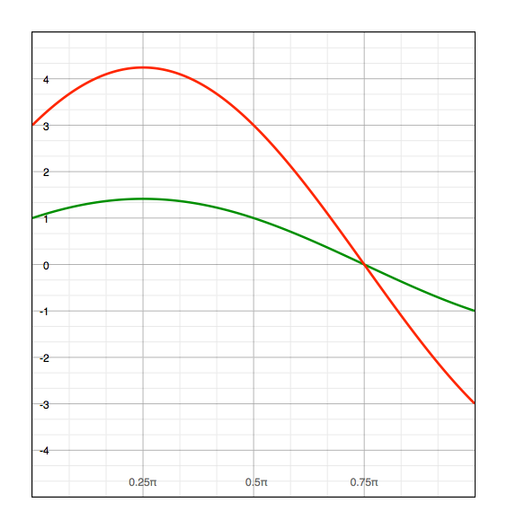
$(ρ,θ)$ parameter space
variables
parameters
Image space
Parameter space

Slide 47
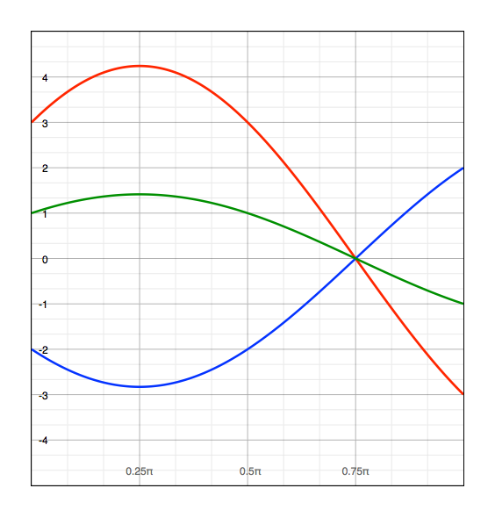
$(ρ,θ)$ parameter space
variables
parameters
Image space
Parameter space

Slide 48
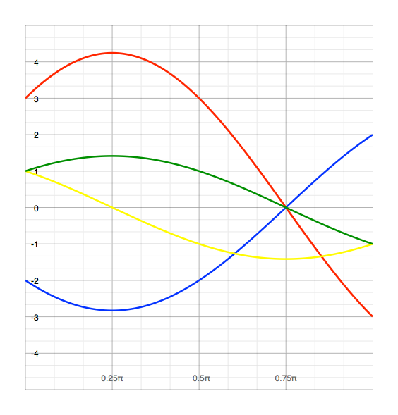
$(ρ,θ)$ parameter space
variables
parameters
Image space
Parameter space

Slide 49
Hough transform algorithm stays the same!
Build accumulator table.
For each point in image space:
find corresponding line in parameter space and increment +1 the intersecting bins.
Threshold the accumulator table result by some TH and get the corresponding line parameters.

Slide 50
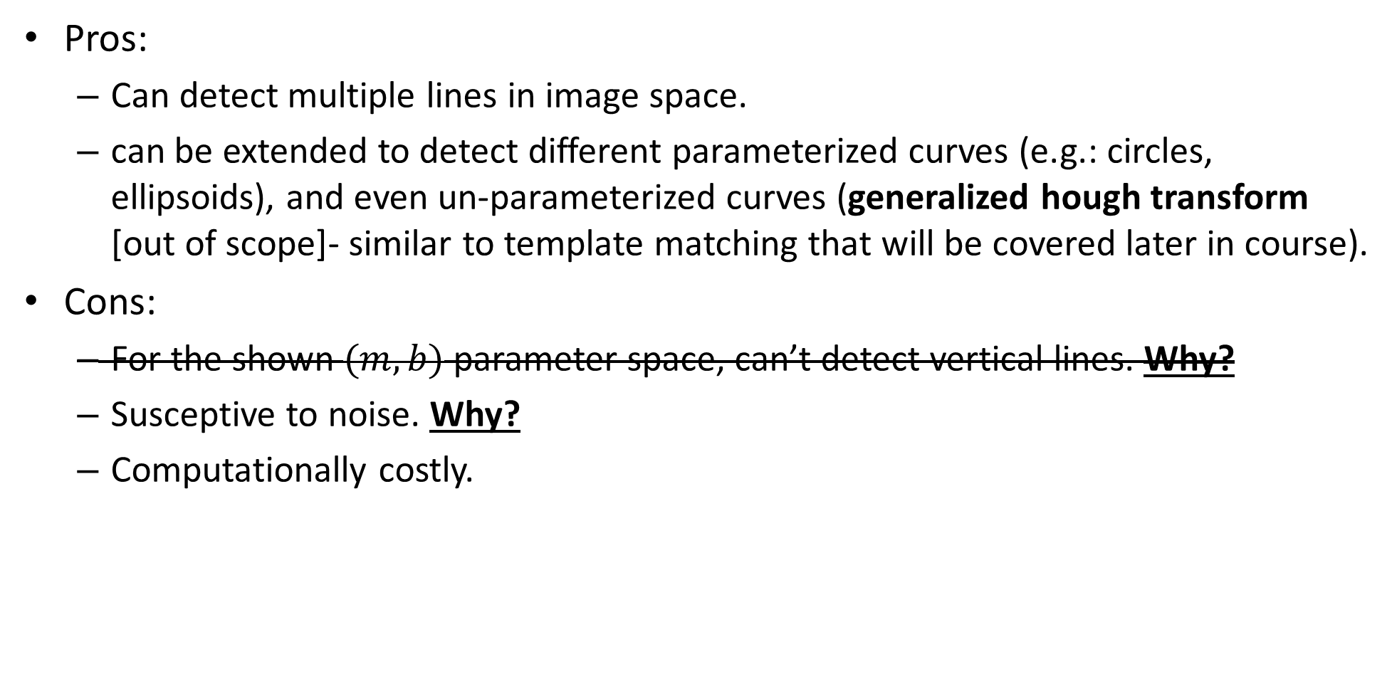
Hough transform- pros & cons
Pros:
Can detect multiple lines in image space.
can be extended to detect different parameterized curves (e.g.: circles, ellipsoids), and even un-parameterized curves (generalized hough transform [out of scope]- similar to template matching that will be covered later in course).
Cons:
For the shown $(m,b)$ parameter space, can’t detect vertical lines. Why?
Susceptive to noise. Why?
Computationally costly.

Slide 51

Hough transform noise
In case that the discovered edge is noisy, the binning process in the accumulation matrix can be problematic.
This is a known problem of Hough transform… some ways to get better results is to try:
Different bin size (different step size for $R \& θ$).
Smooth the accumulation matrix before thresholding.

