Slide 1
Introduction to Statistics and Data Analysis with R
Tel-Aviv University, course#0560.1823
Adi Sarid
2019

Slide 2
Lecturer – Adi Sarid TA – Afek Adler
Professional: Market Research, Data Scientist, Operations Research, Educator
Academia: Mathematics, Statistics and Operations Research (Bsc, MA, Phd-in-process)
Software: R, Python

Slide 3
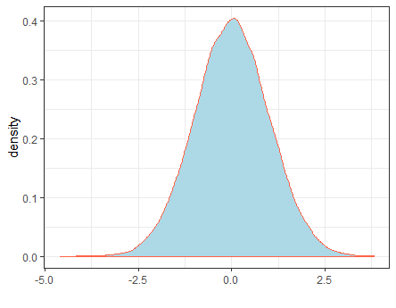


Course goals
Statistics
Learn fundamental terms in statistics and in process data analysis
R
(Start to) acquire R skills
Learn how R can be used for preparing and analyzing data
Enjoy!
Data analysis is interesting and fun, and so is R

Slide 4
What will we learn?
Overview of a research – from design to insights
Statistical inference and parameter estimation
Hypothesis testing
Analysis of variance (ANOVA)
Experiment design
Linear regression
Logistic regression
More material if time permits

Slide 5

Technicalities
We have a github repository
https://github.com/adisarid/intro_statistics_R
We will be uploading the materials to moodle as well
Moodle will be used for exercise submission and grading
Please make sure you have:
Latest R (3.6.1) – https://www.r-project.org/
Rstudio IDE (https://www.rstudio.com/products/rstudio/download/)
Books – see in the GitHub repository

Slide 6
The foundations
(Of a research project)

Slide 7
A “quiz”, in pairs:
Rank the following activities starting from the one which takes up most of your time to the one which takes up the least:
Gathering and preparing data
Visualizing
Finding insights
Building models
Putting things into production
Other activities

Slide 8
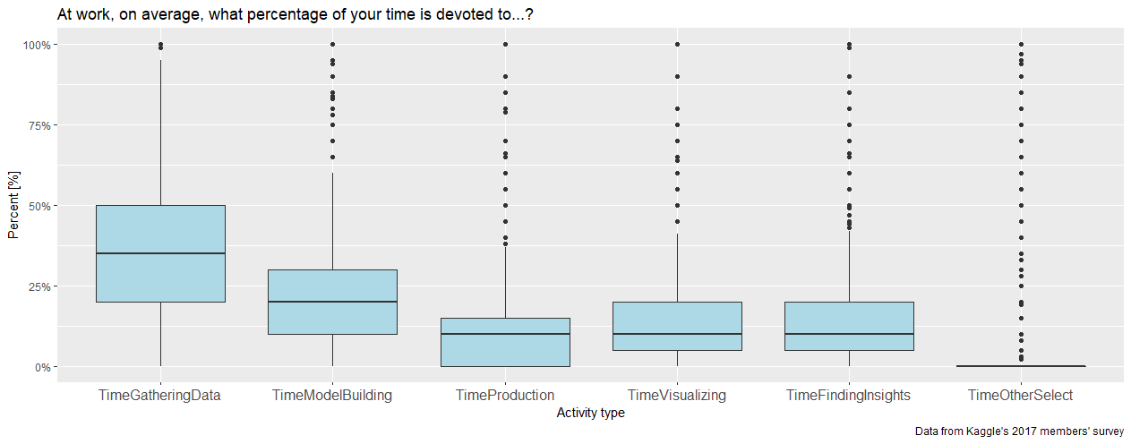
Here’s what 45,000+ kaggle members thought (and what is a “boxplot”)

Slide 9
Arrange this into a workflow model:
Communicate
Import
Model
Tidy
Transform
Visualize
* R for Data Science, chapter 1

Slide 10
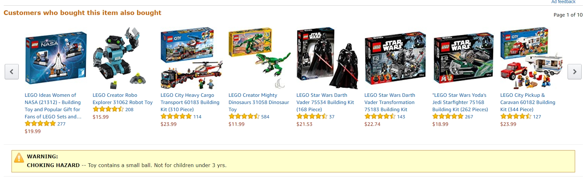
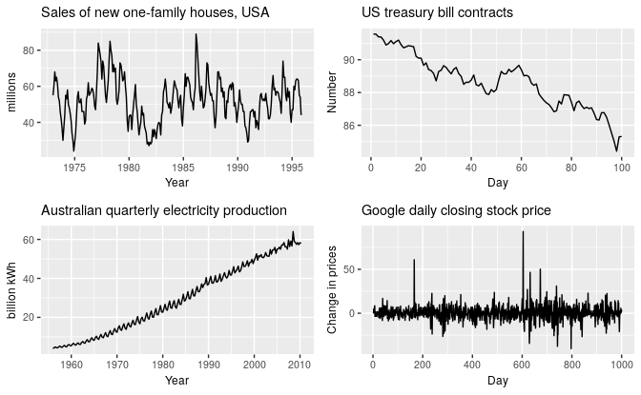
Examples for Data Science Problems
Time series analysis:
Recommendation systems:
(example from Amazon)
Commerce:
Fraud detection, identify and prevent churn
Healthcare (mortality analysis): https://colorectalcancermortalityprediction.shinyapps.io/CRCShiny/
Rob J. Hyndman and George Athansasopoulos, Forecasting: Principles and Practice 2nd edition,
OTexts, 2018. Available Online https://otexts.org/fpp2/ (fetched Sep 2018)
Dashboards (reporting and communicating analysis): https://sarid.shinyapps.io/Sarid-Sample-Report/

Slide 11




What is R?
A free software environment for statistical computing and graphics (r-project.org)
An analogy I adopted (from Garret Grolemund)
C++

Slide 12

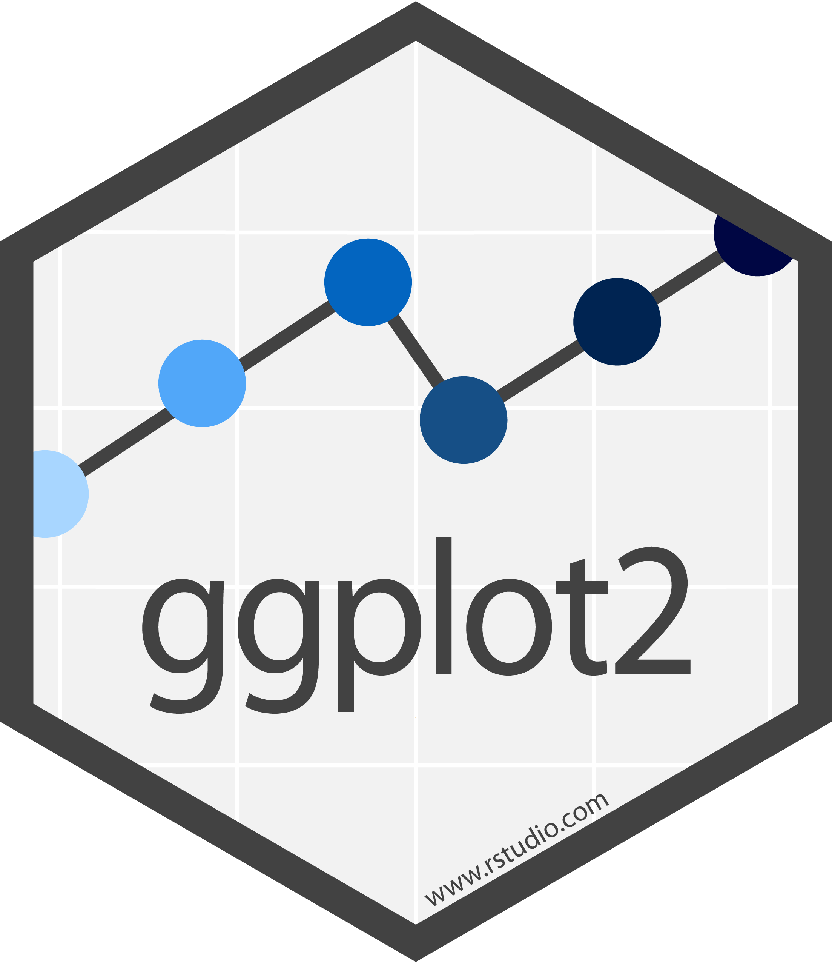


Some terms
Packages
(e.g. stringr)
functions
(e.g., str_to_lower,
str_replace,…)
Bare-bone
.R files
(script)
.Rmd files
Notes:
R-Base – the “bare bone R”
functions – extend the base capabilities
str_to_lower() takes an “UPPERCASE” and turns it to “uppercase”
packages – wraps together a set of functions with a shared vision
(e.g., stringr contains functions for working with strings)
scripts – contains code that R can run (.R files)
Rmarkdown – combination of code and text formatted documentation
R Studio IDE – an environment for working with R
Which adds a lot of functionality for the programmer’s convenience
gui (shiny) and api (plumbr) – allows you to bring R into production

Slide 13
Contents for Today
Rows (observations)
The tidy philosophy
Columns (variables)
Data
Working with data
Variable types
Visualizing
Summarizing
Numeric (Integer, Double)
Factor (categorial, ordinal)

Slide 14
The Tidy Philosophy
There is a “package of packages” called tidyverse. Why tidyverse? because it deals with “tidy” data. So what is tidy data?
“An opinionated collection of R packages designed for data science. All packages share an underlying design philosophy, grammar, and data structures” – https://www.tidyverse.org
A | B | C
Each row is an observation
Each column is a variable

Slide 15
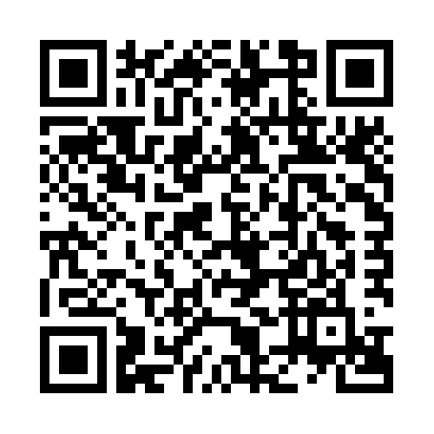
Quiz – which is “tidy”?
Which of the following files are tidy? which are un-tidy? Explain.
The central Bureau of Statistics
Population by group, religion, gender and age (/00-Introduction/st02_03.xls)
Ministry of Health
Weekly Epidemiological report (/00-Introduction/IWER34_2019.xlsx)
Lego brick data (rebrickable.com)
Lego parts (/00-Introduction/Lego_parts.csv)

Slide 16
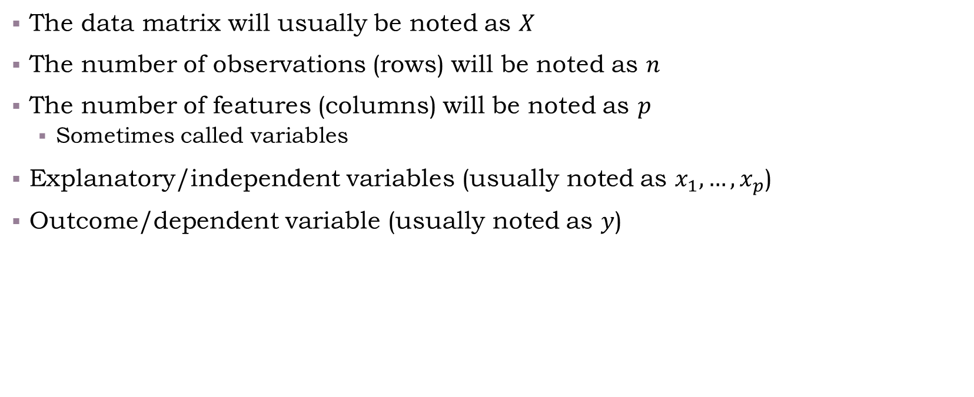
Common Notations
The data matrix will usually be noted as $X$
The number of observations (rows) will be noted as $n$
The number of features (columns) will be noted as $p$
Sometimes called variables
Explanatory/independent variables (usually noted as $x_{1},…,x_{p}$)
Outcome/dependent variable (usually noted as $y$)

Slide 17
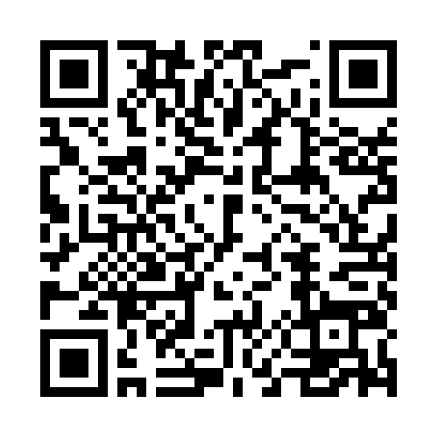
Types of Variables
The common types of variables include:
Numeric (integer, double)
Factor (category, ordinal)
Date or datetime (2020-01-30; 2020-01-30 13:25:00)
Logical (True/False)
Character

Slide 18
Contents for Today
Rows (observations)
The tidy philosophy
Columns (variables)
Data
Working with data
Variable types
Visualizing
Summarizing
Numeric (Integer, Double)
Factor (categorial, ordinal)

Slide 19
Summarizing and Visualizing Data
“Working with Data” will be covered in more details in the recitations and homework.
Throughout the course we will show examples via R, specifically I’m using tidyverse packages (but base R is also ok)
Now, we’re going to demonstrate live:
/00-introduction/00-introduction_script.R

Slide 20
Contents for Today
Rows (observations)
Sampling
The tidy philosophy
Columns (variables)
Data
Working with data
Variable types
Visualizing
Summarizing
Numeric (Integer, Double)
Factor (categorial, ordinal)

Slide 21
Sampling
In most cases, we can’t compute measures on the “entire population”
e.g., that’s what a census does
In such cases we sample the population: selecting observations out of a given population (a “sample”), which would represent the population, for statistical purposes
Various methods for sampling, e.g.:
Random sampling
Layered sampling
Cluster sampling
Important to make sure: avoid a method which causes bias in the sample
Garbage in-garbage out
Population
Sample

