Slide 1
Introduction to Data Science with R
2019

Slide 2
Instructor – Adi Sarid
Professional: Market Research, Data Scientist, Operations Research, Educator
Academia: Mathematics, Statistics and Operations Research (Bsc, MA, Phd-in-process)
Software: R, Python

Slide 3



Course goals
Novice:
I’m not afraid to use R.
When I have a problem with data, I will be comfortable using R to solve it.
Get to know:
The basics of common data science algorithms.
Research process and methods.
Intermediate:
Formal knowledge
Strengthen the basics (functions, iterations)
Get everyone on the same page of state-of-the-art
dplyr, tidyr, ggplot2, purrr, etc.
Evaluation and calibration of data science algorithms

Slide 4
What will we learn?
Introduction
The data science process
Rstudio IDE, Base Syntax
Visualization (telling stories with charts)
ggplot2 – theory and practice
Intrdoduction to tidyverse
Solving business problems
Modelling, optimization, classification/regression ROC
Iterations purrr-ing functions
Functional programming with and iterations with map
Additional topics – as time permits

Slide 5


How will we learn?
Github repo. To download (clone) it, use:
git clone https://github.com/adisarid/intro_to_data_science_R DS_Intro
To pull updates use (inside the directory): git pull
(Consider forking your own copy)
Sticky notes
Please make sure you have:
Latest R (3.5.3) – https://www.r-project.org/
Rstudio IDE (https://www.rstudio.com/products/rstudio/download/)
git (https://git-scm.com/)
Enthusiasm and curiousity! (it’s going to be fun)

Slide 6
Additional sources
R for Data Science by Hadley Wickham & Garrett Grolemund: https://r4ds.had.co.nz/
Advanced R by Hadley Wickham: https://adv-r.hadley.nz/
RStudio cheatsheets (dead tree copies + link)
Sign-up to R-Bloggers mailing list
We will use a lot of data sets from kaggle

Slide 7
The foundations
(Of a data science project)

Slide 8
A “quiz”, in pairs:
Rank the following activities starting from the one which takes up most of your time to the one which takes up the least:
Gathering and preparing data
Visualizing
Finding insights
Building models
Putting things into production
Other activities

Slide 9
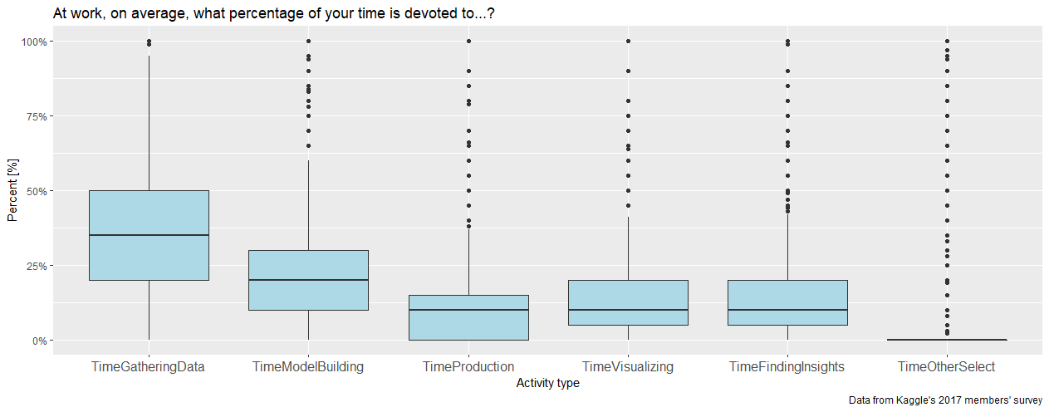
Here’s what 45,000+ kaggle members thought (and what is a “boxplot”)

Slide 10
Arrange this into a workflow model:
Communicate
Import
Model
Tidy
Transform
Visualize
* R for Data Science, chapter 1

Slide 11
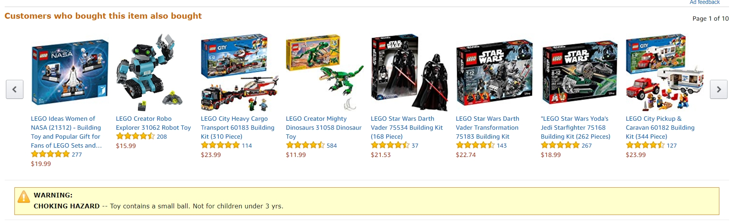
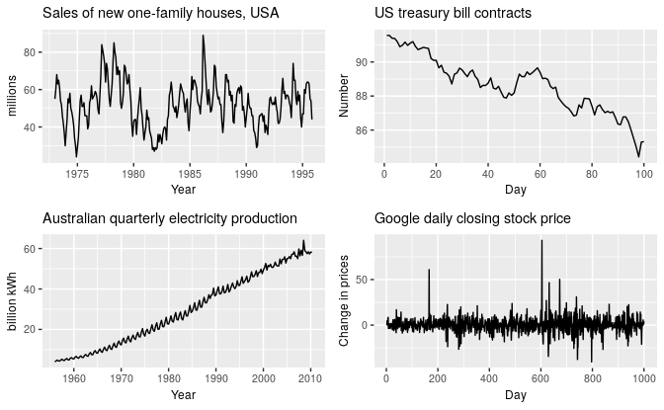
Examples for Data Science Problems
Time series analysis:
Recommendation systems:
(example from Amazon)
Commerce:
Fraud detection, identify and prevent churn
Healthcare (mortality analysis): https://colorectalcancermortalityprediction.shinyapps.io/CRCShiny/
Rob J. Hyndman and George Athansasopoulos, Forecasting: Principles and Practice 2nd edition,
OTexts, 2018. Available Online https://otexts.org/fpp2/ (fetched Sep 2018)
Dashboards (reporting and communicating analysis): https://sarid.shinyapps.io/Sarid-Sample-Report/

Slide 12
Examples for Data Science Problems
Your turn
Share an example from your work for data science or analysis problems.

Slide 13


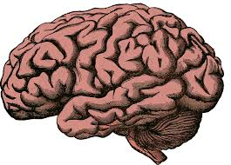
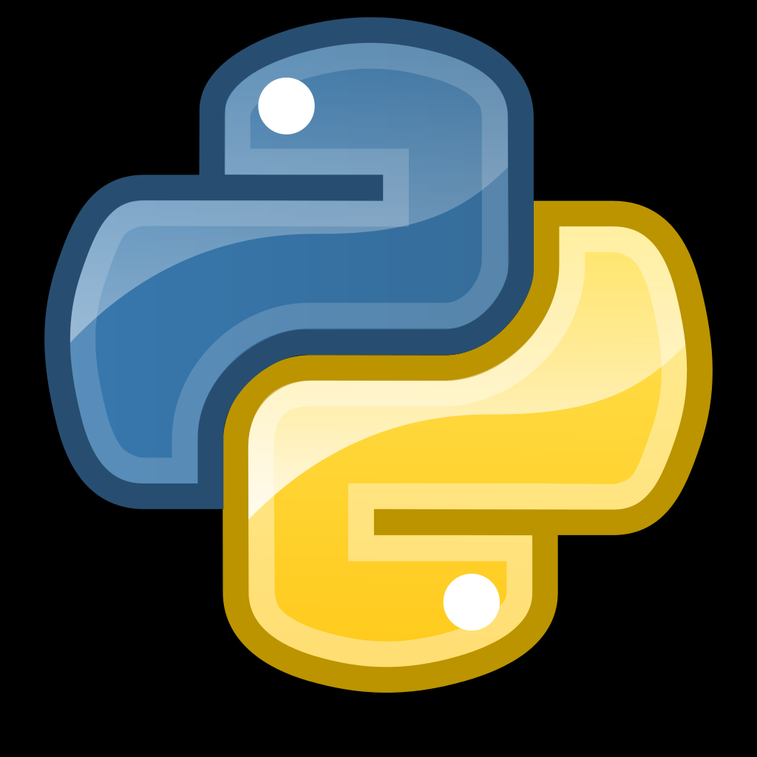
What is R?
A free software environment for statistical computing and graphics (r-project.org)
An analogy I adopted (from Garret Grolemund)
C++

Slide 14




Some terms
Packages
(e.g. stringr)
functions
(e.g., str_to_lower,
str_replace,…)
Bare-bone
.R files
(script)
.Rmd files
Notes:
R-Base – the “bare bone R”
functions – extend the base capabilities
str_to_lower() takes an “UPPERCASE” and turns it to “uppercase”
packages – wraps together a set of functions with a shared vision
(e.g., stringr contains functions for working with strings)
scripts – contains code that R can run (.R files)
Rmarkdown – combination of code and text formatted documentation
R Studio IDE – an environment for working with R
Which adds a lot of functionality for the programmer’s convenience
gui (shiny) and api (plumbr) – allows you to bring R into production

Slide 15
RStudio

Slide 16
Exercise
Clone the repository (if you know what fork means, do it)
Open up 00-Introduction.Rmd from the exercises folder.
Follow the instructions.
Novice – 30 minutes
Intermediate – 15 minutes

