Slide 1
Linear Regression Methods
December 2019
The statistician cannot evade the responsibility for understanding the process he/she appliers or recommends.
- Ronald Fisher (1890-1962)

Slide 2
Contents for today (we might not have enough time to cover everything)
Unsupervised learning
Supervised learning
PCA
Methods
Models
Feature importance
Linear regression
Variable selection
Model evaluation
Classification
Regression
Quantile regression
Additional algorithms (e.g. knn, trees,…)
Ridge
Shrinkage methods
Lasso

Slide 3



Our goal
Given data X (matrix) with independent variable Y (vector)
Assuming a relationship f such that
Find f (predicting Y using X)
How do we measure accuracy? with a loss function, e.g.:
The solution which minimizes the expectancy of this loss function is given by:
This is known as a “regression function”
$$Y=f\left(X\right)+ε$$
$$L\left(Y,f\left(X\right)\right)={\left(Y−f\left(X\right)\right)}^{2}$$
$$f\left(x\right)=E(Y|X=x)$$

Slide 4
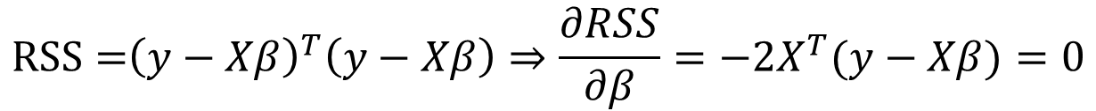


Linear regression “the least squares estimate”
Let’s assume that the regression function, f(x), is actually linear, i.e.:
This is a model based approach: we assume an underlying (linear) model
$$f\left(x\right)≈x^{T}β=1⋅β_{0}+x_{1}β_{1}+x_{2}β_{2}+…$$
$$RSS={{\left(y−Xβ\right)}^{T}\left(y−Xβ\right)⇒\frac{∂RSS}{∂β}=−2X^{T}(y−Xβ)}=0$$
$$X^{T}\left(y−Xβ\right)=0$$
$$\hat{β}={\left(X^{T}X\right)}^{−1}X^{T}y$$

Slide 5
Coding example for linear regression – The beer model
What influences the beer consumption around the world?
/class code/01-linear_regression_example1.Rmd

Slide 6



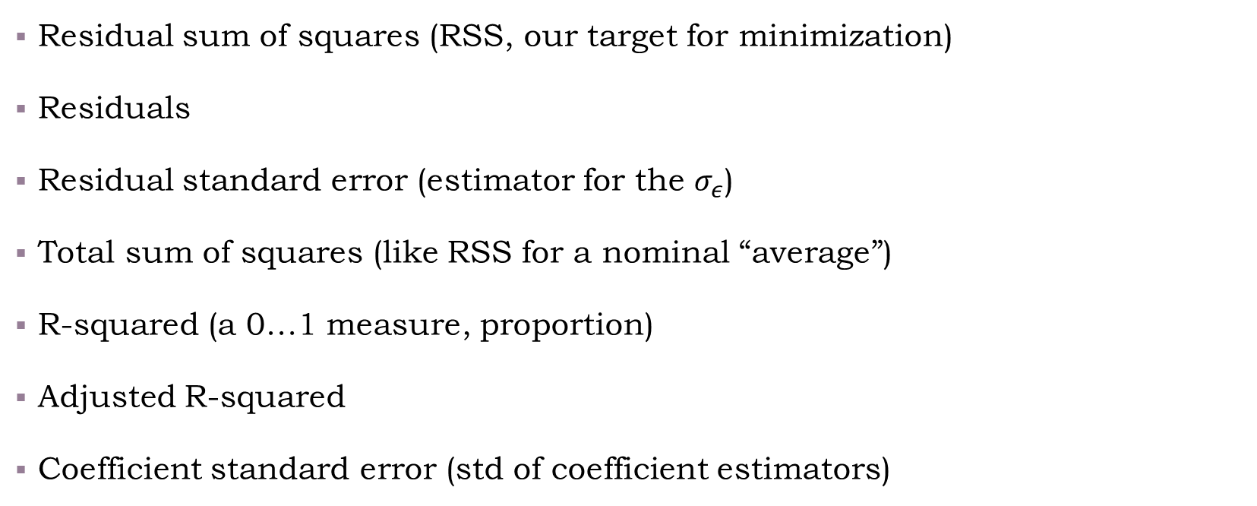

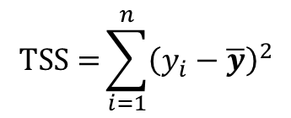
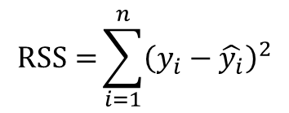
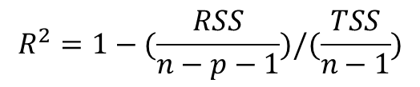
Note the following terms (then, we will see what we can do with them)
$$RSS={\sum_{i=1}^{n}{{\left(y_{i}−\hat{y_{i}}\right)}^{2}}}$$
Residual sum of squares (RSS, our target for minimization)
Residuals
Residual standard error (estimator for the $σ_{ε}$)
Total sum of squares (like RSS for a nominal “average”)
R-squared (a 0…1 measure, proportion)
Adjusted R-squared
Coefficient standard error (std of coefficient estimators)
$$e_{i}=y_{i}−\hat{y_{i}}$$
$$RSE={\sqrt{\frac{RSS}{n−p−1}}}$$
$$TSS={\sum_{i=1}^{n}{{\left(y_{i}−\overline{y}\right)}^{2}}}$$
$$R^{2}=1−RSS/TSS$$
$$R^{2}=1−(\frac{RSS}{n−p−1})/(\frac{TSS}{n−1})$$
$$SE{\left(β_{j}\right)}^{2}= {\left[{\hat{σ}}^{2}{\left(X^{T}X\right)}^{−1}\right]}_{jj}$$

Slide 7
Word of caution (1): Extrapolating, Missing the relationship/not using domain expertise

Slide 8

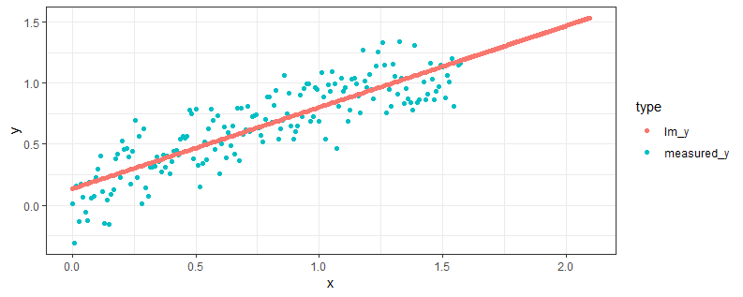
Warm-up example (which starts with a quiz)
Take a moment to think: Is this a good model?
Call:
lm(formula = measured_y ~ x, data = data_in_partial)
Residuals:
Min 1Q Median 3Q Max
-0.45050 -0.12257 -0.00307 0.13733 0.39436
Coefficients:
Estimate Std. Error t value Pr(>|t|)
(Intercept) 0.13405 0.02618 5.12 7.88e-07 ***
x 0.66828 0.02883 23.18 < 2e-16 ***
---
Signif. codes: 0 ‘***’ 0.001 ‘**’ 0.01 ‘*’ 0.05 ‘.’ 0.1 ‘ ’ 1
Residual standard error: 0.1764 on 178 degrees of freedom
Multiple R-squared: 0.7512, Adjusted R-squared: 0.7498
F-statistic: 537.3 on 1 and 178 DF, p-value: < 2.2e-16

Slide 9
The good
If we are just predicting 0,…,pi/2, it’s roughly ok, even though we could’ve done better
Call:
lm(formula = measured_y ~ x, data = data_in_partial)
Residuals:
Min 1Q Median 3Q Max
-0.45050 -0.12257 -0.00307 0.13733 0.39436
Coefficients:
Estimate Std. Error t value Pr(>|t|)
(Intercept) 0.13405 0.02618 5.12 7.88e-07 ***
x 0.66828 0.02883 23.18 < 2e-16 ***
---
Signif. codes: 0 ‘***’ 0.001 ‘**’ 0.01 ‘*’ 0.05 ‘.’ 0.1 ‘ ’ 1
Residual standard error: 0.1764 on 178 degrees of freedom
Multiple R-squared: 0.7512, Adjusted R-squared: 0.7498
F-statistic: 537.3 on 1 and 178 DF, p-value: < 2.2e-16

Slide 10
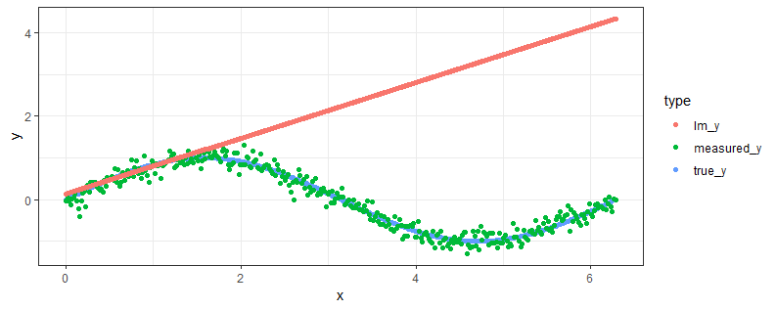
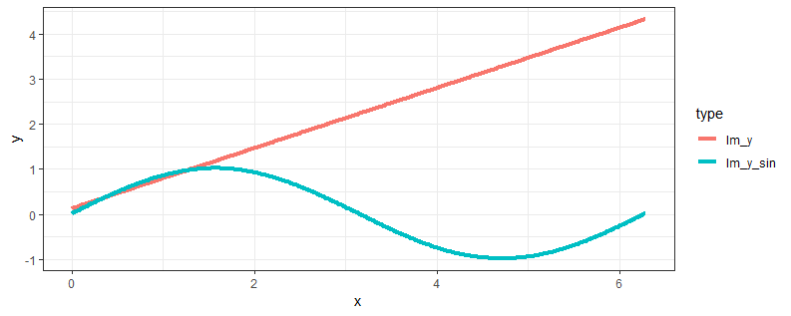
The bad
If we’re trying to extrapolate we’re going to make a huge mistake – and not even know about it
We’re approximating a sine function + error as a linear function…
A linear model can be extended to be “non-linear” using transformations on x

Slide 11
Word of caution (2): Overfitting

Slide 12
Overfitting
/class code/01-overfitting_example.Rmd

Slide 13
Questions we need to ask ourselves when running a model
Did we capture an overall relationship between response and predictors?
How do we decide on important variables? (and avoid over-fitting)
How would we measure the extent to which the model fits the data?
Given a set of predictor values, how accurate is our prediction?
Variable selection
R-squared
Hypothesis test
Prediction intervals
Notes:
These assume a normal distribution for the error.
F = \frac{(TSS - RSS)/p}{RSS/(n-p-1)} \Rightarrow as the difference is small between the TSS and RSS, the F increases, to the point its p-value is extremely small (hence the overall relationship is significant). This is equivalent to a hypothesis test of:
H0: \beta_0=\beta_1=\ldots=\beta_p=0
H1: \exists i such that \beta_i\neq0
Individual tests for \beta_i also exist, using the t-test distribution.
\beta \sim N(\beta, (X^TX)^{-1}\sigma^2)
So by using the coefficient’s standard error and nominal estimate we can compute the individual \beta’s confidence interval.

Slide 14
Questions we need to ask ourselves when running a model
Did we capture an overall relationship between response and predictors?
How do we decide on important variables? (and avoid over-fitting)
How would we measure the extent to which the model fits the data?
Given a set of predictor values, how accurate is our prediction?
Variable selection
R-squared
Hypothesis test
Prediction intervals
Notes:
These assume a normal distribution for the error.
F = \frac{(TSS - RSS)/p}{RSS/(n-p-1)} \Rightarrow as the difference is small between the TSS and RSS, the F increases, to the point its p-value is extremely small (hence the overall relationship is significant). This is equivalent to a hypothesis test of:
H0: \beta_0=\beta_1=\ldots=\beta_p=0
H1: \exists i such that \beta_i\neq0
Individual tests for \beta_i also exist, using the t-test distribution.
\beta \sim N(\beta, (X^TX)^{-1}\sigma^2)
So by using the coefficient’s standard error and nominal estimate we can compute the individual \beta’s confidence interval.

Slide 15
Live coding examples
Model evaluation using R-squared
Hypothesis testing
Using relaimpo for feature importance
Feature selection with stepwise
Prediction intervals with predict

Slide 16
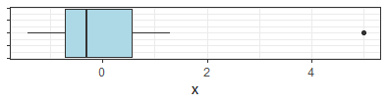
The influence of outliers
median
How to detect an outlier? e.g. using a boxplot
But, is that enough? a short quiz
Live coding example: /class code/01-outliers.R
Mitigation:
Quantile regression
Outlier detection (out of scope for now)
quartiles
outlier

Slide 17
Exercise – Diamond prices
Use linear regression to build a model for diamond’s prices
(Use the data set diamonds from ggplot2)
Start by loading the package and familiarizing yourself with the data set
Use visualizations to see the relationship of various variables to price
Consider using `step` for variable selection
Consider various transformations (e.g., `log`) on key variables

Slide 18
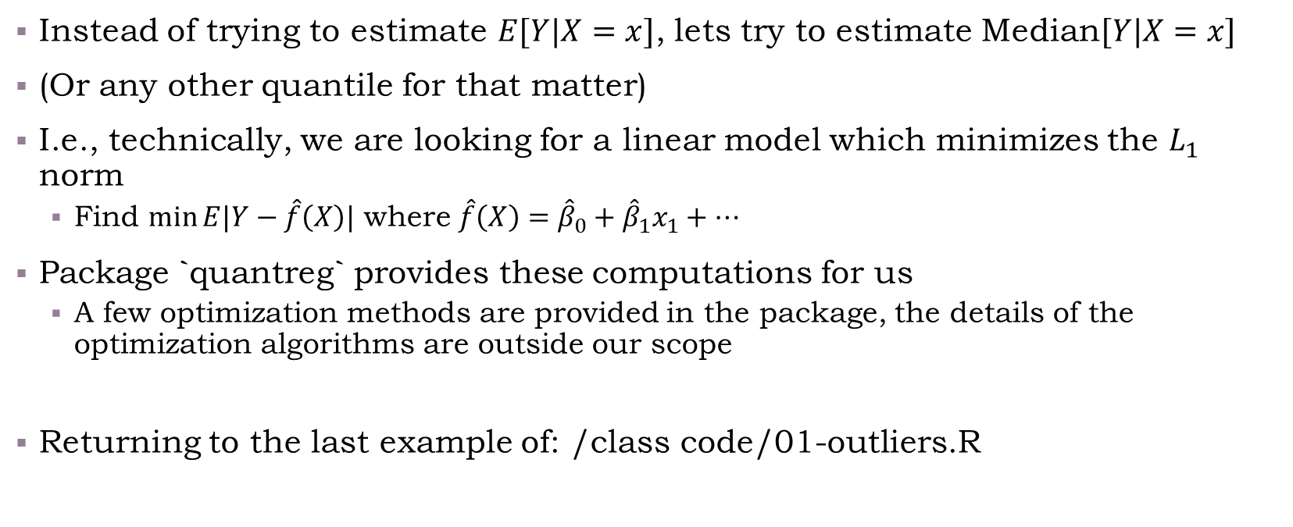
Quantile regression
Instead of trying to estimate $E[Y|X=x]$, lets try to estimate Median$[Y|X=x]$
(Or any other quantile for that matter)
I.e., technically, we are looking for a linear model which minimizes the $L_{1}$ norm
Find $\min{E|Y−\hat{f}\left(X\right)|}$ where $\hat{f}\left(X\right)={\hat{β}}_{0}+{\hat{β}}_{1}x_{1}+…$
Package `quantreg` provides these computations for us
A few optimization methods are provided in the package, the details of the optimization algorithms are outside our scope
Returning to the last example of: /class code/01-outliers.R

Slide 19
Contents
Unsupervised learning
Supervised learning
PCA
Methods
Models
Feature importance
Linear regression
Variable selection
Model evaluation
Classification
Regression
Quantile regression
Additional algorithms (e.g. knn, trees,…)
Ridge
Shrinkage methods
Lasso

Slide 20
Dimension reduction using Principle Component Analysis (PCA)
Sometimes our explanatory variables are correlated
We may also get too many variables
As discussed, feature selection is one option, another options is PCA
/class code/01-pca.Rmd

Slide 21
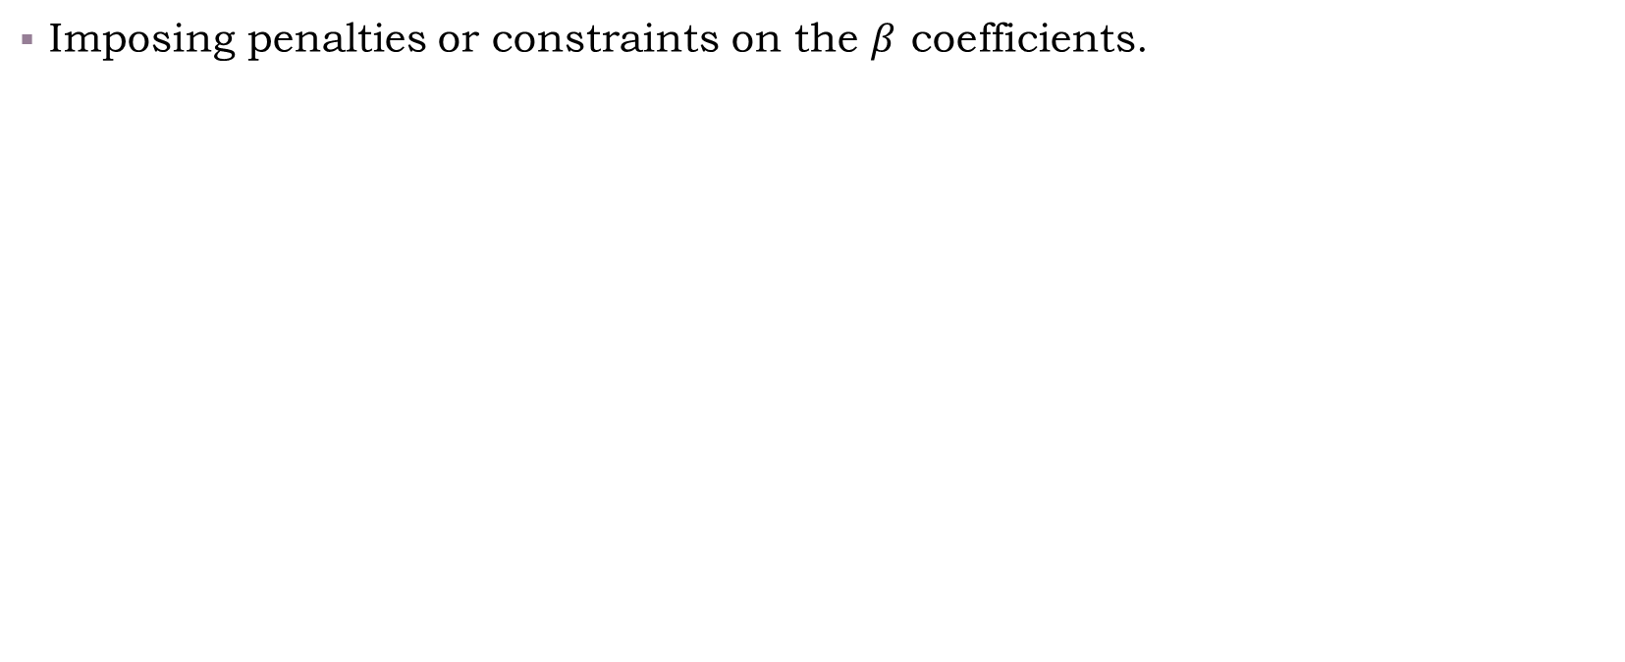
Regularization methods
Imposing penalties or constraints on the $β$ coefficients.

Slide 22
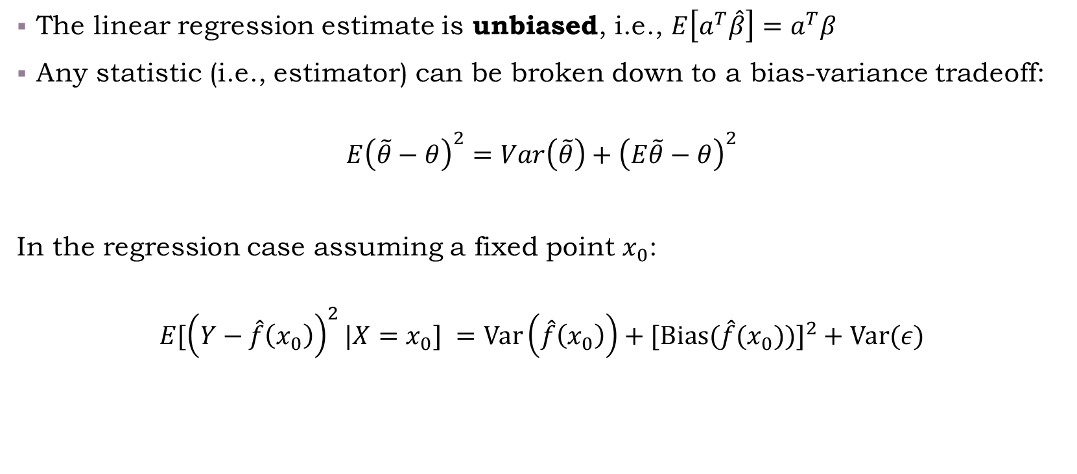
The Bias-Variance tradeoff
The linear regression estimate is unbiased, i.e., $E\left[a^{T}\hat{β}\right]=a^{T}β$
Any statistic (i.e., estimator) can be broken down to a bias-variance tradeoff:
$$E{\left(\tilde{θ}−θ\right)}^{2}=Var\left(\tilde{θ}\right)+{\left(E\tilde{θ}−θ\right)}^{2}$$
In the regression case assuming a fixed point $x_{0}$:
$$E[{\left(Y−\hat{f}\left(x_{0}\right)\right)}^{2}|X=x_{0}] =\text{Var}\left(\hat{f}\left(x_{0}\right)\right)+\text{[}\text{Bias}\text{(}{\hat{f}(x_{0}))]}^{2}+\text{Var}(ε)$$
Model variance
Model bias
Irreducible error
Notes:
$$Ea^{T}{\left(X^{T}X\right)}^{−1}X^{T}y=E\left(a^{T}{\left(X^{T}X\right)}^{−1}X^{T}Xβ\right)=Ea^{T}β$$
E[(Y-\hat{f}(x_0))^2|X=x_0] = \var(\epsilon) + E[\hat{f}(x_0) - f(x_0)]^2 + E[\hat{f}(x_0)-E\hat{f}(x_0)]^2 = \sigma_\epsilon^2+Bias^2(\hat{f}(x_0)) + \var(\hat{f}(x_0))
When we make the model “more complex”, i.e., more features, we usually get a lower bias, but a higher variance. There is also an irreducible error which cannot be avoided (unless \sigma_\epsilon=0).

Slide 23
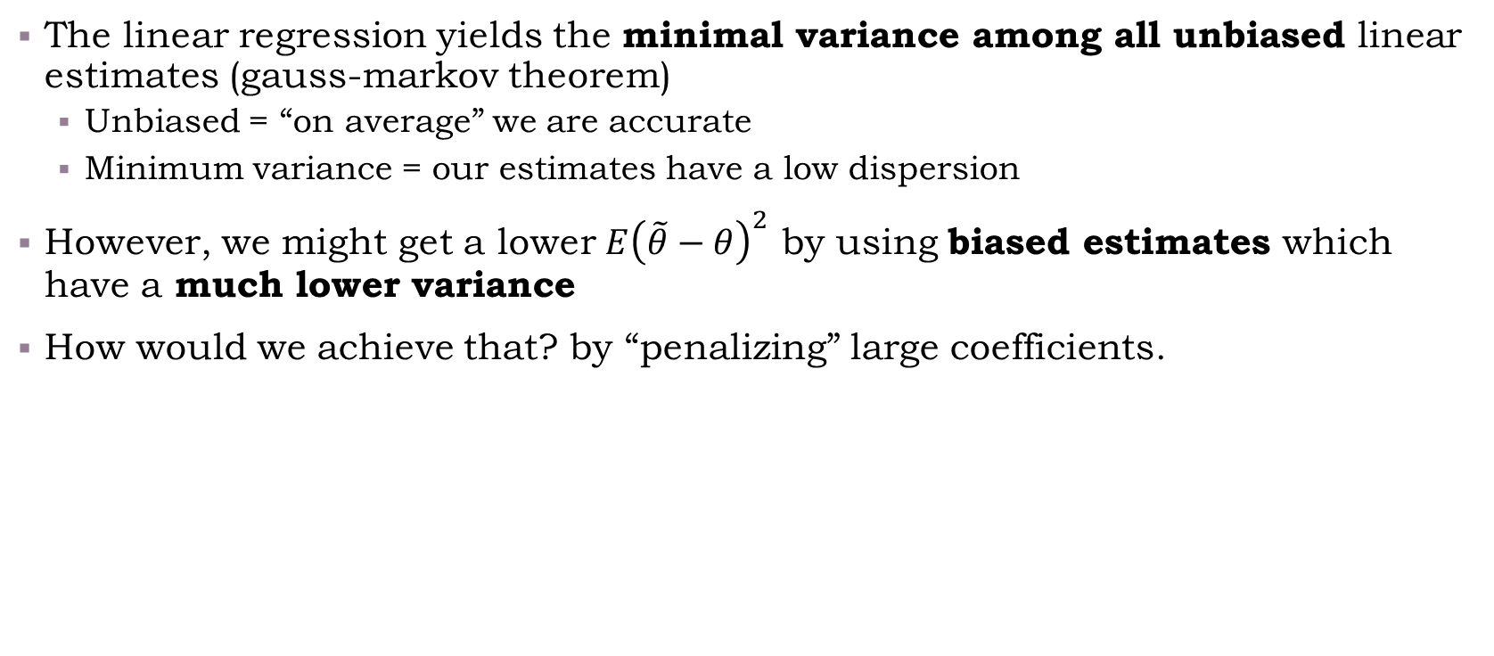
Some properties of linear regression
The linear regression yields the minimal variance among all unbiased linear estimates (gauss-markov theorem)
Unbiased = “on average” we are accurate
Minimum variance = our estimates have a low dispersion
However, we might get a lower $E{\left(\tilde{θ}−θ\right)}^{2}$ by using biased estimates which have a much lower variance
How would we achieve that? by “penalizing” large coefficients.
Notes:
$$Ea^{T}{\left(X^{T}X\right)}^{−1}X^{T}y=E\left(a^{T}{\left(X^{T}X\right)}^{−1}X^{T}Xβ\right)=Ea^{T}β$$

Slide 24
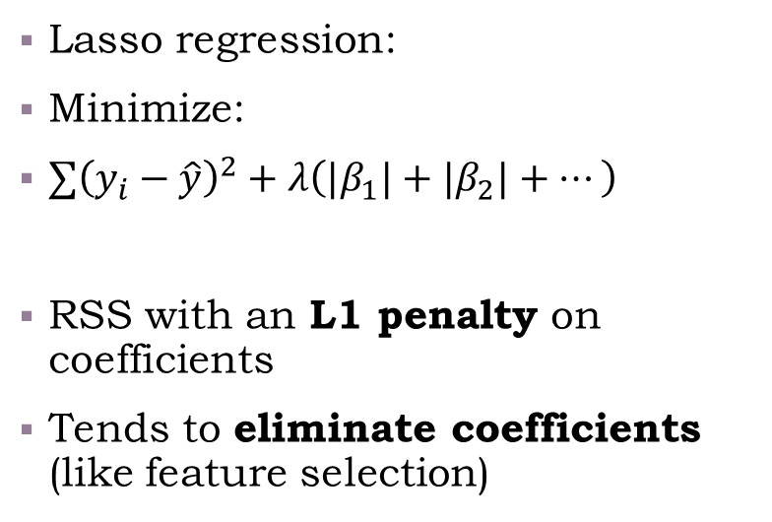
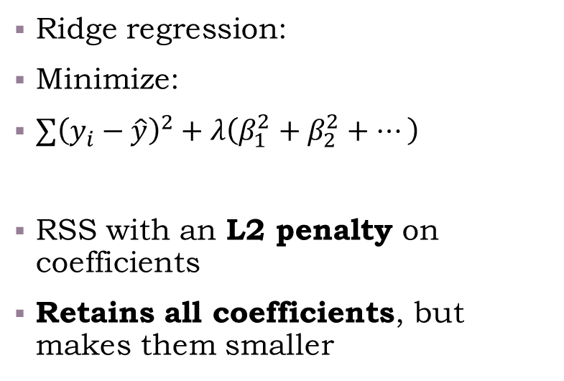
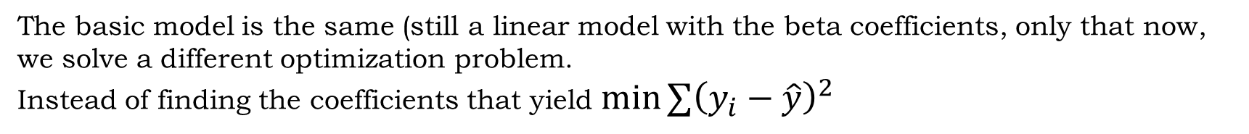
The Ridge and the Lasso
The basic model is the same (still a linear model with the beta coefficients, only that now, we solve a different optimization problem.
Instead of finding the coefficients that yield $\min{∑{\left(y_{i}−\hat{y}\right)}^{2}}$
Ridge regression:
Minimize:
$∑{\left(y_{i}−\hat{y}\right)}^{2}+λ\left(β_{1}^{2}+β_{2}^{2}+…\right)$
RSS with an L2 penalty on coefficients
Retains all coefficients, but makes them smaller
Lasso regression:
Minimize:
$∑{\left(y_{i}−\hat{y}\right)}^{2}+λ\left(|β_{1}|+|β_{2}|+…\right)$
RSS with an L1 penalty on coefficients
Tends to eliminate coefficients (like feature selection)

Slide 25
Ridge and Lasso demonstration
/class code/01-ridge_lasso_glmnet.Rmd

Slide 26
Contents
Unsupervised learning
Supervised learning
PCA
Methods
Models
Feature importance
Linear regression
Variable selection
Model evaluation
Classification
Regression
Quantile regression
Additional algorithms (e.g. knn, trees,…)
Ridge
Shrinkage methods
Lasso

Slide 27
Summary
Summary quiz
Though a very “simplistic tool”, linear regression can be a very good tool for gaining insights, and help the exploratory process
It is quick to run, and can illustrate relationships of variables
It has some nice extensions, which can be beneficial in various situations
Even though it is not as flexible as other regression tools (i.e., forests, boosting, neural networks), it can provide a reference – “starting point”, from which one can improve further with other models

