Slide 1
Classification Methods
August 2019
When I want to understand what is happening today or try to decide what will happen tomorrow, I look back.
- Omar Khayyam

Slide 2
Contents for today
Unsupervised learning
Supervised learning
Methods
Models
Model evaluation
ROC/AUC
Linear methods
Classification
Regression
Cross validation
Discriminant Analysis
Logistic regression
Support Vector Machines (SVM)
Trees, Forests, Boosting, etc.
k-fold xval
Leave one out

Slide 3
Support Vector Machines

Slide 4

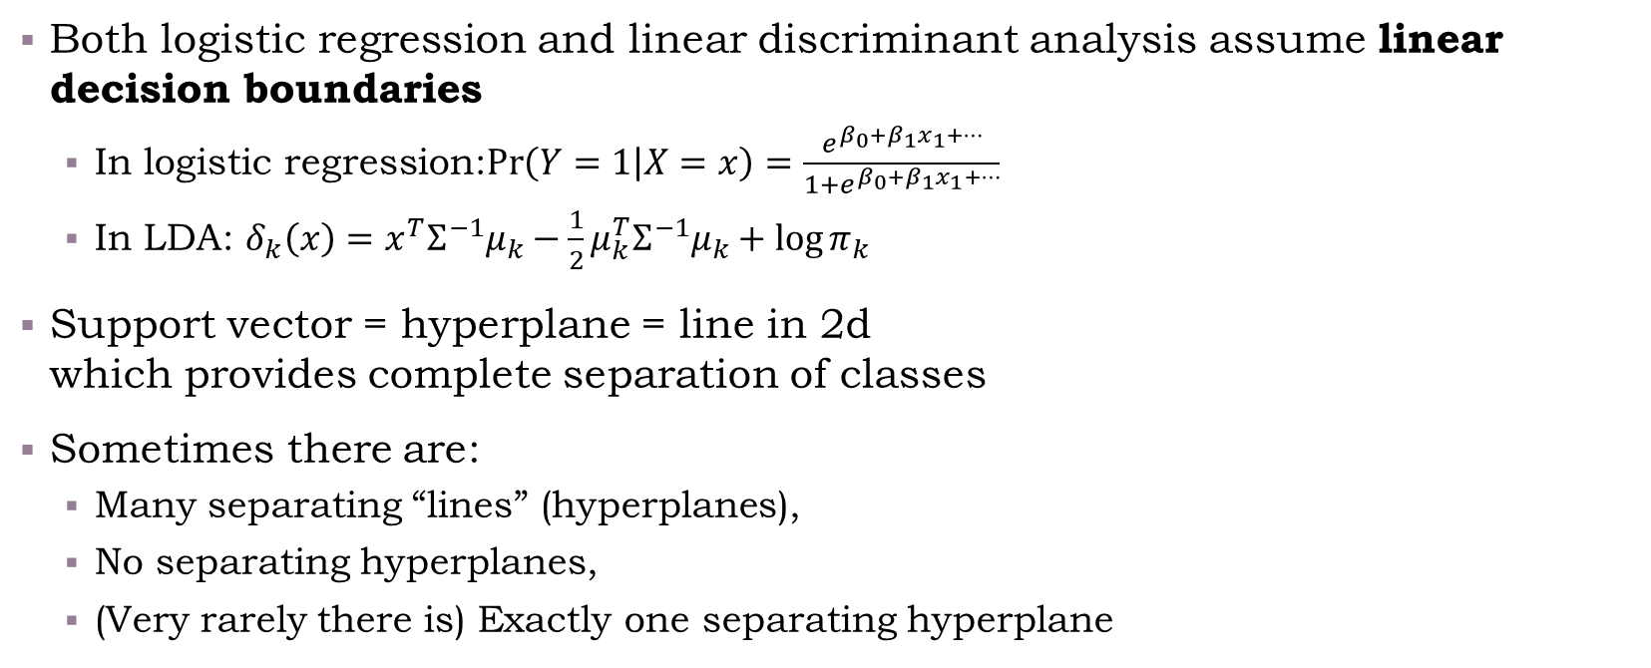
Separating Hyperplanes
Both logistic regression and linear discriminant analysis assume linear decision boundaries
In logistic regression:$\operatorname{Pr}\left(Y=1 | X=x\right)=\frac{e^{β_{0}+β_{1}x_{1}+…}}{1+e^{β_{0}+β_{1}x_{1}+…}}$
In LDA: $δ_{k}\left(x\right)=x^{T}Σ^{−1}μ_{k}−\frac{1}{2}μ_{k}^{T}Σ^{−1}μ_{k}+\log{π_{k}}$
Support vector = hyperplane = line in 2d which provides complete separation of classes
Sometimes there are:
Many separating “lines” (hyperplanes),
No separating hyperplanes,
(Very rarely there is) Exactly one separating hyperplane
separating hyperplane

Slide 5
What is an “Optimal” Separator?
Out of the possible hyperplanes, which is “better”?

Slide 6
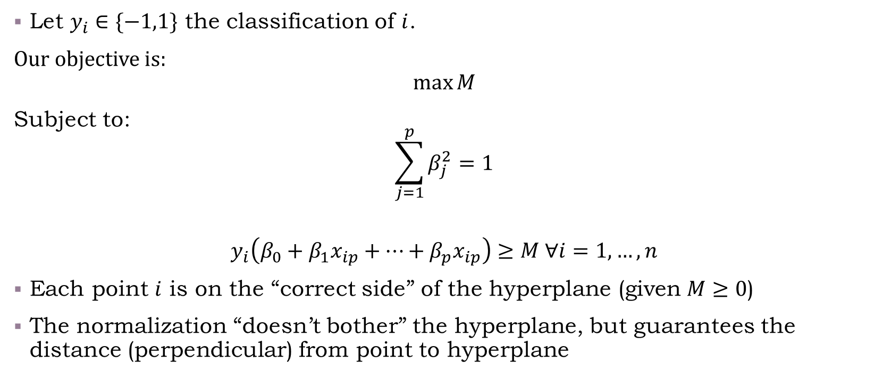
Maximal Margin Separator
Let $y_{i}∈\{−1,1\}$ the classification of $i$.
Our objective is:
$$\max{M}$$
Subject to:
$$\sum_{j=1}^{p}{β_{j}^{2}=1}$$
$$y_{i}\left(β_{0}+β_{1}x_{ip}+…+β_{p}x_{ip}\right)≥M ∀i=1,…,n$$
Each point $i$ is on the “correct side” of the hyperplane (given $M≥0$)
The normalization “doesn’t bother” the hyperplane, but guarantees the distance (perpendicular) from point to hyperplane
Notes:
For additional information about how to find \beta, see ESLII pages 132-135, and pages 418-421. It turns out to be a convex optimization problem. The technical details are interesting (for those of you interested in optimization, check it out).

Slide 7
Margin Separator
Live coding example
/class code/03-Hyperplane_illustration.R

Slide 8
Support Vector Classifier
Sometimes a separating hyperplane does not exist
We can still find a hyperplane which would do a good job with classification, but our previous optimization problem would be infeasible
Correction: Allow for some misclassifications to find a viable hyperplane

Slide 9
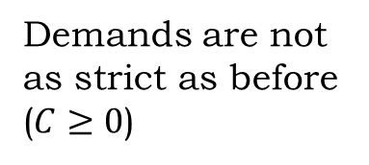

Support Vector Classifier
Correction: Allow for some misclassifications to find a viable hyperplane
Our objective is:
$$\max{M}$$
Subject to:
$$\sum_{j=1}^{p}{β_{j}^{2}=1}$$
$$y_{i}\left(β_{0}+β_{1}x_{ip}+…+β_{p}x_{ip}\right)≥M\left(1−ε_{i}\right) ∀i=1,…,n$$
$$ε_{i}≥0, ∑ε_{i}≤C$$
Demands are not as strict as before
($C≥0$)

Slide 10

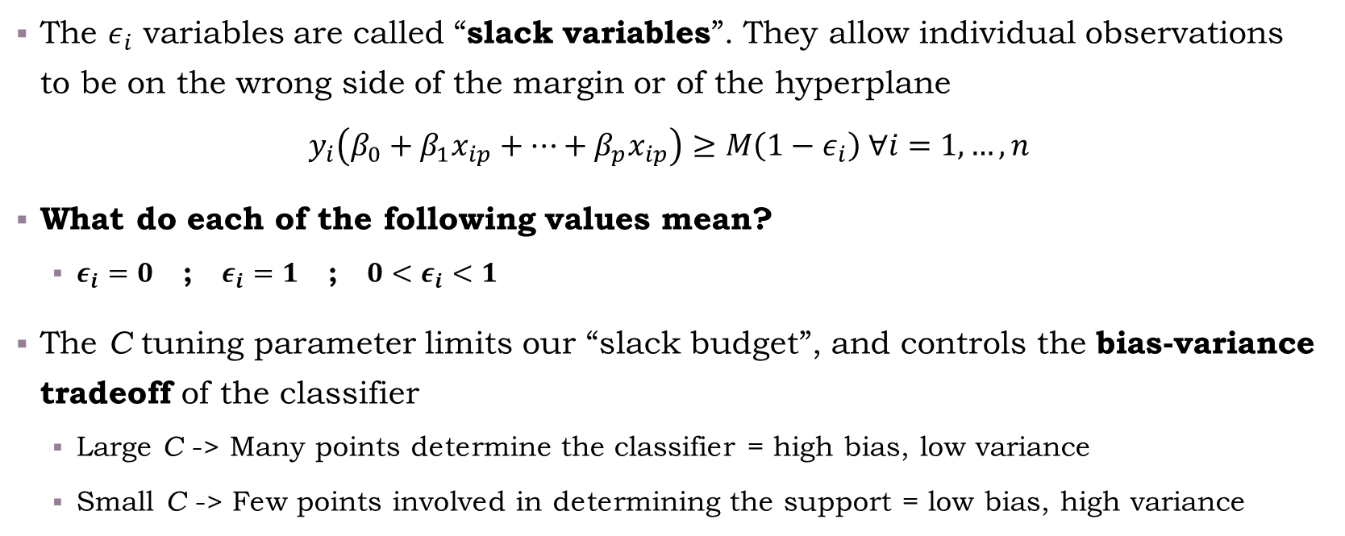
Slack (not )
The $ε_{i}$ variables are called “slack variables”. They allow individual observations to be on the wrong side of the margin or of the hyperplane
$$y_{i}\left(β_{0}+β_{1}x_{ip}+…+β_{p}x_{ip}\right)≥M\left(1−ε_{i}\right) ∀i=1,…,n$$
What do each of the following values mean?
$ε_{i}=0$ ; $ε_{i}=1$ ; ${0<ε}_{i}<1$
The C tuning parameter limits our “slack budget”, and controls the bias-variance tradeoff of the classifier
Large C -> Many points determine the classifier = high bias, low variance
Small C -> Few points involved in determining the support = low bias, high variance

Slide 11
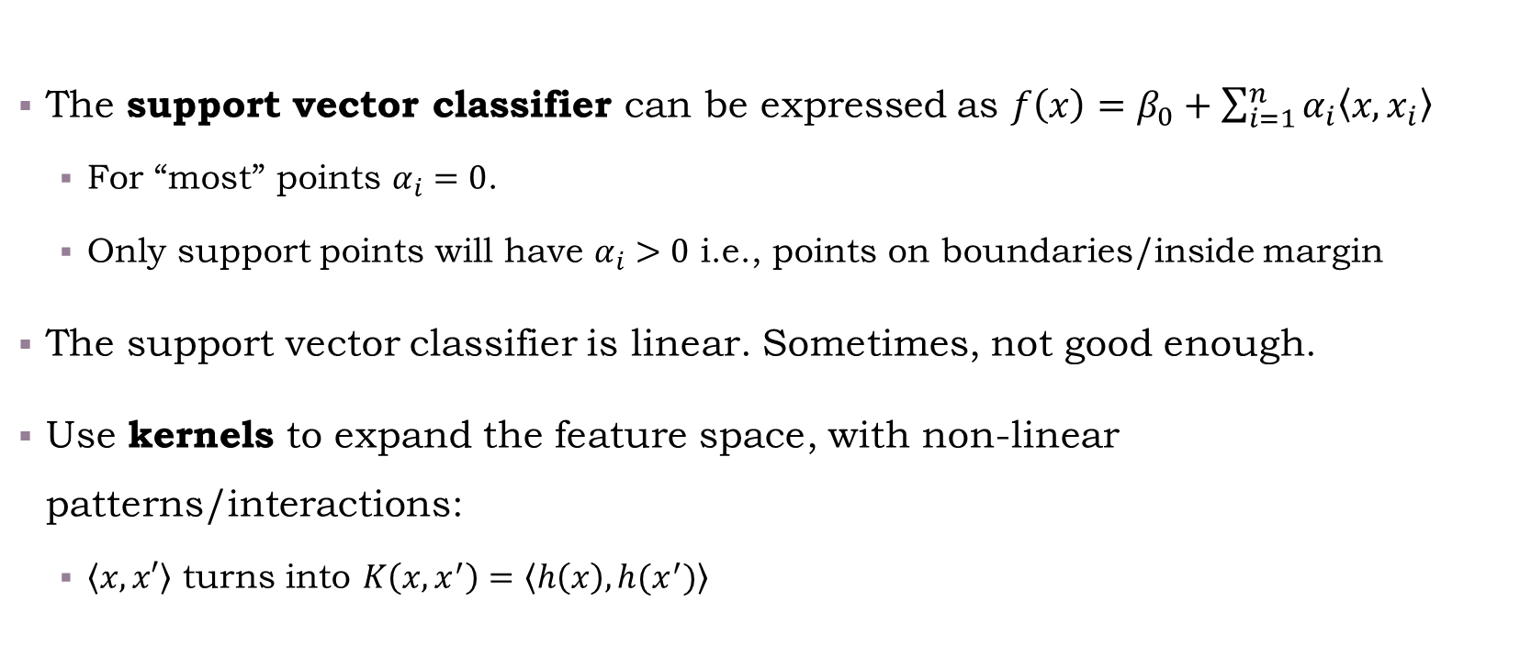
Support Vector Machines
The support vector classifier can be expressed as $f\left(x\right)=β_{0}+\sum_{i=1}^{n}{α_{i}\left\langle x,x_{i}\right\rangle }$
For “most” points $α_{i}=0$.
Only support points will have $α_{i}>0$ i.e., points on boundaries/inside margin
The support vector classifier is linear. Sometimes, not good enough.
Use kernels to expand the feature space, with non-linear patterns/interactions:
$\left\langle x,x′\right\rangle$ turns into $K\left(x,x^{′}\right)=\left\langle h\left(x\right),h(x^{′})\right\rangle$
Notes:
Details on the formulation of the inner product are given in ESLII pages 132-135, and pages 418-421.

Slide 12

Examples for Kernels
dth-Degree polynomial (separating hyperplane -> a polynomial separator)
$K\left(x,x^{′}\right)={\left(1+〈x,x^{′}〉\right)}^{d}$
Radial basis (“circular” decision rule)
$K\left(x,x^{′}\right)=\exp\left(−γ{\left\|x−x^{′}\right\|}^{2}\right)$
Neural network
$K\left(x,x^{′}\right)=\tanh\left(κ_{1}〈x,x^{′}〉+κ_{2}\right)$
Source: Introduction to Statistical Learning, Chapter 9.3 (Support Vector Machines) Pages 349, 353
Notes:
Pages 356-359 in ISLR provide very good intuition on the relationship between SVMs and logistic regression. A recommended read.

Slide 13

Multiple Classes
One versus one
Build $\left(\begin{matrix}k \\ 2\end{matrix}\right)$ classifiers, choose the one mostly “voted for”
One versus many
Build $K$ classifiers
For each point $x_{i}$, set its class according to the classifier with the highest $β_{k}^{t}x_{i}$

Slide 14
Illustration of SVM
Hands-on demonstration:
/Class Code/03-SVM_example.R

Slide 15
Cross Validation

Slide 16
Classification and Decision Trees

Slide 17
Match the Classifier
For each of the following images, which classifier was used to generate the classification?
Choose out of the following list:
Logistic regression
Linear regression
LDA
QDA
SVM
Trees
/class code/03-Match_the_classifier.R
Add quiz/illustration here!

