Slide 1
Linear Regression Methods
July 2019
The statistician cannot evade the responsibility for understanding the process he/she appliers or recommends.
- Ronald Fisher (1890-1962)

Slide 2
Contents for today (we might not have enough time to cover everything)
Unsupervised learning
Supervised learning
PCA
Methods
Models
Feature importance
Linear regression
Variable selection
Model evaluation
Classification
Regression
Quantile regression
Additional algorithms (e.g. knn, trees,…)
Ridge
Shrinkage methods
Lasso

Slide 3



Our goal
Given data X (matrix) with independent variable Y (vector)
Assuming a relationship f such that
Find f (predicting Y using X)
How do we measure accuracy? with a loss function, e.g.:
The solution which minimizes the expected prediction error is
This is known as a “regression function”
$$Y=f\left(X\right)+ε$$
$$L\left(Y,f\left(X\right)\right)={\left(Y−f\left(X\right)\right)}^{2}$$
$$f\left(x\right)=E(Y|X=x)$$

Slide 4
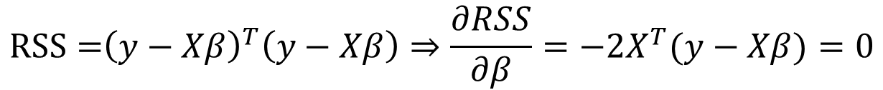


Linear regression “the least squares estimate”
Let’s assume that the regression function, f(x), is actually linear, i.e.:
A model based approach (set the lm into the loss function and take derivative)
$$f\left(x\right)≈x^{T}β=1⋅β_{0}+x_{1}β_{1}+x_{2}β_{2}+…$$
$$RSS={{\left(y−Xβ\right)}^{T}\left(y−Xβ\right)⇒\frac{∂RSS}{∂β}=−2X^{T}(y−Xβ)}=0$$
$$X^{T}\left(y−Xβ\right)=0$$
$$\hat{β}={\left(X^{T}X\right)}^{−1}X^{T}y$$

Slide 5
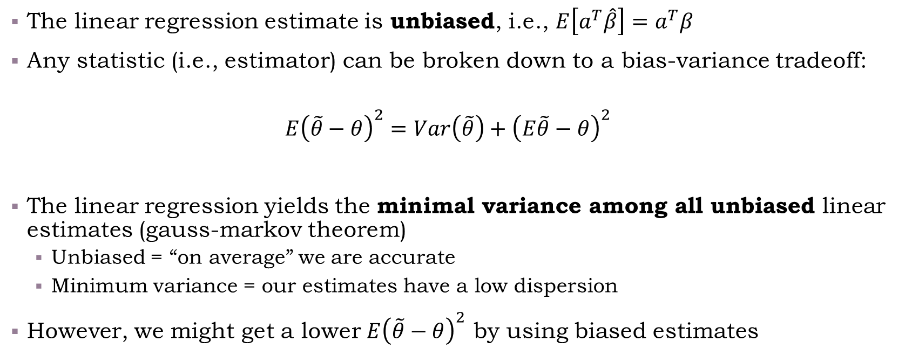
Key properties of linear regression
The linear regression estimate is unbiased, i.e., $E\left[a^{T}\hat{β}\right]=a^{T}β$
Any statistic (i.e., estimator) can be broken down to a bias-variance tradeoff:
$$E{\left(\tilde{θ}−θ\right)}^{2}=Var\left(\tilde{θ}\right)+{\left(E\tilde{θ}−θ\right)}^{2}$$
The linear regression yields the minimal variance among all unbiased linear estimates (gauss-markov theorem)
Unbiased = “on average” we are accurate
Minimum variance = our estimates have a low dispersion
However, we might get a lower $E{\left(\tilde{θ}−θ\right)}^{2}$ by using biased estimates
Notes:
$$Ea^{T}{\left(X^{T}X\right)}^{−1}X^{T}y=E\left(a^{T}{\left(X^{T}X\right)}^{−1}X^{T}Xβ\right)=Ea^{T}β$$

Slide 6

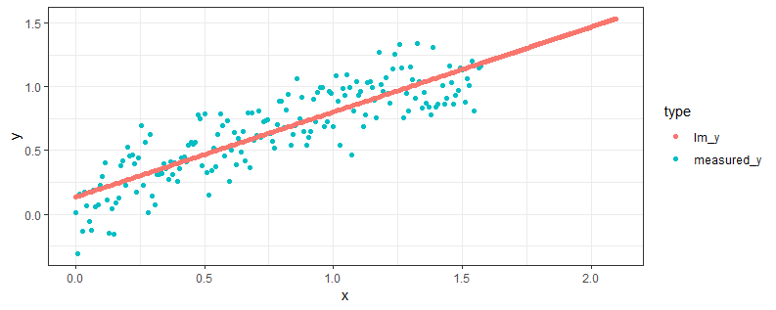
Warm-up quiz
Take a moment to think: Is this a good model? (Is it unbiased? Does the linearity assumption hold?)
Call:
lm(formula = measured_y ~ x, data = data_in_partial)
Residuals:
Min 1Q Median 3Q Max
-0.45050 -0.12257 -0.00307 0.13733 0.39436
Coefficients:
Estimate Std. Error t value Pr(>|t|)
(Intercept) 0.13405 0.02618 5.12 7.88e-07 ***
x 0.66828 0.02883 23.18 < 2e-16 ***
---
Signif. codes: 0 ‘***’ 0.001 ‘**’ 0.01 ‘*’ 0.05 ‘.’ 0.1 ‘ ’ 1
Residual standard error: 0.1764 on 178 degrees of freedom
Multiple R-squared: 0.7512, Adjusted R-squared: 0.7498
F-statistic: 537.3 on 1 and 178 DF, p-value: < 2.2e-16

Slide 7
It depends: the good
If we are just predicting 0,…,pi/2, it’s roughly ok, even though we could’ve done better
Call:
lm(formula = measured_y ~ x, data = data_in_partial)
Residuals:
Min 1Q Median 3Q Max
-0.45050 -0.12257 -0.00307 0.13733 0.39436
Coefficients:
Estimate Std. Error t value Pr(>|t|)
(Intercept) 0.13405 0.02618 5.12 7.88e-07 ***
x 0.66828 0.02883 23.18 < 2e-16 ***
---
Signif. codes: 0 ‘***’ 0.001 ‘**’ 0.01 ‘*’ 0.05 ‘.’ 0.1 ‘ ’ 1
Residual standard error: 0.1764 on 178 degrees of freedom
Multiple R-squared: 0.7512, Adjusted R-squared: 0.7498
F-statistic: 537.3 on 1 and 178 DF, p-value: < 2.2e-16

Slide 8
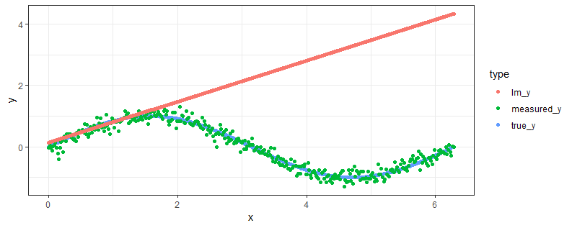
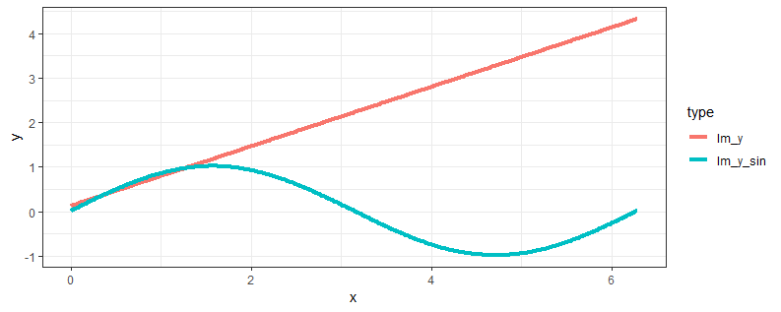
It depends: the bad
If we’re trying to extrapolate we’re going to make a huge mistake – and not even know about it
We’re approximating a sine function + error as a linear function…

Slide 9

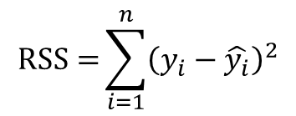

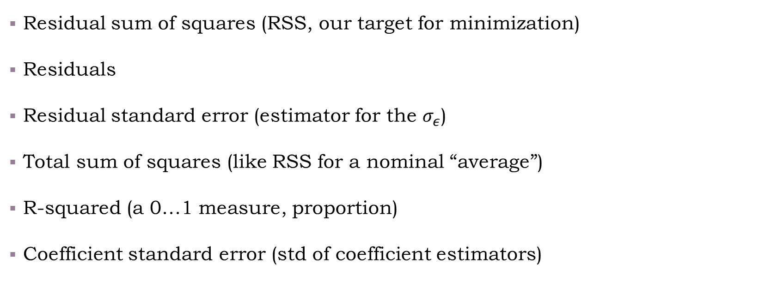
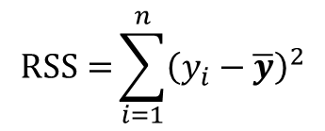


Note the following terms (discussing linear regression)
$$RSS={\sum_{i=1}^{n}{{\left(y_{i}−\hat{y_{i}}\right)}^{2}}}$$
Residual sum of squares (RSS, our target for minimization)
Residuals
Residual standard error (estimator for the $σ_{ε}$)
Total sum of squares (like RSS for a nominal “average”)
R-squared (a 0…1 measure, proportion)
Coefficient standard error (std of coefficient estimators)
$$e_{i}=y_{i}−\hat{y_{i}}$$
$$RSE={\sqrt{\frac{RSS}{n−p−1}}}$$
$$RSS={\sum_{i=1}^{n}{{\left(y_{i}−\overline{y}\right)}^{2}}}$$
$$R^{2}=1−RSS/TSS$$
$$SE{\left(β_{j}\right)}^{2}= {\left[{\hat{σ}}^{2}{\left(X^{T}X\right)}^{−1}\right]}_{jj}$$

Slide 10
Questions we need to ask ourselves when running a model
Did we capture an overall relationship between response and predictors?
How do we decide on important variables?
How would we measure the extent to which the model fits the data?
Given a set of predictor values, how accurate is our prediction?
Variable selection
R-squared
Hypothesis test
Prediction intervals
Notes:
These assume a normal distribution for the error.
F = \frac{(TSS - RSS)/p}{RSS/(n-p-1)} \Rightarrow as the difference is small between the TSS and RSS, the F increases, to the point its p-value is extremely small (hence the overall relationship is significant). This is equivalent to a hypothesis test of:
H0: \beta_0=\beta_1=\ldots=\beta_p=0
H1: \exists i such that \beta_i\neq0
Individual tests for \beta_i also exist, using the t-test distribution.
\beta \sim N(\beta, (X^TX)^{-1}\sigma^2)
So by using the coefficient’s standard error and nominal estimate we can compute the individual \beta’s confidence interval.

Slide 11
Live coding examples
Model evaluation using R-squared
Using relaimpo for feature importance
Variable selection with stepwise
Hypothesis testing
Prediction intervals with predict

Slide 12
Exercise
01 - Subset selection, dimension reduction, and variable importance

Slide 13
The influence of outliers
Live coding example
Mitigation:
Outlier detection (out of scope for now)
Quantile regression

Slide 14
Contents
Unsupervised learning
Supervised learning
PCA
Methods
Models
Feature importance
Linear regression
Variable selection
Model evaluation
Classification
Regression
Quantile regression
Additional algorithms (e.g. knn, trees,…)
Ridge
Shrinkage methods
Lasso

Slide 15
Dimension reduction using Principle Component Analysis (PCA)

Slide 16
Overfitting with linear regression Coding example

