Slide 1
Classification Methods and Cross Validation
August 2019
When I want to understand what is happening today or try to decide what will happen tomorrow, I look back.
- Omar Khayyam

Slide 2
Contents for today
Unsupervised learning
Supervised learning
Methods
Models
Model evaluation
ROC/AUC
Linear methods
Classification
Regression
Cross validation
Discriminant Analysis
Logistic regression
Support Vector Machines (SVM)
Trees, Forests, Boosting, etc.
k-fold xval
Leave one out

Slide 3
Support Vector Machines

Slide 4

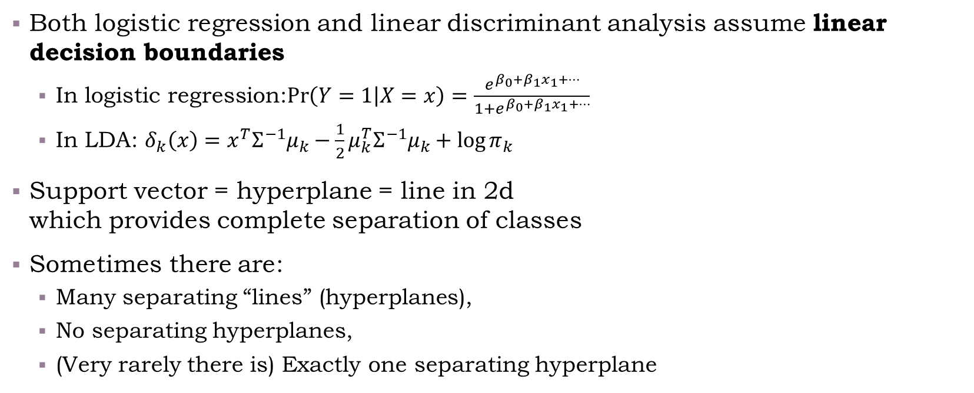
Separating Hyperplanes
Both logistic regression and linear discriminant analysis assume linear decision boundaries
In logistic regression:$\operatorname{Pr}\left(Y=1 | X=x\right)=\frac{e^{β_{0}+β_{1}x_{1}+…}}{1+e^{β_{0}+β_{1}x_{1}+…}}$
In LDA: $δ_{k}\left(x\right)=x^{T}Σ^{−1}μ_{k}−\frac{1}{2}μ_{k}^{T}Σ^{−1}μ_{k}+\log{π_{k}}$
Support vector = hyperplane = line in 2d which provides complete separation of classes
Sometimes there are:
Many separating “lines” (hyperplanes),
No separating hyperplanes,
(Very rarely there is) Exactly one separating hyperplane
separating hyperplane

Slide 5
What is an “Optimal” Separator?
Out of the possible hyperplanes, which is “better”?

Slide 6
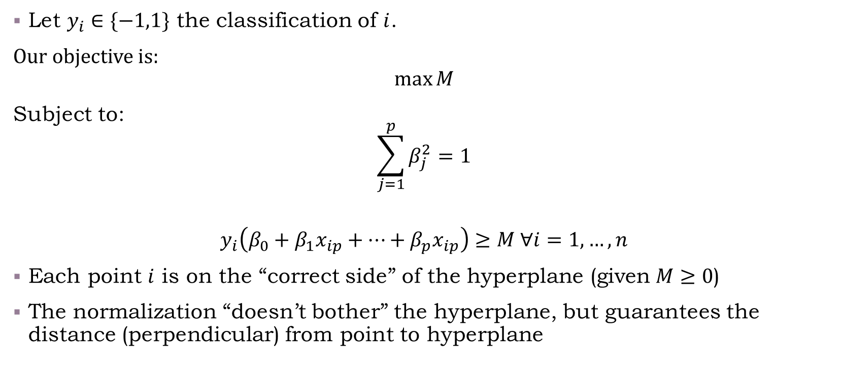
Maximal Margin Separator
Let $y_{i}∈\{−1,1\}$ the classification of $i$.
Our objective is:
$$\max{M}$$
Subject to:
$$\sum_{j=1}^{p}{β_{j}^{2}=1}$$
$$y_{i}\left(β_{0}+β_{1}x_{ip}+…+β_{p}x_{ip}\right)≥M ∀i=1,…,n$$
Each point $i$ is on the “correct side” of the hyperplane (given $M≥0$)
The normalization “doesn’t bother” the hyperplane, but guarantees the distance (perpendicular) from point to hyperplane
Notes:
For additional information about how to find \beta, see ESLII pages 132-135, and pages 418-421. It turns out to be a convex optimization problem. The technical details are interesting (for those of you interested in optimization, check it out).

Slide 7
Margin Separator
Live coding example
/class code/03-Hyperplane_illustration.R

Slide 8
Support Vector Classifier
Sometimes a separating hyperplane does not exist
We can still find a hyperplane which would do a good job with classification, but our previous optimization problem would be infeasible
Correction: Allow for some misclassifications to find a viable hyperplane

Slide 9
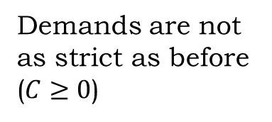

Support Vector Classifier
Correction: Allow for some misclassifications to find a viable hyperplane
Our objective is:
$$\max{M}$$
Subject to:
$$\sum_{j=1}^{p}{β_{j}^{2}=1}$$
$$y_{i}\left(β_{0}+β_{1}x_{ip}+…+β_{p}x_{ip}\right)≥M\left(1−ε_{i}\right) ∀i=1,…,n$$
$$ε_{i}≥0, ∑ε_{i}≤C$$
Demands are not as strict as before
($C≥0$)

Slide 10

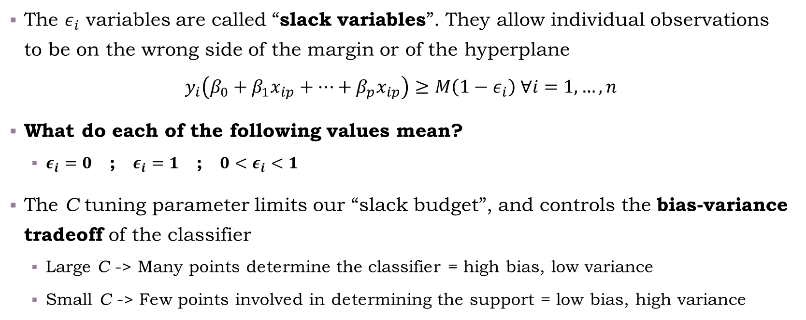
Slack (not )
The $ε_{i}$ variables are called “slack variables”. They allow individual observations to be on the wrong side of the margin or of the hyperplane
$$y_{i}\left(β_{0}+β_{1}x_{ip}+…+β_{p}x_{ip}\right)≥M\left(1−ε_{i}\right) ∀i=1,…,n$$
What do each of the following values mean?
$ε_{i}=0$ ; $ε_{i}=1$ ; ${0<ε}_{i}<1$
The C tuning parameter limits our “slack budget”, and controls the bias-variance tradeoff of the classifier
Large C -> Many points determine the classifier = high bias, low variance
Small C -> Few points involved in determining the support = low bias, high variance

Slide 11
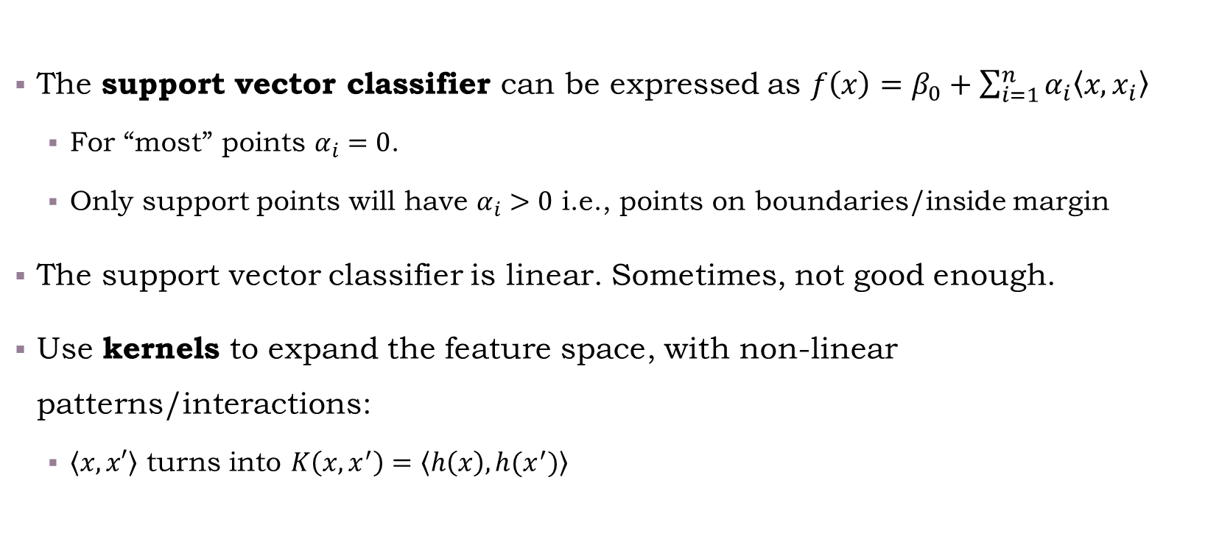
Support Vector Machines
The support vector classifier can be expressed as $f\left(x\right)=β_{0}+\sum_{i=1}^{n}{α_{i}\left\langle x,x_{i}\right\rangle }$
For “most” points $α_{i}=0$.
Only support points will have $α_{i}>0$ i.e., points on boundaries/inside margin
The support vector classifier is linear. Sometimes, not good enough.
Use kernels to expand the feature space, with non-linear patterns/interactions:
$\left\langle x,x′\right\rangle$ turns into $K\left(x,x^{′}\right)=\left\langle h\left(x\right),h(x^{′})\right\rangle$
Notes:
Details on the formulation of the inner product are given in ESLII pages 132-135, and pages 418-421.

Slide 12

Examples for Kernels
dth-Degree polynomial (separating hyperplane -> a polynomial separator)
$K\left(x,x^{′}\right)={\left(1+〈x,x^{′}〉\right)}^{d}$
Radial basis (“circular” decision rule)
$K\left(x,x^{′}\right)=\exp\left(−γ{\left\|x−x^{′}\right\|}^{2}\right)$
Neural network
$K\left(x,x^{′}\right)=\tanh\left(κ_{1}〈x,x^{′}〉+κ_{2}\right)$
Source: Introduction to Statistical Learning, Chapter 9.3 (Support Vector Machines) Pages 349, 353
Notes:
Pages 356-359 in ISLR provide very good intuition on the relationship between SVMs and logistic regression. A recommended read.

Slide 13

Multiple Classes
One versus one
Build $\left(\begin{matrix}k \\ 2\end{matrix}\right)$ classifiers, choose the one mostly “voted for”
One versus many
Build $K$ classifiers
For each point $x_{i}$, set its class according to the classifier with the highest $β_{k}^{t}x_{i}$

Slide 14
Illustration of SVM
Hands-on demonstration:
/Class Code/03-SVM_example.R

Slide 15
Contents for today
Unsupervised learning
Supervised learning
Methods
Models
Model evaluation
ROC/AUC
Linear methods
Classification
Regression
Cross validation
Discriminant Analysis
Logistic regression
Support Vector Machines (SVM)
Trees, Forests, Boosting, etc.
k-fold xval
Leave one out

Slide 16
Cross Validation

Slide 17
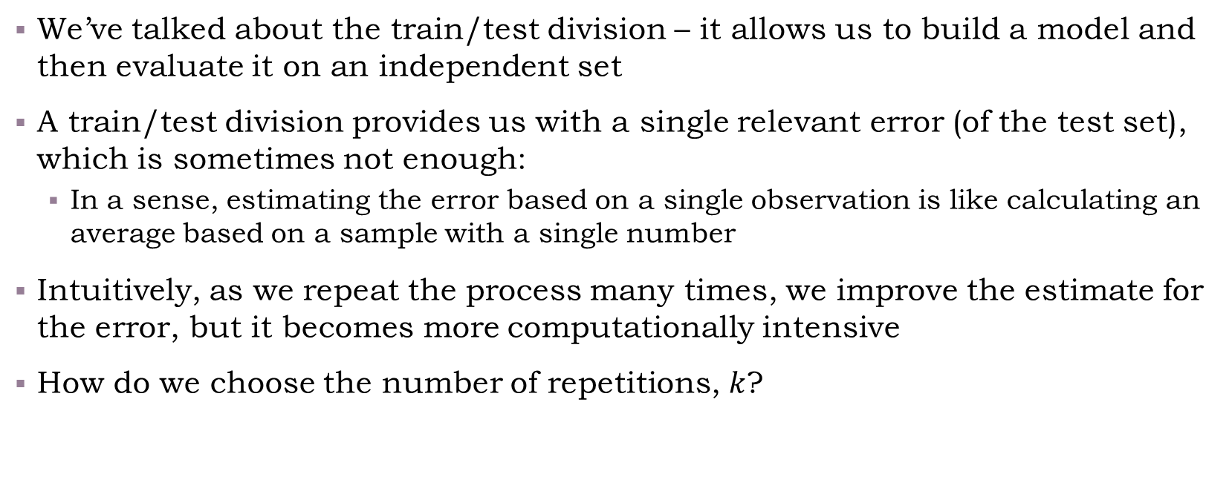
Why Cross Validation?
We’ve talked about the train/test division – it allows us to build a model and then evaluate it on an independent set
A train/test division provides us with a single relevant error (of the test set), which is sometimes not enough:
In a sense, estimating the error based on a single observation is like calculating an average based on a sample with a single number
Intuitively, as we repeat the process many times, we improve the estimate for the error, but it becomes more computationally intensive
How do we choose the number of repetitions, $k$?

Slide 18
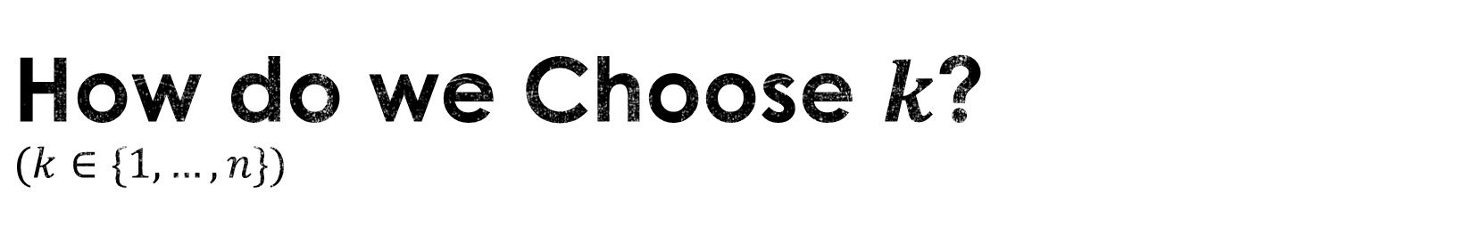
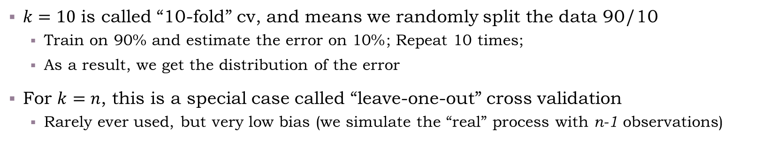
How do we Choose $k$? $$(k∈\{1,…,n\})$$
$k=10$ is called “10-fold” cv, and means we randomly split the data 90/10
Train on 90% and estimate the error on 10%; Repeat 10 times;
As a result, we get the distribution of the error
For $k=n$, this is a special case called “leave-one-out” cross validation
Rarely ever used, but very low bias (we simulate the “real” process with n-1 observations)
Computational intensity, Variance increases
Bias decreases
Train/Validation
(i.e., 50/50, once)
k-fold, k=10
Leave one out
Intuition: In LOOCV we’re essentially using almost “the same” version of train set
This yields lower bias, but highly correlated models provide high variance
Notes:
The explanation here of bias-variance tradeoff of the test set error is somewhat “hand waving”. If you’re interested, it is also explained in pages 183-184 in ISLR.

Slide 19
Estimating Error vs. Parameter Tuning
The cross-validation is utilized for various tasks:
When we want to provide an estimate for a model’s performance (KPI’s such as MSE, Type-I/II errors, etc.)
Compare modelling approaches and we want to choose a model which yields the lowest error (or the lowest error variance/bias/etc.)
When we want to tune hyper-parameters within our model, e.g.: In the svm example, find the optimal cost parameter (which yields the minimum classification error), or in knn find the optimal number of neighbors.

Slide 20
Live Coding Example k-fold cv
/class code/03-cv_example.R

Slide 21
Contents for today
Unsupervised learning
Supervised learning
Methods
Models
Model evaluation
ROC/AUC
Linear methods
Classification
Regression
Cross validation
Discriminant Analysis
Logistic regression
Support Vector Machines (SVM)
Trees, Forests, Boosting, etc.
k-fold xval
Leave one out

Slide 22
Classification and Regression Trees

Slide 23
Building Trees
Classification and Regression Trees is an algorithm used to divide the space into sub-regions. In each region the prediction is given according to the observations which “reside” in the region.
This makes trees a very flexible model.
Trees can be used for either regression or classification.
Caution, flexibility = very high bias = can be easily abused into over-fitting.

Slide 24









Example: How a Tree Classifies
Plane ($p=2$, two classes)
Example tree
Train set error:
Err 46%
Root
$$x_{2}$$
7
6
$$x_{2}≤t_{1}$$
yes
no
$$t_{1}$$
Err 23%
6
2
1
4
$$x_{1}≤t_{2}$$
$$x_{1}≤t_{3}$$
Err 8%
y
n
y
n
Leaf
Leaf
Leaf
Leaf
0
2
6
0
0
4
1
0
$$t_{2}$$
$$t_{3}$$
$$x_{1}$$
Err 0%

Slide 25
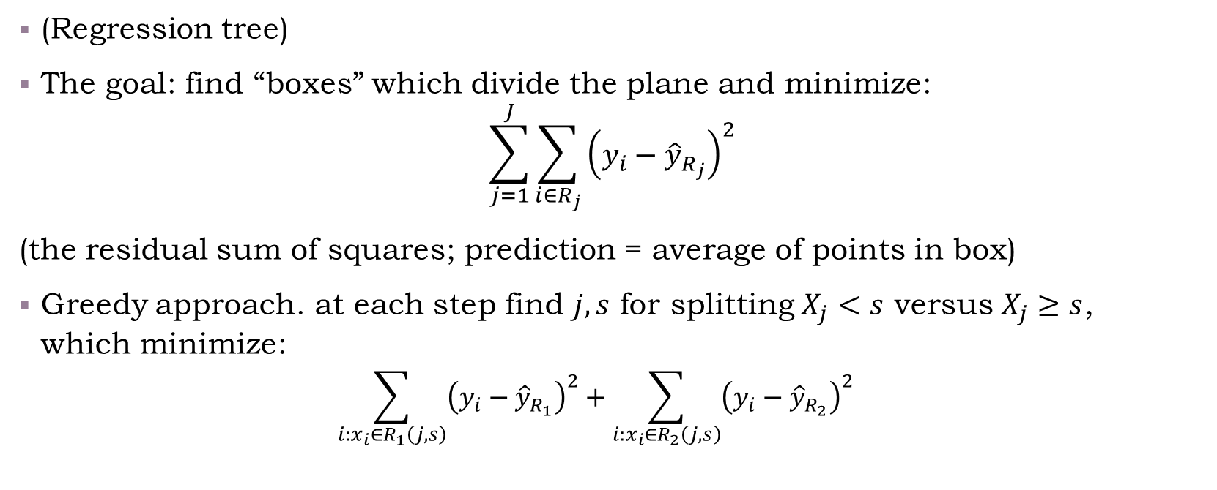
How a Tree is Grown?
(Regression tree)
The goal: find “boxes” which divide the plane and minimize:
$$\sum_{j=1}^{J}{\sum_{i∈R_{j}}{{\left(y_{i}−{\hat{y}}_{R_{j}}\right)}^{2}}}$$
(the residual sum of squares; prediction = average of points in box)
Greedy approach. at each step find $j,s$ for splitting $X_{j}<s$ versus $X_{j}≥s$, which minimize:
$$\sum_{i:x_{i}∈R_{1}\left(j,s\right)}{{\left(y_{i}−{\hat{y}}_{R_{1}}\right)}^{2}}+\sum_{i:x_{i}∈R_{2}\left(j,s\right)}{{\left(y_{i}−{\hat{y}}_{R_{2}}\right)}^{2}}$$
Recursive binary splitting

Slide 26
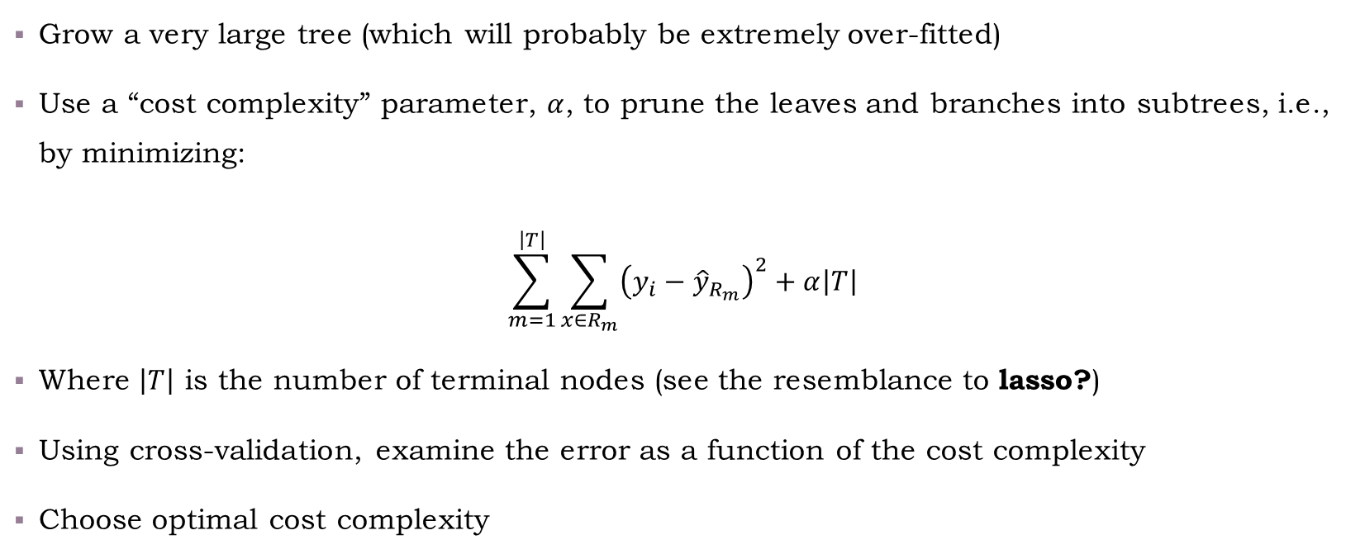
Tree Pruning
Grow a very large tree (which will probably be extremely over-fitted)
Use a “cost complexity” parameter, $α$, to prune the leaves and branches into subtrees, i.e., by minimizing:
$$\sum_{m=1}^{\left|T\right|}{\sum_{x∈R_{m}}{{\left(y_{i}−{\hat{y}}_{R_{m}}\right)}^{2}+α\left|T\right|}}$$
Where $\left|T\right|$ is the number of terminal nodes (see the resemblance to lasso?)
Using cross-validation, examine the error as a function of the cost complexity
Choose optimal cost complexity

Slide 27
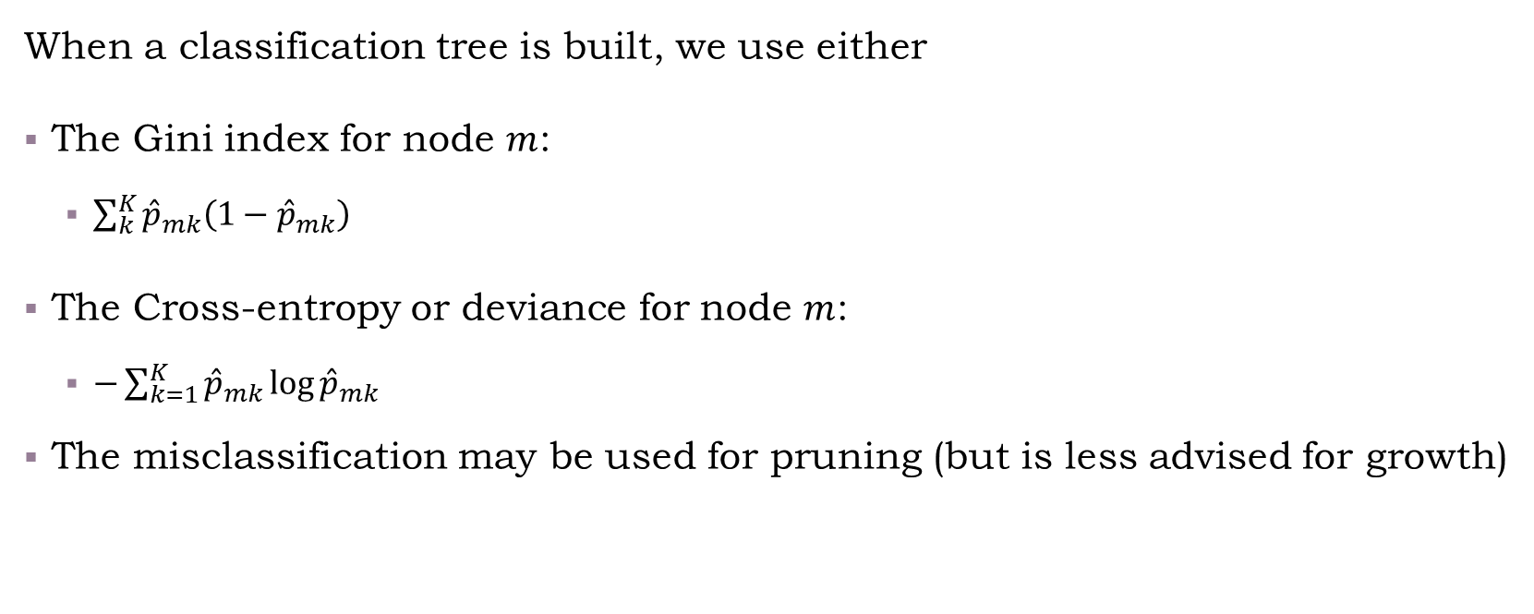
Classification Trees
When a classification tree is built, we use either
The Gini index for node $m$:
$\sum_{k}^{K}{{\hat{p}}_{mk}\left(1−{\hat{p}}_{mk}\right)}$
The Cross-entropy or deviance for node $m$:
$−\sum_{k=1}^{K}{{\hat{p}}_{mk}\log{{\hat{p}}_{mk}}}$
The misclassification may be used for pruning (but is less advised for growth)
Notes:
For details about measures and why misclassification is not that advised, see ESLII pages 309-310.

