Slide 1
Classification Methods
July 2019
It is only when they go wrong that machines remind you how powerful they are.
- Clive James

Slide 2
Contents for today
Unsupervised learning
Supervised learning
Methods
Models
Model evaluation
Linear methods
Classification
Regression
Linear (LDA)
Discriminant Analysis
Logistic regression
Support Vector Machines (SVM)
Quadratic (QDA)

Slide 3
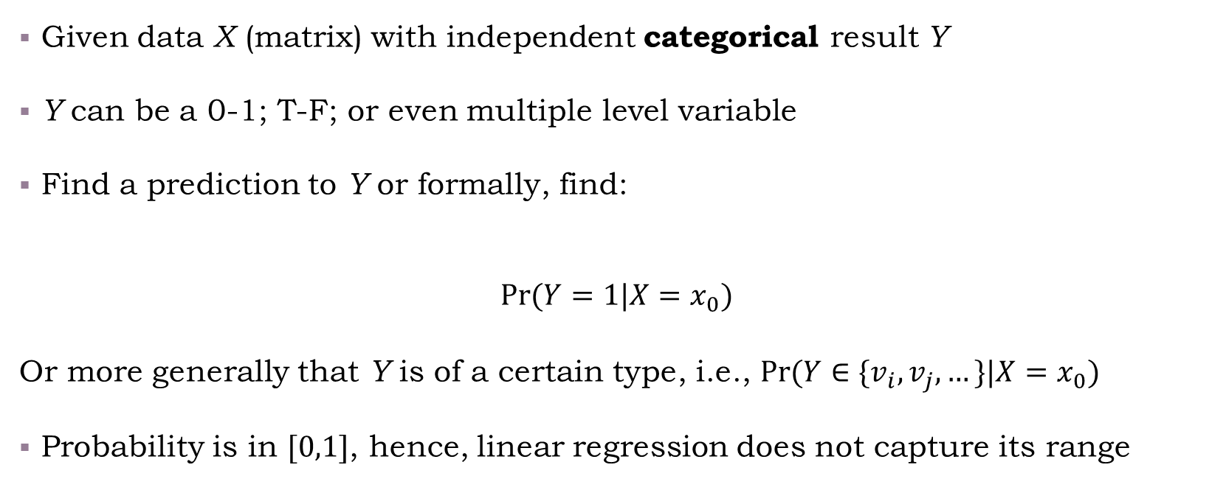
Background
Given data X (matrix) with independent categorical result Y
Y can be a 0-1; T-F; or even multiple level variable
Find a prediction to Y or formally, find:
$$\operatorname{Pr}{(Y=1|X=x_{0})}$$
Or more generally that Y is of a certain type, i.e., $Pr⁡(Y∈\{v_{i},v_{j},…\}|X=x_{0})$
Probability is in $[0,1]$, hence, linear regression does not capture its range

Slide 4

Classification accuracy
How would we measure accuracy?
Objective: e.g., likelihood function, vs.:
Performance: e.g., Confusion matrix (misclassification), ROC, AUC,…
Objective
Performance
Entropy
Likelihood
Type-I
ROC
Gini
Bayes
Type-II
AUC
Separator Margin
…
Operational Implications
…
Sanity check:
Objectives vs. performance in lm

Slide 5
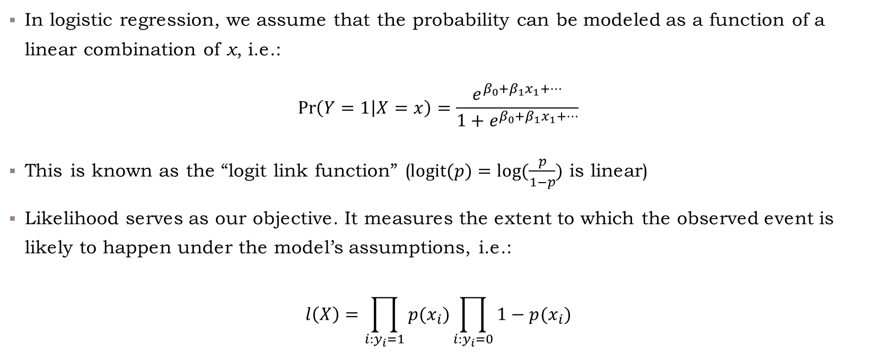
Logistic regression and likelihood
In logistic regression, we assume that the probability can be modeled as a function of a linear combination of x, i.e.:
$$\operatorname{Pr}\left(Y=1 | X=x\right)=\frac{e^{β_{0}+β_{1}x_{1}+…}}{1+e^{β_{0}+β_{1}x_{1}+…}}$$
This is known as the “logit link function” ($\text{logit}(p)=log⁡(\frac{p}{1−p})$ is linear)
Likelihood serves as our objective. It measures the extent to which the observed event is likely to happen under the model’s assumptions, i.e.:
$$l\left(X\right)=\prod_{i:y_{i}=1}{p(x_{i})}\prod_{i:y_{i}=0}{1−p(x_{i})}$$

Slide 6

Finding the optimal $β$
In the linear regression case, we had a closed analytical form of the solution
With logistic regression there is no closed analytical form to solve the max(log-likelihood), instead optimization algorithms such as Newton-Raphson are employed (see ESLII p.120-122)
Logistic regression example:
/class code/02-classification.Rmd

