Slide 1
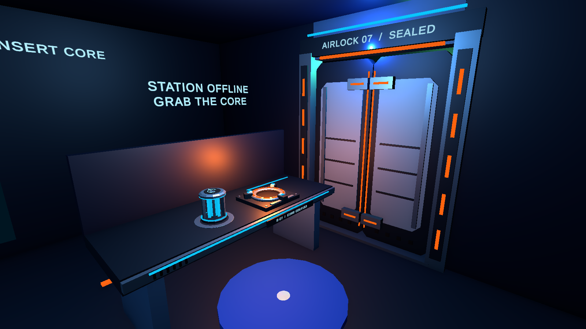
WEEK 07 MIDTERM
Lost Station
Restart the Hatch
A one-room VR repair prototype
Wang Haobin
Independent student group
UNITY EDITOR PREVIEW / WEEK 07 HARDWARE
Notes:
讲述建议（约 20 秒）：我的一人小组开发了单房间 VR 维修游戏。玩家恢复供电后穿过舱门到达出口。第七周更新了笼架式能量核心、配套夹爪插槽和分段双门动画。本页图片是 Unity Editor 场景预览，不是 Quest 实机。
Source: C:\Users\31797\Documents\ChatGPT\作业 3\VR_Project_2026_2\CourseValidation\Runtime\Week07_Station_EditorPreview.png
Prior presentation visual reference: C:\Users\31797\Documents\ChatGPT\作业 3\VR_Presentation_20261008\output\Lost_Station_ZH_KO_20261008.pptx

Slide 2
One short task from power loss to exit
The player can finish the complete loop in one room.
01
02
03
04
05
TELEPORT
GRAB
INSERT
OPEN
EXIT
Move to the blue repair pad
Pick up the E-07 energy core
Release it at the amber coupler
Watch both door panels slide apart
Cross the doorway
Interaction rule
The core must be grabbed, then released close to the socket.
The clamps engage, the locks retract, and both doors open.
WANG HAOBIN / WEEK 07 MIDTERM
02
Notes:
讲述建议（约 45 秒）：用五步解释玩法。抓取后必须在插槽附近松开，单纯接近插槽不会触发。三只夹爪固定核心，门锁缩回，双门滑开，通行灯变绿，再走到出口。完整开门动画的实现时长为 2.65 秒。
Source: C:\Users\31797\Documents\ChatGPT\作业 3\VR_Project_2026_2\Assets\02_Scripts\SpaceStationMission.cs
Source: C:\Users\31797\Documents\ChatGPT\作业 3\VR_Project_2026_2\Assets\02_Scripts\SpaceStationHardware.cs
Source: C:\Users\31797\Documents\ChatGPT\作业 3\VR_Project_2026_2\Docs\Week06_UI_Peer_Test.md

Slide 3
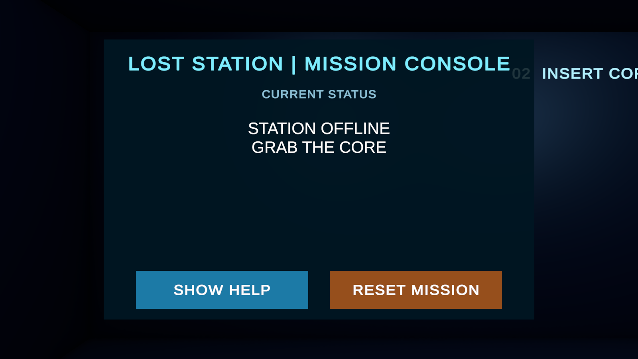
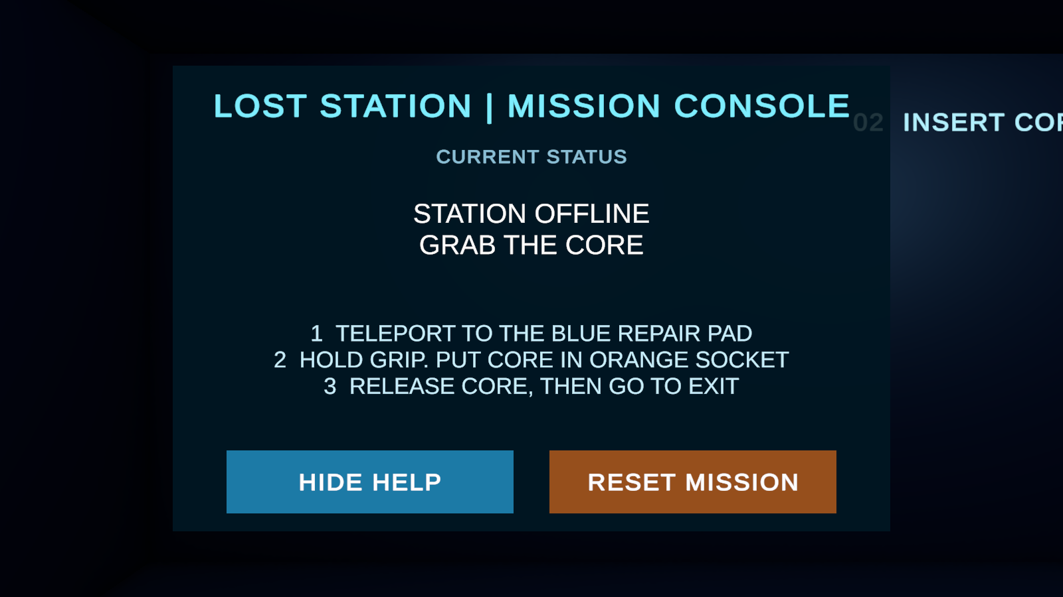
Mission Console makes the next step visible
English status, help and reset controls were added to the world-space panel.
INITIAL STATUS
HELP EXPANDED
Unity Editor previews. Ray-button clicks and headset readability still require Play and Quest checks.
WANG HAOBIN / WEEK 07 MIDTERM
03
Notes:
讲述建议（约 55 秒）：首次玩家可能不知道下一步操作，任务面板用英文状态和三步帮助说明目标。SHOW HELP/HIDE HELP 与 RESET MISSION 已接入场景。截图为 Unity Editor 预览，不能把它说成 Quest 测试。
Source: C:\Users\31797\Documents\ChatGPT\作业 3\VR_Project_2026_2\Docs\Week06_Team_Integration.md
Images: C:\Users\31797\Documents\ChatGPT\作业 3\VR_Project_2026_2\CourseValidation\Runtime\Week06_UI_Status_EditorPreview.png ; C:\Users\31797\Documents\ChatGPT\作业 3\VR_Project_2026_2\CourseValidation\Runtime\Week06_UI_Help_EditorPreview.png

Slide 4
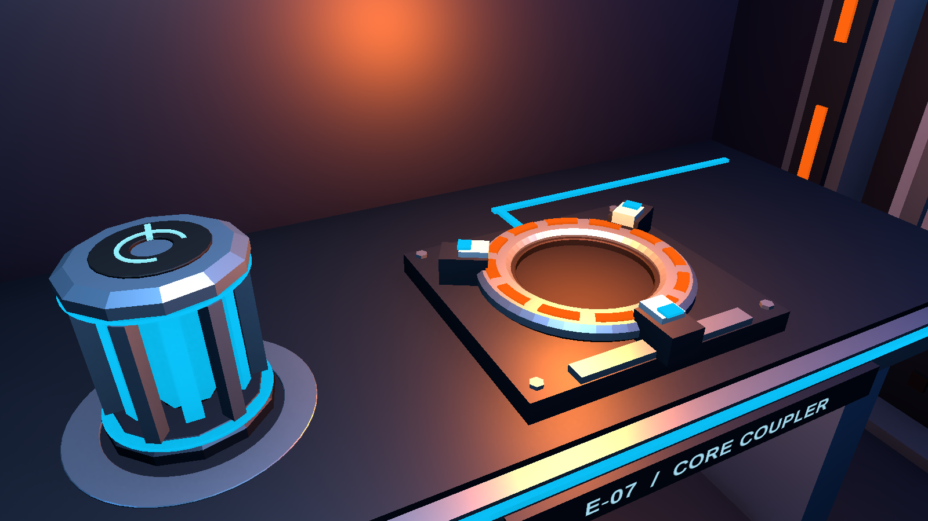
Core, coupler and airlock feedback
E-07 ENERGY CORE
2.65-SECOND OPENING SEQUENCE
1 Clamps secure the core
2 Door locks retract
3 Twin panels slide apart
4 Passage lights turn green
One mission state drives the status panel,
indicator lights and mechanism audio.
Metal cage, cyan crystal and three-clamp coupler
Implemented in Unity. This image shows the Editor preview; runtime and device checks are separate.
Unity Editor preview. Quest handling remains pending.
WANG HAOBIN / WEEK 07 MIDTERM
04
Notes:
讲述建议（约 60 秒）：Meta XR 仍负责传送、抓取和射线输入。任务状态连接任务面板与硬件反馈。本周将小球改为带金属笼架和青色晶体的 E-07 核心，配套插槽带三只夹爪和分段灯环。完整开门过程实现为 2.65 秒，依次固定核心、缩回锁扣、双门向两侧滑开、通行灯变绿，并播放机械音效。图中为 Unity Editor 预览，不能视为实际控制器、Quest 性能或触觉测试结果。
Source: C:\Users\31797\Documents\ChatGPT\作业 3\VR_Project_2026_2\Assets\02_Scripts\SpaceStationHardware.cs
Source: C:\Users\31797\Documents\ChatGPT\作业 3\VR_Project_2026_2\Assets\Editor\StationHardwareBuilder.cs
Image: C:\Users\31797\Documents\ChatGPT\作业 3\VR_Project_2026_2\CourseValidation\Runtime\Week07_CoreDock_EditorPreview.png

Slide 5
Next checks use a peer and a Quest headset
10-MINUTE FIRST-USE TEST
QUEST DEVICE CHECK
One classmate attempts the complete task without step-by-step coaching.
Install the Week 07 APK and replay the task with controllers.
Record pauses, requests for help, button use and completion. Fix the highest-priority issue, then retest the same task.
Check panel readability, teleport, grip, sound, vibration and comfort. Record the real-headset playthrough after verification.
As of 20 Oct: peer observations and Quest footage have not yet been collected.
WANG HAOBIN / WEEK 07 MIDTERM
05
Notes:
讲述建议（约 45 秒）：同学明天可试玩约十分钟；我会记录卡住位置、严重度，修复最重要的问题，并请同一同学做相同任务复测。Quest 也安排明天连接，此前不报告真人观察结果或真机视频。
Source: C:\Users\31797\Documents\ChatGPT\作业 3\VR_Project_2026_2\Docs\Week06_UI_Peer_Test.md
Source: C:\Users\31797\Documents\ChatGPT\作业 3\VR_Project_2026_2\Docs\Week07\Wang_VR_Week07_CreativeAward_Draft.docx

Slide 6
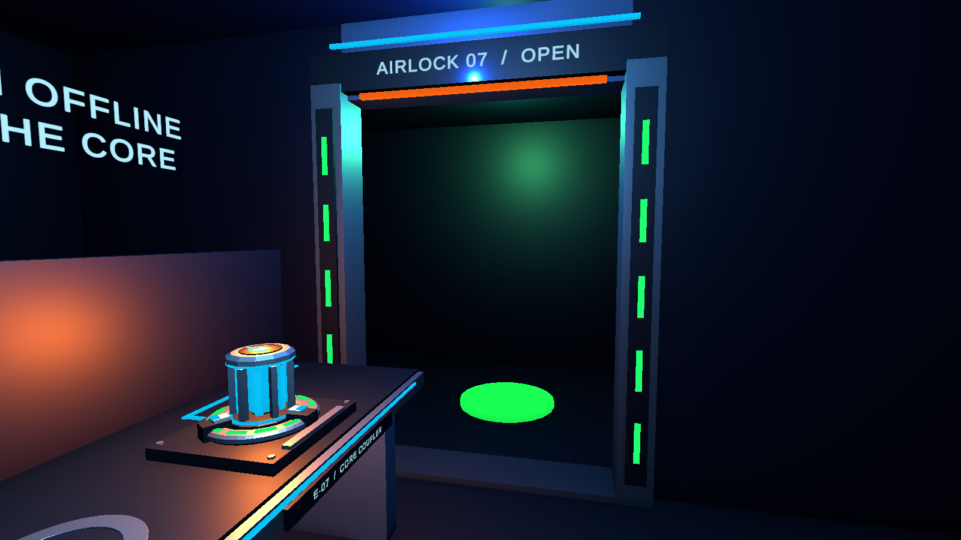
Six-minute live demo sequence
0:00–1:00
Start, read the status, open Help
1:00–2:00
Teleport to the repair pad
2:00–3:00
Grip and move the energy core
3:00–4:00
Release at the socket; show the doors
Current Unity Editor preview
4:00–5:00
Cross to EXIT; show completion
Quest recording follows the device test.
5:00–6:00
Reset and answer questions
WANG HAOBIN / WEEK 07 MIDTERM
06
Notes:
讲述建议（演示约 6 分钟）：演示时依次操作面板、传送、抓取、松开插入、观看夹爪与双门动画、到出口、重置。如改为录像，必须在 Quest 实机录制后使用真实画面。本页右侧是当前双门完全打开时的 Unity Editor 预览，不是视频帧，也不是 Quest 实机。
Image: C:\Users\31797\Documents\ChatGPT\作业 3\VR_Project_2026_2\CourseValidation\Runtime\Week07_AirlockOpen_EditorPreview.png
Source: C:\Users\31797\Documents\ChatGPT\作业 3\VR_Project_2026_2\Docs\Week06_UI_Peer_Test.md

