Slide 1


Medical Imaging × AI for Interventional Guidance
Research & Project Highlights (Medical Imaging)
Yihao Chen（陈奕好）
College of Engineering, Peking University
Feb 2026
chenyihao@stu.pku.edu.cn
github.com/ChenNeuro
Notes:
Hi Hao and Teo, thanks for taking the time to meet with me today. My name is Yihao Chen, an undergraduate student at Peking University. Broadly, I’m interested in sensing and real-world robot interaction—especially how we can use multimodal sensing like IMU, force/pressure, and vision to build reliable perception-to-action loops for contact-rich tasks.
In the next ~15 minutes, I’ll give a quick overview of a few projects I’ve worked on. I’ll organize them in a simple way: first, sensor integration and signal processing; second, robot system building and mechanism design; and third, how I try to use those signals for estimation and control to improve robustness in real environments. For each project, I’ll keep the story concise: what problem I tried to solve, what I built or implemented, what results I got, and what I would do next.
After that, I’d love to hear your thoughts on where my background could fit best in BDML this summer, and I also have a few questions about the kinds of projects and expectations in the lab.
Hao、Teo 你们好，谢谢你们愿意跟我聊一聊。我是陈奕好，北大工学院本科生，专业方向是理论力学和机器人双主修，在周培源书院就读，可以理解为提高班。
我感兴趣的研究方向是：怎么让机器人在真实环境里“敢接触、能接触、接触得稳”。所以我做项目时会很在意传感到控制这一层——比如 IMU、力/压力这些信号，怎么采、怎么对齐、怎么变成对控制有用的信息，最后把它用进闭环里，让系统更稳定、更可靠。
我大概用 15 分钟过一下我做过的几个项目。我会按三个块讲：
第一、系统/机构这类从零搭起来的东西；
第二、多传感集成和信号处理；
第三、把这些信号用到估计和控制里，去提升鲁棒性。
每个项目思路是：我当时想解决什么问题、我具体做了什么、效果怎么样、以及我觉得下一步还能怎么做。
讲完之后我也很想听听你们的建议：如果暑研能加入 BDML，我更适合从哪些方向切进去、你们觉得我该优先补哪些能力。另外我也准备了几个关于你们组项目节奏和期待的问题想请教。

Slide 2
Agenda
1
Quick intro & strengths (skills + working style)
2
Background & research interests (medical imaging)
3
Ongoing Projects: coronary reconstruction, CT–DSA 3D–2D registration, vessel topology modeling
4
Discussion
Notes:
Here’s the plan for today. I’ll start with a quick intro and what I can bring, then walk through three representative projects—one on sensing system integration, one on mechanical prototyping, and one ongoing research effort. After that, I’ll explain why I’m interested in BDML and what I hope to work on this summer, and then we can open it up for discussion.
我今天大概按四步来：先用很短的时间说一下我是谁、我擅长什么；然后用三个项目作为代表，分别对应传感系统、机械原型和我正在做的研究；接着我会讲我为什么想来 BDML、以及暑研我希望切入的方向；最后我们就自由讨论和提问。

Slide 3
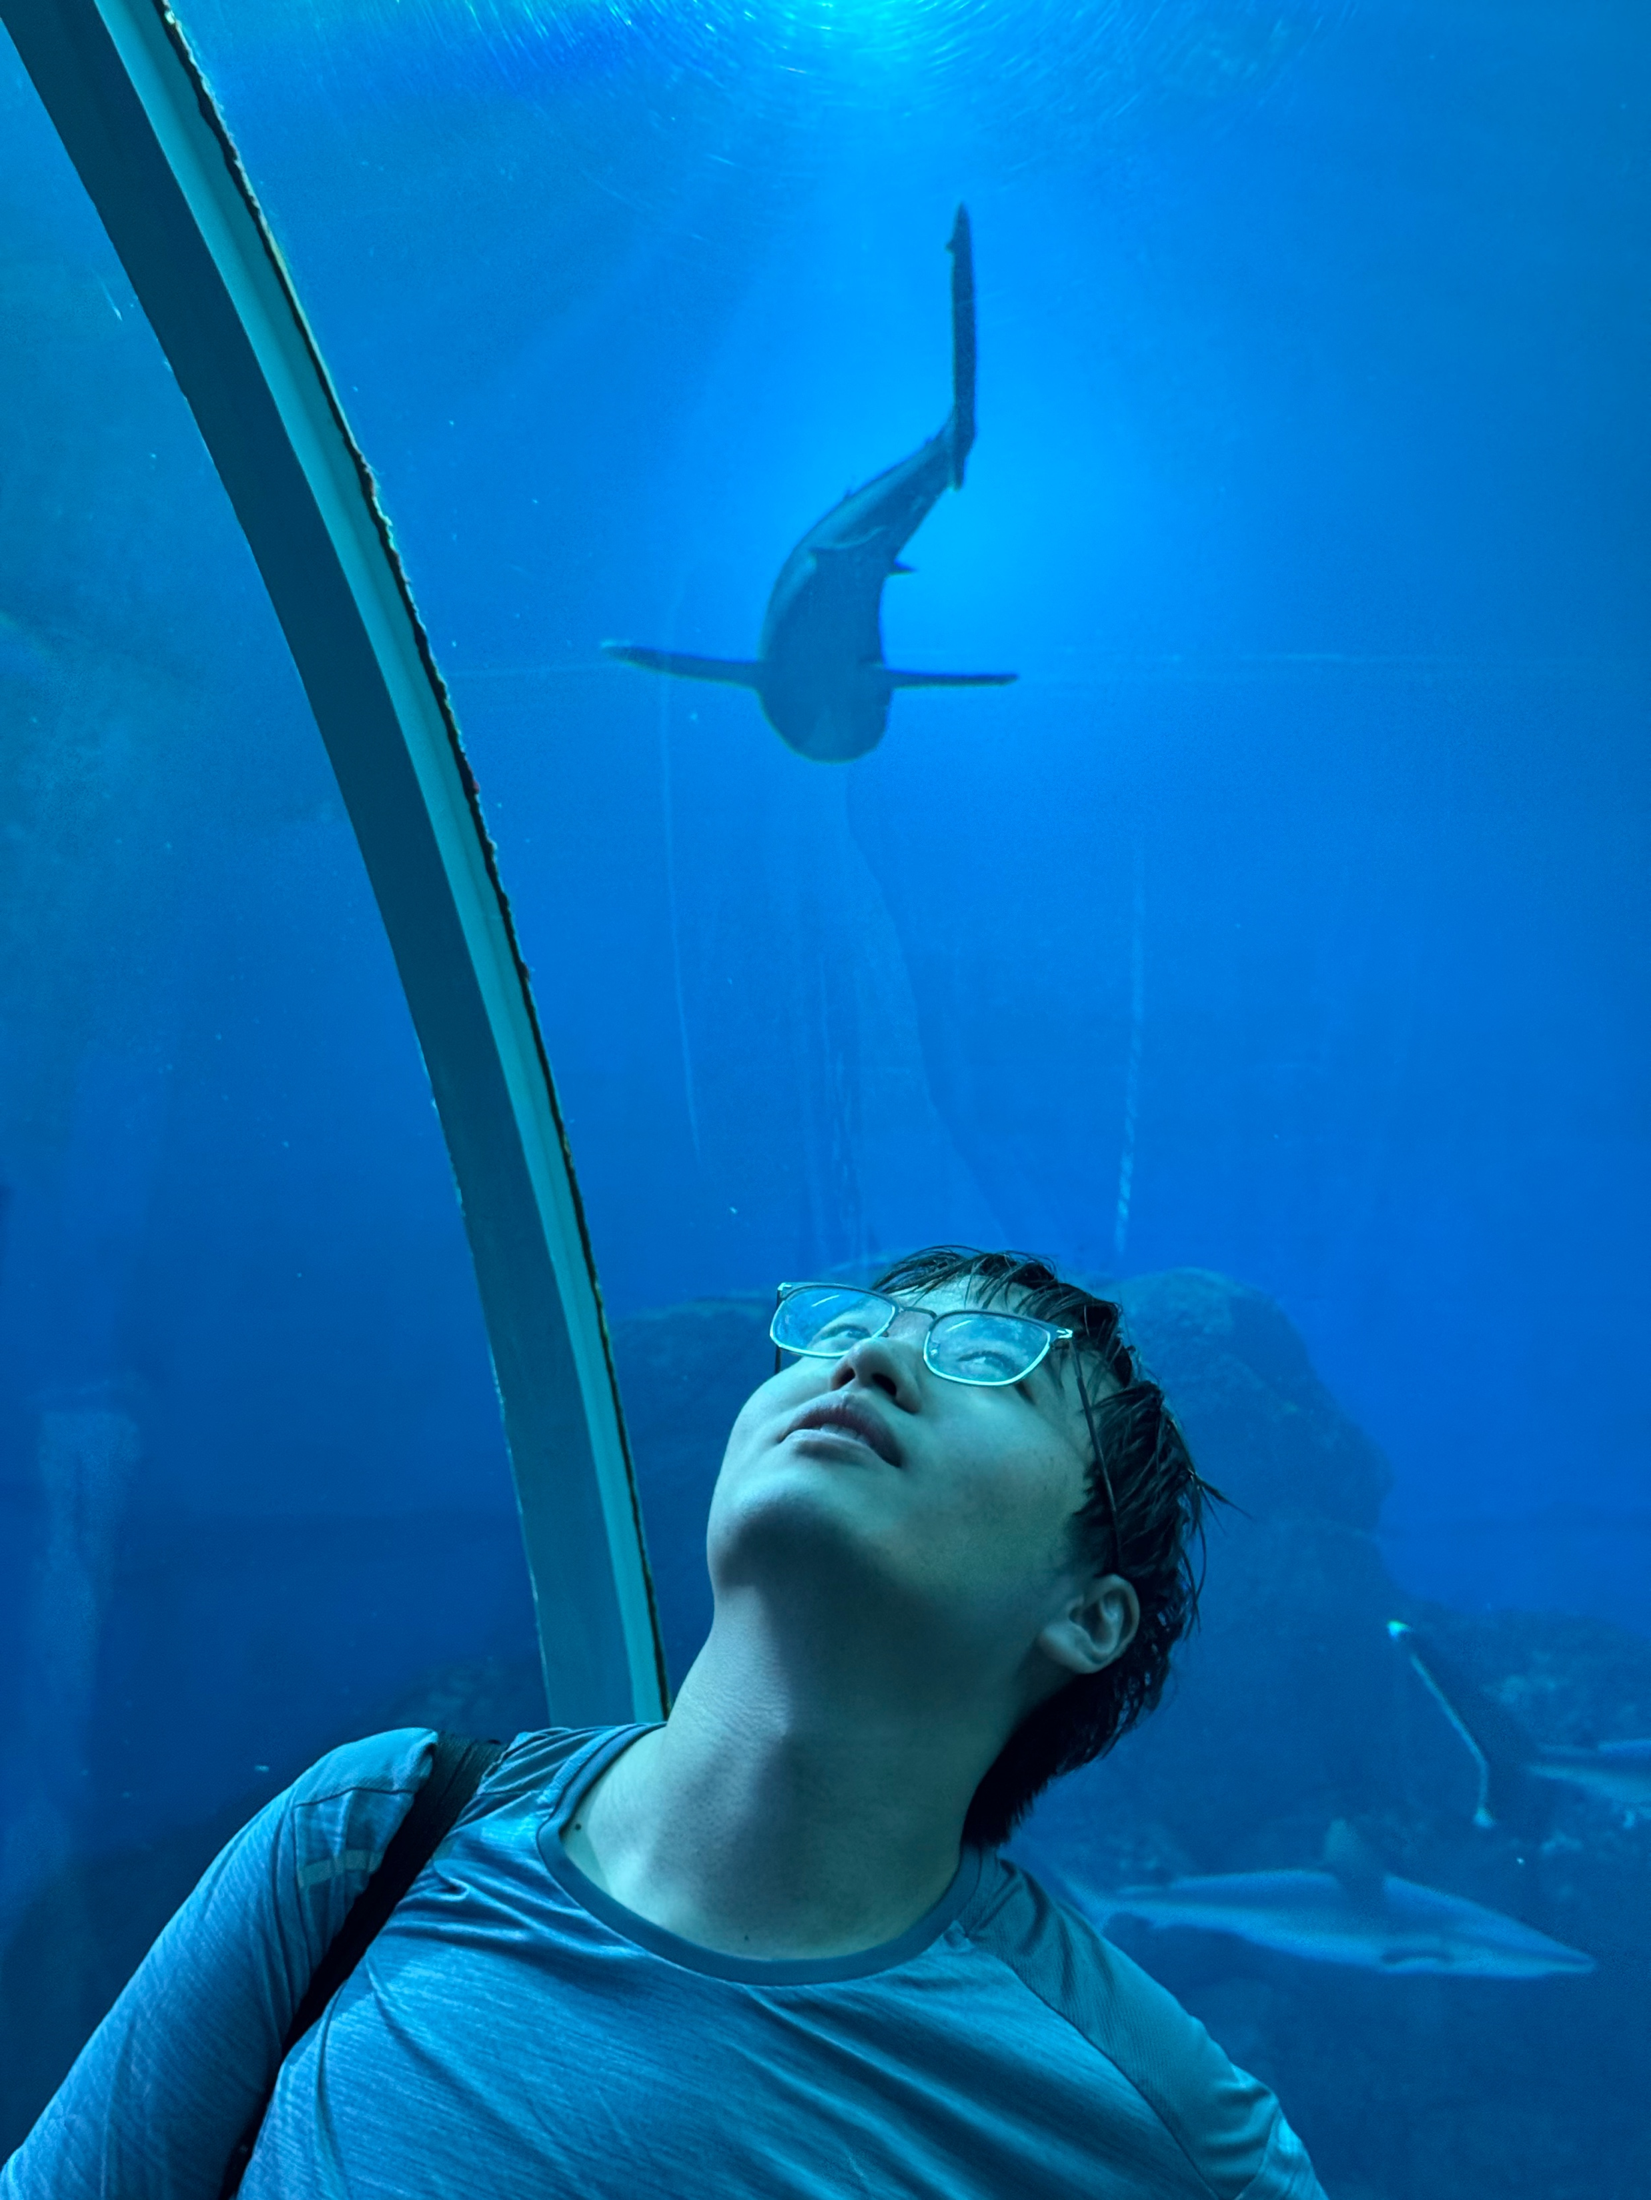

Quick intro & strengths
Yihao Chen（陈奕好）
Medical Imaging | 3D–2D Registration | Temporal Modeling
Build end-to-end imaging pipelines (data → preprocessing → model → evaluation)
Combine geometry constraints with learning (registration, centerline/topology priors)
Reproducible research habits: scripts, ablations, reports
Cross-domain engineering: sensing/robotics experience transfers to real-time systems
Interests: multimodal medical foundation models · temporal modeling for cine/DSA · generative reconstruction
Notes:
Four quick points: I can build end-to-end prototypes; I integrate sensors and produce clean synchronized logs; I debug by isolating failure modes with quick checks; and I work proactively with clear updates and documentation.
And in terms of research interests, I’m particularly excited about tactile and multimodal sensing for robust contact-rich interaction—especially in settings like underwater manipulation where uncertainty and contact make everything harder.
四点要点如下：我能构建端到端的原型；我能整合传感器并生成清晰同步的日志；我能通过快速检查来定位故障模式进行调试；并且我能主动与他人合作，提供明确的更新和文档说明。
至于研究兴趣方面，我对触觉和多模态传感在具有大量接触的可靠交互中的应用尤其感兴趣——特别是在像水下操作这样的环境中，不确定性以及接触因素使得一切变得更加困难。

Slide 4
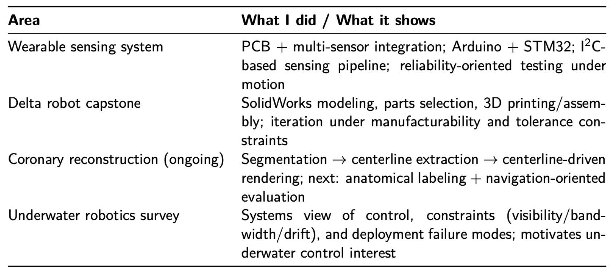
Experience map
Notes:
I’ll use this slide as a map for the rest of the talk.
The wearable sensing project shows my strength in sensor integration and reliability-oriented testing.
The delta robot project is about rapid prototyping under manufacturability and tolerance constraints.
The coronary reconstruction work is my ongoing research, where I combine an algorithmic pipeline with evaluation and iteration.
And finally, the underwater robotics survey gives me a systems view of real deployment constraints—visibility, bandwidth, drift—which is also why I’m excited about robust contact-rich interaction.
我将用这张幻灯片作为接下来演讲的示意图。
可穿戴传感项目展示了我在传感器集成以及可靠性测试方面的能力。
Delta 机器人项目涉及在可制造性和公差限制条件下进行快速原型制作。
冠状动脉重建工作是我正在进行的研究，其中我将算法流程与评估和迭代相结合。
最后，水下机器人调查让我对实际部署的限制（如可见度、带宽、漂移）有了系统性的认识——这也是我对丰富且具有接触性的稳健交互感到兴奋的原因。

Slide 5
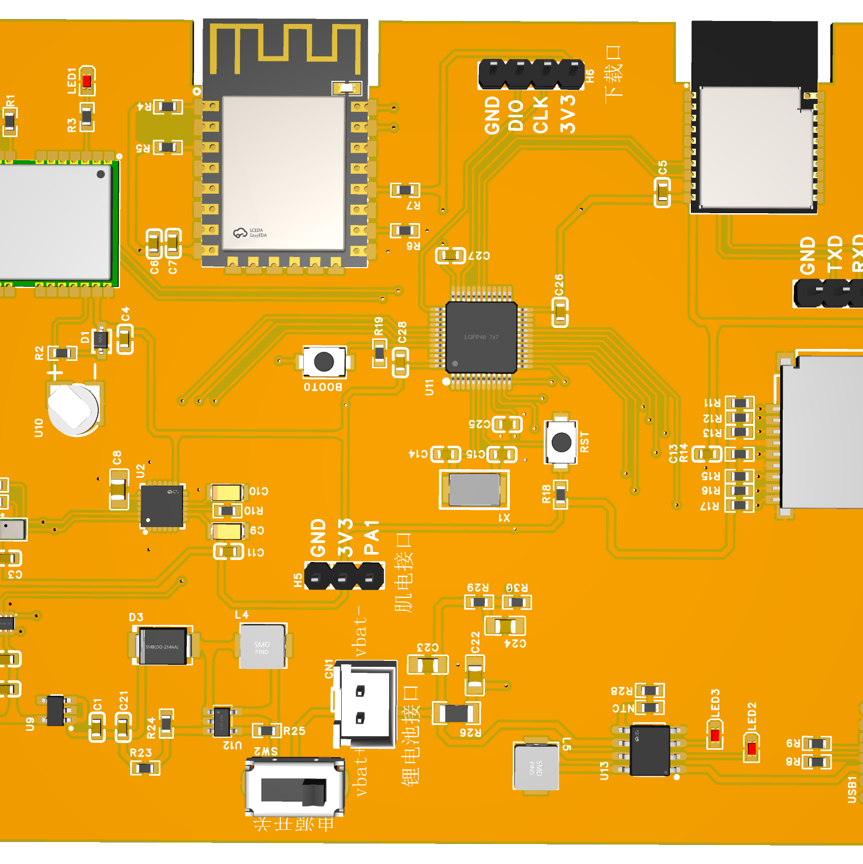
Project 1: Wearable leg-guard sensing system
Objective
Implementation
Wearable sensing for motion/load monitoring under realistic movement, emphasizing stable data acquisition.
Arduino + STM32 for acquisition/control
Multi-sensor integration via I2C and related interfaces
My role
Validation
Project planning & system architecture
PCB/circuit design; component selection
Integration and bring-up across HW/FW/comm
Iterative testing under realistic motion
Prioritized repeatability over one-off demos
Logged issues/failure cases to drive iteration
Notes:
This project is a wearable leg-guard sensing system. The motivation was pretty practical: when you collect motion and load signals on a human body, the real challenge is not getting any signal—it’s getting stable, repeatable data under realistic movement.
I led the project end-to-end: I did the system planning and architecture, designed the PCB and selected components, and then brought the whole stack up across hardware, firmware, and communications. For implementation, I used an Arduino plus an STM32 for acquisition and control, and integrated multiple sensors mainly through I²C and related interfaces.
For validation, I focused on reliability: I tested it repeatedly under real motion, logged failure cases like dropouts and synchronization issues, and iterated based on those logs rather than optimizing for a one-off demo. The main takeaway for me is that I’m comfortable building sensing systems end-to-end, and I tend to work in a reliability-oriented way.

Slide 6
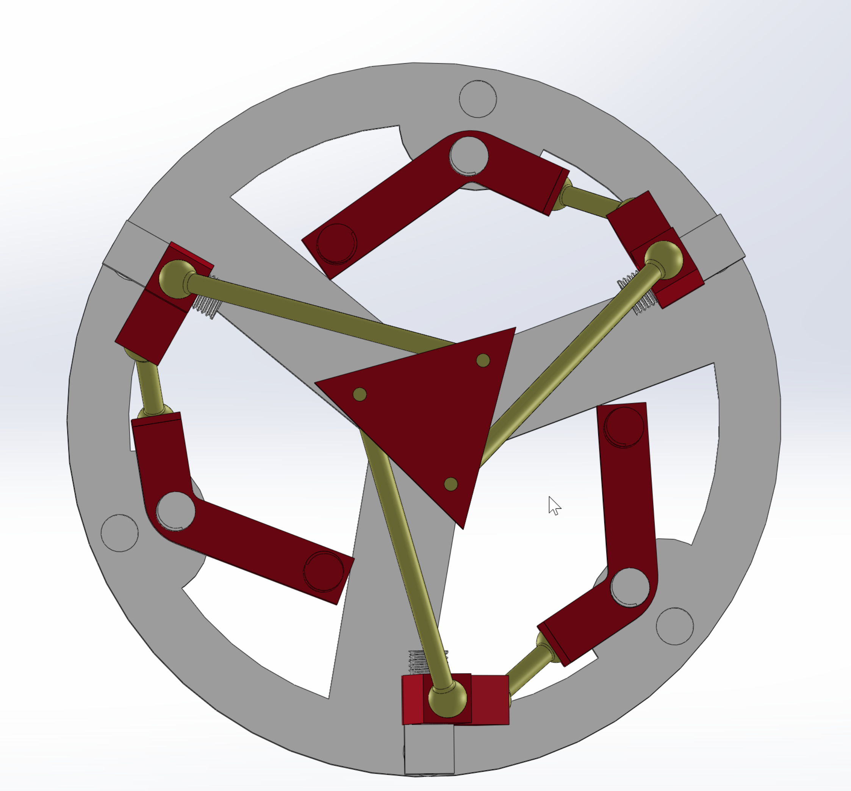
Project 2: 3-DOF Delta robot (mechanical capstone)
Objective
Implementation
End-to-end mechanical design and prototyping of a Delta parallel robot.
Mechanism + detailed part design
Manufacturing/assembly constraints considered early
My role
Validation
Project lead — owned requirements, timeline, and integration decisions
SolidWorks modeling
Planning and parts selection
3D printing and assembly; iteration
Prototype feedback: tolerances, interference, robustness
Iterated geometry and interfaces accordingly
Notes:
This project is a 3-DOF Delta robot that I built as a mechanical capstone. The objective was to take a kinematics-driven concept and push it all the way to a working physical prototype.
My role covered the full mechanical pipeline: I did the SolidWorks CAD modeling, planned the design and selected parts early, and then went through multiple rounds of 3D printing and assembly. On the implementation side, I didn’t stop at the mechanism level—I also designed the detailed parts and interfaces, and I tried to consider manufacturing and assembly constraints upfront rather than fixing everything at the end.
Validation was very prototype-driven. The main issues were tolerances, interference between moving links, and overall robustness. Each time we assembled the prototype, the feedback immediately translated into geometry and interface changes—clearance, joint design, mounting, and alignment—so the design converged through iteration.
The takeaway is that I’m comfortable turning kinematics-based ideas into manufacturable hardware by iterating through real build-and-test cycles.

Slide 7
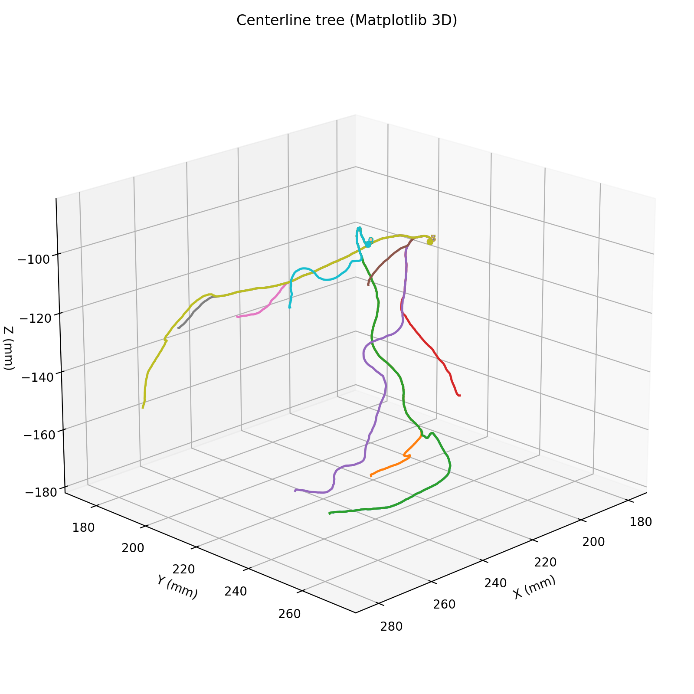
Ongoing research: coronary reconstruction pipeline
Objective
Current progress
Build a reconstruction/modeling pipeline with long-term relevance to clinically grounded workflows and evaluation.
Surveyed workflows + established a first working pipeline
Segmentation → centerline extraction → centerline-driven representation/rendering
Defined output schema (tree/branch structure) for consistent experiments
My role
Next phase
Project lead & upstream workflow owner (problem framing, milestones, interface definitions)
Built the pipeline end-to-end and standardized outputs for evaluation and downstream use
Incorporate hospital data constraints and clinical feedback loops
Anatomically consistent labeling (segment-level) for standardization
Evaluation aligned with navigation/decision support (robustness + usability)
Notes:
This is my ongoing research project, and I’m leading the upstream workflow and pipeline development. The long-term objective is to build a reconstruction and modeling pipeline that stays clinically relevant—meaning the outputs are structured, evaluable, and compatible with real hospital workflows.
So far, I’ve done an initial survey and built a working pipeline: segmentation, then centerline extraction, and then a centerline-driven representation for visualization and rendering. Importantly, I’m also standardizing the outputs—so the same case can be evaluated consistently and used downstream.
The next phase is where it becomes more “clinically grounded”: incorporating hospital data and workflow constraints, adding anatomically consistent labeling so different segments are comparable, and defining evaluation metrics that align with navigation or decision-support use cases—so we’re not just optimizing for pretty reconstructions, but for robustness and usefulness.
The takeaway is that I’m comfortable owning a pipeline end-to-end, and I’m building it with deployability and evaluation in mind.
“Takeaway: building structure-aware pipelines + evaluation habits transferable to tactile/contact learning.”

Slide 8
Why BDML
Why I’m excited
Directions I align with
How I can contribute
Working style
Contact-rich interaction
Real-world sensing and reliability
Building systems that work end-to-end
Integration + testing + experiment design
Data/pipeline implementation and evaluation
Documentation for reproducibility and handoff
Underwater manipulation: control and sensing under bandwidth/visibility limits
Weekly milestones
Fast iteration
Small tests first
then scale
Notes:
Let me summarize why I’m excited about BDML and how I think I can contribute.
I’m most interested in contact-rich interaction where sensing actually closes the loop with control, and where robustness matters because the real world is messy—noise, drift, and failures. That’s also why BDML stands out to me.
In terms of alignment, I’m especially drawn to tactile sensing and perception-to-action, and to underwater manipulation/control where constraints force you to think in a systems way.
For contribution, I’m very hands-on: I can build and stabilize sensing stacks—synchronization, calibration, logging, and failure tracking—then design tight experiments and metrics so iterations are comparable, and package everything into reproducible pipelines with clean handoff.
And my working style is simple: weekly milestones, fast iteration, and small sanity tests first before scaling.

Slide 9
What I’d like to work on this summer
I’m flexible on topics—happy to take on new challenges. If I pick one, tactile is the best fit.
Track A: Tactile sensing (preferred)
Track B: Underwater control (open)
Ideal deliverables
Working style
Calibration + signal conditioning (noise, drift, synchronization)
Contact-state estimation (onset / slip cues / force trends)
Experiments + metrics for iteration (repeatability first)
Robust estimation/control under constraints (bandwidth / visibility / drift)
Benchmark + evaluation setup (stability / accuracy)
A reliable pipeline + reproducible experiments
Clear results (plots) + clean code + documentation
Weekly milestones
measurable outcomes
Notes:
I won’t repeat my background here since I think the earlier slides already show what I can do. For this summer, I’m very flexible and happy to take on new challenges or a new problem the lab cares about.
If I had to choose a primary direction, tactile sensing is probably the best fit—because I enjoy building reliable sensing pipelines and designing experiments that actually drive iteration. Concretely, I’d love to work on calibration and signal conditioning, contact-state estimation like onset and slip cues, and setting up clear metrics and experiments.
At the same time, I’m also open to an underwater control track—especially problems around robust estimation and control under constraints. If there’s a project you think is a better fit than these two tracks, I’m totally open—I care more about impact and learning than the label of the topic. My goal is simple: clear weekly milestones and measurable deliverables, with reproducible code and results.

Slide 10

Q&A
Notes:
So that’s my background and the kinds of problems I’m excited about. I’d really appreciate your feedback on where I’d fit best in BDML, and then I have a few questions about the projects and mentorship workflow.

Slide 11
Questions for discussion
1
Are the project areas in the spreadsheet specific ongoing projects this summer, or general directions?
2
What stage are the tactile / underwater efforts currently at (prototype, data, algorithms, experiments)?
3
What is the typical mentorship workflow for UGVR students (day-to-day with PhD mentor, periodic check-ins with Prof Cutkosky)?
Notes:
“I’ll start with the first one.”

Slide 12
vessel_seg Summer Research Progress
CT -> Segmentation -> Centerline -> Repair -> Feature -> Reconstruction
Supervisor update (10-15 min)
Focus: reproducible quantitative pipeline + concrete technical fixes
Cases: Normal_1 and Normal_2

Slide 13
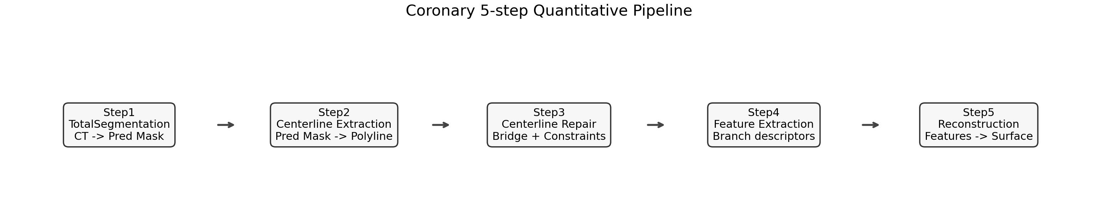
Pipeline Overview

Slide 14
Metrics at Each Step
Step1: Dice, ASD(mm), HD95(mm)
Step2/3: pred2gt mean/p95, coverage@1mm
Step4: branch count diff, descriptor cosine/l1/l2
Step5: reconstructed mesh vs GT mask boundary (same distance metrics)

Slide 15
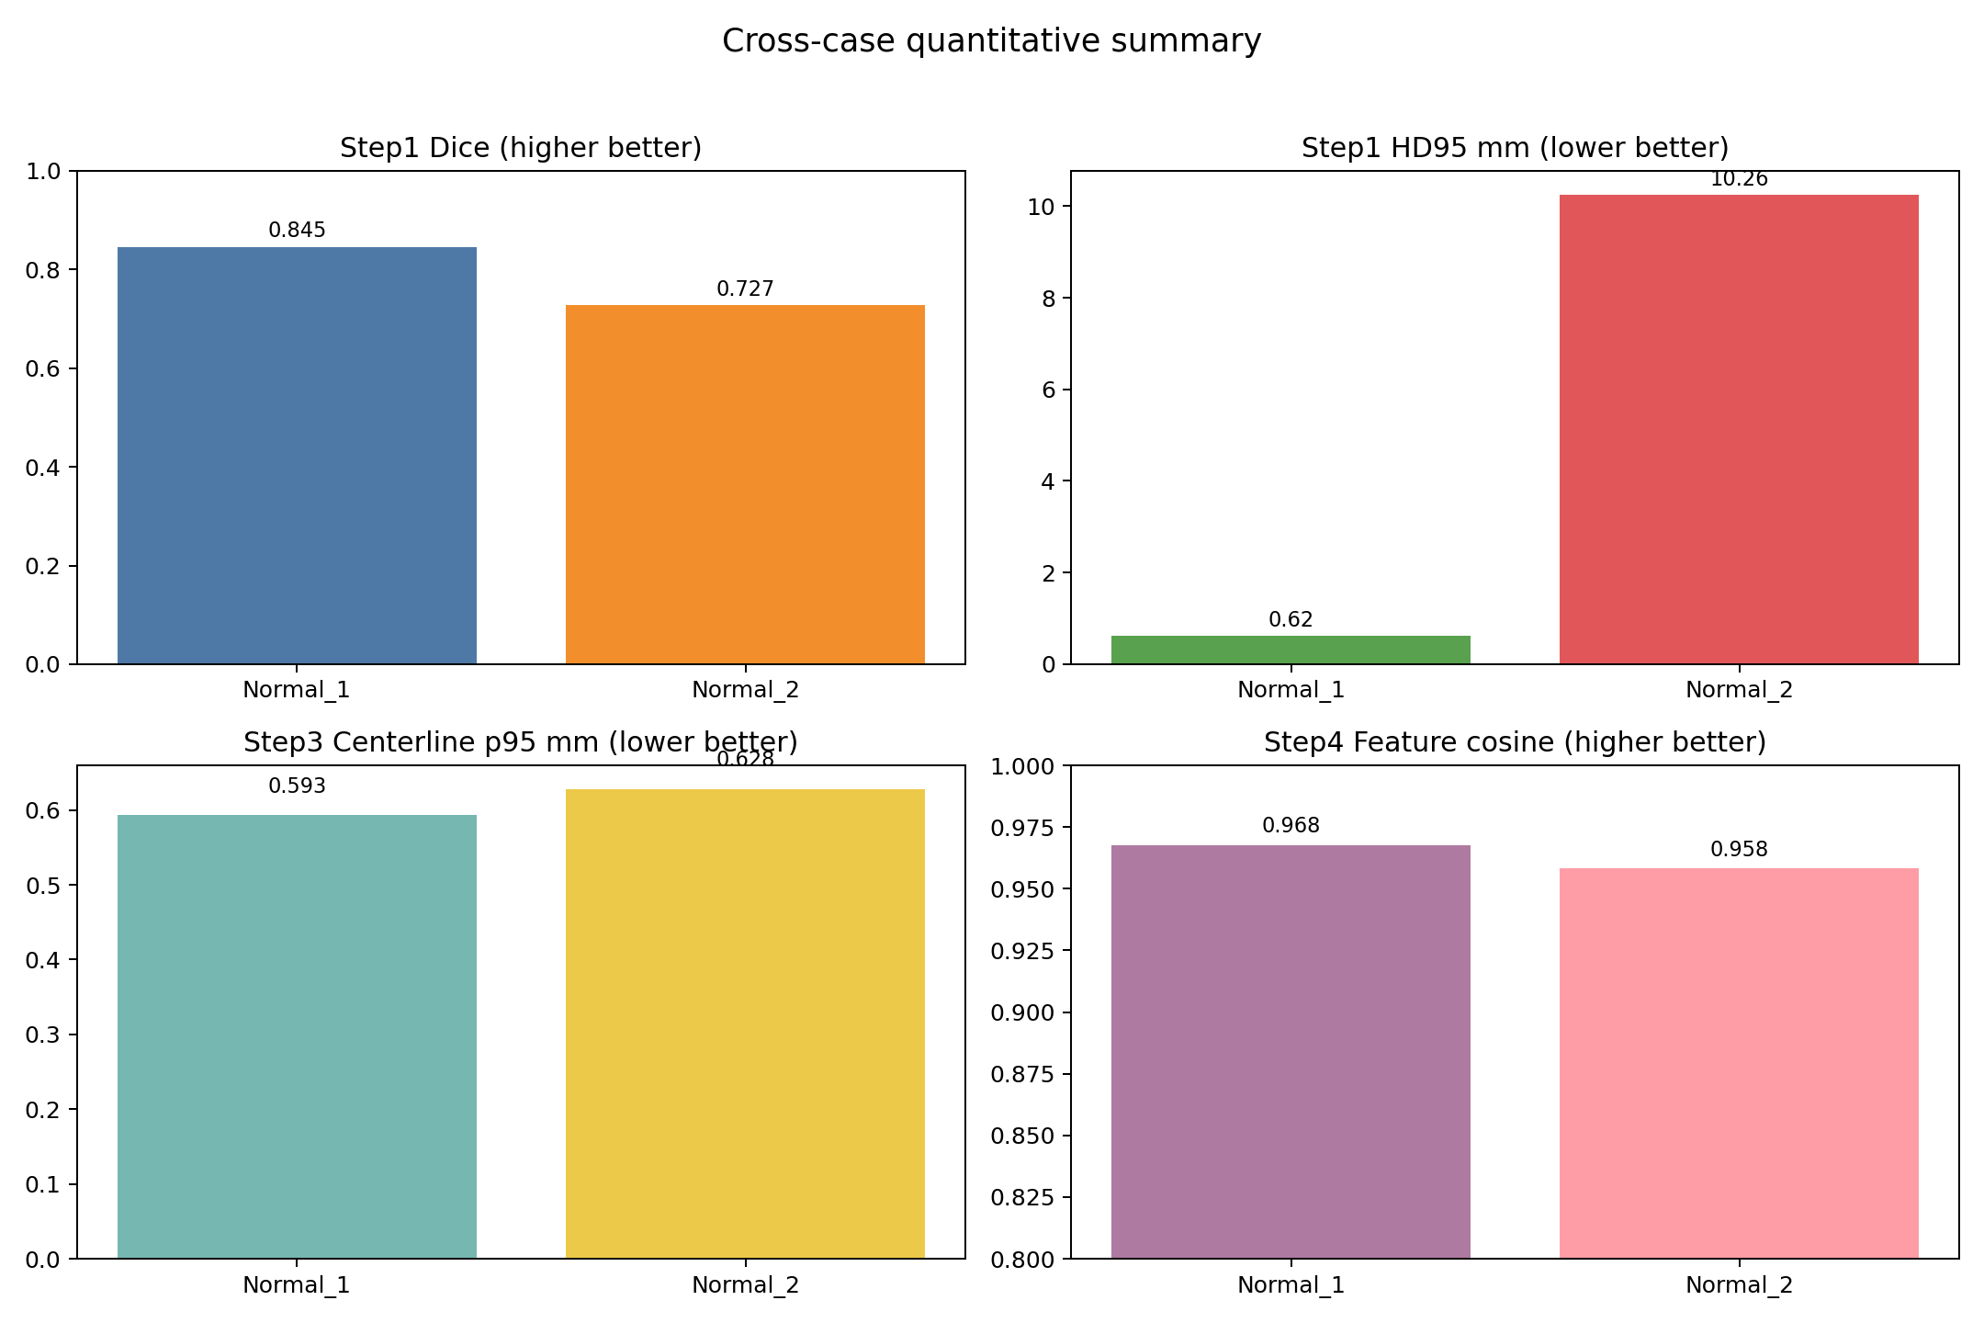
Cross-case Quantitative Summary

Slide 16
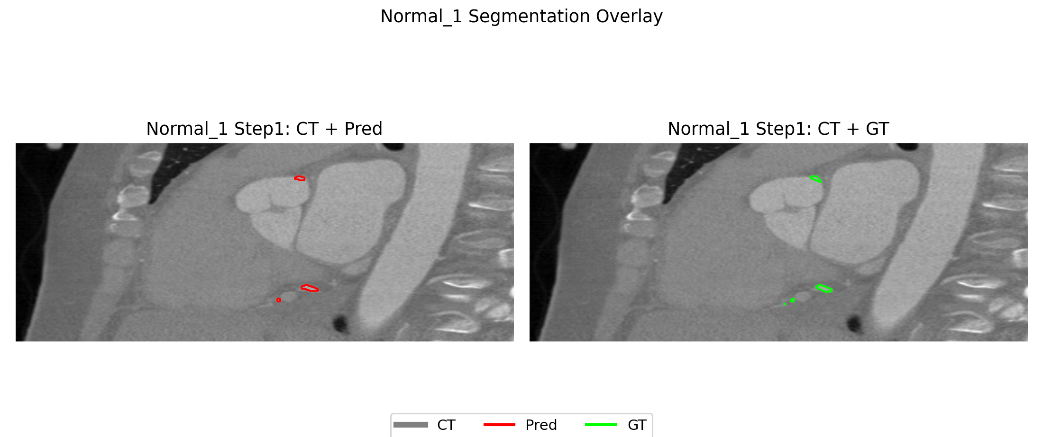
Step1 Segmentation: Normal_1
Dice = 0.8450
HD95 = 0.625 mm
Interpretation: strong upstream quality for downstream steps

Slide 17
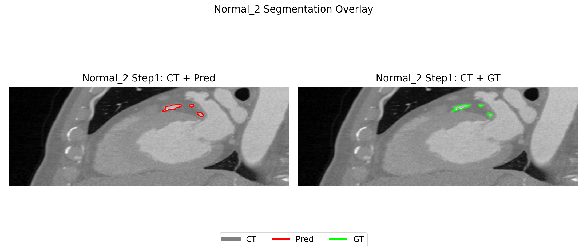
Step1 Segmentation: Normal_2
Dice = 0.7274
HD95 = 10.2556 mm
Main bottleneck: segmentation quality variance

Slide 18
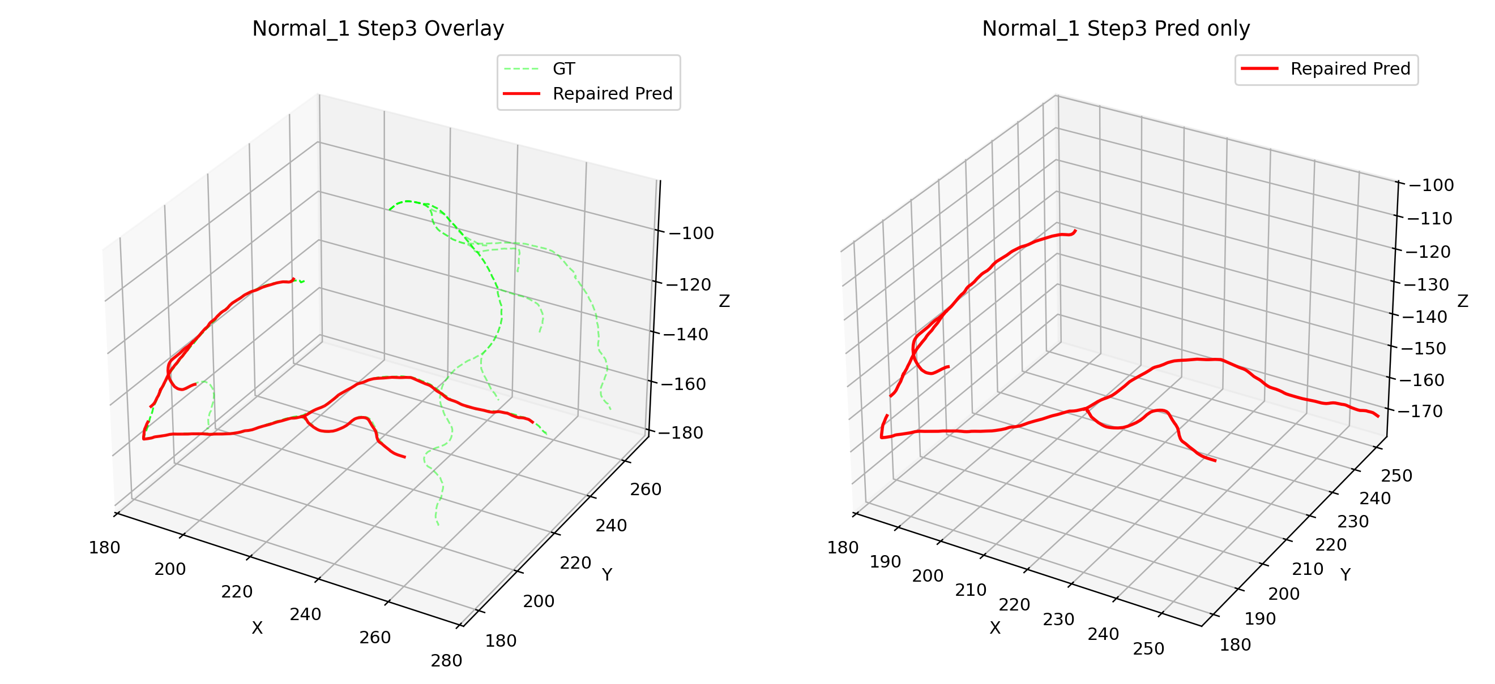
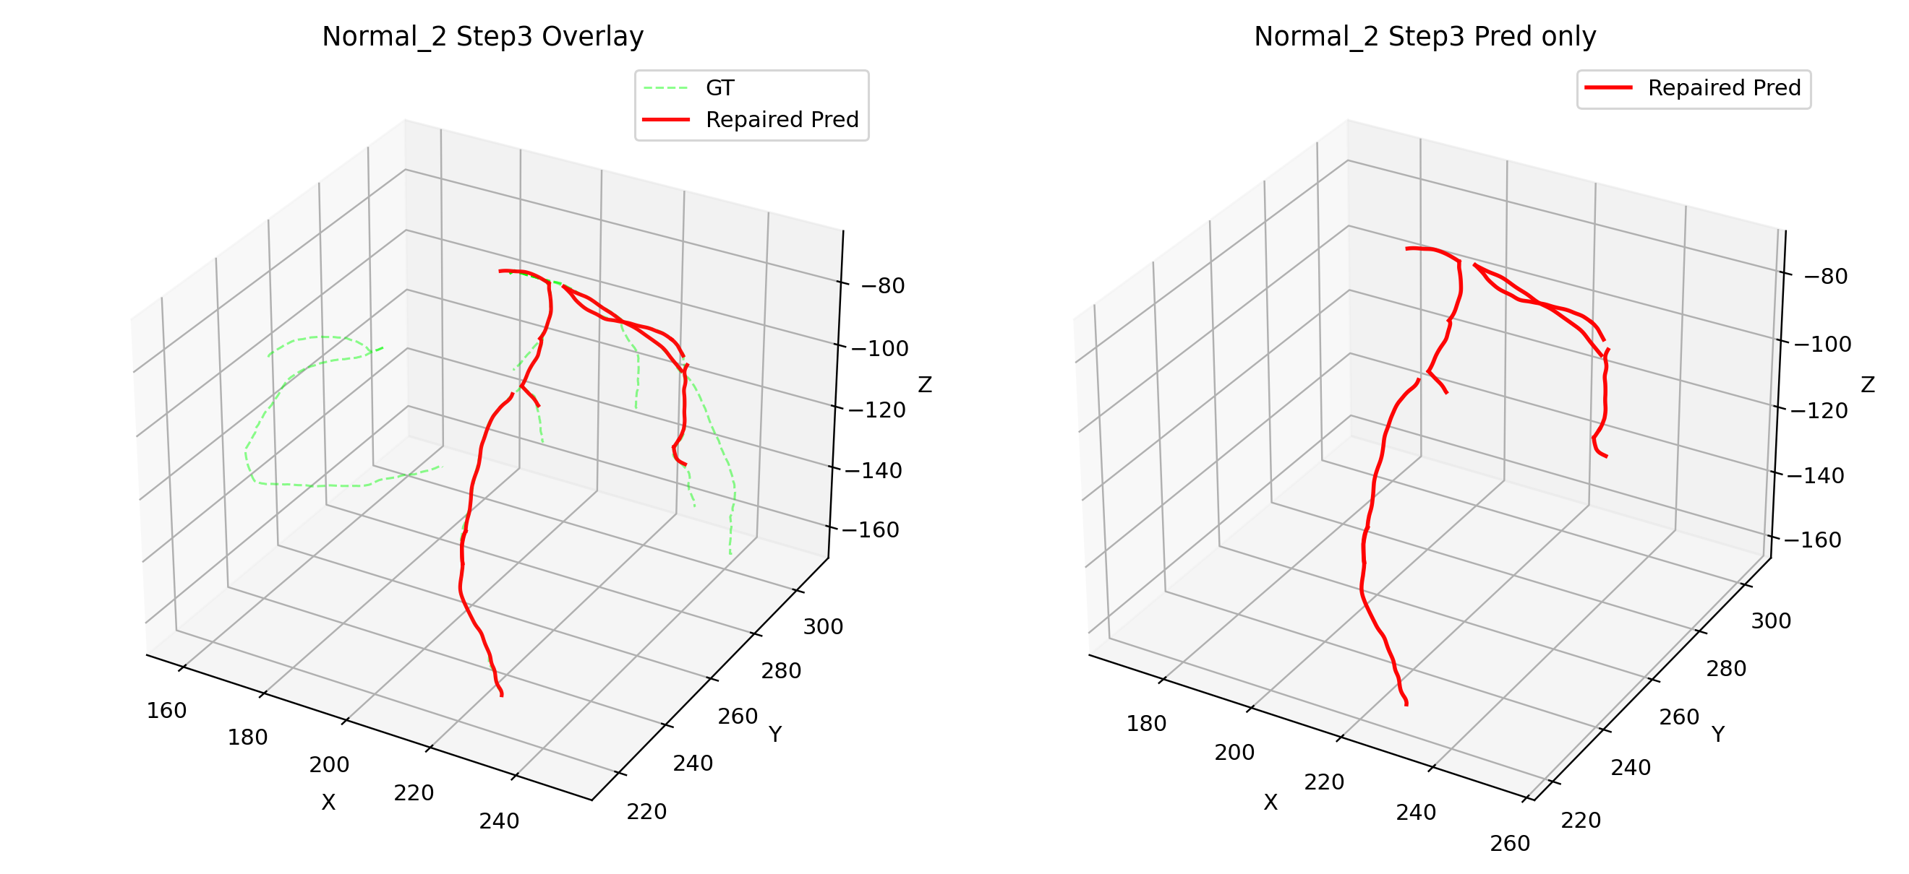
Step3 Centerline Comparison

Slide 19
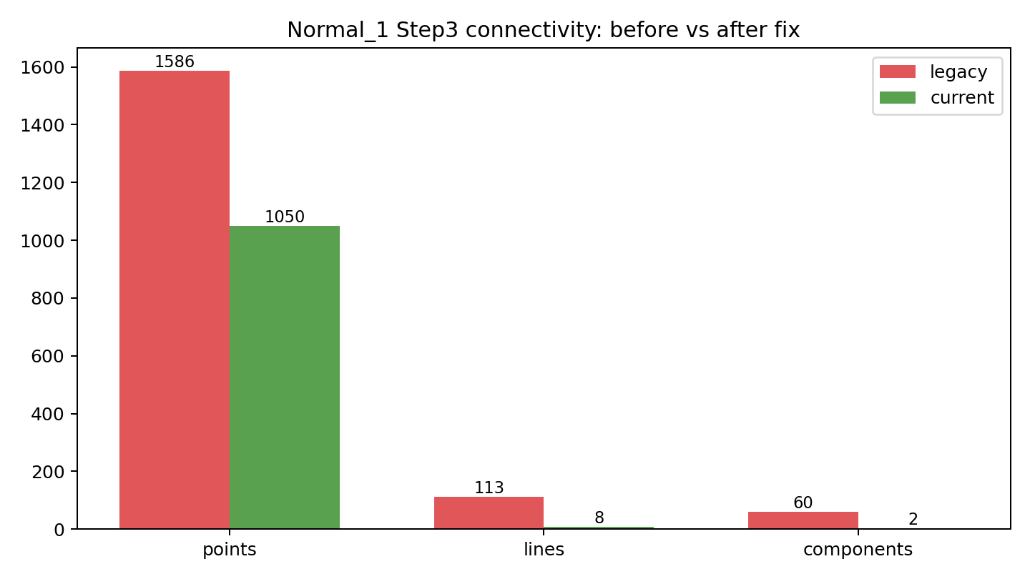
Key Engineering Fix: Repair Topology
Root cause: duplicated endpoint points in VTP writer
Fix: merge coincident endpoints to shared point IDs
Outcome: disconnected fragments -> anatomically coherent components

Slide 20
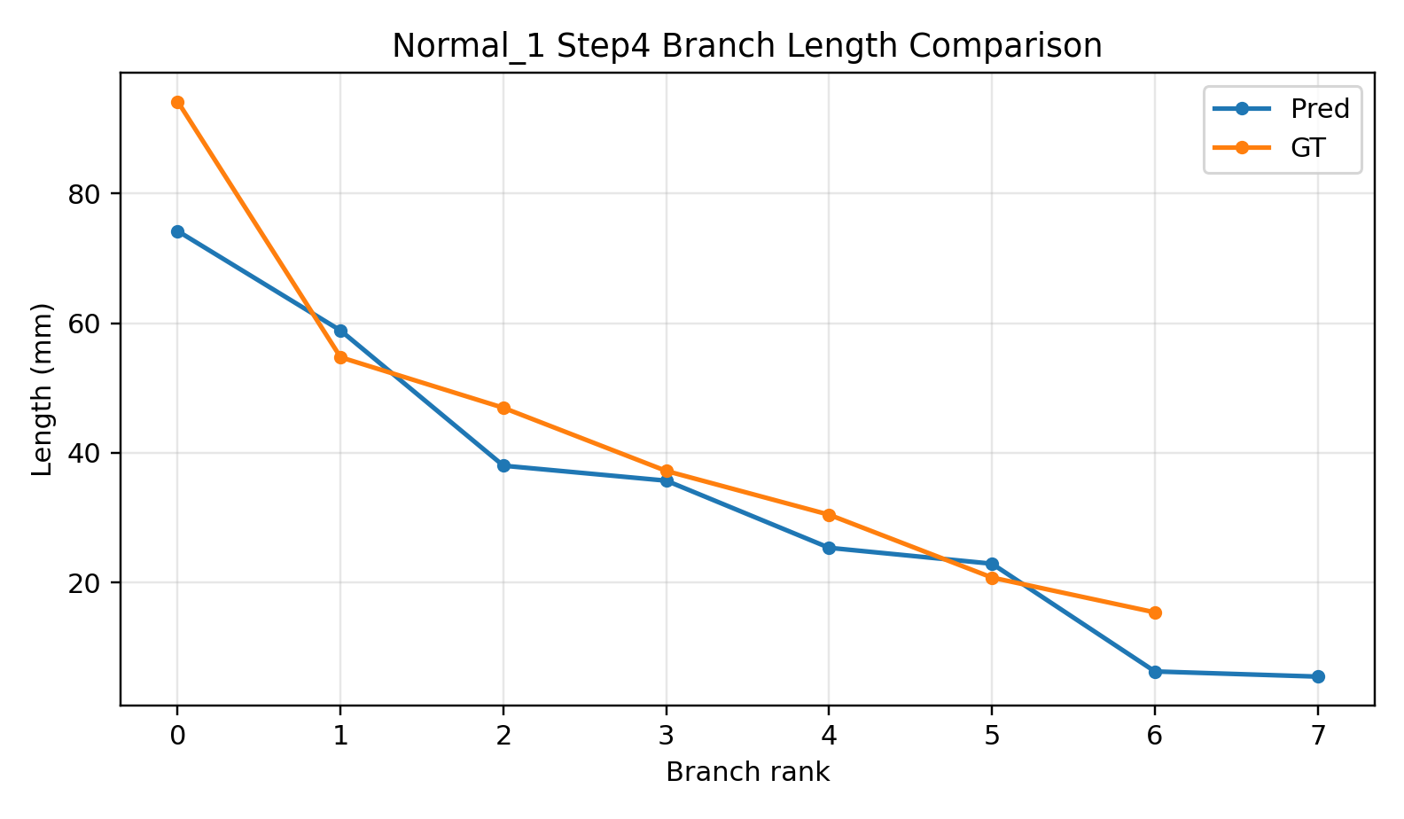
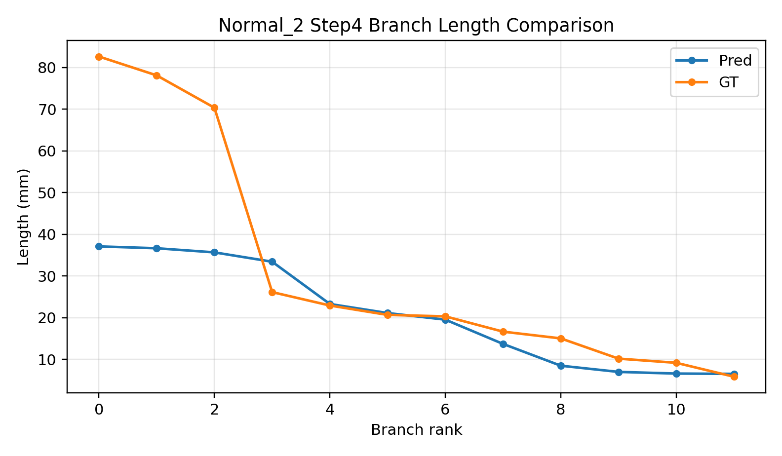
Step4 Feature Extraction

Slide 21
Current Risks and Next 2 Weeks
Open Risks
Execution Plan
Step4 still has branch count mismatch on some cases
Case-to-case variability remains high
Need stronger failure-case regression set
Week 1: repair trigger + topology constraints
Week 2: branch governance + batch evaluation (10-20 cases)
Deliver reproducible report-ready figures/tables

Slide 22
My Core Contributions
Built an end-to-end quantitative pipeline (not isolated scripts)
Defined step-wise metrics to make progress measurable and auditable
Diagnosed and fixed topology-level bug with reproducible evidence
Converted blockers into actionable engineering tasks and benchmarks

Slide 23
Discussion / Feedback Needed
Do you agree with metric priority (Step1 stability first)?
Should we prioritize method novelty or robust clinical engineering pipeline first?
Is this progression acceptable: small-case closure -> larger batch validation?

