Slide 1


Medical Imaging × AI for Interventional Guidance
Research & Project Highlights (Medical Imaging)
Yihao Chen（陈奕好）
College of Engineering, Peking University
Feb 2026
chenyihao@stu.pku.edu.cn
github.com/ChenNeuro
Notes:
Good afternoon Professor Wang. I’m Yihao Chen from Peking University. My current focus is medical imaging for interventional guidance, especially coronary reconstruction and CT–DSA 3D–2D registration. Today I’ll briefly summarize my ongoing pipeline work, what I’ve already made measurable, and how that aligns with PixAIL’s interests in multimodal models, temporal modeling, and generative methods.

Slide 2
Agenda
1
Quick intro & strengths (skills + working style)
2
Background & research interests (medical imaging)
3
Ongoing Projects: coronary reconstruction, CT–DSA 3D–2D registration, vessel topology modeling
4
Discussion
Notes:
I’ll start with a quick background and what I’m aiming to do in medical imaging. Then I’ll walk through my current coronary pipeline, focusing on what is already working end-to-end and what I’m fixing next. Finally, I’ll summarize how this maps to PixAIL, and propose what I can deliver in the first weeks if I join

Slide 3
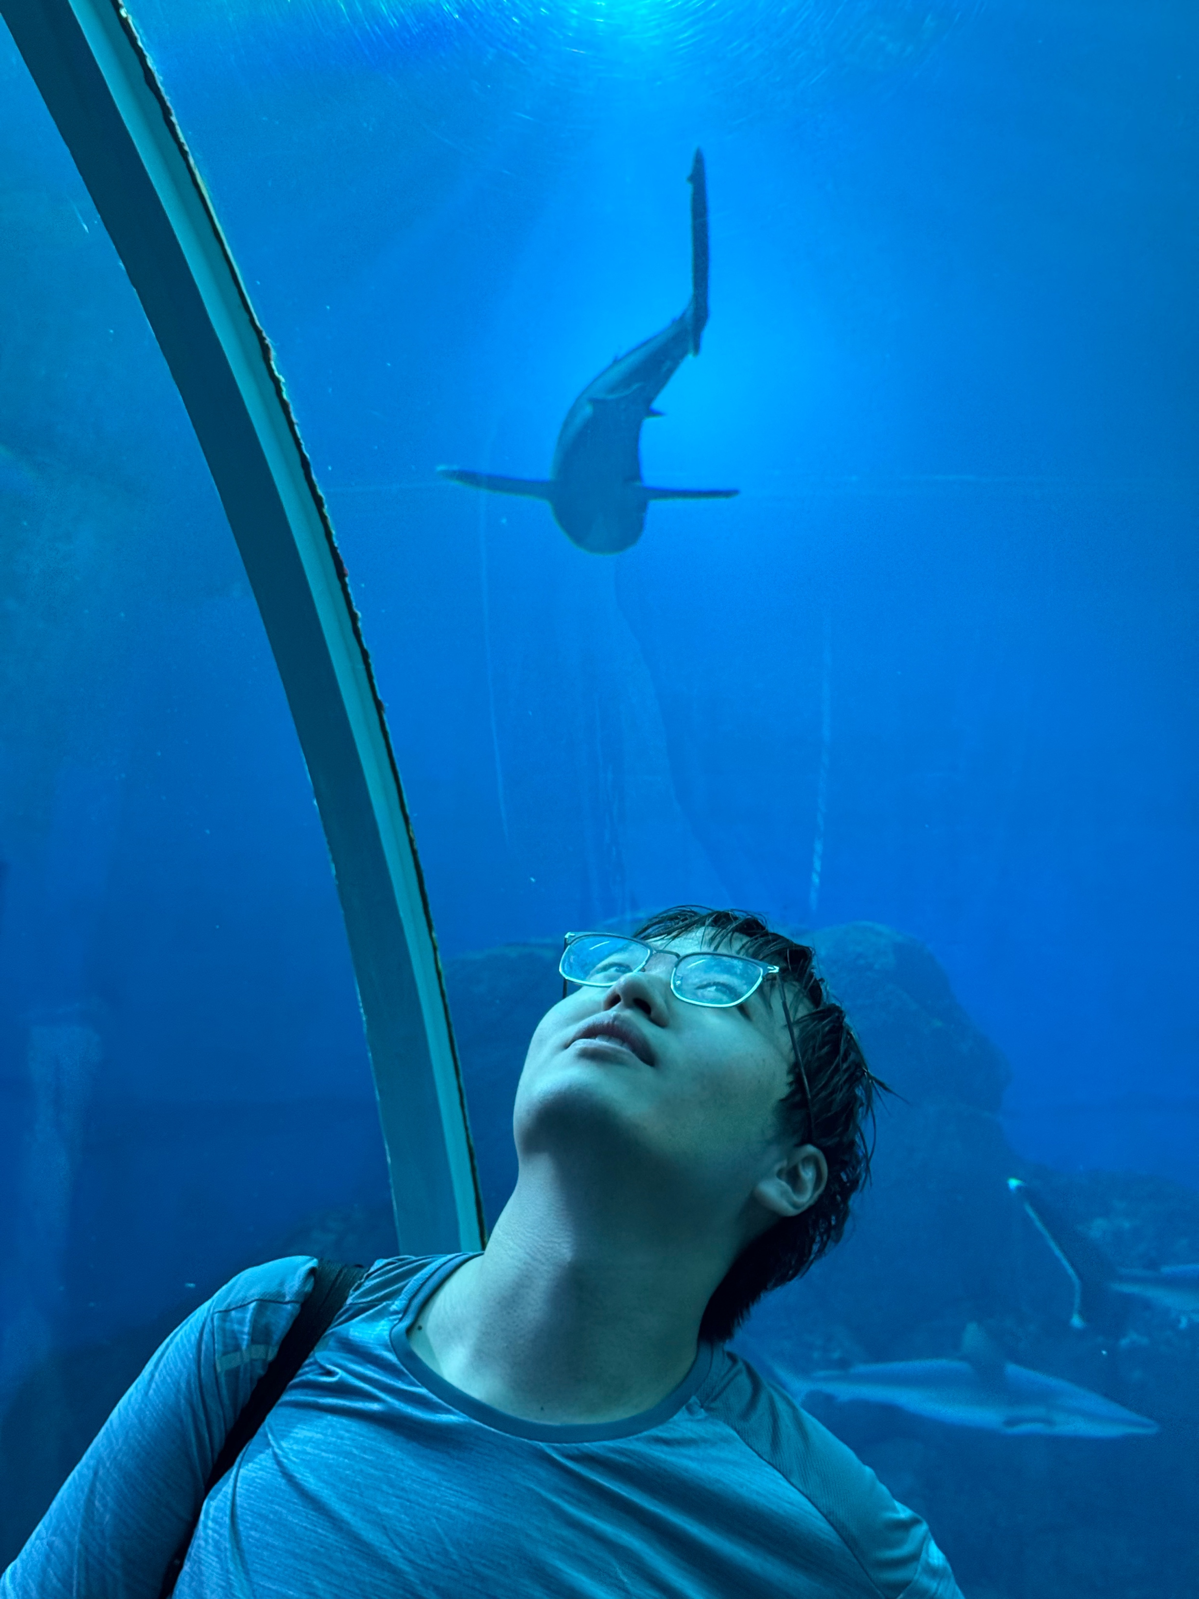

Quick intro & strengths
Yihao Chen（陈奕好）
Medical Imaging | 3D–2D Registration | Temporal Modeling
Build end-to-end imaging pipelines (data → preprocessing → model → evaluation)
Combine geometry constraints with learning (registration, centerline/topology priors)
Reproducible research habits: scripts, ablations, reports
Cross-domain engineering: sensing/robotics experience transfers to real-time systems
Interests: multimodal medical foundation models · temporal modeling for cine/DSA · generative reconstruction
Notes:
My strength is building end-to-end research pipelines rather than isolated scripts: data preprocessing, model training, evaluation, and failure-case tracking. I like combining geometry constraints with learning, which is essential for 3D–2D registration and anatomical consistency. I also keep experiments reproducible—configs, ablations, and report-ready figures—so progress is auditable. Research-wise, I’m most excited about multimodal medical foundation models, fine-grained temporal modeling for cine/DSA, and generative reconstruction with uncertainty.

Slide 4
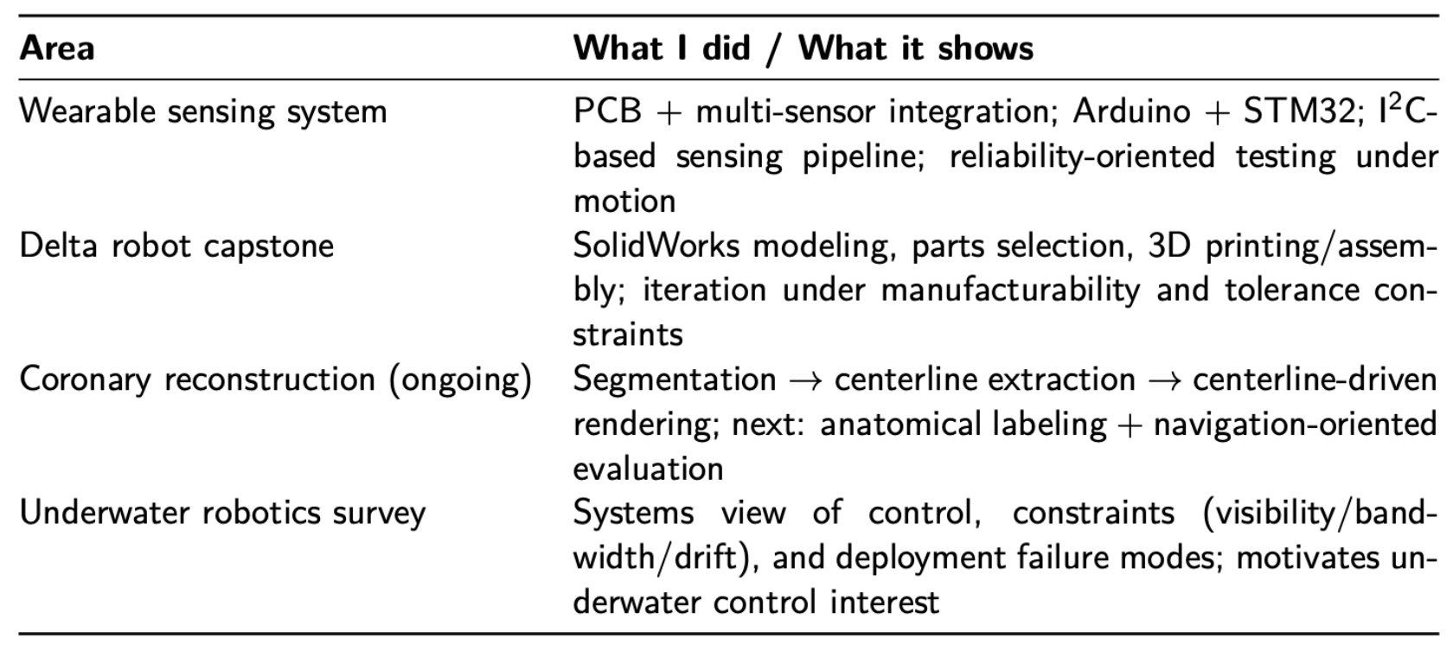
Experience map
Notes:
“I’m trained in mechanics and robotics, and I’m now pivoting my main effort to clinically grounded medical imaging. Since 2024 I’ve been building a coronary reconstruction and CT–DSA alignment pipeline, and in parallel I’ve been working on vessel topology modeling and shape priors on ASOCA2020. I also spent time observing cath-lab workflow, so I care about evaluation that matches clinical usage, not just offline metrics.”

Slide 5
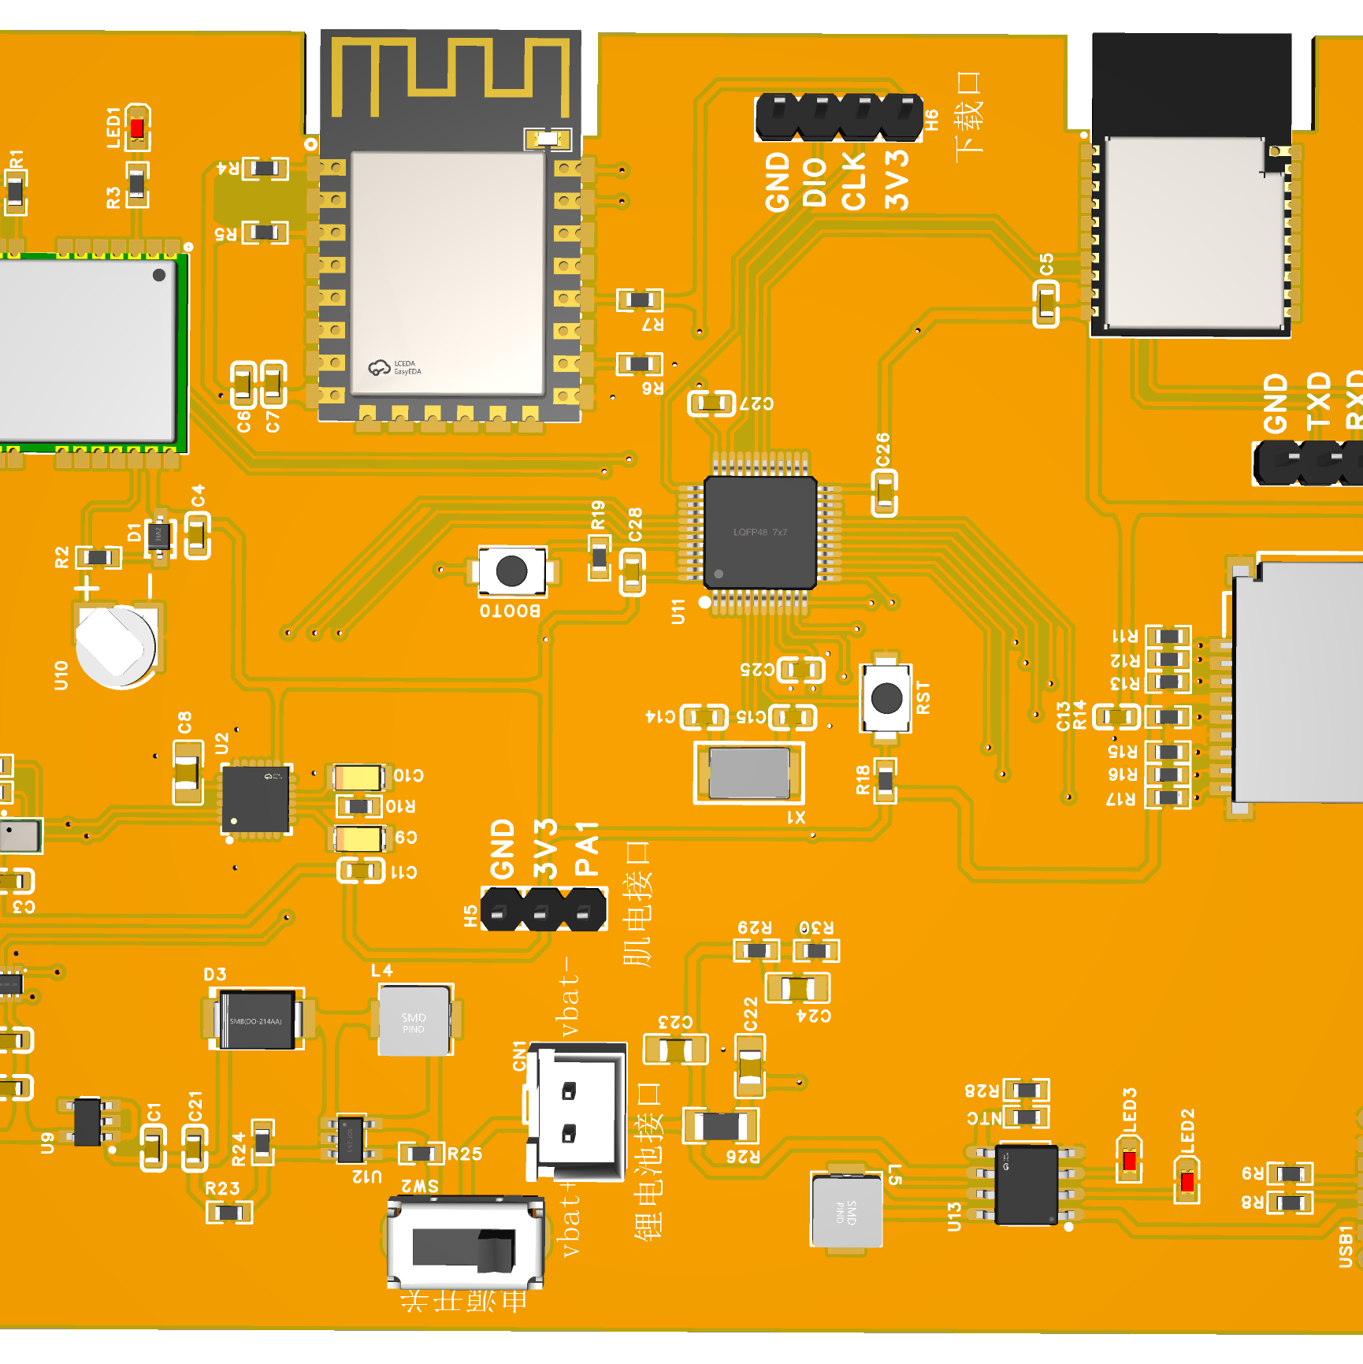
Project 1: Wearable leg-guard sensing system
Objective
Implementation
Wearable sensing for motion/load monitoring under realistic movement, emphasizing stable data acquisition.
Arduino + STM32 for acquisition/control
Multi-sensor integration via I2C and related interfaces
My role
Validation
Project planning & system architecture
PCB/circuit design; component selection
Integration and bring-up across HW/FW/comm
Iterative testing under realistic motion
Prioritized repeatability over one-off demos
Logged issues/failure cases to drive iteration
Notes:
This slide is background engineering. I built a wearable multi-sensor acquisition/control system with stable sampling and logging under real motion. The reason I mention it here is not the application itself, but the engineering style: I prioritize repeatability, debugging via failure-case logs, and interface clarity—habits that transfer directly to building reliable medical imaging pipelines.

Slide 6
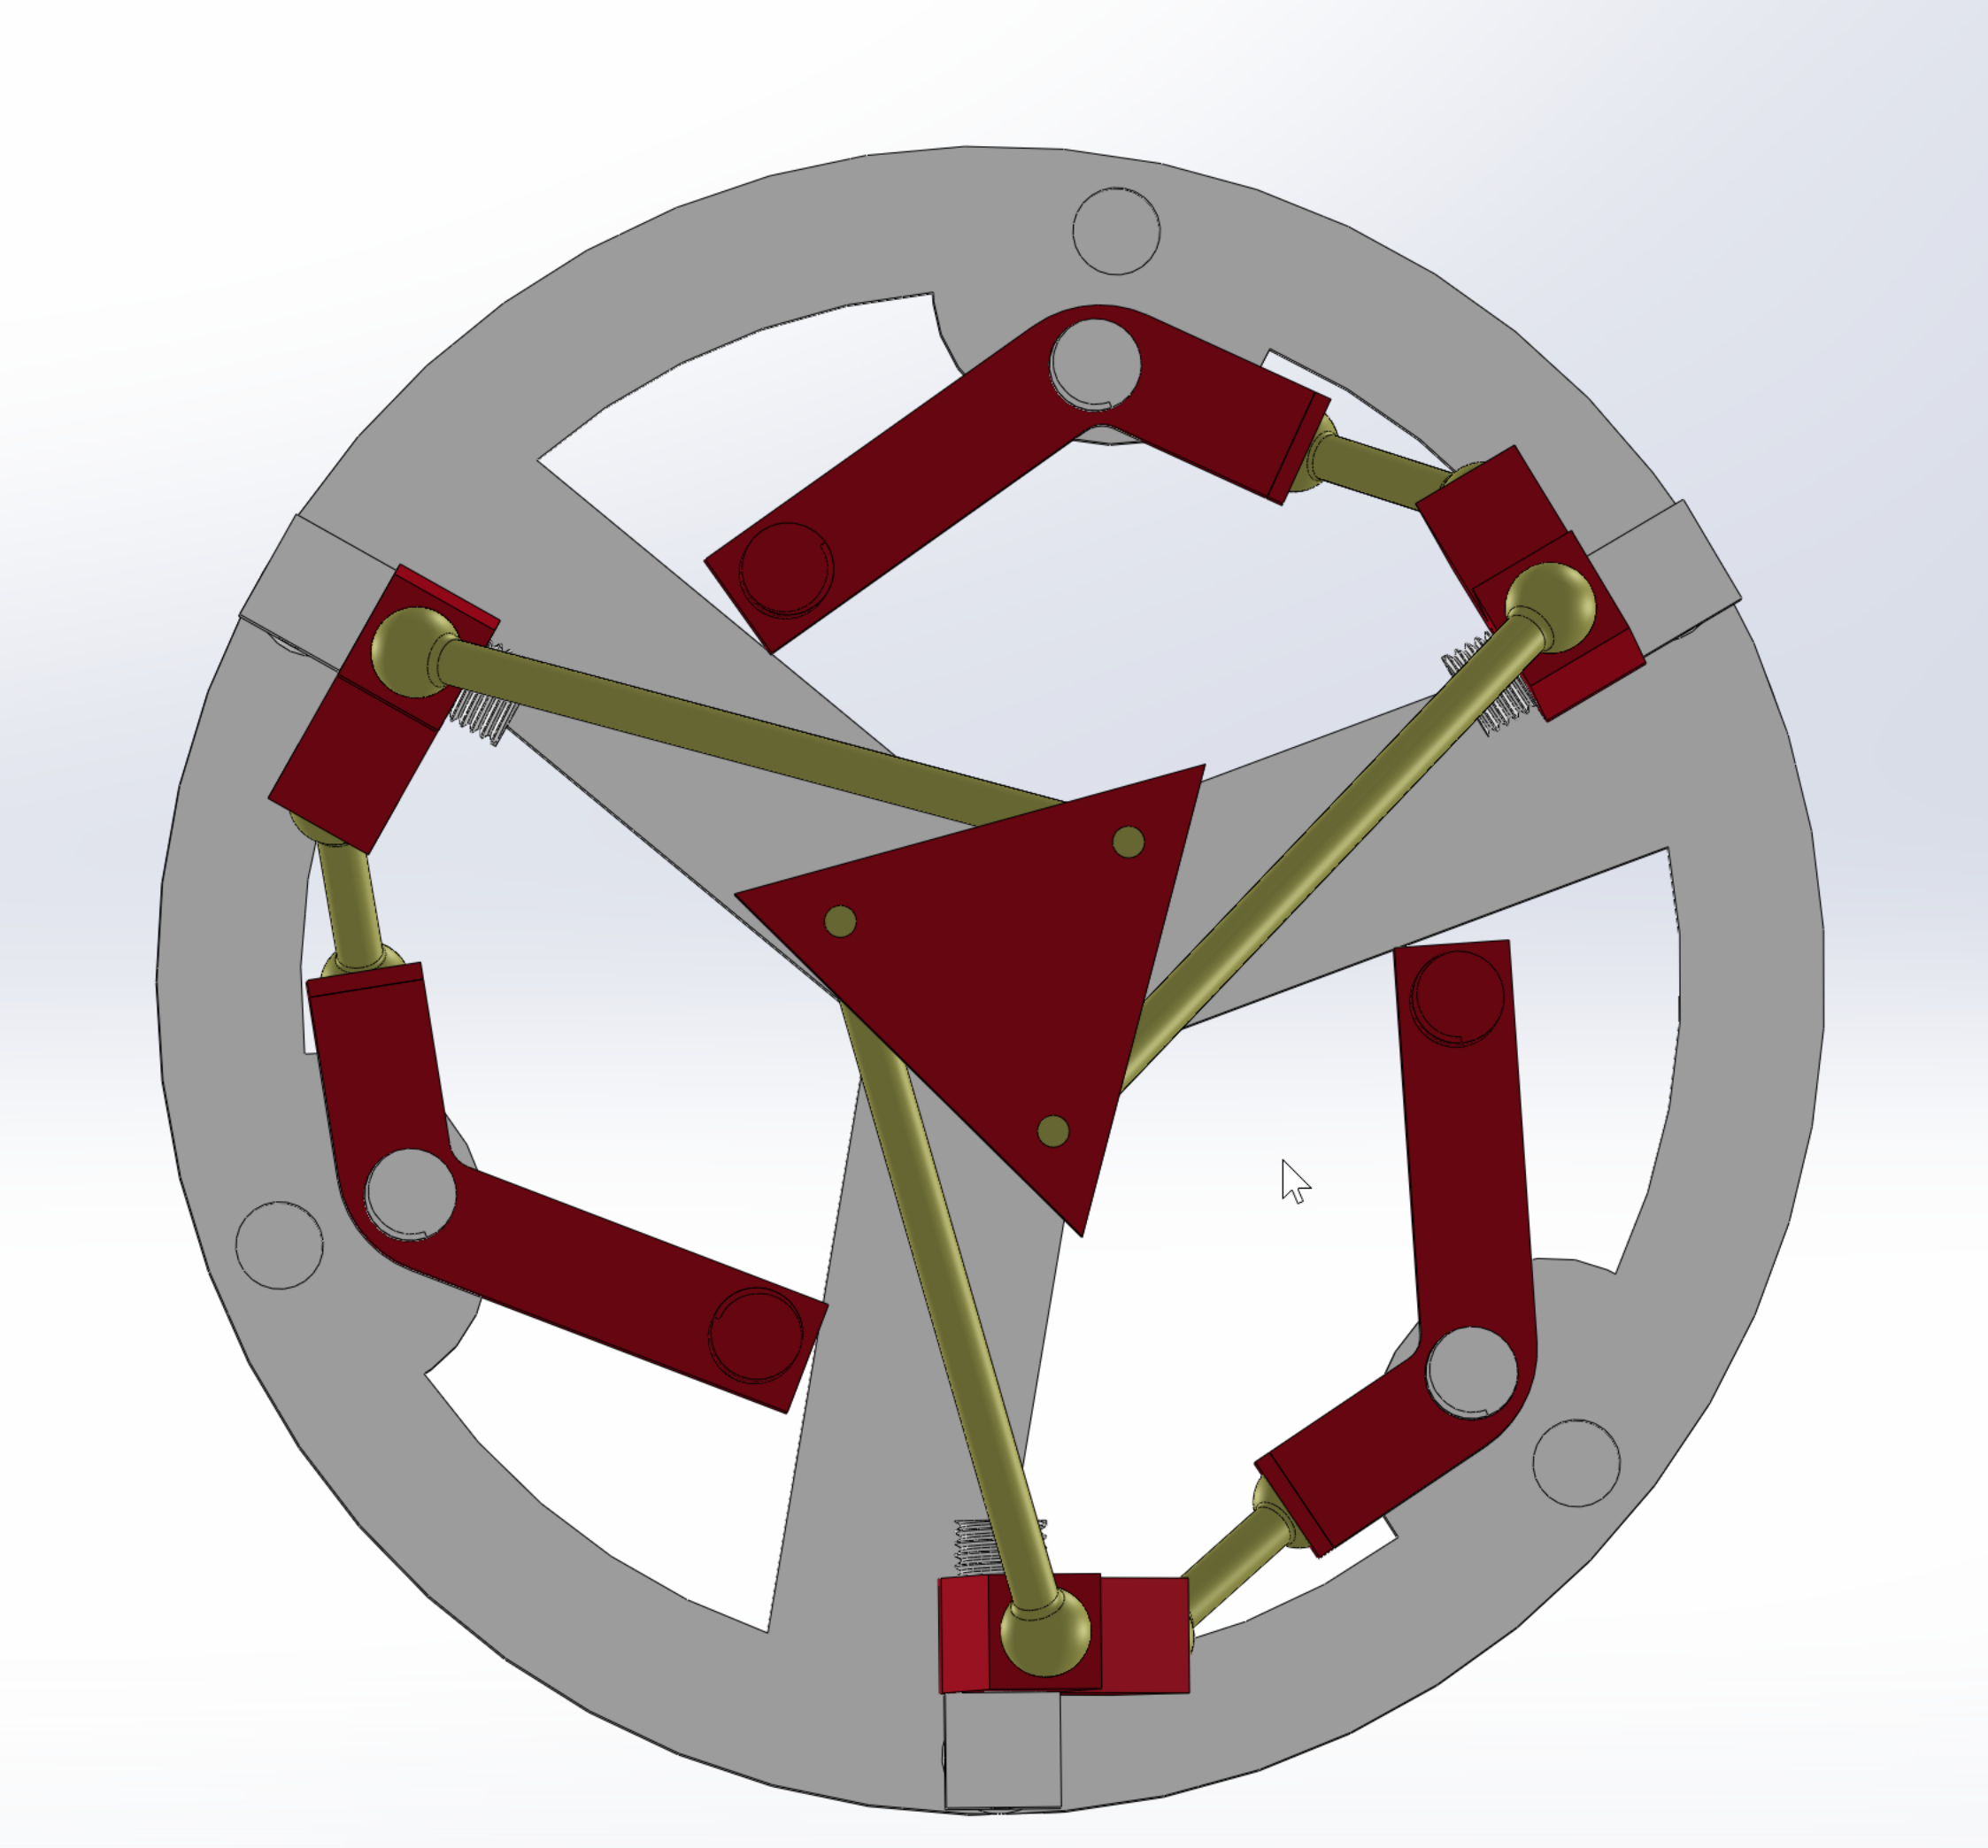
Project 2: 3-DOF Delta robot (mechanical capstone)
Objective
Implementation
End-to-end mechanical design and prototyping of a Delta parallel robot.
Mechanism + detailed part design
Manufacturing/assembly constraints considered early
My role
Validation
Project lead — owned requirements, timeline, and integration decisions
SolidWorks modeling
Planning and parts selection
3D printing and assembly; iteration
Prototype feedback: tolerances, interference, robustness
Iterated geometry and interfaces accordingly
Notes:
Another transferable engineering project: I led an end-to-end design and prototyping cycle for a Delta robot, including CAD, manufacturing constraints, assembly iteration, and robustness debugging. Again, the takeaway is that I’m comfortable owning a system end-to-end and iterating based on measurable failure modes—exactly what I do now for medical imaging workflows.

Slide 7
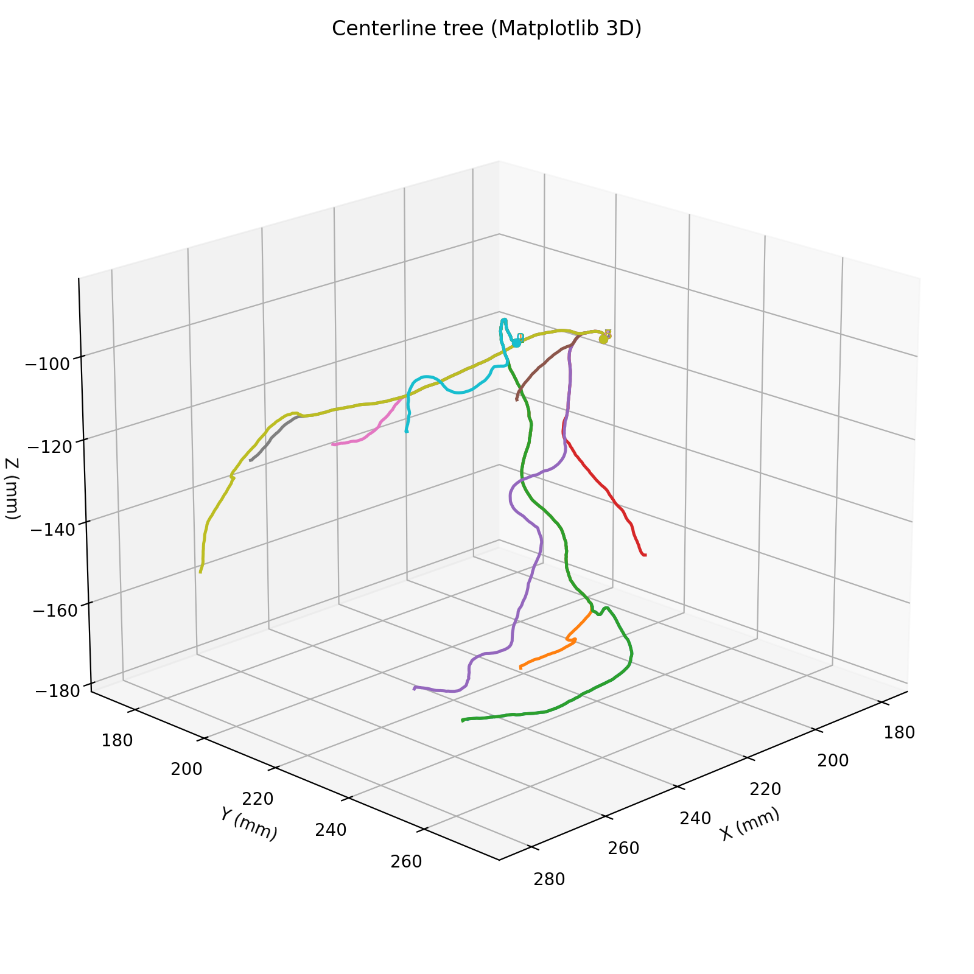
Ongoing research: coronary reconstruction pipeline
Objective
Current progress
Build a reconstruction/modeling pipeline with long-term relevance to clinically grounded workflows and evaluation.
Surveyed workflows + established a first working pipeline
Segmentation → centerline extraction → centerline-driven representation/rendering
Defined output schema (tree/branch structure) for consistent experiments
My role
Next phase
Project lead & upstream workflow owner (problem framing, milestones, interface definitions)
Built the pipeline end-to-end and standardized outputs for evaluation and downstream use
Incorporate hospital data constraints and clinical feedback loops
Anatomically consistent labeling (segment-level) for standardization
Evaluation aligned with navigation/decision support (robustness + usability)
Notes:
My main project is a coronary modeling pipeline with long-term relevance to interventional guidance. I’ve established a first working chain: segmentation, centerline extraction, and a centerline-driven representation/rendering. Importantly, I defined a consistent output schema (tree/branch structure) so experiments are comparable across cases. Next, I’m aligning the workflow with hospital constraints: standardized anatomical labeling and evaluation criteria that reflect robustness and usability for navigation/decision support

Slide 8
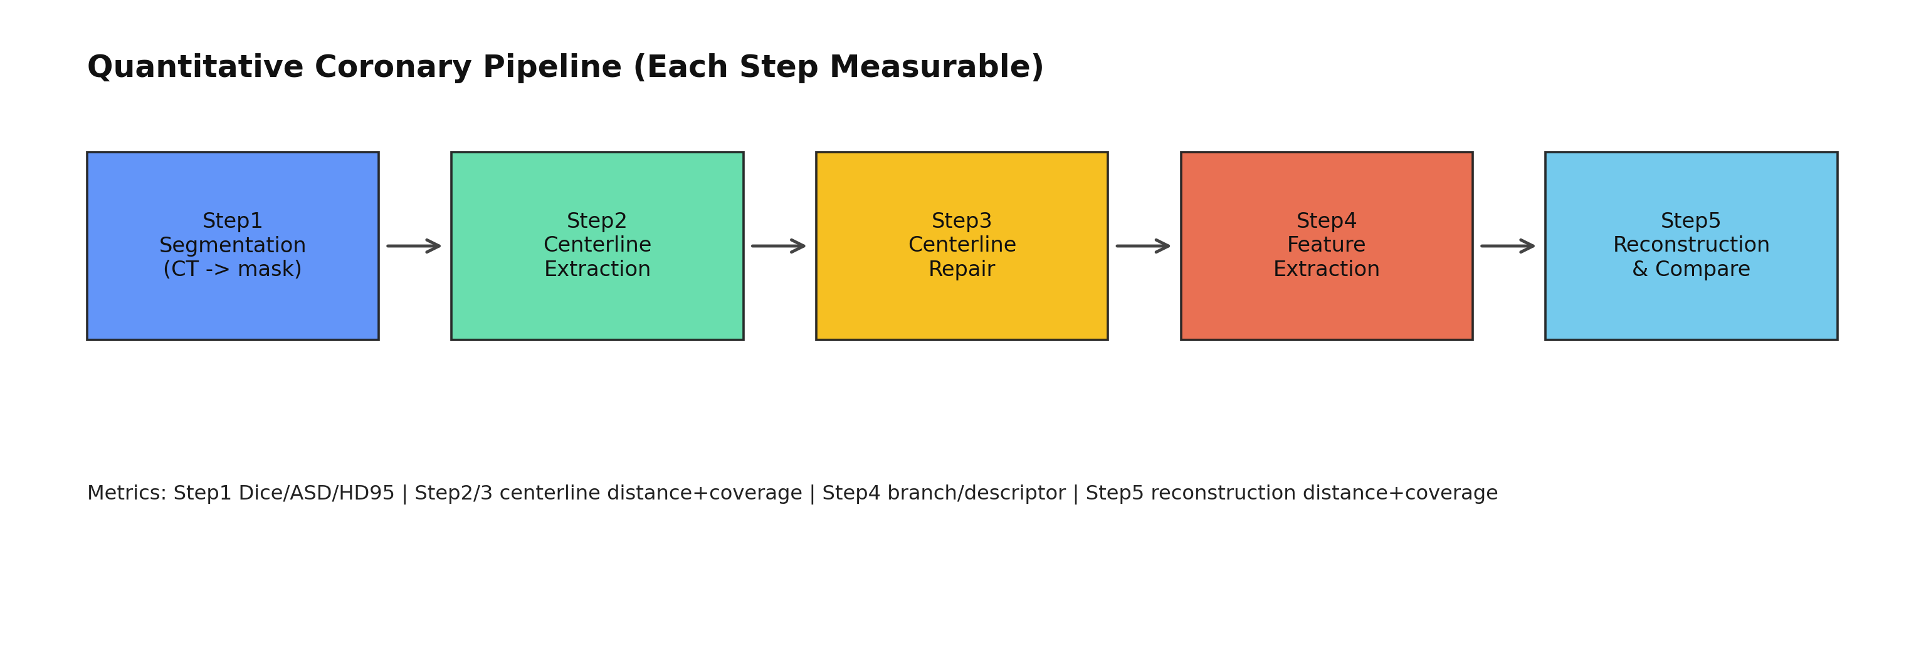
Vessel_seg: Research Progress
CT -> Segmentation -> Centerline -> Repair -> Feature -> Reconstruction
Notes:
这页展示了五步流程和数据流向。输入是 CT 和 GT，输出是每一步的中间结果与指标文件。这样做的好处是，任何一步出问题都能快速定位，不会出现‘结果不好但不知道错在哪’。”
我目前的项目，是3维与2维DSA的匹配，所以跟注重中心线的准确性，强调血管的物理约束以及形变，目前呢，分割这块内容大致是这样的。 这五步分别是 1. CT -> mask 2. mask -> Polyline 3. repairment 4. feature extraction 5. reconstruction
第四步主要是继承了我学长在肌肉重建方面的工作，主要目的是降维加速计算，提高算法的实时性潜力。 至于量化指标呢 “Step1 用 Dice/ASD/HD95 看分割质量；Step2/3 用中心线点到点距离和覆盖率；Step4 用分支数量差和特征向量相似度；Step5 用重建结果到 GT 的距离分布。核心原则是：距离类越小越好，覆盖率/相似度越大越好。” 过渡句：“有了指标后，看 case 的总结果。”

Slide 9
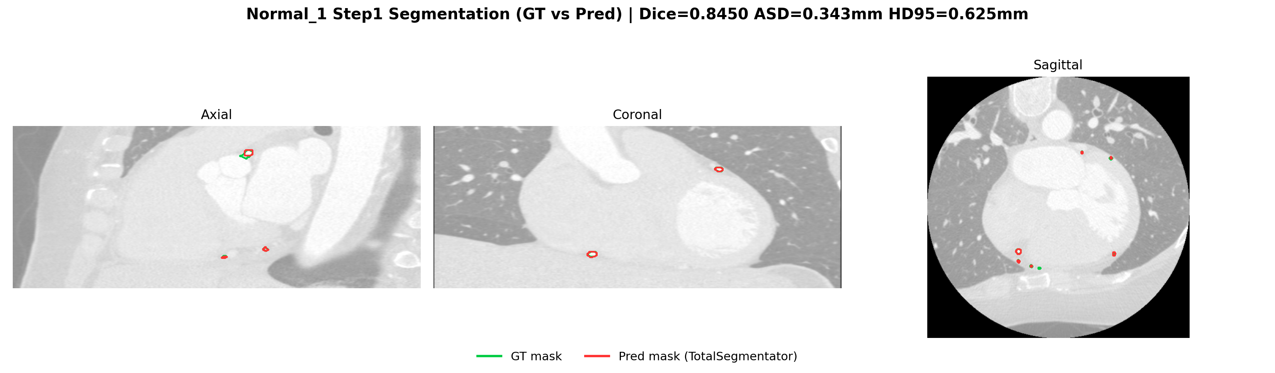
Step1 Segmentation: Normal_1
CT -> Segmentation -> Centerline -> Repair -> Feature -> Reconstruction
Dice = 0.8450
HD95 = 0.625 mm
Interpretation: strong upstream quality for downstream steps
Notes:
“Normal_1 的 Dice 和 HD95 都比较理想，说明预测 mask 与 GT 对齐度高。这个 case 适合验证下游算法本身，而不是被上游噪声主导。” 过渡句：“再看困难样例，理解失败模式。”

Slide 10
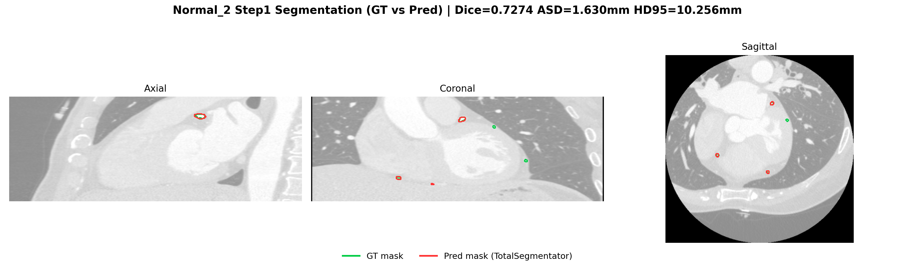
Step1 Segmentation: Normal_2
Dice = 0.7274
HD95 = 10.2556 mm
Main bottleneck: segmentation quality variance
CT -> Segmentation -> Centerline -> Repair -> Feature -> Reconstruction
Notes:
Normal_2 的 HD95 明显偏大，说明局部边界有较大误差。这个 case 提醒我们：上游分割稳定性是全流程上限，不先解决 Step1，后面优化收益会打折。
对于Step1 在实验了多个样例后，我主要发现的问题是，
部分血管，gt没有标注，但被分割出来了
部分血管，gt标注出来了，但没分割出来
之前我手搓了一个算法，但效果表现一般。目前这一版目前采用的分割方法是调用了Totalsegmentation的。后期需要视情况，决定是基于Total segmentation微调，还是直接写个新的。” 过渡句：“在这个背景下看 Step2/3 的中心线表现。”

Slide 11
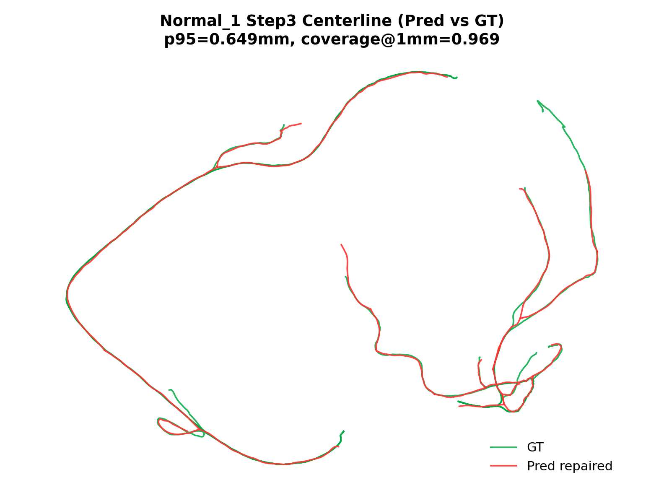
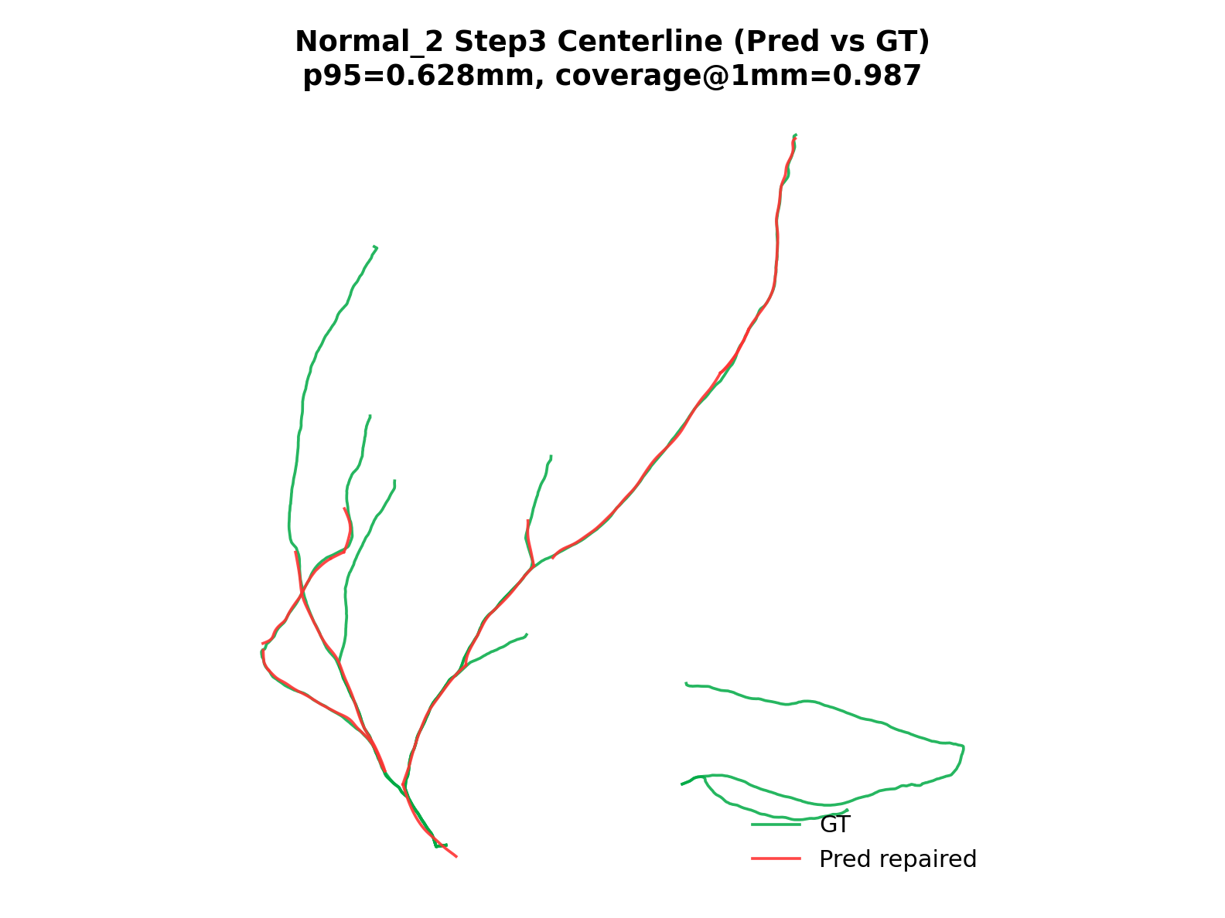
Step3 Centerline Comparison
CT -> Segmentation -> Centerline -> Repair -> Feature -> Reconstruction
Notes:
“这页对比了中心线修复后的空间表现。核心看两点：一是是否连续且符合血管走形，二是与 GT 的偏差是否下降。当前结果说明 repair 对尾部误差和局部断裂有改善。” 过渡句：“这里有一个关键工程问题我专门修复过。”

Slide 12
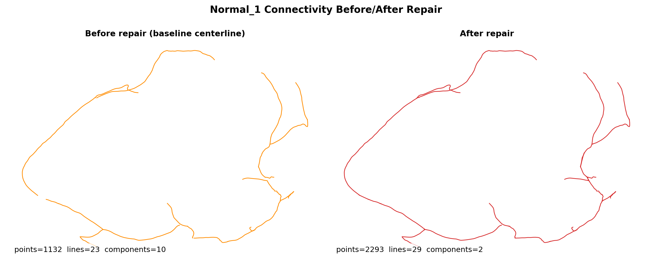
Key Engineering Fix: Repair Topology
CT -> Segmentation -> Centerline -> Repair -> Feature -> Reconstruction
Root cause: duplicated endpoint points in VTP writer
Fix: merge coincident endpoints to shared point IDs
Outcome: disconnected fragments -> anatomically coherent components
Notes:
修复原理是基于血管的物理约束和走形。我调研了血管的物理约束（包括空间曲率的问题），以及血管走形来修复。至于为什么要用血管走形呢？我的想法是因为血管是管状结构，其中心线有很好的指向性，利用这一点，可以把断裂的中心线，按照血管物理约束进行连接。从而达到修复效果。
“之前的 repaired 线看起来连着，但拓扑上是碎的。根因是写 VTP 时端点没有共享 point ID。修复后引入端点合并和拓扑监控，结果从大量离散组件收敛到符合解剖的连通结构。这说明我做的是‘结构层面修复’，不是只调参数。” 过渡句：“修好拓扑后，再看跨case层面的对比。”

Slide 13
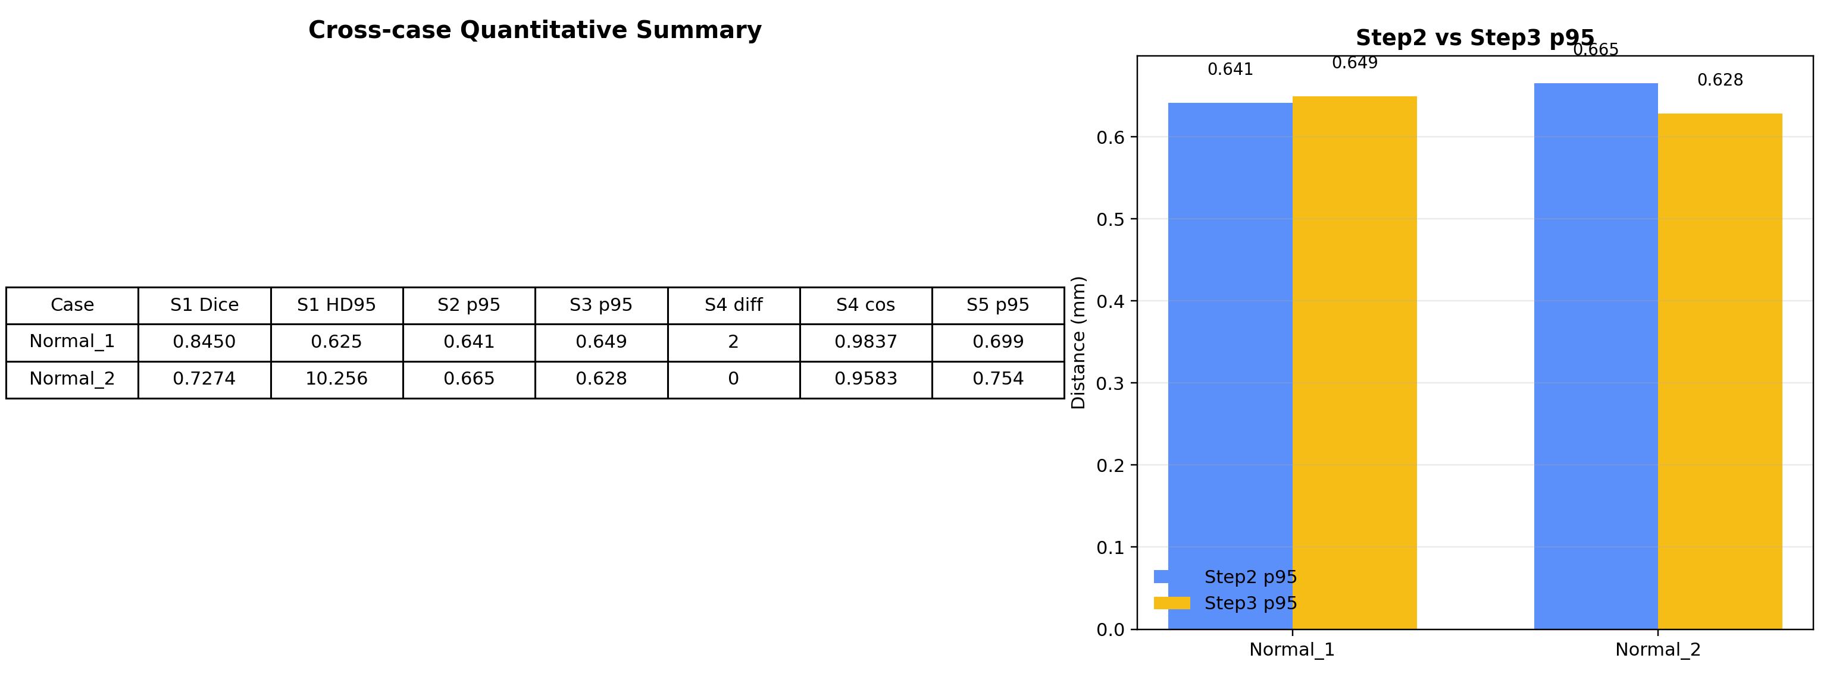
Cross-case Quantitative Summary
CT -> Segmentation -> Centerline -> Repair -> Feature -> Reconstruction
Notes:
“这里是 Normal_1 和 Normal_2 的横向对比。Normal_1 的 Step3 p95 从 Step2 明显下降，说明修复有效；Normal_2 的主要瓶颈在 Step1 分割，导致后续受影响。这个表帮助我们决定优化优先级。”

Slide 14
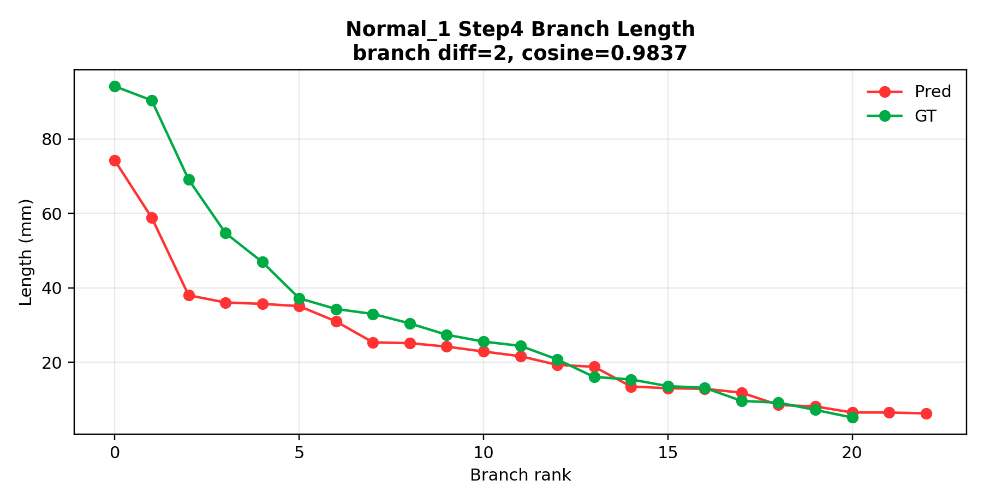
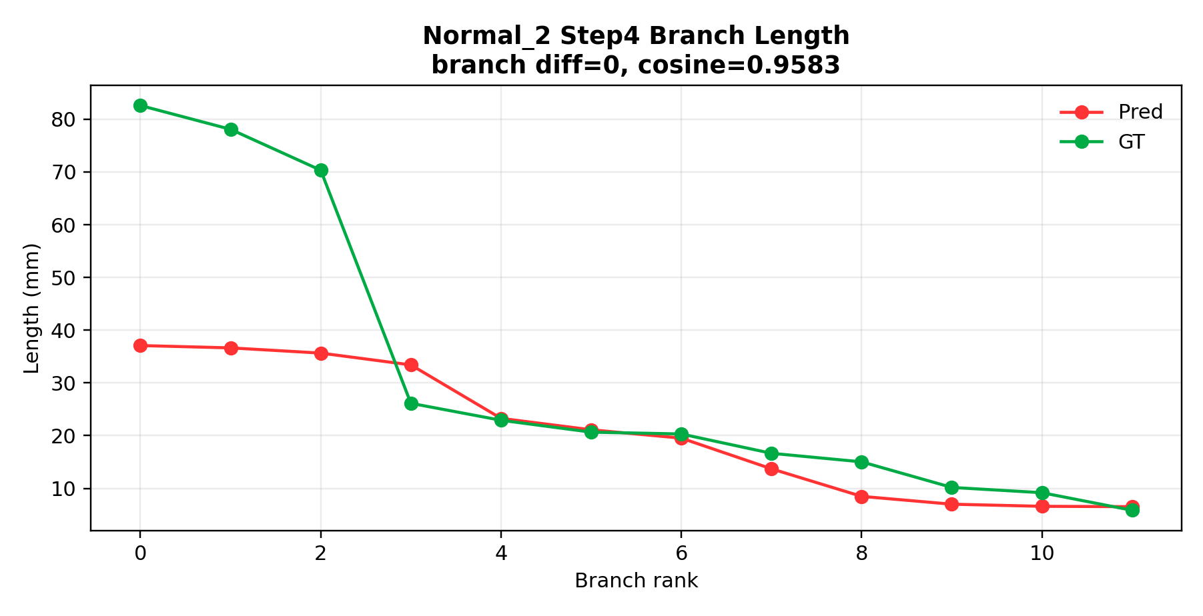
Step4 Feature Extraction
CT -> Segmentation -> Centerline -> Repair -> Feature -> Reconstruction
Notes:
“这页看分支级特征。Normal_2 的分支计数和 GT 对齐较好；Normal_1 还有一段冗余分支，需要继续治理。整体上特征向量相似度已经较高，说明主干结构基本合理。” 过渡句：“最后给出风险和两周执行计划。”

Slide 15
Current Risks and Following Weeks
CT -> Segmentation -> Centerline -> Repair -> Feature -> Reconstruction
Open Risks
Execution Plan
Step4 still has branch count mismatch on some cases
Case-to-case variability remains high
Need stronger failure-case regression set
Week 1: repair trigger + topology constraints
Week 2&3: branch governance + batch evaluation (10-20 cases)
Deliver reproducible report-ready figures/tables
Notes:
“当前风险主要有三个：Step1 稳定性波动、Step3 补线能力还不够、Step4 冗余分支偶发。两周计划是：第一周做结构化补线与回归测试，第二周做分支治理和多例统计。” 过渡句：“接下来总结我这阶段的核心贡献。”

Slide 16
My Core Contributions
CT -> Segmentation -> Centerline -> Repair -> Feature -> Reconstruction
Built an end-to-end quantitative pipeline (not isolated scripts)
Defined step-wise metrics to make progress measurable and auditable
Diagnosed and fixed topology-level bug with reproducible evidence
Converted blockers into actionable engineering tasks and benchmarks
Notes:
“我把原先分散脚本整合成端到端可复现流程，并建立了统一指标口径。其次我定位并修复了拓扑层面的关键 bug。最后，我把失败案例转化成可回归的问题清单，形成持续迭代机制。”
这部分还主要聚焦修复部分。之后可能需要聚焦多模态匹配以及血管变形部分。 过渡句：“最后我希望得到导师的方向性反馈。”

Slide 17
Why PixAIL
Why I’m excited
Directions I align with
How I can contribute
Working style
PixAIL directions: multimodal medical foundation models;
multimodal agents; fine-grained temporal modeling;
generative models
clean data/model/eval pipelines;
geometry + learning; clinical workflow awareness (PCI observership)
multimodal imaging (CCTA + DSA),
3D–2D registration,
temporal modeling, and generative shape priors
Weekly milestones
Fast iteration
Small tests first
then scale
Notes:
“I’m interested in PixAIL because your directions align directly with what my pipeline needs next: multimodal medical modeling, fine-grained temporal modeling for cine/DSA-like sequences, and generative or probabilistic methods for reconstruction and uncertainty. My current work already sits at the intersection of geometry-aware alignment and structured vascular representation, so I believe I can plug into ongoing projects quickly while also contributing engineering rigor and reproducibility.”

Slide 18
What I’d like to work on this summer
I’m flexible on topics—happy to take on new challenges.
Week 1–2
Week 3–6
Week 6–8
Working style
reproduce baselines; set up data preprocessing + evaluation (SimpleITK/VTK/3D Slicer)
prototype temporal-consistency / real-time alignment modules for cine/DSA guidance
explore multimodal (imaging + text/structured data) or generative/uncertainty-aware enhancements
Weekly milestones
measurable outcomes
Notes:
“I’m flexible on the exact topic, but I’d like to prioritize something that is both clinically grounded and technically deep. Concretely, I can start by reproducing a baseline and setting up clean data/evaluation pipelines, then prototype temporal-consistency or real-time alignment modules, and finally explore multimodal or generative enhancements if that fits the lab’s direction. My preference is to deliver measurable progress every one to two weeks.”

Slide 19

Q&A
Notes:
“I’ll stop here—happy to go deeper on any stage of the pipeline, the metrics, the topology repair, or how I would structure milestones if I join.”

Slide 20
Questions for discussion
1
Which modality / project is top priority this summer (CT/MRI/US/pathology, cine/DSA video)?
2
What is your preferred RA workflow (weekly milestones, code reviews, paper goals, compute/data access)?
3
Is funding available for this position (RA stipend or summer support), and could you advise on visa options or sponsorship (e.g., J-1/F-1 CPT/OPT) for a visiting research appointment?
Notes:
“First, what modality or project would be the highest priority in your group this summer—CT/DSA video, other medical video, or multimodal settings? Second, what RA workflow do you prefer—weekly milestones, code reviews, and the expected deliverables (e.g., a reproducible baseline, a workshop submission, or an internal demo)? Third, do you anticipate any funding support for a summer visiting researcher (RA stipend or hourly support)? If funding is limited, I can pursue external funding—would your group be able to provide an invitation/support letter if needed? Finally, could you advise what visa route typically works for visiting students in your lab (for example, J-1 visiting student or other options)?”

