Slide 1


Medical Imaging × AI for Interventional Guidance
Research & Project Highlights (Medical Imaging)
Yihao Chen（陈奕好）
College of Engineering, Peking University
Feb 2026
chenyihao@stu.pku.edu.cn
github.com/ChenNeuro
Notes:
Hi Hao and Teo, thanks for taking the time to meet with me today. My name is Yihao Chen, an undergraduate student at Peking University. Broadly, I’m interested in sensing and real-world robot interaction—especially how we can use multimodal sensing like IMU, force/pressure, and vision to build reliable perception-to-action loops for contact-rich tasks.
In the next ~15 minutes, I’ll give a quick overview of a few projects I’ve worked on. I’ll organize them in a simple way: first, sensor integration and signal processing; second, robot system building and mechanism design; and third, how I try to use those signals for estimation and control to improve robustness in real environments. For each project, I’ll keep the story concise: what problem I tried to solve, what I built or implemented, what results I got, and what I would do next.
After that, I’d love to hear your thoughts on where my background could fit best in BDML this summer, and I also have a few questions about the kinds of projects and expectations in the lab.
Hao、Teo 你们好，谢谢你们愿意跟我聊一聊。我是陈奕好，北大工学院本科生，专业方向是理论力学和机器人双主修，在周培源书院就读，可以理解为提高班。
我感兴趣的研究方向是：怎么让机器人在真实环境里“敢接触、能接触、接触得稳”。所以我做项目时会很在意传感到控制这一层——比如 IMU、力/压力这些信号，怎么采、怎么对齐、怎么变成对控制有用的信息，最后把它用进闭环里，让系统更稳定、更可靠。
我大概用 15 分钟过一下我做过的几个项目。我会按三个块讲：
第一、系统/机构这类从零搭起来的东西；
第二、多传感集成和信号处理；
第三、把这些信号用到估计和控制里，去提升鲁棒性。
每个项目思路是：我当时想解决什么问题、我具体做了什么、效果怎么样、以及我觉得下一步还能怎么做。
讲完之后我也很想听听你们的建议：如果暑研能加入 BDML，我更适合从哪些方向切进去、你们觉得我该优先补哪些能力。另外我也准备了几个关于你们组项目节奏和期待的问题想请教。

Slide 2
Agenda
1
Quick intro & strengths (skills + working style)
2
Background & research interests (medical imaging)
3
Ongoing Projects: coronary reconstruction, CT–DSA 3D–2D registration, vessel topology modeling
4
Discussion
Notes:
Here’s the plan for today. I’ll start with a quick intro and what I can bring, then walk through three representative projects—one on sensing system integration, one on mechanical prototyping, and one ongoing research effort. After that, I’ll explain why I’m interested in BDML and what I hope to work on this summer, and then we can open it up for discussion.
我今天大概按四步来：先用很短的时间说一下我是谁、我擅长什么；然后用三个项目作为代表，分别对应传感系统、机械原型和我正在做的研究；接着我会讲我为什么想来 BDML、以及暑研我希望切入的方向；最后我们就自由讨论和提问。

Slide 3
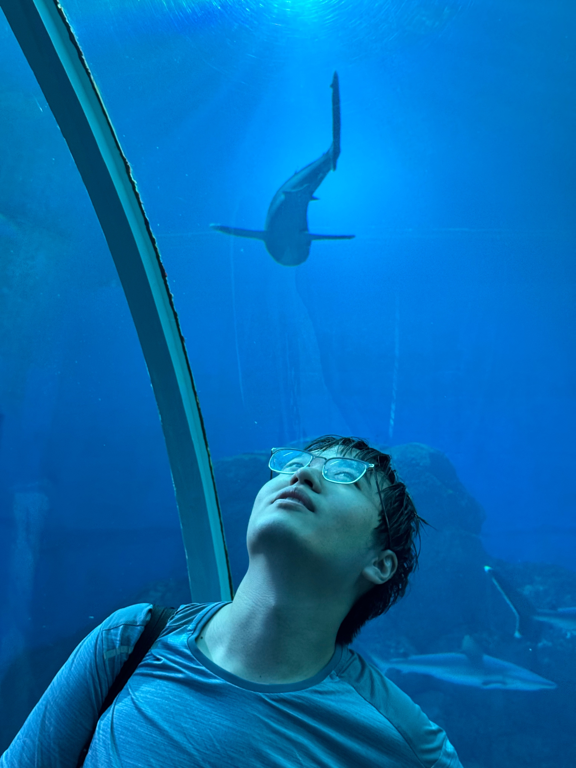

Quick intro & strengths
Yihao Chen（陈奕好）
Medical Imaging | 3D–2D Registration | Temporal Modeling
Build end-to-end imaging pipelines (data → preprocessing → model → evaluation)
Combine geometry constraints with learning (registration, centerline/topology priors)
Reproducible research habits: scripts, ablations, reports
Cross-domain engineering: sensing/robotics experience transfers to real-time systems
Interests: multimodal medical foundation models · temporal modeling for cine/DSA · generative reconstruction
Notes:
Four quick points: I can build end-to-end prototypes; I integrate sensors and produce clean synchronized logs; I debug by isolating failure modes with quick checks; and I work proactively with clear updates and documentation.
And in terms of research interests, I’m particularly excited about tactile and multimodal sensing for robust contact-rich interaction—especially in settings like underwater manipulation where uncertainty and contact make everything harder.
四点要点如下：我能构建端到端的原型；我能整合传感器并生成清晰同步的日志；我能通过快速检查来定位故障模式进行调试；并且我能主动与他人合作，提供明确的更新和文档说明。
至于研究兴趣方面，我对触觉和多模态传感在具有大量接触的可靠交互中的应用尤其感兴趣——特别是在像水下操作这样的环境中，不确定性以及接触因素使得一切变得更加困难。

Slide 4
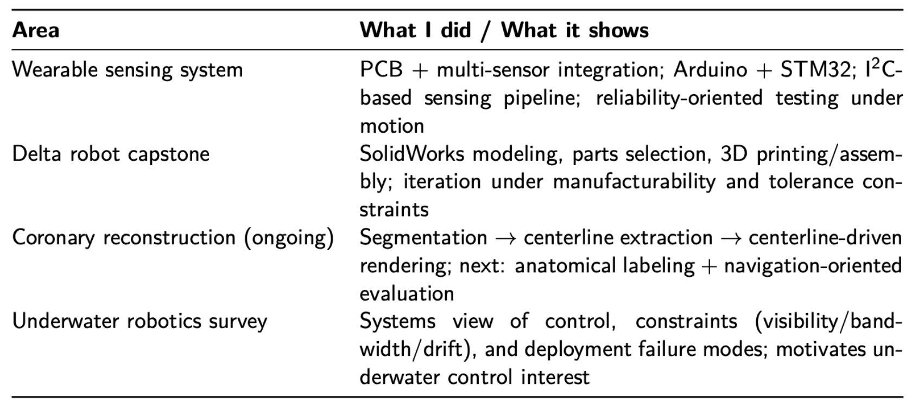
Experience map
Notes:
I’ll use this slide as a map for the rest of the talk.
The wearable sensing project shows my strength in sensor integration and reliability-oriented testing.
The delta robot project is about rapid prototyping under manufacturability and tolerance constraints.
The coronary reconstruction work is my ongoing research, where I combine an algorithmic pipeline with evaluation and iteration.
And finally, the underwater robotics survey gives me a systems view of real deployment constraints—visibility, bandwidth, drift—which is also why I’m excited about robust contact-rich interaction.
我将用这张幻灯片作为接下来演讲的示意图。
可穿戴传感项目展示了我在传感器集成以及可靠性测试方面的能力。
Delta 机器人项目涉及在可制造性和公差限制条件下进行快速原型制作。
冠状动脉重建工作是我正在进行的研究，其中我将算法流程与评估和迭代相结合。
最后，水下机器人调查让我对实际部署的限制（如可见度、带宽、漂移）有了系统性的认识——这也是我对丰富且具有接触性的稳健交互感到兴奋的原因。

Slide 5
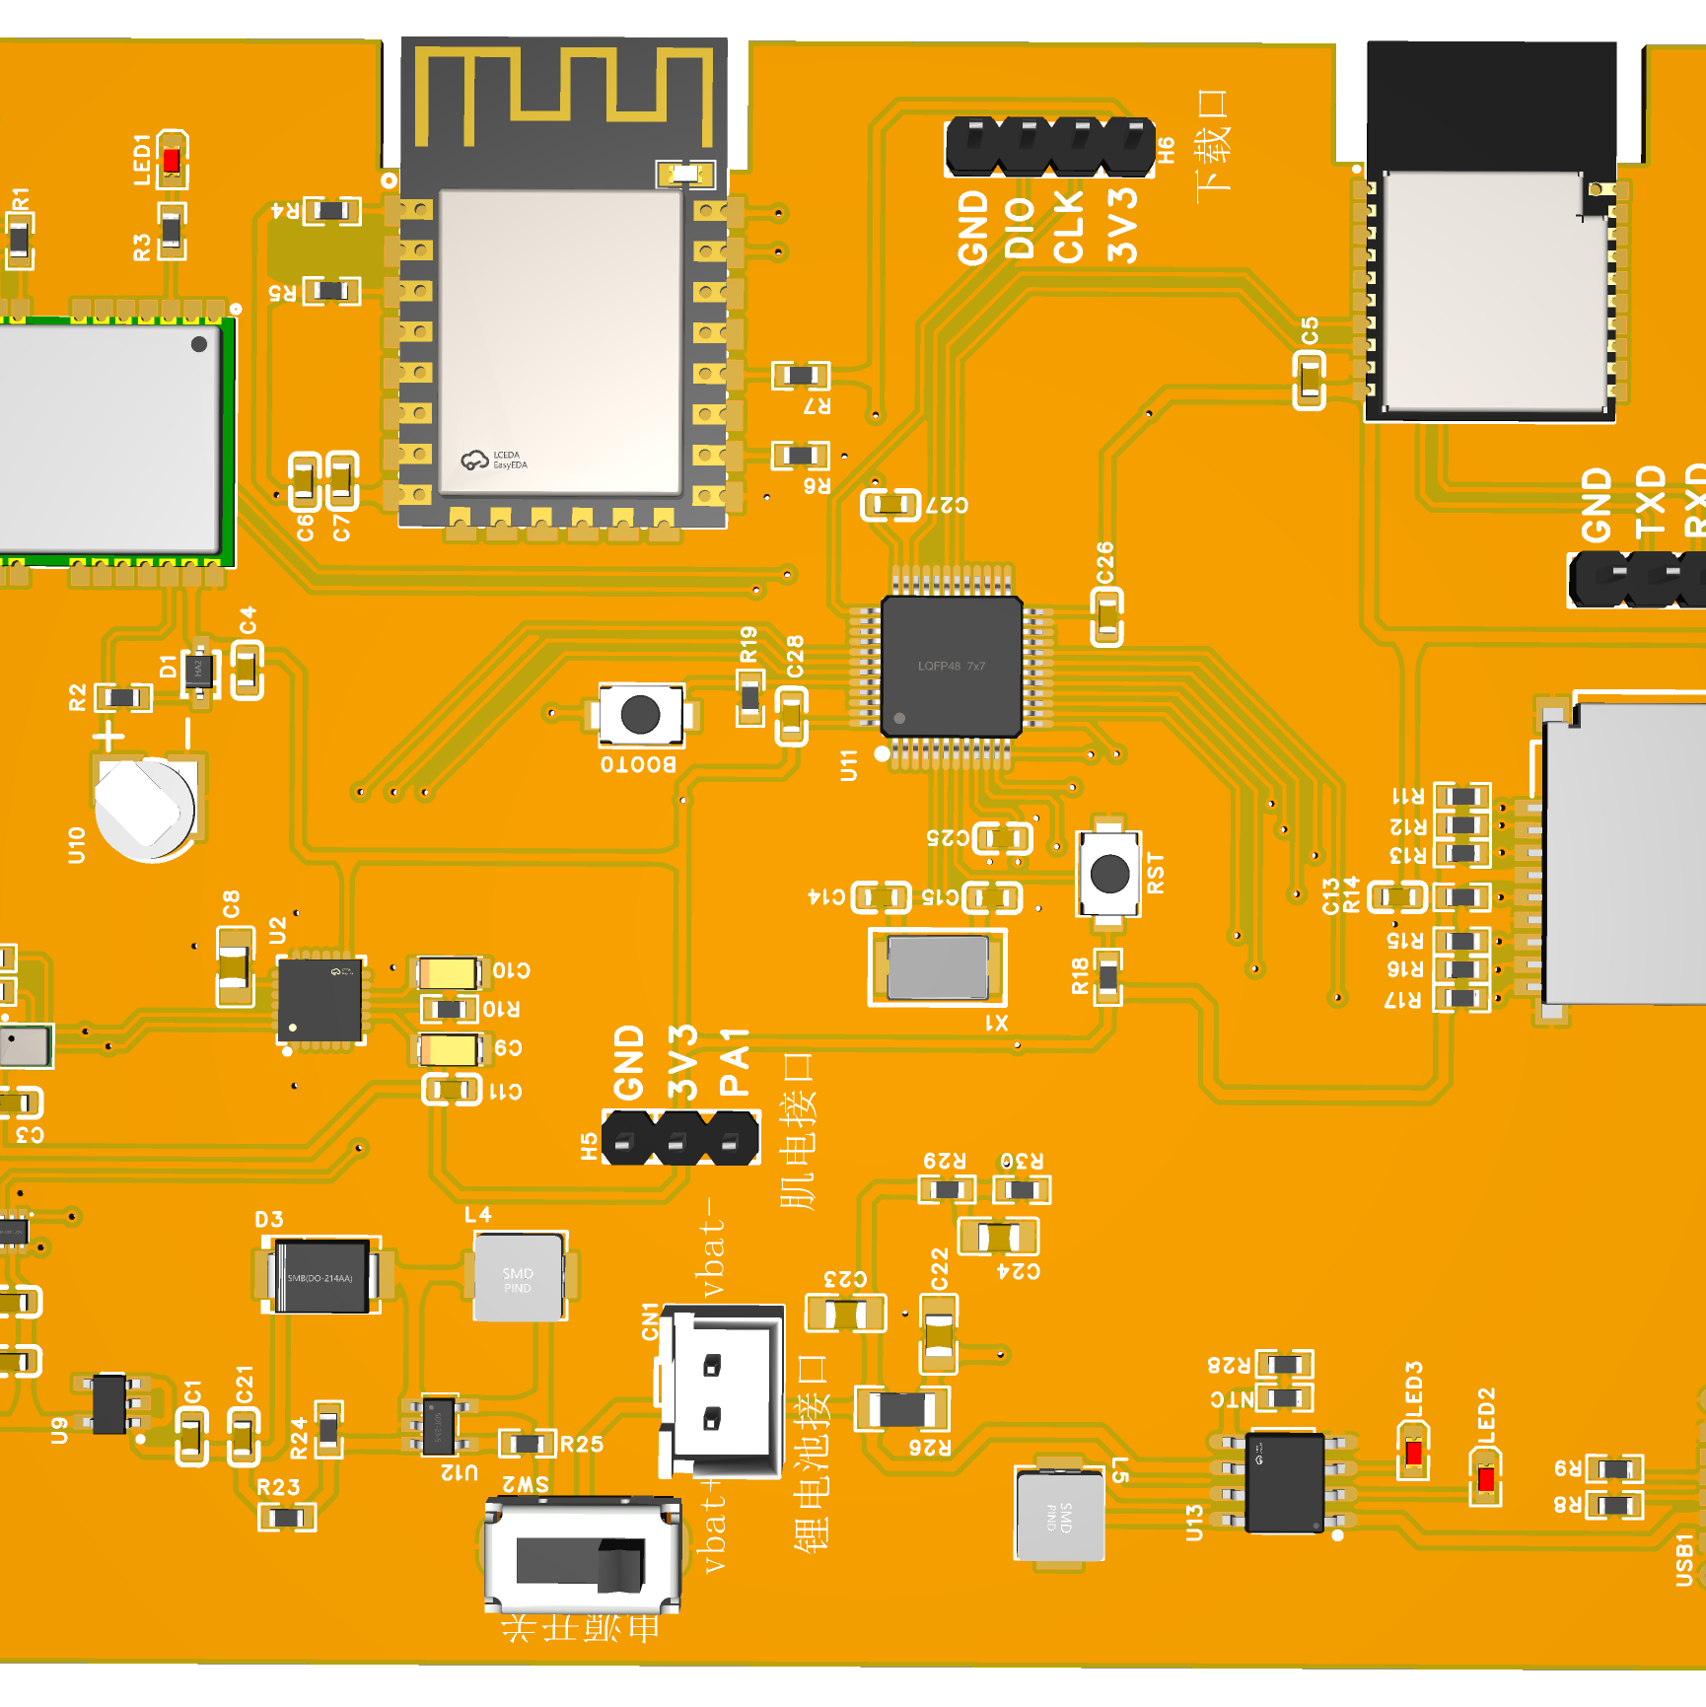
Project 1: Wearable leg-guard sensing system
Objective
Implementation
Wearable sensing for motion/load monitoring under realistic movement, emphasizing stable data acquisition.
Arduino + STM32 for acquisition/control
Multi-sensor integration via I2C and related interfaces
My role
Validation
Project planning & system architecture
PCB/circuit design; component selection
Integration and bring-up across HW/FW/comm
Iterative testing under realistic motion
Prioritized repeatability over one-off demos
Logged issues/failure cases to drive iteration
Notes:
This project is a wearable leg-guard sensing system. The motivation was pretty practical: when you collect motion and load signals on a human body, the real challenge is not getting any signal—it’s getting stable, repeatable data under realistic movement.
I led the project end-to-end: I did the system planning and architecture, designed the PCB and selected components, and then brought the whole stack up across hardware, firmware, and communications. For implementation, I used an Arduino plus an STM32 for acquisition and control, and integrated multiple sensors mainly through I²C and related interfaces.
For validation, I focused on reliability: I tested it repeatedly under real motion, logged failure cases like dropouts and synchronization issues, and iterated based on those logs rather than optimizing for a one-off demo. The main takeaway for me is that I’m comfortable building sensing systems end-to-end, and I tend to work in a reliability-oriented way.

Slide 6
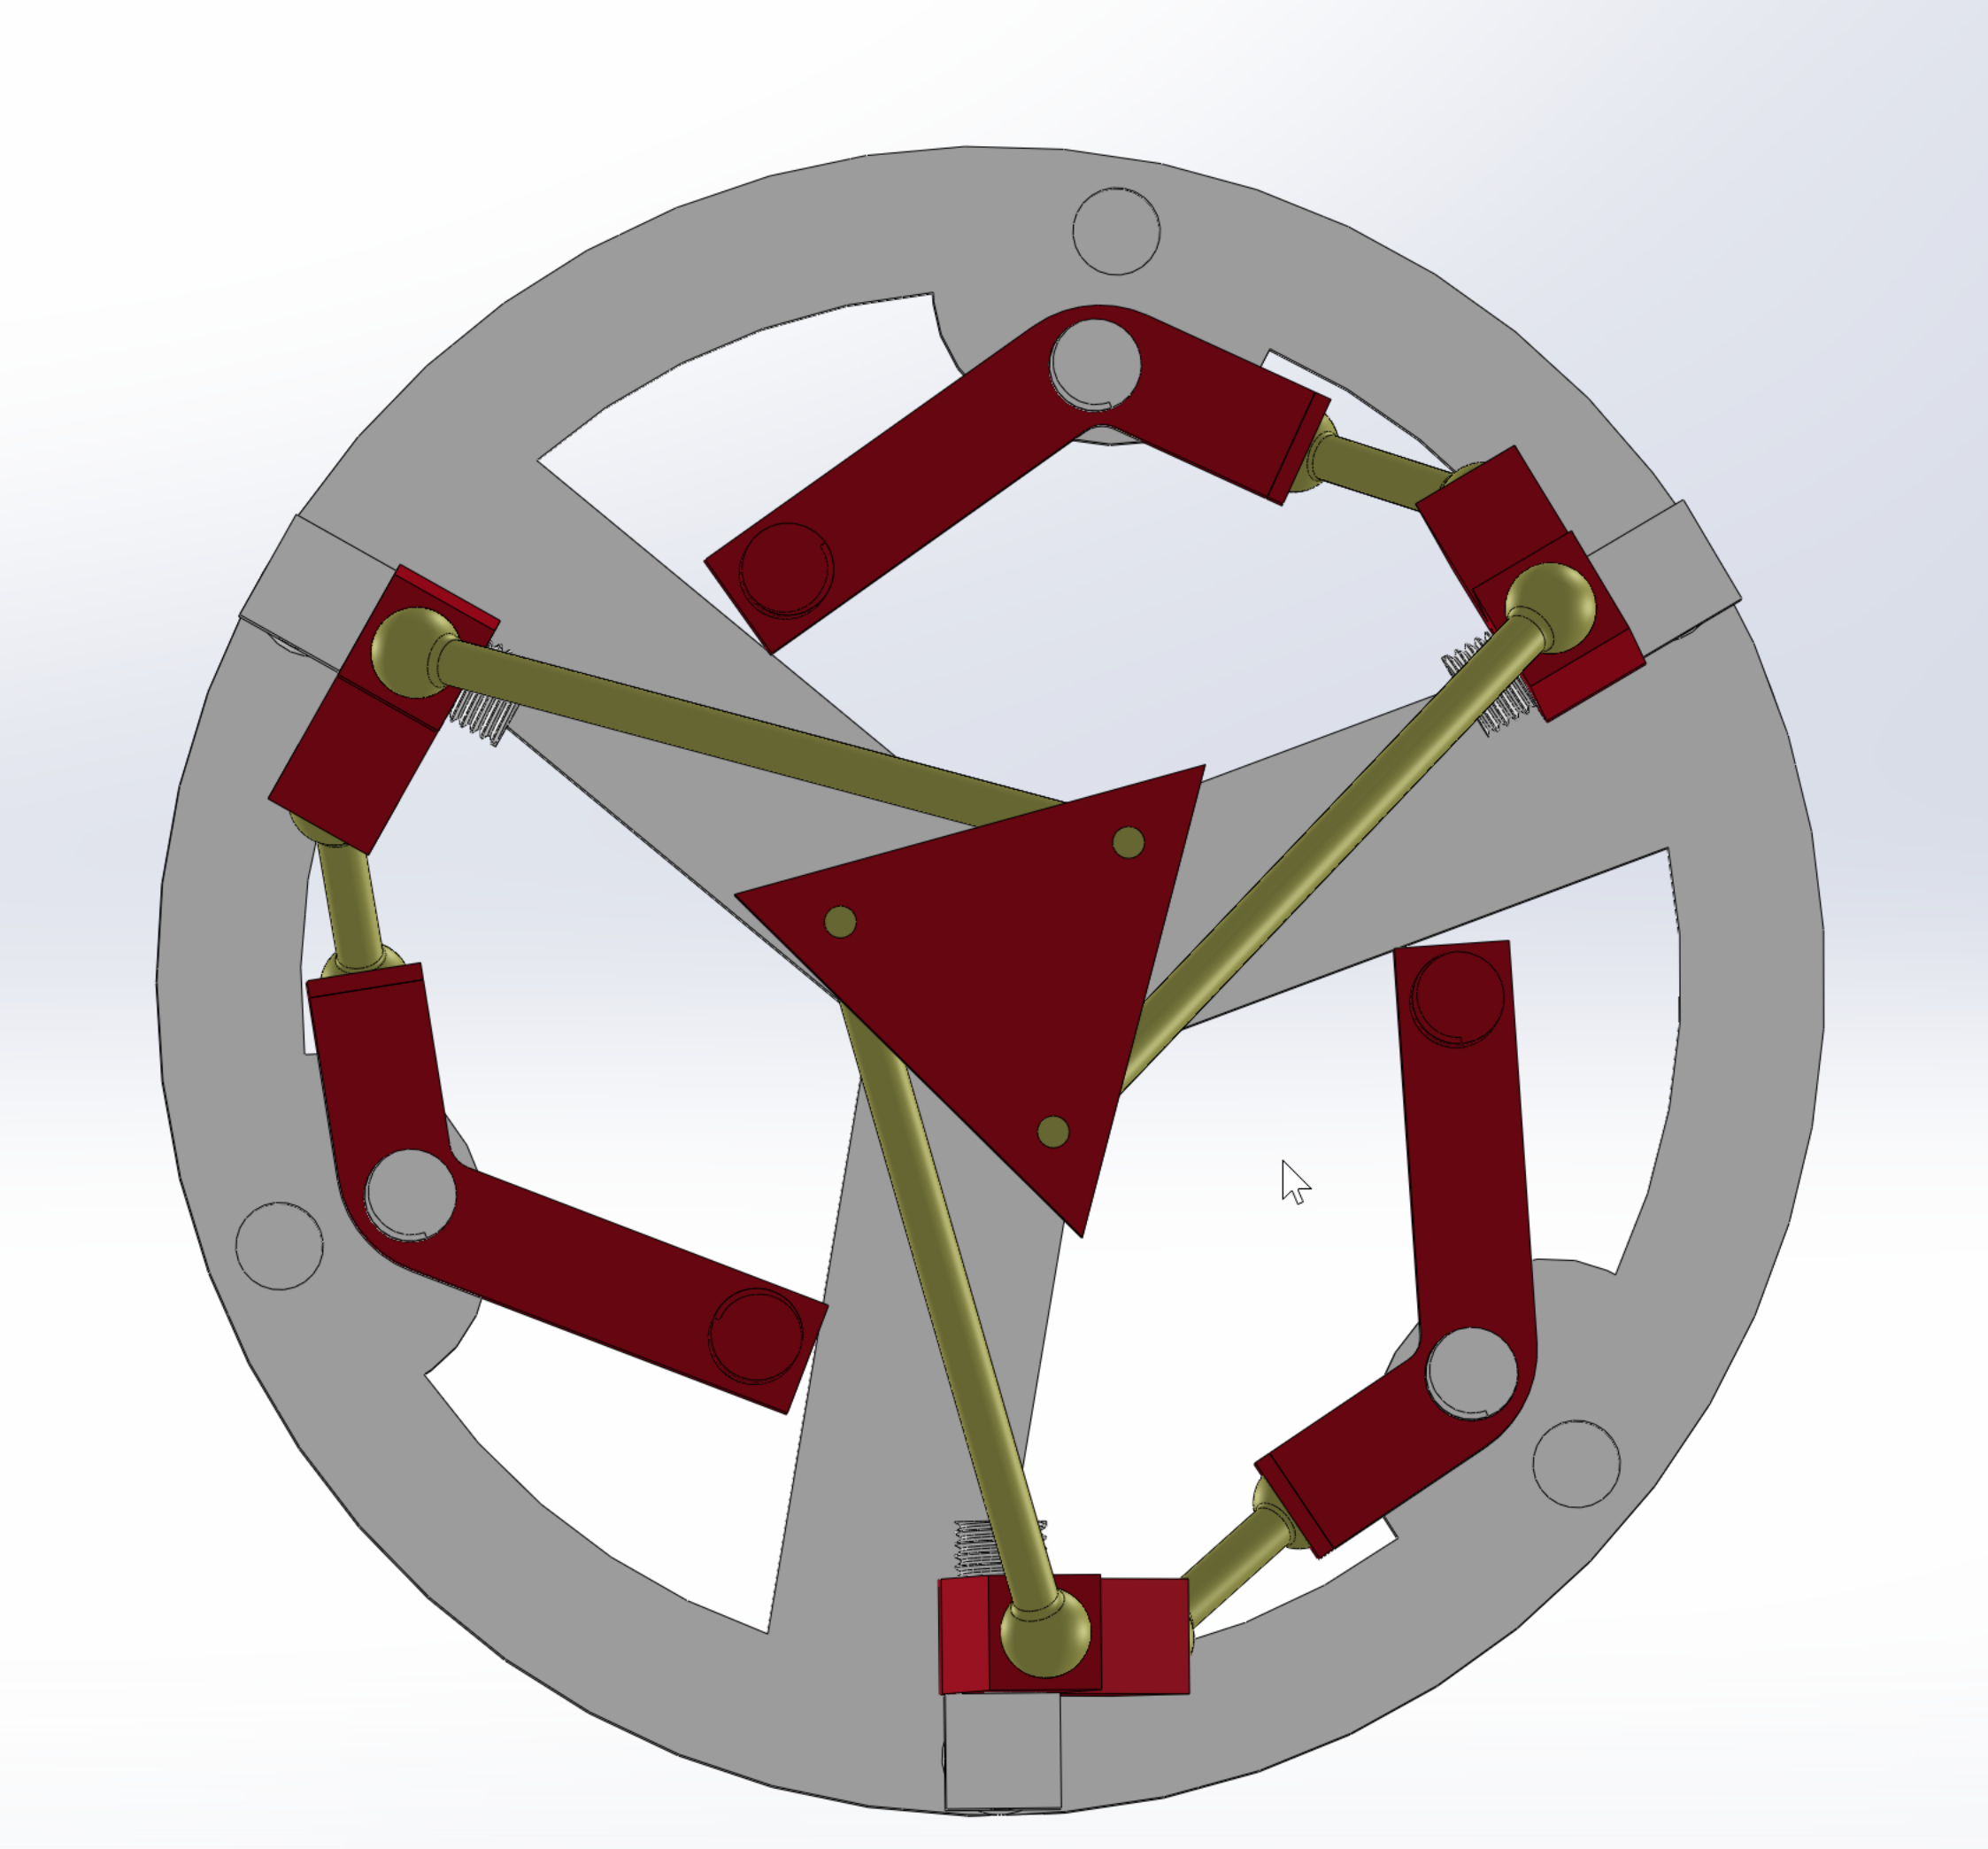
Project 2: 3-DOF Delta robot (mechanical capstone)
Objective
Implementation
End-to-end mechanical design and prototyping of a Delta parallel robot.
Mechanism + detailed part design
Manufacturing/assembly constraints considered early
My role
Validation
Project lead — owned requirements, timeline, and integration decisions
SolidWorks modeling
Planning and parts selection
3D printing and assembly; iteration
Prototype feedback: tolerances, interference, robustness
Iterated geometry and interfaces accordingly
Notes:
This project is a 3-DOF Delta robot that I built as a mechanical capstone. The objective was to take a kinematics-driven concept and push it all the way to a working physical prototype.
My role covered the full mechanical pipeline: I did the SolidWorks CAD modeling, planned the design and selected parts early, and then went through multiple rounds of 3D printing and assembly. On the implementation side, I didn’t stop at the mechanism level—I also designed the detailed parts and interfaces, and I tried to consider manufacturing and assembly constraints upfront rather than fixing everything at the end.
Validation was very prototype-driven. The main issues were tolerances, interference between moving links, and overall robustness. Each time we assembled the prototype, the feedback immediately translated into geometry and interface changes—clearance, joint design, mounting, and alignment—so the design converged through iteration.
The takeaway is that I’m comfortable turning kinematics-based ideas into manufacturable hardware by iterating through real build-and-test cycles.

Slide 7
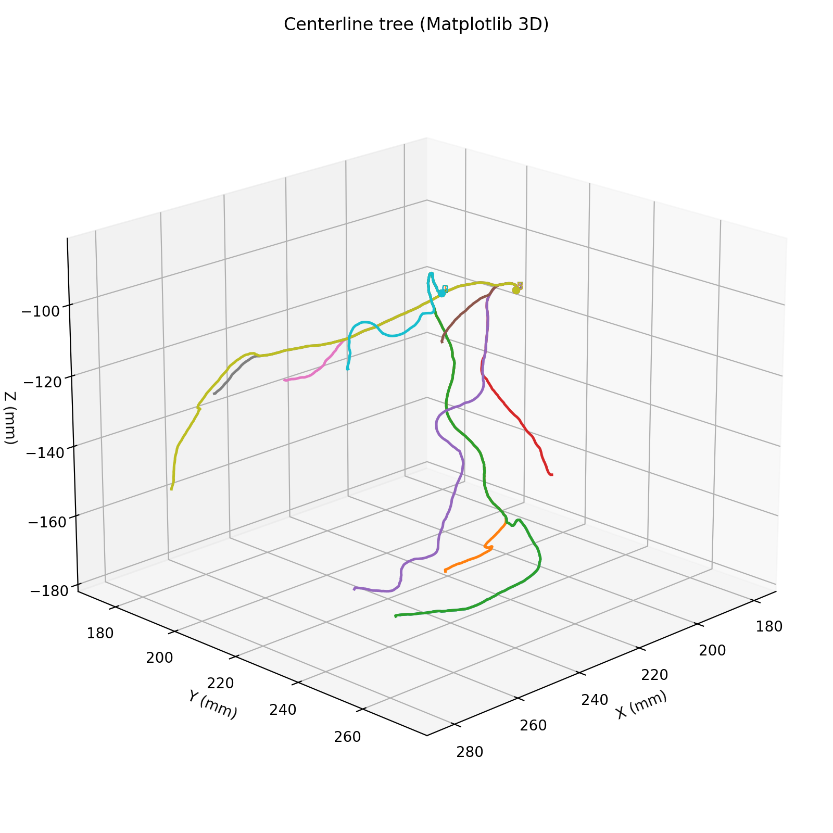
Ongoing research: coronary reconstruction pipeline
Objective
Current progress
Build a reconstruction/modeling pipeline with long-term relevance to clinically grounded workflows and evaluation.
Surveyed workflows + established a first working pipeline
Segmentation → centerline extraction → centerline-driven representation/rendering
Defined output schema (tree/branch structure) for consistent experiments
My role
Next phase
Project lead & upstream workflow owner (problem framing, milestones, interface definitions)
Built the pipeline end-to-end and standardized outputs for evaluation and downstream use
Incorporate hospital data constraints and clinical feedback loops
Anatomically consistent labeling (segment-level) for standardization
Evaluation aligned with navigation/decision support (robustness + usability)
Notes:
This is my ongoing research project, and I’m leading the upstream workflow and pipeline development. The long-term objective is to build a reconstruction and modeling pipeline that stays clinically relevant—meaning the outputs are structured, evaluable, and compatible with real hospital workflows.
The next phase is where it becomes more “clinically grounded”: incorporating hospital data and workflow constraints, adding anatomically consistent labeling so different segments are comparable, and defining evaluation metrics that align with navigation or decision-support use cases—so we’re not just optimizing for pretty reconstructions, but for robustness and usefulness.
这部分我汇报的是一个可复现、可量化的冠脉分析闭环。流程从 CT 出发，经过分割、中心线提取、修复、特征提取，到最后重建与对比。今天重点不是单一算法，而是每一步都有指标、可以持续迭代。

Slide 8
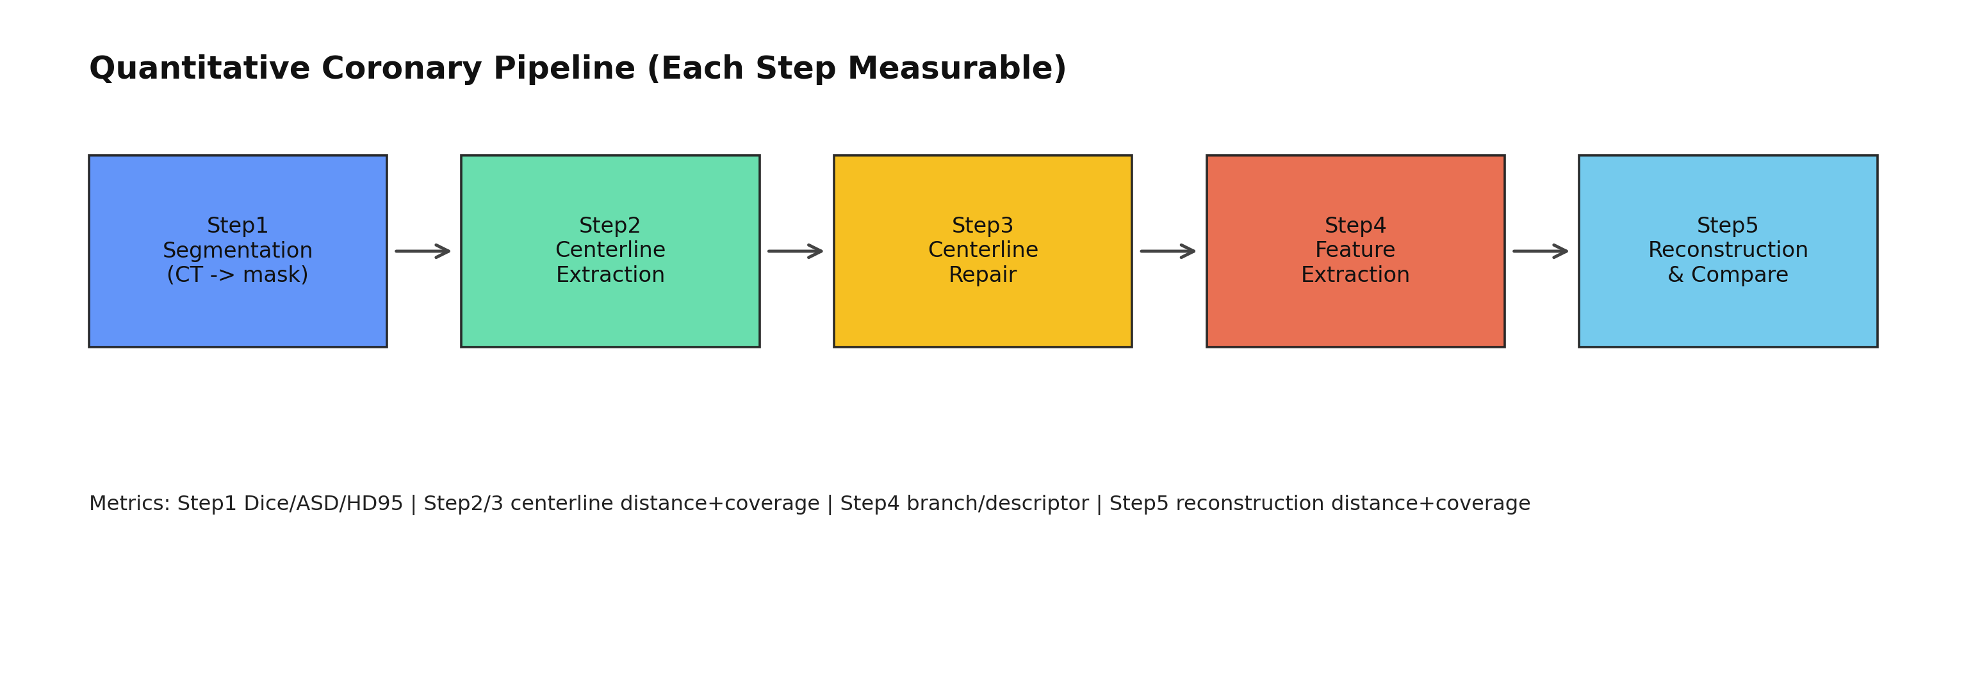
Vessel_seg: Research Progress
CT -> Segmentation -> Centerline -> Repair -> Feature -> Reconstruction
Notes:
这页展示了五步流程和数据流向。输入是 CT 和 GT，输出是每一步的中间结果与指标文件。这样做的好处是，任何一步出问题都能快速定位，不会出现‘结果不好但不知道错在哪’。”
我目前的项目，是3维与2维DSA的匹配，所以跟注重中心线的准确性，强调血管的物理约束以及形变，目前呢，分割这块内容大致是这样的。 这五步分别是 1. CT -> mask 2. mask -> Polyline 3. repairment 4. feature extraction 5. reconstruction
第四步主要是继承了我学长在肌肉重建方面的工作，主要目的是降维加速计算，提高算法的实时性潜力。 至于量化指标呢 “Step1 用 Dice/ASD/HD95 看分割质量；Step2/3 用中心线点到点距离和覆盖率；Step4 用分支数量差和特征向量相似度；Step5 用重建结果到 GT 的距离分布。核心原则是：距离类越小越好，覆盖率/相似度越大越好。” 过渡句：“有了指标后，看跨 case 的总结果。”

Slide 9
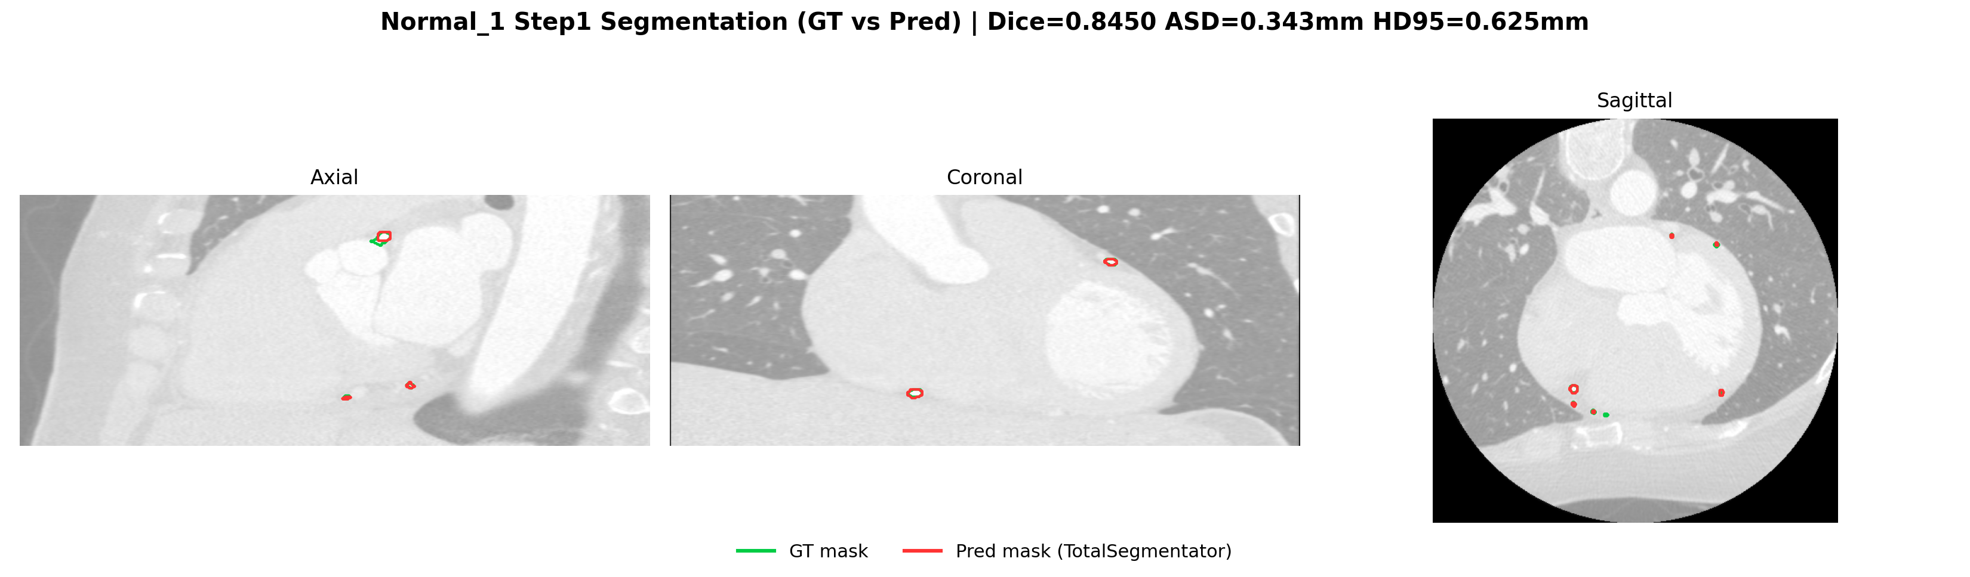
Step1 Segmentation: Normal_1
CT -> Segmentation -> Centerline -> Repair -> Feature -> Reconstruction
Dice = 0.8450
HD95 = 0.625 mm
Interpretation: strong upstream quality for downstream steps
Notes:
“Normal_1 的 Dice 和 HD95 都比较理想，说明预测 mask 与 GT 对齐度高。这个 case 适合验证下游算法本身，而不是被上游噪声主导。” 过渡句：“再看困难样例，理解失败模式。”

Slide 10
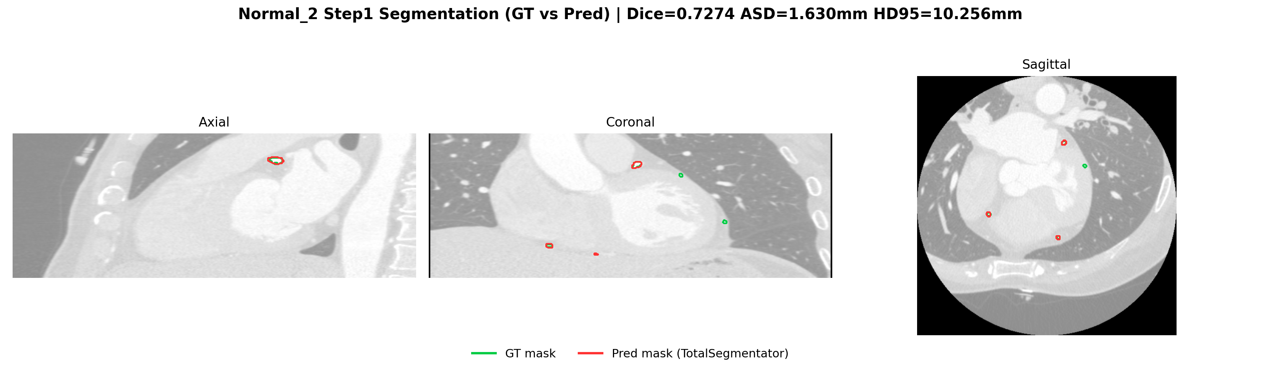
Step1 Segmentation: Normal_2
Dice = 0.7274
HD95 = 10.2556 mm
Main bottleneck: segmentation quality variance
CT -> Segmentation -> Centerline -> Repair -> Feature -> Reconstruction
Notes:
Normal_2 的 HD95 明显偏大，说明局部边界有较大误差。这个 case 提醒我们：上游分割稳定性是全流程上限，不先解决 Step1，后面优化收益会打折。
对于Step1 在实验了多个样例后，我主要发现的问题是，
部分血管，gt没有标注，但被分割出来了
部分血管，gt标注出来了，但没分割出来
之前我手搓了一个算法，但效果表现一般。目前这一版目前采用的分割方法是调用了Totalsegmentation的。后期需要视情况，决定是基于Total segmentation微调，还是直接写个新的。” 过渡句：“在这个背景下看 Step2/3 的中心线表现。”

Slide 11
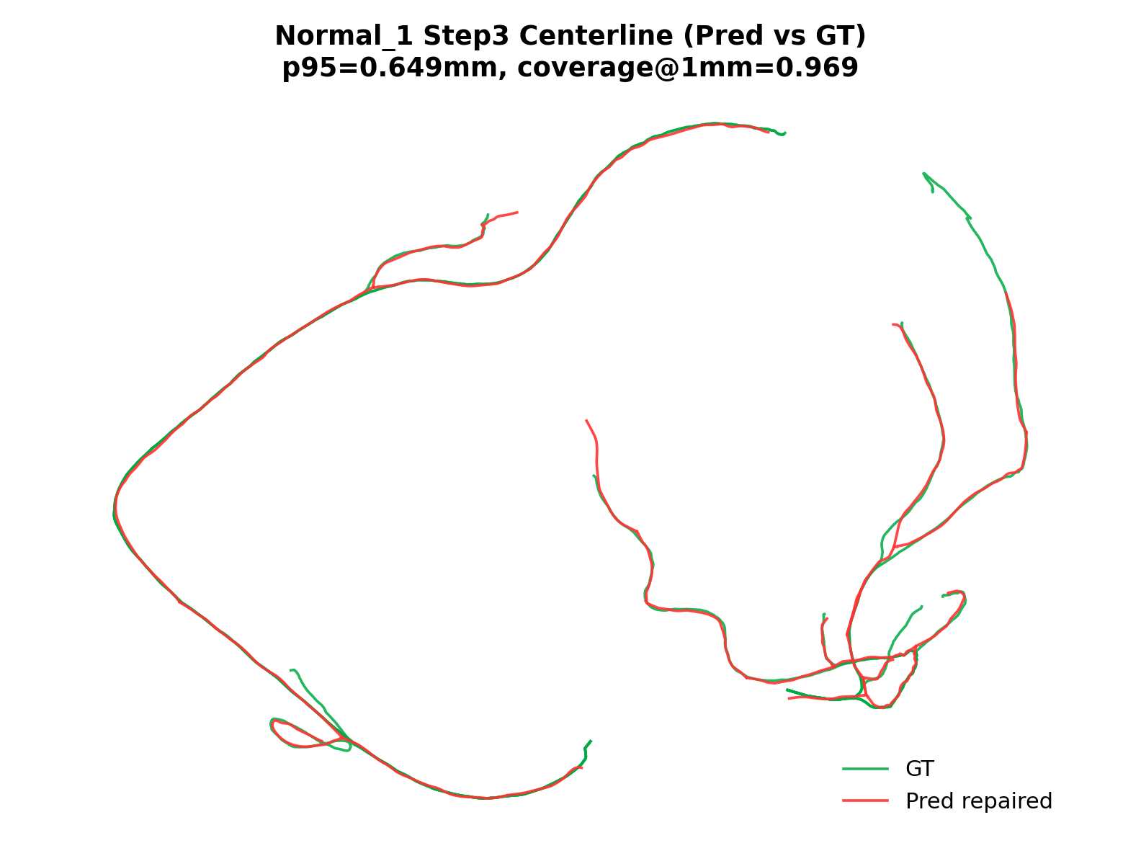
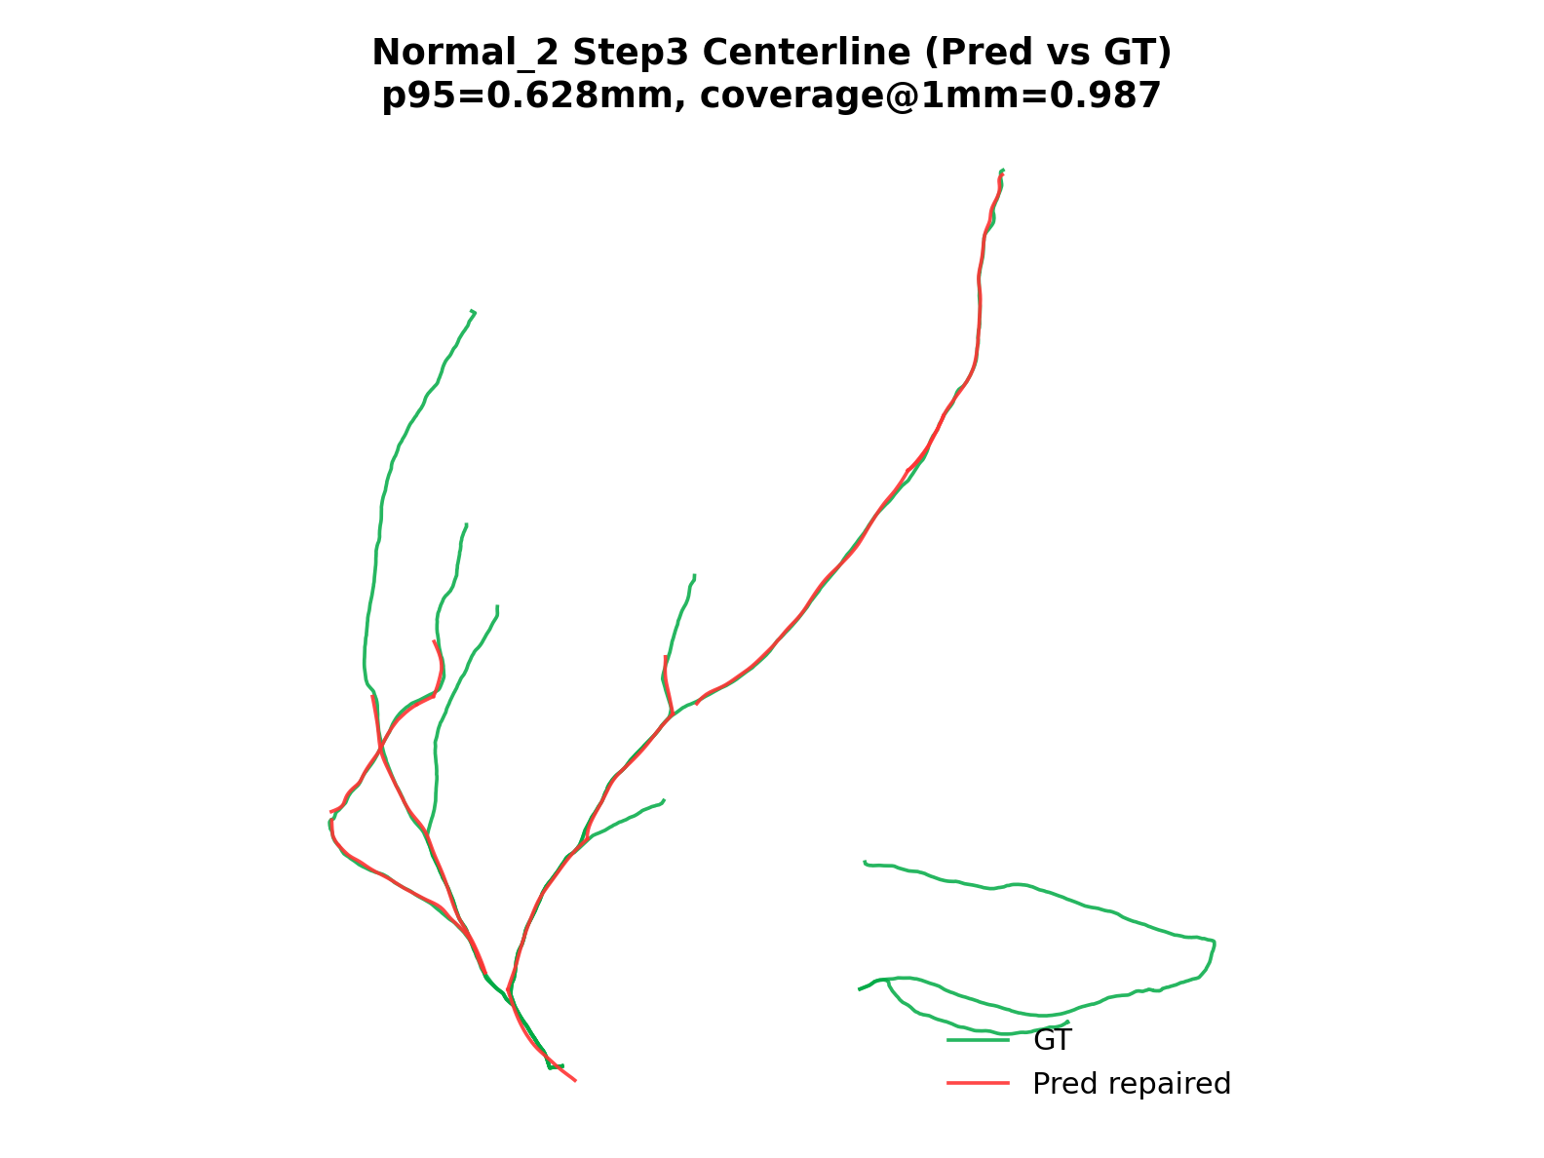
Step3 Centerline Comparison
CT -> Segmentation -> Centerline -> Repair -> Feature -> Reconstruction
Notes:
“这页对比了中心线修复后的空间表现。核心看两点：一是是否连续且符合血管走形，二是与 GT 的偏差是否下降。当前结果说明 repair 对尾部误差和局部断裂有改善。” 过渡句：“这里有一个关键工程问题我专门修复过。”

Slide 12
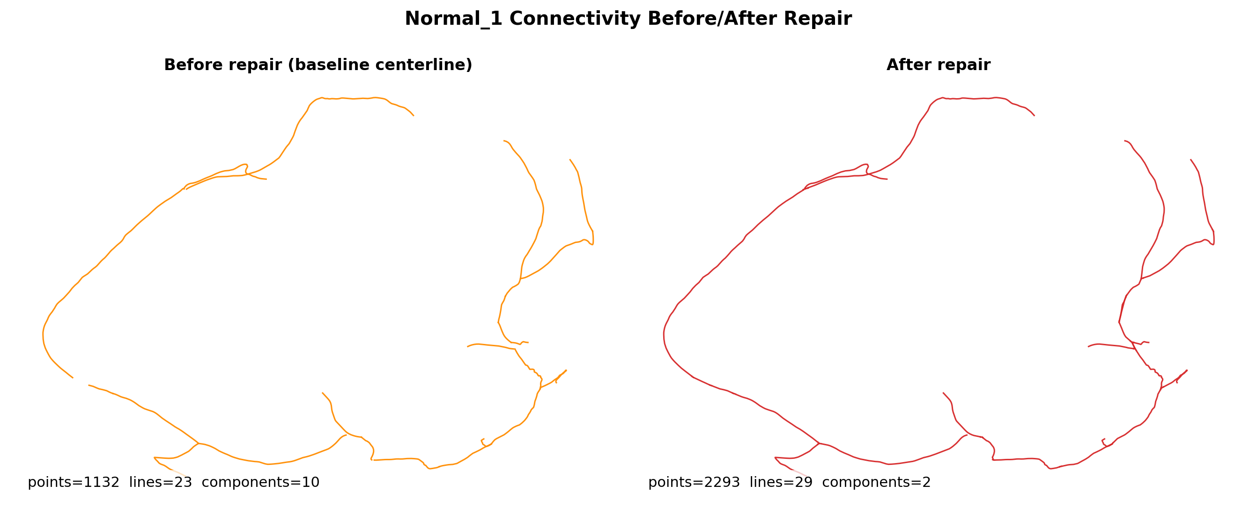
Key Engineering Fix: Repair Topology
CT -> Segmentation -> Centerline -> Repair -> Feature -> Reconstruction
Root cause: duplicated endpoint points in VTP writer
Fix: merge coincident endpoints to shared point IDs
Outcome: disconnected fragments -> anatomically coherent components
Notes:
修复原理是基于血管的物理约束和走形。我调研了血管的物理约束（包括空间曲率的问题），以及血管走形来修复。至于为什么要用血管走形呢？我的想法是因为血管是管状结构，其中心线有很好的指向性，利用这一点，可以把断裂的中心线，按照血管物理约束进行连接。从而达到修复效果。
“之前的 repaired 线看起来连着，但拓扑上是碎的。根因是写 VTP 时端点没有共享 point ID。修复后引入端点合并和拓扑监控，结果从大量离散组件收敛到符合解剖的连通结构。这说明我做的是‘结构层面修复’，不是只调参数。” 过渡句：“修好拓扑后，再看跨case层面的对比。”

Slide 13
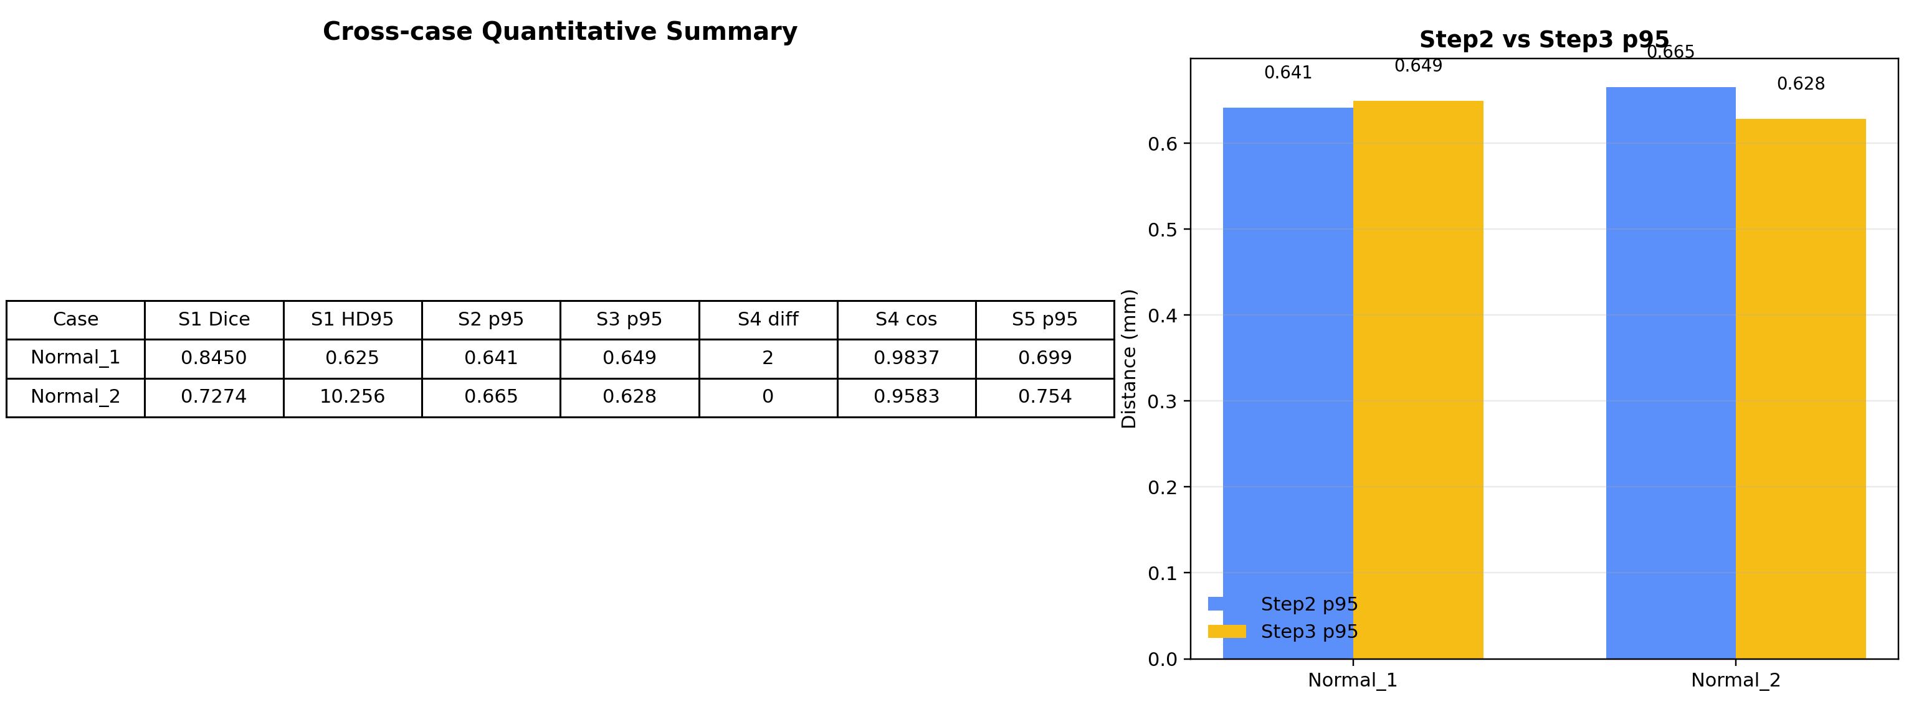
Cross-case Quantitative Summary
CT -> Segmentation -> Centerline -> Repair -> Feature -> Reconstruction
Notes:
“这里是 Normal_1 和 Normal_2 的横向对比。Normal_1 的 Step3 p95 从 Step2 明显下降，说明修复有效；Normal_2 的主要瓶颈在 Step1 分割，导致后续受影响。这个表帮助我们决定优化优先级。”

Slide 14
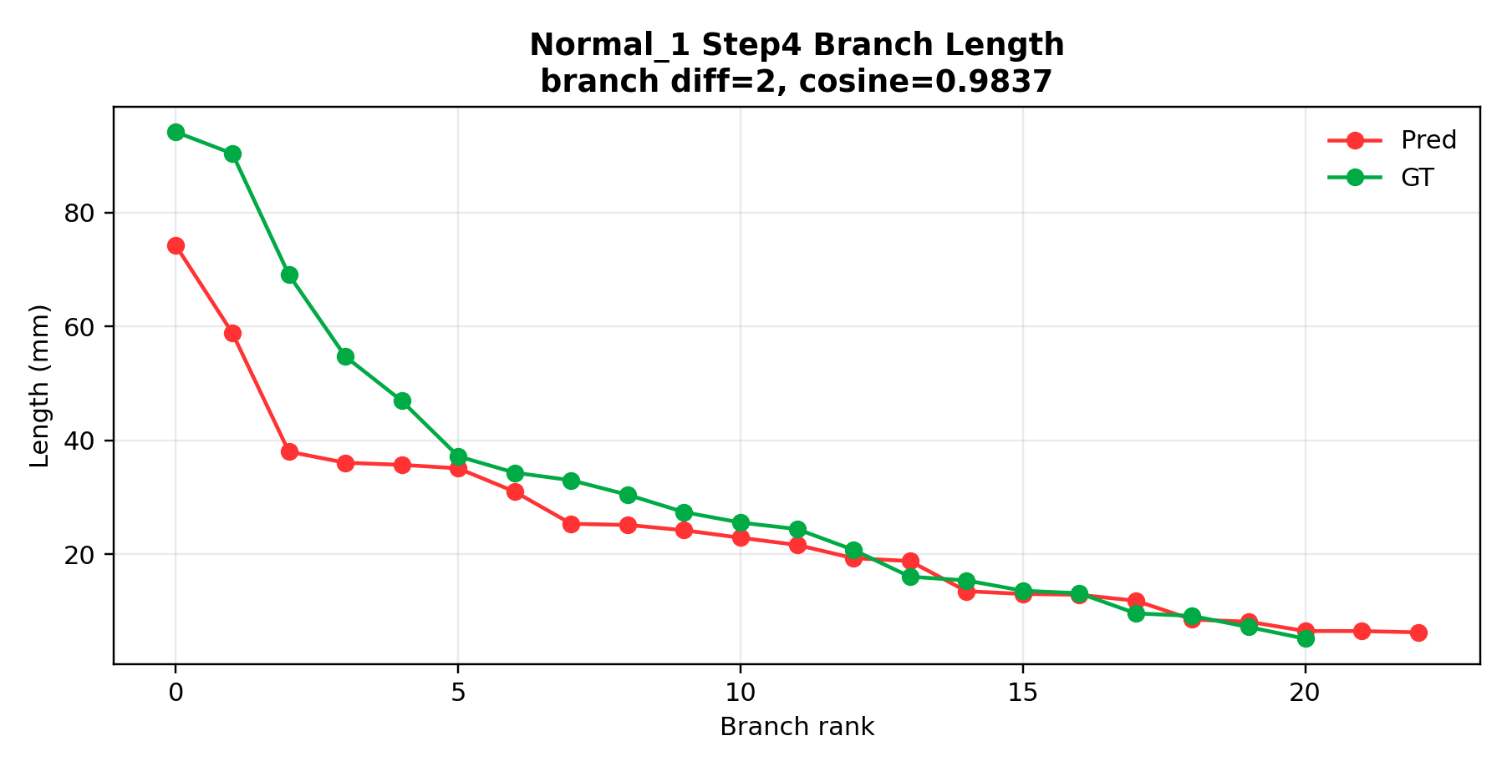
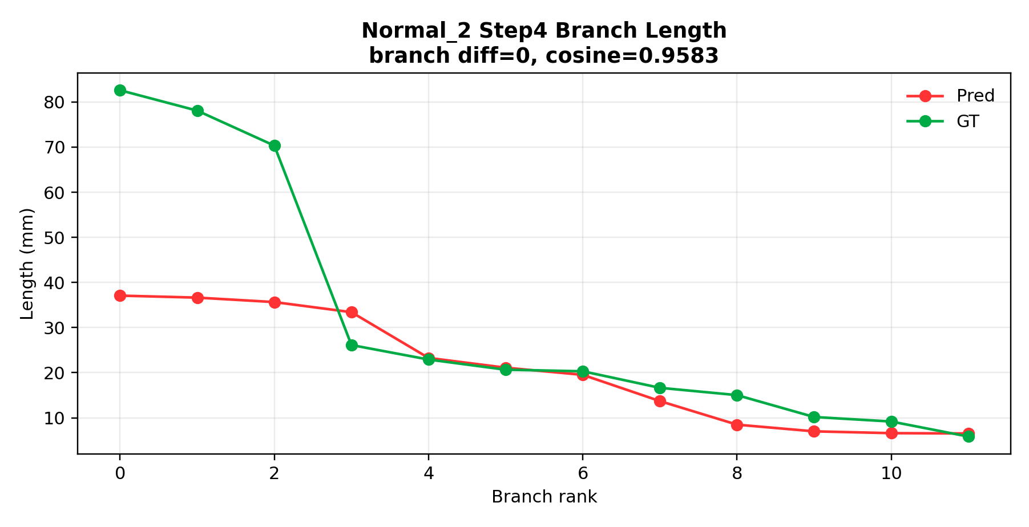
Step4 Feature Extraction
CT -> Segmentation -> Centerline -> Repair -> Feature -> Reconstruction
Notes:
“这页看分支级特征。Normal_2 的分支计数和 GT 对齐较好；Normal_1 还有一段冗余分支，需要继续治理。整体上特征向量相似度已经较高，说明主干结构基本合理。” 过渡句：“最后给出风险和两周执行计划。”

Slide 15
Current Risks and Following Weeks
CT -> Segmentation -> Centerline -> Repair -> Feature -> Reconstruction
Open Risks
Execution Plan
Step4 still has branch count mismatch on some cases
Case-to-case variability remains high
Need stronger failure-case regression set
Week 1: repair trigger + topology constraints
Week 2: branch governance + batch evaluation (10-20 cases)
Deliver reproducible report-ready figures/tables
Notes:
“当前风险主要有三个：Step1 稳定性波动、Step3 补线能力还不够、Step4 冗余分支偶发。两周计划是：第一周做结构化补线与回归测试，第二周做分支治理和多例统计。” 过渡句：“接下来总结我这阶段的核心贡献。”

Slide 16
My Core Contributions
CT -> Segmentation -> Centerline -> Repair -> Feature -> Reconstruction
Built an end-to-end quantitative pipeline (not isolated scripts)
Defined step-wise metrics to make progress measurable and auditable
Diagnosed and fixed topology-level bug with reproducible evidence
Converted blockers into actionable engineering tasks and benchmarks
Notes:
“我把原先分散脚本整合成端到端可复现流程，并建立了统一指标口径。其次我定位并修复了拓扑层面的关键 bug。最后，我把失败案例转化成可回归的问题清单，形成持续迭代机制。”
这部分还主要聚焦修复部分。之后可能需要聚焦多模态匹配以及血管变形部分。 过渡句：“最后我希望得到导师的方向性反馈。”

Slide 17
Step4 Feature Extraction

Slide 18
Current Risks and Next 2 Weeks
Open Risks
Execution Plan
Step4 still has branch count mismatch on some cases
Case-to-case variability remains high
Need stronger failure-case regression set
Week 1: repair trigger + topology constraints
Week 2: branch governance + batch evaluation (10-20 cases)
Deliver reproducible report-ready figures/tables

Slide 19
My Core Contributions
Built an end-to-end quantitative pipeline (not isolated scripts)
Defined step-wise metrics to make progress measurable and auditable
Diagnosed and fixed topology-level bug with reproducible evidence
Converted blockers into actionable engineering tasks and benchmarks

Slide 20
Discussion / Feedback Needed
Do you agree with metric priority (Step1 stability first)?
Should we prioritize method novelty or robust clinical engineering pipeline first?
Is this progression acceptable: small-case closure -> larger batch validation?

