Slide 1


Medical Imaging × AI for Interventional Guidance
Research & Project Highlights (Medical Imaging)
Yihao Chen（陈奕好）
College of Engineering, Peking University
Feb 2026
chenyihao@stu.pku.edu.cn
github.com/ChenNeuro
Notes:
开场（20-30秒）
大家好，我是陈奕好。这次汇报聚焦于医疗影像与AI在介入导航中的应用，我会重点展示我近期在冠脉分析pipeline上的工程化推进和量化结果。

Slide 2
Agenda
1
Quick intro & strengths (skills + working style)
2
Background & research interests (medical imaging)
3
Ongoing Projects: coronary reconstruction, CT–DSA 3D–2D registration, vessel topology modeling
4
Discussion
Notes:
议程（20秒）
先简要介绍我的背景和能力，再进入当前核心项目 vessel_seg，最后给出风险、下一步计划，以及希望老师给我的反馈点。

Slide 3


Quick intro & strengths
Yihao Chen（陈奕好）
Medical Imaging | 3D–2D Registration | Temporal Modeling
Build end-to-end imaging pipelines (data → preprocessing → model → evaluation)
Combine geometry constraints with learning (registration, centerline/topology priors)
Reproducible research habits: scripts, ablations, reports
Cross-domain engineering: sensing/robotics experience transfers to real-time systems
Interests: multimodal medical foundation models · temporal modeling for cine/DSA · generative reconstruction
Notes:
个人能力（35-45秒）
我的强项是把问题从算法点推进到可复现的系统流程：
1) 能完整搭建 data -> preprocessing -> model -> evaluation。
2) 能结合几何约束与学习方法处理医疗影像问题。
3) 在工程上注重可复现和可审计，便于快速迭代。

Slide 4
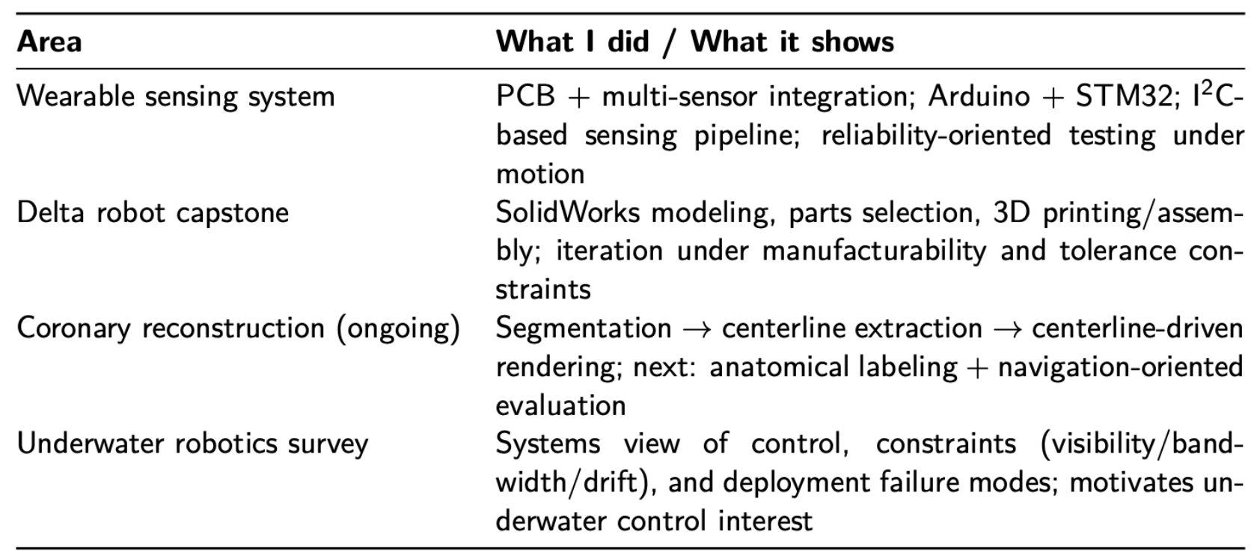
Experience map
Notes:
经历地图（30-40秒）
这页展示我的项目积累路径：从硬件/系统实现，到医学影像建模与评估。核心不是做很多零散demo，而是逐步形成面向真实研究问题的稳定推进能力。

Slide 5
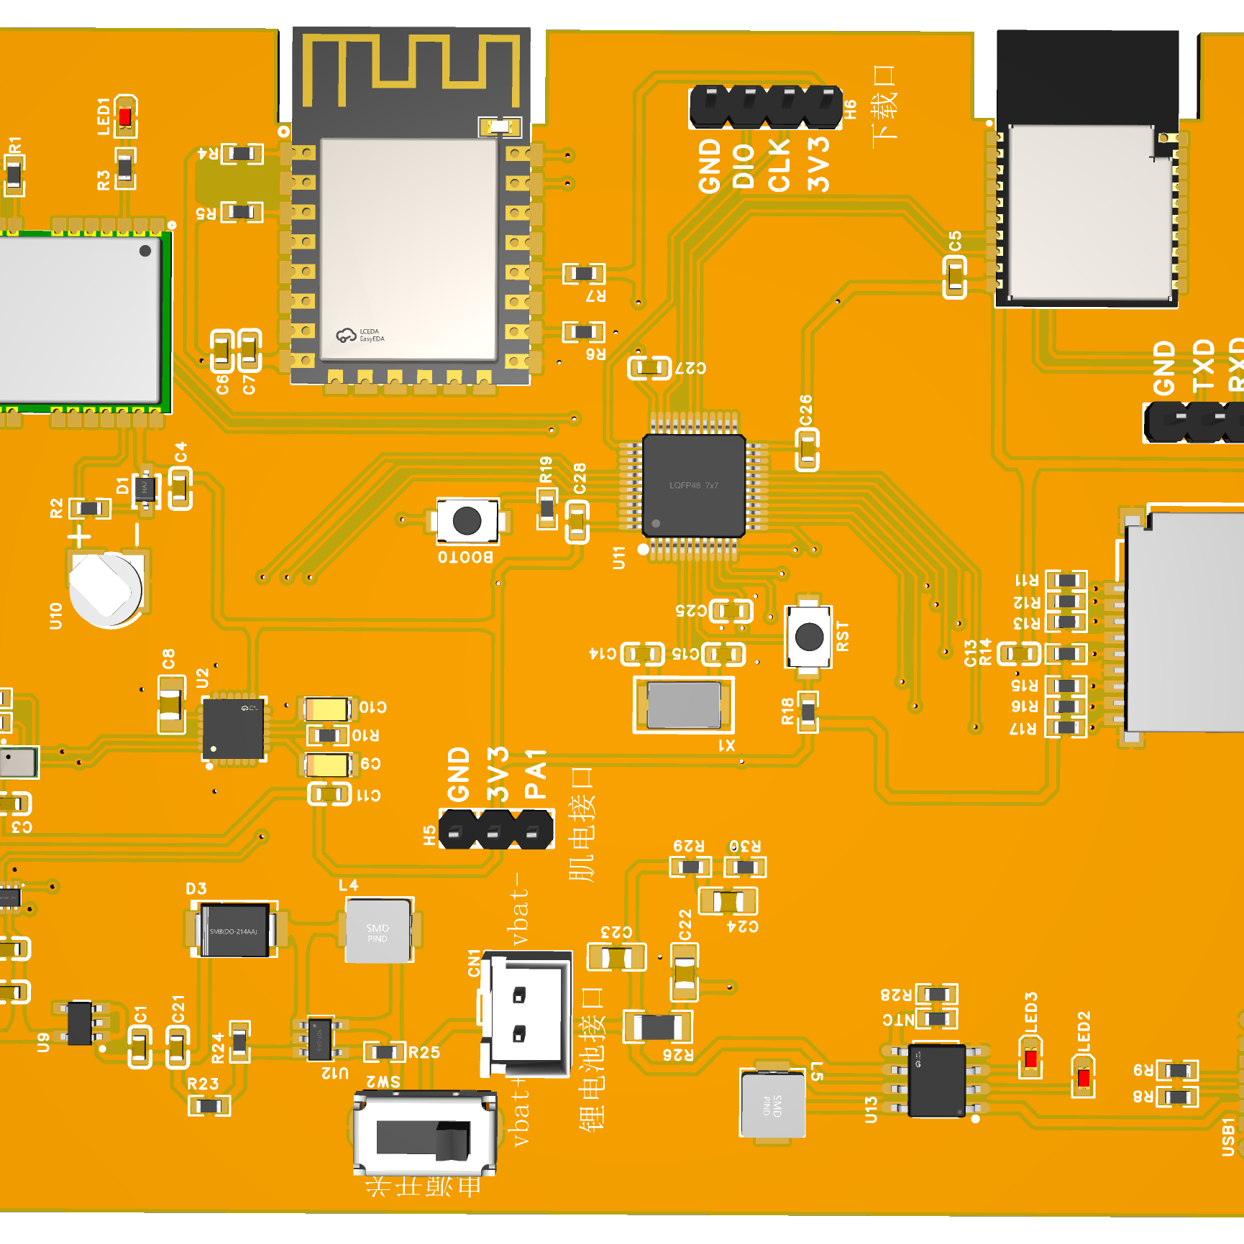
Project 1: Wearable leg-guard sensing system
Objective
Implementation
Wearable sensing for motion/load monitoring under realistic movement, emphasizing stable data acquisition.
Arduino + STM32 for acquisition/control
Multi-sensor integration via I2C and related interfaces
My role
Validation
Project planning & system architecture
PCB/circuit design; component selection
Integration and bring-up across HW/FW/comm
Iterative testing under realistic motion
Prioritized repeatability over one-off demos
Logged issues/failure cases to drive iteration
Notes:
实现经验1（30-40秒）
在硬件与系统控制项目中，我负责采集与控制链路实现，重点是多传感器协同和可重复验证。这个阶段训练了我做复杂系统调试和故障定位的能力。

Slide 6
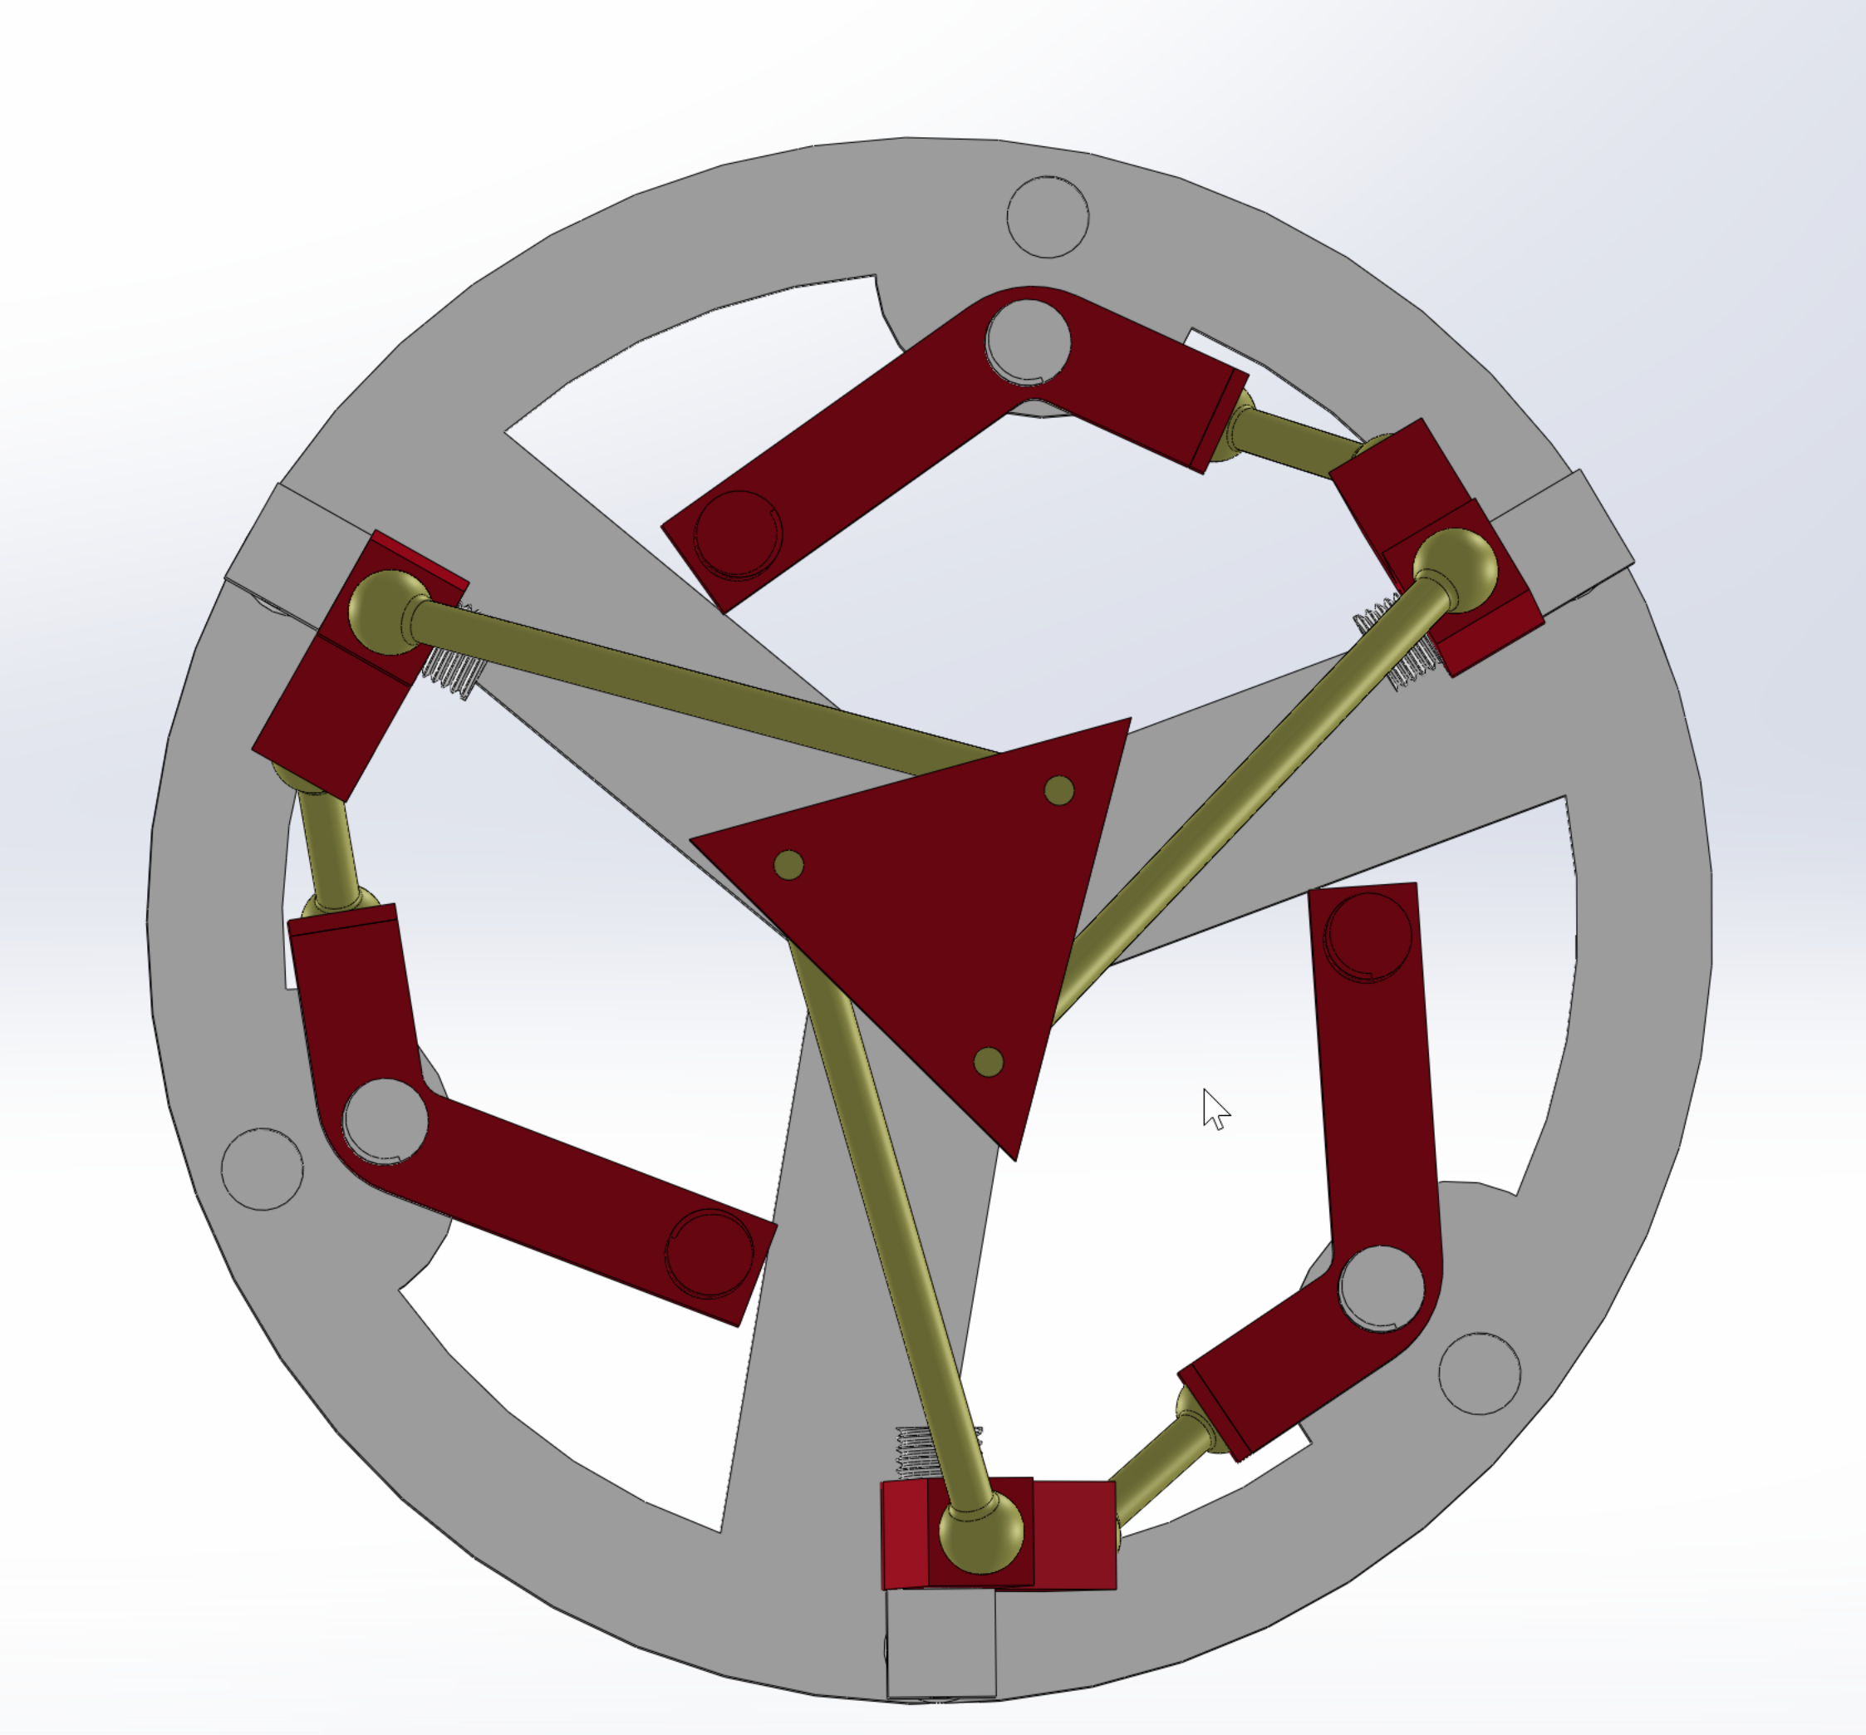
Project 2: 3-DOF Delta robot (mechanical capstone)
Objective
Implementation
End-to-end mechanical design and prototyping of a Delta parallel robot.
Mechanism + detailed part design
Manufacturing/assembly constraints considered early
My role
Validation
Project lead — owned requirements, timeline, and integration decisions
SolidWorks modeling
Planning and parts selection
3D printing and assembly; iteration
Prototype feedback: tolerances, interference, robustness
Iterated geometry and interfaces accordingly
Notes:
实现经验2（30-40秒）
这里强调机械与结构层面的迭代思路：先考虑制造约束，再做几何细化和原型反馈闭环。这套方法后来直接迁移到我在医学影像pipeline上的工程迭代里。

Slide 7
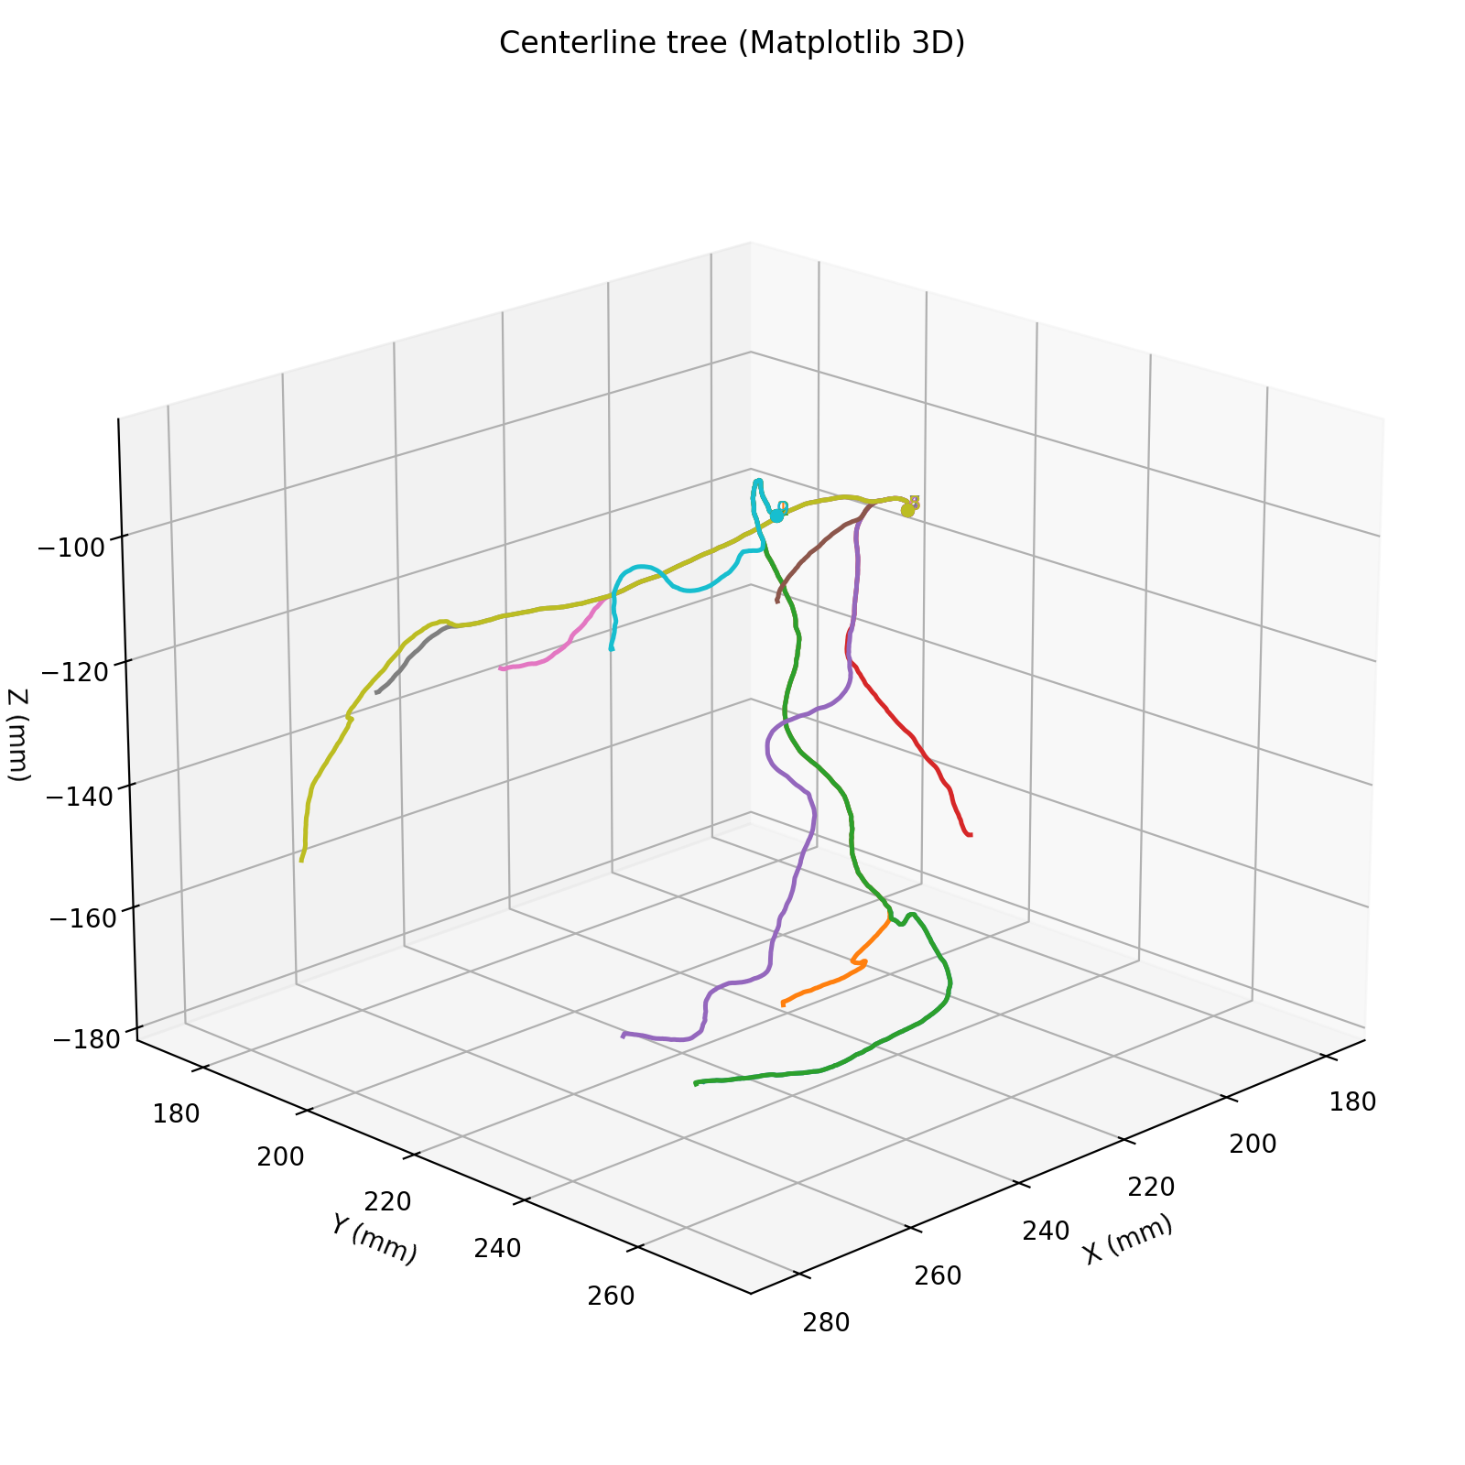
Ongoing research: coronary reconstruction pipeline
Objective
Current progress
Build a reconstruction/modeling pipeline with long-term relevance to clinically grounded workflows and evaluation.
Surveyed workflows + established a first working pipeline
Segmentation → centerline extraction → centerline-driven representation/rendering
Defined output schema (tree/branch structure) for consistent experiments
My role
Next phase
Project lead & upstream workflow owner (problem framing, milestones, interface definitions)
Built the pipeline end-to-end and standardized outputs for evaluation and downstream use
Incorporate hospital data constraints and clinical feedback loops
Anatomically consistent labeling (segment-level) for standardization
Evaluation aligned with navigation/decision support (robustness + usability)
Notes:
过渡页（35-45秒）
目前我已经把冠脉相关流程打通为可运行原型，并统一了输出结构。下一阶段会更强调两点：真实临床场景约束，以及分段标注/量化评估的一致性。

Slide 8
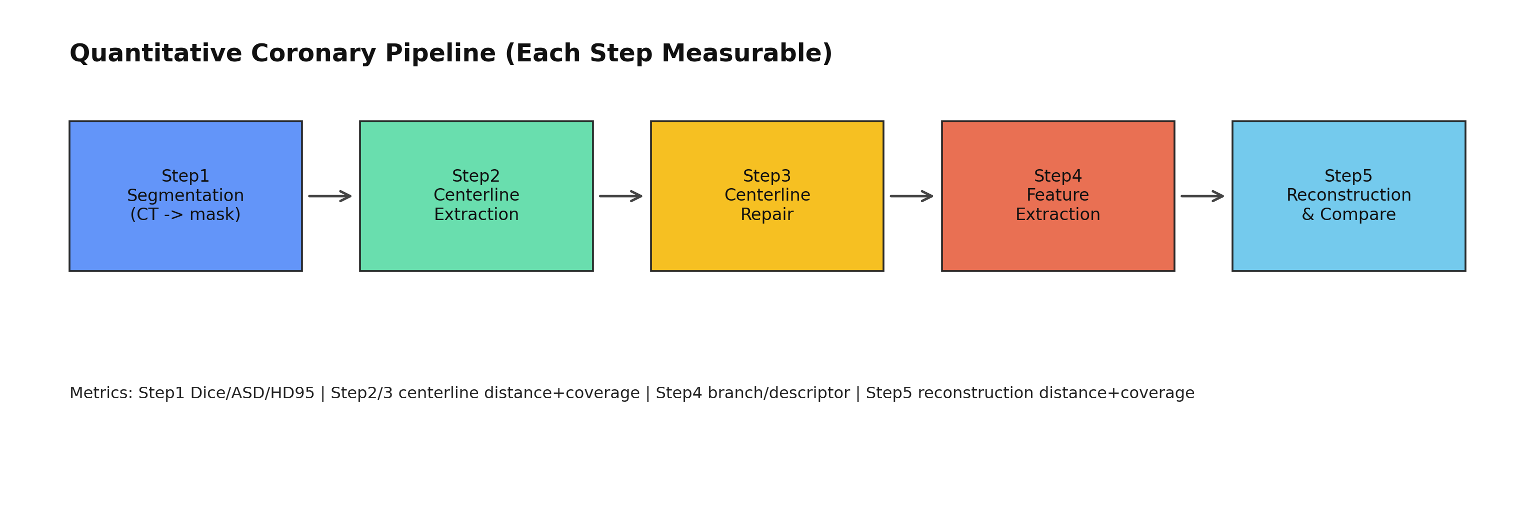
Vessel_seg: Research Progress
CT -> Segmentation -> Centerline -> Repair -> Feature -> Reconstruction
Notes:
项目总览（40-50秒）
这是 vessel_seg 的5步流程：分割、中心线提取、修复、特征提取、重建对比。我把每一步都定义了量化指标，目标是把问题从“看起来不错”变成“可测量、可比较、可回归”。

Slide 9
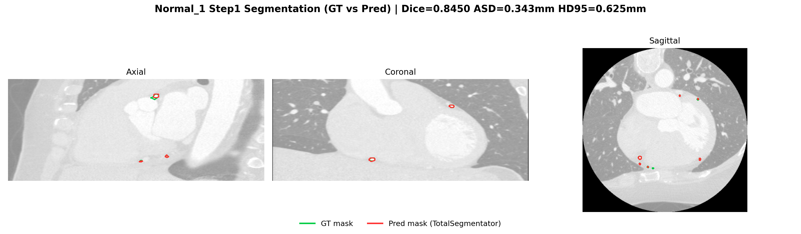
Step1 Segmentation: Normal_1
CT -> Segmentation -> Centerline -> Repair -> Feature -> Reconstruction
Dice = 0.8450
HD95 = 0.625 mm
Interpretation: strong upstream quality for downstream steps
Notes:
Step1 正例（40秒）
Normal_1 的 Dice 和 HD95 都比较好，说明分割质量稳定。这个case证明当前上游质量足以支撑后续中心线和特征分析。

Slide 10
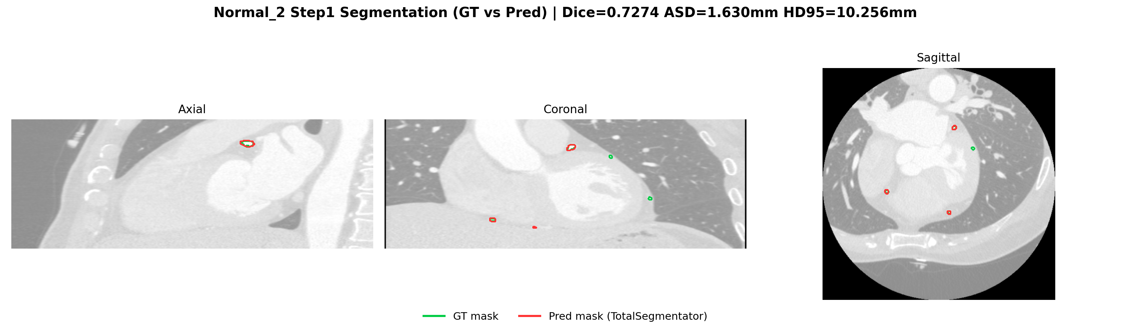
Step1 Segmentation: Normal_2
Dice = 0.7274
HD95 = 10.2556 mm
Main bottleneck: segmentation quality variance
CT -> Segmentation -> Centerline -> Repair -> Feature -> Reconstruction
Notes:
Step1 难例（45秒）
Normal_2 的 HD95 偏高，提示存在明显边界误差。这说明 Step1 稳定性是全流程上限，若上游波动大，下游再优化也会受限。

Slide 11
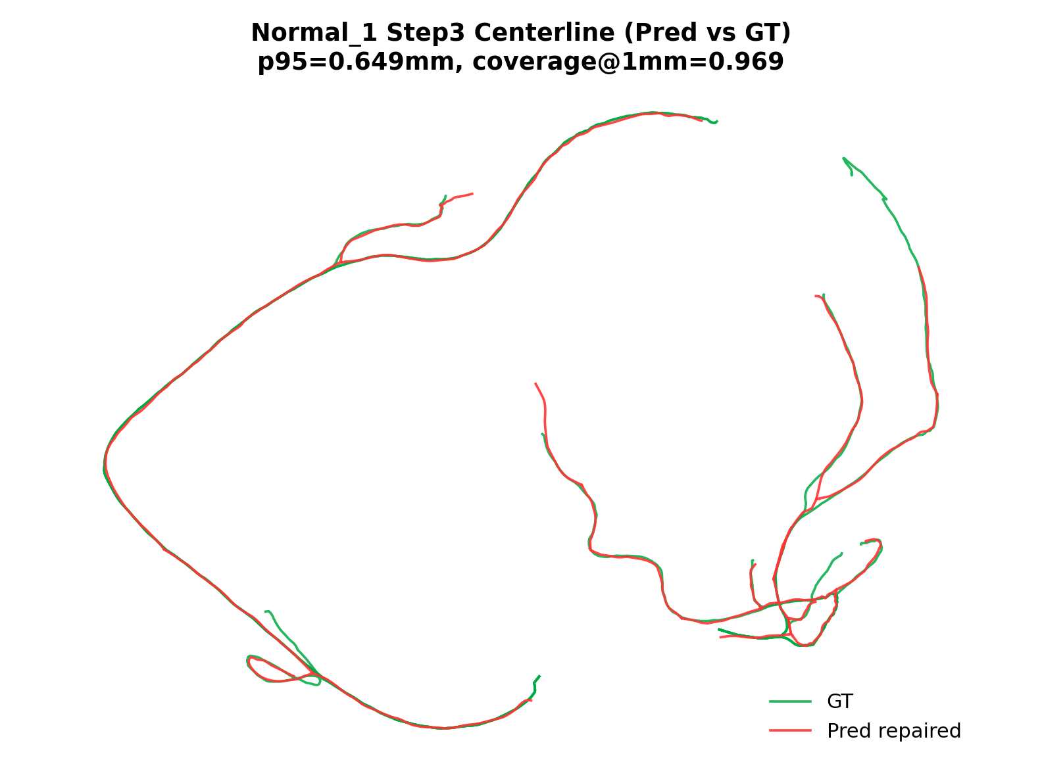
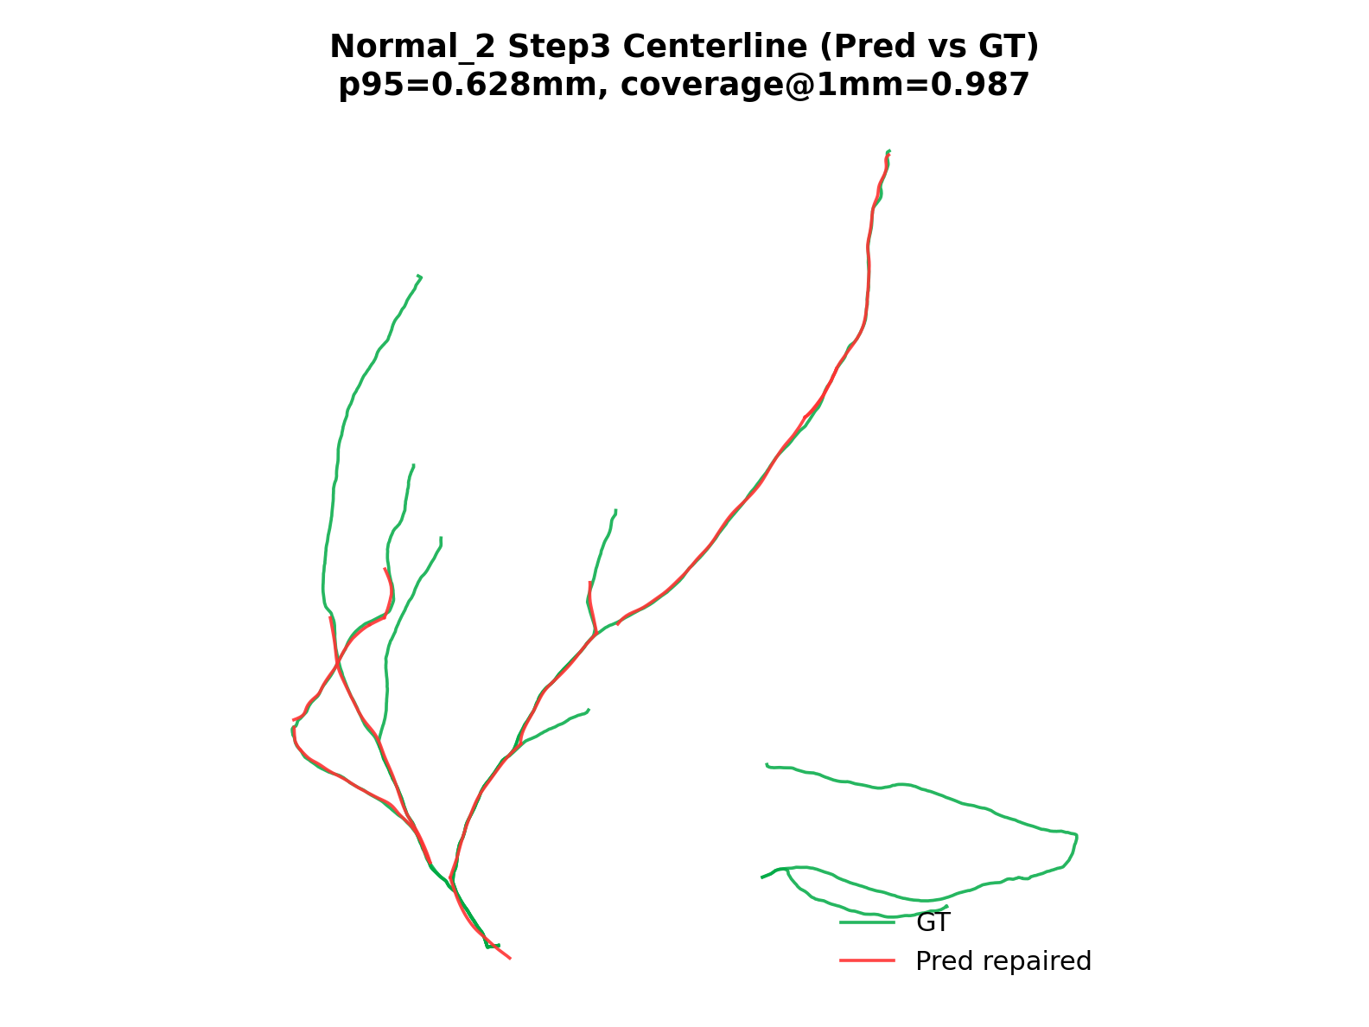
Step3 Centerline Comparison
CT -> Segmentation -> Centerline -> Repair -> Feature -> Reconstruction
Notes:
Step3 对比（45-60秒）
这里看中心线在修复前后的几何质量和对GT贴合度。关注点是：误差尾部是否下降、连通性是否更符合血管解剖结构。这一步是后续特征和重建可靠性的关键。

Slide 12
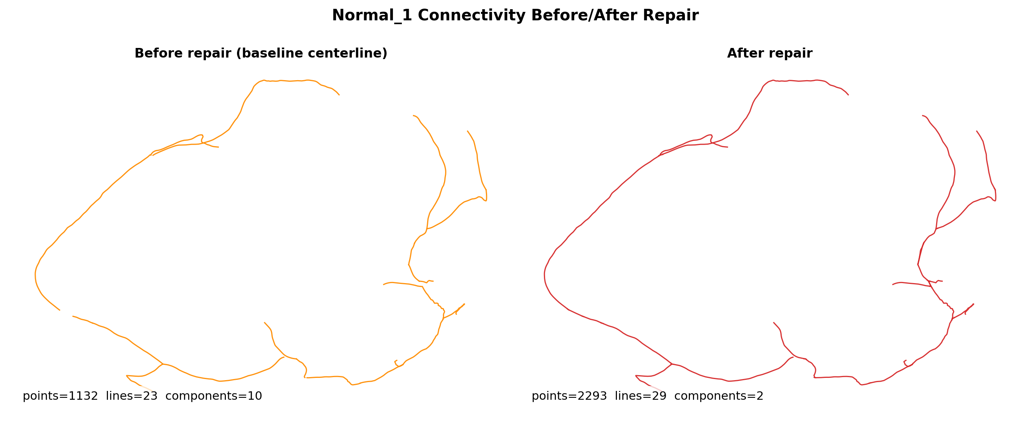
Key Engineering Fix: Repair Topology
CT -> Segmentation -> Centerline -> Repair -> Feature -> Reconstruction
Root cause: duplicated endpoint points in VTP writer
Fix: merge coincident endpoints to shared point IDs
Outcome: disconnected fragments -> anatomically coherent components
Notes:
关键修复（60秒）
我定位到一个拓扑层面的根因：端点在写VTP时重复建点，导致视觉像连着、拓扑却是碎的。修复后改为共享端点ID，并加入拓扑监控字段，把问题从临时patch变成可验证、可回归的工程修复。

Slide 13
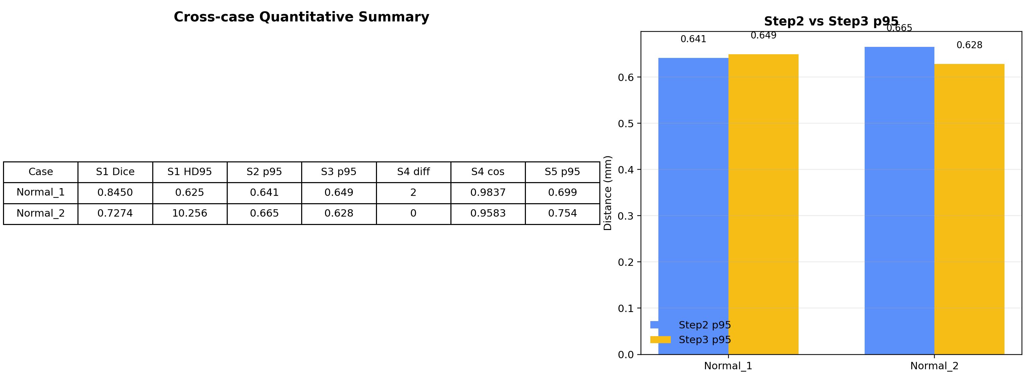
Cross-case Quantitative Summary
CT -> Segmentation -> Centerline -> Repair -> Feature -> Reconstruction
Notes:
跨case总结（50-60秒）
这一页是关键决策页：横向比较不同case，判断瓶颈到底在Step1、Step3还是Step4。目前结论是：Step1稳定性和Step4分支治理是优先优化方向。

Slide 14
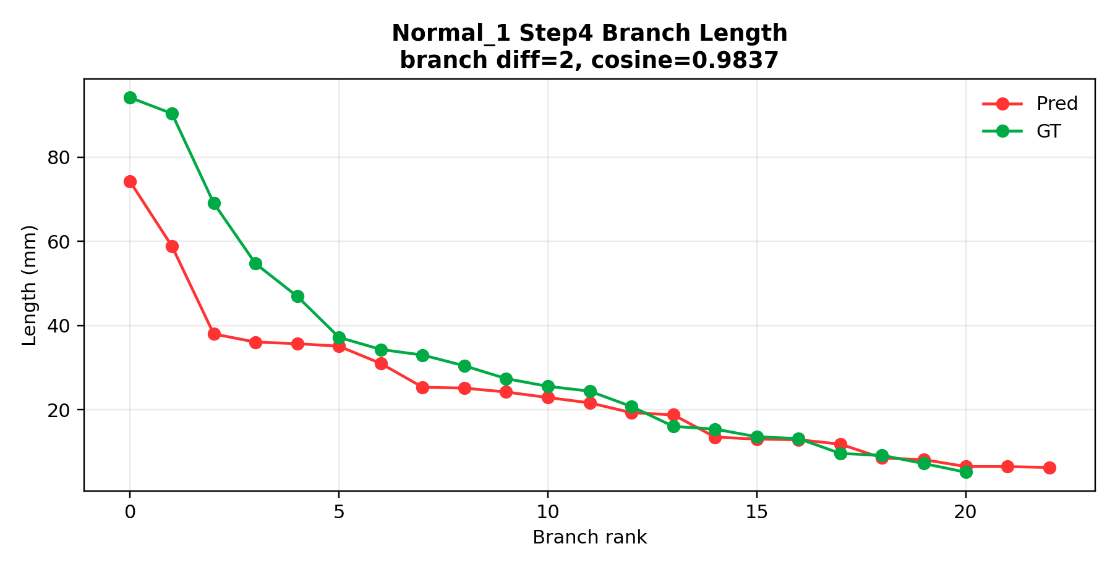
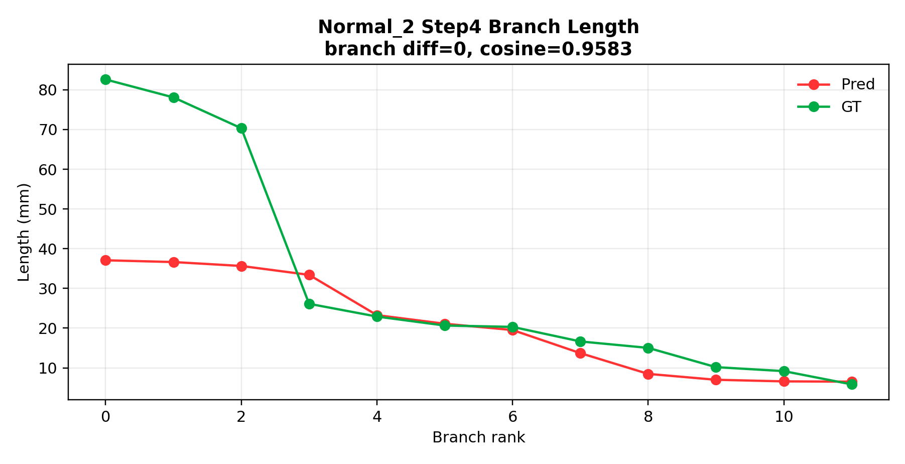
Step4 Feature Extraction
CT -> Segmentation -> Centerline -> Repair -> Feature -> Reconstruction
Notes:
Step4（旧版页，可作为备份，30-40秒）
这一页展示分支级特征提取与GT对比。若时间有限可以快讲，重点只说两句：分支数量一致性和描述子相似度。

Slide 15
Current Risks and Following Weeks
CT -> Segmentation -> Centerline -> Repair -> Feature -> Reconstruction
Open Risks
Execution Plan
Step4 still has branch count mismatch on some cases
Case-to-case variability remains high
Need stronger failure-case regression set
Week 1: repair trigger + topology constraints
Week 2: branch governance + batch evaluation (10-20 cases)
Deliver reproducible report-ready figures/tables
Notes:
风险与计划（旧版页，可作为备份，30-40秒）
如果保留此页，强调三点风险：分支计数偏差、case波动、回归集不足；并说明你已有对应两周执行计划。

Slide 16
My Core Contributions
CT -> Segmentation -> Centerline -> Repair -> Feature -> Reconstruction
Built an end-to-end quantitative pipeline (not isolated scripts)
Defined step-wise metrics to make progress measurable and auditable
Diagnosed and fixed topology-level bug with reproducible evidence
Converted blockers into actionable engineering tasks and benchmarks
Notes:
贡献总结（旧版页，可作为备份，25-35秒）
若讲到此页，聚焦工程价值：端到端可复现、统一量化口径、关键bug闭环修复。

Slide 17
Step4 Feature Extraction
Notes:
Step4（新版主讲页，50秒）
这里重点讲“分支层面的可解释比较”：branch count diff反映拓扑是否对齐，descriptor cosine反映形态特征是否接近GT。当前结果说明整体方向正确，但仍需压缩冗余分支。

Slide 18
Current Risks and Next 2 Weeks
Open Risks
Execution Plan
Step4 still has branch count mismatch on some cases
Case-to-case variability remains high
Need stronger failure-case regression set
Week 1: repair trigger + topology constraints
Week 2: branch governance + batch evaluation (10-20 cases)
Deliver reproducible report-ready figures/tables
Notes:
风险与两周计划（60秒）
风险：Step4偶发分支偏差、跨case波动、失败样本覆盖不足。
计划：Week1 做 repair 触发与拓扑约束强化；Week2 做分支治理+10-20例批评估；输出可复现图表和对比报告，直接支撑导师讨论与后续投稿路线。

Slide 19
My Core Contributions
Built an end-to-end quantitative pipeline (not isolated scripts)
Defined step-wise metrics to make progress measurable and auditable
Diagnosed and fixed topology-level bug with reproducible evidence
Converted blockers into actionable engineering tasks and benchmarks
Notes:
核心贡献（45-55秒）
我这阶段最核心的价值不是单个模型指标，而是把研究问题工程化：统一流程、统一指标、统一回归机制。这让每次改动都能被量化验证，能稳定推进而不是反复试错。

Slide 20
Discussion / Feedback Needed
Do you agree with metric priority (Step1 stability first)?
Should we prioritize method novelty or robust clinical engineering pipeline first?
Is this progression acceptable: small-case closure -> larger batch validation?
Notes:
收尾提问（45秒）
我希望老师给三个方向性反馈：
1) 指标优先级是否以Step1稳定性为先；
2) 论文叙事更偏方法创新还是工程闭环；
3) 小样本闭环到批量验证的节奏是否合理。
谢谢老师，欢迎直接指出优先级调整建议。

