Slide 1
vessel_seg Summer Research Progress
CT -> Segmentation -> Centerline -> Repair -> Feature -> Reconstruction
Supervisor update (10-15 min)
Focus: reproducible quantitative pipeline + concrete technical fixes
Cases: Normal_1 and Normal_2

Slide 2
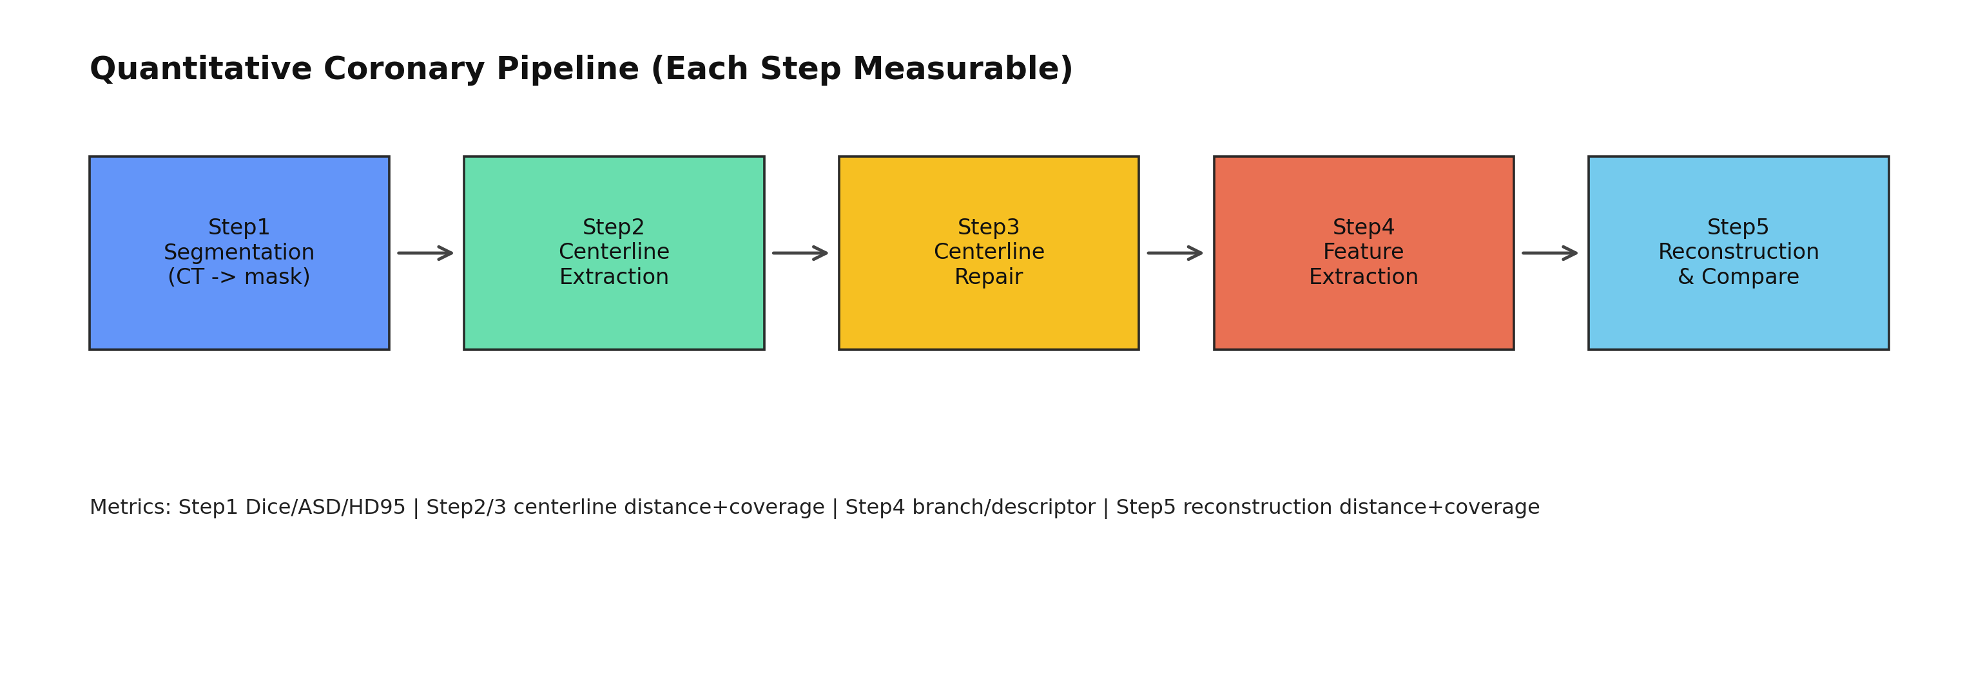
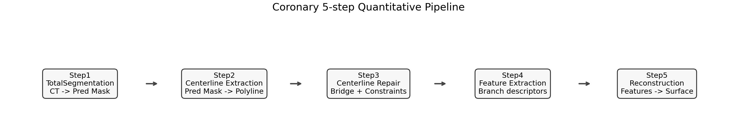
Pipeline Overview

Slide 3
Metrics at Each Step
Step1: Dice, ASD(mm), HD95(mm)
Step2/3: pred2gt mean/p95, coverage@1mm
Step4: branch count diff, descriptor cosine/l1/l2
Step5: reconstructed mesh vs GT mask boundary (same distance metrics)

Slide 4
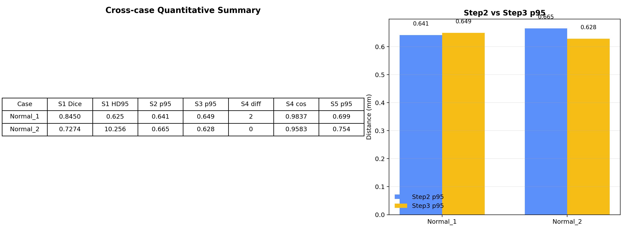
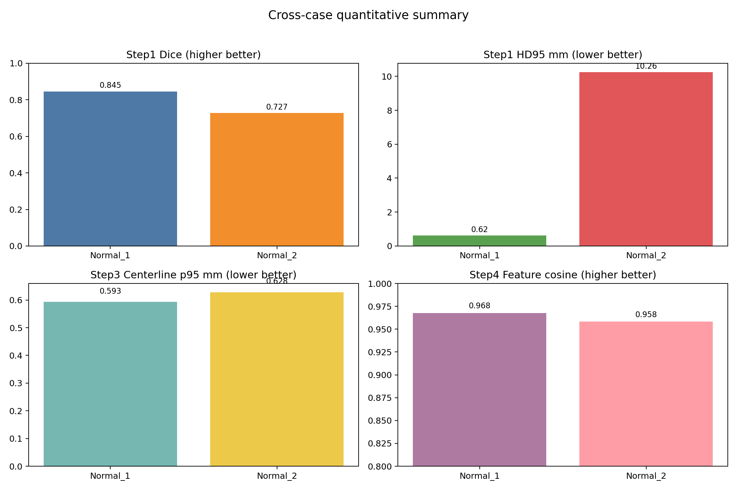
Cross-case Quantitative Summary

Slide 5
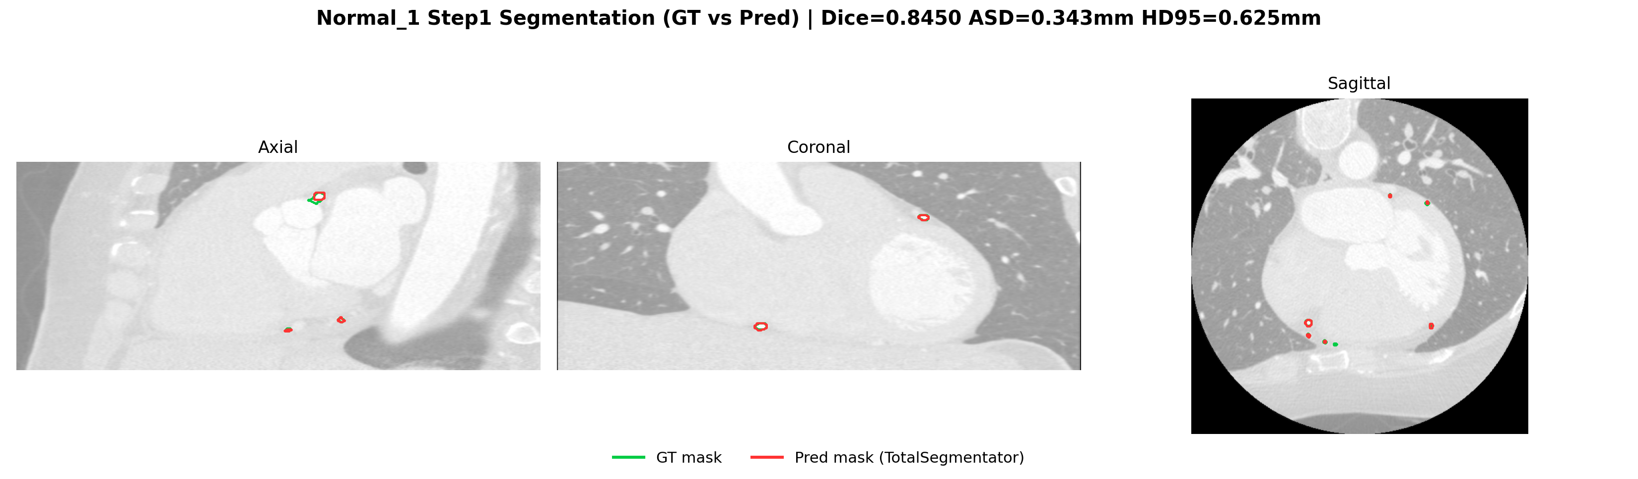
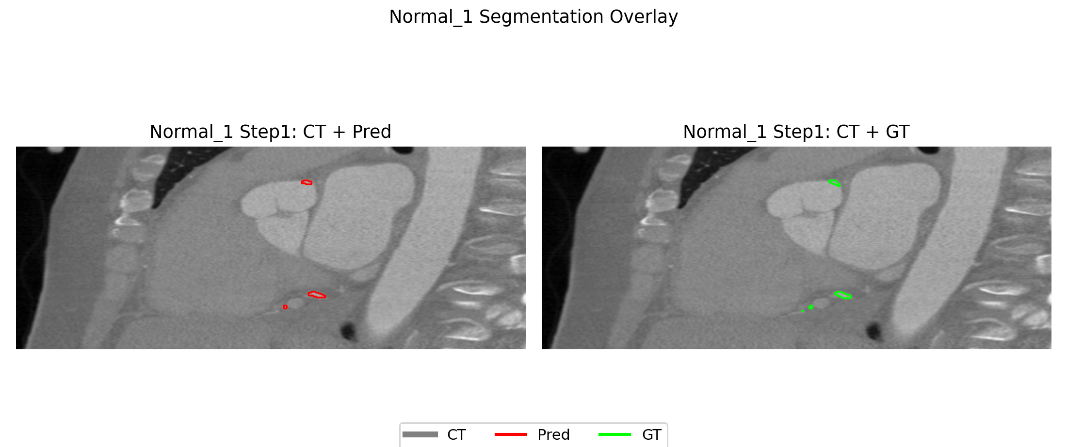
Step1 Segmentation: Normal_1
Dice = 0.8450
HD95 = 0.625 mm
Interpretation: strong upstream quality for downstream steps

Slide 6
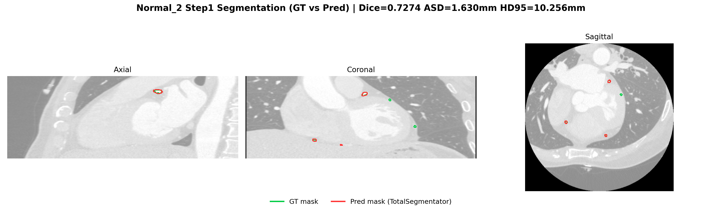
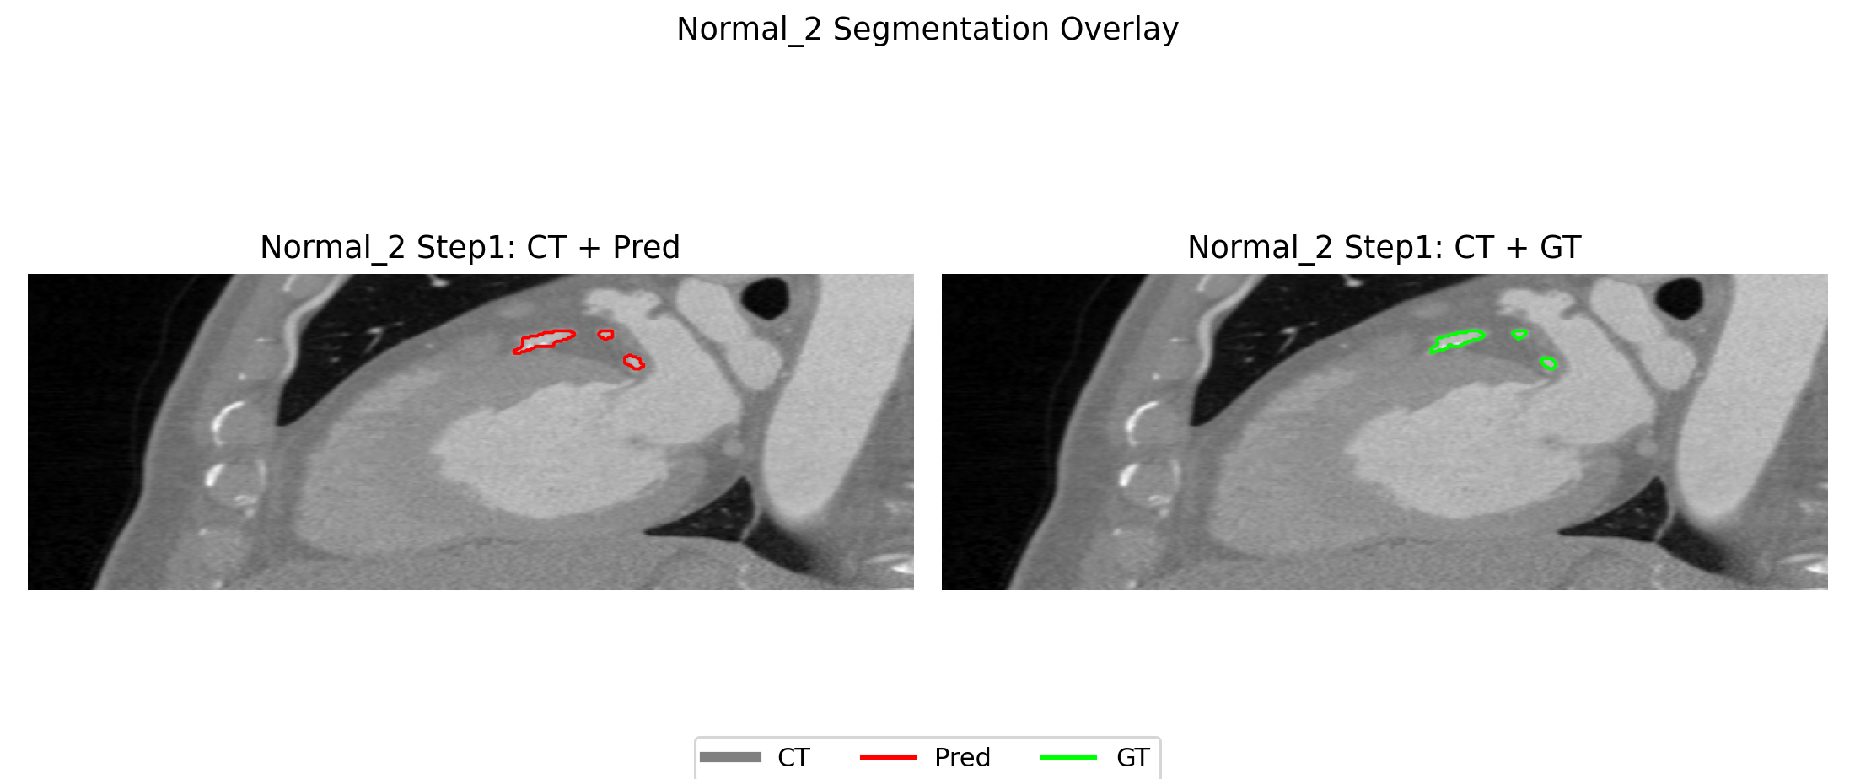
Step1 Segmentation: Normal_2
Dice = 0.7274
HD95 = 10.2556 mm
Main bottleneck: segmentation quality variance

Slide 7
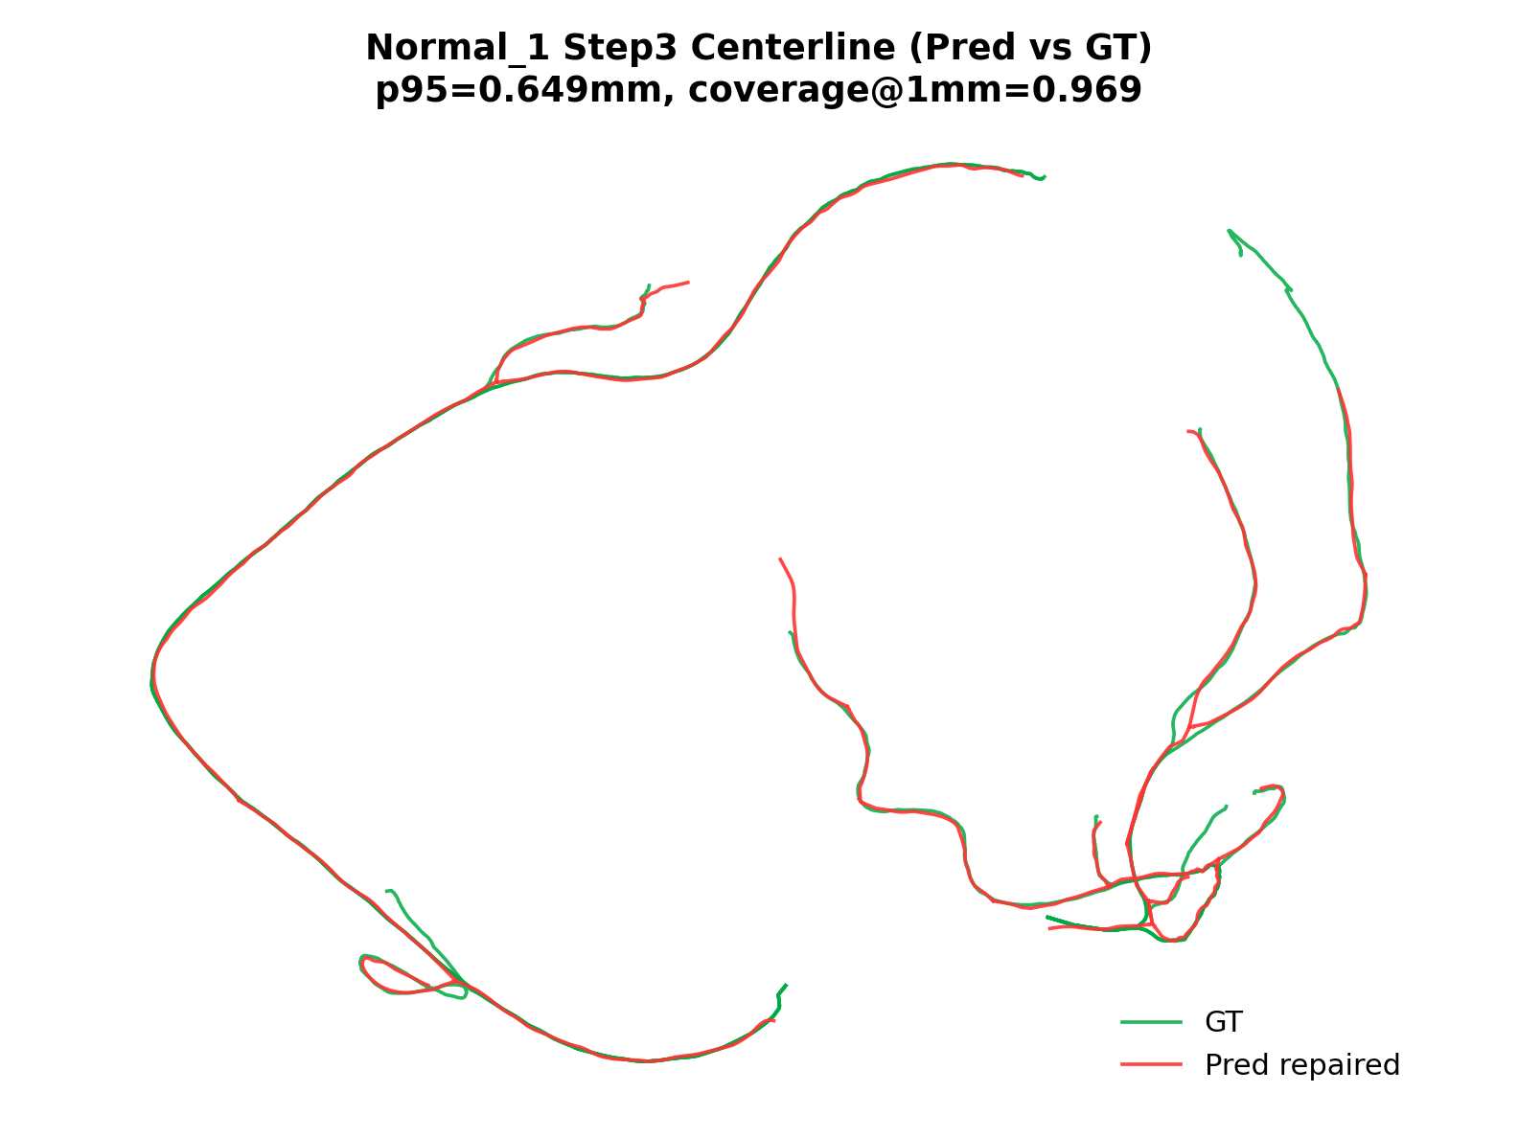
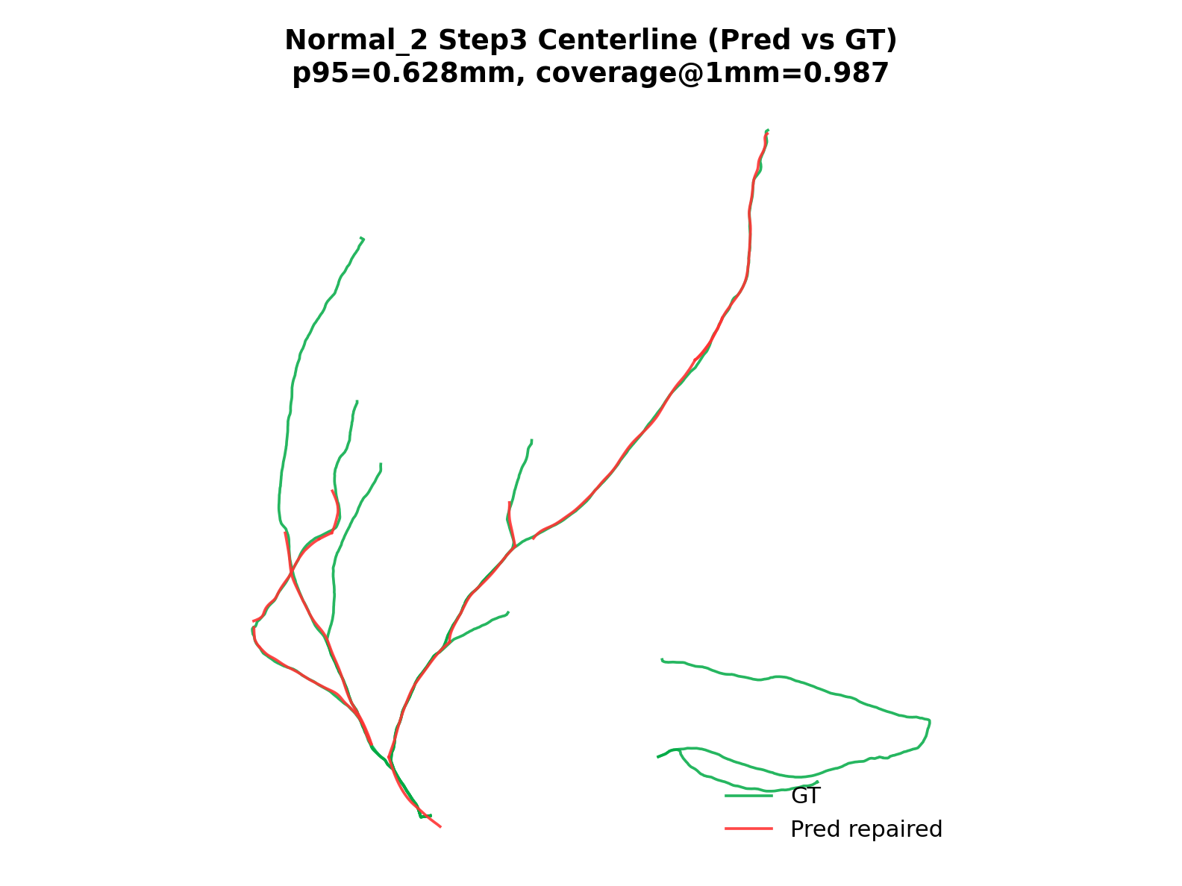
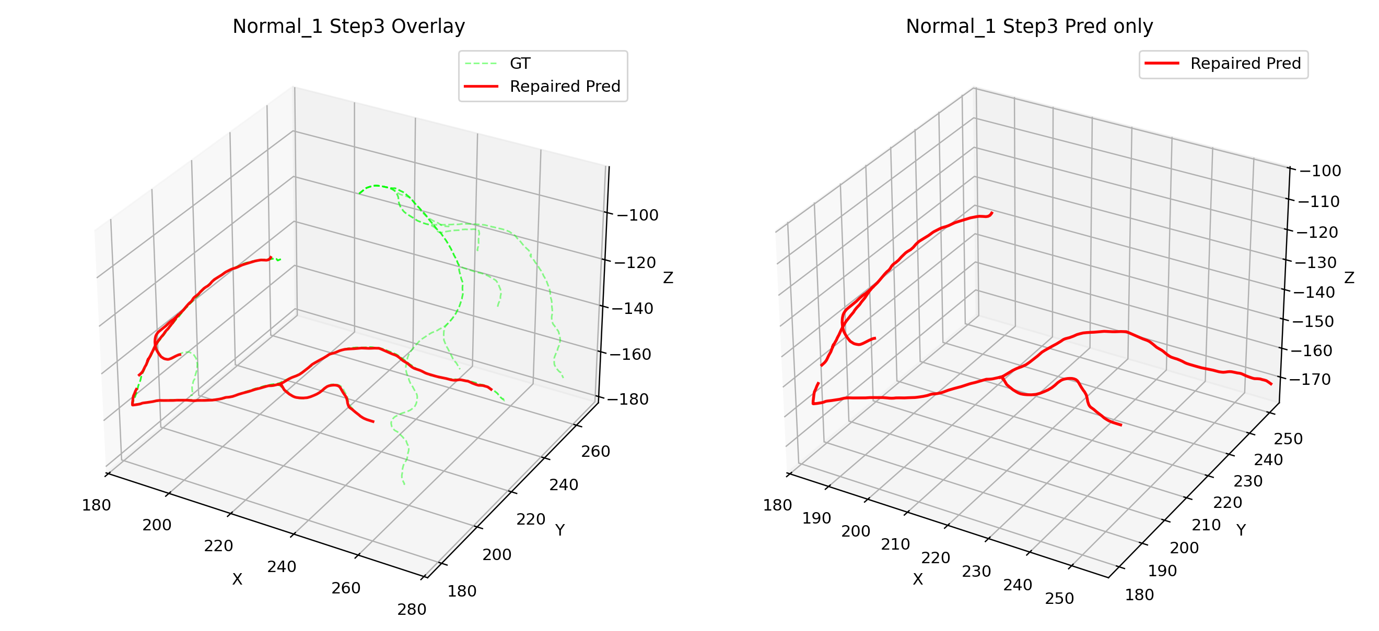
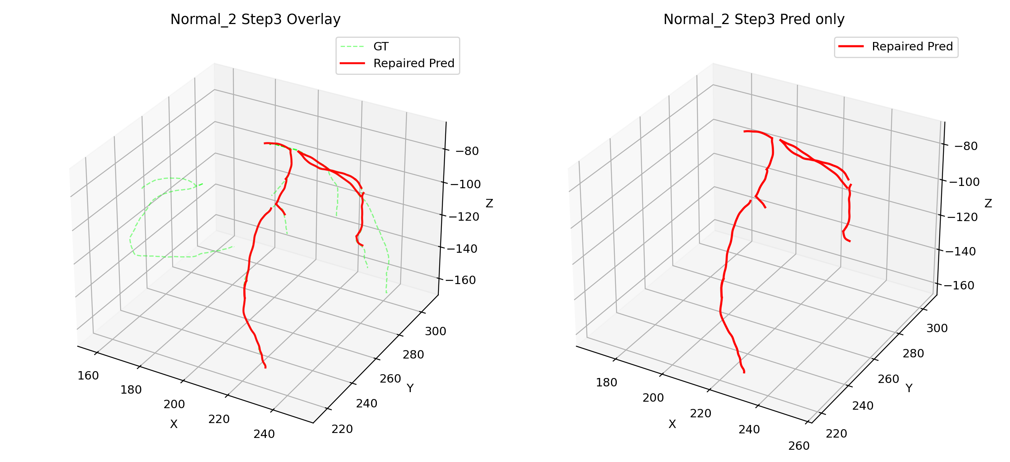
Step3 Centerline Comparison

Slide 8
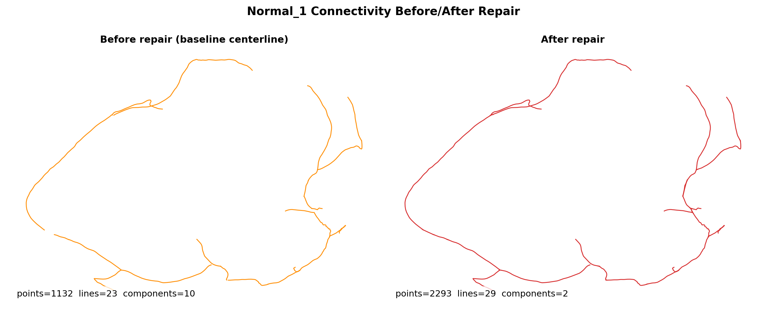
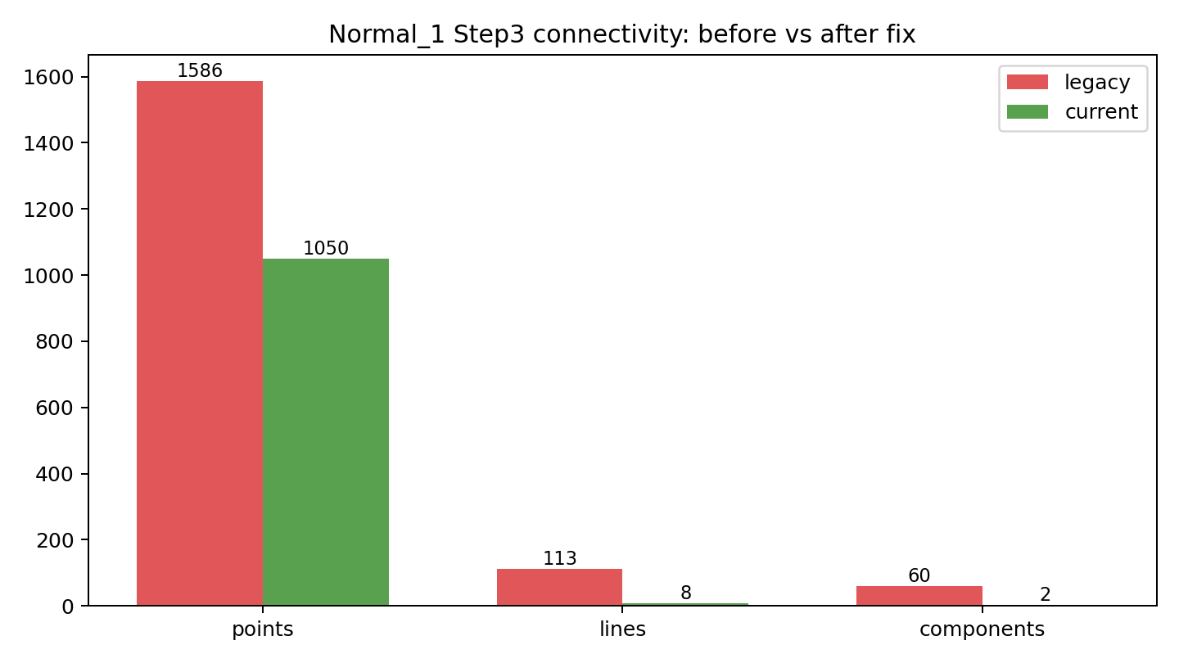
Key Engineering Fix: Repair Topology
Root cause: duplicated endpoint points in VTP writer
Fix: merge coincident endpoints to shared point IDs
Outcome: disconnected fragments -> anatomically coherent components

Slide 9
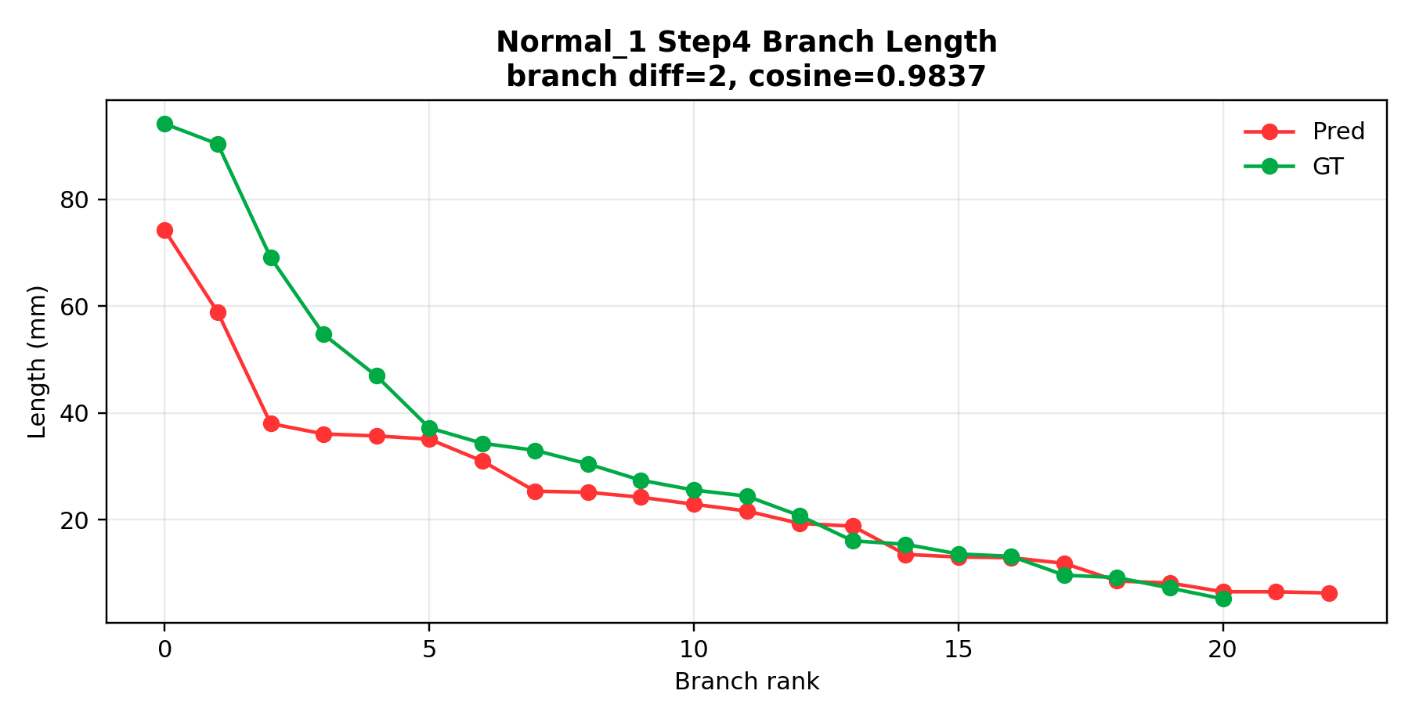
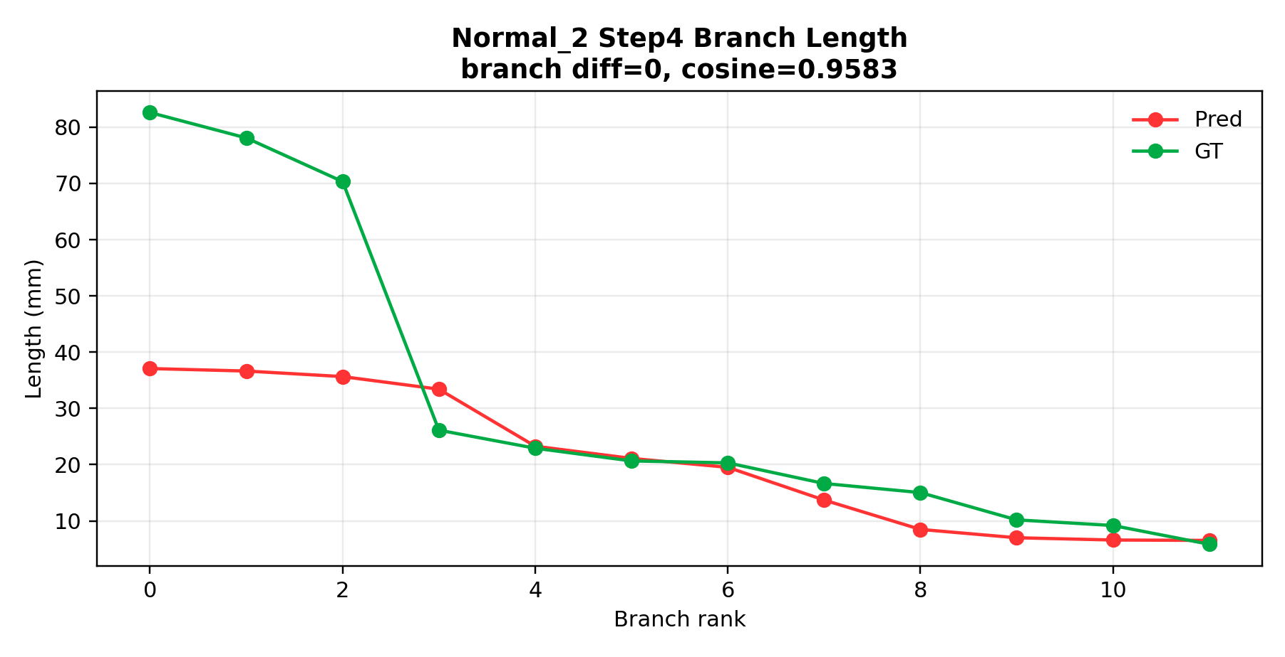
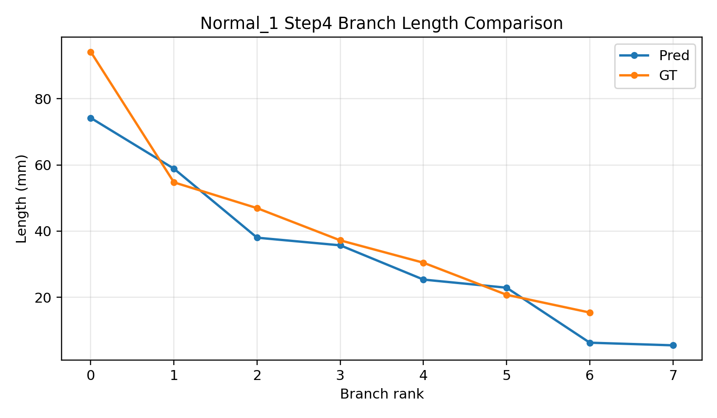
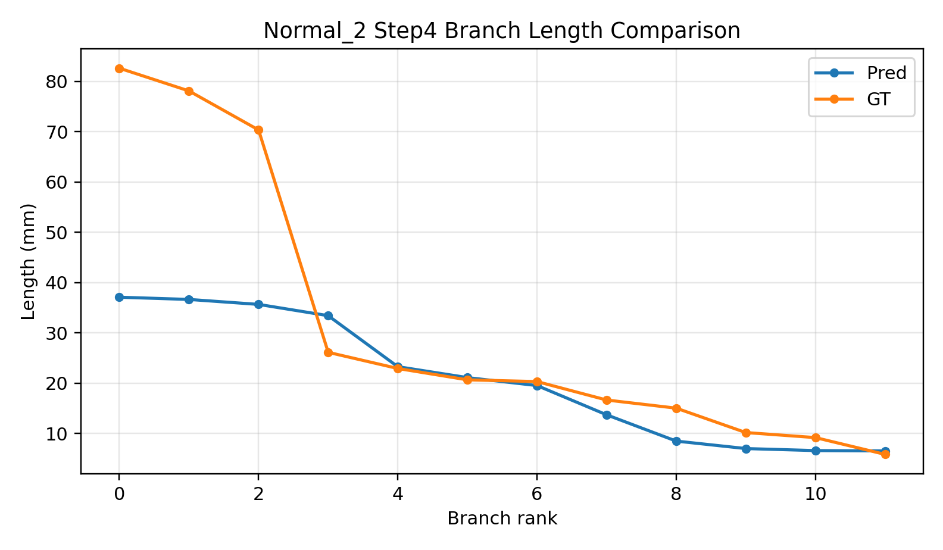
Step4 Feature Extraction

Slide 10
Current Risks and Next 2 Weeks
Open Risks
Execution Plan
Step4 still has branch count mismatch on some cases
Case-to-case variability remains high
Need stronger failure-case regression set
Week 1: repair trigger + topology constraints
Week 2: branch governance + batch evaluation (10-20 cases)
Deliver reproducible report-ready figures/tables

Slide 11
My Core Contributions
Built an end-to-end quantitative pipeline (not isolated scripts)
Defined step-wise metrics to make progress measurable and auditable
Diagnosed and fixed topology-level bug with reproducible evidence
Converted blockers into actionable engineering tasks and benchmarks

Slide 12
Discussion / Feedback Needed
Do you agree with metric priority (Step1 stability first)?
Should we prioritize method novelty or robust clinical engineering pipeline first?
Is this progression acceptable: small-case closure -> larger batch validation?

