Slide 1
Extra-Supplymentary of “TFN: An Interpretable Neural Network with Time-Frequency Transform Embedded for Intelligent Fault Diagnosis”
Qian Chen (chenqian2020@sjtu.edu.cn)
Dec 25, 2023

Slide 2
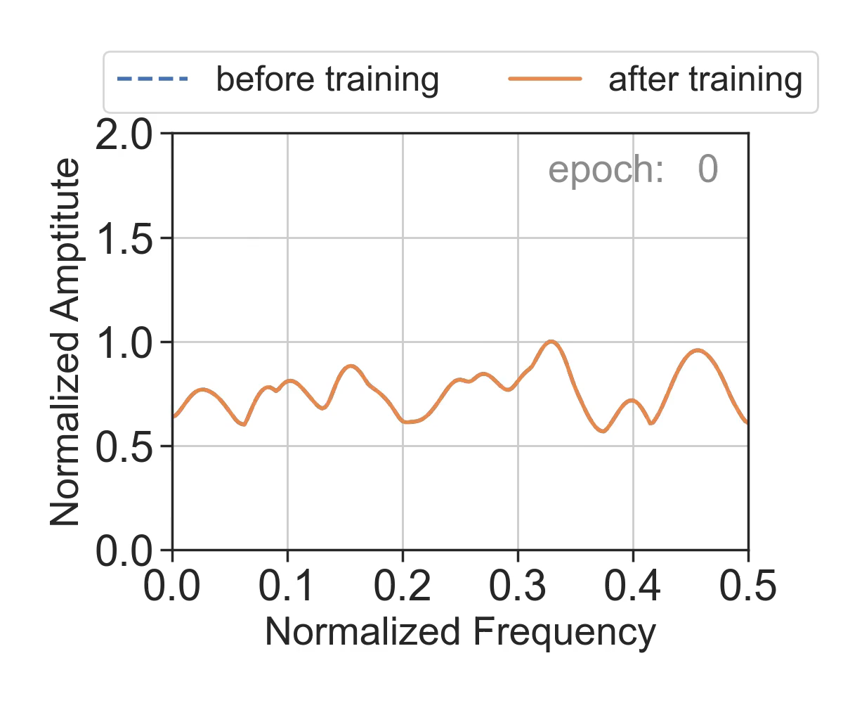
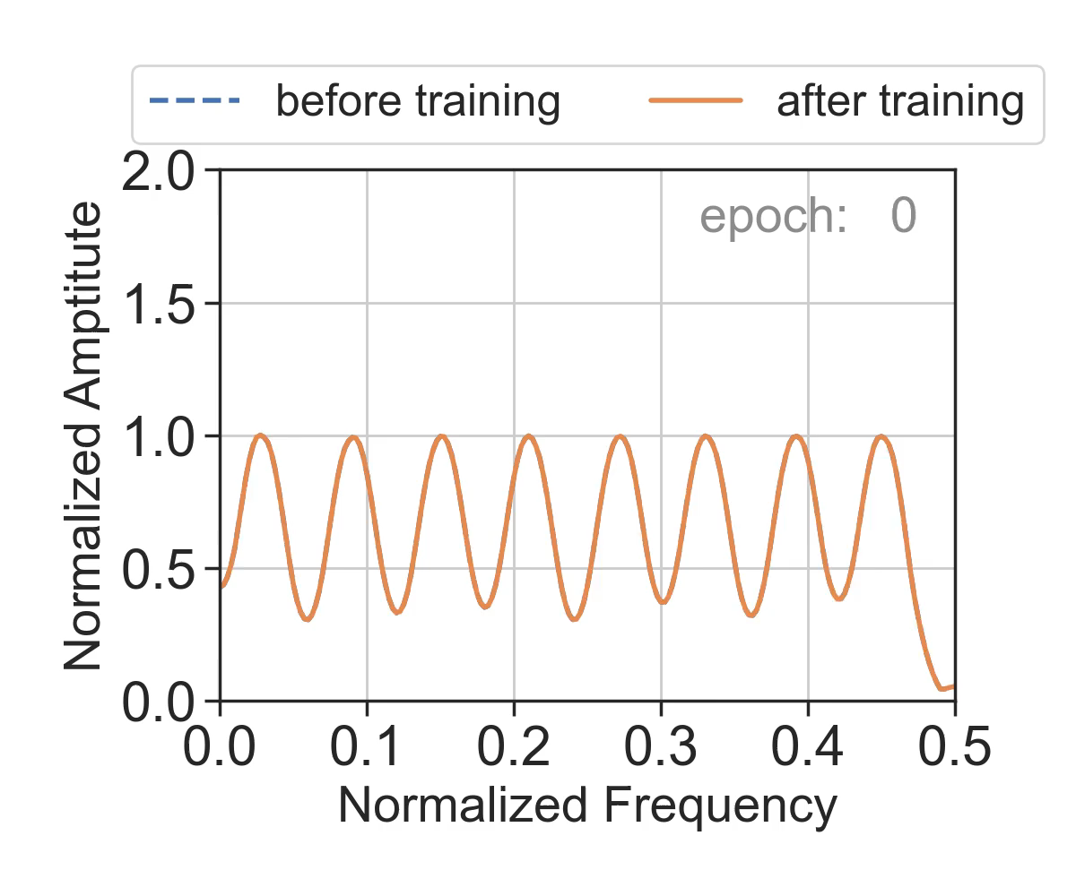

1/3
Animation: O-FR changes during training process on CWRU dataset
CWRU dataset spectrum
BaseCNN
TFN-STTF
TFN-Chirplet
Qian Chen et al., “TFN: An interpretable neural network with time-frequency transform embedded for intelligent fault diagnosis,” Mechanical Systems and Signal Processing, vol. 207, p. 110952, Jan. 2024, doi: 10.1016/j.ymssp.2023.110952.

Slide 3
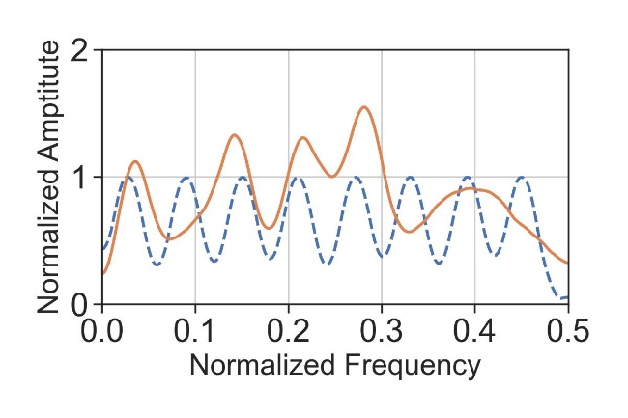
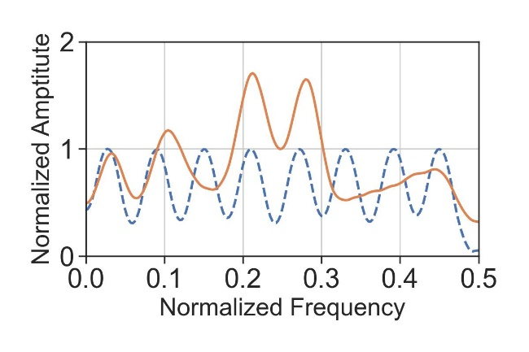
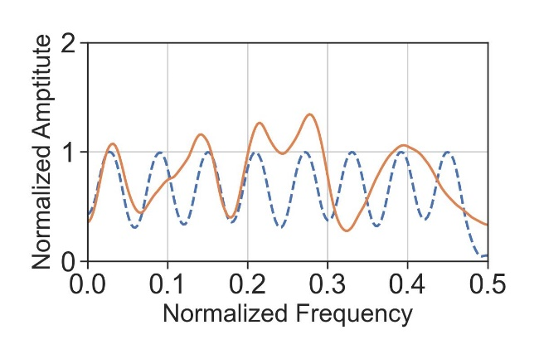
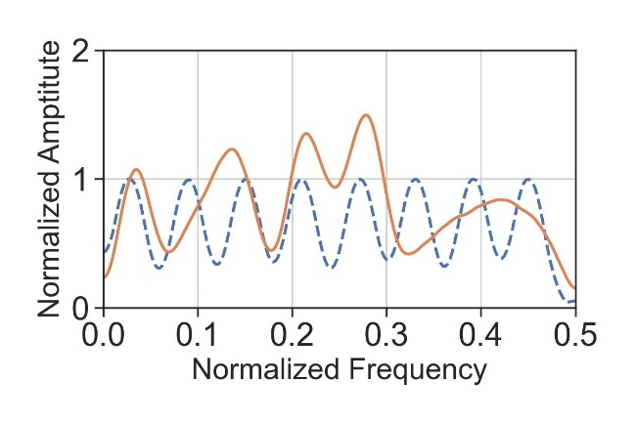

2/3
Stability: repeat the training process of TFN-Chirplet in 5 times
CWRU dataset spectrum
TFN-Chirplet-round1
TFN-Chirplet-round2
TFN-Chirplet-round3
TFN-Chirplet-round4
TFN-Chirplet-round5
Under appropriate hyperparameters, the interpretability results of TFN under five repetitions are similar and consistent with the CWRU dataset spectrum, demonstrating the robustness of the proposed method.
Qian Chen et al., “TFN: An interpretable neural network with time-frequency transform embedded for intelligent fault diagnosis,” Mechanical Systems and Signal Processing, vol. 207, p. 110952, Jan. 2024, doi: 10.1016/j.ymssp.2023.110952.

Slide 4
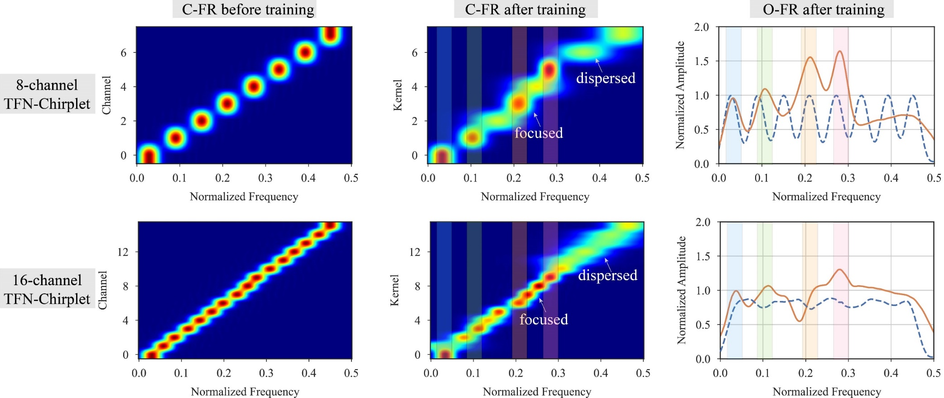
3/3
Exploration: the interpretability results under different channel numbers.
Figure. The C-FR and O-FR results of TFN-Chirplet with different channels on the CWRU dataset.
The O-FR of 16-channel TFN-Chirplet still has a good correspondence with the frequency spectrum of the CWRU dataset, but the amplitude peaks of O-FR become less obvious and the O-FR still has high amplitude in the high frequency range. As for the first phenomenon, with the channel number increases, the fault-related frequency could not attract further O-FR because the bandwidth of each O-FR decreases, which leads to the amplitude peaks of O-FR becoming less obvious. As for the second phenomenon, with the channel number increasing, the O-FR of TFN-Chirplet disperses more uniformly, making the amplitude still exist in the high-frequency range. In conclusion, the O-FR result of 16-channel TFN-Chirplet still demonstrates the interpretability of our models, but the O-FR result of 8-channel is clearer than that of 16-channel.
Qian Chen et al., “TFN: An interpretable neural network with time-frequency transform embedded for intelligent fault diagnosis,” Mechanical Systems and Signal Processing, vol. 207, p. 110952, Jan. 2024, doi: 10.1016/j.ymssp.2023.110952.

Slide 5
Thanks.

