Slide 1


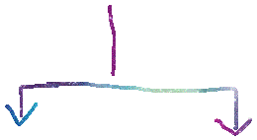







High Level App Relationships
Can Assign Task to
Manager 1
Report To
Manager 2
subordinates
Can Assign Task to
Report To
Report To
John Doe
Yafa Doe

