Slide 1

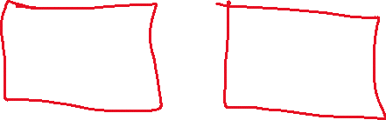
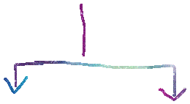


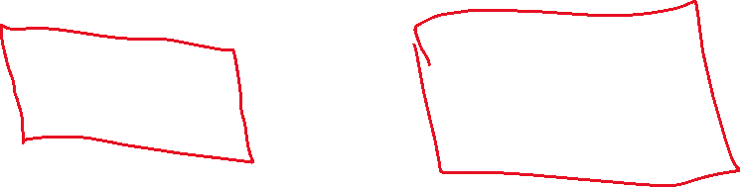




High Level App Relationships
Can Assign Task to
Manager 1
Report To
Manager 2
subordinates
Can Assign Task to
Report To
Report To
John Doe
Yafa Doe

Slide 2
High Level FE Architecture
App Header Component
App Tabs Navigation Component
Router Outlet
Employee Module
Employees Screen
Managers Screen
Manager Module
Person List
Shared Module
Person Details

