Slide 1
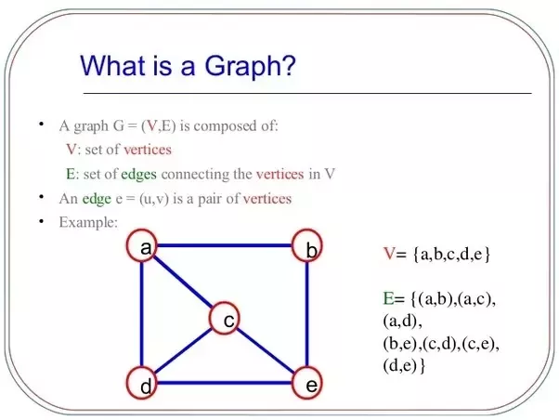
Introduction

Slide 2
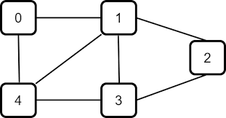

Definition of graphs
A graph is a collection of vertices (also called nodes) and edges that connect them.

Slide 3
Applications of graphs
Graphs are used in a wide range of fields, such as computer science, mathematics, physics, biology, and many more. Some examples include social networks, transportation networks, and computer networks.

Slide 4
Types of Graphs
Directed vs. Undireccted
Weighted vs. Unweighted
Simple graphs vs. Multigraphs
Cyclic vs. Acyclic
Complete vs. sparse
Regular vs. Irregular

Slide 5
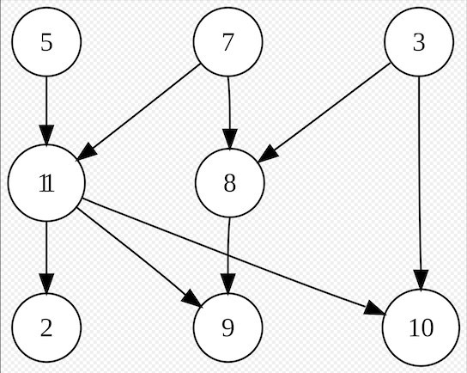
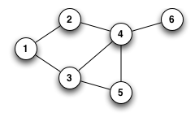
Directed and undirected
Directed graphs have edges with a direction, while undirected graphs have edges with no direction.

Slide 6
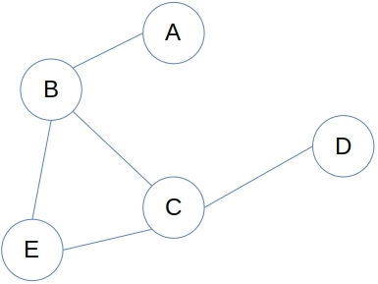
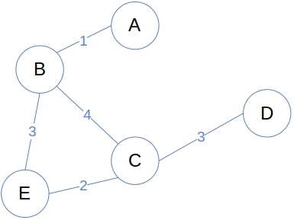
Weighted and unweighted
Weighted graphs have edges with weights or values associated with them, while unweighted graphs do not.

Slide 7
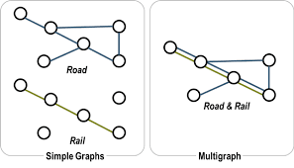
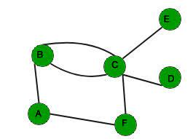
Simple and multigraphs
Simple graphs do not have multiple edges between the same pair of vertices, while multigraphs can have multiple edges between the same pair of vertices.

Slide 8
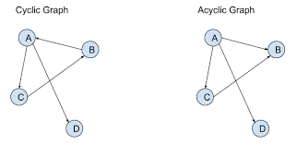
Cyclic and acyclic
Cyclic graphs contain at least one cycle, while acyclic graphs do not contain any cycles.

Slide 9
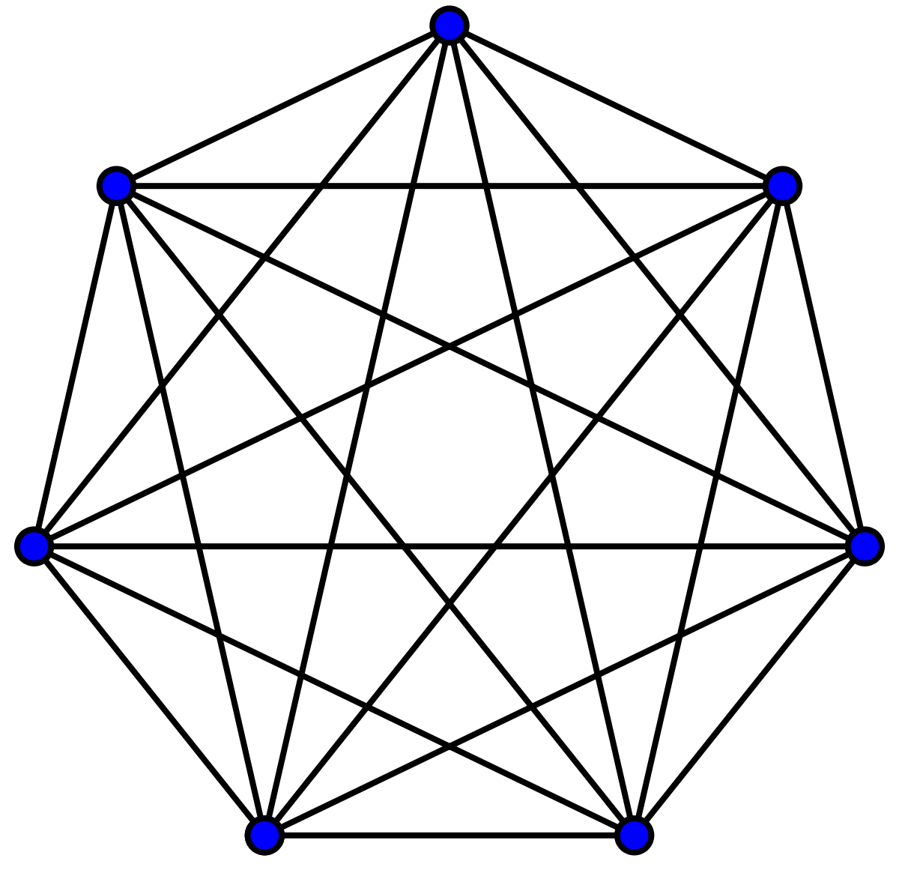
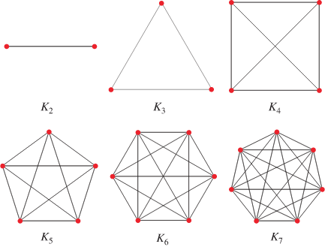
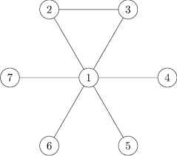
Complete and sparse
Complete graphs have all vertices connected to every other vertex, while sparse graphs have less edges than the maximum possible number of edges. For a complete graph, E = (V * (V – 1)) / 2

Slide 10
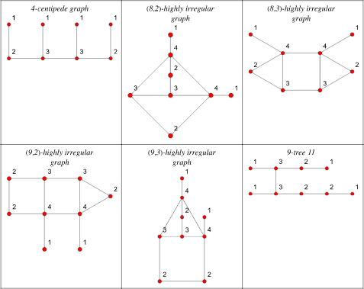
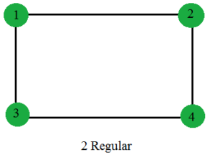
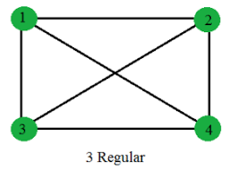
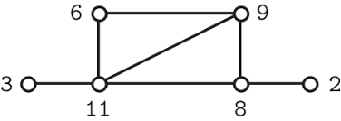
Regular and irregular
Regular graphs have all vertices with the same degree, while irregular graphs have vertices with different degrees. A highly irregular graph is a graph in which, for every vertex, all neighbors of that vertex have distinct degrees.

Slide 11
Representations of Graphs
Adjacency Matrix
Adjacency List
Edges List

Slide 12
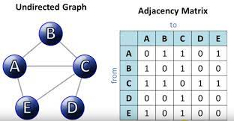
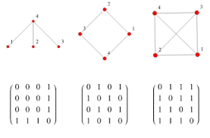
Adjacency matrix
A two-dimensional matrix where the rows and columns represent the vertices and the entries represent the edges between them.

Slide 13
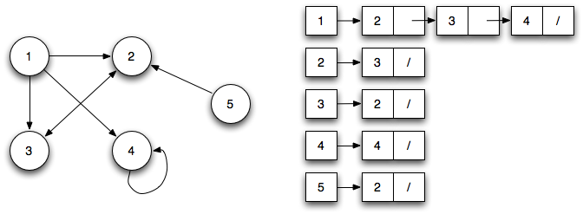
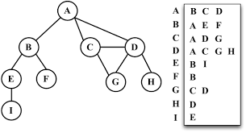
Adjacency list
Adjacency List: A list of vertices, where each vertex has a list of the vertices it is connected to.
Self-loops are allowed in directed graphs

Slide 14
Edge Lists
An edges list stores all the edges from our graph inside a linked list.
Let’s call this list as G. Each object inside the linked list will hold two things, node u and node v, indicating that an edge exists that connects node u with node v.
If the graph is weighted then each object will hold a piece of third information, which is the weight of the edge between nodes u and v.
This data structure is especially helpful with graphs that have a large number of nodes, but only a small number of edges.

Slide 15
Advantages and disadvantages of each representation
Adjacency Matrices:
  Adjacency matrices are helpful when we need to quickly find whether two nodes are adjacent (connected) or not. The adjacency matrix is a 2D boolean array of a size V^2. However, in case the handled graph was weighted, then each cell G_{uv} will be a 2D array that contains the weight of the direct edge between u and v.
  If there is no edge between u and v, then G_{uv} will contain a special value indicating there is no direct connection between u and v. Usually, we can use a large value, indicating that moving directly between u and v costs a lot, or is impossible.
Adjacency Lists:
  We don’t aim to store the value of all different pairs u and v. Instead, for each node, we store the neighboring nodes only. Hence it has low memory space complexity.
Edge Lists:
  we use edge lists when we have an enormous amount of nodes that can’t be stored inside the memory, with only a few edges. In that case, we wouldn’t have any other option but to use the edge list. So, the only advantage of the edges list is its low memory space complexity.

Slide 16

Complexity

Slide 17
Basic Graph Algorithms
Searching

Slide 18
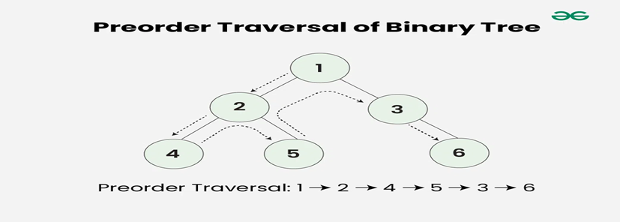
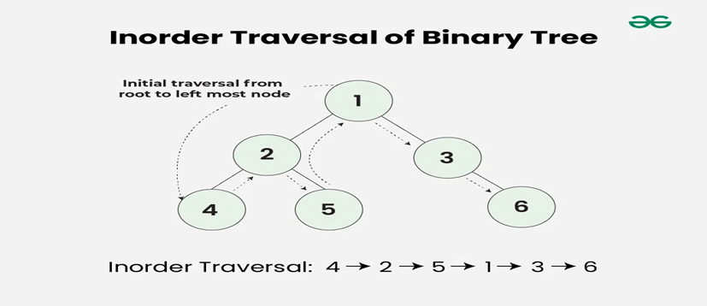
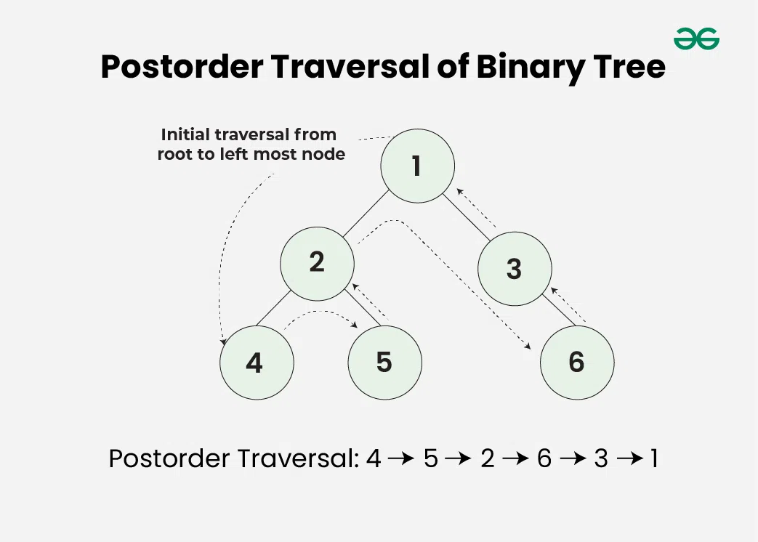
Review Tree Traversals
Preorder traversal | Inorder Traversal | Postorder Traversal

Slide 19
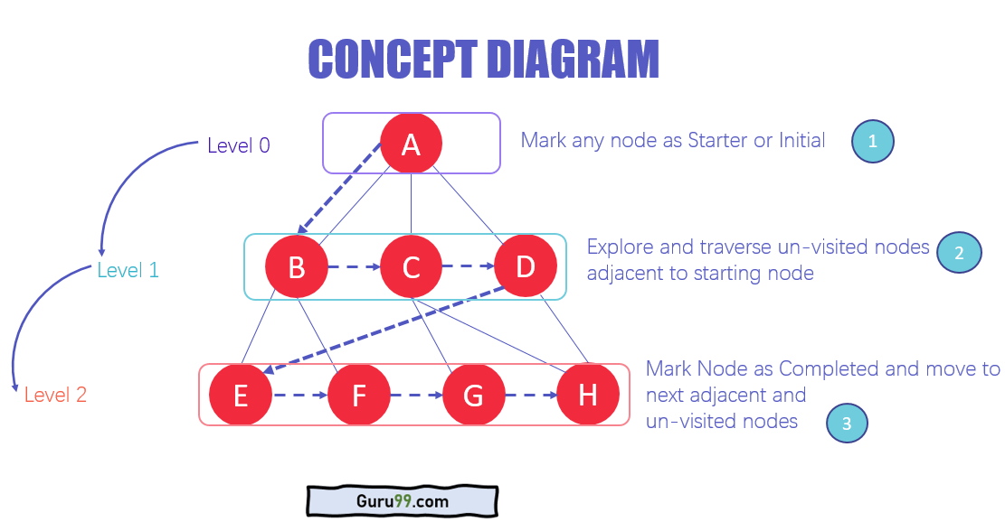
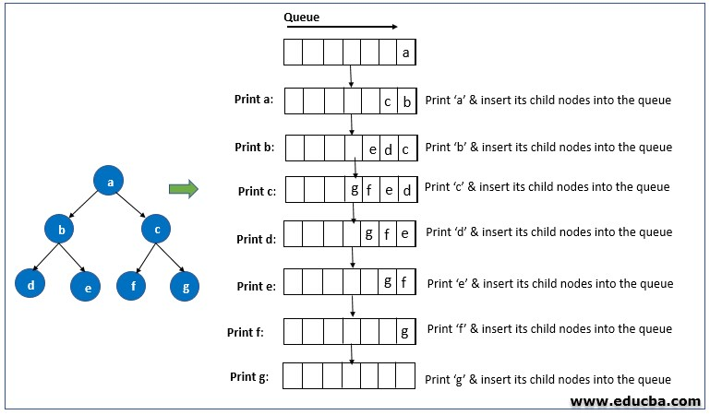
Breadth-first search (BFS): Tree Examples
Breadth-first Search (BFS): A traversal algorithm that visits all the vertices of a graph in breadth-first order.

Slide 20
BFS in Graphs
Breadth First Search (BFS) is a fundamental graph traversal algorithm. It begins with a node, then first traverses all its adjacent. Once all adjacent are visited, then their adjacent are traversed. We mainly traverse vertices level by level. A lot of popular graph algorithms like Dijkstra’s shortest path, and Prim’s algorithm are based on BFS. BFS itself can be used to detect cycle in a directed and undirected graph, find shortest path in an unweighted graph and many more problems.
Recall there are no cycles in a tree

Slide 21
BFS Algorithm
Initialization: Enqueue the given source vertex into a queue and mark it as visited.
Exploration: While the queue is not empty:
  Dequeue a node from the queue and visit it (e.g., print its value).
  For each unvisited neighbor of the dequeued node:
  Enqueue the neighbor into the queue.
  Mark the neighbor as visited.
Termination: Repeat step 2 until the queue is empty.

Slide 22
Difference between BFS in Trees and Graphs
There are no cycles in trees but there may be cycles in a graph
Hence, we need an extra boolean array to mark visited nodes

Slide 23
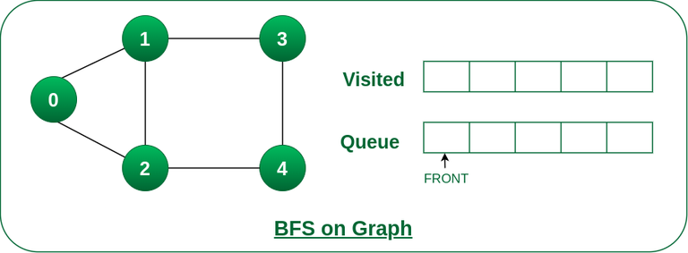
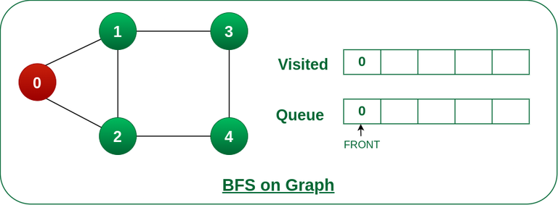
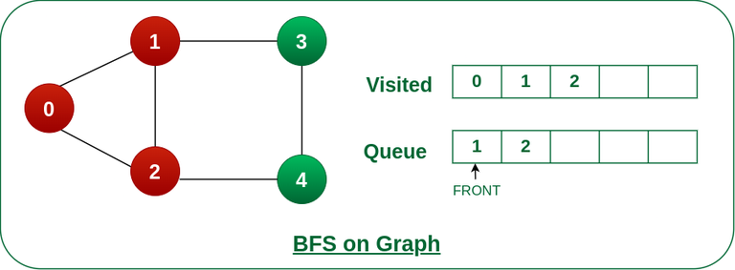
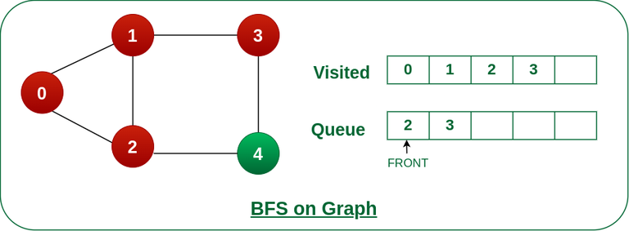
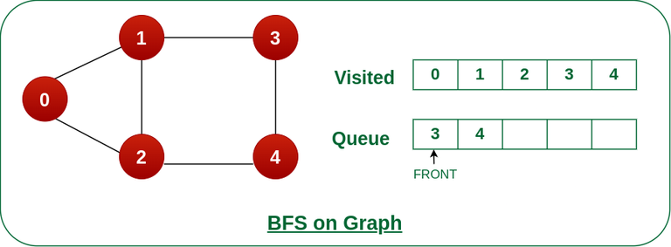


BFS Example

Slide 24
Complexities
Time Complexity: O(V+E), where V is the number of nodes and E is the number of edges.
Auxiliary Space: O(V)

Slide 25
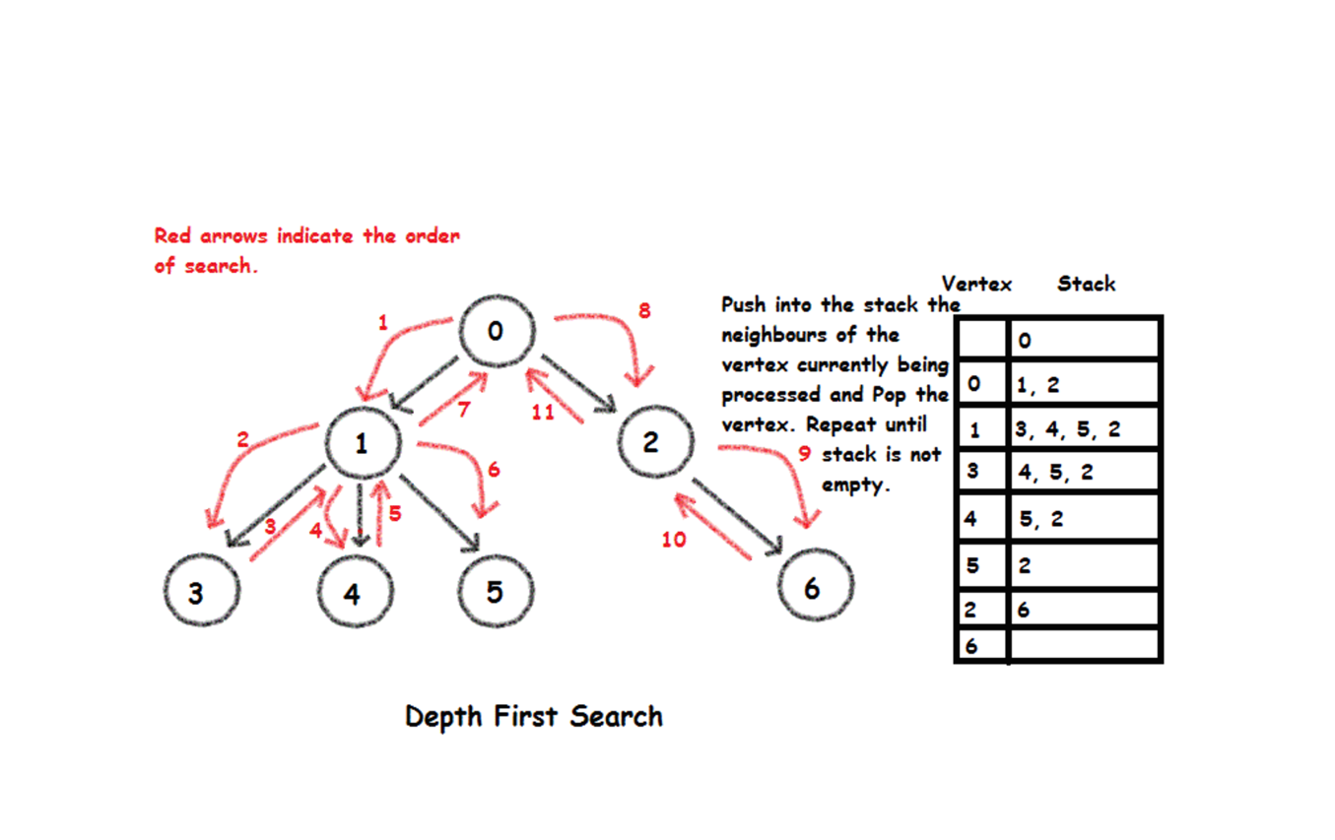
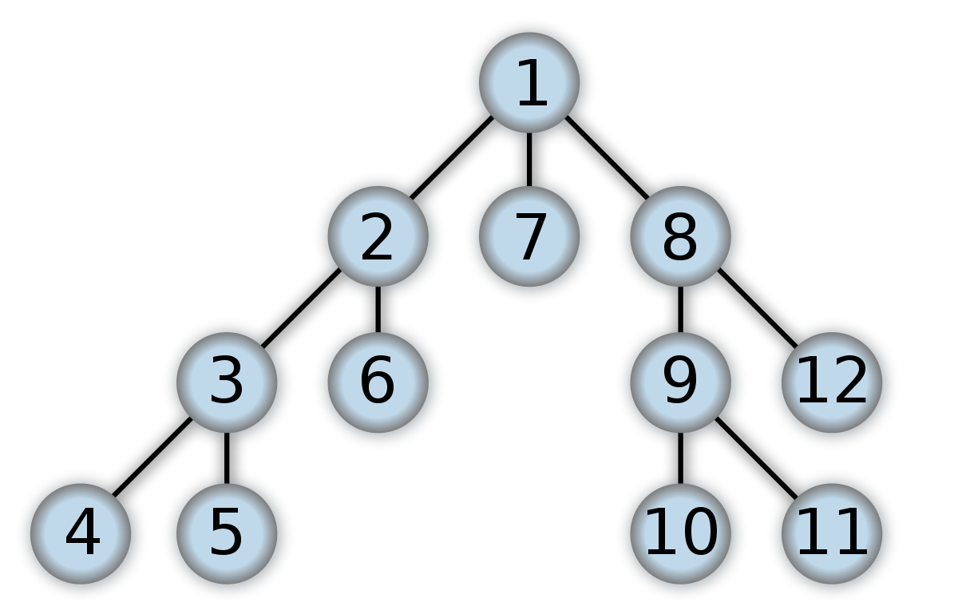
Depth-first Search (DFS): Tree Examples
A traversal algorithm that visits all the vertices of a graph in depth-first order.

Slide 26
DFS in Graphs
Depth First Traversal (or DFS) for a graph is similar to Depth First Traversal of a tree. But unlike trees, graphs may contain cycles (a node may be visited twice). To avoid processing a node more than once, use a boolean visited array. A graph can have more than one DFS traversal as it can traverse in different ways.

Slide 27
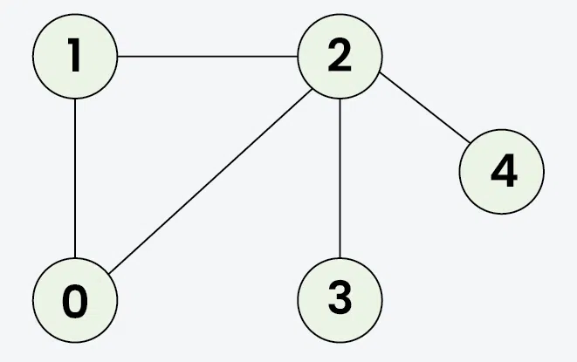
DFS
Input: V = 5, E = 5, edges = {{1, 2}, {1, 0}, {0, 2}, {2, 3}, {2, 4}}, source = 1
Output: 1 2 0 3 4
Explanation: DFS Steps:
Start at 1: Mark as visited. Output: 1
Move to 2: Mark as visited. Output: 2
Move to 0: Mark as visited. Output: 0 (backtrack to 2)
Move to 3: Mark as visited. Output: 3 (backtrack to 2)
Move to 4: Mark as visited. Output: 4 (backtrack to 1)

Slide 28
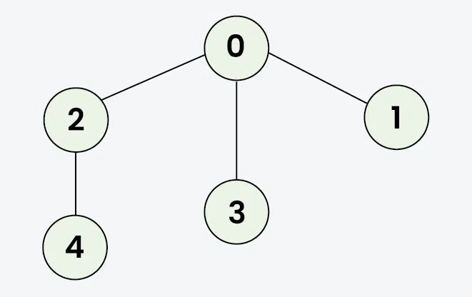
DEF Example
Input: V = 5, E = 4, edges = {{0, 2}, {0, 3}, {0, 1}, {2, 4}}, source = 0
Output: 0 2 4 3 1
Start at 0: Mark as visited. Output: 0
Move to 2: Mark as visited. Output: 2
Move to 4: Mark as visited. Output: 4 (backtrack to 2, then backtrack to 0)
Move to 3: Mark as visited. Output: 3 (backtrack to 0)
Move to 1: Mark as visited. Output: 1

Slide 29
Complexities
Time complexity: O(V + E), where V is the number of vertices and E is the number of edges in the graph.
Auxiliary Space: O(V ), since an extra visited array of size V is required, And stack size for recursive calls to DFSRec function.
  1. Recursion Stack:
    DFS uses a function call stack to track vertices.
    Space complexity depends on the maximum recursion depth.
    Maximum depth in a graph with V vertices is O(V).
  2. Visited Array:
    May use a visited array to mark visited vertices.
    Size equals the number of vertices (V).

Slide 30
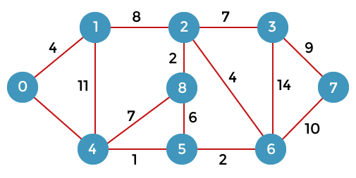
Shortest path algorithms (Dijkstra's, Bellman-Ford)
Algorithms for finding the shortest path between two vertices in a graph, such as Dijkstra's algorithm and Bellman-Ford algorithm.

Slide 31
Dijkstra’s Shortest Path Algorithm
Dijkstra's algorithm (/ˈdaɪkstrəz/ DYKE-strəz) is an algorithm for finding the shortest paths between nodes in a weighted graph, which may represent, for example, road networks. It was conceived by computer scientist Edsger W. Dijkstra in 1956 and published three years later.

Slide 32
Dijkstra’s Shortest Path Algorithm
Dijkstra's algorithm finds the shortest path from a given source node to every other node. It can also be used to find the shortest path to a specific destination node, by terminating the algorithm once the shortest path to the destination node is known. For example, if the nodes of the graph represent cities, and the costs of edges represent the average distances between pairs of cities connected by a direct road, then Dijkstra's algorithm can be used to find the shortest route between one city and all other cities. A common application of shortest path algorithms is network routing protocols, most notably IS-IS (Intermediate System to Intermediate System) and OSPF (Open Shortest Path First).

Slide 33
Time Complexities
Using a simple array as the priority queue:
Time complexity: 𝑂(𝑉²).
In this case, for each vertex, you may need to iterate over all other vertices to find the minimum distance vertex, which results in 𝑂(𝑉²) operations. This is efficient for dense graphs, where the number of edges 𝐸 approaches 𝑉² .
Using a binary heap (priority queue):
  Time complexity: 𝑂((𝑉+𝐸)log⁡𝑉)
  Each vertex is processed once, and inserting and extracting the minimum element from the priority queue takes 𝑂(log⁡𝑉). Relaxing an edge can also take 𝑂(log⁡𝑉), and since there are E edges, the total complexity becomes 𝑂((𝑉+𝐸)log⁡𝑉). This implementation is more efficient for sparse graphs, where 𝐸 is much smaller than 𝑉².

Slide 34
Space Complexity
The space complexity of Dijkstra's algorithm is O(V), where V is the number of vertices in the graph. This is because the algorithm needs to store the tentative distances for each vertex.
Recall that we use an array to implement a binary heap

Slide 35
Big O, Big Omega, and Big Theta
We can think of Big O, Big Omega, and Big Theta like conditional operators:
Big O is like <=, meaning the rate of growth of an algorithm is less than or equal to a specific value, e.g: f(x) <= O(n^2)
Big Omega is like >=, meaning the rate of growth is greater than or equal to a specified value, e.g: f(x) >= Ω(n).
Big Theta is like ==, meaning the rate of growth is equal to a specified value, e.g: f(x) = Θ(n^2).
But if we needed to make a blanket statement for all cases, we would use Big O, and, for example, say that Insertion Sort is O(n^2).

Slide 36
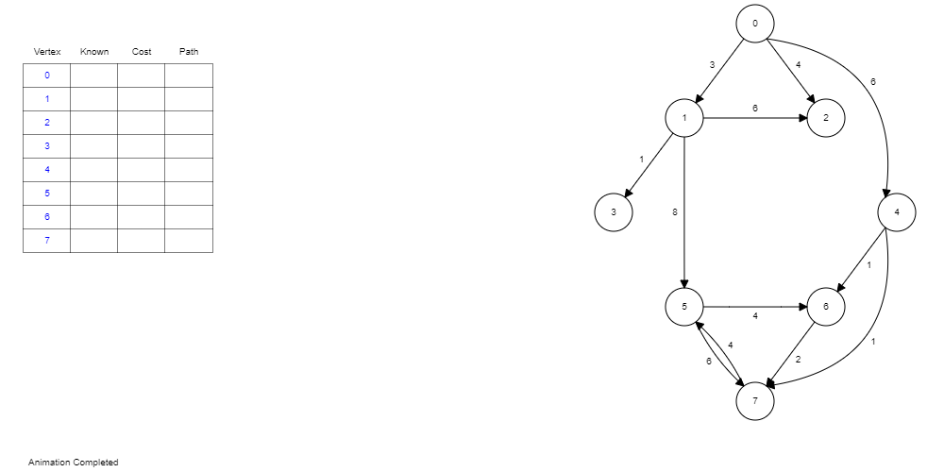
Dijkstra’s algorithm for Shortest Path

Slide 37
Bellman-Ford Shortest Path Algorithm
The Bellman-Ford algorithm emulates the shortest paths from a single source vertex to all other vertices in a weighted digraph. It is slower than Dijkstra's algorithm for the same problem but more versatile because it can handle graphs with some edge weights that are negative numbers. Alfonso Shimbel proposed the algorithm in 1955, but it is now named after Richard Bellman and Lester Ford Jr., who brought it out in 1958 and 1956. In 1959, Edward F. Moore published a variation of the algorithm, sometimes referred to as the Bellman-Ford–Moore algorithm.

Slide 38
Bellman-Ford Shortest Path Algorithm
Step 1: Make a list of all the graph's edges. This is simple if an adjacency list represents the graph.
Step 2: "V - 1" is used to calculate the number of iterations.
Step 3: Begin with an arbitrary vertex and a minimum distance of zero. Because you are exaggerating the actual distances, all other nodes should be assigned positive infinity. For each edge u-v, relax the path lengths for the vertices. If distance[v] is greater than distance[u] + weight of uv, then distance[v] = distance[u] + weight of uv
Step 4:If the new distance is less than the previous one, update the distance for each edge in each iteration. The distance to each node is the total distance from the starting node to this specific node.
Step 5: To ensure that all possible paths are considered, you must consider all iterations.

Slide 39
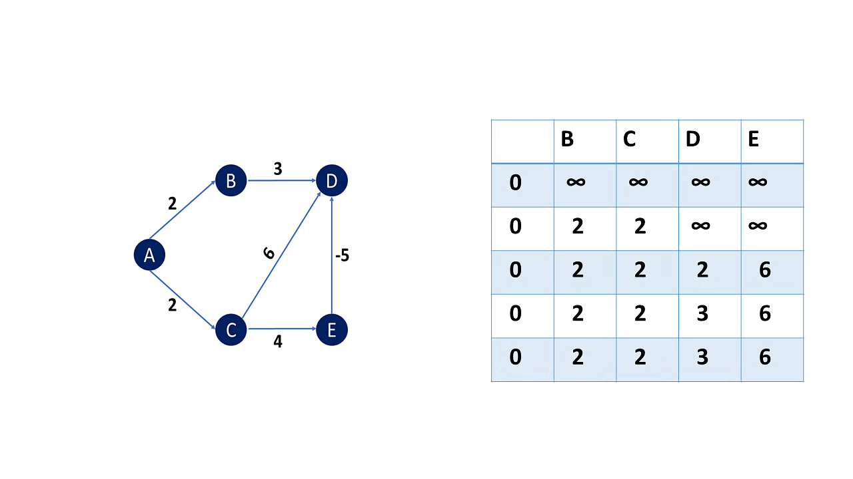
Bellman-Ford Shortest Path Algorithm
Bellman-Ford algorithm begins with a starting vertex and calculates the distances between other vertices that a single edge can reach. It then searches for a path with two edges, and so on.
 | B | C | D | E
0 | ∞ | ∞ | ∞ | ∞
0 | 2 | 2 | ∞ | ∞
0 | 2 | 2 | 5 | 6
0 | 2 | 2 | 1 | 6

Slide 40
Bellman-Ford Shortest Path Algorithm
Based on the "Principle of Relaxation," more accurate values gradually recovered an approximation to the proper distance until finally reaching the optimum solution.
Negative weight edges can generate negative weight cycles, which reduce the total path distance by returning to the same point.

Slide 41
Bellman-Ford Time Complexity
  The Bellman-Ford algorithm has a time complexity of O(VE), where V is the number of vertices and E is the number of edges in a graph. In a complete graph with n vertices, V = n, and E = O(n²), so the overall time complexity is O(n³)

Slide 42
Bellman-Ford Space Complexity
  Graph representation:
    If the graph is stored as an edge list, the space complexity for the graph itself is 𝑂(𝐸), where 𝐸 is the number of edges.
    If an adjacency matrix is used (though uncommon for sparse graphs), it would take 𝑂(𝑉2) space, where 𝑉 is the number of vertices.
  Distance and predecessor arrays:
  The algorithm typically maintains a distance array to store the shortest distance estimates from the source to each vertex. This takes 𝑂(𝑉) space. A predecessor array (sometimes used to reconstruct paths) also takes 𝑂(𝑉) space if implemented.

Slide 43
Bellman-Ford Space Complexity
Overall Space Complexity:
For a graph represented as an edge list: The total space complexity is 𝑂(𝑉+𝐸), where 𝑉 accounts for the distance and predecessor arrays, and 𝐸 accounts for the edge list.
For a graph represented as an adjacency matrix: The space complexity would be 𝑂(𝑉2), though this is generally inefficient for sparse graphs.
In most cases, Bellman-Ford uses an edge list, so the common space complexity is 𝑂(𝑉+𝐸).

Slide 44
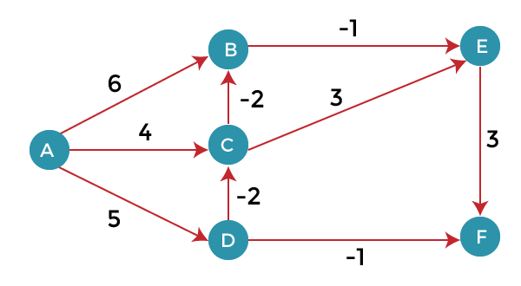
Bellman-Ford Shortest Path Algorithm
Practice

Slide 45
Prim’s Algorithm for Minimum Spanning Tree
Prim’s algorithm is a Greedy algorithm. This algorithm always starts with a single node and moves through several adjacent nodes, in order to explore all of the connected edges along the way.
The algorithm starts with an empty spanning tree. The idea is to maintain two sets of vertices. The first set contains the vertices already included in the MST, and the other set contains the vertices not yet included. At every step, it considers all the edges that connect the two sets and picks the minimum weight edge from these edges. After picking the edge, it moves the other endpoint of the edge to the set containing MST.

Slide 46
Prim’s Algorithm for Minimum Spanning Tree
The working of Prim’s algorithm can be described by using the following steps:
  Step 1: Determine an arbitrary vertex as the starting vertex of the MST.
  Step 2: Follow steps 3 to 5 as long as there exist vertices that are not included in the MST (known as fringe vertex).
  Step 3: Find edges connecting any tree vertex with the fringe vertices.
  Step 4: Find the minimum among these edges.
  Step 5: Add the chosen edge to the MST if it does not form any cycle.
  Step 6: Return the MST and exit

Slide 47
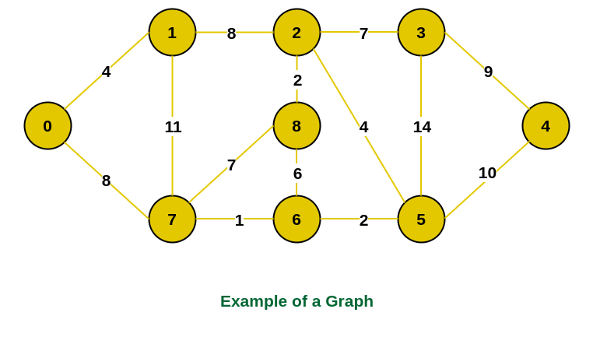
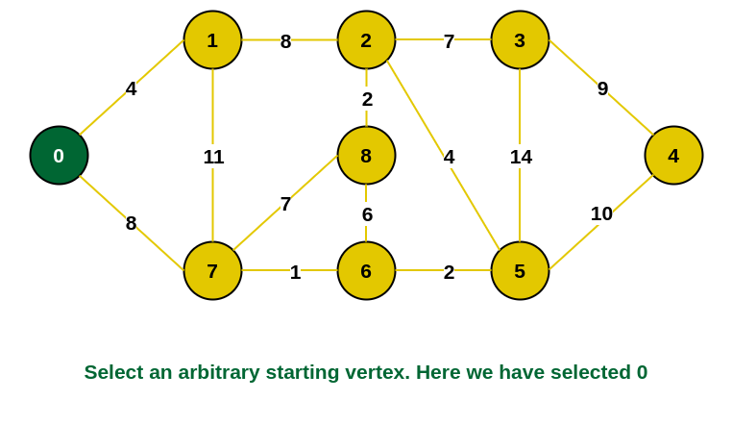
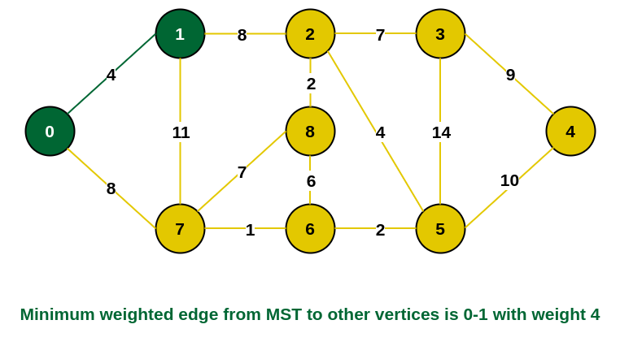
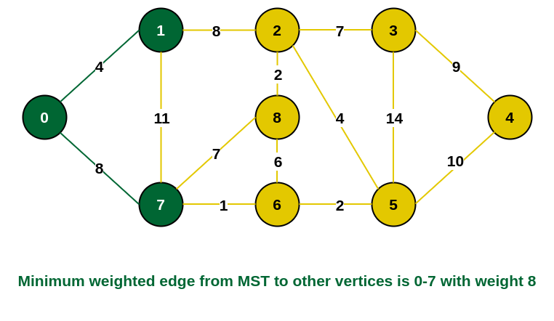
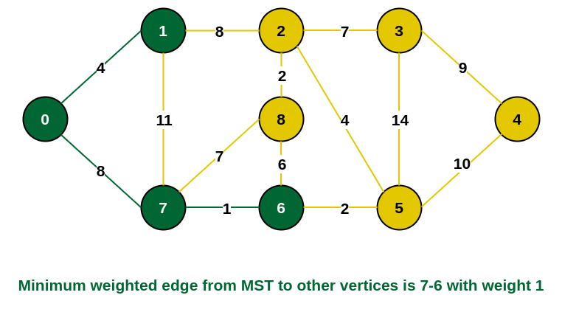
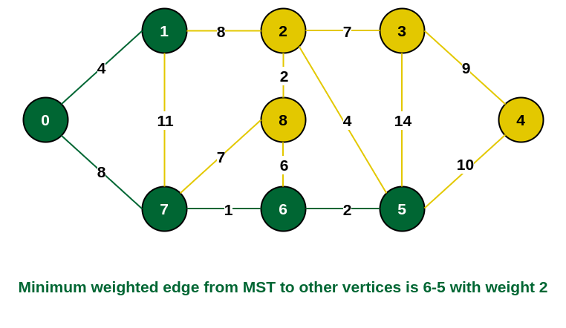
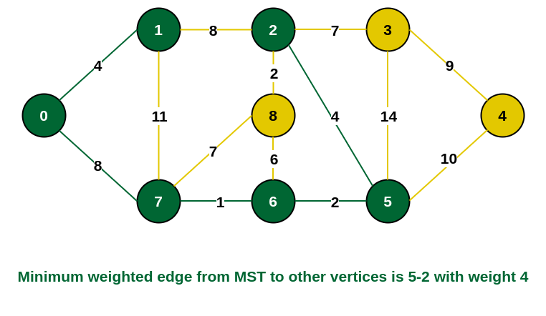
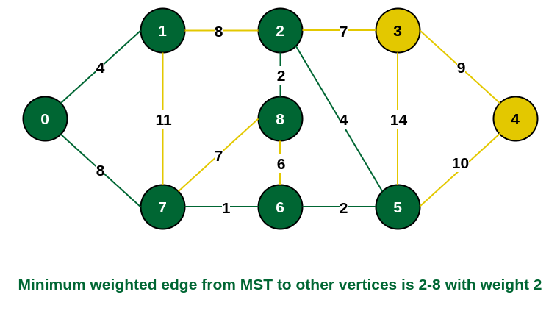
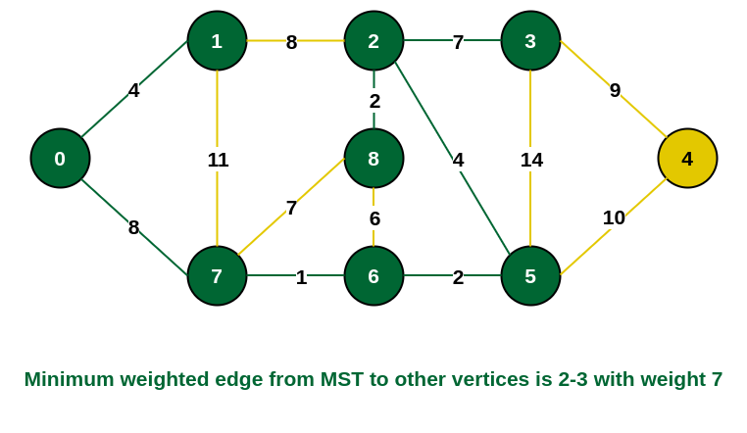
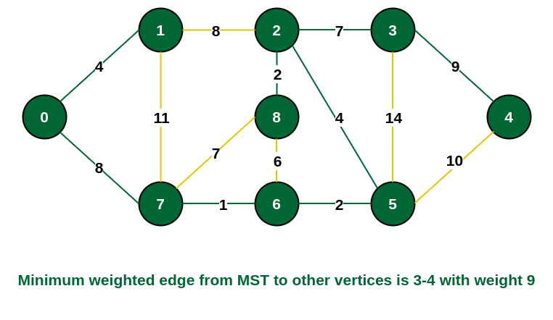
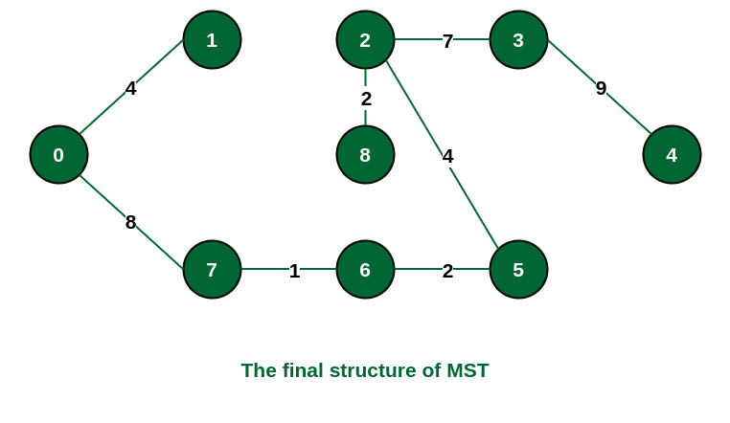
Prim’s Algorithm: An example

Slide 48
Prim’s Algorithm Time Complexity
Using an Adjacency Matrix and Simple Array (Priority Queue): Time complexity: 𝑂(𝑉²). In this case, for each vertex, you find the minimum edge connecting it to the MST by scanning all vertices, which takes 𝑂(𝑉) time. Since this process is repeated for 𝑉 vertices, the overall time complexity is 𝑂(𝑉²). This is suitable for dense graphs where 𝐸 approaches 𝑉² .
2. Using an Adjacency List and Binary Heap (Priority Queue):Time complexity: 𝑂((𝑉+𝐸)log⁡𝑉). Each vertex insertion and extraction from the priority queue takes 𝑂(log⁡𝑉). Relaxing an edge also takes 𝑂(log⁡𝑉) time. Since the algorithm processes 𝐸 edges and 𝑉 vertices, the total complexity becomes 𝑂((𝑉+𝐸)log⁡𝑉). This implementation is more efficient for sparse graphs where 𝐸 is much smaller than 𝑉² .
Summary of Time Complexities:
Dense graphs (Adjacency Matrix + Simple Array): 𝑂(𝑉2)
Sparse graphs (Adjacency List + Binary Heap): 𝑂((𝑉+𝐸)log⁡𝑉)
The binary heap implementation is most common in practice due to its balance between simplicity and efficiency.

Slide 49
Prim’s Algorithm Space Complexity
1. Graph Representation: If the graph is represented using an adjacency list, the space required for the graph is 𝑂(𝑉+𝐸). If the graph is represented using an adjacency matrix, the space required for the graph is 𝑂(𝑉²), which is more space-consuming and typically used for dense graphs.
2. Auxiliary Data Structures: Prim's algorithm maintains the following data structures: Key array (or priority queue): Stores the minimum edge weights for each vertex. This takes 𝑂(𝑉) space. Parent array: Stores the parent (predecessor) of each vertex in the MST. This also requires 𝑂(𝑉) space. Visited or in-MST set: Keeps track of which vertices have already been added to the MST. This takes 𝑂(𝑉) space.
Summary:
  Adjacency list representation: 𝑂(𝑉+𝐸).
  Adjacency matrix representation: 𝑂(𝑉²).

Slide 50
Kruskal’s Algorithm for Minimum Spanning Tree
Kruskal’s Algorithm is a greedy algorithm used to find the Minimum Spanning Tree (MST) for a connected, undirected graph. The MST is a subset of the edges that connects all vertices in the graph without any cycles and with the minimum possible total edge weight.

Slide 51
Kruskal’s Algorithm: Steps
Sort all the edges in the graph in non-decreasing order of their weight.
Initialize a forest in which each vertex is a separate tree.
For each edge in the sorted list, check if adding the edge forms a cycle in the tree:
  If it doesn’t form a cycle, include the edge in the MST.
  If it forms a cycle, discard the edge.
Repeat this process until there are exactly V−1 edges in the MST, where V is the number of vertices in the graph.

Slide 52
Kruskal’s Algorithm: Key Concepts
Greedy approach: The algorithm always picks the smallest weight edge that doesn't form a cycle, aiming to build the MST in an optimal way.
Cycle detection: To detect cycles, the algorithm uses a Disjoint-Set (Union-Find) data structure.

Slide 53
Kruskal’s Algorithm: Time Complexity
Sorting the edges: O(Elog⁡E), where E is the number of edges.
Union-Find operations: O(Elog⁡V), where V is the number of vertices, assuming an efficient implementation of Union-Find with path compression and union by rank.
Thus, the overall time complexity of Kruskal’s algorithm is 𝑂(𝐸log⁡𝐸) or equivalently 𝑂(𝐸log⁡𝑉), since 𝐸≥𝑉−1.

