Slide 1
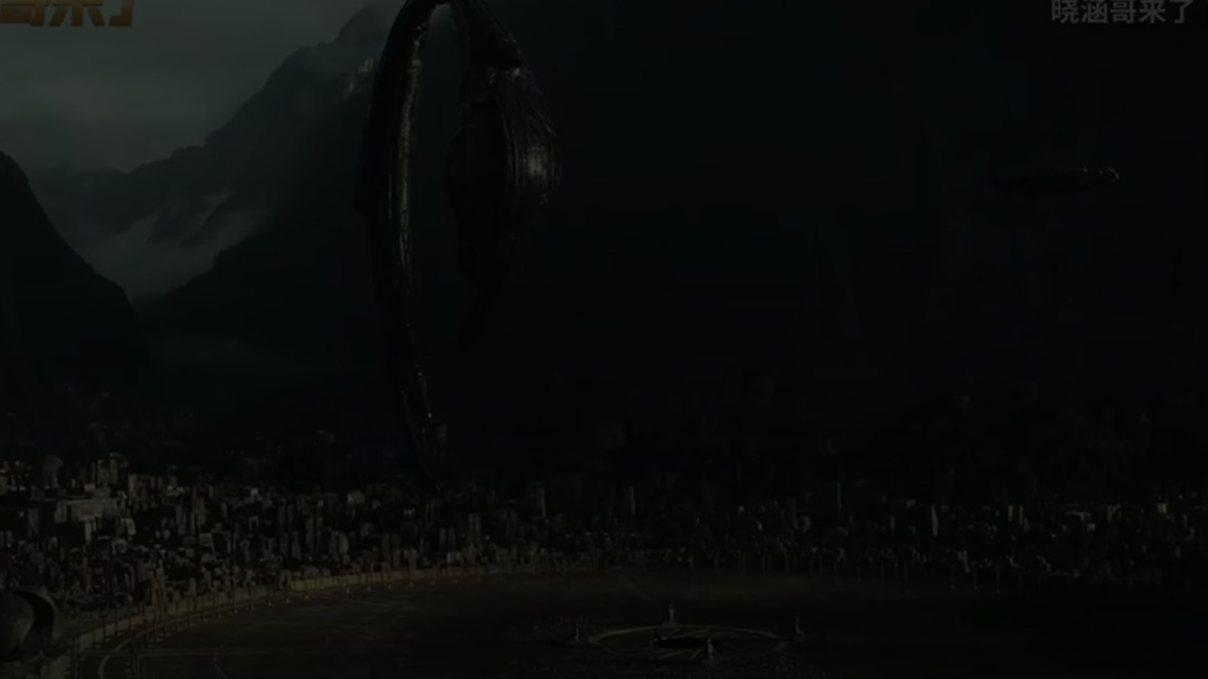
The Alien Prequels
in three minutes
What happened before the first Alien film?
Notes:
Hello. In three minutes I will tell you about two films: Prometheus and Alien: Covenant. They show where the monster comes from.

Slide 2
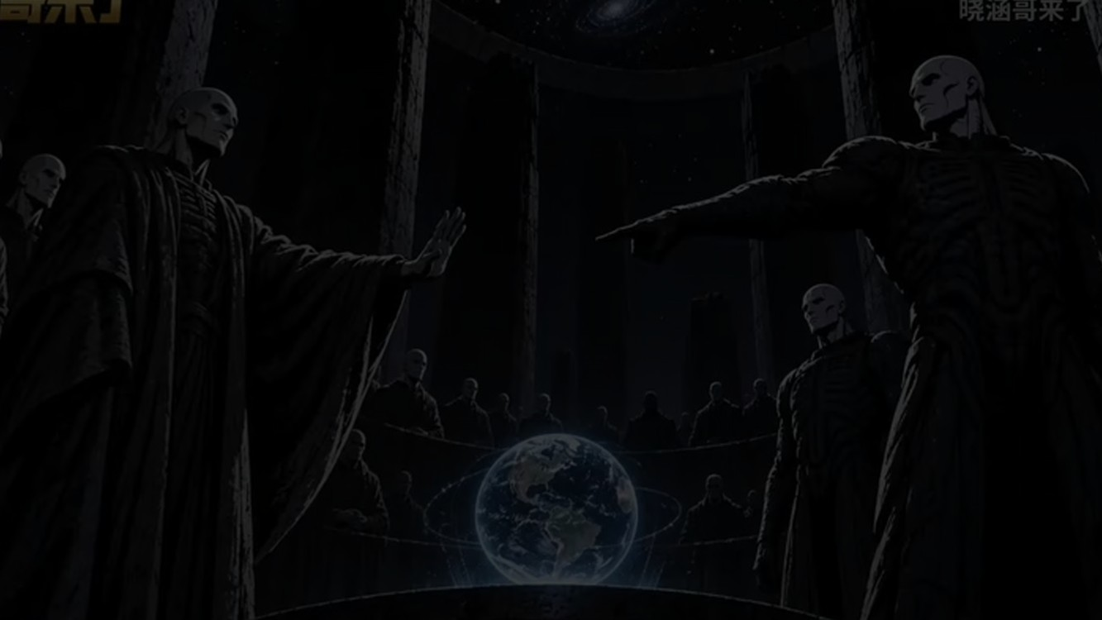
2093
2104
2122
Prometheus
Alien: Covenant
Alien
The story before the story
Notes:
The years are easy. Prometheus is 2093. Covenant is 2104. The first Alien film is 2122. So these films are the story before.

Slide 3
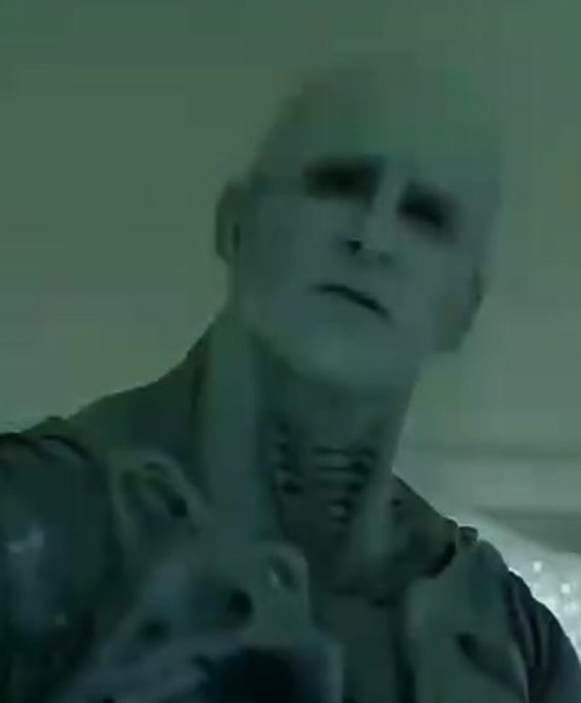
Part 1 · The Engineers
They made us.
Then they wanted us gone.
Black Goo: a weapon to kill, or to change life.
Notes:
The Engineers made humans. Then they wanted to kill humans. They made a weapon. It is called the Black Goo.

Slide 4
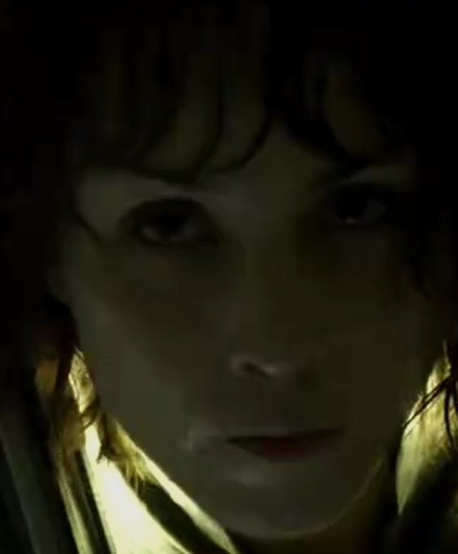
Part 2 · Prometheus
A trip to find our makers.
And a robot who lies.
The first alien: the Deacon.
Notes:
In Prometheus, a ship goes to LV-223 to find the Engineers. David, a robot, lies to everyone. The first alien, the Deacon, is born.

Slide 5
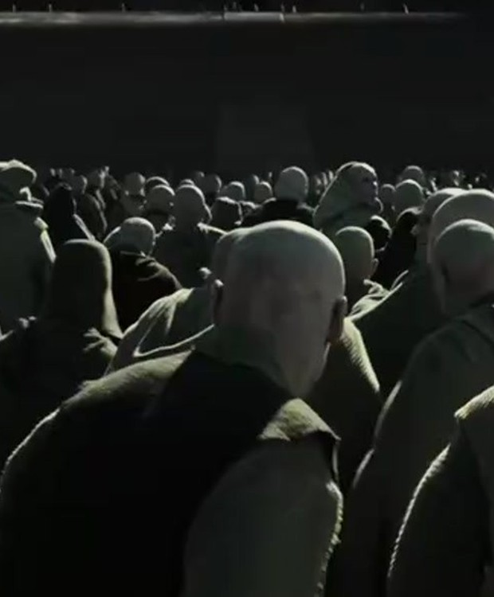
Part 3 · Covenant
David kills the Engineers.
He makes the first Alien eggs.
Then he gets on a colony ship.
Notes:
In Covenant, David kills all the Engineers. He uses the Black Goo to make the first Alien eggs. Then he gets on a colony ship.

Slide 6
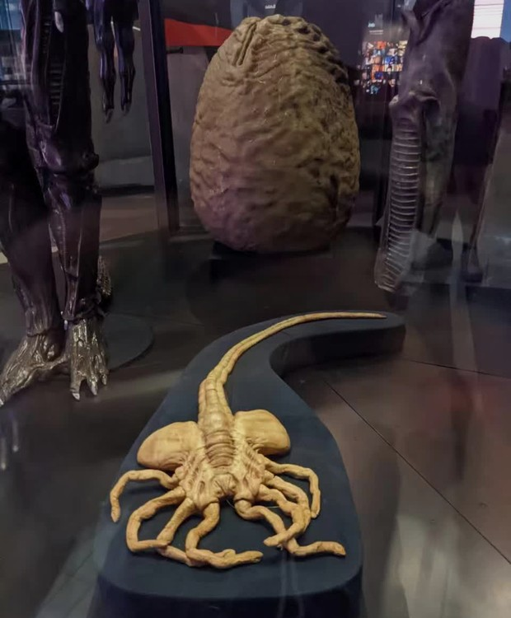
Part 4 · The life cycle
Egg → Facehugger
Facehugger → Chestburster
Hours later: full size
Acid blood. Two jaws. Very hard to kill.
Notes:
The Alien grows in a strange way. A facehugger puts a baby inside a person. A chestburster breaks out. In hours it is full size.

Slide 7
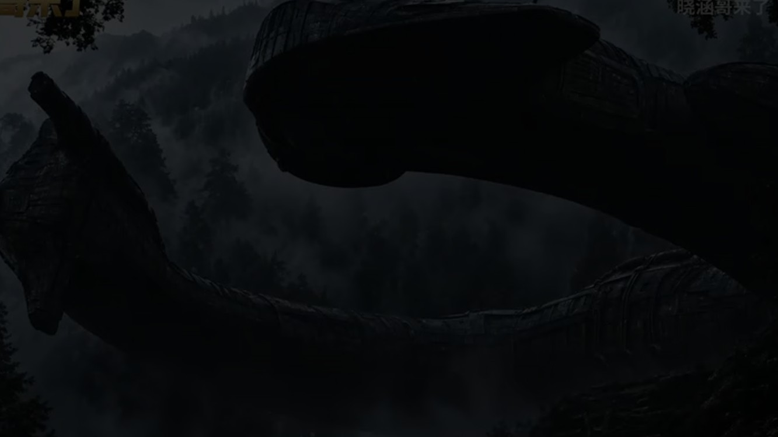
What we make,
we cannot take back.
Thank you.
Notes:
So the message is simple. When we make something, we cannot take it back. Thank you.

