Slide 1
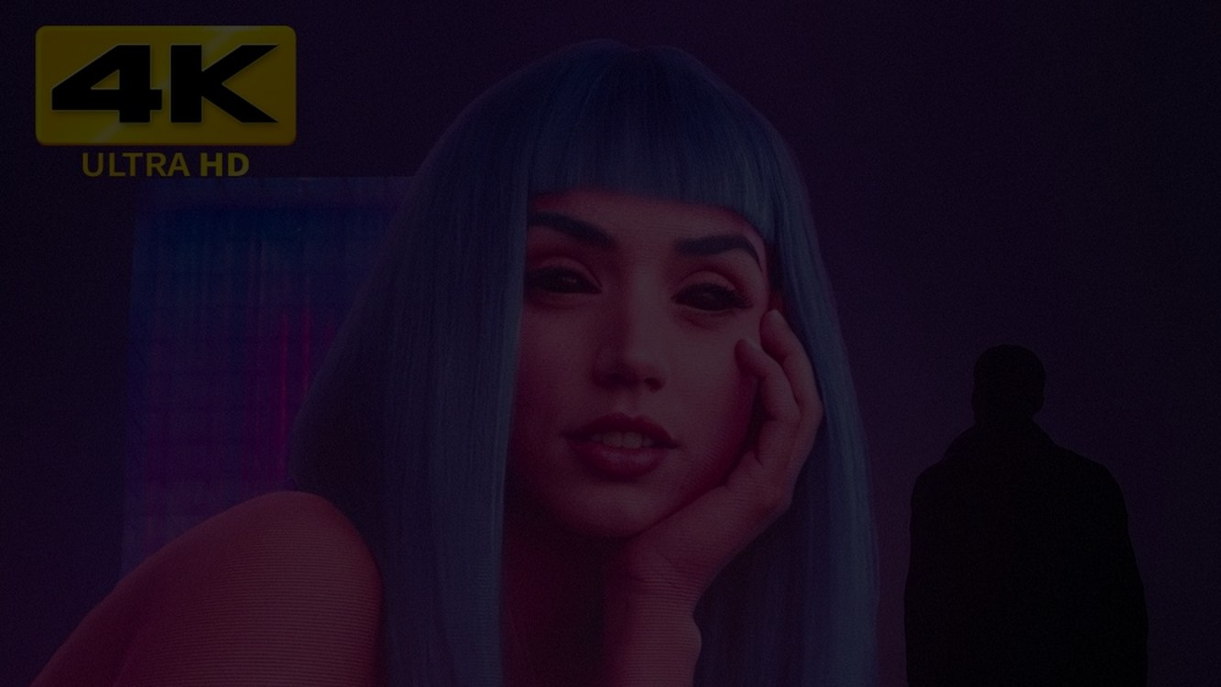
A VISUAL PRESENTATION
Blade Runner 2049
Denis Villeneuve · 2017 · cinematography by Roger Deakins
What makes us human — in a world that builds people
# Humanity
# Memory
# Replicants
Notes:
Good morning everyone. Today I want to talk about Blade Runner 2049 — a sequel that took thirty-five years to arrive, and somehow became one of the most beautiful science-fiction films ever made. I'll look at its world, its images, and the question at its centre: what makes us human?

Slide 2
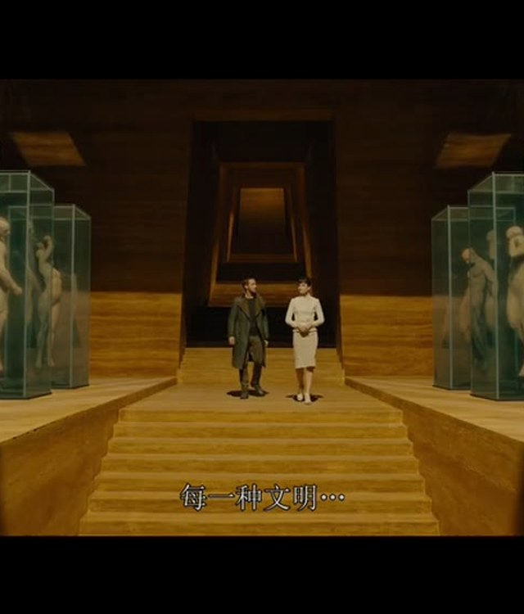
THE WORLD IN 2049
A city that never dries
— Los Angeles, 2049
— Acid rain, fog, endless neon
— Replicants do the work
— Humans dream of escape
Earth is dying. The colonies are a promise no one keeps.
# Los Angeles
# Decay
Notes:
The film is set in Los Angeles in 2049. Earth is dying: acid rain, fog, endless neon, and a population that mostly can't afford to leave. Replicants — bio-engineered humans — do the work that humans no longer want to do.

Slide 3
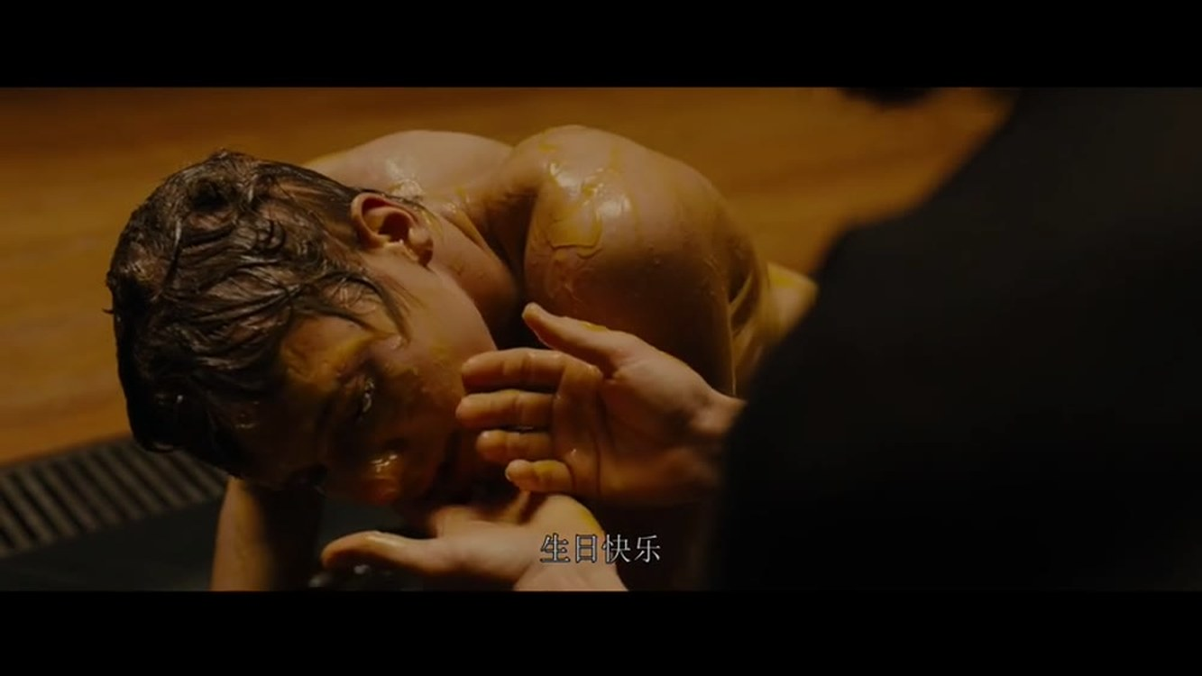
Fog over the city
Deakins built the atmosphere with fog, light and rain — not digital haze
# Atmosphere
# Light
Notes:
This is the city from above: fog rolling over the towers. Roger Deakins built the atmosphere with real fog, real light and real rain, not digital haze — and you can feel it in every frame.

Slide 4
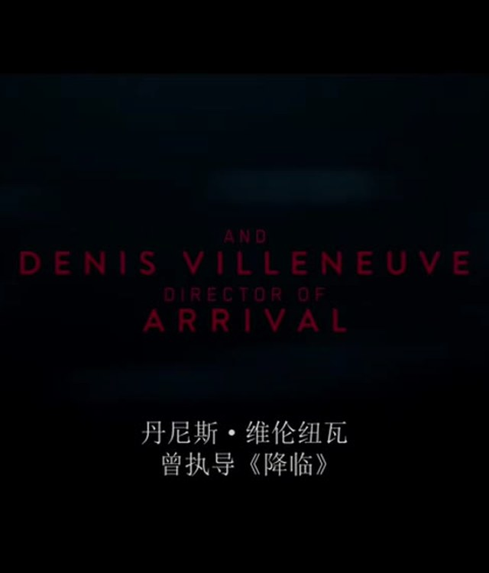
THE PROTAGONIST
K — a blade runner
— A replicant who retires his own kind
— Told his memories are fake
— Then finds a memory that is real
— Starts to ask: who am I?
"I've never seen a tree before."
# K
# Identity
Notes:
Our protagonist is K, a blade runner — a replicant whose job is to 'retire' other replicants. He is told his memories are implants. Then he finds one that is real, and starts to ask a dangerous question: who am I?

Slide 5
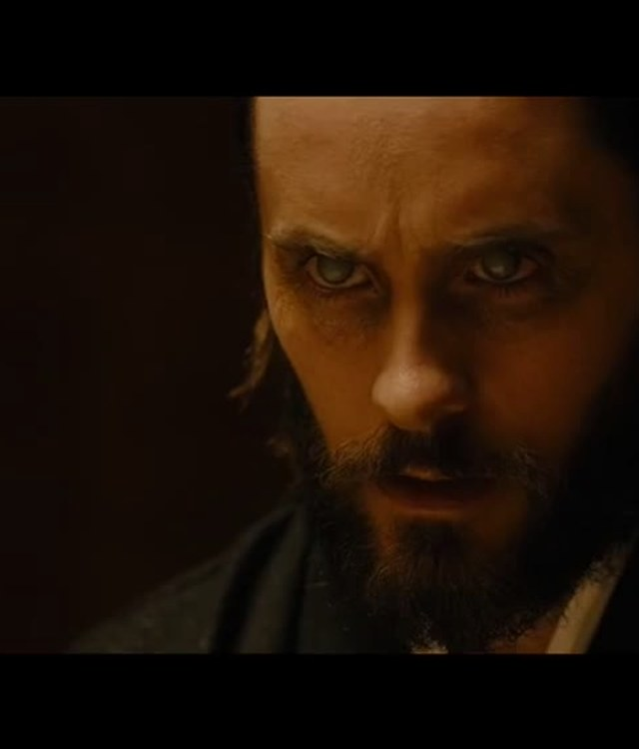
THE MYSTERY
A child born of two replicants
— A miracle: replicants can create life
— Wallace wants it — for profit
— The resistance wants it — for hope
— K wants the truth about himself
# Miracle
# Birth
Notes:
The plot turns on a miracle: a child born of two replicants. For Wallace, it is a product. For the resistance, it is hope. For K, it is a clue about himself.

Slide 6
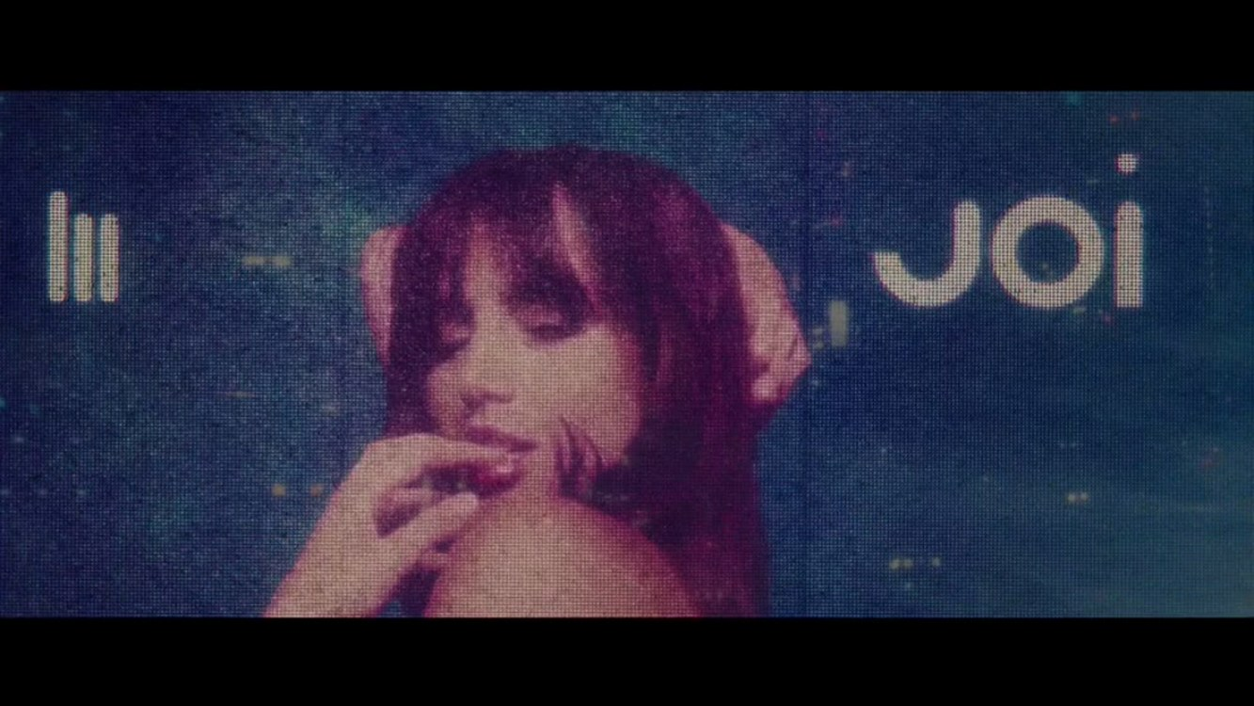
Las Vegas, after the blackout
Orange sandstorms, ruined statues — the most beautiful wasteland in film
# Vegas
# Silence
Notes:
This is Las Vegas after the blackout — orange sandstorms and ruined statues. It is one of the most striking sequences in modern cinema: a wasteland, but beautiful.

Slide 7
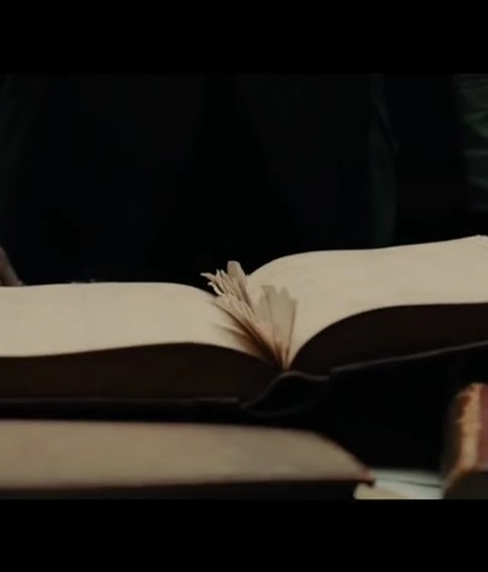
02
Visual poetry
How Roger Deakins painted
2049 with light
# Cinematography
# Deakins
Notes:
Now, the visual language. If the film is remembered for one thing, it's how it looks.

Slide 8
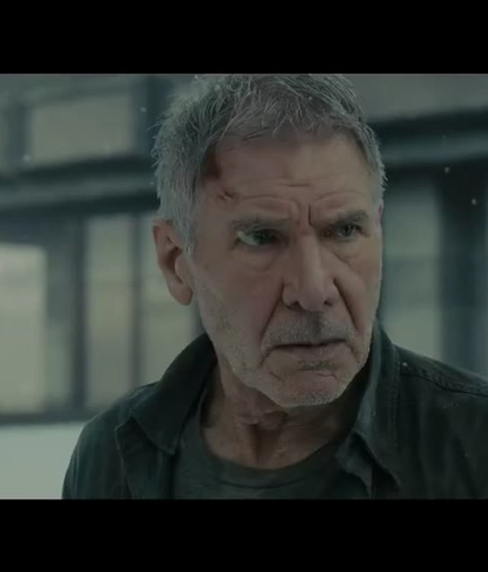
THE LOOK
Three colours, one city
— Cyan fog — the outside world
— Amber interiors — warmth and lies
— Neon signs — memory as advertisement
— Huge emptiness, tiny people
Won the Academy Award for Best Cinematography in 2018.
# Colour
# Composition
Notes:
Deakins works with three colours: cyan fog for the outside world, amber for interiors, and neon for memory and advertising. He also uses scale — vast empty spaces, tiny people — to make us feel small. For this work he won the Academy Award for Best Cinematography.

Slide 9
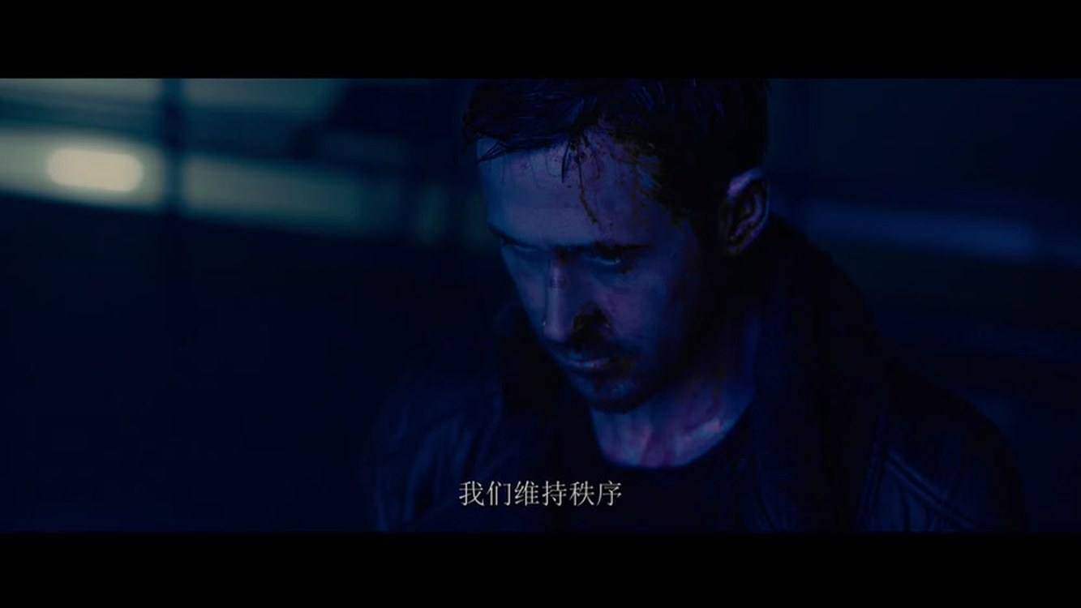
Rain, neon, reflection
The original 1982 film invented this look — 2049 perfects it
# Rain
# Neon
Notes:
Rain, neon, reflection. The original 1982 film invented this look; 2049 perfects it, and makes it feel like a memory.

Slide 10
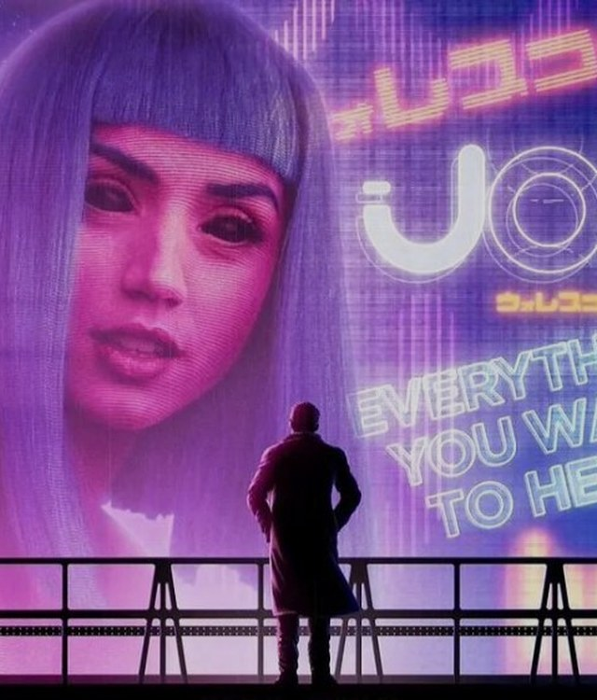
JOI
Love as a hologram
— A product designed to please
— She says what he needs to hear
— When she is deleted, was it real?
— The film lets you decide
# Joi
# Illusion
Notes:
Then there is Joi — a holographic companion, designed to please. She says what K needs to hear. When she is deleted, the film never tells us whether it was real. It lets you decide.

Slide 11
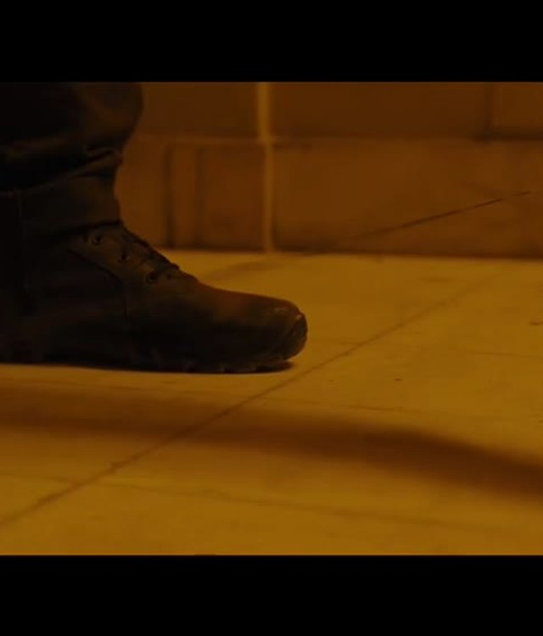
03
What makes
us human
Not birth. Not memory.
The choice to matter
# Choice
# Sacrifice
Notes:
So what makes us human? Not birth, and not memory. The film suggests it is the choice to matter.

Slide 12
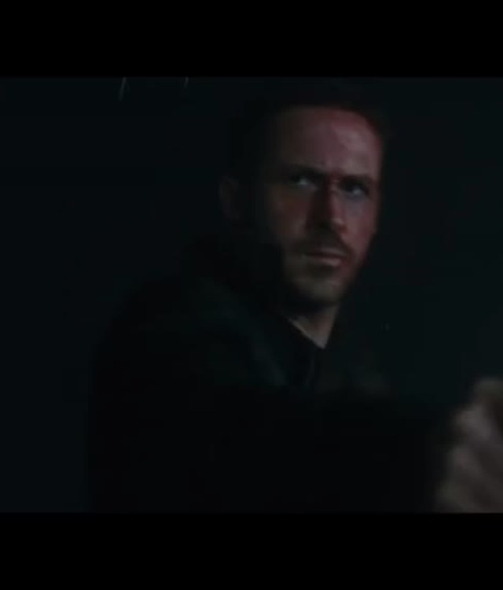
THE CHOICE
Dying for the right cause
— K learns he is not the miracle child
— He is ordinary — and chooses anyway
— He saves Deckard and his daughter
— He dies as a person, not a product
"Dying for the right cause is the most human thing we can do."
# K
# Humanity
Notes:
In the end K learns he is not the miracle child — he is ordinary. And he chooses anyway: he saves Deckard and his daughter, and dies as a person, not a product. 'Dying for the right cause is the most human thing we can do.'

Slide 13
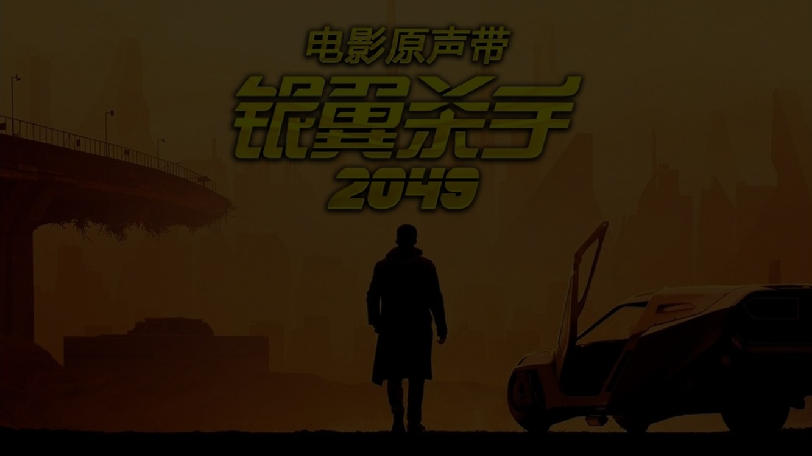
LEGACY
A sequel that became a classic
— 2017 — box office disappointment
— 2018 — two Academy Awards
— Today — a reference point for sci-fi visuals
— Proof that slow, quiet science fiction can still be made
# Legacy
# Cinema
Notes:
At the box office the film disappointed. But it won two Academy Awards, and today it is a reference point for science-fiction visuals — proof that slow, quiet science fiction can still be made.

Slide 14

"All the best memories
are hers."
Thank you
# Memory
# Humanity
Notes:
To close: 'All the best memories are hers.' The film asks whether memory and love can be manufactured — and answers that they don't have to be real to be true. Thank you — I'm happy to take questions.

