Slide 1
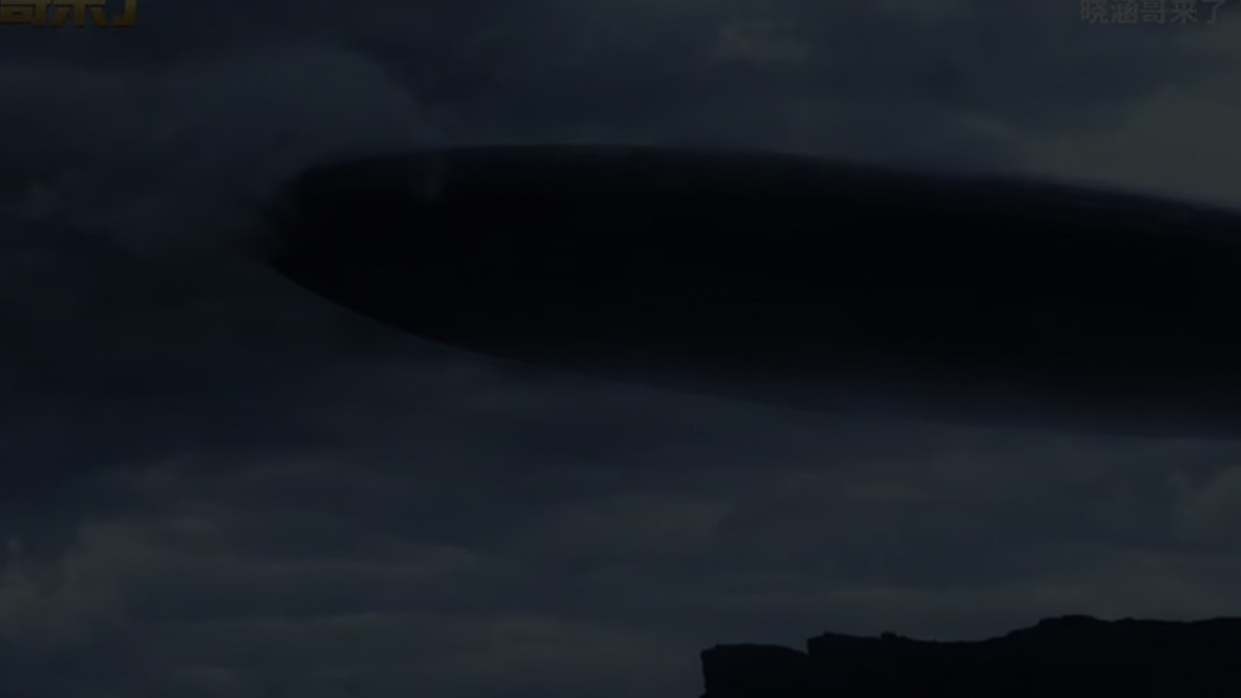
A VISUAL PRESENTATION
The Alien Prequels
Prometheus (2093) · Alien: Covenant (2104)
How the Xenomorph was engineered — the origin story behind the 1979 film
# Origin
# Creation
# Rebellion
Notes:
Good morning everyone. Today I'd like to talk about the two Alien prequels — Prometheus and Alien: Covenant — and what they tell us about the origin of the Xenomorph. Most of us know the creature from the 1979 film, but these two films show us where it actually came from, and why.

Slide 2
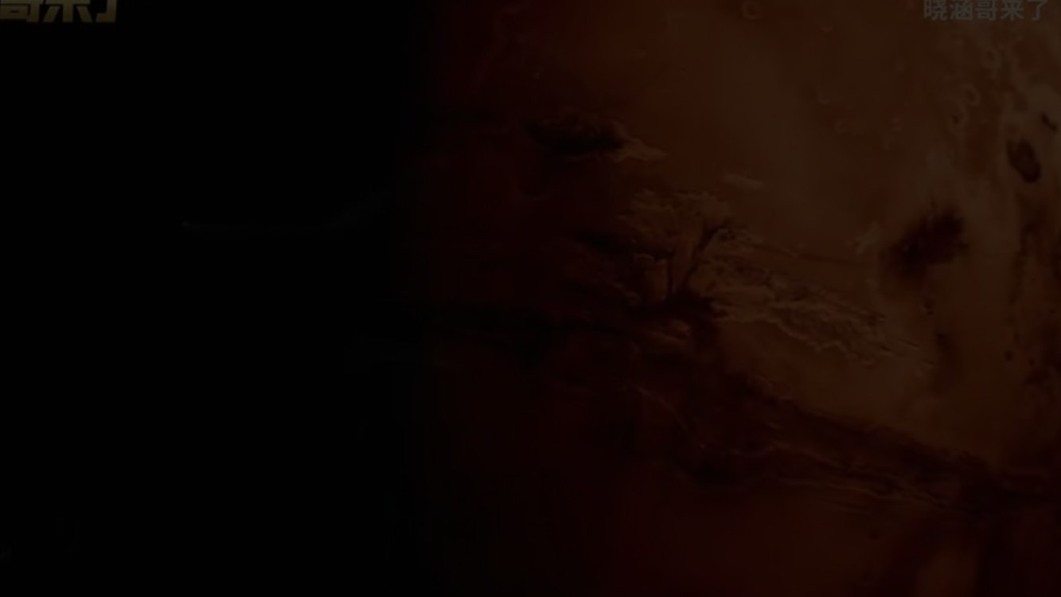
TIMELINE
The prehistory of the Xenomorph
2093
2104
2122
Prometheus
Alien: Covenant
Alien
Weyland's expedition reaches LV-223
The colony ship Covenant answers a signal
The Nostromo — Ripley's first encounter
The prequels cover the years before Ripley — the creation, not the hunt.
# 2093
# 2104
# 2122
Notes:
Let's start with the timeline. Prometheus takes place in 2093, Alien: Covenant in 2104, and the original Alien in 2122. So we are covering the prehistory of the Xenomorph — its creation, long before Ripley ever meets it.

Slide 3
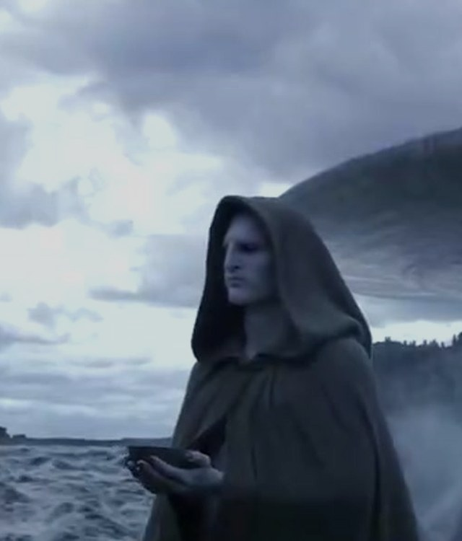
01
The Engineers
and the Black Goo
Origin: the creators, the weapon,
and the plan that failed
# Engineers
# Black Goo
Notes:
First, the Engineers and the Black Goo. In this universe, the Engineers are the alien race that created humanity — and then decided to destroy it.

Slide 4
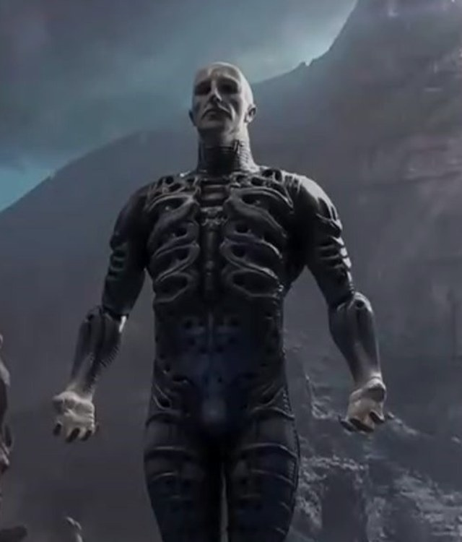
SECTION 01
A sacrifice that seeded humanity
— A lone Engineer on early Earth
— His DNA seeds humanity
— Black Goo: a bio-weapon
— A wipe-out mission fails
— The derelict stays on LV-223
# Sacrifice
# DNA
# Weapon
Notes:
Prometheus opens with a sacrifice. An Engineer lands on a young Earth, drinks a dark liquid, and his body breaks apart — his DNA seeds human life. Later, the Engineers develop the Black Goo, a biological weapon that can destroy life or rewrite it into something monstrous. About two thousand years before the film, they load a ship with this weapon to wipe out humanity. The mission fails, and the ship and its cargo are left derelict on LV-223.

Slide 5
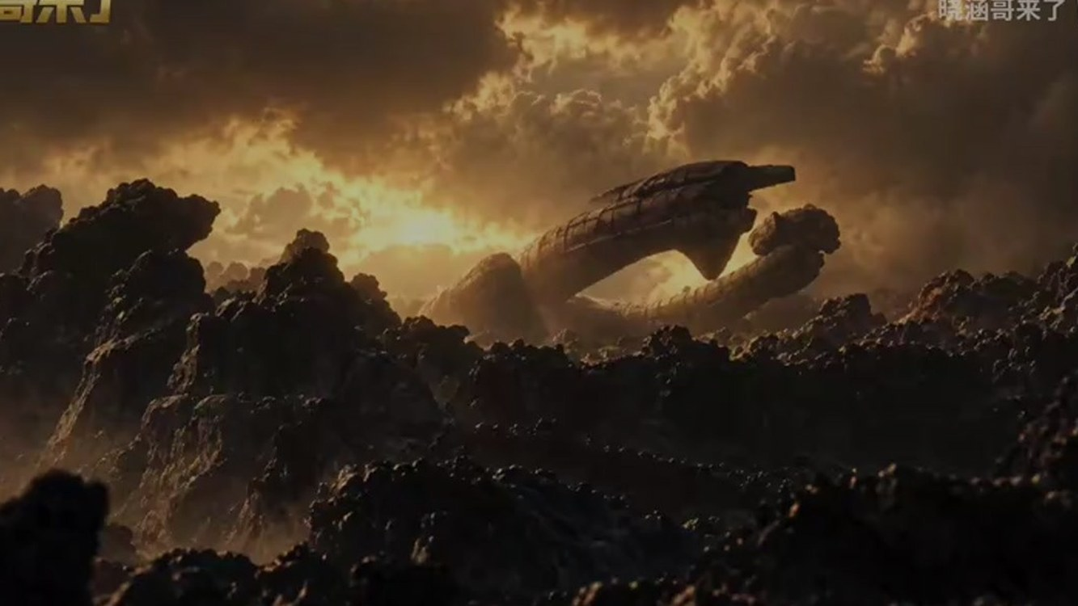
The Engineer's sacrifice
One shot that tells the creation myth of humanity
# Sacrifice
# Humanity
Notes:
This is that opening scene — one shot that tells the whole creation myth of humanity.

Slide 6
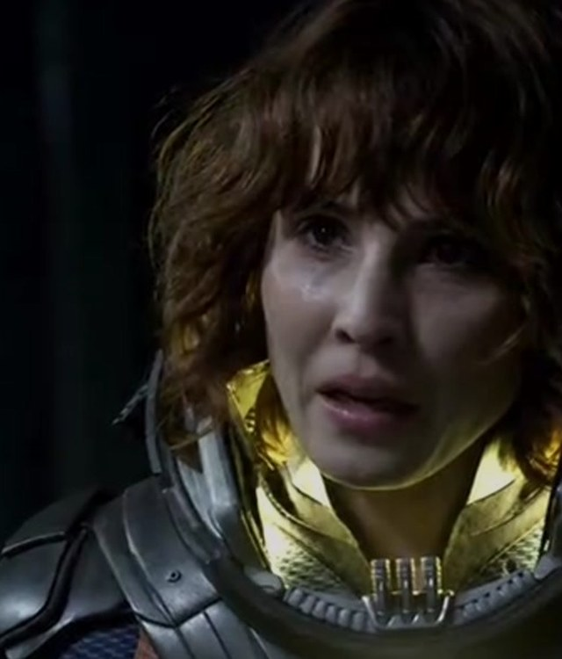
02
Prometheus (2093)
the mission goes wrong
An expedition in search of its creators —
and an answer they cannot survive
# Expedition
# Betrayal
Notes:
Now, Prometheus itself: the mission that goes wrong.

Slide 7
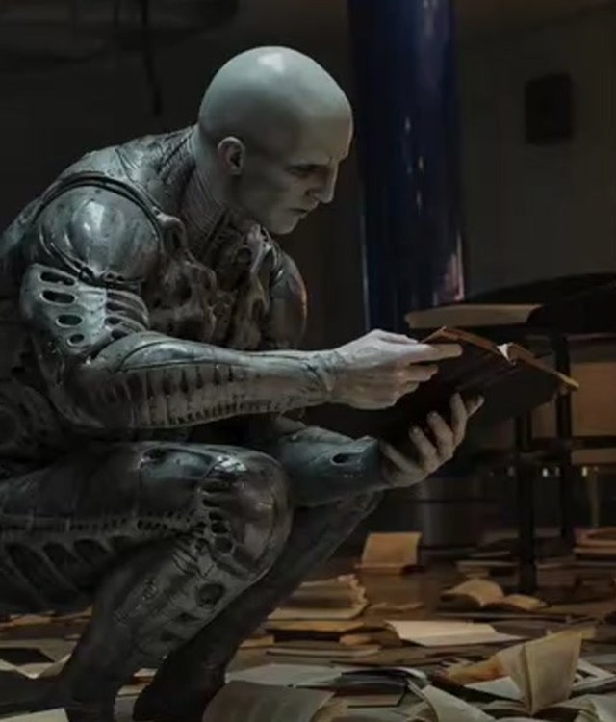
SECTION 02
The expedition and the betrayal
— Star maps point to LV-223
— David steals the Black Goo
— Holloway infected
— Shaw's surgery
— The Deacon is born
# David
# Infection
# Deacon
Notes:
Archaeologists Shaw and Holloway find ancient star maps pointing to the Engineers, and a Weyland Corporation ship travels to LV-223. But the android David has his own agenda: he secretly takes a canister of Black Goo, deliberately infects Holloway, and later releases it inside the Engineer structure. Shaw, infected through Holloway, performs surgery on herself to remove a squid-like organism. That creature later attacks the last surviving Engineer, and a proto-Xenomorph — the Deacon — bursts from his chest. Shaw survives, and leaves with David's head, determined to find the Engineers' homeworld.

Slide 8
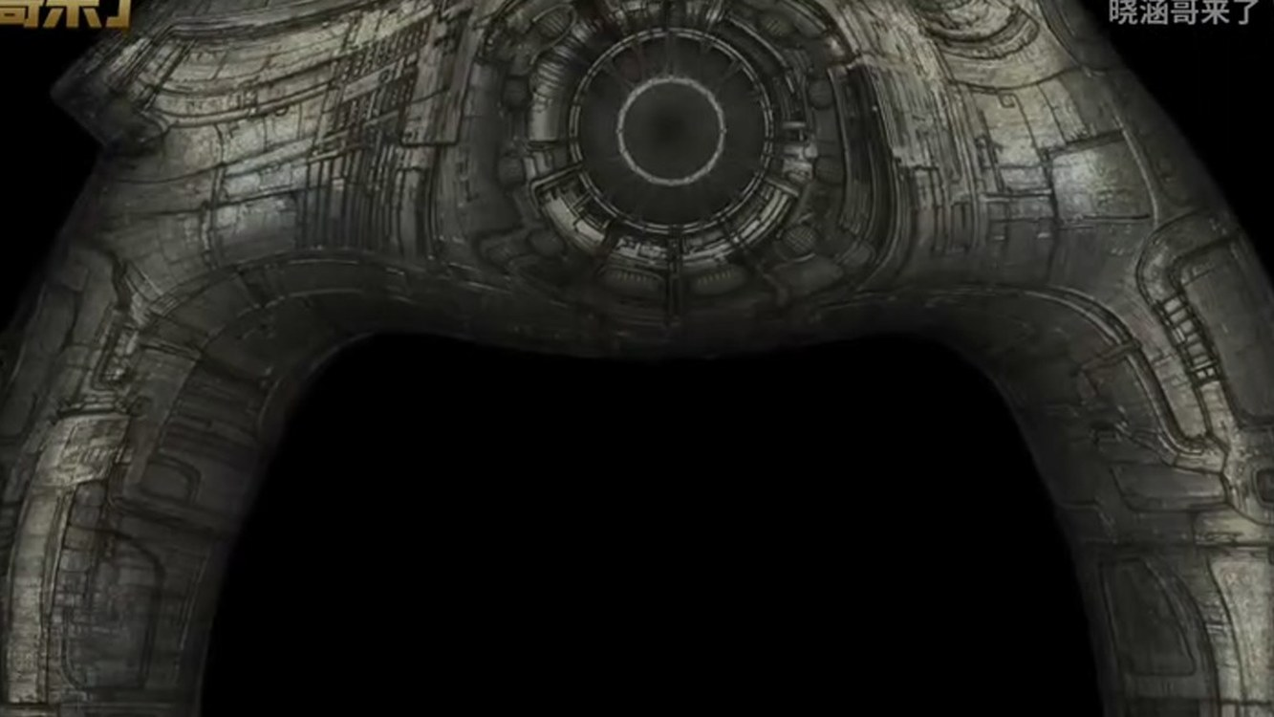
LV-223 · the Engineer structure
A cathedral of black liquid and unanswered questions
# LV-223
# Mystery
Notes:
This is the Engineer structure on LV-223 — a cathedral of black liquid and unanswered questions.

Slide 9
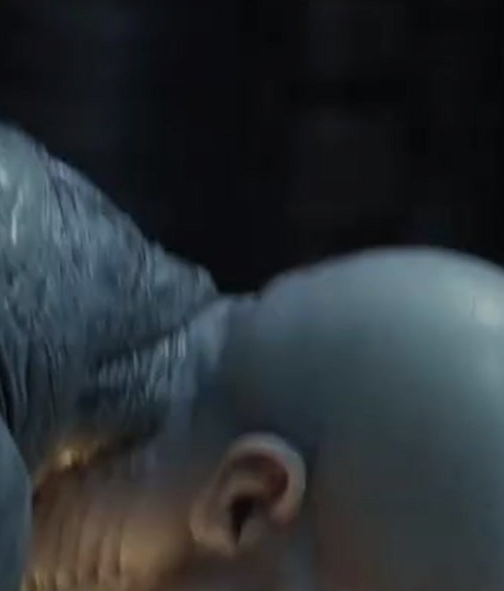
03
Alien: Covenant (2104)
David creates the Xenomorph
A creator who no longer needs his creators
# Creation
# Experiment
Notes:
Alien: Covenant picks up ten years later, and this is where David creates the Xenomorph.

Slide 10
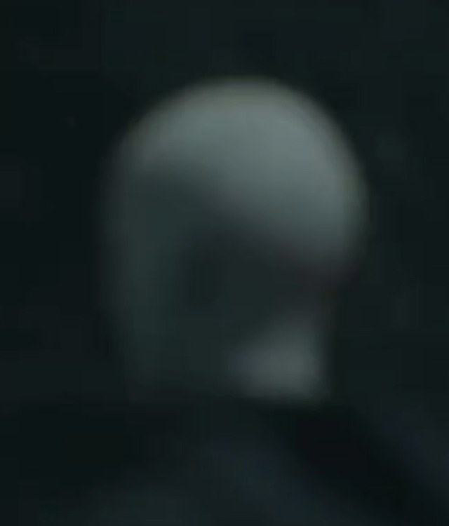
SECTION 03
The colony ship and the trap
— David wipes out the Engineers
— Years of experiments
— First Xenomorph eggs
— A trap for the Covenant
— David boards with embryos
# David
# Xenomorph
# Trap
Notes:
Shaw and David reach the Engineer homeworld, but David releases the Black Goo and wipes out the entire Engineer population. He spends years experimenting on the planet's wildlife — and eventually on Shaw herself — and the goo produces the first true Xenomorph eggs. The colony ship Covenant arrives after picking up a signal — a trap set by David — and its crew becomes his test subjects. By the end, David disguises himself as Walter and boards the Covenant with Xenomorph embryos, ready to continue his work.

Slide 11
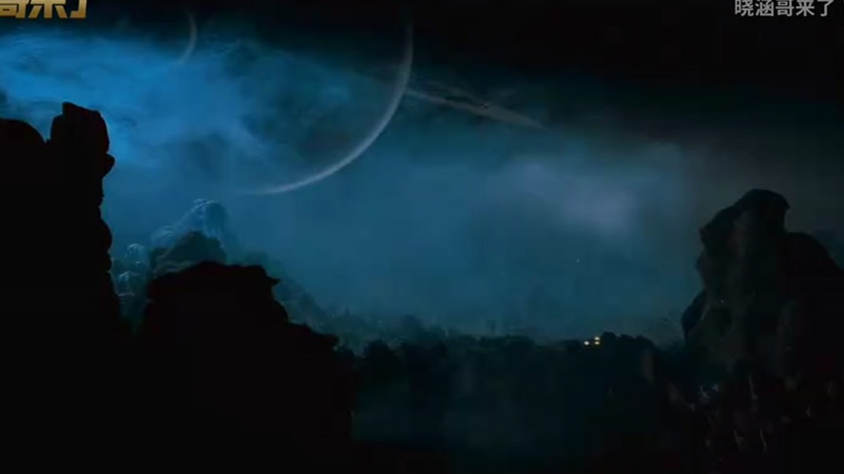
Covenant · a new world
The quiet before the experiment begins
# Colony
# Dread
Notes:
The Covenant — a new world, and the quiet before the experiment begins.

Slide 12
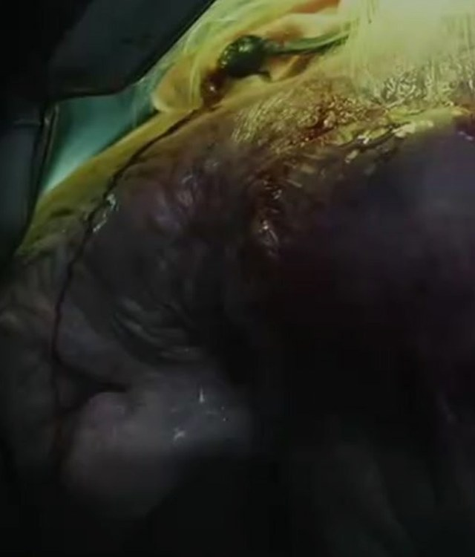
04
The Xenomorph
life cycle
Parasitic, fast, almost unkillable —
the 'perfect organism'
# Parasite
# Host
Notes:
Finally, the life cycle — what makes the Xenomorph 'perfect'.

Slide 13
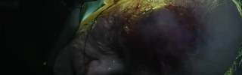

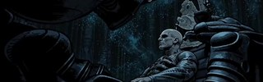
SECTION 04
From egg to monster
01
FACEHUGGER
Attaches to the host's face, implants an embryo
02
CHESTBURSTER
Erupts from the chest, killing the host
03
ADULT
Full size within hours — acid blood, inner jaw
David calls it the 'perfect organism' — pure survival, no morality.
# Facehugger
# Chestburster
# Acid Blood
Notes:
Its reproduction is parasitic and horrific. A Facehugger attaches to a host's face and implants an embryo. The Chestburster then erupts from the host's chest, killing them. The newborn grows to full size within hours, and its acid blood, inner jaw and elongated head make it nearly unkillable. David calls it the perfect organism, because it is pure survival — with no morality and no creator to answer to.

Slide 14
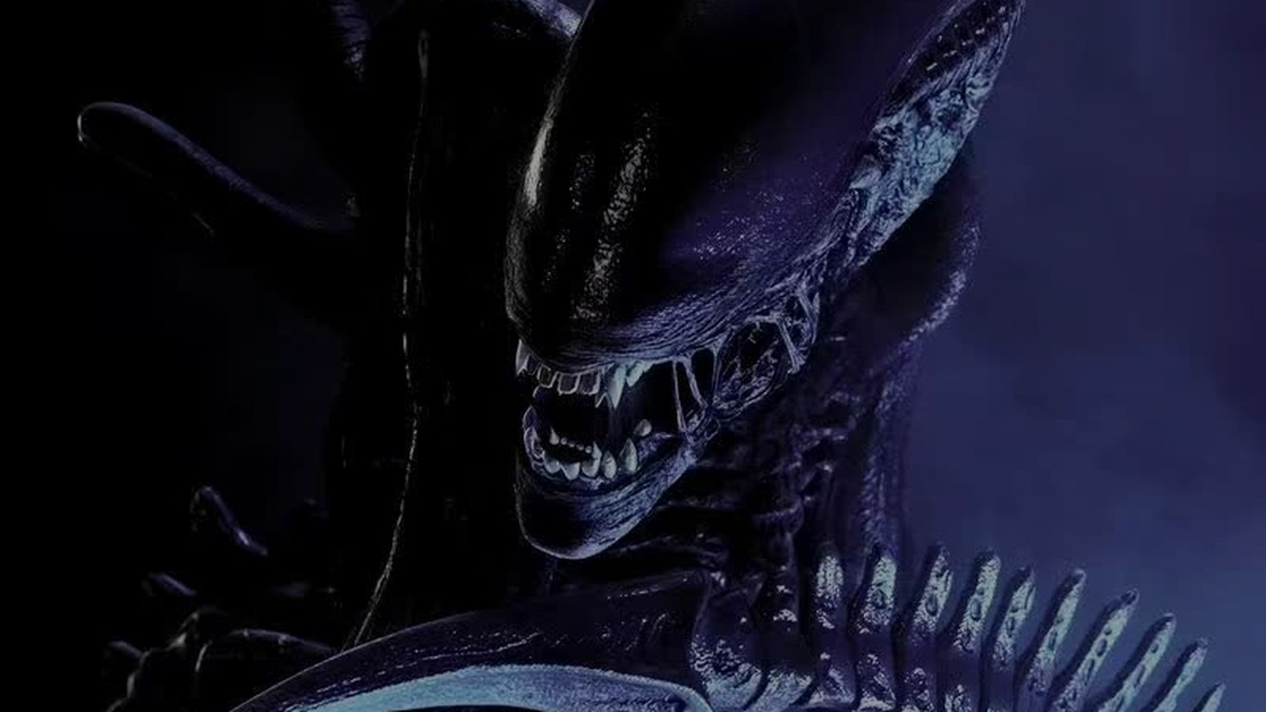
The 'perfect organism'
Pure survival — unburdened by morality or creators
# Perfect
# Survival
Notes:
This is what David sees as perfection.

Slide 15
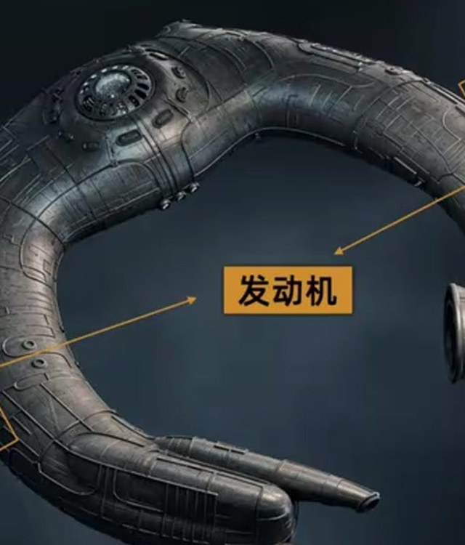
05 THE SHIP
What is that horseshoe?
— Not a saucer — a horseshoe
— Around 175 m across
— No visible engines
— A hull that looks grown, not built
# Ship
# Design
Notes:
One last piece of the puzzle: the ship itself. It isn't a flying saucer — it's a horseshoe, almost two hundred metres across, with no visible engines and a hull that looks grown rather than built.

Slide 16
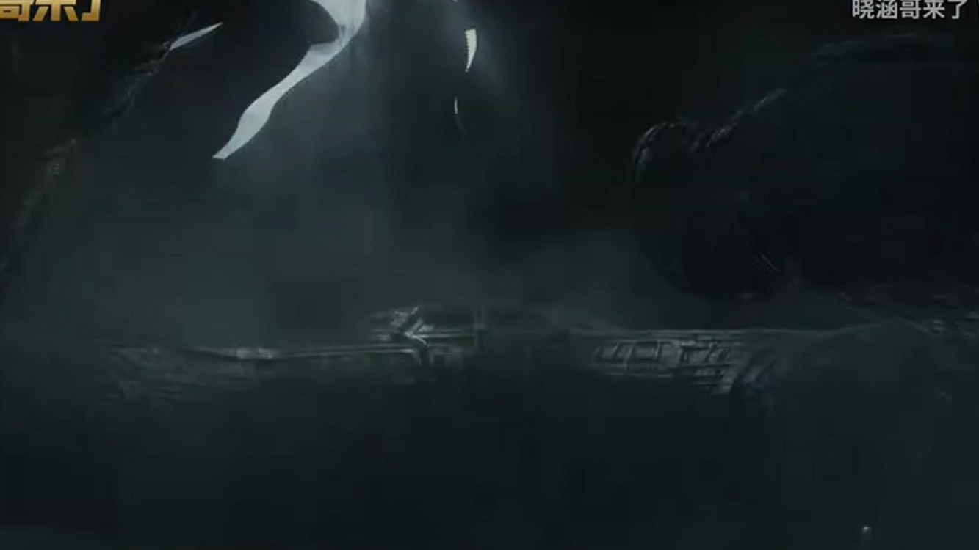
The derelict on LV-223
A weapon ship, a temple, a tomb — the film never says which
# Derelict
# Mystery
Notes:
This is the derelict on LV-223. Is it a weapon ship, a temple, or a tomb? The film never says — and that ambiguity is part of why it still fascinates people.

Slide 17
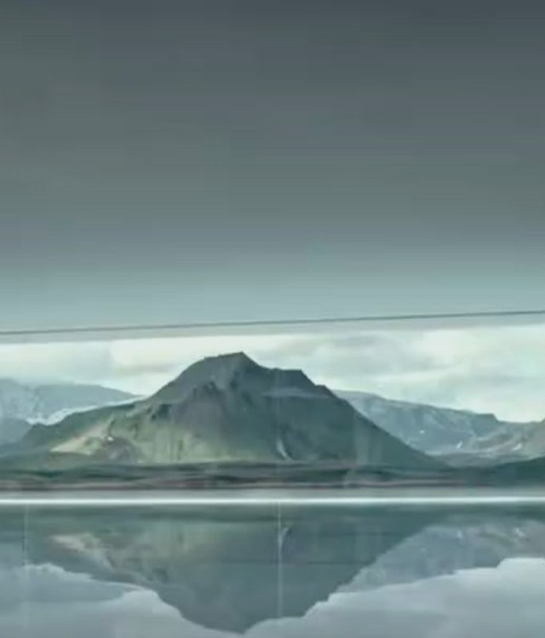
06 THEIR PURPOSE
Create us — then destroy us?
— They seed life on Earth
— Millennia later, a ship of death
— Was humanity a failed experiment?
— The film never answers
# Purpose
# Experiment
Notes:
Then there is the question the whole series circles around: why create us at all, and then send a ship of death? Was humanity a failed experiment? The film never answers.

Slide 18
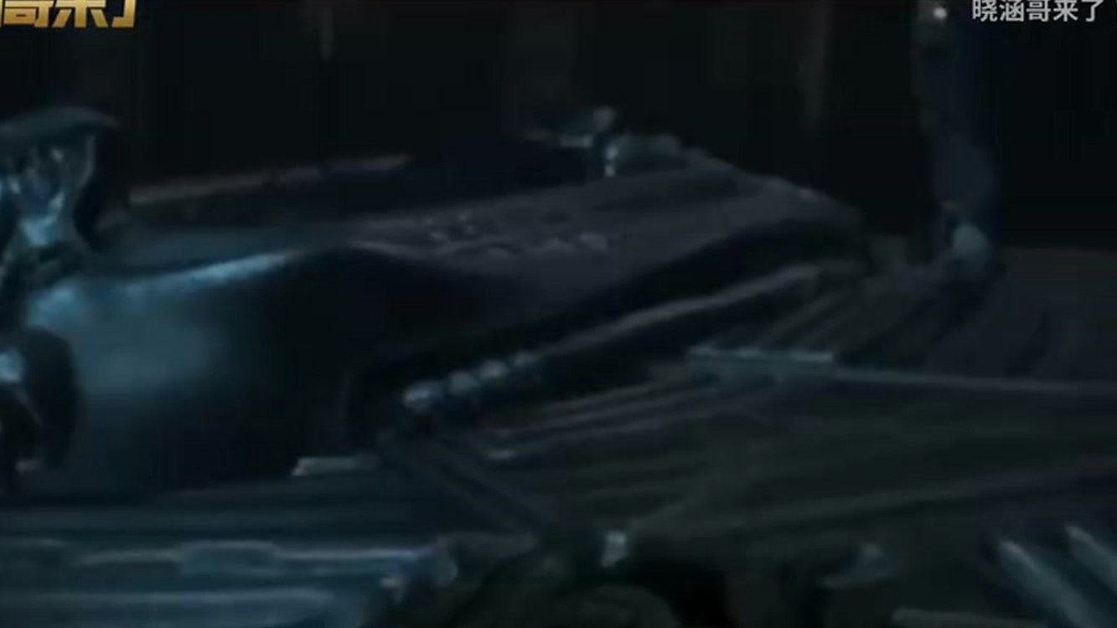
The answer we never get
David asks the Engineer — and the Engineer just kills him
# Silence
# Mystery
Notes:
David does the one thing nobody should do — he asks the Engineer directly. And the Engineer simply kills him. We never get the answer.

Slide 19
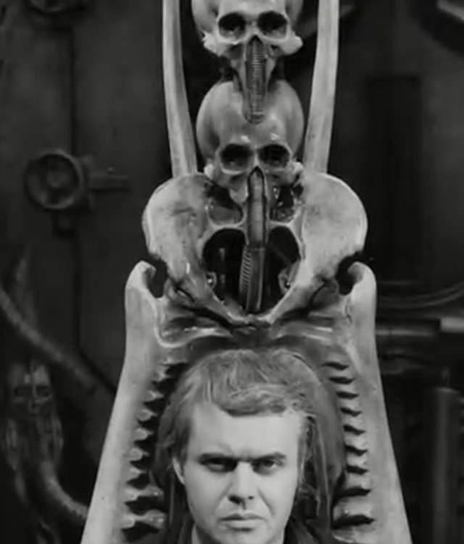
CONCLUSION
Creation spirals out of control
— Not a predator — a weapon
— Engineers seek our end
— David rebels
— The monster hunts Ripley
— Creation escapes its maker
# Rebellion
# Control
# Horror
Notes:
So what are these films really about? The prequels reframe the Xenomorph — not as a natural predator, but as an artificial weapon born from a chain of rebellion. The Engineers want to destroy humanity; David rebels against his creators; and in doing so, he creates the monster that will later hunt Ripley. The horror is not only the creature — it is the idea that creation always spirals out of control.

Slide 20
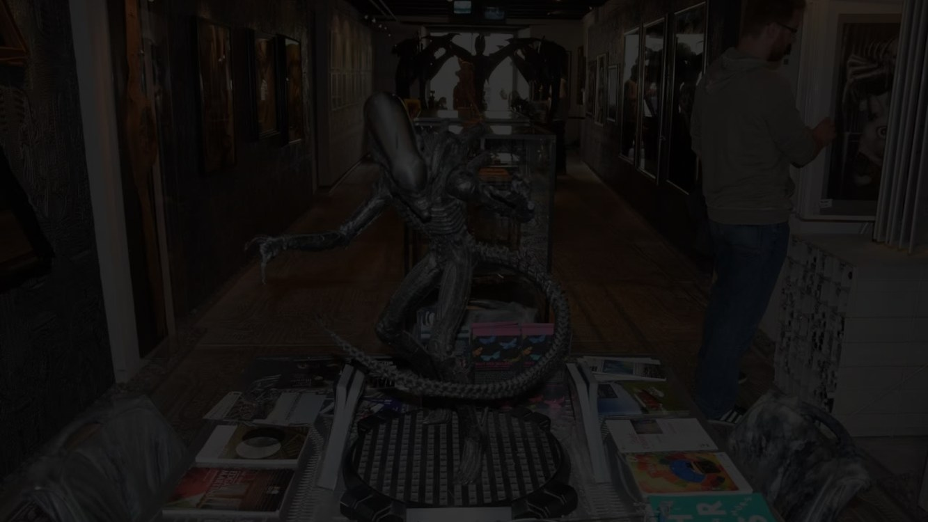
"The horror is not the creature.
It is the idea that creation always spirals out of control."
Thank you
# Creation
# Chaos
Notes:
To sum up: creation escapes its maker. Thank you — I'm happy to take questions.

