Slide 1
A case study for US Census Bureau: Predict person’s income is more or less than 50000 dollar
Xi Chen

Slide 2
Overview
Background
Usage of model considerations
Data overview
Exploratory data analysis (EDA) & Insights
Modeling & Performance
Conclusion
Next step
Backup slides

Slide 3
Background
What is US Census Bureau
A government agency responsible for collecting and analyzing demographic and economic data
Conduct a nationwide census every 10 years to guide policy and funding decision
Why Census Data important
Helps allocate billions of dollar for public services
Provide valuable demographic insights for economic and social planning
Objective
Analyze US Census data to identify factors influencing income levels
Develop a data analysis and modeling pipeline to predict whether an individual earns more or less than $50000 per year

Slide 4
Usage of model considerations
It is important to understand the usage of the model, considering it has a big impact on the analysis:
Impact on predicting target:
There might be better target to predict other than 50k depends on the usage. For example, to predict income bucket, or directly predict whether to give out benefit(Social benefit) or not instead of purly based on income is larger than 50k or not.
Impact on the evaluation approach:
We might use different way to evaluate the model depends on the objective. i.e, for tax fraud might focusing on the >50k.
To help to understand how good the model’s performance need to reach.
Impact on the Data:
There might be more features can be gathered for specific target.
Data regulation.
Model bias based on race/gender.
The potential data sampling approach, data drifting issue

Slide 5
Data overview
Data size: Total data size is 299285 records. 199534 ( 66.66% ) for training and 99762 ( 33.34 % ) for testing.
Data collected year : 94 and 95
Feature size: In metadata file, there are 45 different features in total, but in dataset only contains 42 features.
Main feature groups:
Demographics: Age, Gender, Race, Citizenship
Employment: Occupation, Industry, Work Class, Hours Worked
Financial: Capital Gains/Losses, Dividends, Tax Status
Education & Family: Education Level, Marital Status, Household Composition
Geography & Migration: State, Region, Migration Patterns
PS: There is no column name in the data, I matched it based on the feature order and the value report from metadata file.

Slide 6
Exploratory data analysis (EDA)
There are two groups of features: 8 Numeric features & 33 Categorical features.
We’re mainly into the value distribution, frequency distribution to identify missing value, outliers, potential opportunity to extract more features for modeling purpose

Slide 7
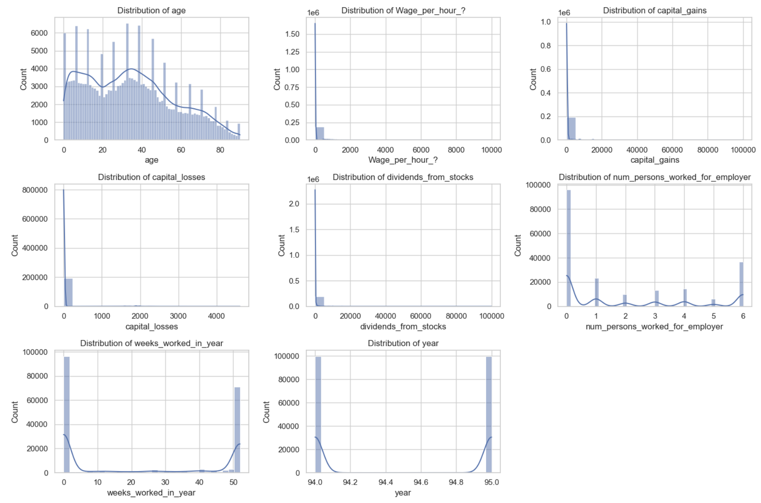
EDA – Numeric feature
Feature | Findings
Age | There is a spike in each age group indictes there might have certain data sampling pattern.
Wage per hour Capital gains Capital losses Dividens | Majority are empty. Zoom in distribution(Remove 0) will show in next slide

Slide 8
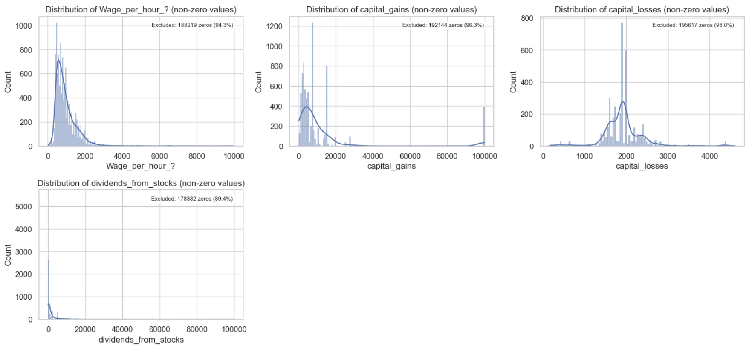
EDA – Numeric feature
Feature | Findings
Wage per hour | This feature might be weeky income instead of hourly imcome. As the average is 800 dollar per hour, which is too high for hourly wage
Capital gains | There is a peak in 100000, there might be a cap on the declaration?
Capital losses | Compared with capital gain, the number of the capital losses is surprisingly small. I would expect the capital losses is also

Slide 9
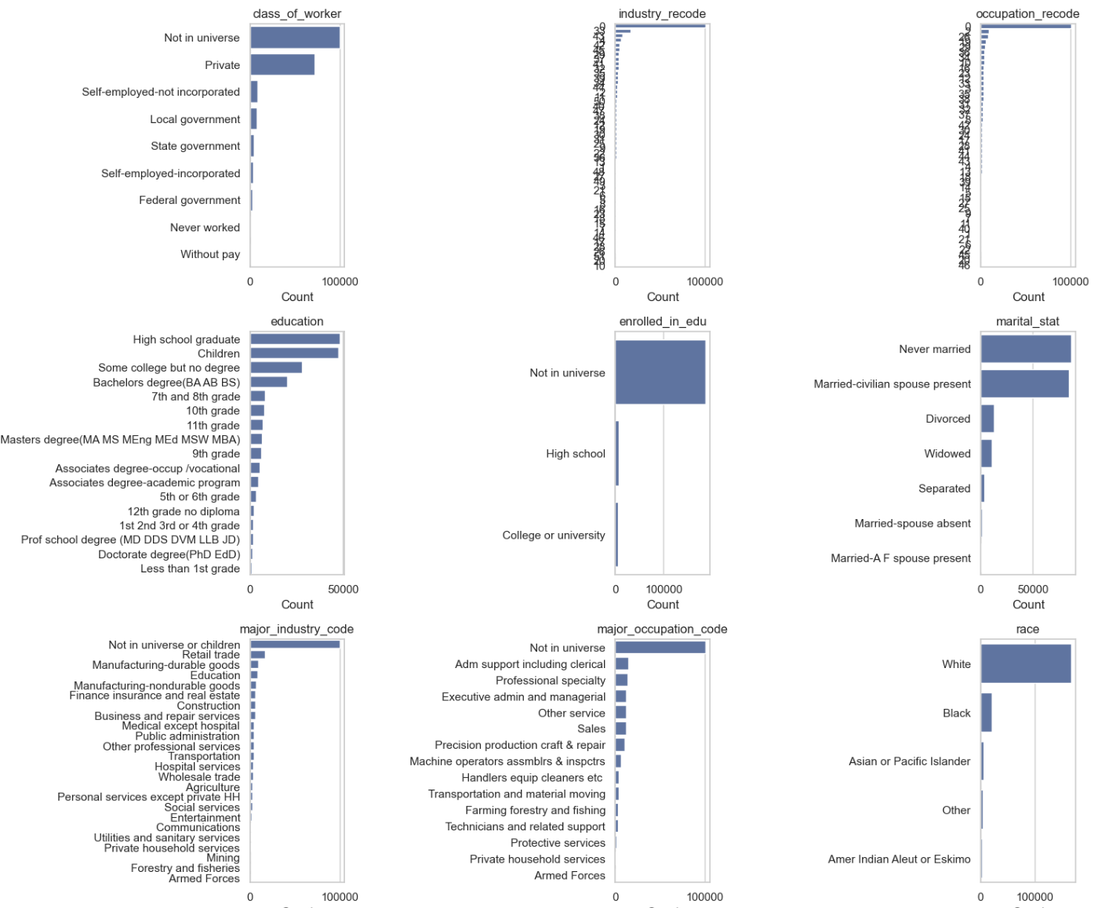
EDA – Numeric feature
Feature | Findings
Class of worker Industry recode Occupation recode Major industry code | Class 0 might indicates students / children. The class of worker have a lot of private might need pay a bit attention. Might be caused by the sampling approach
Race | Majority are white, need to pay attention when it comes to race / gender bias if there is any ethical concerns might be raised by public

Slide 10
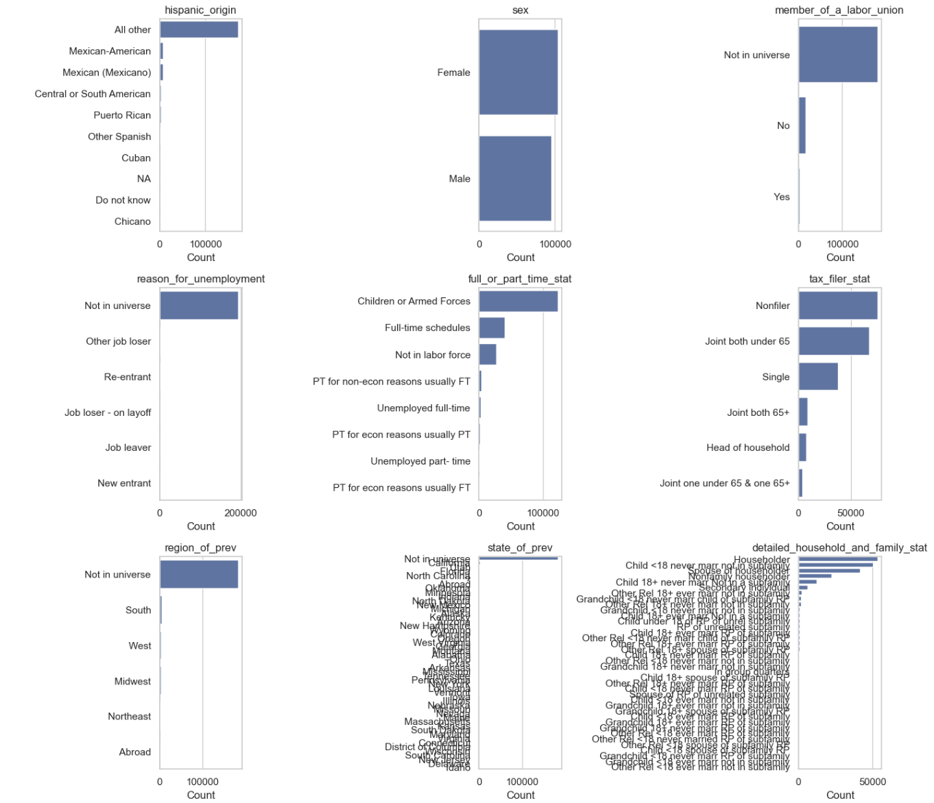
EDA – Categorical feature
Feature | Findings
State_of_prev | Majority are the locals(who didn’t move)
Household and family stat | This category might be able to break down to multiple categories

Slide 11
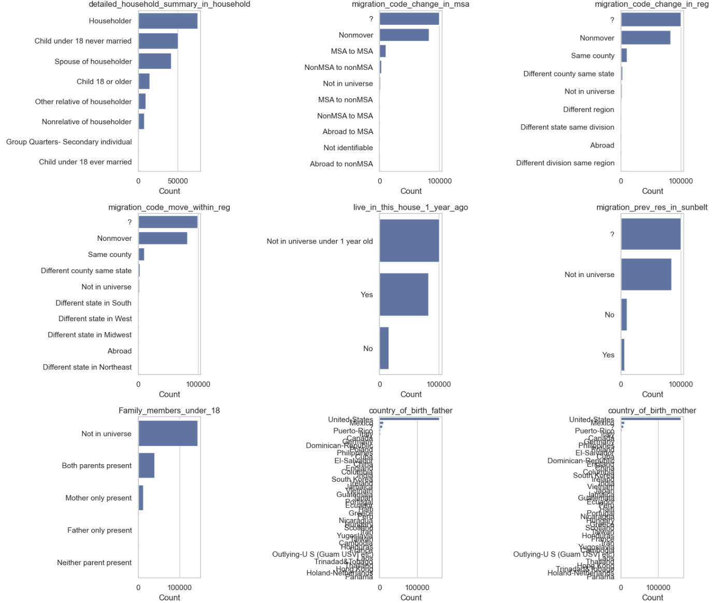
EDA – Categorical feature
Feature | Findings
Migration code change | What’s the difference between “?” And Not in universe?
Country of birth father/mother/self | Majority are native Americans

Slide 12
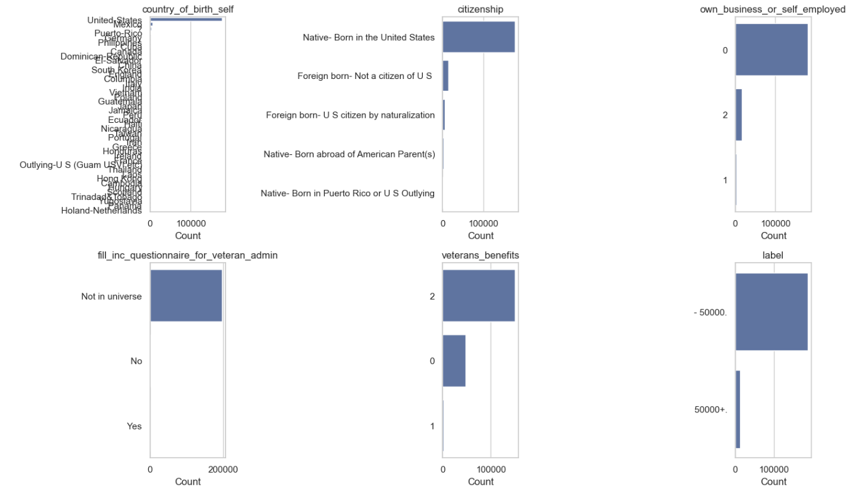
EDA – Categorical feature
Feature | Findings
Label | The distribution of income is highly imbalanced

Slide 13
EDA – Insights
Data correctness:
1. No empty filed and obvious outlier
2. Potential conflicted records: ( I,e age vs education: below 18 with PhD, age vs marital status: below 18 and “Widowed”, Occupation vs. Industry: Teacher in construction industry. To be consolidated with business. )
Data Sampling:
1. There are spike in ages distribution. Need to find out why.
2. There are lots of people under 18. For predicting purpose, would be better to have more people above 18 if the predicting target is income > 50k or not.
Data preparation for modeling:
1. Numeric feature: Some of the features distribution are skewed
2. Geo related feature: We can extract geo / embedding for data modeling
3. Feature engineering:
• Expand the feature to multiple features such as household info
• Statistics for the numeric value
4. Tackle imbalanced dataset

Slide 14
Modeling – results
Two different models (XGBoost) with accuracy of: 90.86% and 95.72%
Predicted label
Predicted label
< 50k
> 50k
< 50k
> 50k
< 50k
85686 (91.6%) | 7890 (8.4%)
1226 (19.8%) | 4960 (80.2%)
99.0 (99%) | 907 (1.0%)
3366 (54.4%) | 2860 (45.6%)
True label
> 50k
Model A: Accuray 90.86%
Model B: Accuray 95.72%
Even the model B has overall higher accuracy. But depends on the objective Model A might be a better choice. i.e Identify someone is under-declare income for tax benefit.

Slide 15
Conclusion
The model can predict the income threshold of 50k with 95.72% accuracy
Impact & benefit ( Depends on the use case )
Limitaions: The data sample is bit too old, and highly imbalanced data is challenging for modeling
Domain knowledge: Some of the features, value and objective will need business to clarify

Slide 16
Next step
Business:
• Objective: Explore the other possible objectives for modeling target
• Data sampling: Evaluate if the sampling approach is representative or not
• Attributes: Identify if there is more attributes can be gathered
• Conflicting record’s value: Verify the rules and consolidate it for data cleansing
Technical:
• Feature engineering: Review it together with business
• Model enhancement: Tryout deep learning models (i.e deep learning model).
• Explore ensemble methods

Slide 17
Backup slides

Slide 18
Modeling – setup ( Backup)
Data prepartion:
Encoding
Standarlization
Feature engineering
Hyperparameter tuning: Cross-validation
Model:
LR
XGBOOST
Deep learning

Slide 19
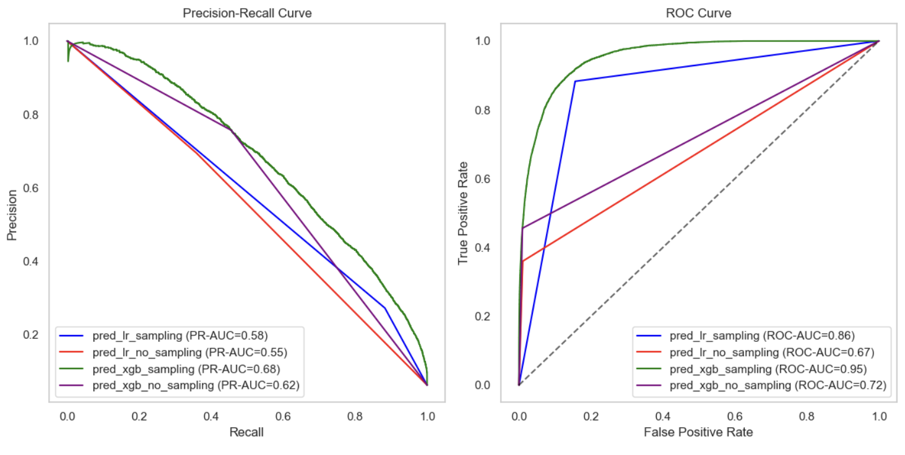
Backup

Slide 20
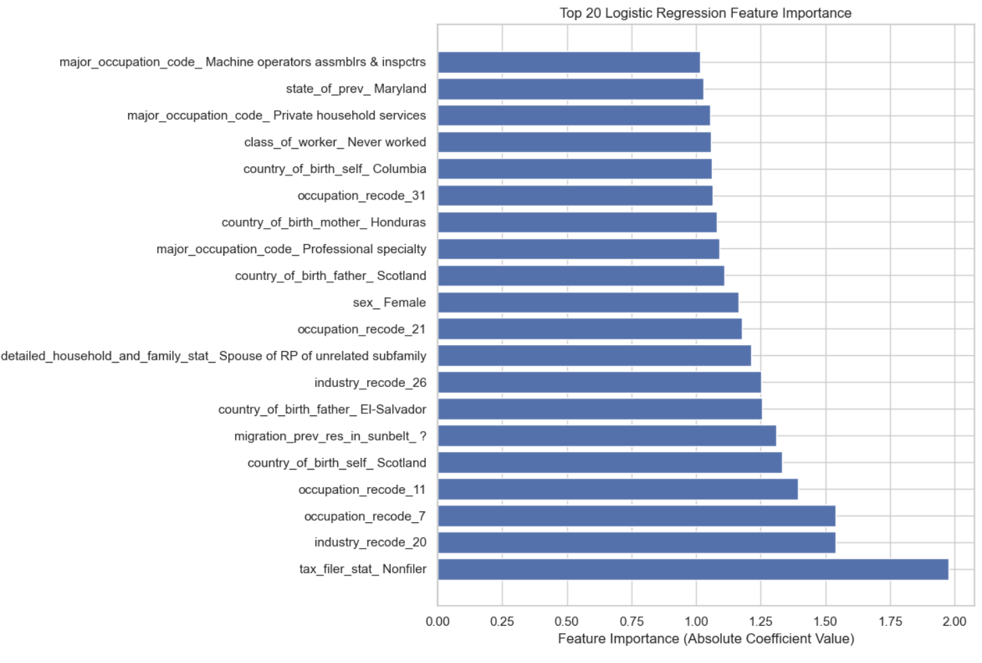
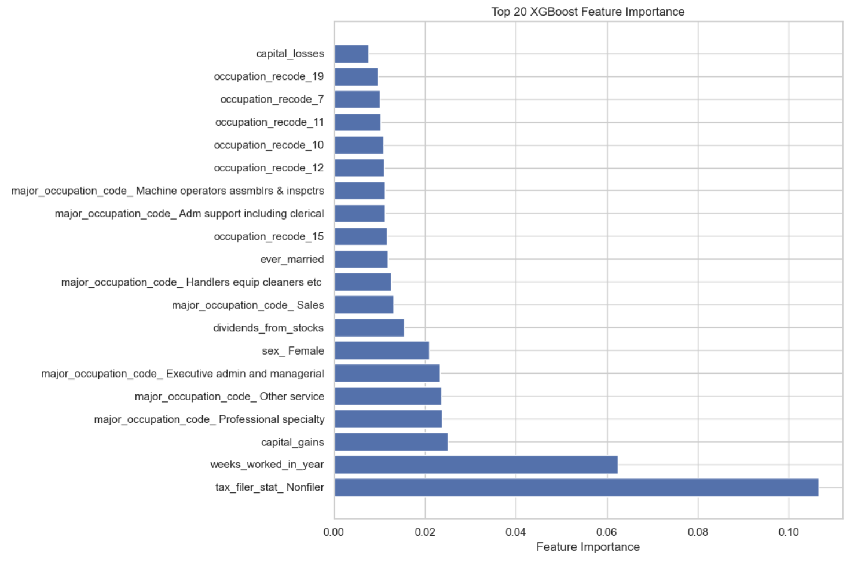
Backup

