Slide 1
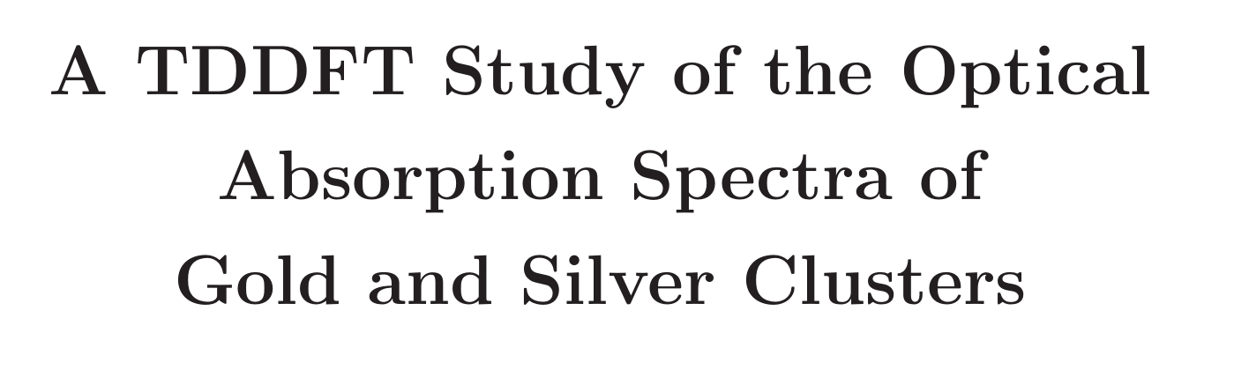

PseudopotentialSet = hscv_pbe XCFunctional = lb94_xc_cmplx FilterPotentials = filter_none
Smearing = 0.1*eV SmearingFunction = fermi_dirac RestartFixedOccupations = yes
Spacing = 0.4 # Bohr
nk = 20 * 20 * 20
TDTimeStep = 0.01 TDPropagationTime = 500 TDPropagator = aetrs TDExponentialMethod = lanczos TDExpOrder = 16
LB94 long-range exchange-correlation

Slide 2
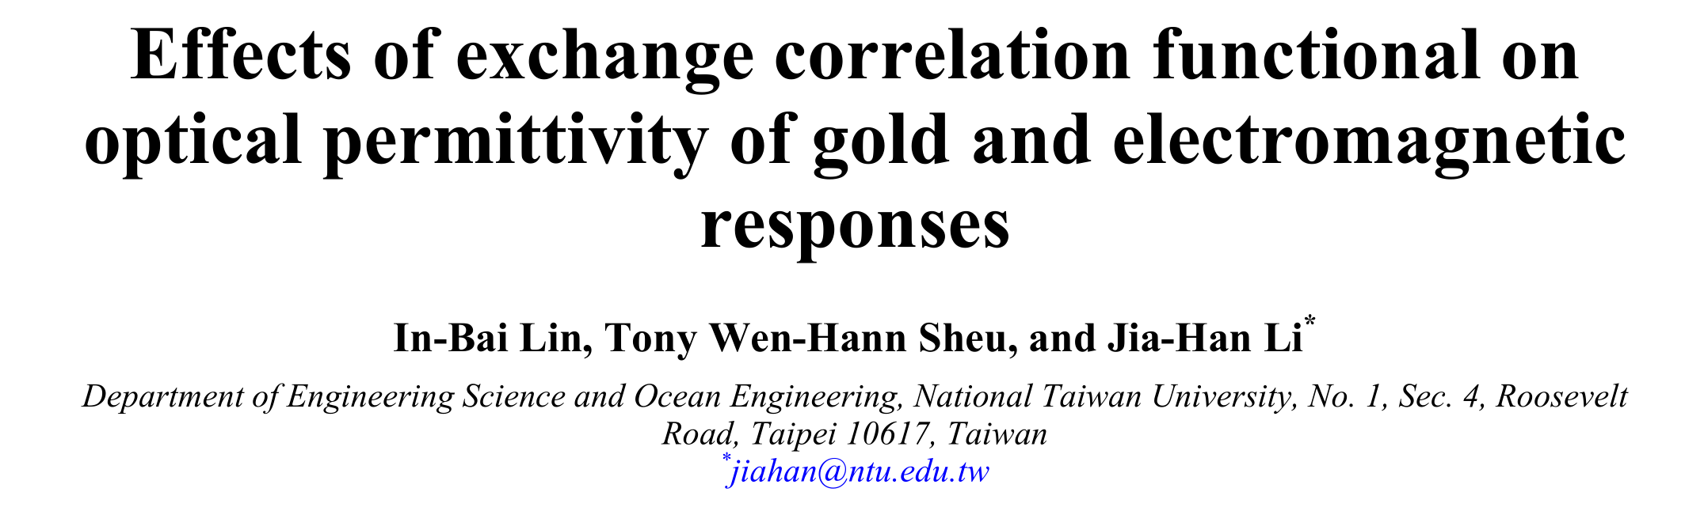
Spacing 0.02nm ~ 0.38 Bohr
K 40*40*40(bulk) 40*40*1 (film)
XCfunctional: GLLBSC
orbital-dependent functional
Random phase approximation (RPA) framework

Slide 3
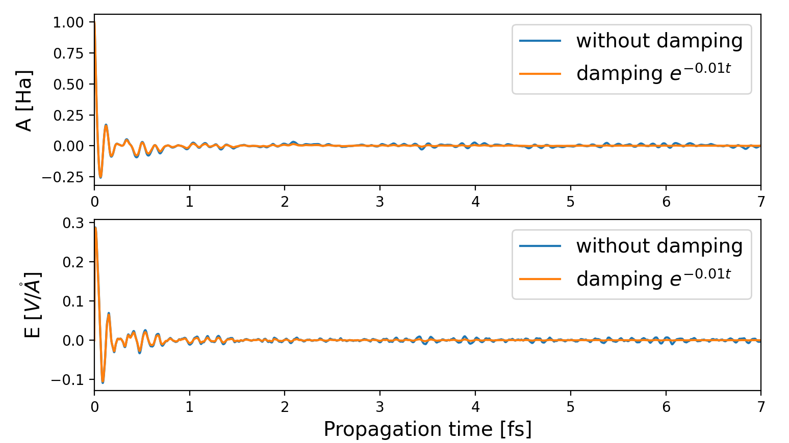

Slide 4
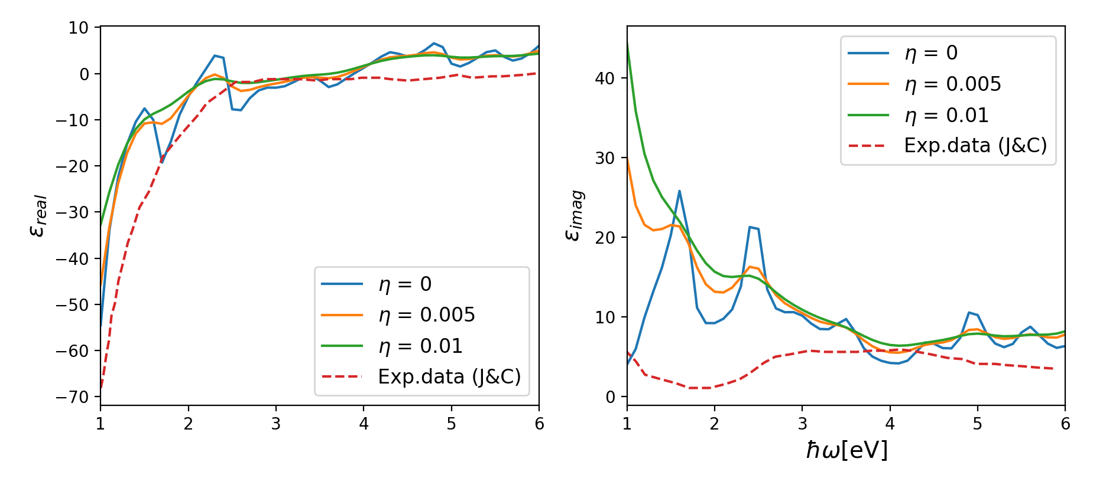
[1] Effects of exchange correlation functional on optical permittivity of gold and electromagnetic responses
In-Bai Lin, Tony Wen-Hann Sheu, and Jia-Han Li. Optics Express (2014)

Slide 5
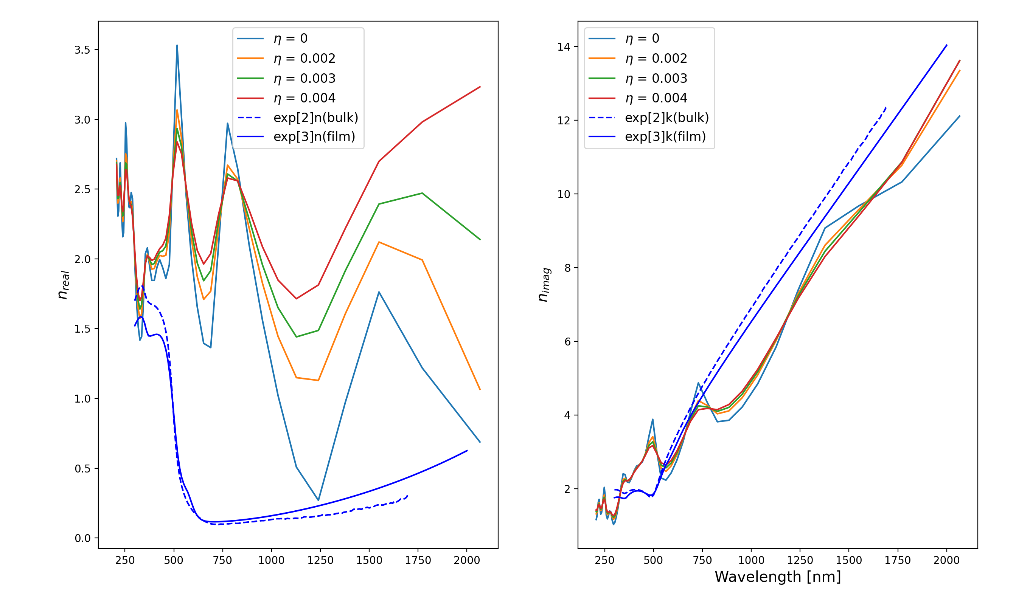
[2] https://refractiveindex.info/?shelf=main&book=Au&page=McPeak
[3] https://refractiveindex.info/?shelf=main&book=Au&page=Rosenblatt-21nm

Slide 6
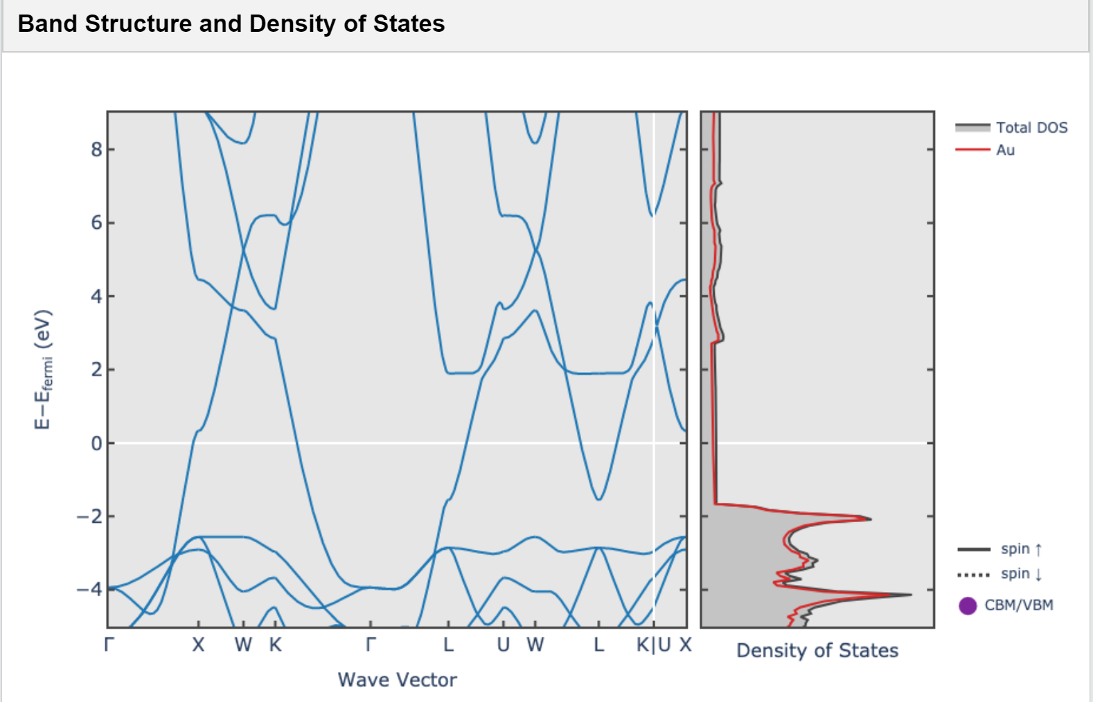
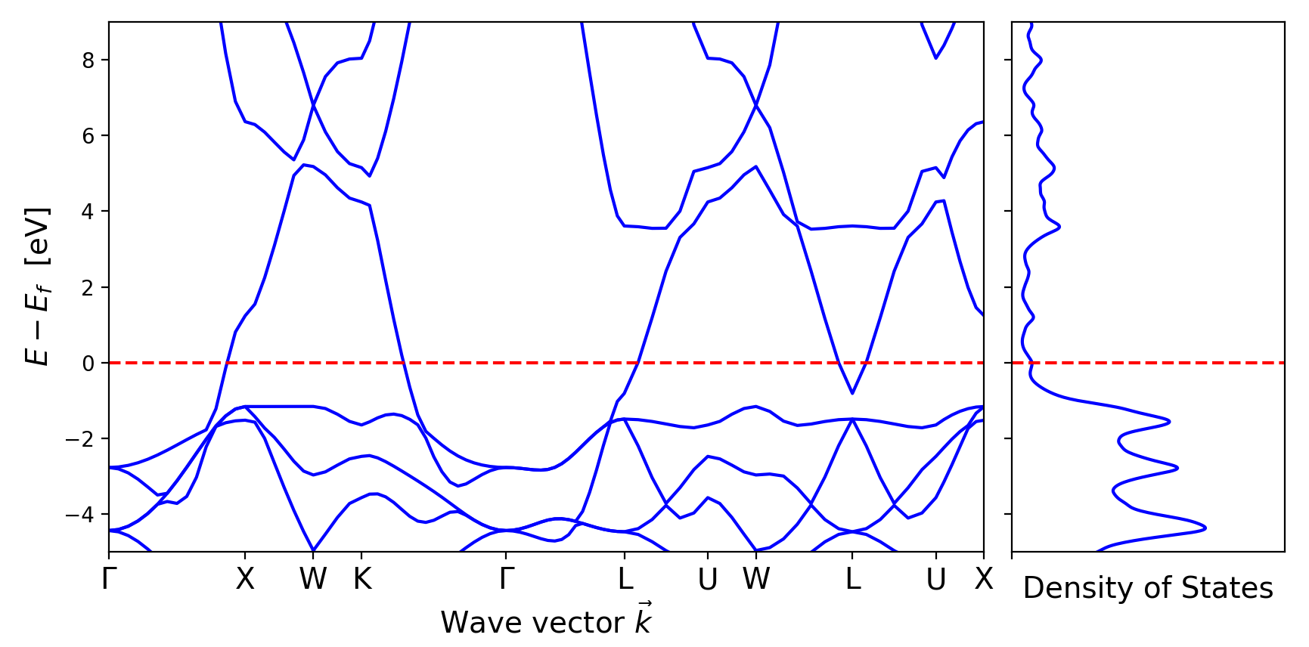
vasp
pseudodojo_pbesol

Slide 7
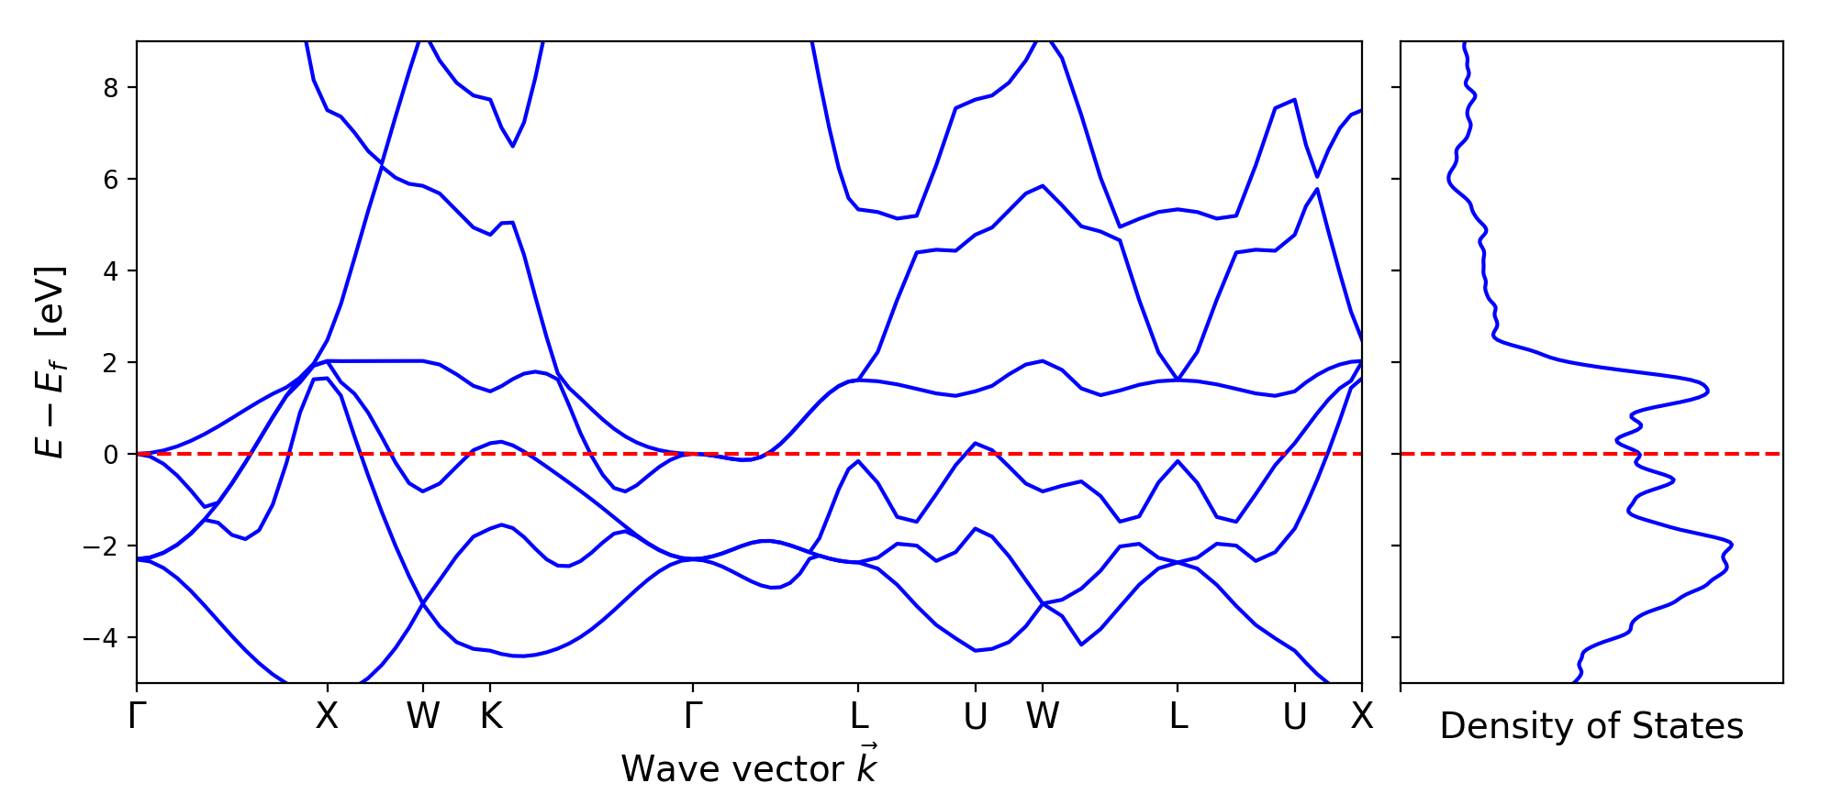
PseudopotentialSet = hscv_pbe XCFunctional = lb94_xc_cmplx

