Slide 1
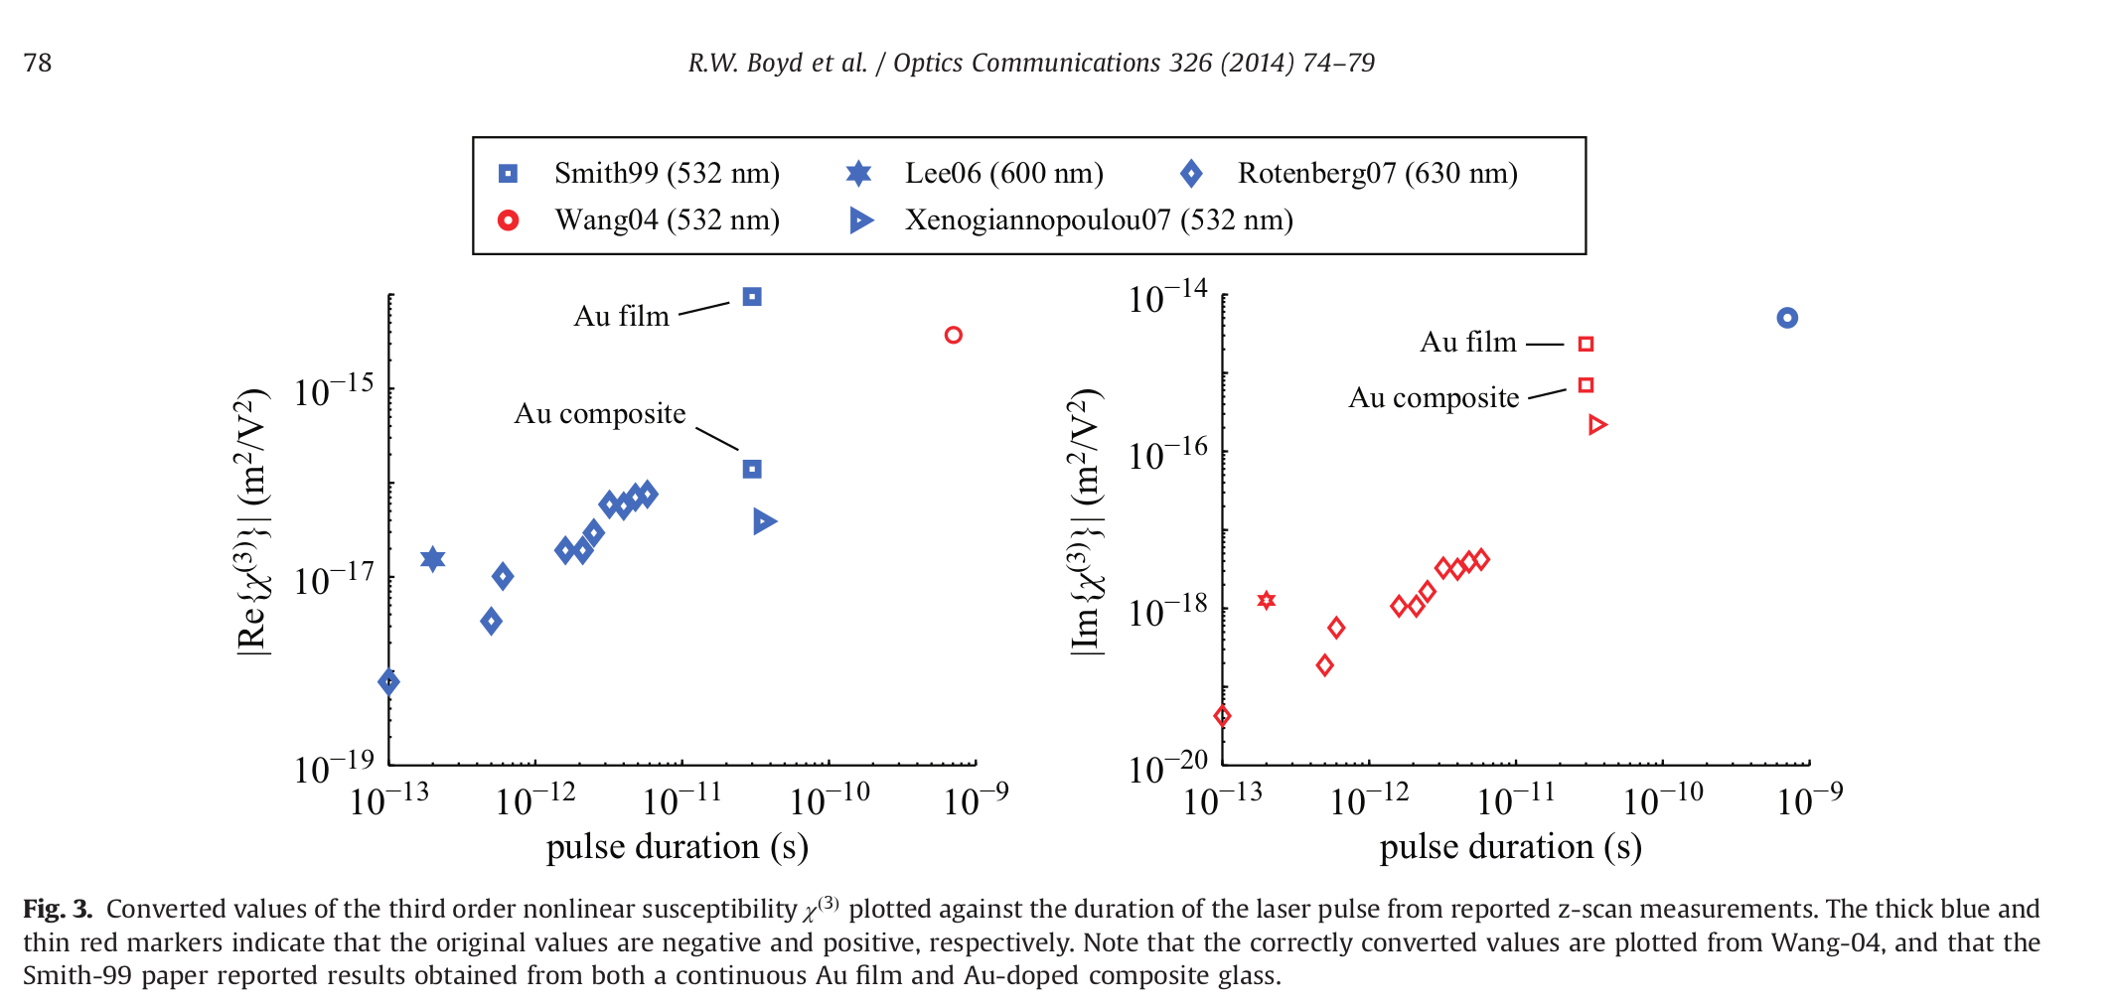
Motivation: chi3 should change with pulse durations
[1] Robert W. Boyd, Zhimin Shi, and Israel De Leon. The third-order non-linear optical susceptibility of gold. Optics Communications, 326:74–79, 2014.

Slide 2
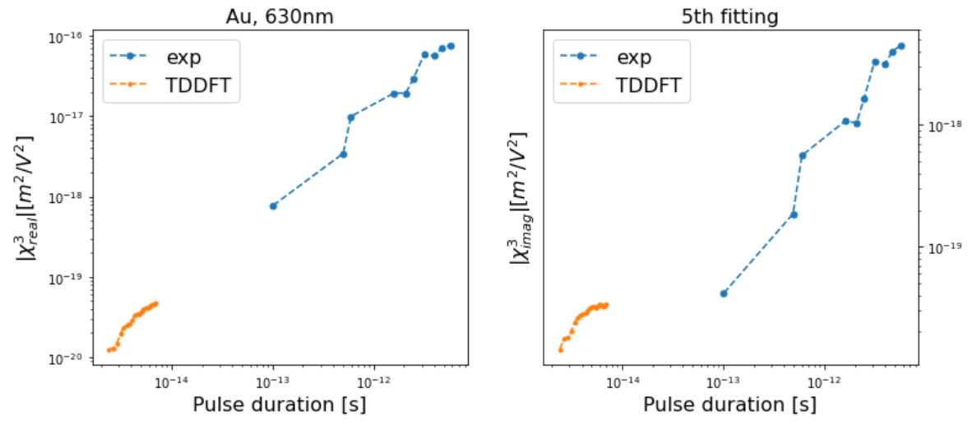
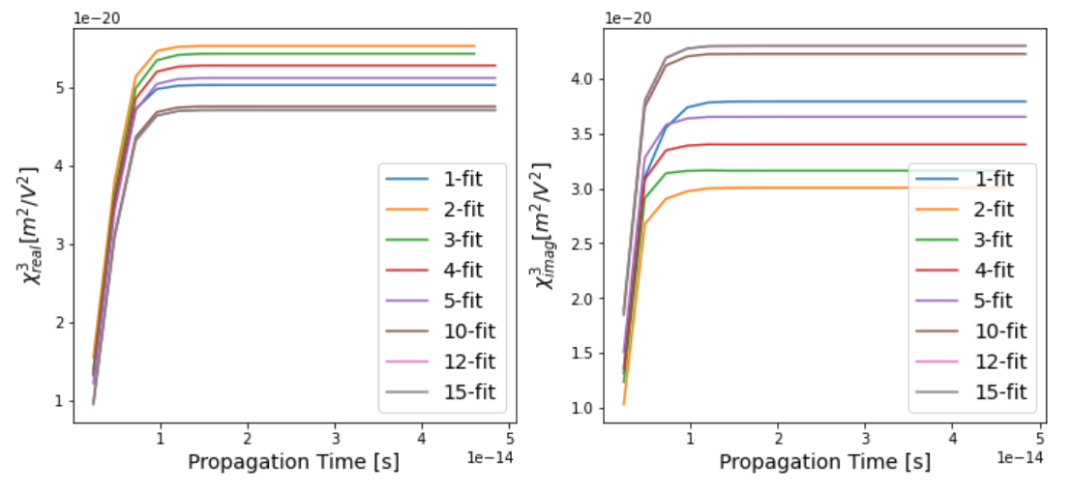
Former gold simulation
[1] Robert W. Boyd, Zhimin Shi, and Israel De Leon. The third-order non-linear optical susceptibility of gold. Optics Communications, 326:74–79, 2014.

Slide 3
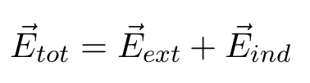
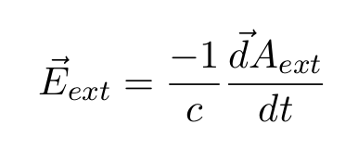
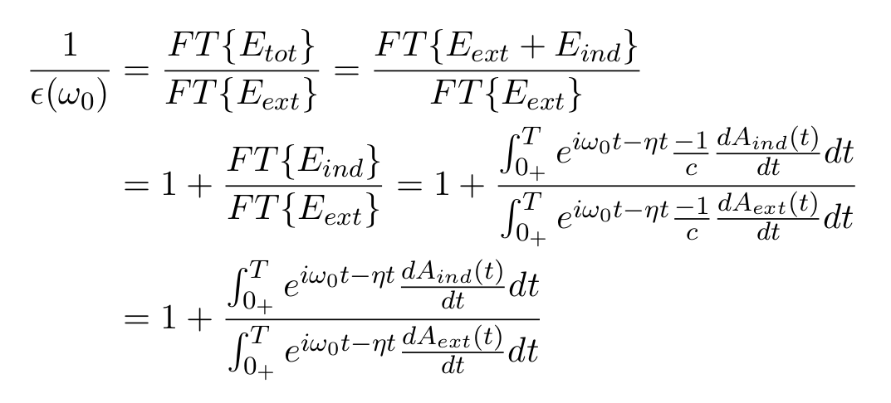
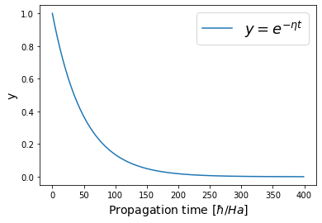
Check back for the original formula!
[2] G. F. Bertsch, J.-I. Iwata, Angel Rubio, and K. Yabana. Real-space, real-time method for the dielectric function. Phys. Rev. B, 62:7998–8002, Sep, 2000

Slide 4
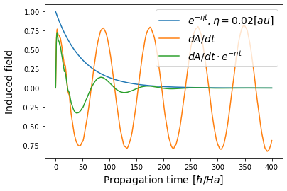
exp(- eta t) envelope
1. exp(eta t) works for the kick delta function, but not suitable for our continuous laser pulse!
2 . It can converge the edge of Fourier transformation range, avoid strange peaks after FT!
3. When we increase the propagation time, we can get nothing more new information, they all lost!

Slide 5
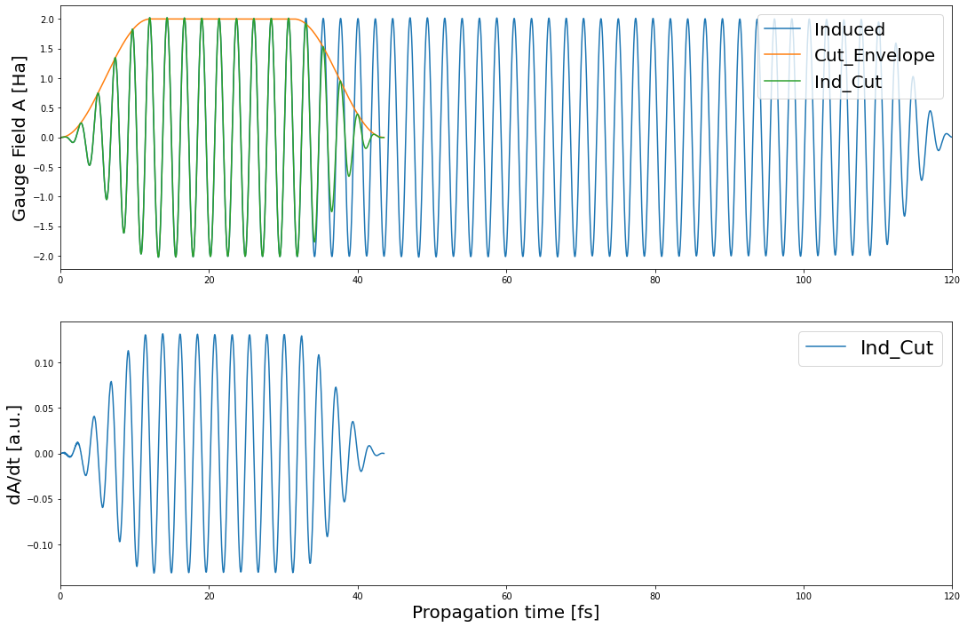
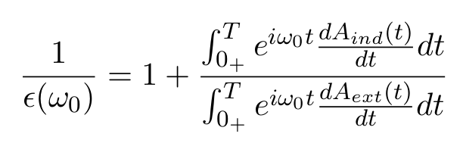
A new envelope for continuous wave
10 fs sin^2 head + arbitrary flat pulse duration + 10 fs sin^2 tail
\eta = 0
Derivative smooth
No singularity

Slide 6
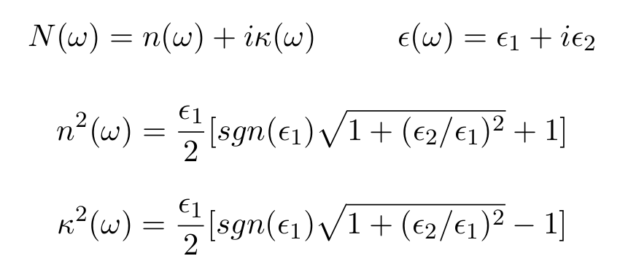
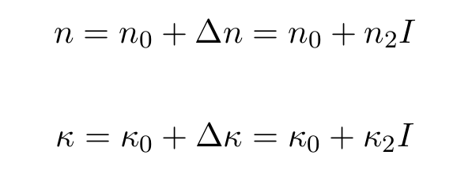
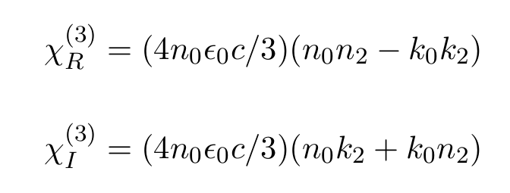

Further formulas
[3] Raúl del Coso and Javier Solis. Relation between nonlinear refractive index and third-order susceptibility in absorbing media. J. Opt. Soc. Am. B, 21(3):640–644, Mar 2004

Slide 7
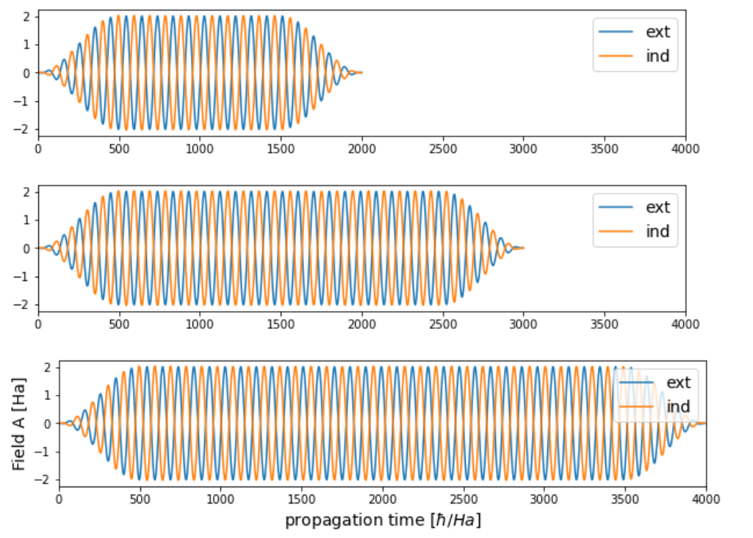
Iridium: pulse duration = 1000, 2000, 3000 [hbar/Ha], A = 2 [Ha]
Gauge field A

Slide 8
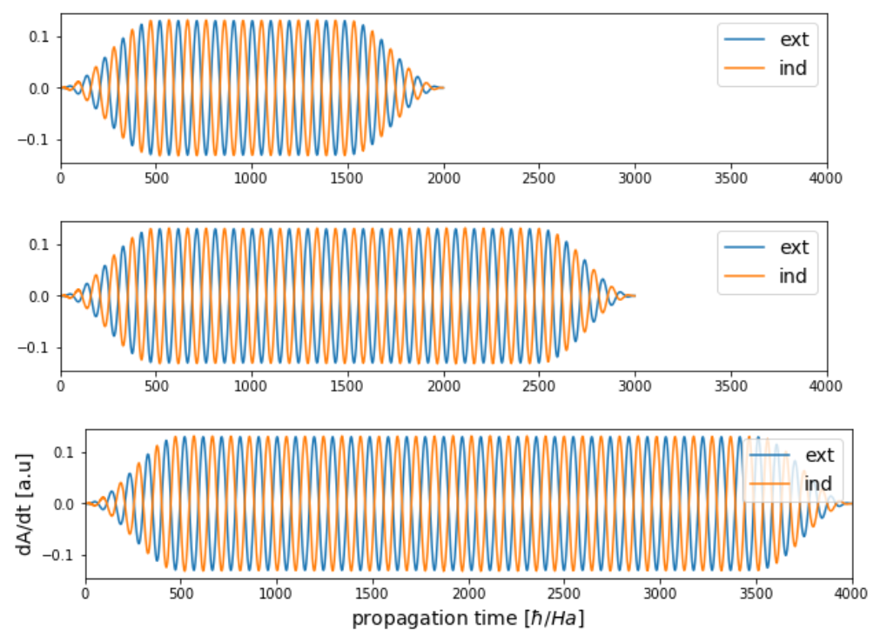
Iridium: pulse duration = 1000, 2000, 3000 [hbar/Ha], A = 2 [Ha]
dA/dt Derivative smooth, No singularity

Slide 9
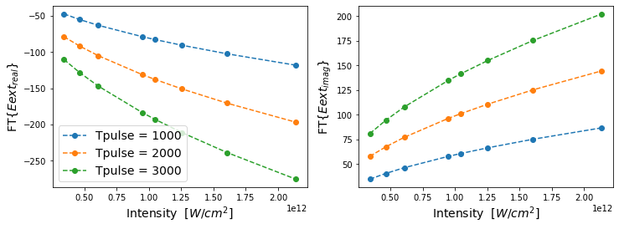
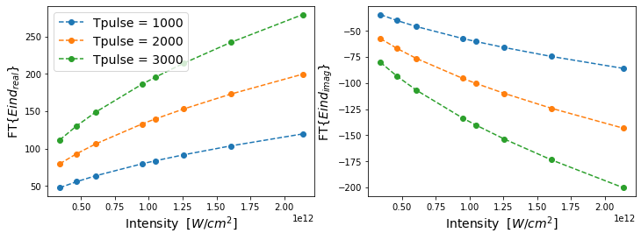
Iridium: pulse duration = 1000, 2000, 3000 [hbar/Ha], A = [ 1.2, 1.4, 1.6, 2, 2.1, 2.3, 2.6, 3] [Ha]
FT{Eext} FT{Eind} Intensity without modification

Slide 10
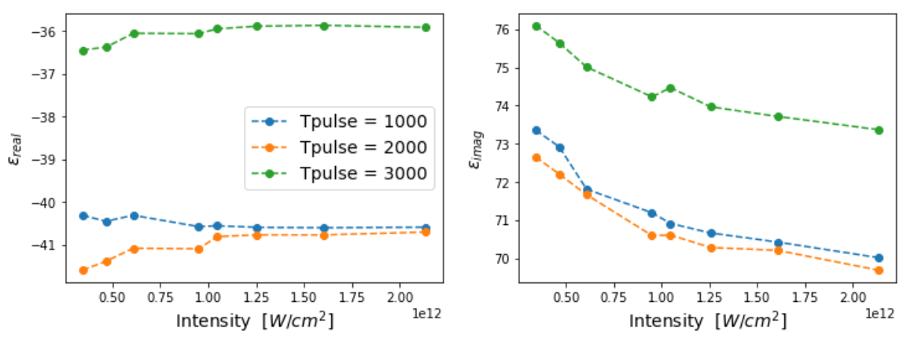
Iridium: pulse duration = 1000, 2000, 3000 [hbar/Ha], A = [ 1.2, 1.4, 1.6, 2, 2.1, 2.3, 2.6, 3] [Ha]
Dielectric function epsilon

Slide 11
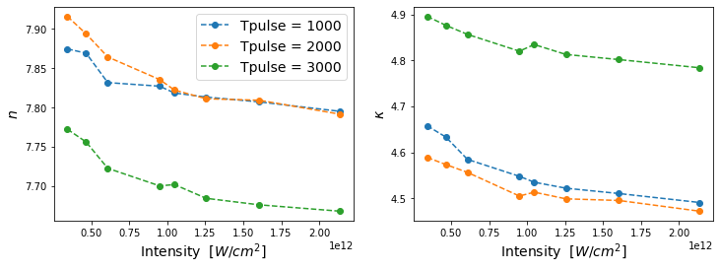
Iridium: pulse duration = 1000, 2000, 3000 [hbar/Ha], A = [ 1.2, 1.4, 1.6, 2, 2.1, 2.3, 2.6, 3] [Ha]
Refractive index n, k
FT-- same for exp(iwt) or exp(-iwt)

Slide 12
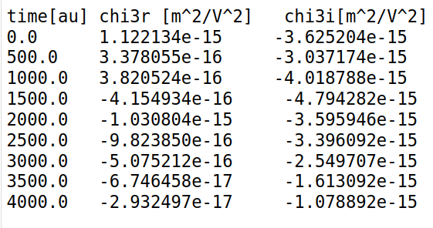
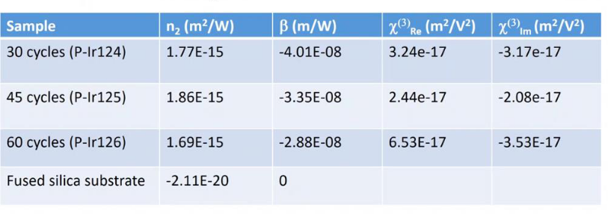
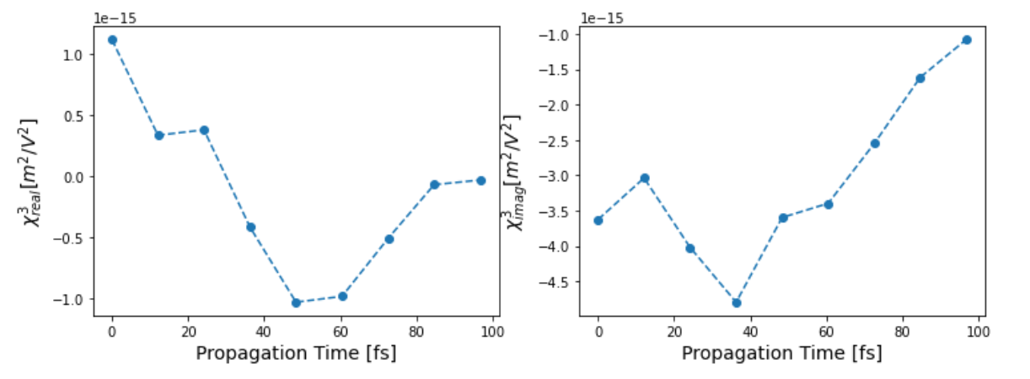
Iridium: A = [ 1.2, 1.4, 1.6, 2, 2.1, 2.3, 2.6, 3] [Ha] Linear fitting

Slide 13
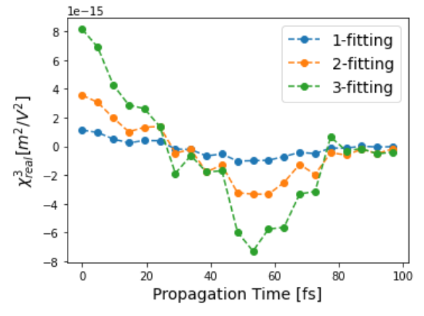
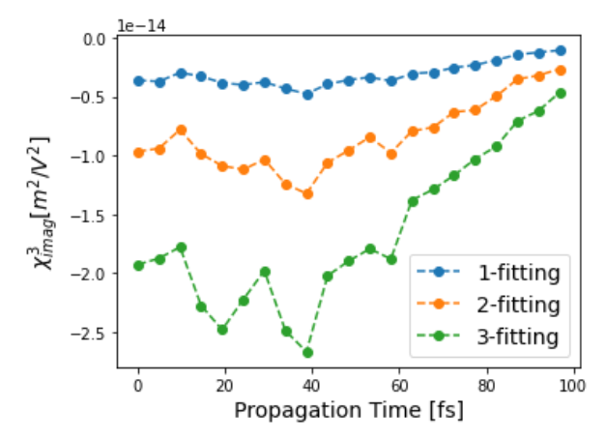
Iridium: A = [ 1.2, 1.4, 1.6, 2, 2.1, 2.3, 2.6, 3] [Ha]
Polynomial fitting!

Slide 14
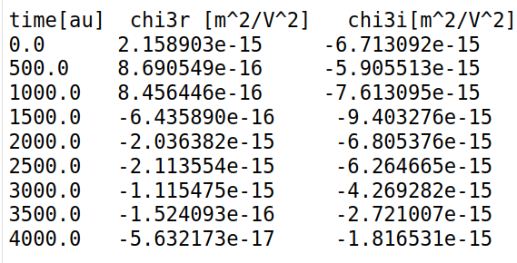
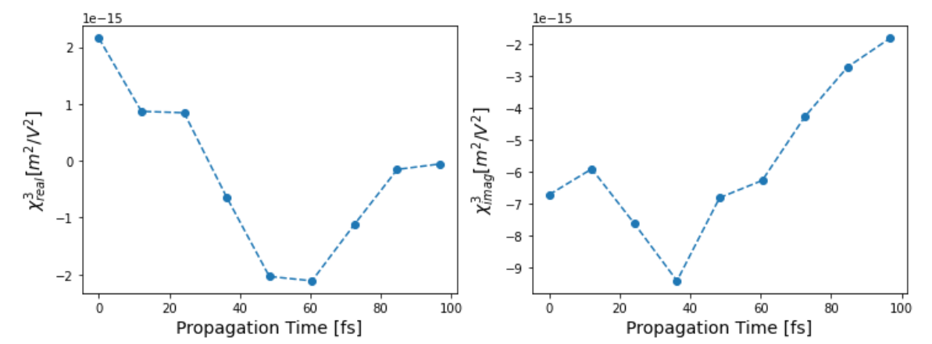
Iridium: A = [ 1.2, 1.4, 1.6, 2, 2.1] [Ha] Linear fitting

Slide 15
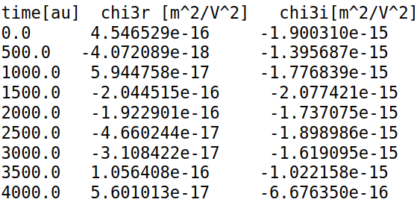
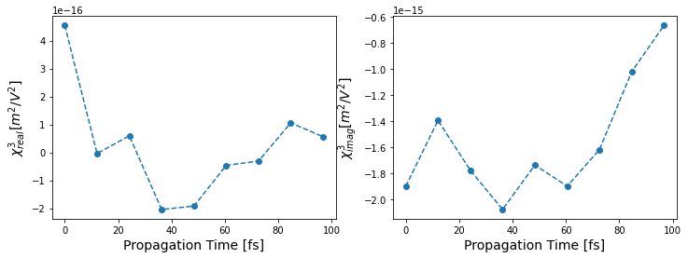
Iridium: A = [ 2.1, 2.3, 2.6, 3] [Ha] Linear fitting

Slide 16
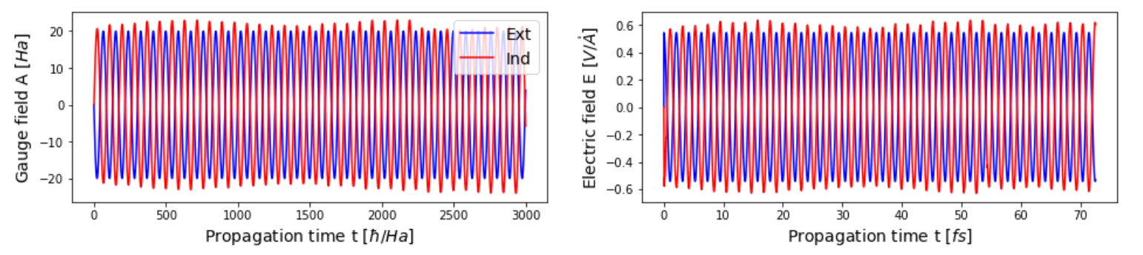
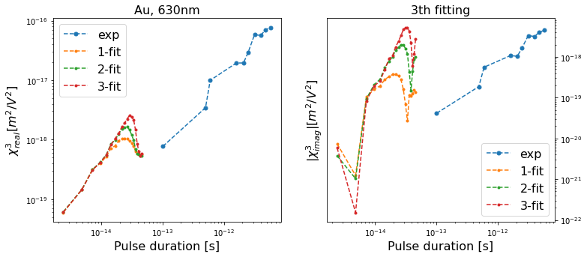
Gold polynomial fitting A =[10,20,30,40]

Slide 17
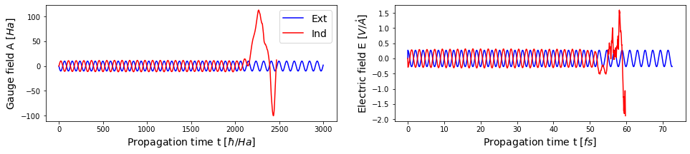
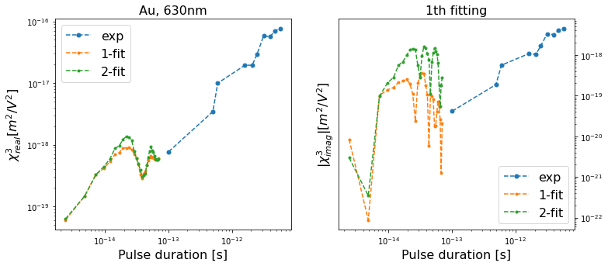
Gold polynomial fitting with A =[20,30,40]
A=10 divergent, delete it!

Slide 18
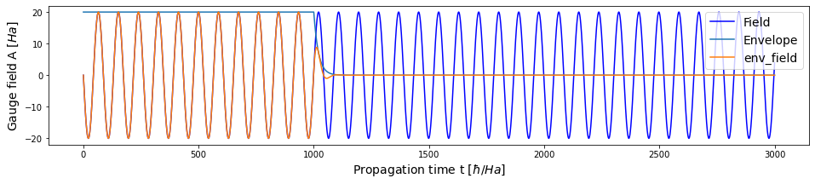
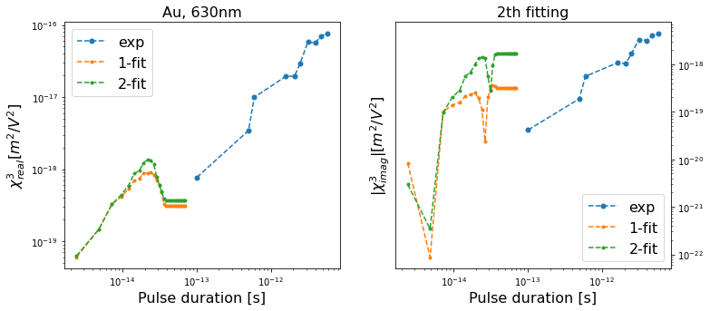
Gold Add the envelope

Slide 19
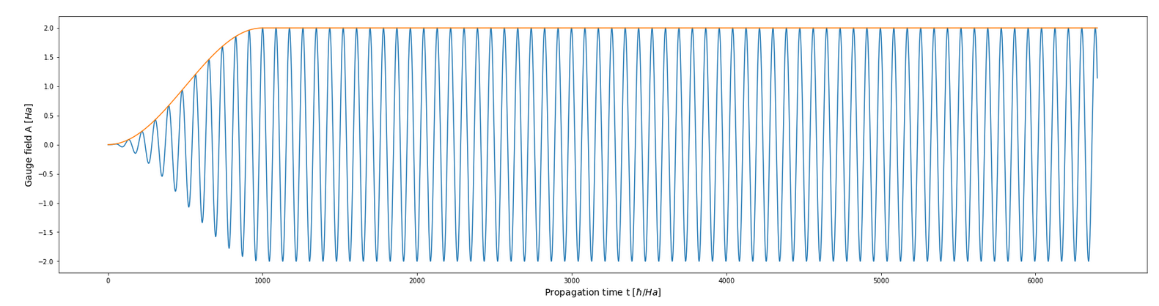
Gold on Calculating!
Propagation time 50,000 au = 1200 fs ~ 10^{-12} s
5 Amplitudes! A = 0.1, 0.7, 1.2, 1.6, 2
5 Intensity [GW/cm^2] 0.08, 4.02, 11.82, 21.01, 32.82

