Slide 1
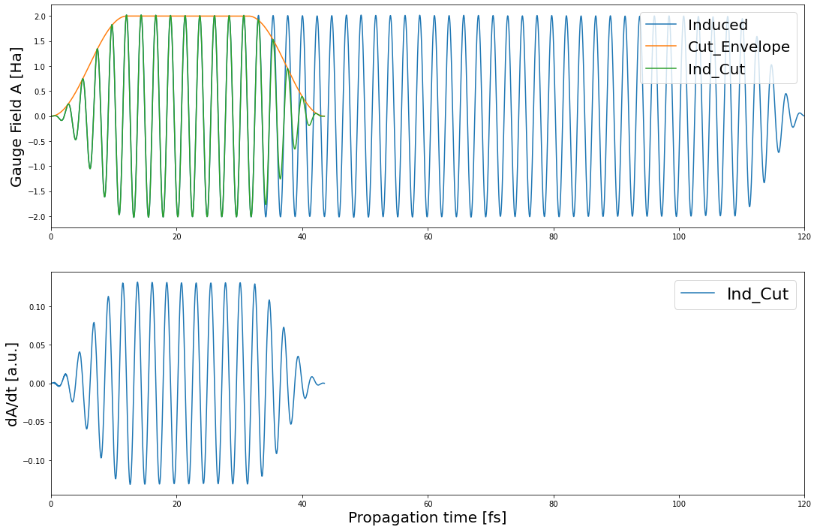

Slide 2
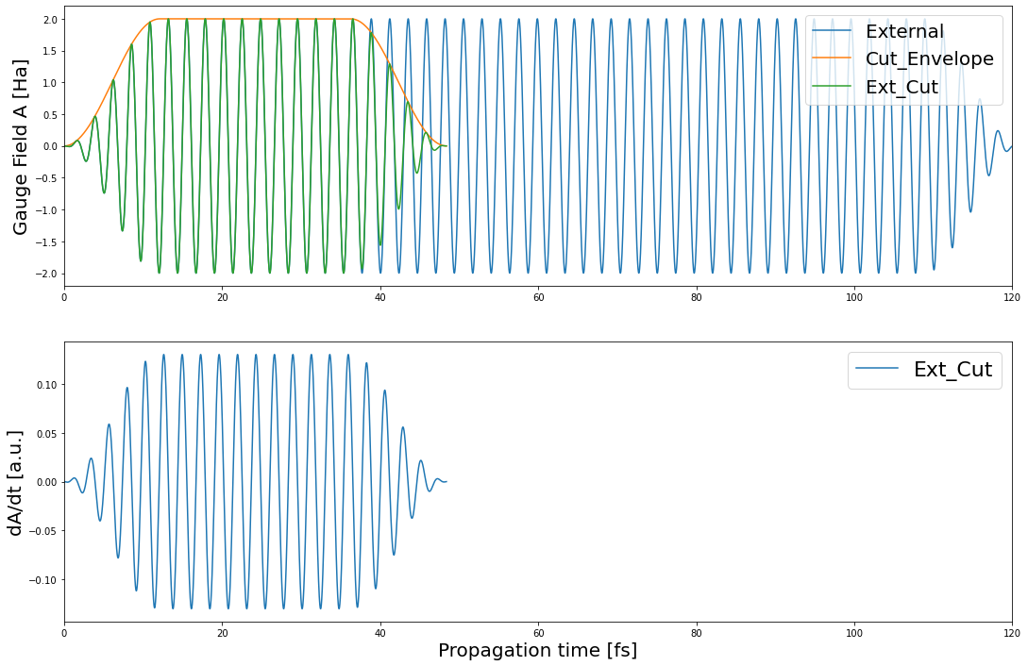

Slide 3
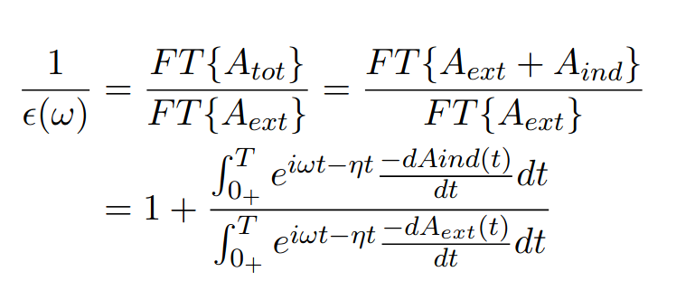
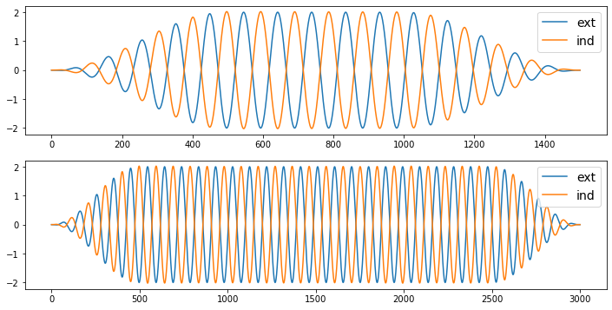
A = 2 [Ha], Pulse duration = 500 and 2000. head 500 tail 500.

Slide 4
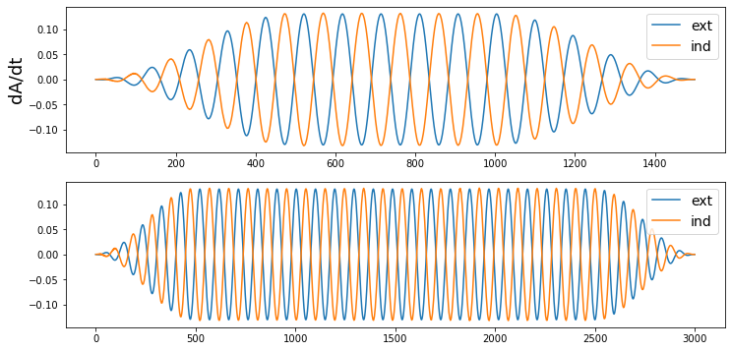
dA/dt: Pulse duration = 500 and 2000. head 500 tail 500.

Slide 5
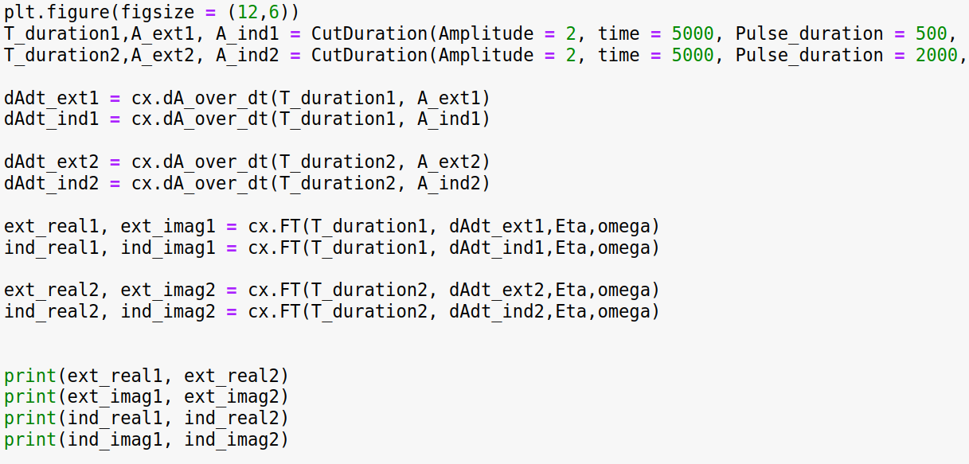
0.14400135291997646 0.14400135321851068
-0.049733841188673585 -0.04973384129191779
-0.14553442494080052 -0.1455344252421078
0.04692346503464121 0.04692346513435849

Slide 6
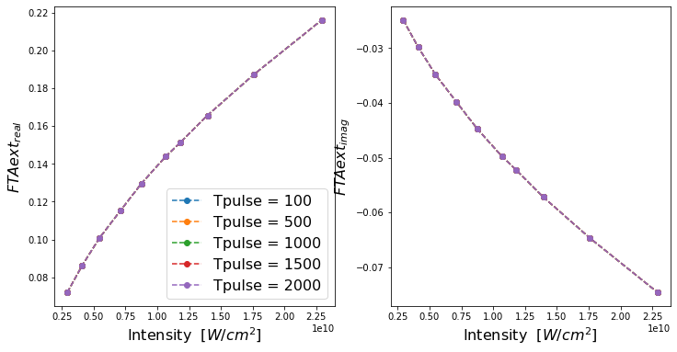

Slide 7
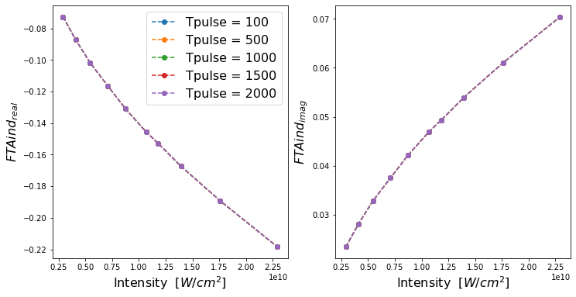

Slide 8
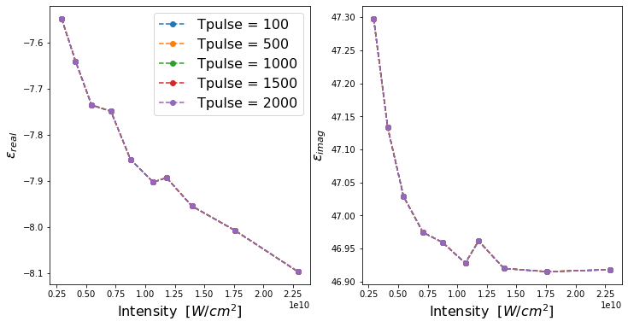

Slide 9
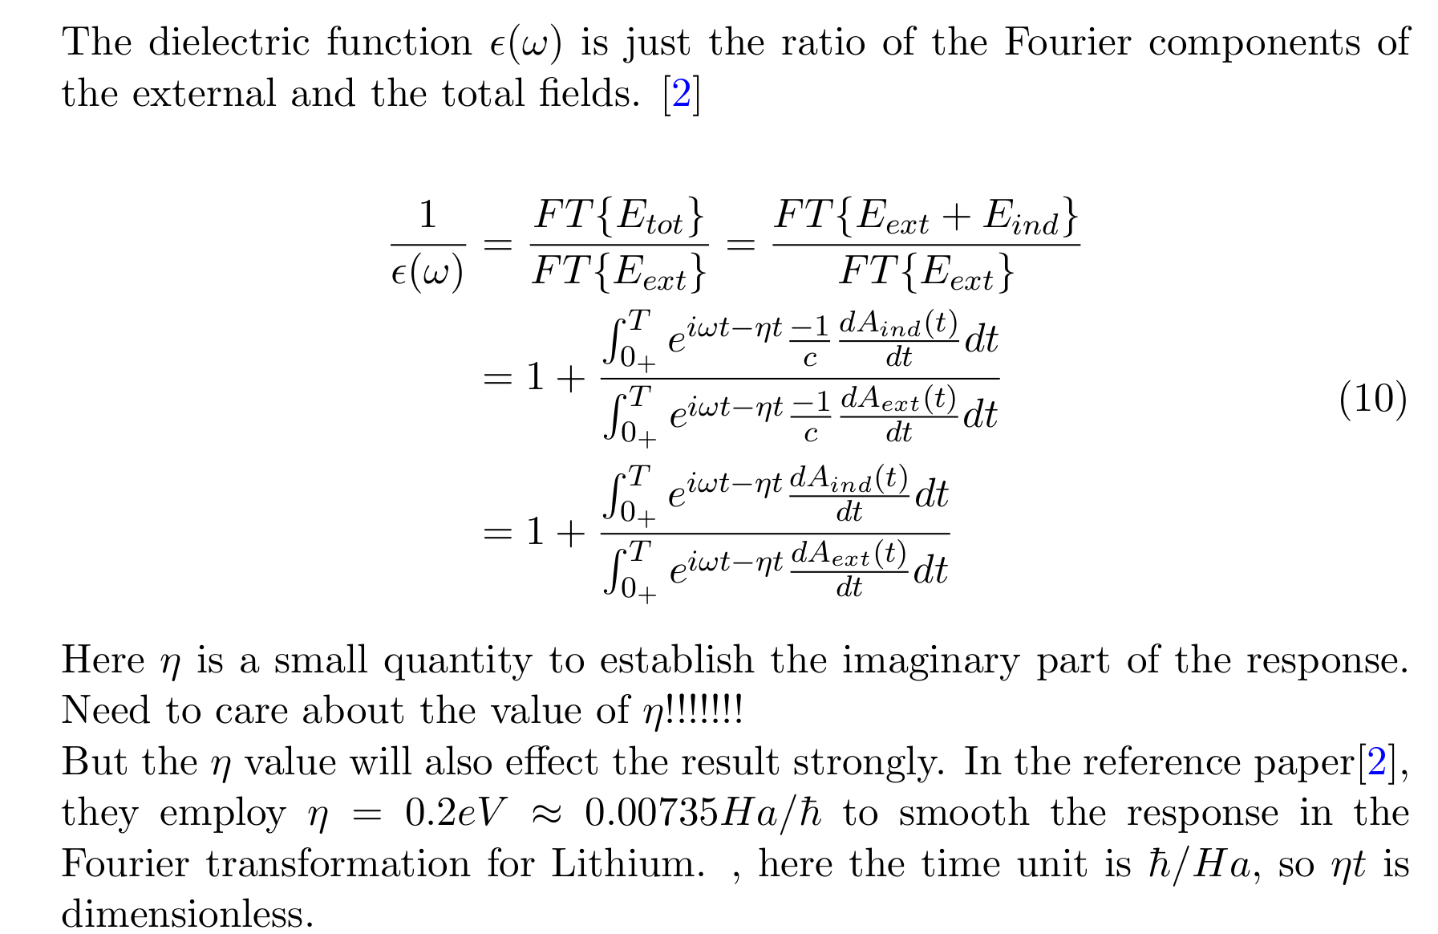

Slide 10
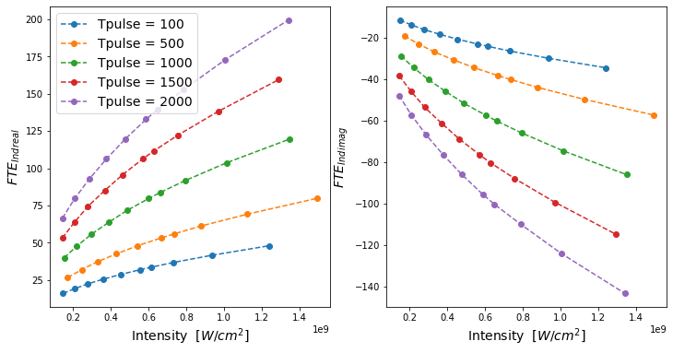
Eta = 0: FT(E_ind)

Slide 11
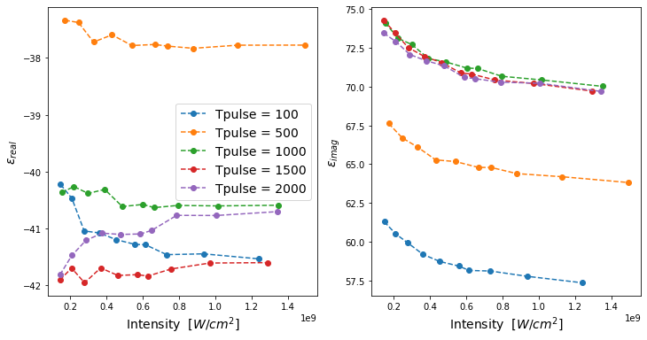
Eta = 0 Dielectric function epsilon

Slide 12
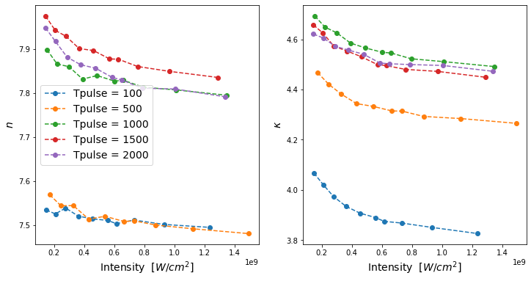
Eta = 0 Refractive index n, k

Slide 13
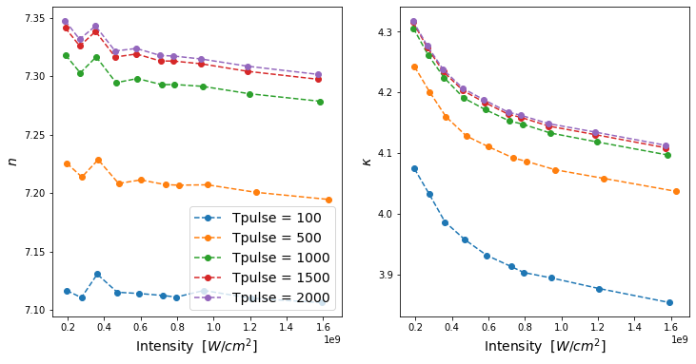
Eta = 0.002 # [Ha/hbar]

Slide 14
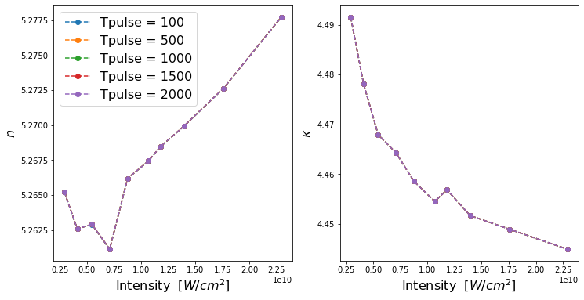
Eta = 0.02 # [Ha/hbar]

Slide 15
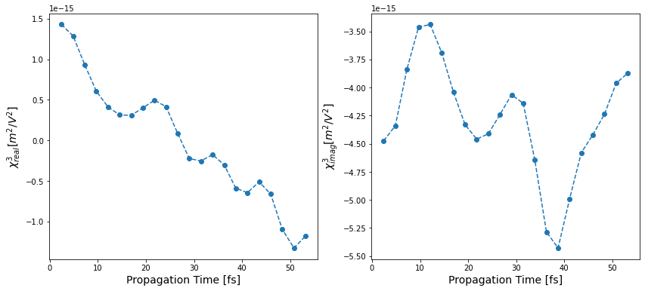
Eta = 0 Third-order Susceptibility chi3, fitting order 1

