Slide 1
Nonlinear properties calculation for Gold
Xiao Chen
22/07/2022

Slide 2
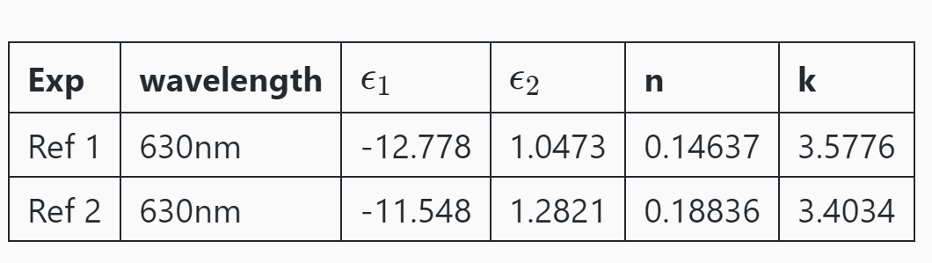
Linear Experimental data
[Ref1] https://refractiveindex.info/?shelf=main&book=Au&page=McPeak
[Ref2] https://refractiveindex.info/?shelf=main&book=Au&page=Johnson

Slide 3
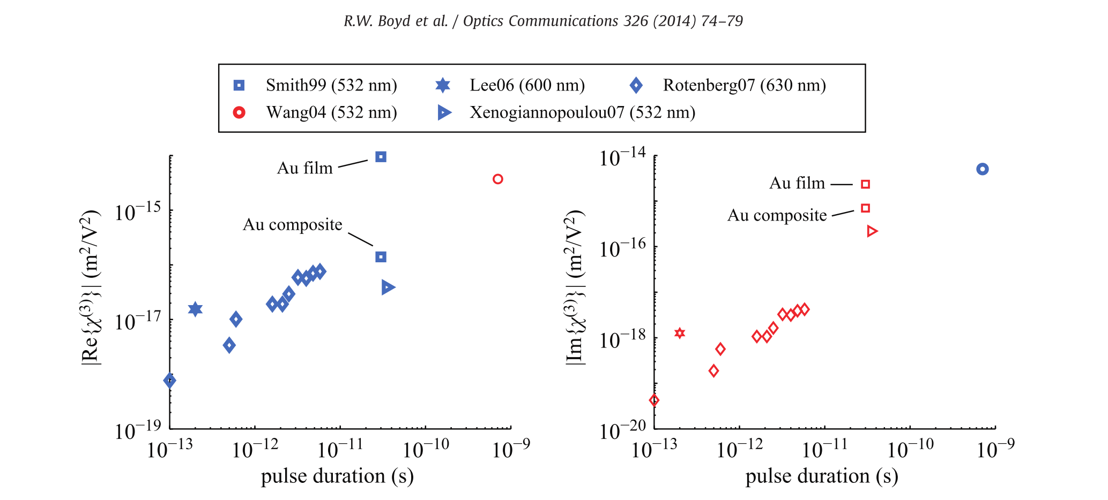
Nonlinear Experimental data
Robert W. Boyd, Zhimin Shi, and Israel De Leon. The third-order nonlinear optical susceptibility of gold. Optics Communications, 326:74–79, 2014

Slide 4
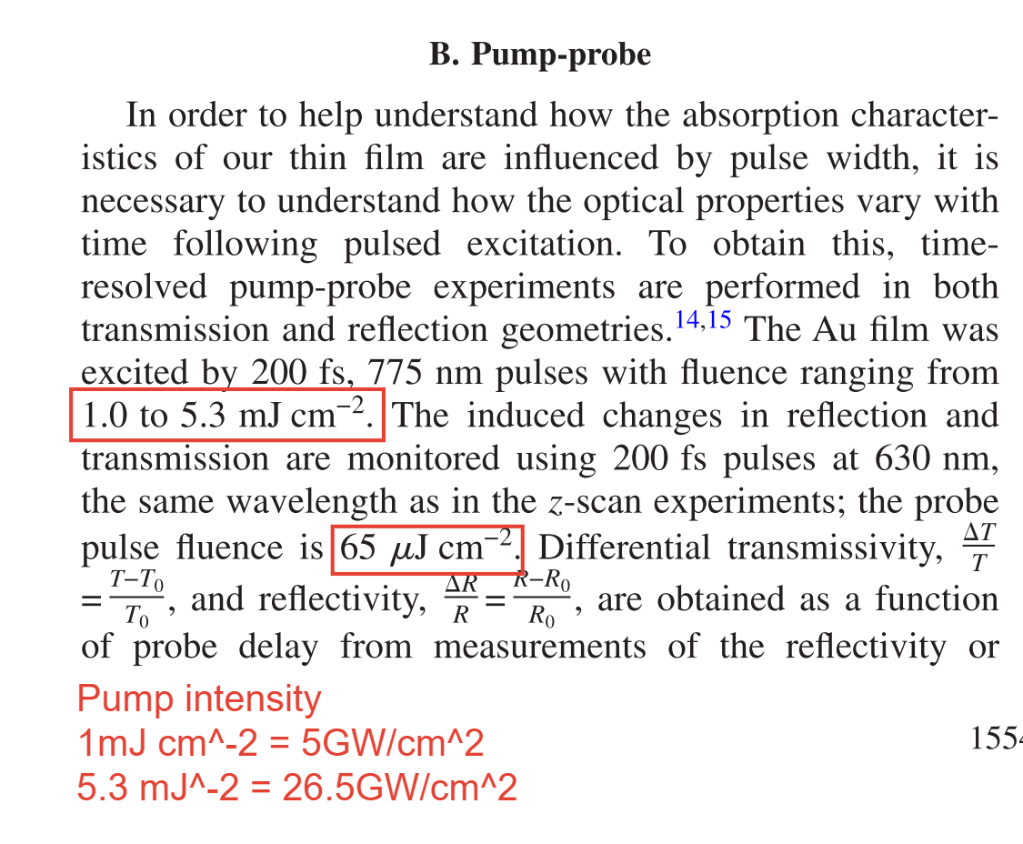
Experimental: Rotenberg07(630nm)
Usually, our simulation intensity should be smaller than the experimental intensity.
Because of the reflection, scattering, focusing …
Here they use the 20nm thick Au film
on microscope slide with 630 nm laser
N. Rotenberg, A.D. Bristow, M. Pfeiffer, M. Betz, H.M. van Driel, Phys. Rev. B 75 (2007) 155426

Slide 5
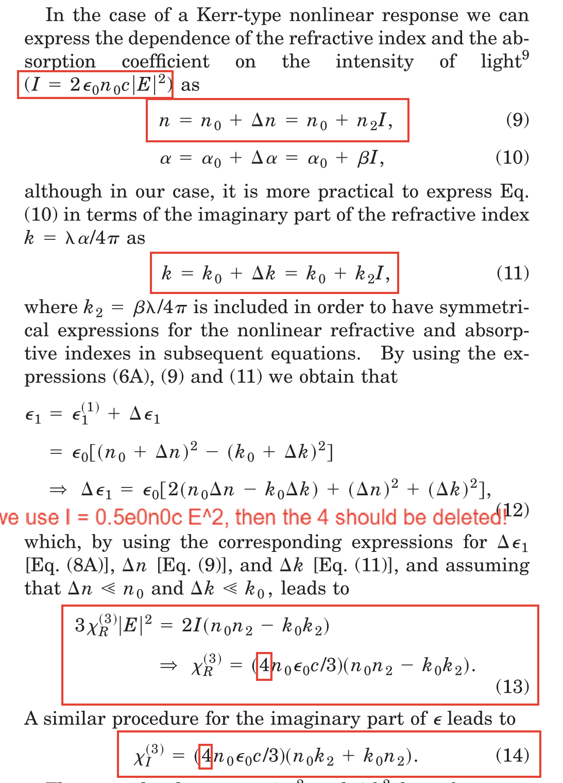
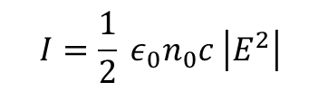
Intensity
$$I=\frac{1}{2} ε_{0}n_{0}c \left|E^{2}\right|$$
Raúl del Coso and Javier Solis. Relation between nonlinear refractive index and third-order susceptibility in absorbing media. J. Opt. Soc. Am. B, 21(3):640–644, Mar 2004.

Slide 6

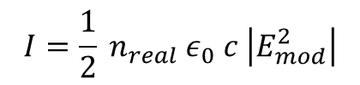

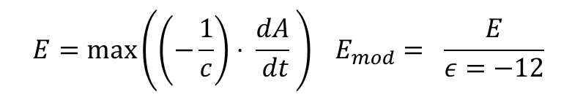
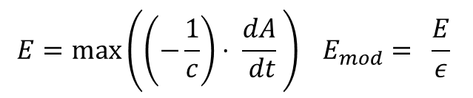
Intensity
Emax = max(cx.A2E(time, A_ext)) I1 = cx.E2I(Emax, 1)
$E=\max\left(\left(−\frac{1}{c}\right)⋅ \frac{dA}{ dt} \right) I=\frac{1}{2} n_{0} ε_{0} c \left|E^{2}\right| (n_{0}=1)$
IntensityMode = 1
c = 137.03604 E = max(A_ext) * omega / c I2 = np.square(E * np.sqrt(3.509470 * 1e16))
IntensityMode = 2
$$E=\frac{\max\left(A\right) ω}{c} I={\left(E \sqrt{3.50947×{10}^{16}}\right)}^{2}$$
IntensityMode = 3
$E=\max\left(\left(−\frac{1}{c}\right)⋅ \frac{dA}{ dt} \right) I=\frac{1}{2} n_{0} ε_{0} c \left|E^{2}\right| (n_{0}=0.18)$
I3 = cx.E2I(Emax, n00=0.18)
IntensityMode = 4
modification = epsilon_real Emax = max(cx.A2E(time, A_ext)) / modification I4= cx.E2I(Emax, n_real)
$$E=\max\left(\left(−\frac{1}{c}\right)⋅ \frac{dA}{ dt} \right) E_{mod}= \frac{E}{ε}$$
$$I=\frac{1}{2} n_{real} ε_{0} c \left|E_{mod}^{2}\right|$$
modification = - 12 Emax = max(cx.A2E(time, A_ext)) / modification
I5= cx.E2I(Emax, n_real) # [W/cm^2]
$$E=\max\left(\left(−\frac{1}{c}\right)⋅ \frac{dA}{ dt} \right) E_{mod}= \frac{E}{ε=−12}$$
IntensityMode = 5

Slide 7
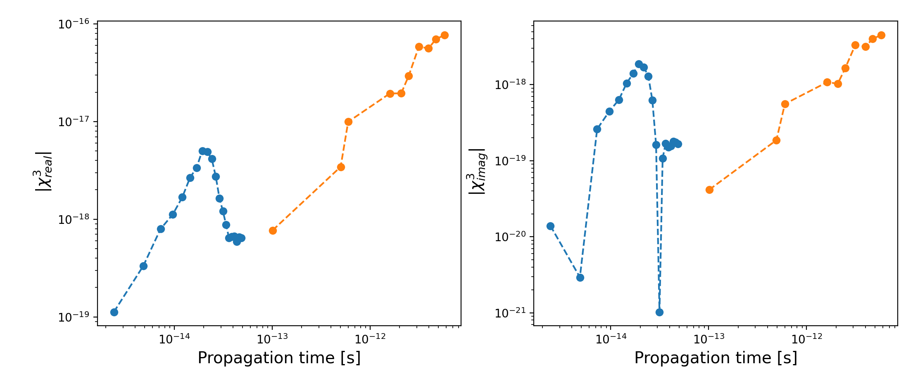
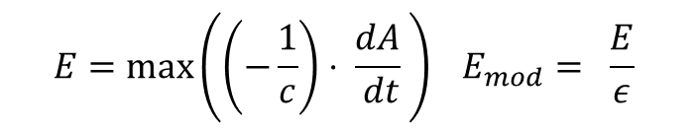

Amplitude range A = [10,20, 30,40] Ha/e without envelope
$$E=\max\left(\left(−\frac{1}{c}\right)⋅ \frac{dA}{ dt} \right) E_{mod}= \frac{E}{ε}$$
$I=\frac{1}{2} n_{0} ε_{0} c \left|E^{2}\right| (n_{0}=n_{real})$
IntensityMode = 4

Slide 8
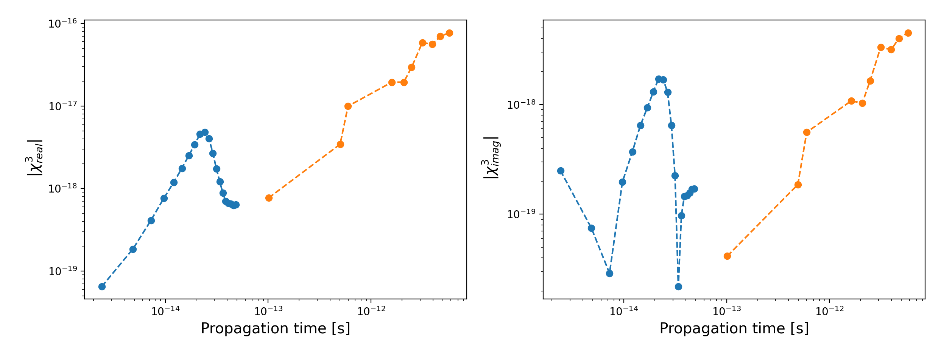

Amplitude range A = [10,20, 30,40] Ha/e with envelope
$$E=\max\left(\left(−\frac{1}{c}\right)⋅ \frac{dA}{ dt} \right) E_{mod}= \frac{E}{ε}$$
$I=\frac{1}{2} n_{0} ε_{0} c \left|E^{2}\right| (n_{0}=n_{real})$
IntensityMode = 4

Slide 9
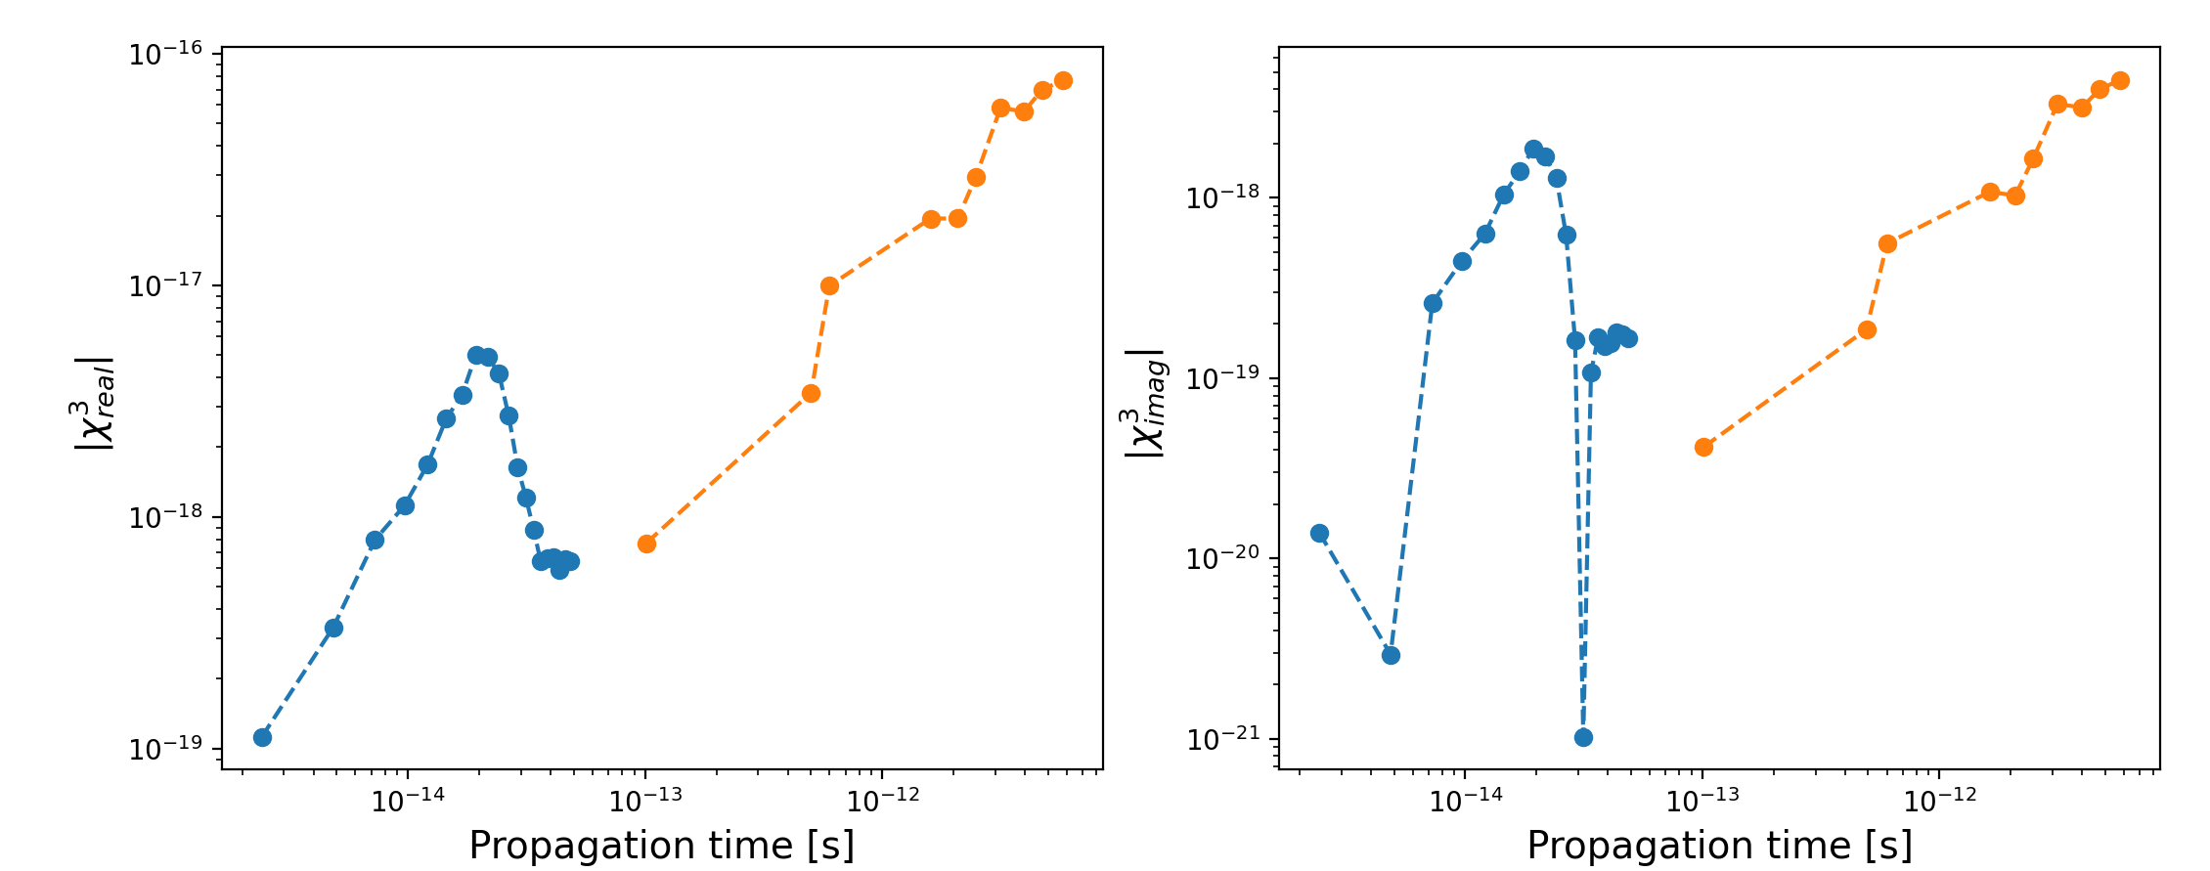
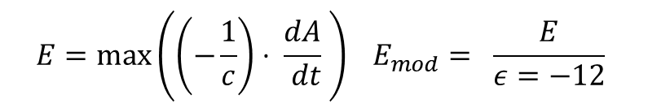

Amplitude range A = [10,20, 30,40] Ha/e without envelope
$$E=\max\left(\left(−\frac{1}{c}\right)⋅ \frac{dA}{ dt} \right) E_{mod}= \frac{E}{ε=−12}$$
IntensityMode = 5
$I=\frac{1}{2} n_{0} ε_{0} c \left|E^{2}\right| (n_{0}=n_{real})$

Slide 10
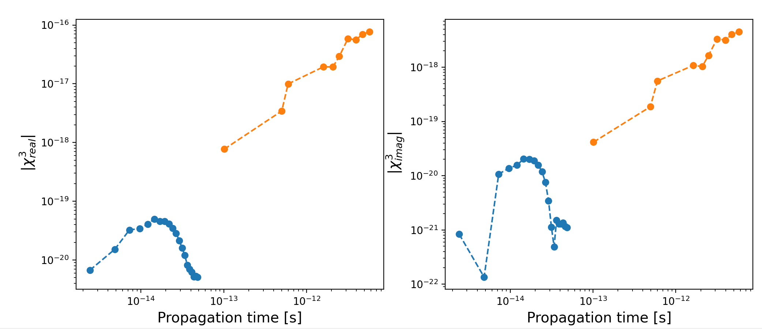
Amplitude range A = [10,20, 30,40] Ha/e without envelope
IntensityMode = 3
$E=\max\left(\left(−\frac{1}{c}\right)⋅ \frac{dA}{ dt} \right) I=\frac{1}{2} n_{0} ε_{0} c \left|E^{2}\right| (n_{0}=0.18)$

Slide 11
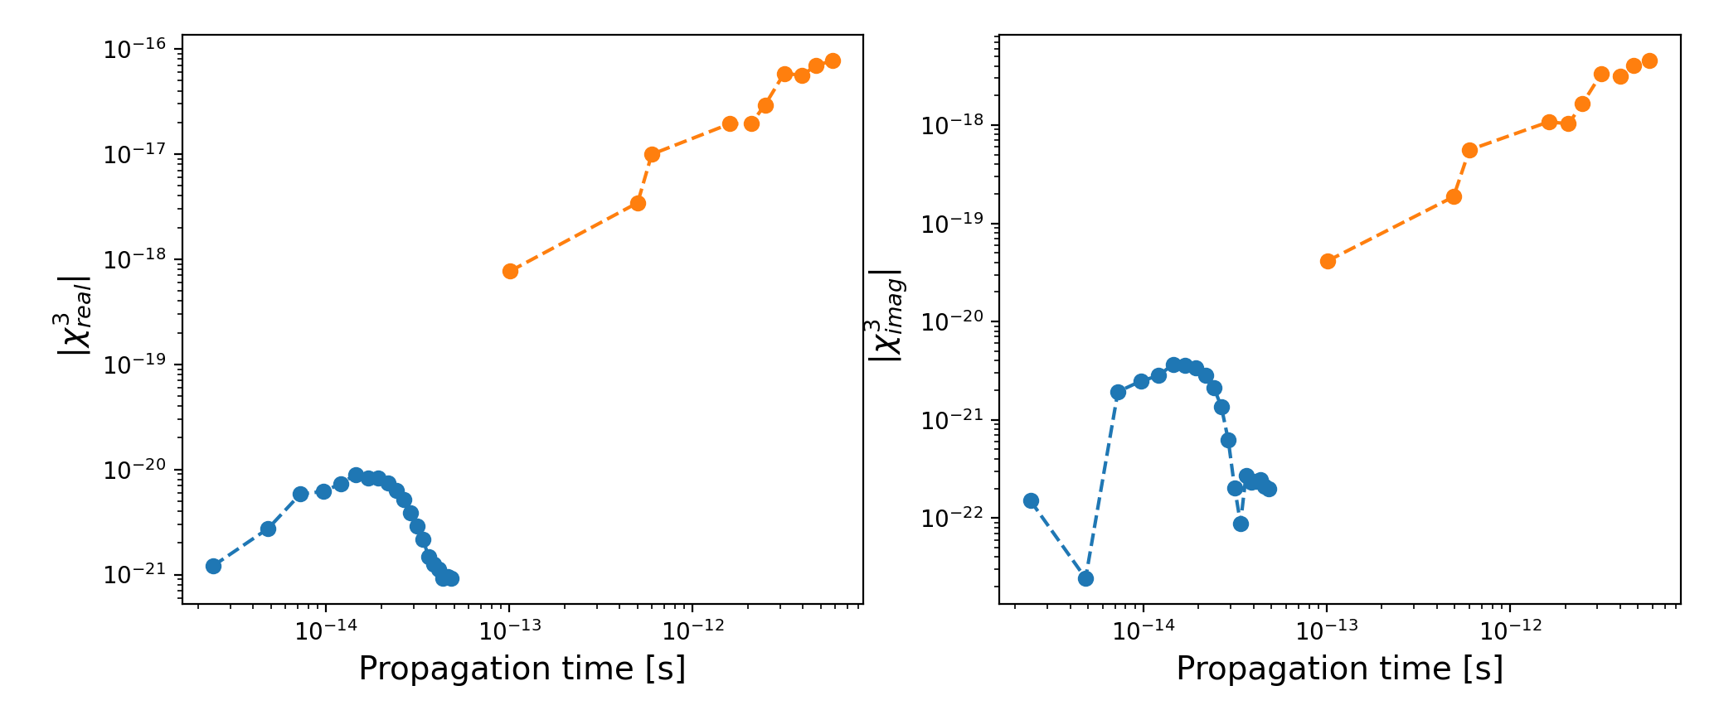


Amplitude range A = [10,20, 30,40] Ha/e without envelope
$E=\max\left(\left(−\frac{1}{c}\right)⋅ \frac{dA}{ dt} \right) I=\frac{1}{2} n_{0} ε_{0} c \left|E^{2}\right| (n_{0}=1)$
IntensityMode = 1 or 2
$$E=\frac{\max\left(A\right) ω}{c} I={\left(E \sqrt{3.50947×{10}^{16}}\right)}^{2}$$

Slide 12
How to calculate intensity exactly?
Do we need epsilon modification?
Find the suitable amplitude range ?

Slide 13
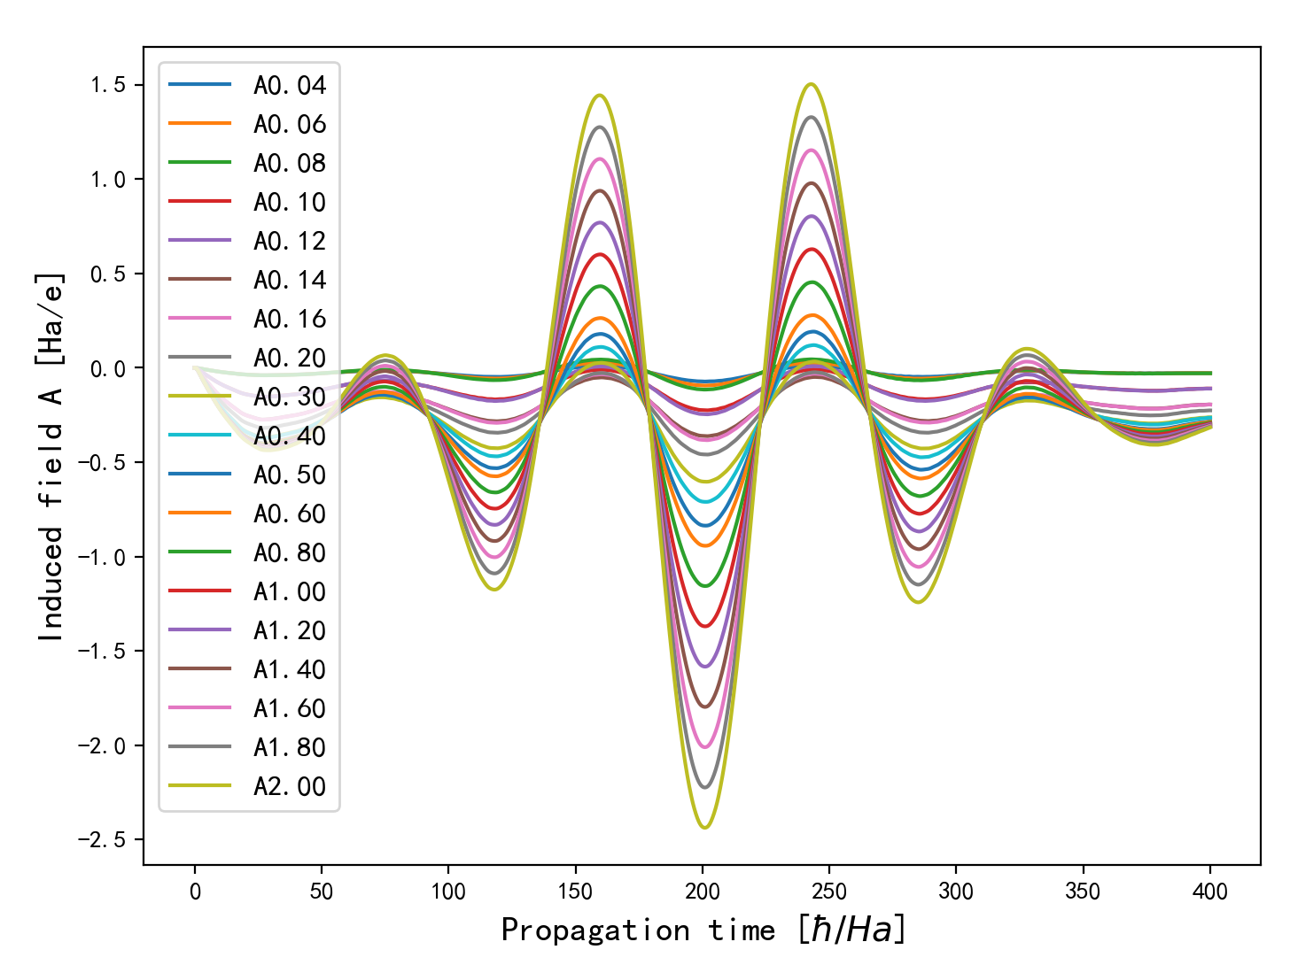
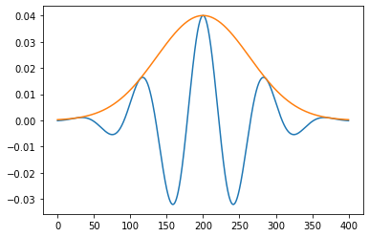


$E=\max\left(\left(−\frac{1}{c}\right)⋅ \frac{dA}{ dt} \right) I=\frac{1}{2} n_{0} ε_{0} c \left|E^{2}\right| (n_{0}=1)$
IntensityMode = 1/2
$$E=\frac{\max\left(A\right) ω}{c} I={\left(E \sqrt{3.50947×{10}^{16}}\right)}^{2}$$
Gaussian shape Propagation time = 400 [hbar/Ha] dt = 0.2 [hbar/Ha]
A= [0.04, 0.06, 0.08, 0.1, 0.12, 0.14, 0.16, 0.2, 0.3, 0.4, 0.5, 0.6, 0.8, 1, 1.2, 1.4, 1.6,1.8, 2] Ha/e
Intensity = [0.02, 0.04, 0.06, 0.10, 0.14, 0.19, 0.25, 0.39, 0.88, 1.56, 2.44, 3.52, 6.26, 9.78, 14.08,
19.16, 25.02, 31.67, 39.10 ] GW/cm^2
Spacing = 0.5 [Bohr] k = 20 LDA

Slide 14
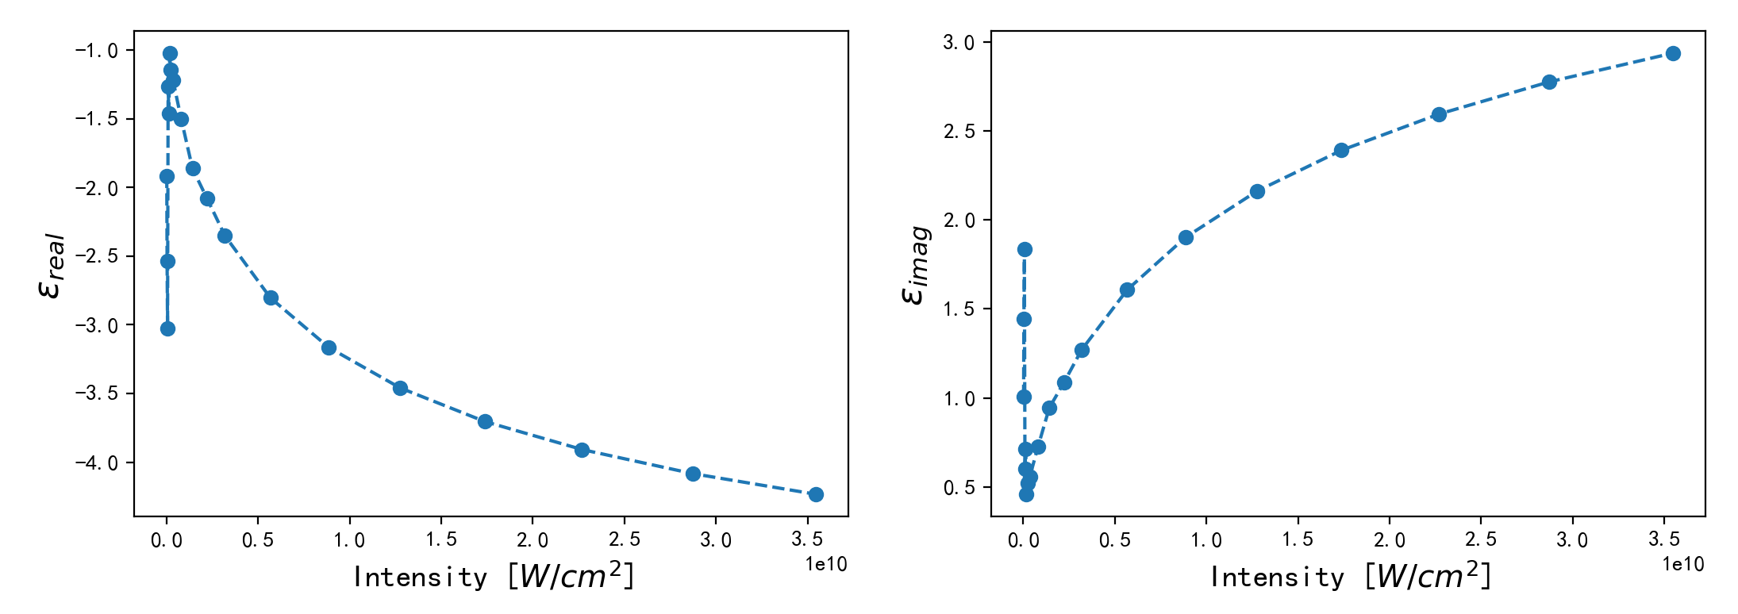
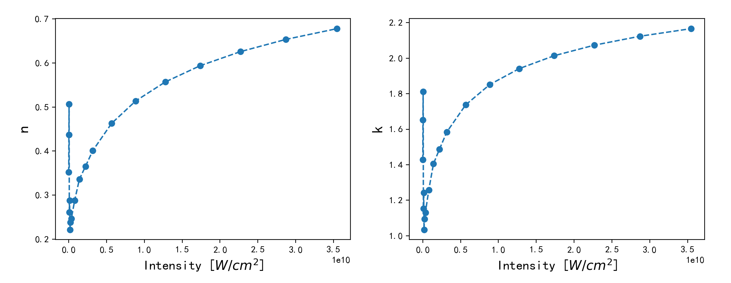
saturation
Linear range
(should be flatten)
Nonlinear

Slide 15
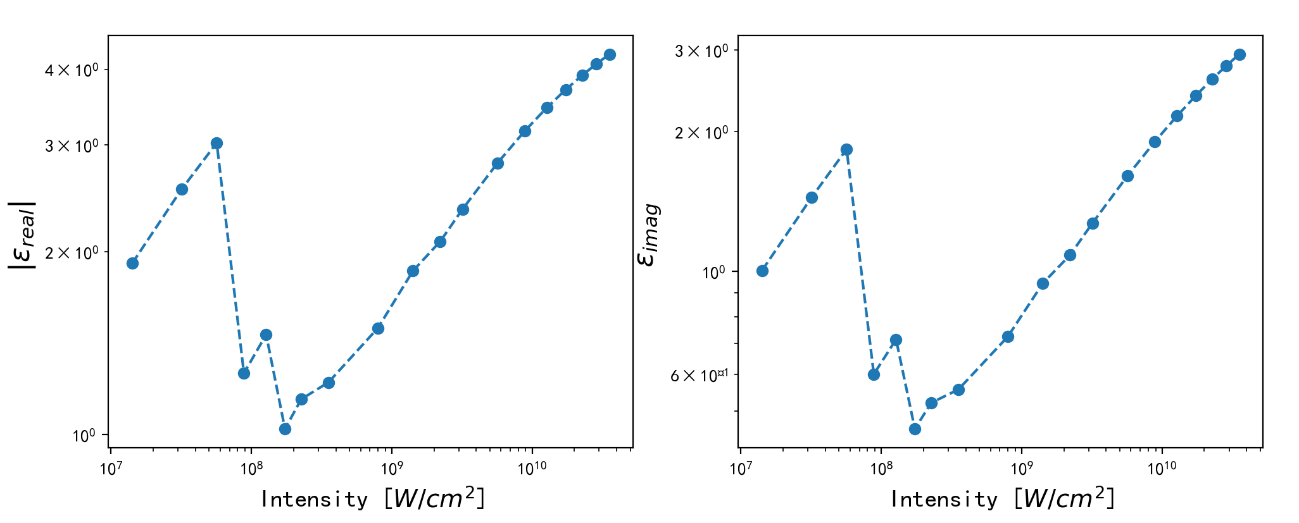
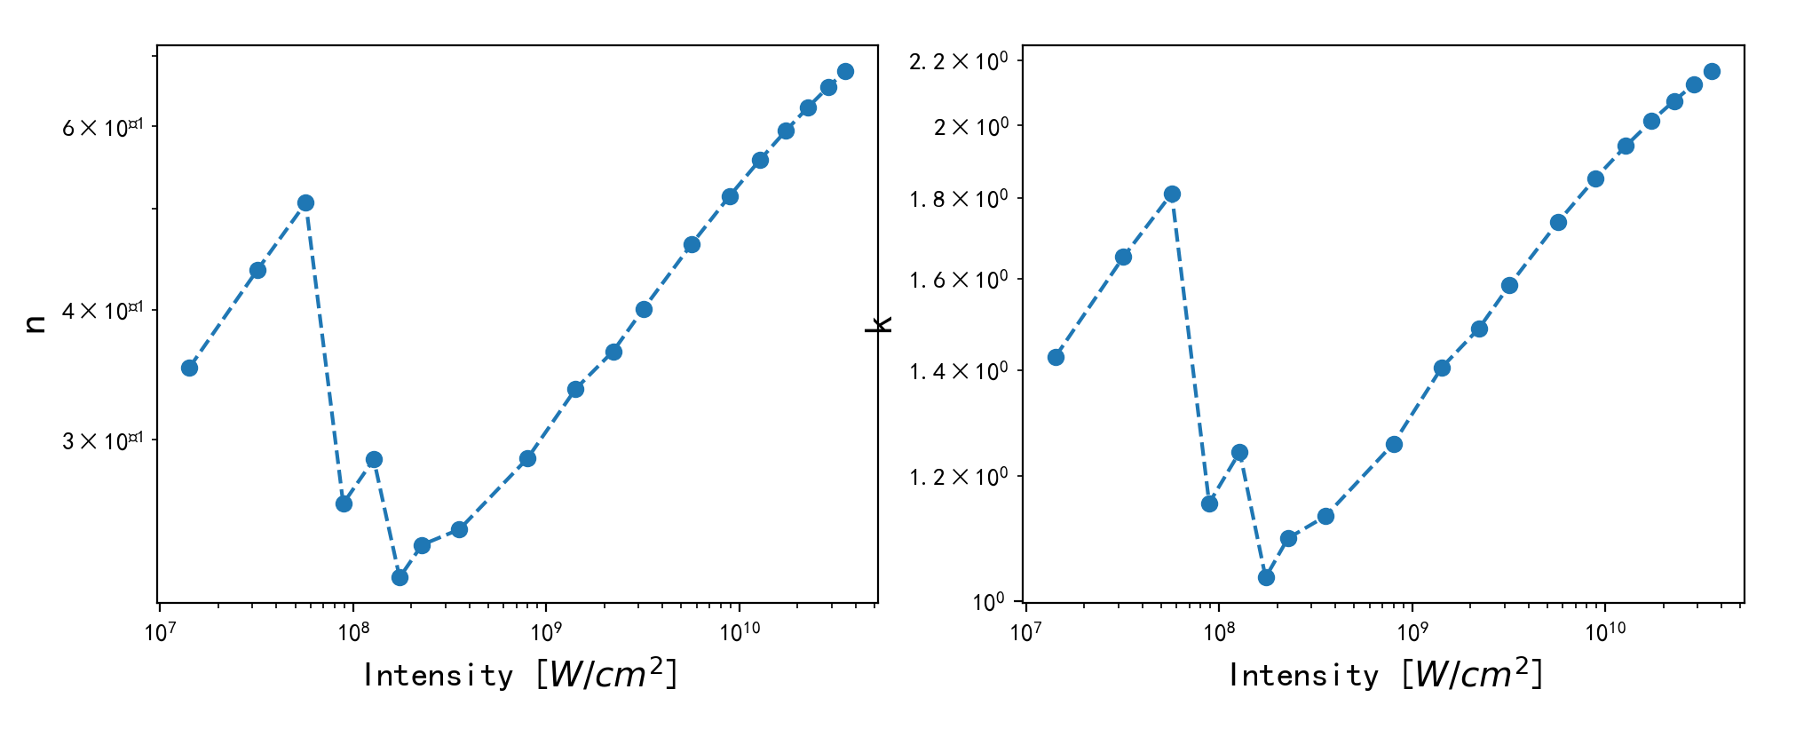
Double log coordinate system
Linear
saturation
Nonlinear

Slide 16
Choose the amplitude range A = [0.16, 0.20, 0.30, 0.40] Ha/e
spacing = 0.5, k = 20, LDA, dt = 0.2
A = 0.40
A = 0.30
A = 0.16
A = 0.20

Slide 17
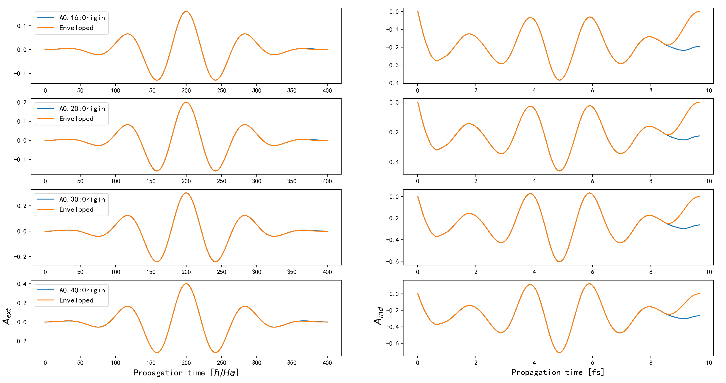
Choose the amplitude range A = [0.16, 0.20, 0.30, 0.40] Ha/e T = 400 au = 10 fs

Slide 18
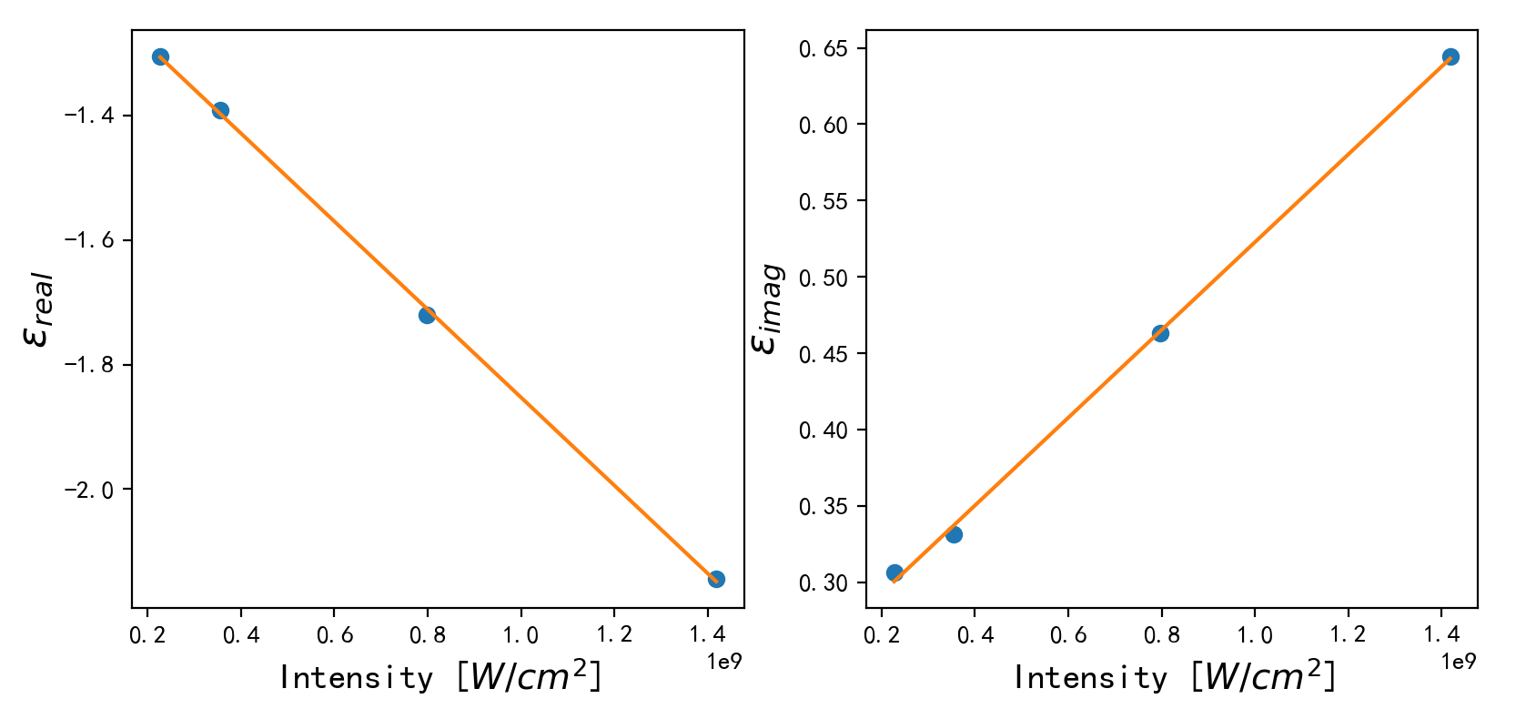
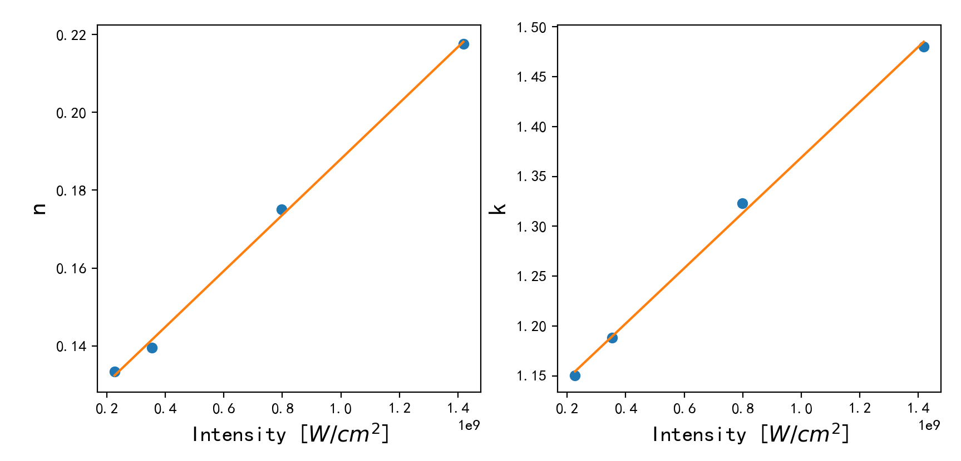
Choose the amplitude range A = [0.16, 0.20, 0.30, 0.40] Ha/e T = 400 au = 10 fs

Slide 19
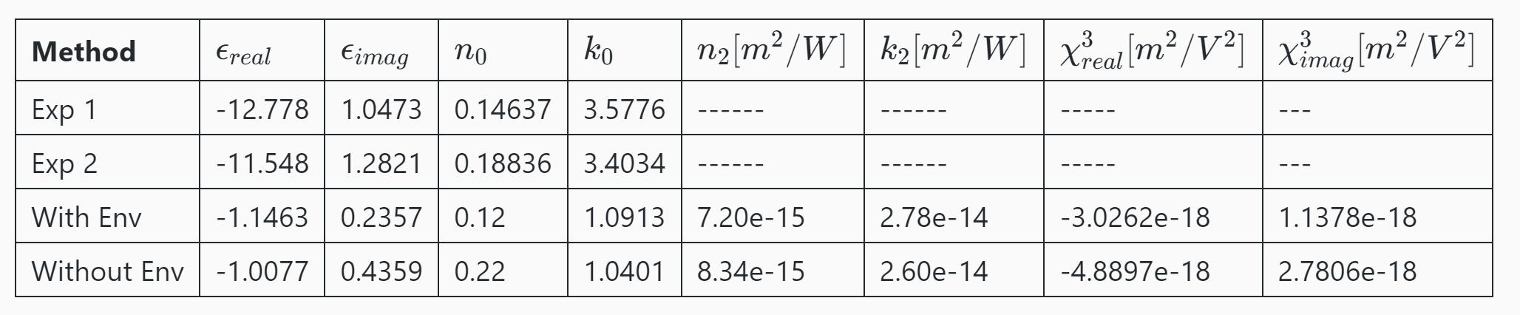
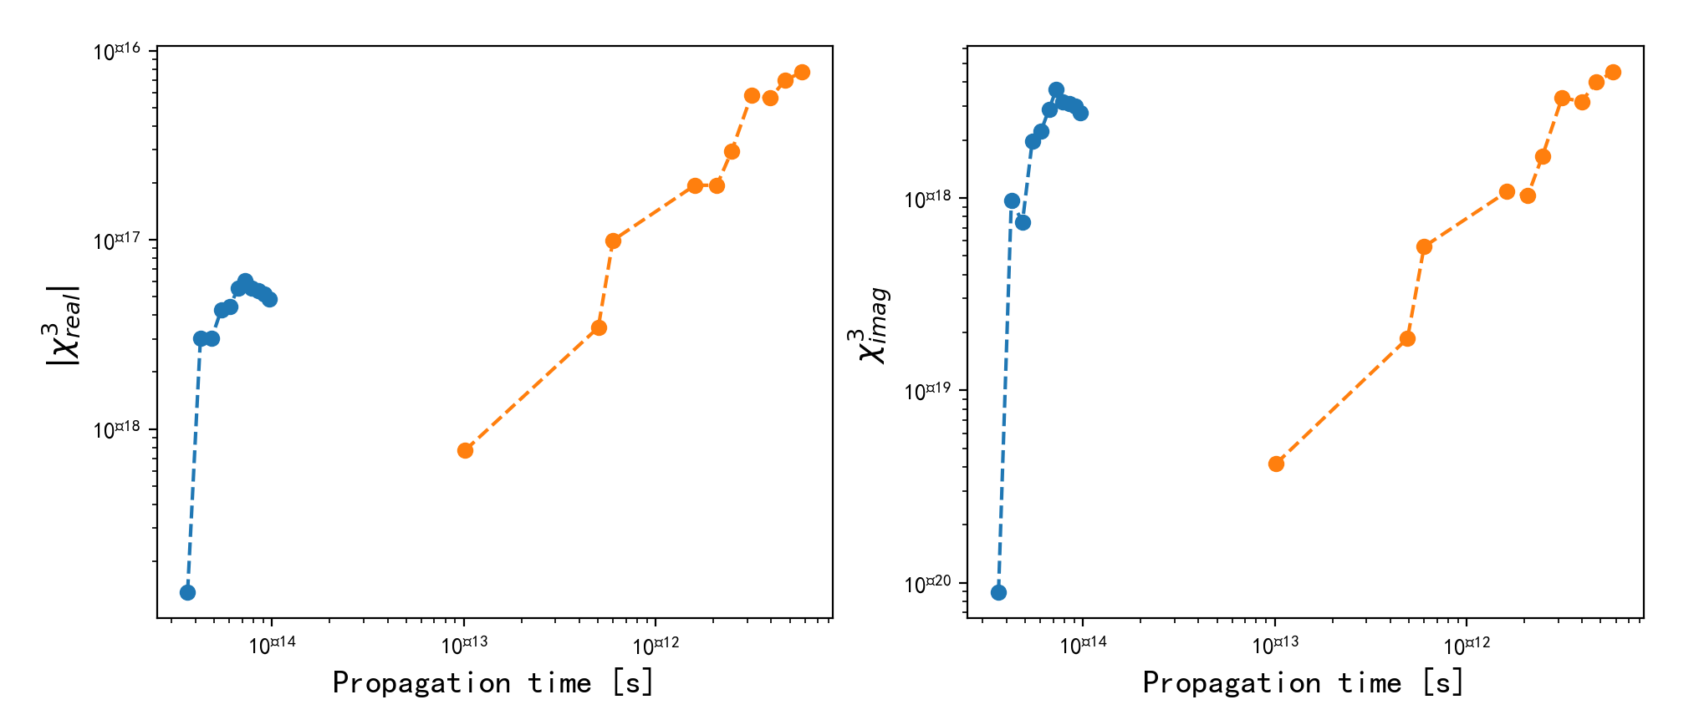
Choose the amplitude range A = [0.16, 0.20, 0.30, 0.40] Ha/e T = 400 au = 10 fs

Slide 20
Another amplitude range A = [0.18, 0.20, 0.22, 0.24] Ha/e T = 10,000 au = 240 fs
spacing = 0.5, k = 20, GGA, dt = 0.2
A = 0.30
A = 0.16
A = 0.20

Slide 21
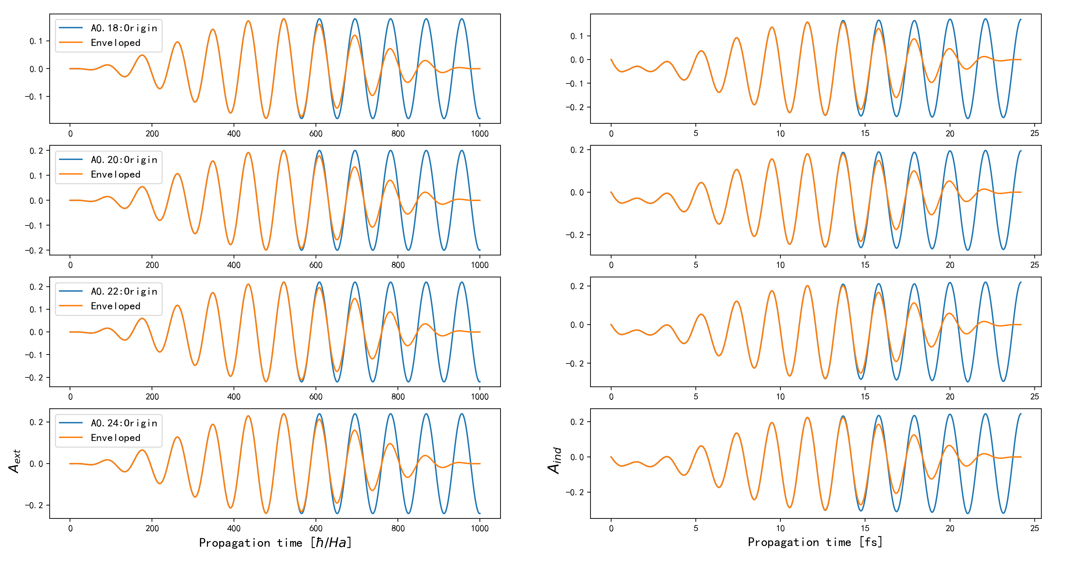
Amplitude range A = [0.18, 0.20, 0.22, 0.24] Ha/e T = 10,000 au = 240 fs
spacing = 0.5, k = 20, GGA, dt = 0.2

Slide 22
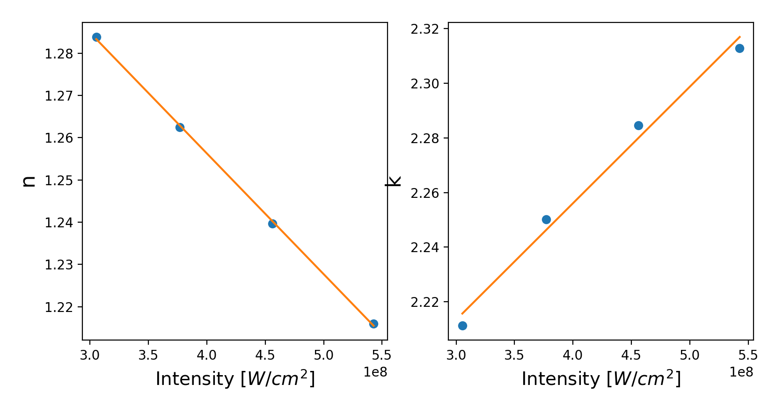
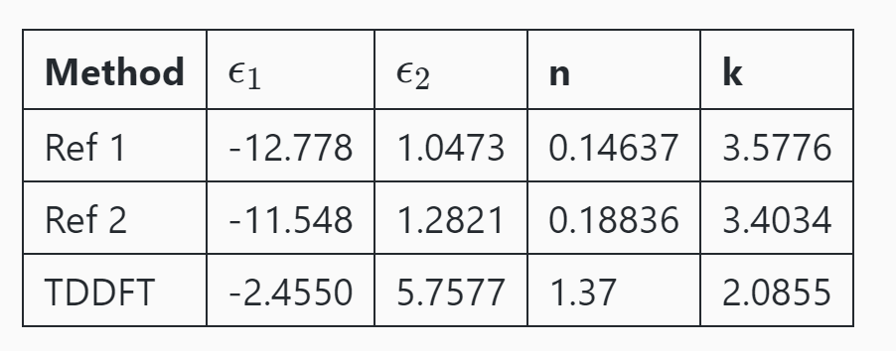
Amplitude range A = [0.18, 0.20, 0.22, 0.24] Ha/e T = 10,000 au = 240 fs
Why decrease?
Maybe still the problem of amplitude choosing.
For some small range, the n decrease.

Slide 23
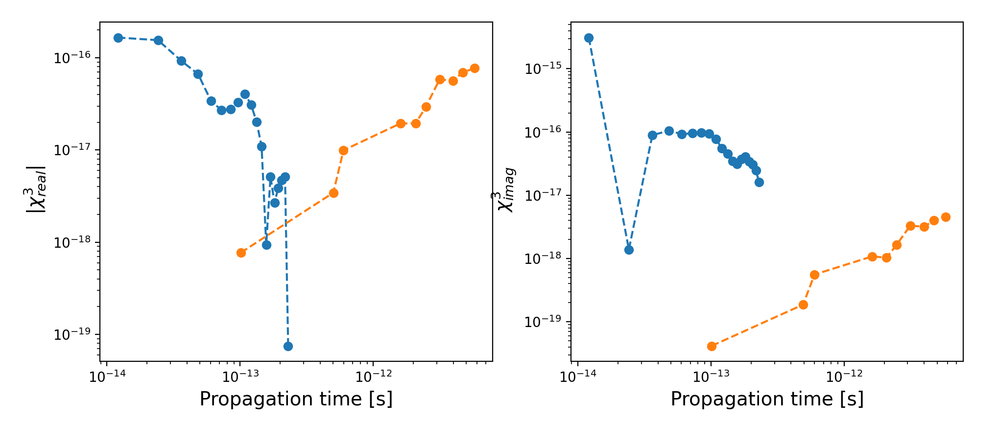
Amplitude range A = [0.18, 0.20, 0.22, 0.24] Ha/e with envelope T = 10,000 au = 240 fs

Slide 24
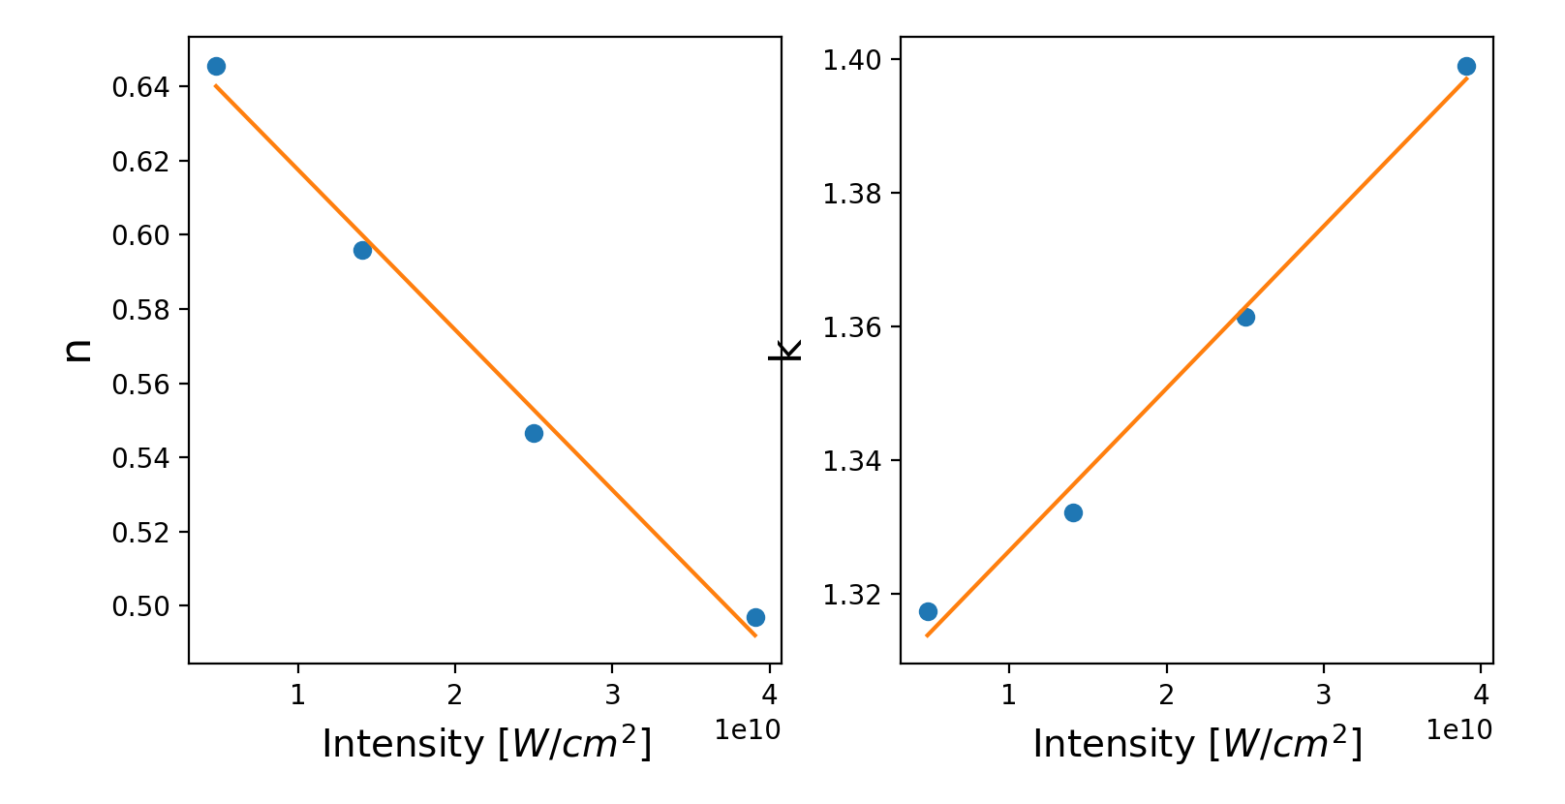
Amplitude range A = [0.7, 1.2, 1.6, 2] Ha/e T = 5000 au = 120 fs
Spacing = 0.20 k = 16 dt = 0.08 LDA

Slide 25
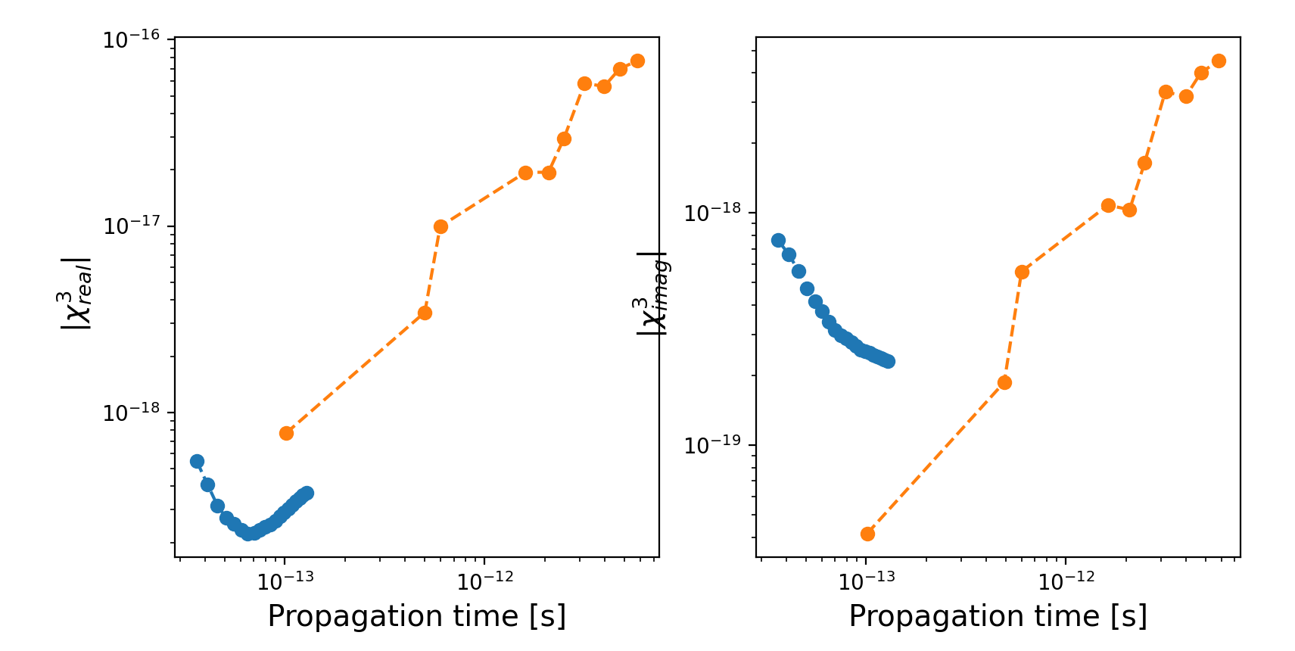
Amplitude range A = [0.7, 1.2, 1.6, 2] Ha/e T = 5000 au = 120 fs

Slide 26
Next step?
Finding other amplitude range?
PBE_sol? Mohanmond said it works well for gold
Spin-orbital interaction including?

