Slide 1
Spatiotemporal Ego-Graph Domain Adaptation for
Traffic Prediction With Data Missing
Chen Xu
2024-09-19

Slide 2
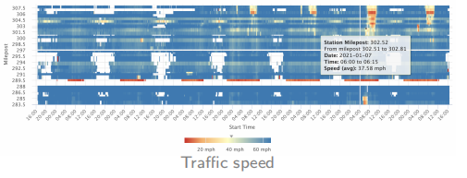
Introduction
Traffic Data is a type of multivariate time series that contains complex spatiotemporal dependencies.
Data Missing is a common problem in most cities due to loop detector failure and transmission loss.
Two approaches for time series prediction in the presence of missing data:
Imputation + Prediction:
Missing data is imputed to fill the gaps, followed by applying prediction models on the completed dataset.
Direct Prediction:
The prediction model is trained to handle missing data directly, bypassing the imputation step.
Both methods may fail to work properly or even crash when the data has a high missing rate.

Slide 3
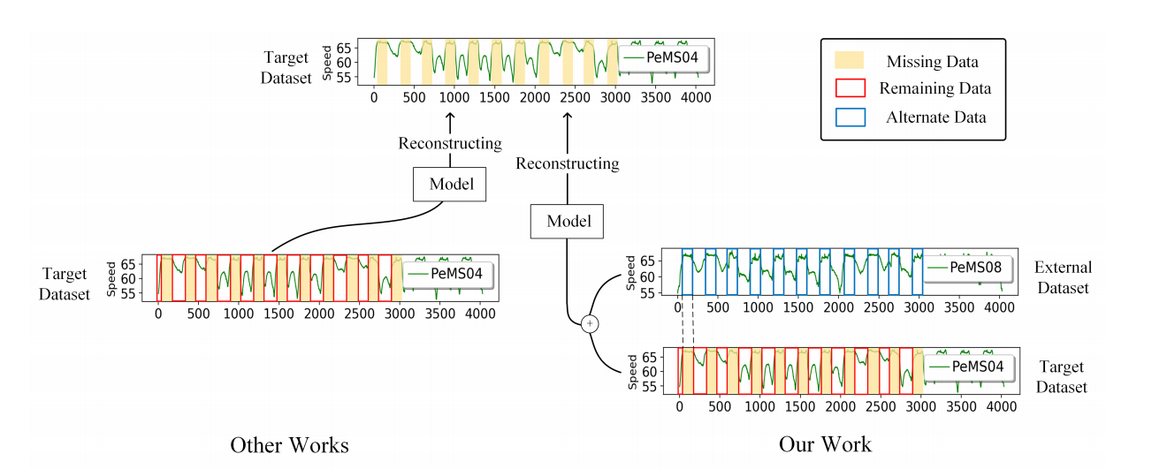
Introduction
Two basic assumptions for a prediction model to function properly:
The training data and testing data must be in the same feature space with independent and identical distribution.
The training data used to calibrate prediction models should be sufficient and representative, containing almost all the features in the feature space.
when the missing rate is high, the remaining data cannot cover the entire feature space.

Slide 4
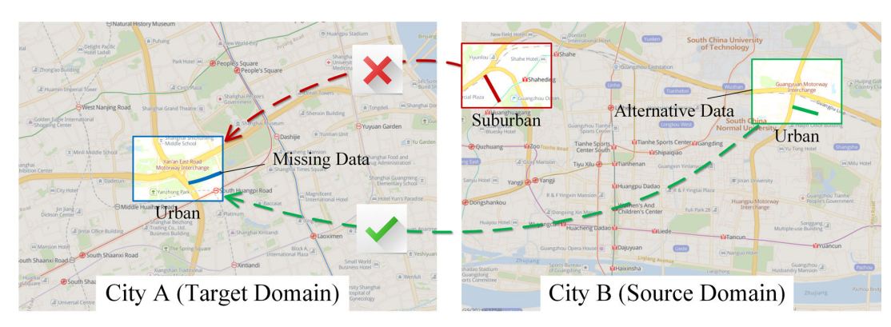
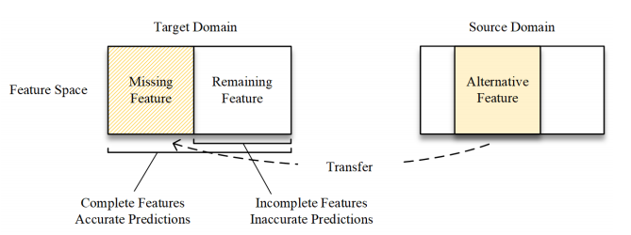
Introduction
Motivation:
Introduce the knowledge from external datasets to assist prediction of the target dataset.
Challenge:
How to find the alternative data for the missing data from an external source.
How to reconstruct the missing features based on the alternative data.

Slide 5
Introduction
Contribution:
A Spatiotemporal Ego-graph Domain Adaptation framework (SEDA) that directly makes traffic prediction in data missing scenarios by introducing knowledge of external sources.
An ego-graphs cross-domain alignment method based on multi-dimensional topological information for matching alternative data of missing features. (Challenge 1)
A Dual-branch Cross reCoupling method (DCC) for reconstructing missing features. It symmetrically decouples the features of alternative data into inter-domain and intra-domain branches, then cross recouples two branches with isolating external domain specificity. (Challenge 2)
Experimental results on real public datasets show that SEDA outperforms both the state-of-the-art incomplete data prediction baselines and the knowledge transfer-based prediction baselines with “Imputation + Prediction” mode.

Slide 6

Problem Formulation
Given an incomplete dataset as the target domain and an external dataset as the source domain.
Our purpose is to predict the future traffic state of target domain based on the historical data from target domain and the external knowledge from source domain.

Slide 7
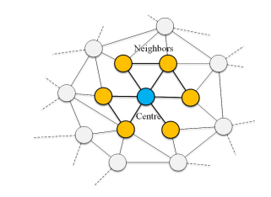
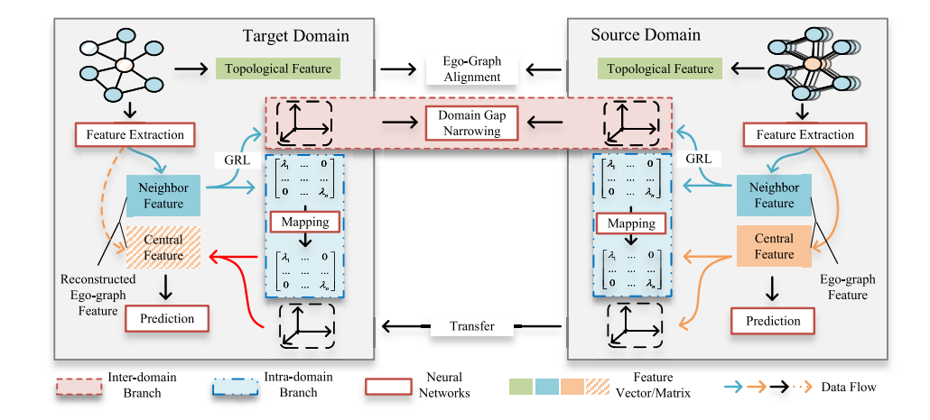
Methodology
Ego-graph:
a subgraph that represents the local neighborhood around a specific node (ego) in a network.
Overview of SEDA:

Slide 8
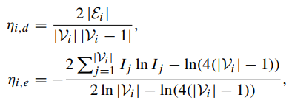
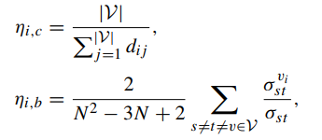

Methodology
Ego-Graphs Cross-Domain Alignment
The structure of a complex network, including factors significantly influences the dynamics of propagation processes within the network.¹
Local topological features:
Degree density, Structure entropy
Global topological features:
Closeness centrality, Betweenness centrality
The structure of an ego-graph
The position of the ego-graph in a network.
Euclidean distance is used to calculate the similarity of topological vectors:
1. Albert and A.-L. Barabási, “Statistical mechanics of complex net_x0002_works,” Rev. Mod. Phys., vol. 74, no. 1, p. 47, 2002.

Slide 9
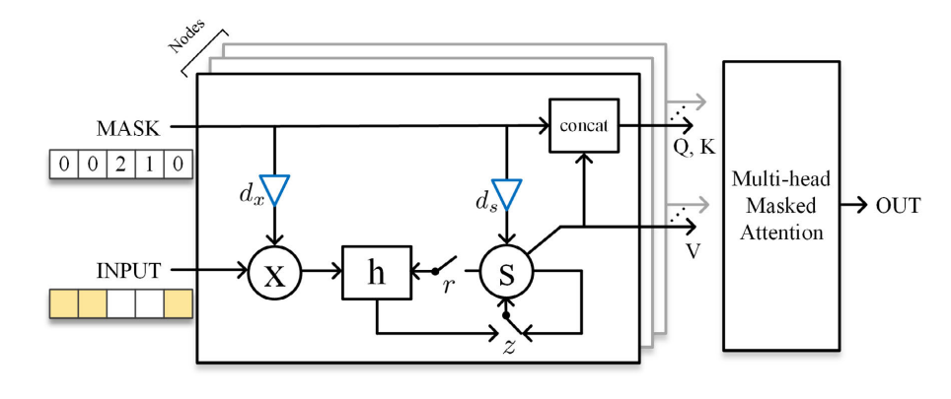

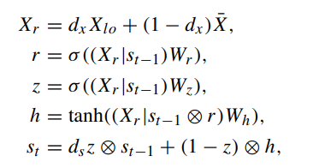
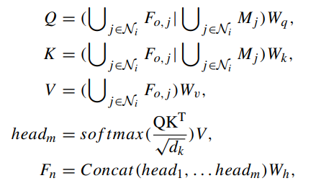
Methodology
Spatiotemporal Feature Extraction With Missing Mask
Masking: Enables the model to recognize which data is missing ("fake").
Delay coefficient: Preliminarily imputing missing data based on the time intervals.
Attention mechanism: Handles varying numbers of neighbors and adaptively aggregates both real and imputed data.

Slide 10


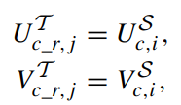

Methodology
Missing Feature Reconstruction by Dual-Branch Cross reCoupling
Perform Singular Value Decomposition (SVD) on the features of the ego graphs
Obtain the basis (singular vectors) and scales (singular values) of the feature space.
Inter-domain Branch
Narrow the representation gap between the bases of neighbor features in two domains.
Intra-domain Branch
Learn the mapping from neighbor feature singular values to central feature singular values.
Reconstruct the missing feature:

Slide 11




Methodology
Loss Function
Prediction loss
Singular value loss
Discriminative (domain adaptation) loss
The final loss function is:

Slide 12
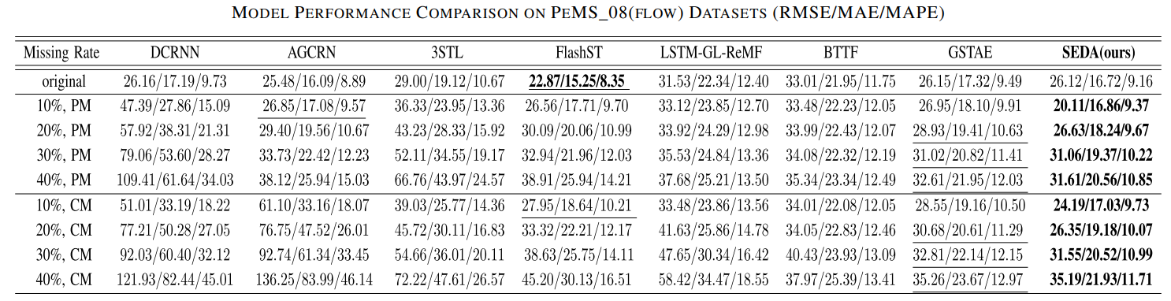
Experiment
Compare SEDA with the baseline model in the scenario without data imputation.
The direct prediction models (LSTM-GL-ReMF, BTTF, GSTAE) that are capable of handling missing data achieved relatively good performance compared to other baselines.
Traditional models that cannot handle missing data experience a sharp decline in performance as the missing data rate increases.

Slide 13
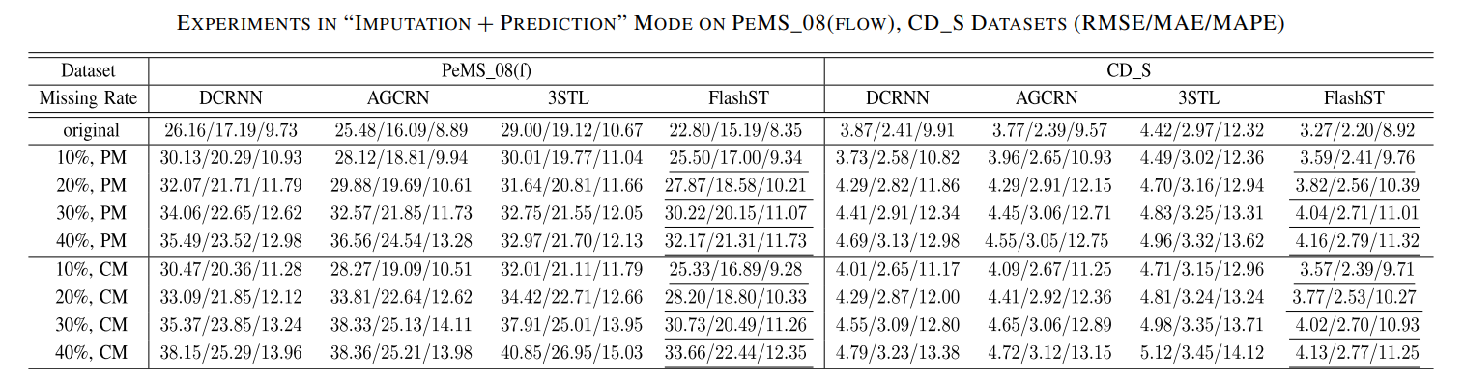
Experiment
Compare SEDA (Source-Enhanced Domain Adaptation) with the baseline model in the scenario with data imputation.
After imputing missing data, traditional models show a noticeable decline in performance due to error accumulation. In contrast, knowledge transfer models, which leverage additional knowledge, maintain better performance.

Slide 14
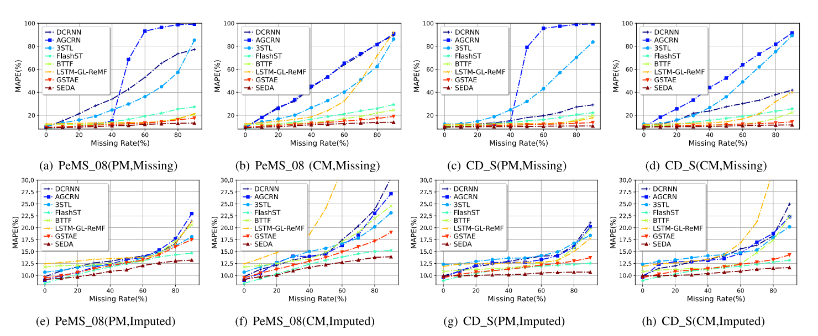
Experiment
Comparing SEDA with a baseline model under extreme missing data conditions.
In scenarios with additional missing data, knowledge transfer models (SEDA, FlashST) achieve superior performance. The direct prediction mechanism of SEDA avoids cumulative errors and shows more stable performance compared to model FlashST.

Slide 15
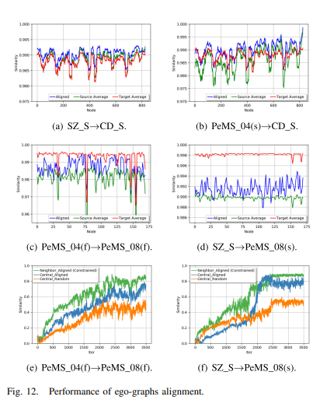
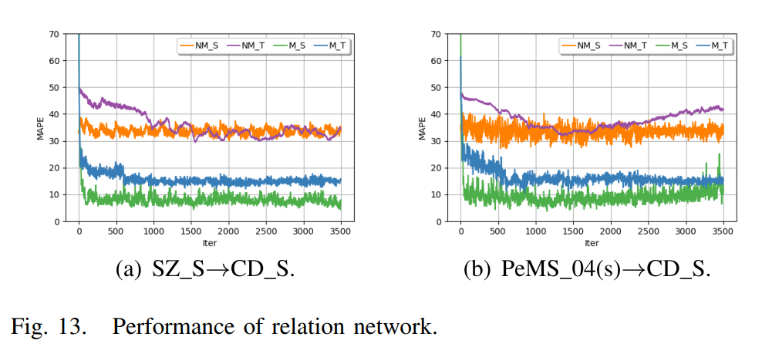
Experiment
The performance improvement of MAPE through subgraph alignment and mapping networks.

Slide 16
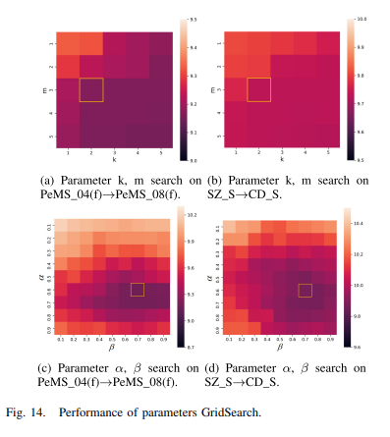
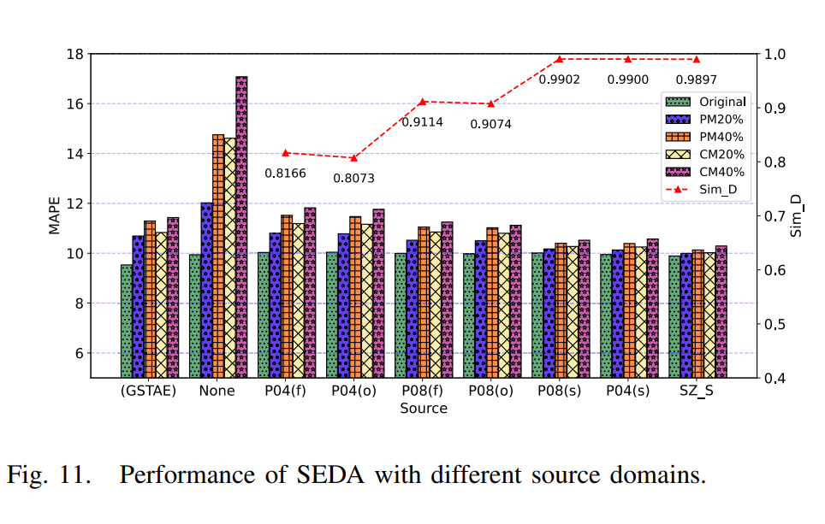
Experiment
Source domain selection and hyperparameter tuning.

