Slide 1



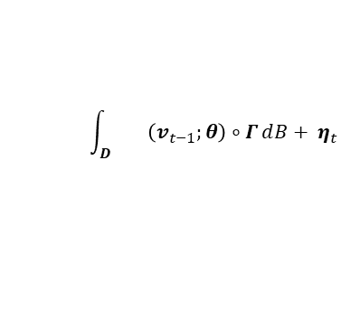











$$Observation Y$$
$$y_{t−1}$$
$$y_{t}$$
HDCM
$$Point-level process W$$
$${ w}_{t−1}$$
$$w_{t}$$
$$Hv_{t−1}+μ_{t−1}$$
$$Hv_{t}+μ_{t}$$
$$Grid-level dynamic process V$$
$$\int_{D}{ \left(v_{t−1};θ\right)∘Γ}ⅆB+ η_{t}$$
$$v_{t−1}$$
$$v_{t}$$
Past
Future
Day $t−1$
Day $t$

