Slide 1
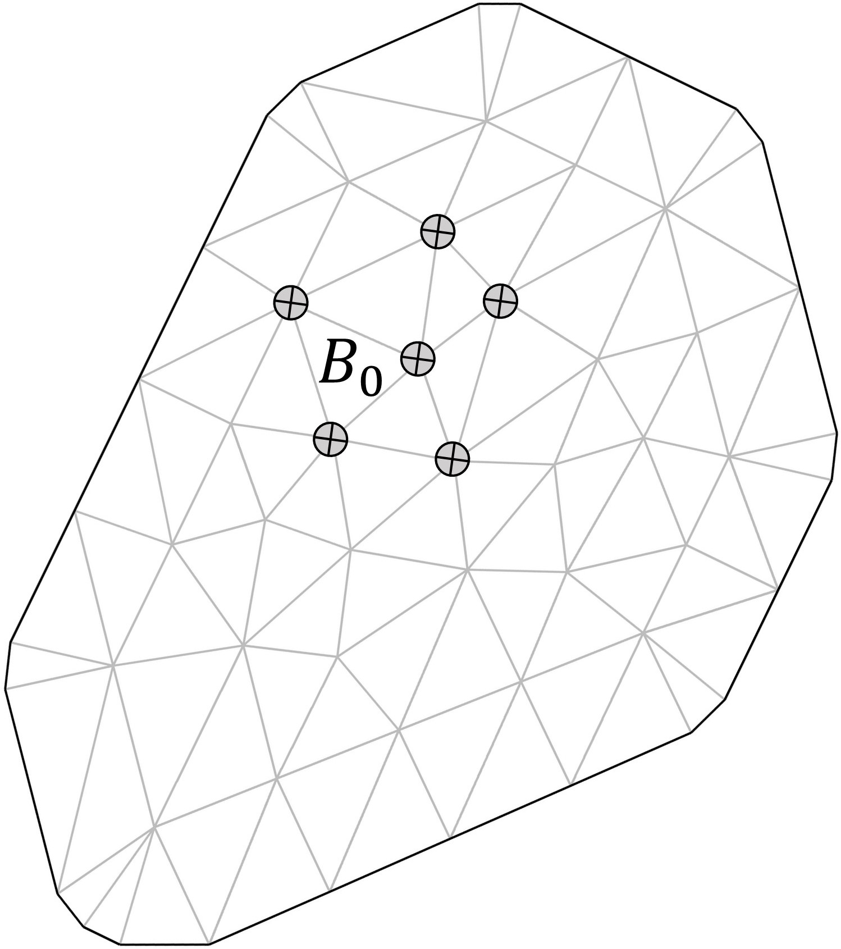
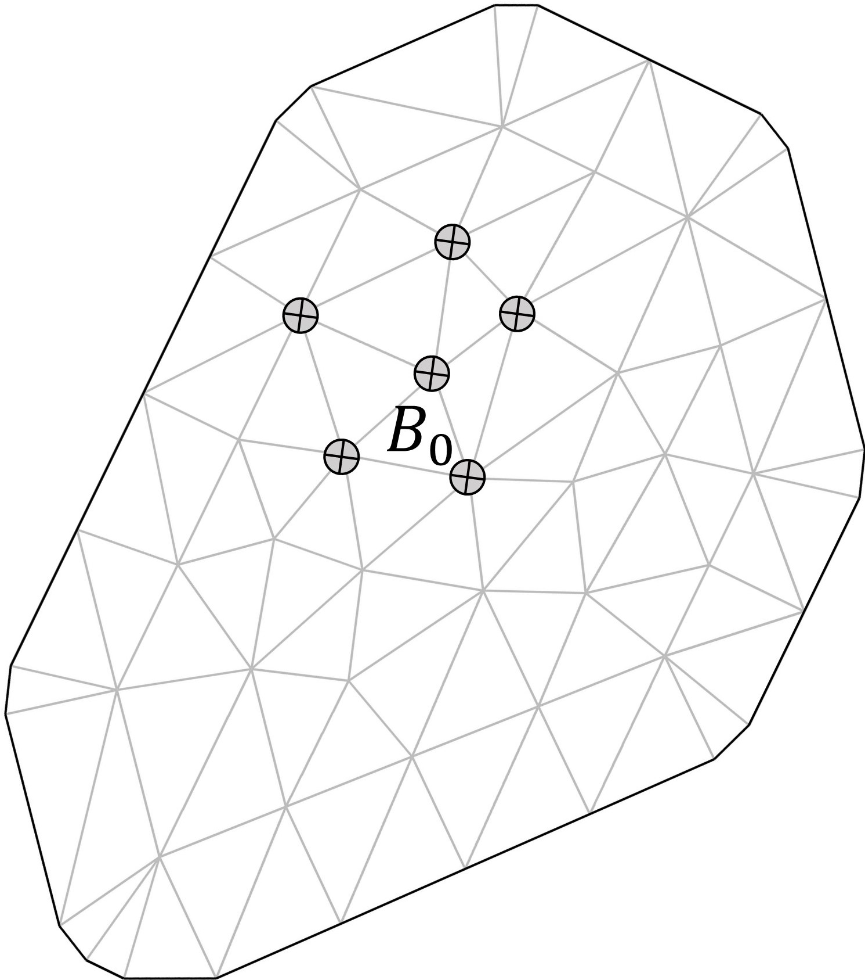

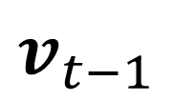


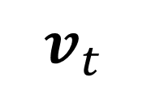
$$Dynamic process for grid-level{ B}_{0 }$$
$$v_{t−1}$$
$$v_{t}$$
$$D$$
$$D$$
$$v_{t}\left(B_{0}\right)=\sum_{j=1}^{m}{ \left\{{B_{0},B_{j};v}_{t−1}\left(B_{j}\right);θ\right\}Γ\left(B_{0},B_{j}\right)}+η_{t}(B_{0})$$

