Slide 1
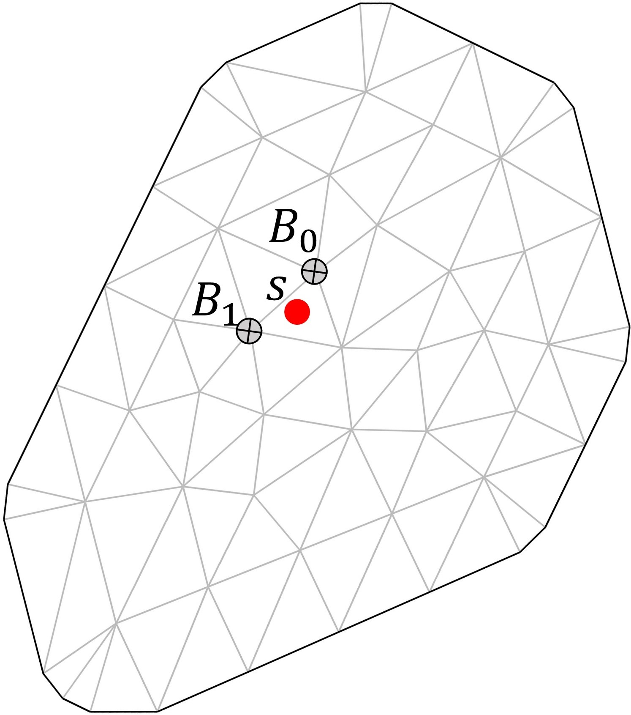
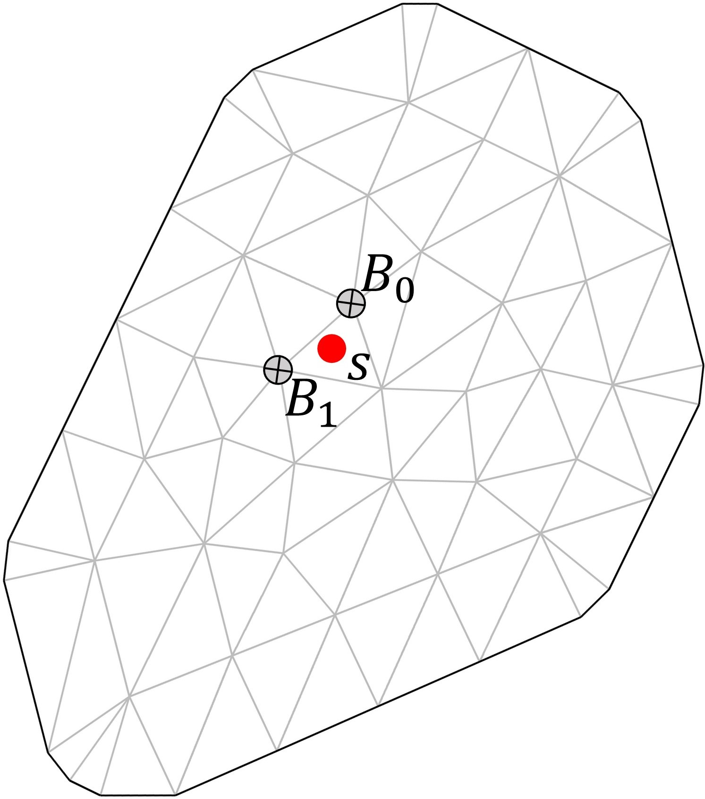





$$Process W$$
$$D$$
$$w_{t}\left(s\right)=h_{s}^{T}v_{t}+μ_{t}\left(s\right)$$
$$Process V$$
$$D$$

