Slide 1
support
HIPP MPE Library
(Out-of-standard Enhancement)
HIPP High-level MPI Library
(Pure-OOP Interfaces, Memory Management)
support
support
HIPP CNTL Library
(Exception Layers, Stream Manipulation, Memory Management Utilities ...)
Member
support
HIPP Low-level MPI Library
(Semi-OOP Interfaces, Exception Handling)
support
Member
support
MPI Standard Implementation
(OpenMPI, MPICH, ...)

Slide 2
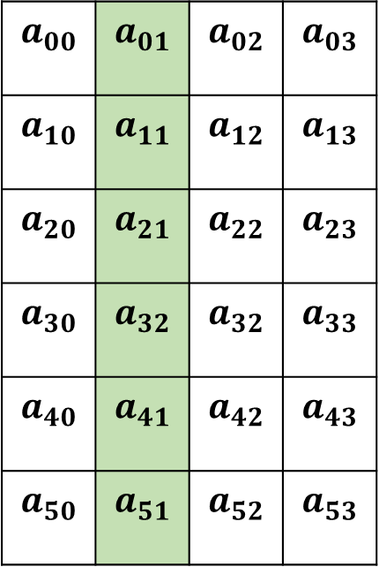
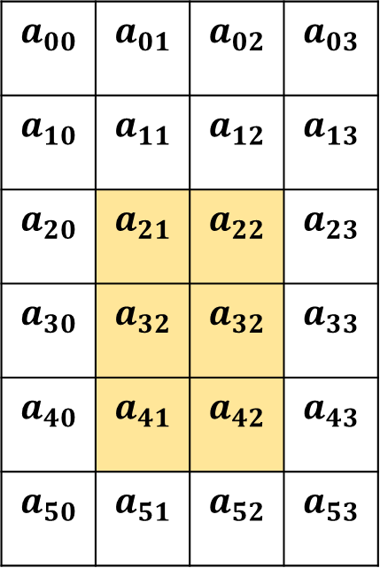


$$A_{1}$$
$$A_{2}$$
$$a_{00}$$ | $$a_{01}$$ | $$a_{02}$$ | $$a_{03}$$
$$a_{10}$$ | $$a_{11}$$ | $$a_{12}$$ | $$a_{13}$$
$$a_{20}$$ | $$a_{21}$$ | $$a_{22}$$ | $$a_{23}$$
$$a_{30}$$ | $$a_{32}$$ | $$a_{32}$$ | $$a_{33}$$
$$a_{40}$$ | $$a_{41}$$ | $$a_{42}$$ | $$a_{43}$$
$$a_{50}$$ | $$a_{51}$$ | $$a_{52}$$ | $$a_{53}$$
$$a_{00}$$ | $$a_{01}$$ | $$a_{02}$$ | $$a_{03}$$
$$a_{10}$$ | $$a_{11}$$ | $$a_{12}$$ | $$a_{13}$$
$$a_{20}$$ | $$a_{21}$$ | $$a_{22}$$ | $$a_{23}$$
$$a_{30}$$ | $$a_{32}$$ | $$a_{32}$$ | $$a_{33}$$
$$a_{40}$$ | $$a_{41}$$ | $$a_{42}$$ | $$a_{43}$$
$$a_{50}$$ | $$a_{51}$$ | $$a_{52}$$ | $$a_{53}$$
world.send(dest, tag, &a[2][1], 1, DOUBLE.vector(3, 2, 4));
world.send(dest, tag, &a[0][1], 1, DOUBLE.vector(6, 1, 4));

Slide 3






Comm world;
Process 0
Process 1
Process 2
Process 3
vector<double>
rands;
$$a_{0}$$ | $$a_{1}$$ | $$a_{2}$$ | $$a_{3}$$
Before
scatter
double
local_rand;
vector<double>
rands;
$$a_{0}$$ | $$a_{1}$$ | $$a_{2}$$ | $$a_{3}$$
After
scatter
world.scatter();
double
local_rand;
$$a_{0}$$
$$a_{1}$$
$$a_{2}$$
$$a_{3}$$

Slide 4
namespace HIPP
Functions and Objects
pout, perr
str(), str_f(), str_a()
prt(), prt_f(), prt_a()
MemRaw, MemObj<>
ErrRuntime, ErrLogic, ErrSystem
#include <hippcntl.h>
MPI
IO
SIMD
NUMERICAL
ALGORITHM
<hippmpi.h>
<hippio.h>
<hippsimd.h>
<hippnumerical.h>
<hippalgorithm.h>
Comm, Group
Counter, Mutex
ErrMPI
H5File, H5Group
H5XTable<>
ErrH5
Vec
Packed
Integration
Deriv
Spline
KDTree<>

Slide 5
send/recv
allgather
master
world comm
slaves comm

Slide 6
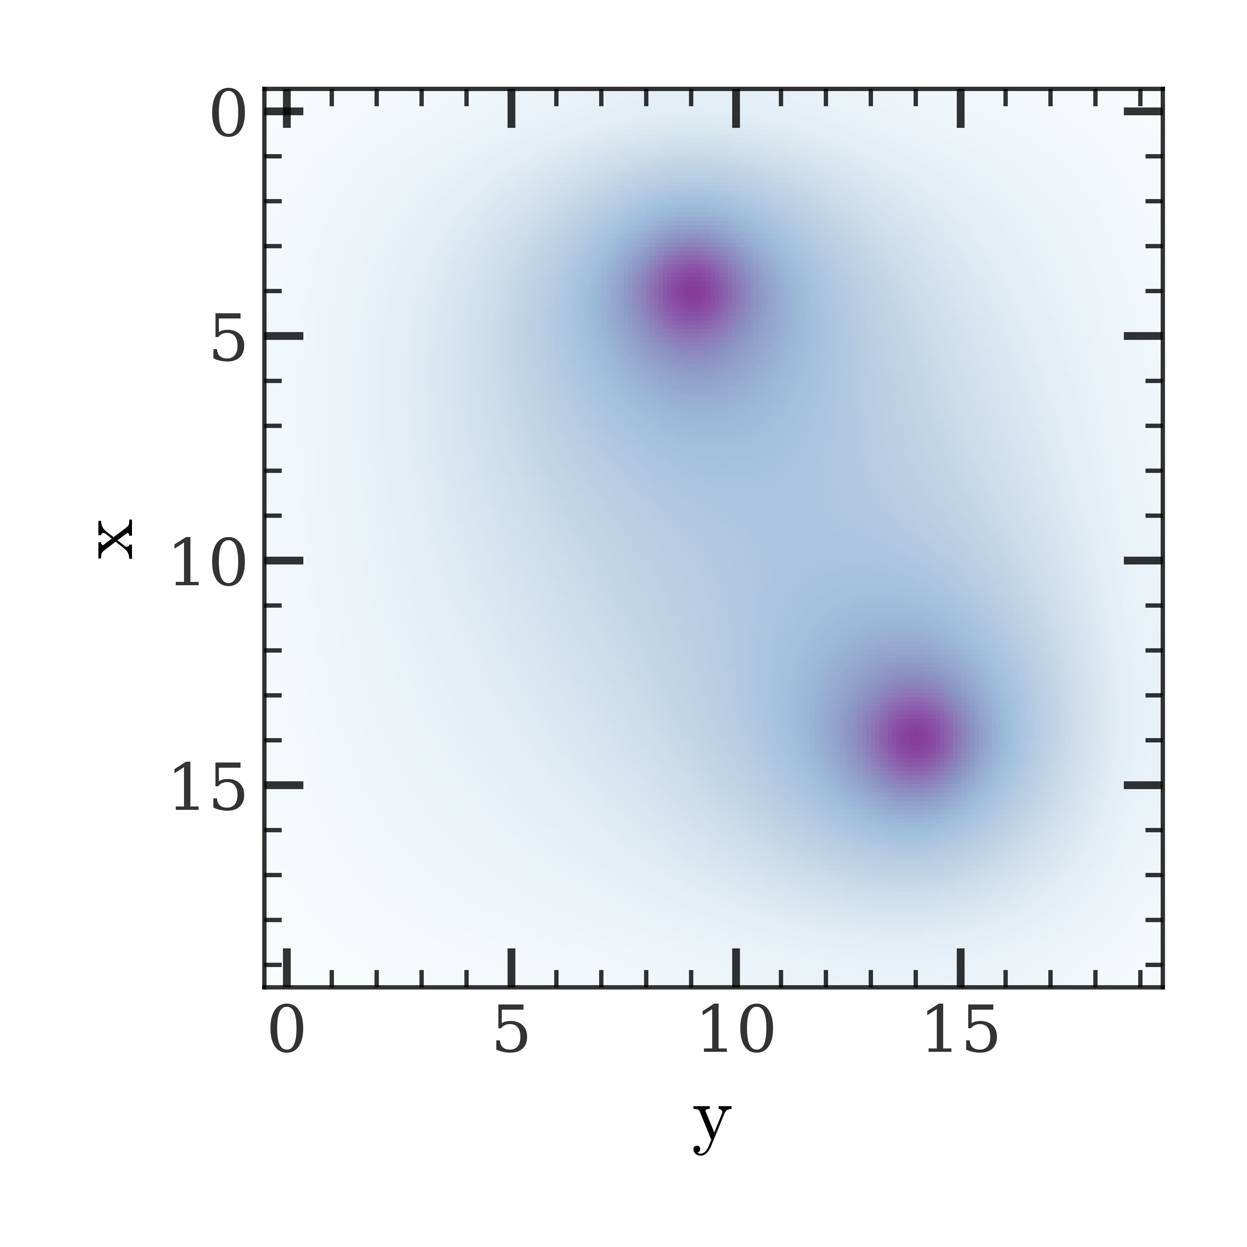


$$y$$
rank=0
1
2
3
Coords=(0,0)
(0,1)
(0,2)
(0,3)
4
5
6
7
$$x$$
Ghost points
(1,0)
(1,1)
(1,2)
(1,3)
Column type
8
9
10
11
Row type
(2,0)
(2,1)
(2,2)
(2,3)
Local grids

Slide 7
Process 0
Process 1
Process 2
Process 0
Process 1
Process 2
Do work
Do work
Barrier
Send
Time
Do work
Recv
Barrier
Do work
Do work
Send
Barrier
Recv
Do work

Slide 8
send request
reply with a value
local comm of master
local comm of slaves
Inter-comm

Slide 9
start={0,1}
stride={4,3}
block={3,2}
count={2,4}

Slide 10
0 | 1 | 2 | 3 | 4
5 | 6 | 7 | 8 | 9
10 | 11 | 12 | 13 | 14
15 | 16 | 17 | 18 | 19
 |  |  | 6 | 7 | 8
 |  |  | 11 | 12 | 13
Read
File space
Memory space
start={1,1}, count={2,3}
start={2,3}, count={2,3}

