Slide 1



An Introduction to High Performance Computation
20190927 @DOA Student Seminar
@Copyright None
Yangyao CHEN （陈洋遥）
cyy12345678@163.com
Faculty Contact: Zheng Cai （蔡峥）

Slide 2
An Introduction to High Performance Computation
Why to know HPC ?
What are the possible ways of improving the performance of your code?
How to locate a parallel software among all and what are their unified (logical) frameworks?
How to choose an algorithm to satisfy your requirement?

Slide 3
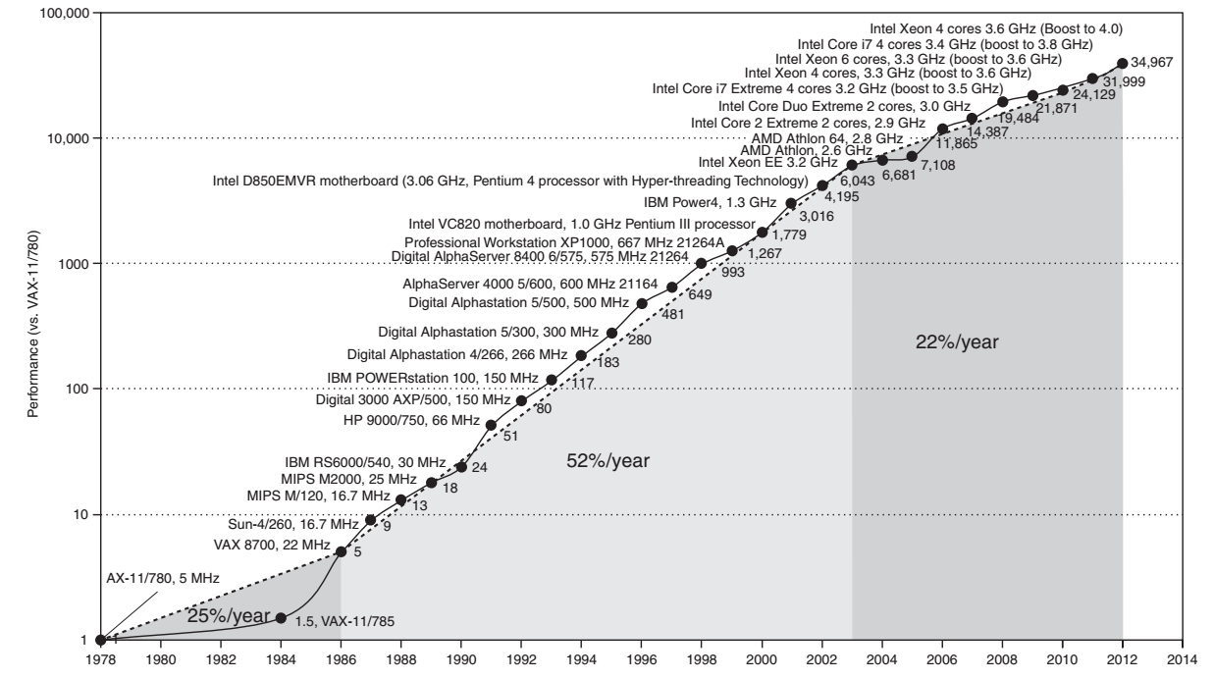

Intro.
Why to know HPC
Moore’s Law
Early boosts of performance rely on Architectures/Hardware technology
New idea after 2000: performance via parallelism
Current slow increase $⇒$ end of Moore’s law
SGI MIPS
Multiprocessor Era
Patterson D. (COD-RiscV)

Slide 4
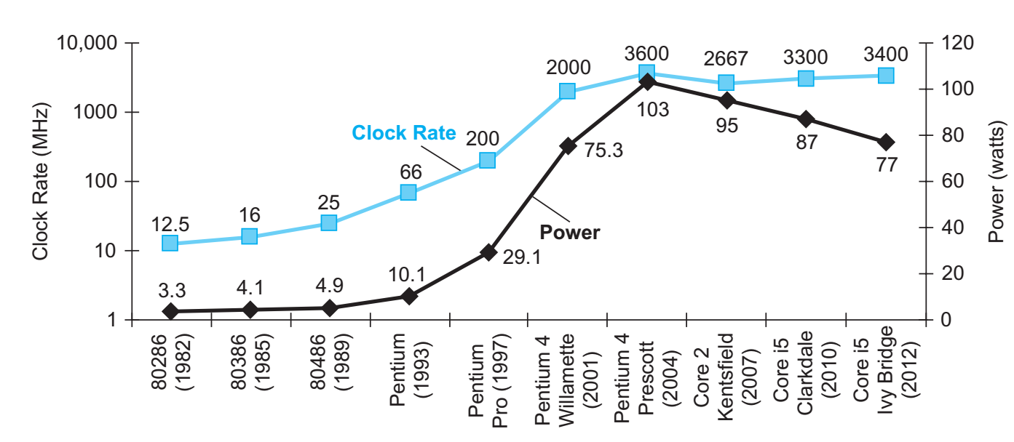
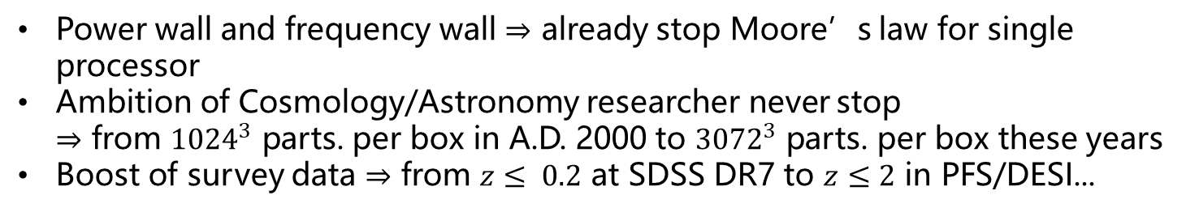
Intro.
Why to know HPC
Necessity: Clock Rate of a Single Processor
Power wall and frequency wall $⇒$ already stop Moore’s law for single processor
Ambition of Cosmology/Astronomy researcher never stop $⇒$ from ${1024}^{3}$ parts. per box in A.D. 2000 to ${3072}^{3}$ parts. per box these years
Boost of survey data $⇒$ from $z≤ 0.2$ at SDSS DR7 to $z≤2$ in PFS/DESI...
Multiprocessor
Era
Patterson D. (COD-RiscV)
Notes:
NN
<2000, wait for speed up; > 2000, new technology

Slide 5
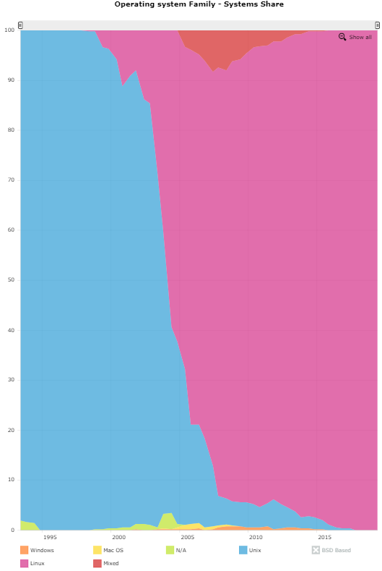
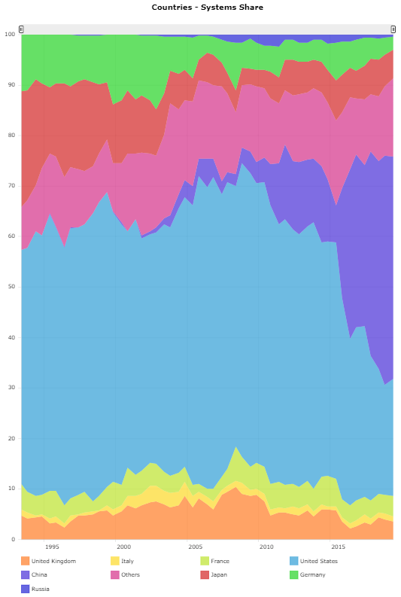
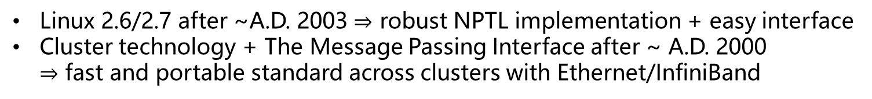
Intro.
Why to know HPC
Possibility: New Hardware/Software Technology
Linux 2.6/2.7 after ~A.D. 2003 $⇒$ robust NPTL implementation + easy interface
Cluster technology + The Message Passing Interface after ~ A.D. 2000 $⇒$ fast and portable standard across clusters with Ethernet/InfiniBand
Operating System Family Share
Country Share
MIXED
Germany
Linux
Japan
Others
China
U.S.
France
Unix(s)
1995
U.K.
2015
1995
Mac OS
2015
Windows
https://www.top500.org/
Notes:
1. China : hardware and software

Slide 6
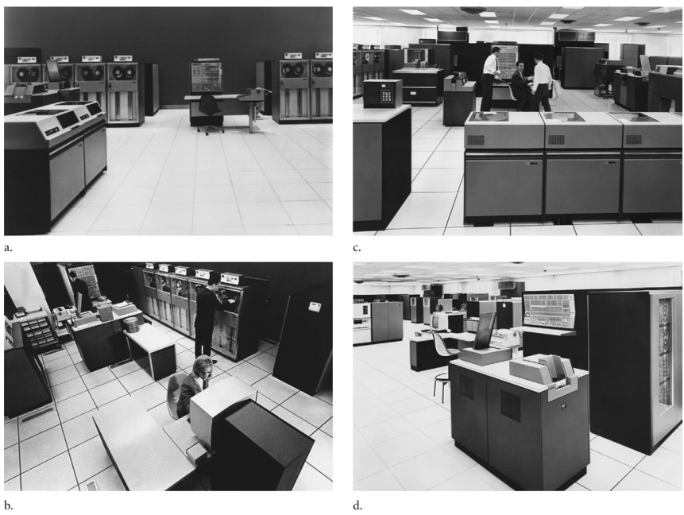
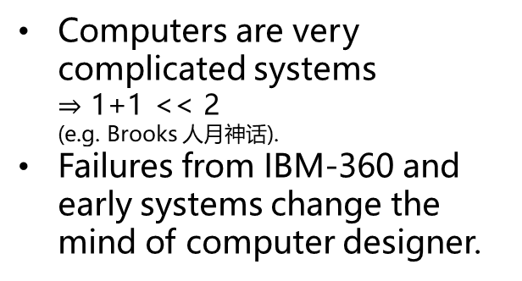
Sec. 1
Computer Systems
Abstraction Layers
Software
Hardware
Four IBM computers at A.D. 1964
IBM 360 - 40
IBM 360 - 50
Computers are very complicated systems $⇒$ 1+1 << 2 (e.g. Brooks 人月神话).
Failures from IBM-360 and early systems change the mind of computer designer.
IBM 360 - 60
IBM 360 - 75

Slide 7
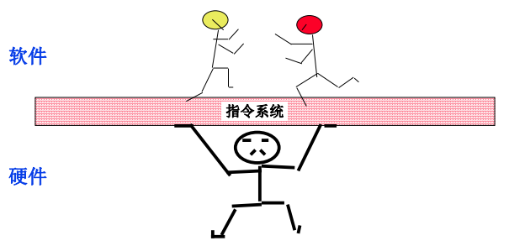
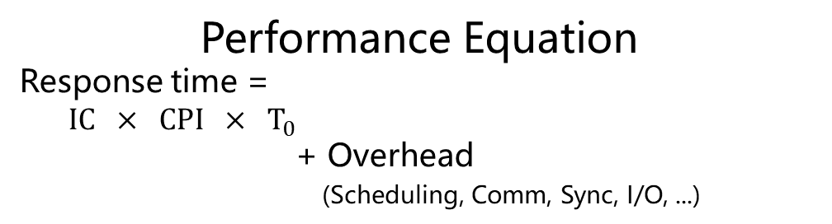
Sec. 1
Computer Systems
Abstraction Layers and Performance Measurement
Hints: Knowing where you can find a performance gain is the first step for HPC
Abstraction Layers
in Modern System
Performance Equation
Response time =
$IC × CPI × T_{0}$
+ Overhead
(Scheduling, Comm, Sync, I/O, ...)
Application
Algorithm
Programming Language
Gates/Register-Transfer Level(RTL)
Circuits
Devices
Physics
OS/Virtual Machine
Instruction Set Architecture(ISA)
Organization
Microarchitecture
Application
Algorithm
Language
OS
Algorithm, Language, OS
Architecture
Organization, RTL,
Circuits, Device,
Physics
Cheng X. 2019 slides @PKU
Comment:
Most important equation in computer designing and application.
Power of abstraction – All details are hidden by the Architecture (recall the Moore’s curve at ~1984).
Each layer could be used to lift your performance.

Slide 8
Sec. 1
Computer Systems
Abstraction Layers and Operating Systems
Abstraction Layers
in Modern System
Operation System Sub-hierarchy
Shell (bash; csh; WinPS; ...)
System Application (network; graphics; ...)
Kernel
Application
Algorithm
Programming Language
Gates/Register-Transfer Level(RTL)
Circuits
Devices
Physics
OS/Virtual Machine
Instruction Set Architecture(ISA)
Organization
Microarchitecture
Example Issues in Programming
What’s the differences between spin-lock, mutex, file-lock in threading?
What’s the differences between malloc(), calloc(), realloc(), kmalloc(), vmalloc(), mmap() ?
What is the output of the following program (in Linux)?
// source.cpp
int main(int argc, char const *argv[]){
printf(“hello\n");
write(STDOUT_FILENO, “world\n", 6);
pid_t pid = fork();
if( pid == 0 ) wait(NULL);
exit(EXIT_SUCCESS);
return 0;
}
Hints: Without knowing the OS,
performance/safety/portability
are really hard to achieve.
$ ./source.out
hello
world
$ ./source.out > ofile; cat ofile
world
hello
hello

Slide 9
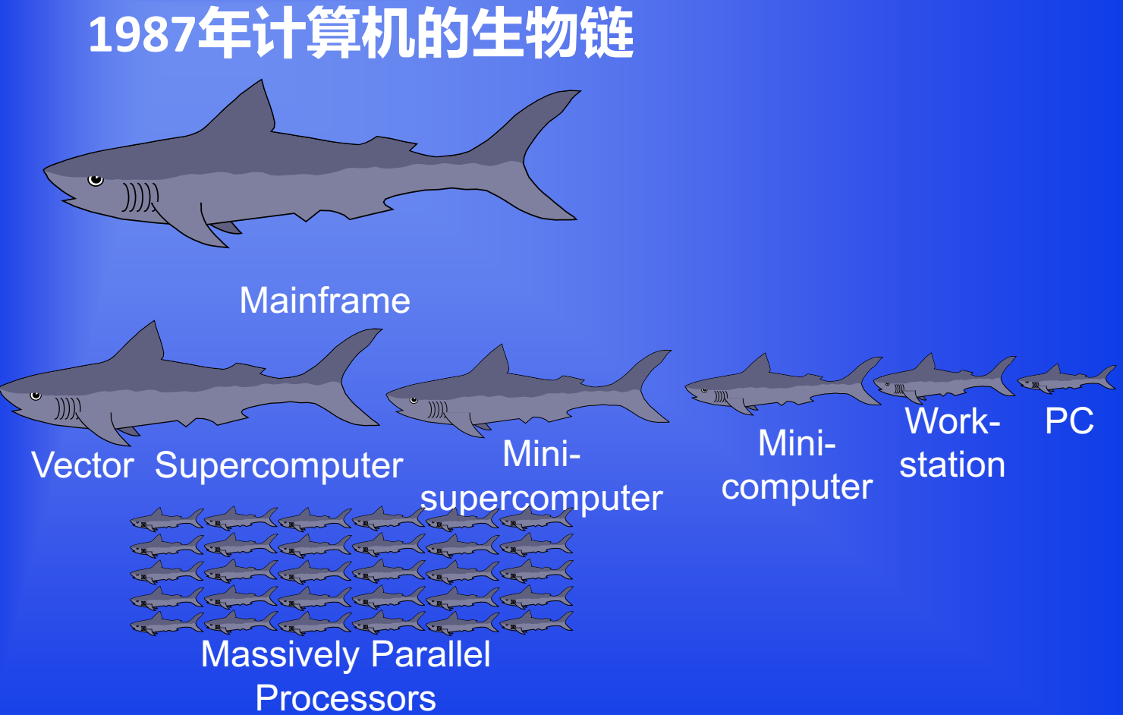
Sec. 1
Computer Systems
Parallelism
Cheng X. 2019 slides @PKU

Slide 10
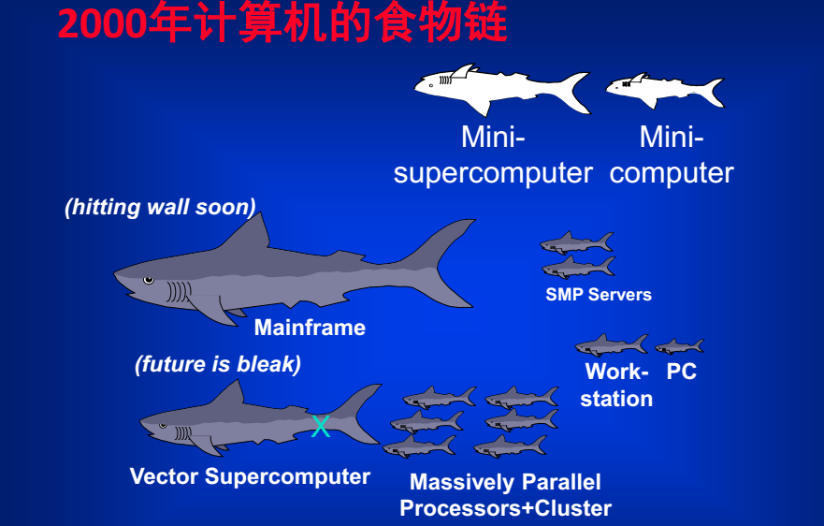
Sec. 1
Computer Systems
Parallelism
Cheng X. 2019 slides @PKU

Slide 11
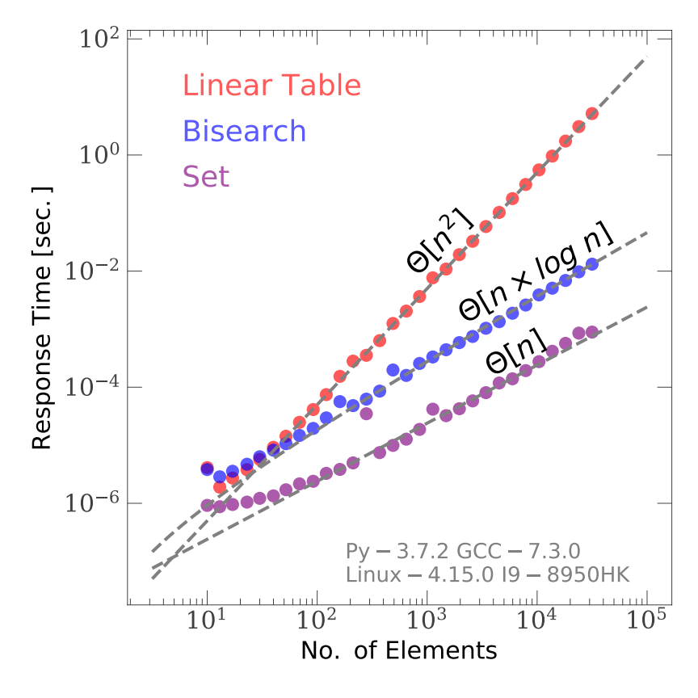
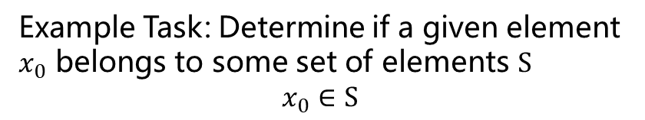
Sec. 1
Computer Systems
Algorithms
Example Task: Determine if a given element $x_{0}$ belongs to some set of elements $S$
$$x_{0}∈S$$
// search_algorithms.py
num_elems = 100
crowds = [ random.randint(0, 99999)
for i in range(num_elems) ]
shuffled = copy.deepcopy(crowds);
random.shuffle( shuffled )
for elem in shuffled:
elem in crowds
Yangyao 2019 @DOA
crowds.sort()
for elem in shuffled:
bisect.bisect_left( crowds, elem )
crowds = set( crowds )
for elem in shuffled:
elem in crowds
# shell output
Measured Executive Time:
5.14e-05 sec
5.72e-05 sec
2.58e-06 sec

Slide 12
Sec. 2
Parallel Techniques
Positions of Modern Parallel Software
Abstraction Layers in Modern System
Hints: Parallelism is the cheapest way for performance gain
Application
Algorithm
Programming Language
Gates/Register-Transfer Level(RTL)
Circuits
Devices
Physics
OS/Virtual Machine
Instruction Set Architecture(ISA)
Organization
Microarchitecture
Library Functions
Compiler and Assembler
OpenMP
MPI
Language-level
parallelism (LLP)
Linux Process and IPC
Pthreads
Processes
Threads
System-level
parallelism (SLP)
Instruction-level parallelism (ILP)
Reading Materials
Websites for LLP (where you can find books)
OpenMP https://www.openmp.org/
MPI https://www.mpi-forum.org/
Reading material for SLP
The Linux Programming Interface by Kerrisk M.
Linux Kernel Development (3rd ed) by Love R.
Linux manual page (e.g. $ man fork )
Reading material for ILP
Computer Organization and Design (RiscV ed) by Patterson D.

Slide 13
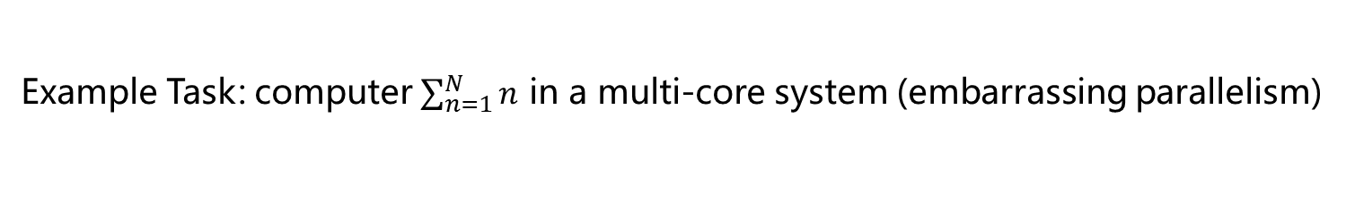
Sec. 2
Parallel Techniques
Examples for threading
Example Task: computer $\sum_{n=1}^{N}{n}$ in a multi-core system (embarrassing parallelism)
Threading with Pthreads:
Threading with OpenMP:
// pthreads.cpp
int subthread( int b, int e ){
int ret = 0;
for(int i=b; i<e; ++i) ret += i;
return ret;
}
int main(int argc, char const *argv[])
{
const int Ntask = 10000, Nsubthread = 8;
// create threads, assign works
vector<std::future<int> > rets;
int Ntask_each = Ntask / Nsubthread;
for(int i=0; i<Nsubthread; ++i)
rets.emplace_back(
std::async(
subthread, Ntask_each*i, Ntask_each*(i+1) ));
// join threads, reduce result
int total = 0;
for(auto &ret: rets) total += ret.get();
cout << "sum to " << Ntask << " equals " << total << endl;
return 0;
}
// openmp.cpp
int main(int argc, char const *argv[]){
const int Ntask = 10000;
// create threads, assign works, reduce result
int total = 0;
#pragma omp parallel for reduction(+:total)
for(int i=0; i<Ntask; ++i)
total += i;
cout << "sum to " << Ntask << " equals " << total << endl;
return 0;
}
Shell outputs:
$ ./pthreads.out
sum to 10000 equals 49995000
$ OMP_NUM_THREADS=8 ./openmp.out
sum to 10000 equals 49995000
Complexity↑ Portability↓
Flexibility↑ Comm/Sync Speed ↑

Slide 14
Sec. 2
Parallel Techniques
Examples for Multi-processing
Multiprocessing with Linux Process and IPC
Multiprocessing with MPI
// linux_process.cpp
int subproc( int b, int e ){
int ret = 0;
for(int i=b; i<e; ++i) ret += i;
return ret;
}
int main(int argc, char const *argv[])
{
const int Ntask = 10000, Nsubproc = 8;
int Ntask_each = Ntask / Nsubproc;
// create processes, assign works
MQueue mq_scatter("/scatter", "rw"),
mq_reduce("/reduce", "rw");
pid_t pid;
for(int i=0; i<Nsubproc; ++i){
if( (pid = fork()) == 0 ) break;
mq_scatter.write( i );
}
// finish and send back result
int rank, ret;
if( pid == 0 ){
mq_scatter.read( rank );
ret = subproc( Ntask_each*rank, Ntask_each*(rank+1) );
mq_reduce.write( ret );
}else{
mq_scatter.set_own(); mq_reduce.set_own();
int total = 0;
for(int i=0; i<Nsubproc; ++i){
mq_reduce.read(ret);
total += ret;
}
cout << "sum to " << Ntask << " equals " << total << endl;
}
return 0;
}
// mpi.cpp
int subproc( int b, int e ){
int ret = 0;
for(int i=b; i<e; ++i) ret += i;
return ret;
}
int main(int argc, char const *argv[])
{
const int Ntask = 10000;
// assign works
Env env; Comm comm;
int Ntask_each = Ntask / comm.size(), rank = comm.rank();
int ret = subproc( Ntask_each*rank, Ntask_each*(rank+1) );
// reduce result
int total;
comm.reduce( ret, total, MPI_SUM, 0 );
if( rank == 0 )
cout << "sum to " << Ntask << " equals " << total << endl;
return 0;
}
Shell outputs:
$ ./linux_process.out
sum to 10000 equals 49995000
$ mpirun –n 8 ./mpi.out
sum to 10000 equals 49995000
Complexity↑ Portability↓
Flexibility↑ Comm/Sync Speed ↑
Notes:
interface pack

Slide 15
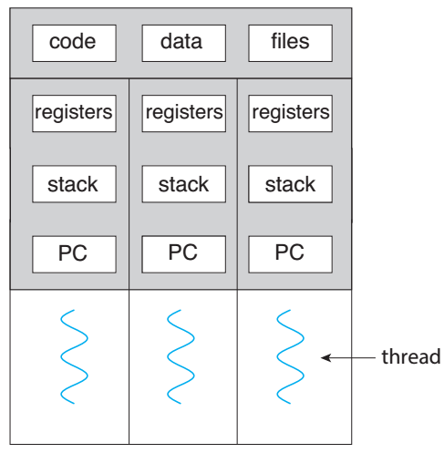
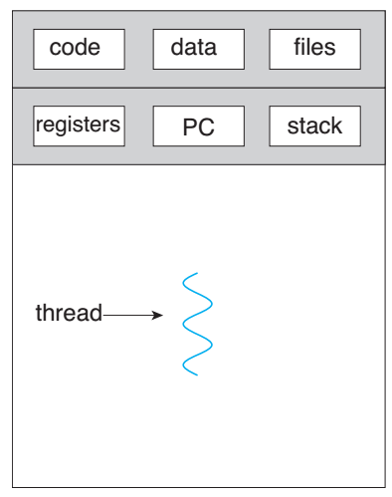
Sec. 2
Parallel Techniques
Overall Description
Hints: Choose the best according to you requirement and hard/soft environment
The Process
The OS
Silberschatz A. OSC 10th ed
Complexity↑ Comm/Sync Speed ↓ Safety↑
Parallelism | Thread Model (Shared Memory) Simple and fast comm/sync Fragile mem-access protection Fast OS scheduling | Process Model (Independent Memory) Complex and slower comm/sync Safe mem access Slow OS scheduling
Language Level Parallelism (LLP) Simple interfaces Coarse-grain functions | OpenMP Pre-compiler directives Run-time library Environment list | MPI Run-time library Environment List Cross heterogeneous platform/Network
System Level Parallelism (SLP) Complicated interfaces Fine-grain functions | Pthreads Run-time library Environment List Operating system specification | Linux Process and IPC Run-time library Environment List Operating system specification Socket interface for network/Internet
Complexity↑ Portability↓
Flexibility↑ Comm/Sync Speed ↑
implement
cooperate

Slide 16
Hints: Any parallel interfaces provide and only provide the following four categories of functionality
Sec. 2
Parallel Techniques
Unified Functionality Of Parallel Interfaces
xxx - minimal set #xxx – macro
xxx() – libfunc xxx – collections
Functionality | Linux Process and IPC | Pthreads | OpenMP | MPI
Processes Management | fork()/ wait() exit()/ exec() getpid()/ getppid() Signals | create() join()/detach() cancel()/exit() self() | #parallel #num_threads omp_get_thread_num() omp_get_num_threads() OMP_NUM_THREADS | MPI_Init() MPI_Finalize() MPI_Comm_rank() MPI_Comm_size() Dynamic Process（>=v2）
Work Sharing | × | × | #for/ #sections/ #single /#schedule/ OMP_DYNAMIC OMP_SCHEDULE | Virtual Topology Commucators Groups
Data Sharing | Mmap and shared-mem Semaphores Message queues (POSIX and System V) pipe and FIFO socket Signals | Natural shared-mem Thread specific data Thread local storage | Natural shared-mem #default #private #shared #reduction #lastprivate #firstprivate | MPI_Send(), MPI_Recv() and variants Collective comm One-side operations GET-PUT Datatypes
Synchronization and Exclusion | semaphores File lock Signals | mutex/ shared_mutex/ recursive mutex/ once future condition variable | #nowait/ #barrier/ #ordered/ #critical/ #atomic/ #master lock() implicit barrier at work-sharing block | Implicit by messages barrier/ mutex MPI_Init()/ MPI_Finalize()

Slide 17


Sec. 3
Algorithms (Data Structures)
Positions and Applications
Application
Algorithm
Language
OS
...
Sequential Lists
Trees
Graphs
Index Lists
$$∈$$
$$∈$$
Data Struct.
Static
Memory
(random access)
Dynamic
Memory
(fast erase/insert)
Mixed
Memory
(hash, index, jump)
Implementations
xxx – examples
Astrophysics | N-body, source catalog | Tree-Particle, 2PCF computation, KNN | FOF (Group Finder), Bayesian model, exact inference, neural nets | Particle-Mesh/SPH
Other fields | stack (compiler), elf (Linux object file), message queue (IPC), process schedule | heap (compiler), rb tree (C++ STL), B+ tree (MYSQL) | optimization, network routing (OSPF) | i-node (fs in Linux), slab (kernel of Linux)
Applications
Python | tuple(), list[], Third-party: np.ndarray | bisect, Third-party: sklearn.neighbors | Third-party: PyTorch, Keras, Tensorflow, ZhuSuan | set {a,b,c,...}, dist {a:b, c:d, ...}, pandas.DataFrame
C++ | new [] operator, vector, stack, queue, list, forward_list, array, dequeue | map, set, make_heap() | × | unordered_map, unordered_set
Fortran/C | internal array, allocator (malloc, calloc, ...) | × | × | ×
Language
Specifications
Hints: Algorithms (models and their implementations) are crucial for performance

Slide 18
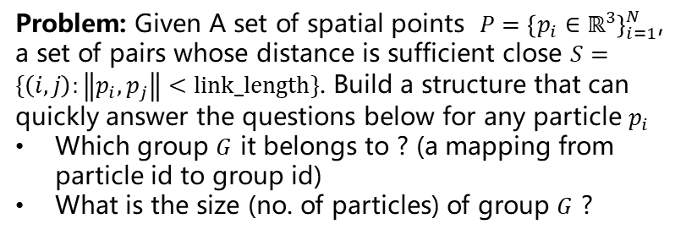
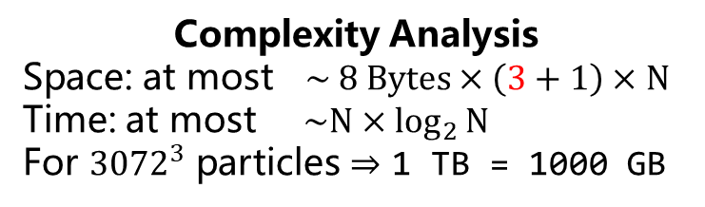
Sec. 3
Algorithms (Data Structures)
Example 1 – The FOF Problem
Problem: Given A set of spatial points $P={\left\{p_{i}∈ℝ^{3}\right\}}_{i=1}^{N}$, a set of pairs whose distance is sufficient close $S=\{\left(i,j\right):\left\|p_{i},p_{j}\right\|<link_length\}$. Build a structure that can quickly answer the questions below for any particle $p_{i}$
Which group $G$ it belongs to ? (a mapping from particle id to group id)
What is the size (no. of particles) of group $G$ ?
// FOF.py
P = [ (3.0, 3.1, 1.5), (7.0, 5.0, 2.5), ... ]
S = [ (1, 2), (5, 4), (2, 5), ...]
def find_group_id( particle_id ):
???
def find_group_size( partile_id ):
???
0
7
11
Complexity Analysis
Space: at most $\sim 8 Bytes×\left(3+1\right)×N$
Time: at most $\sim N×\log_{2}{N}$
For ${3072}^{3}$ particles $⇒$ 1 TB = 1000 GB
4
1
5
2
8
9
10
P2G
Groups
P2G
Groups
P2G
Groups
P2G
Groups
[0,
1,
2,
3,
4,
5,
6,
7,
...]
[ [0]
[1],
[2],
[3],
[4],
[5],
[6],
[7],
...]
[0,
1,
1,
3,
4,
5,
6,
7,
...]
[ [0]
[1,2],
[],
[3],
[4],
[5],
[6],
[7],
...]
[0,
1,
1,
3,
4,
4,
6,
7,
...]
[ [0]
[1,2],
[],
[3],
[4,5],
[],
[6],
[7],
...]
[0,
1,
1,
3,
1,
1,
6,
7,
...]
[ [0]
[1,2,4,5],
[],
[3],
[],
[],
[6],
[7],
...]
...

Slide 19
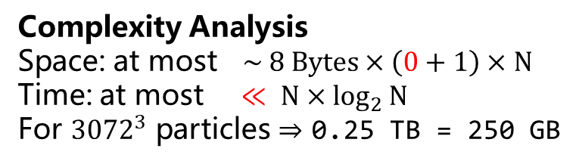
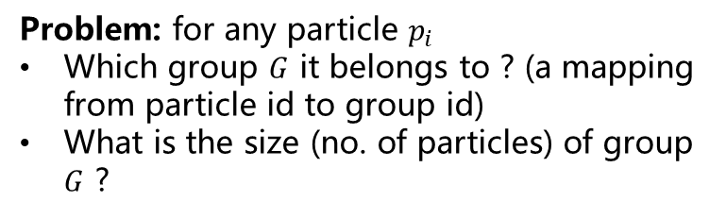
Sec. 3
Algorithms (Data Structures)
Example 1 – The UFSet Algorithm
Problem: for any particle $p_{i}$
Which group $G$ it belongs to ? (a mapping from particle id to group id)
What is the size (no. of particles) of group $G$ ?
S = [ (1, 2), (5, 4), (2, 5), ...]
0
7
11
4
1
5
Complexity Analysis
Space: at most $\sim 8 Bytes×\left(0+1\right)×N$
Time: at most $≪ N×\log_{2}{N}$
For ${3072}^{3}$ particles $⇒$ 0.25 TB = 250 GB
2
8
9
10
-1 | -1 | -1 | -1 | -1 | -1 | -1 | -1 | ...
-1 | -2 | 1 | -1 | -1 | -1 | -1 | -1 | ...
Union-Find-Set Algorithm
for Cluster Representation
-1 | -2 | 1 | -1 | -2 | 4 | -1 | -1 | ...
-1 | -4 | 1 | -1 | 1 | 4 | -1 | -1 | ...
...

Slide 20
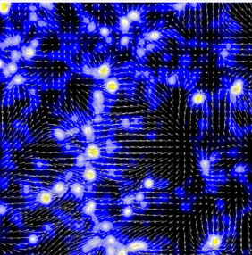

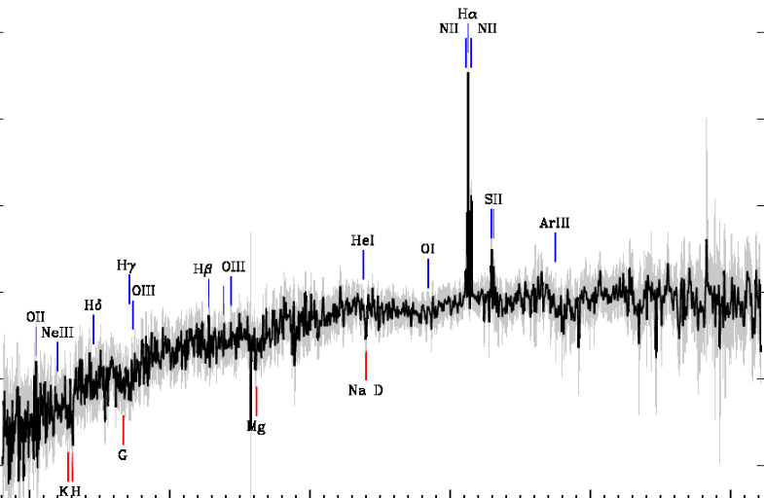

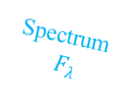
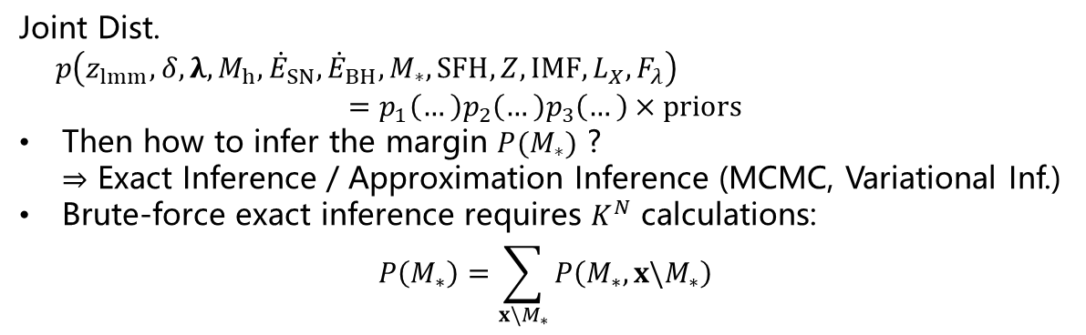







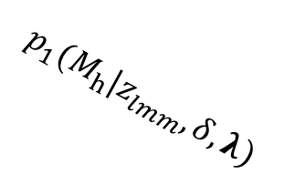



Sec. 3
Algorithms (Data Structures)
Example 2 – The Exact Inference Problem in a Bayesian Net
Problem: How to find the marginal distribution in a complicated statistical model (e.g. a Bayesian Net/Markov RF/Factor Tree)?
Suppose All the N variables are K-state discrete variables.
Tidal Field
$$λ$$
BH feedback
$${\dot{E}}_{BH}$$
Metallicity
$$Z$$
SN feedback
$${\dot{E}}_{SN}$$
SFH
IMF
Density Field
$$δ$$
Photo.
$$L_{X}$$
e.g. An statistical model of
the galaxy spectrum
and photometry
Halo Mass
$$M_{h}$$
Stellar Mass
$$M_{∗}$$
Merger History
$$z_{lmm}$$
Spectrum
$$F_{λ}$$
$$p_{1}(M_{h}|z_{lmm},δ,λ)$$
$$p_{2}(M_{∗}|M_{h},{\dot{E}}_{SN},{\dot{E}}_{BH})$$
$$p_{3}(L_{X},F_{λ}|M_{∗},SFH,Z,IMF)$$
Variable Node
Factor Node
Joint Dist.
$p\left(z_{lmm},δ,λ,M_{h},{\dot{E}}_{SN},{\dot{E}}_{BH},M_{∗},SFH,Z,IMF,L_{X},F_{λ}\right)$
$$=p_{1}\left(…\right)p_{2}\left(…\right)p_{3}\left(…\right)×priors$$
Then how to infer the margin $P(M_{∗})$ ? $⇒$ Exact Inference / Approximation Inference (MCMC, Variational Inf.)
Brute-force exact inference requires $K^{N}$ calculations:
$$P\left(M_{∗}\right)=\sum_{x\backslash M_{∗}}{P\left(M_{∗},x\backslash M_{∗}\right)}$$
Figs: Wang H 2016; Heinz S web; SDSS DR-12
Notes:
connect: Neural Net

Slide 21






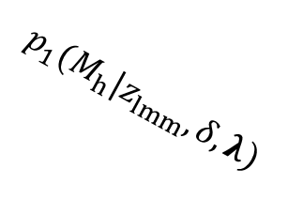




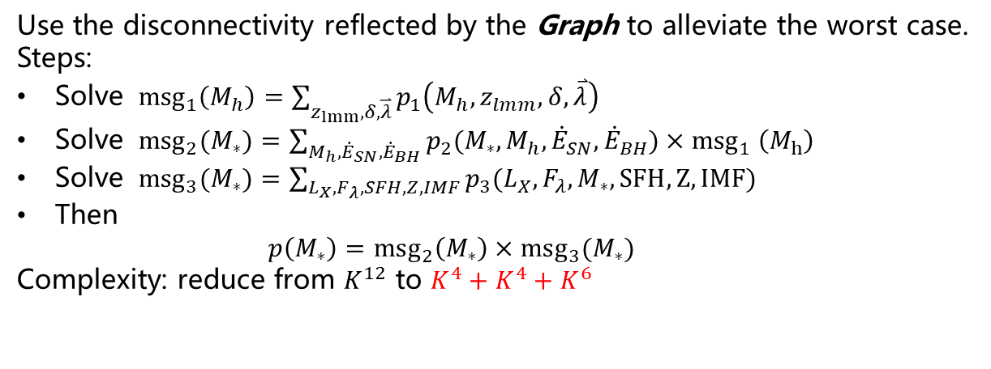


Sec. 3
Algorithms (Data Structures)
Example 2 – The Sum-Product Algorithm
Tidal Field
$$λ$$
BH feedback
$${\dot{E}}_{BH}$$
Metallicity
$$Z$$
SN feedback
$${\dot{E}}_{SN}$$
SFH
IMF
Density Field
$$δ$$
Photo.
$$L_{X}$$
Halo Mass
$$M_{h}$$
Stellar Mass
$$M_{∗}$$
Merger History
$$z_{lmm}$$
Spectrum
$$F_{λ}$$
$$p_{1}(M_{h}|z_{lmm},δ,λ)$$
$$p_{2}(M_{∗}|M_{h},{\dot{E}}_{SN},{\dot{E}}_{BH})$$
$$p_{3}(L_{X},F_{λ}|M_{∗},SFH,Z,IMF)$$
Variable Node
Factor Node
Use the disconnectivity reflected by the Graph to alleviate the worst case.
Steps:
Solve ${msg}_{1}\left(M_{h}\right)=\sum_{z_{lmm},δ,\overset{⃑}{λ}}{p_{1}\left(M_{h},z_{lmm},δ,\overset{⃑}{λ}\right)}$
Solve ${msg}_{2}(M_{∗})=\sum_{M_{h},{\dot{E}}_{SN},{\dot{E}}_{BH}}{p_{2}(M_{∗},M_{h},{\dot{E}}_{SN},{\dot{E}}_{BH}){×msg}_{1}\left(M_{h}\right)}$
Solve ${msg}_{3}(M_{∗})=\sum_{L_{X},F_{λ},SFH,Z,IMF}{p_{3}(L_{X},F_{λ},M_{∗},SFH,Z,IMF) }$
Then $p\left(M_{∗}\right)=msg_{2}\left(M_{∗}\right)×msg_{3}(M_{∗})$
Complexity: reduce from $K^{12}$ to $K^{4}+K^{4}+K^{6}$
Figs: Wang H 2016; Heinz S web; SDSS DR-12

Slide 22




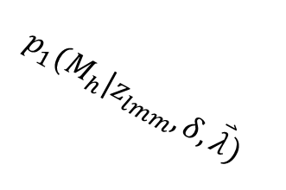

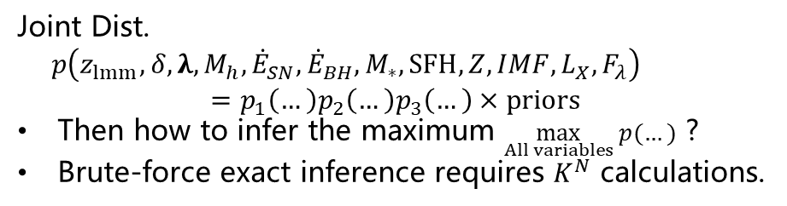





Sec. 3
Algorithms (Data Structures)
Example 3 – The Optimization Problem in a Bayesian Net
Problem: How to find the maximum in a complicated statistical model (e.g. a Bayesian Net/Markov RF/Factor Tree)?
Suppose All the N variables are K-state discrete variables.
Tidal Field
$$λ$$
BH feedback
$${\dot{E}}_{BH}$$
Metallicity
$$Z$$
SN feedback
$${\dot{E}}_{SN}$$
SFH
IMF
Density Field
$$δ$$
Photo.
$$L_{X}$$
e.g. An statistical model of
the galaxy spectrum
and photometry
Halo Mass
$$M_{h}$$
Stellar Mass
$$M_{∗}$$
Merger History
$$z_{lmm}$$
Spectrum
$$F_{λ}$$
$$p_{1}(M_{h}|z_{lmm},δ,\overset{⃑}{λ})$$
$$p_{2}(M_{∗}|M_{h},{\dot{E}}_{SN},{\dot{E}}_{BH})$$
$$p_{3}(L_{X},F_{λ}|M_{∗},SFH,Z,IMF)$$
Variable Node
Factor Node
Joint Dist.
$p\left(z_{lmm},δ,λ,M_{h},{\dot{E}}_{SN},{\dot{E}}_{BH},M_{∗},SFH,Z,IMF,L_{X},F_{λ}\right)$ $$=p_{1}\left(…\right)p_{2}\left(…\right)p_{3}\left(…\right)×priors$$
Then how to infer the maximum $\max_{All variables} p(…)$ ?
Brute-force exact inference requires $K^{N}$ calculations.
Figs: Wang H 2016; Heinz S web; SDSS DR-12

Slide 23

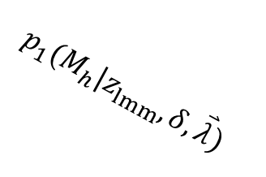


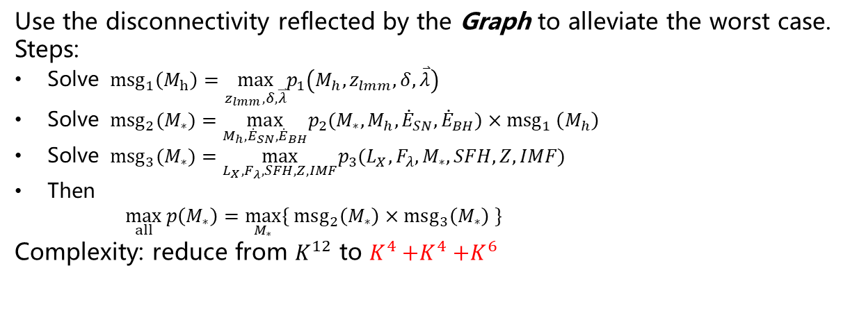
Sec. 3
Algorithms (Data Structures)
Example 3 – The Max-Product Algorithm
Tidal Field
$$λ$$
BH feedback
$${\dot{E}}_{BH}$$
Metallicity
$$Z$$
SN feedback
$${\dot{E}}_{SN}$$
SFH
IMF
Density Field
$$δ$$
Photo.
$$L_{X}$$
Halo Mass
$$M_{h}$$
Stellar Mass
$$M_{∗}$$
Merger History
$$z_{lmm}$$
Spectrum
$$F_{λ}$$
$$p_{1}(M_{h}|z_{lmm},δ,\overset{⃑}{λ})$$
$$p_{2}(M_{∗}|M_{h},{\dot{E}}_{SN},{\dot{E}}_{BH})$$
$$p_{3}(L_{X},F_{λ}|M_{∗},SFH,Z,IMF)$$
Variable Node
Factor Node
Use the disconnectivity reflected by the Graph to alleviate the worst case.
Steps:
Solve ${msg}_{1}\left(M_{h}\right)=\max_{z_{lmm},δ,\overset{⃑}{λ}}p_{1}\left(M_{h},z_{lmm},δ,\overset{⃑}{λ}\right)$
Solve ${msg}_{2}(M_{∗})=\max_{M_{h},{\dot{E}}_{SN},{\dot{E}}_{BH}}p_{2}(M_{∗},M_{h},{\dot{E}}_{SN},{\dot{E}}_{BH}){×msg}_{1}\left(M_{h}\right)$
Solve ${msg}_{3}(M_{∗})=\max_{L_{X},F_{λ},SFH,Z,IMF}p_{3}(L_{X},F_{λ},M_{∗},SFH,Z,IMF)$
Then $\max_{all} p\left(M_{∗}\right)=\max_{M_{∗}}\{ msg_{2}\left(M_{∗}\right)×msg_{3}\left(M_{∗}\right) \}$
Complexity: reduce from $K^{12}$ to $K^{4}{+K}^{4}+K^{6}$
Figs: Wang H 2016; Heinz S web; SDSS DR-12

Slide 24
An Introduction to High Performance Computation
Why to know HPC ? Necessity and Possibility (hardware and software)
What are the possible ways of improving the performance of your code? The abstraction layers covers all aspects that affect the performance.
How to choose a parallel software among all and what are their unified (logical) frameworks? Consider the complexity/speed/portability/flexibility of SLP and LLP parallel software. Keep in mind the (only) four components that must be provided by them.
How to choose an algorithm to satisfy your requirement? Consider their models/implementations/ordinary application/language specifications and to choose what is appropriate/convenient for you task.
Acknowledgement: Thanks Fuheng Liang@DOA for pointing out a typo.

